Slide 1
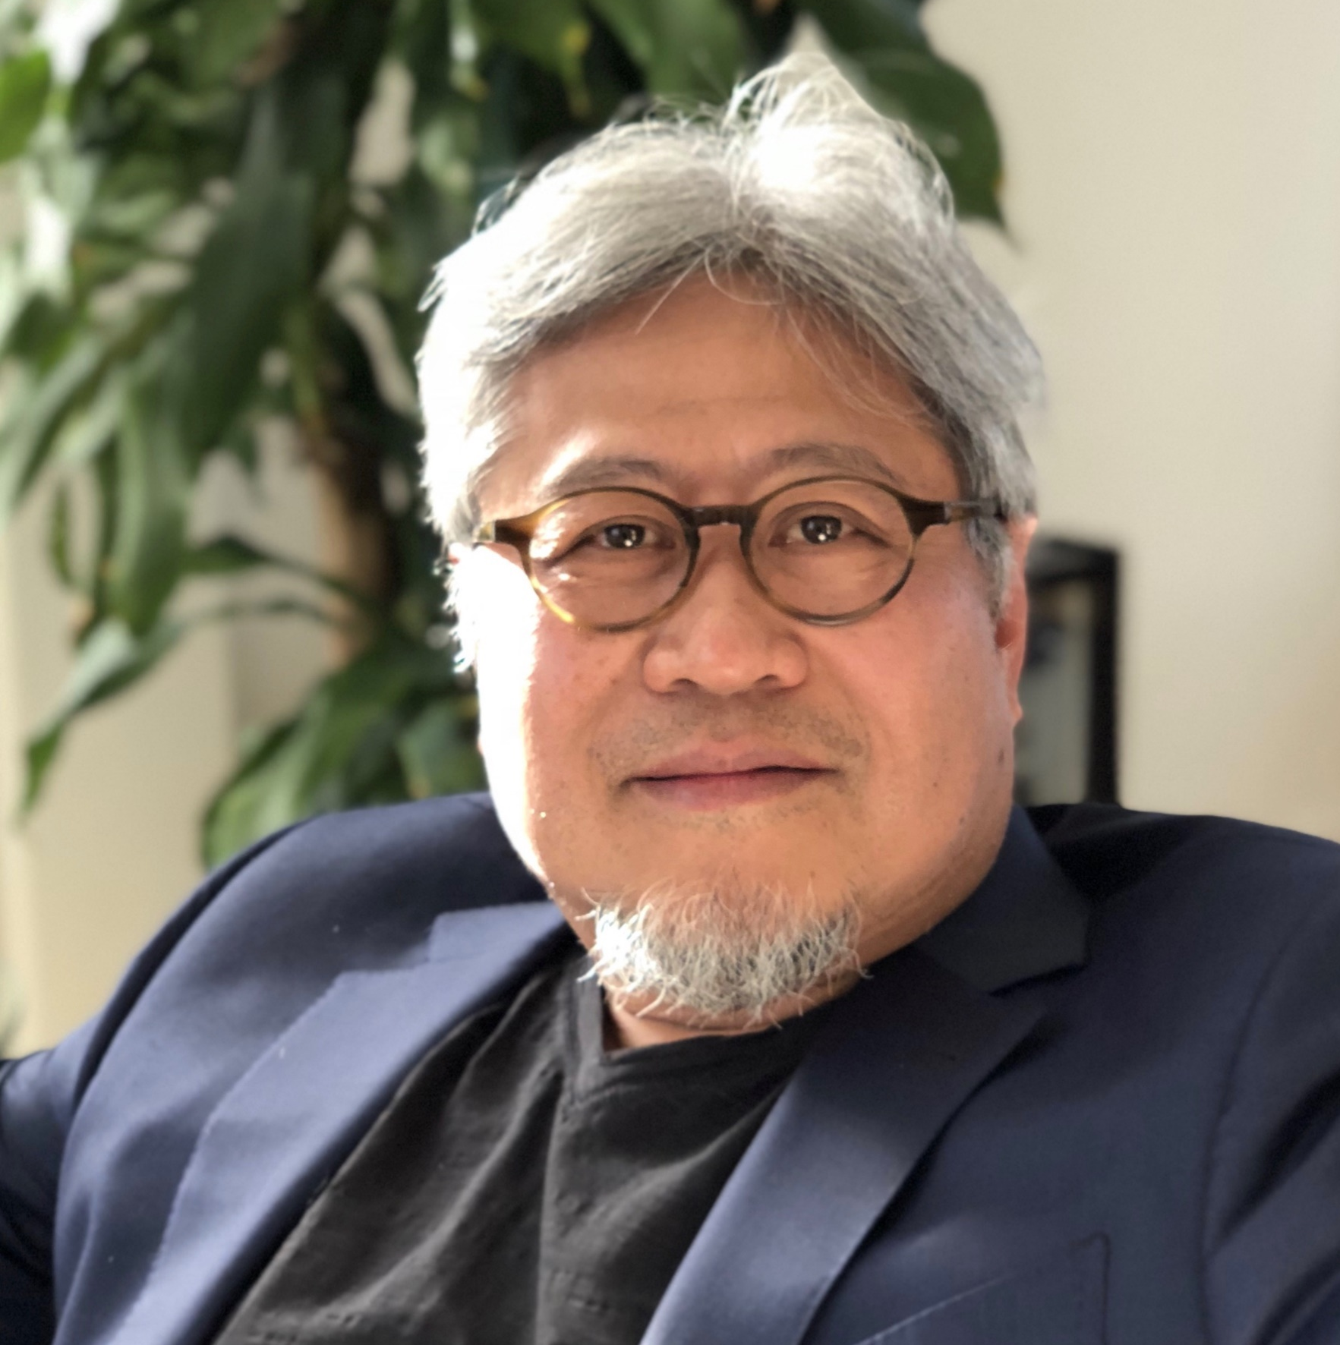

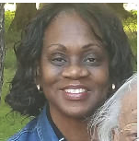
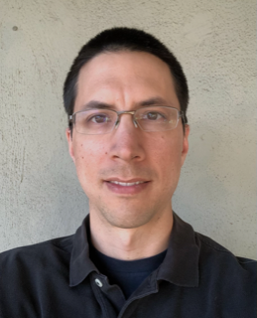
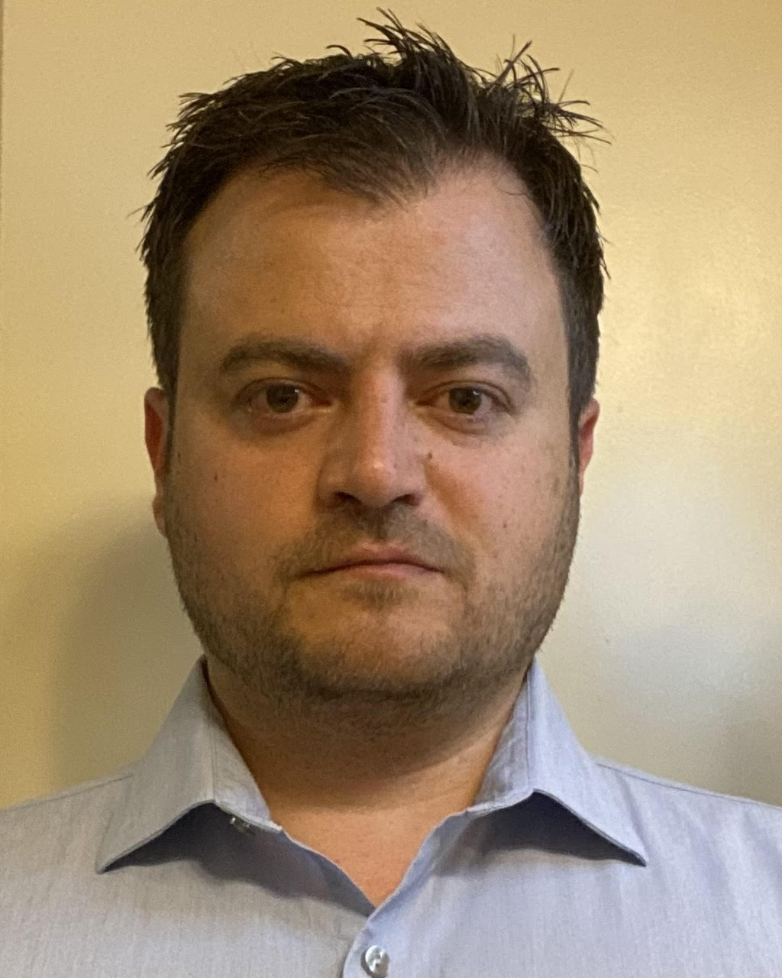
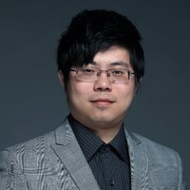

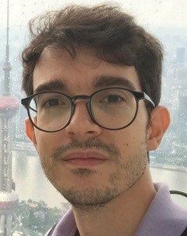
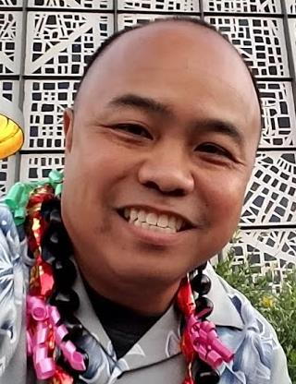
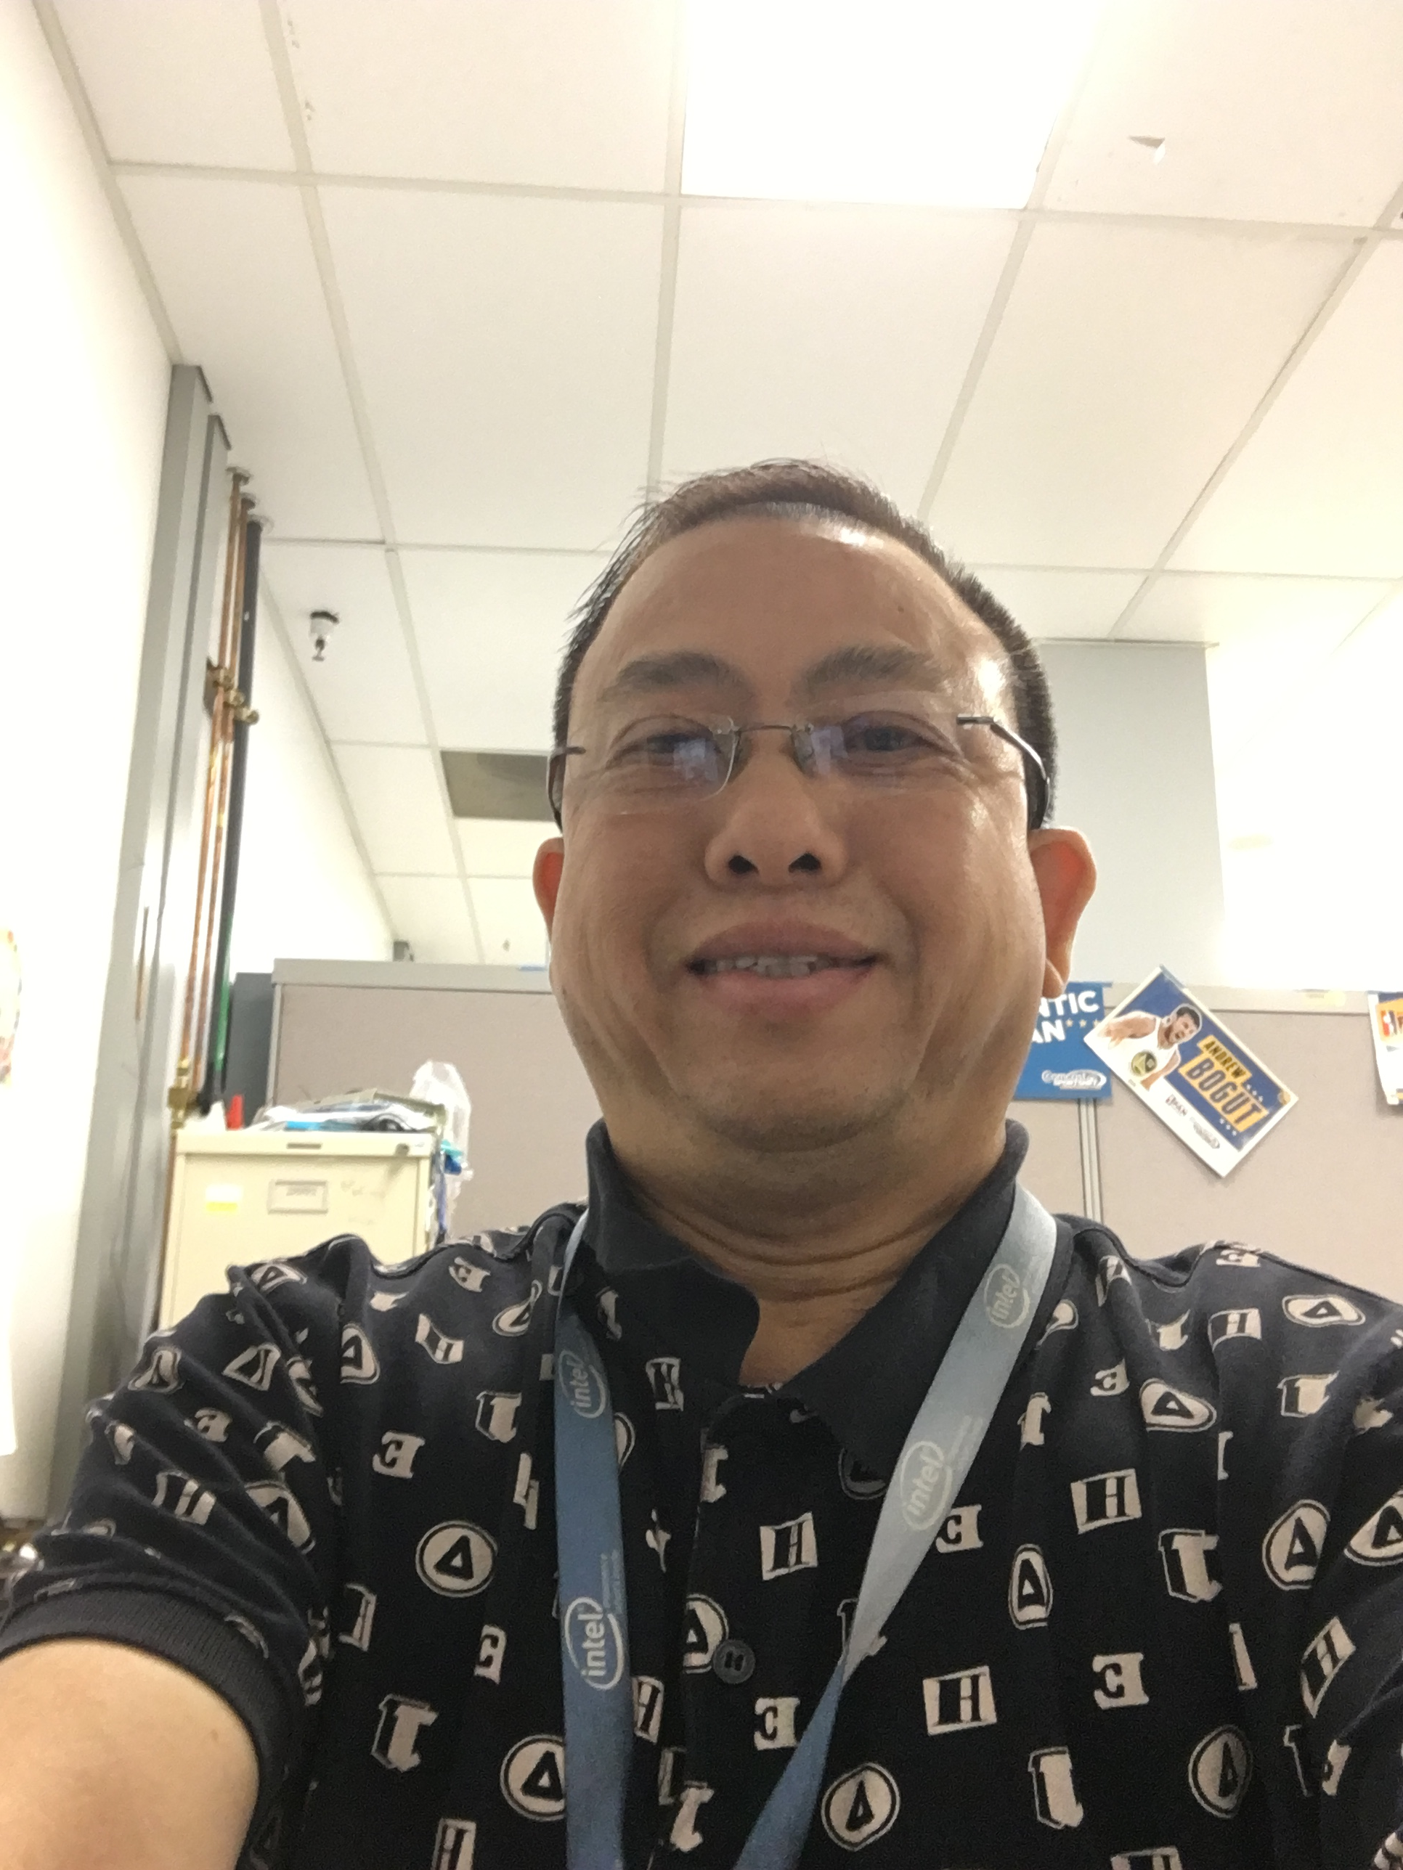

NSG Advanced Pathfinding/NVM Pathfinding
BoS/HC: 8/11
DT: 2, MC:1
DerChang Kau
Fellow
Admin: Amy Davis
Admin: Franwilkinson
Device Technology
Dany Ly-Gagnon
Davide Fugazza
Lu Liu
Memory Cell
Hank Wang
Roberto Carboni
Art Tubera
Louis Luong
Dec/2020

Slide 2
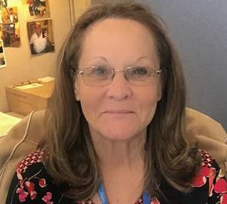


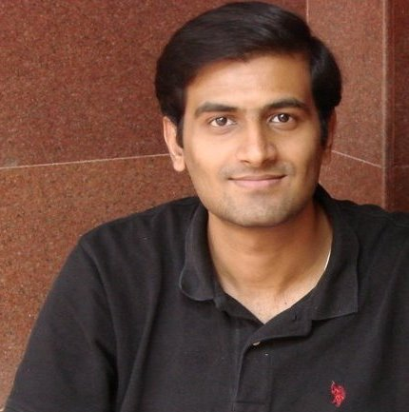
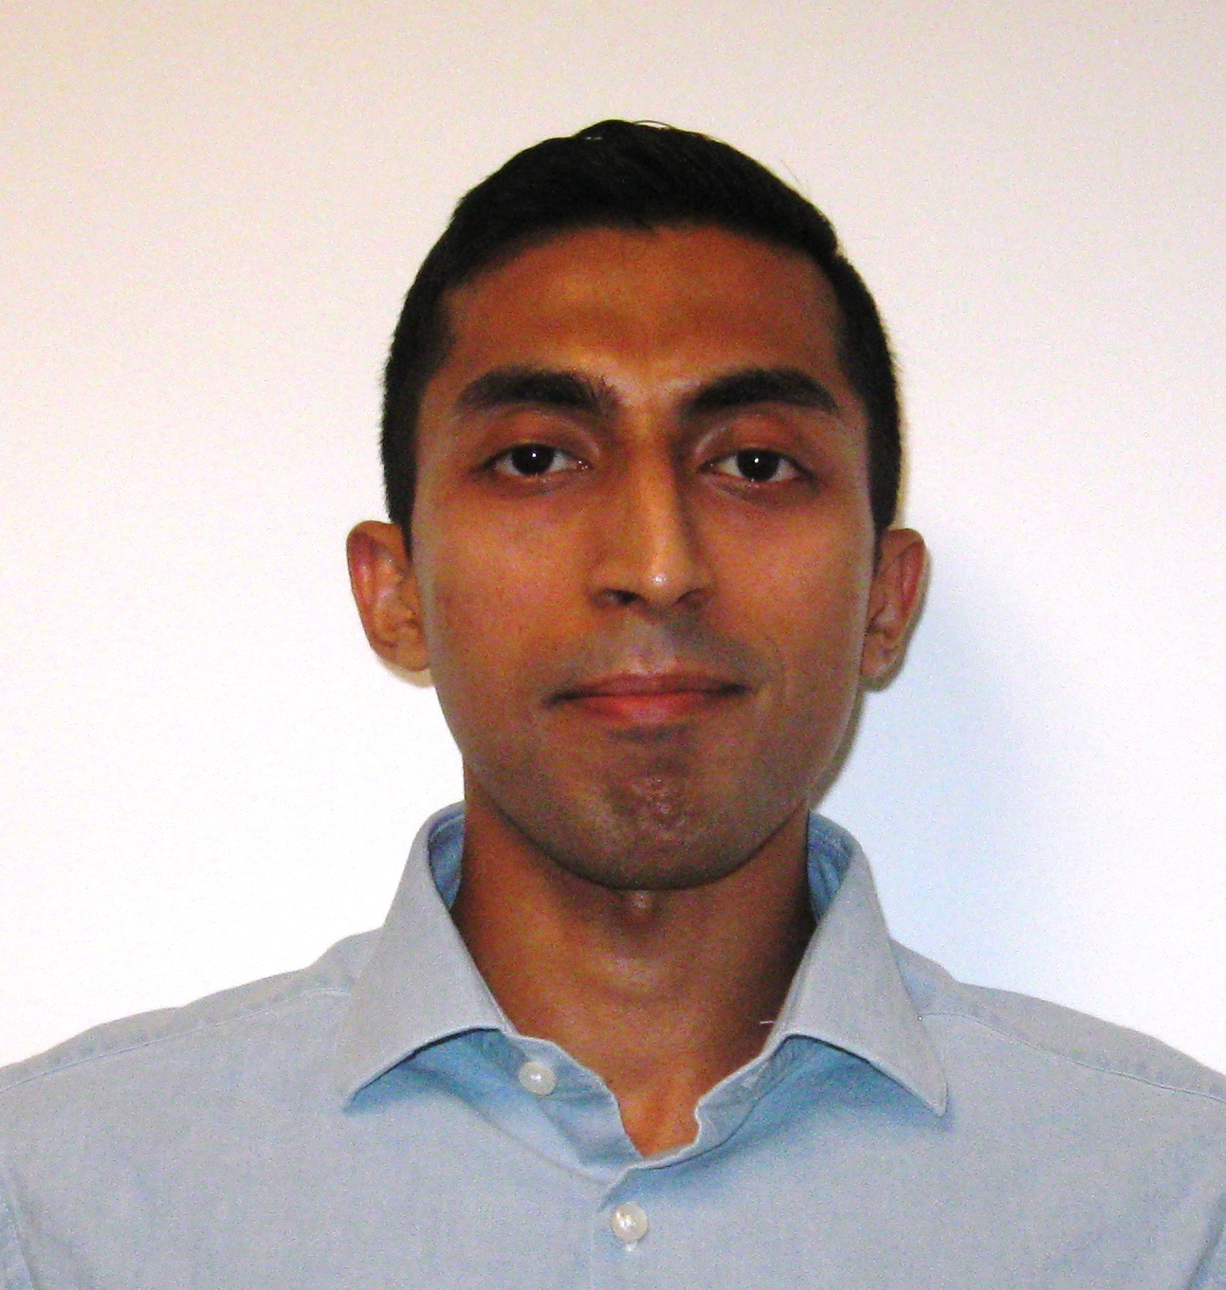
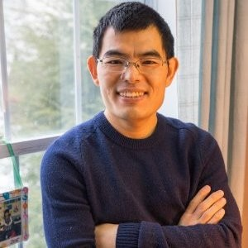
IOG Advanced Pathfinding/NVM Pathfinding
BoS/HC: 12/17
DT: 2, MC:1,
SM:1, TCAD:1
DerChang Kau
Fellow
Admin: Dinah Gevedon
Admin: Marci Lane
SPICE Modeling
Technology CAD
Device Technology
Kalavathi Subramaniam
Santosh Raghavan
Ananth Kaushik
Baofu Zhu
Dany Ly-Gagnon
Davide Fugazza
Principal Engineer
Lu Liu
Memory Cell
Hank Wang
Roberto Carboni
Art Tubera
Louis Luong
Mar/2021

Slide 3
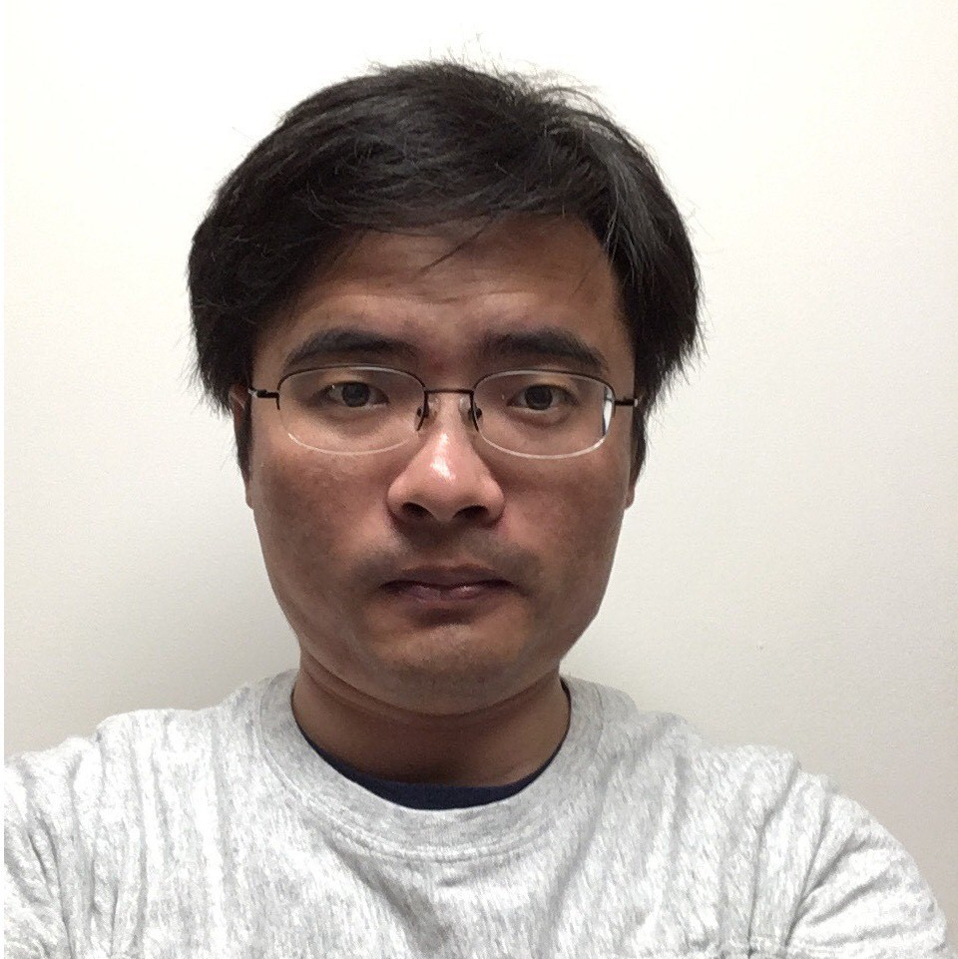
IOG Advanced Pathfinding/NVM Pathfinding
BoS/HC: 10/17
DT: 2, MC:1,
SM:3, TCAD:1
DerChang Kau
Fellow
Admin: Dinah Gevedon
Admin: Marci Lane
SPICE Modeling
Technology CAD
Device Technology
tbh
tbh
Ananth Kaushik
Leitao Liu
Dany Ly-Gagnon
Davide Fugazza
Principal Engineer
Lu Liu
Memory Cell
Hank Wang
Roberto Carboni
Art Tubera
Louis Luong
Jun/2021

Slide 4
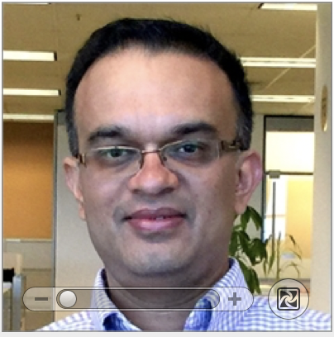
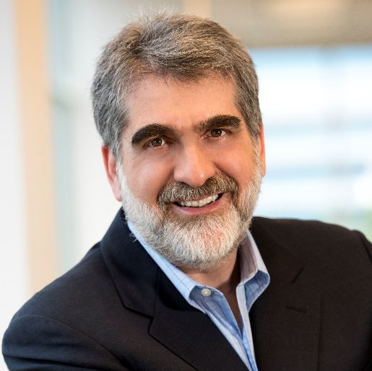
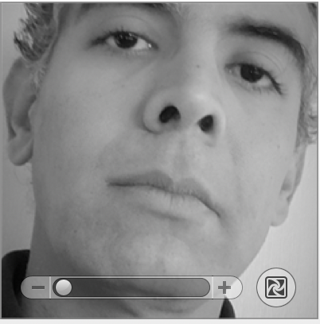
NVM Pathfinding Org Proposal for 2nd Half / 2021
Kia Omid-Zohoor
Engineering Manager
Kiran Pangal
Fellow
Al Fazio
Senior Fellow
Technology CAD
Device & Array
Material & Device
SPICE Modeling
Ananth Kaushik
Leitao Liu
Dany Ly-Gagnon
Lu Liu
Davide Fugazza
Principal Engineer
Kumar Virmani
Principal Engineer
Device/Media Lab
Memory Cell
Art Tubera
Louis Luong
Hank Wang
Roberto Carboni
Jun/2021

Slide 5
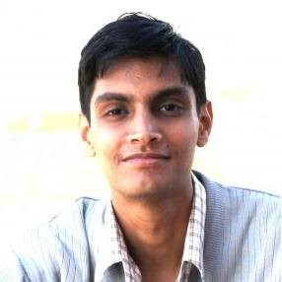

NVM Pathfinding Org Proposal-2 for 2nd Half / 2021
Kia Omid-Zohoor
Engineering Manager
Kiran Pangal
Fellow
Al Fazio
Senior Fellow
Technology CAD
Device & Array
Material & Device
SPICE Modeling
Ananth Kaushik
Leitao Liu
Dany Ly-Gagnon
Lu Liu
Davide Fugazza
Principal Engineer
Kumar Virmani
Principal Engineer
Hemant Rao
Device/Media Lab
Memory Cell
Art Tubera
Louis Luong
Hank Wang
Roberto Carboni
Phoebe Yeoh
Jun/2021

