Slide 1
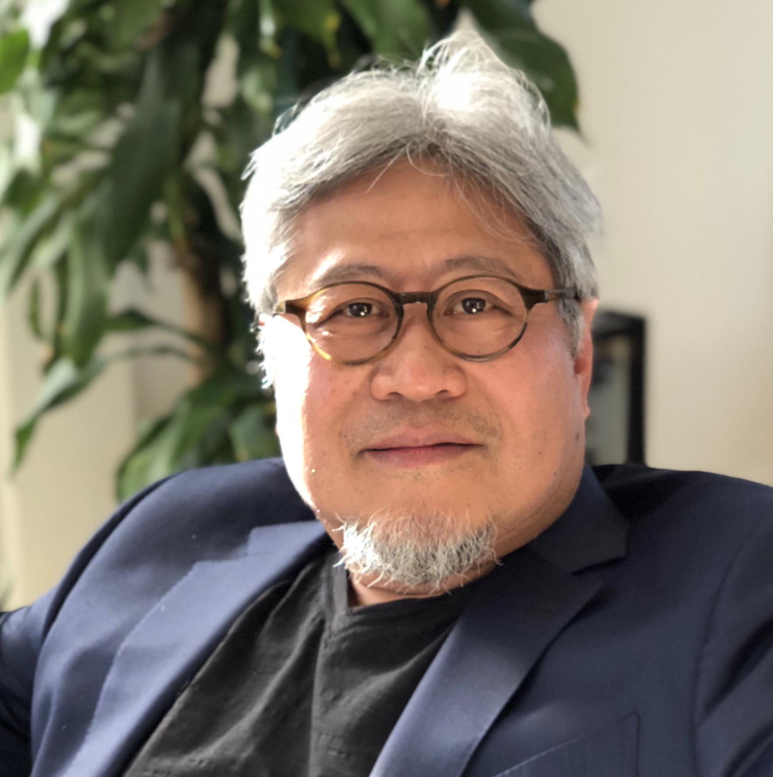
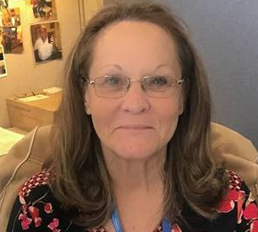

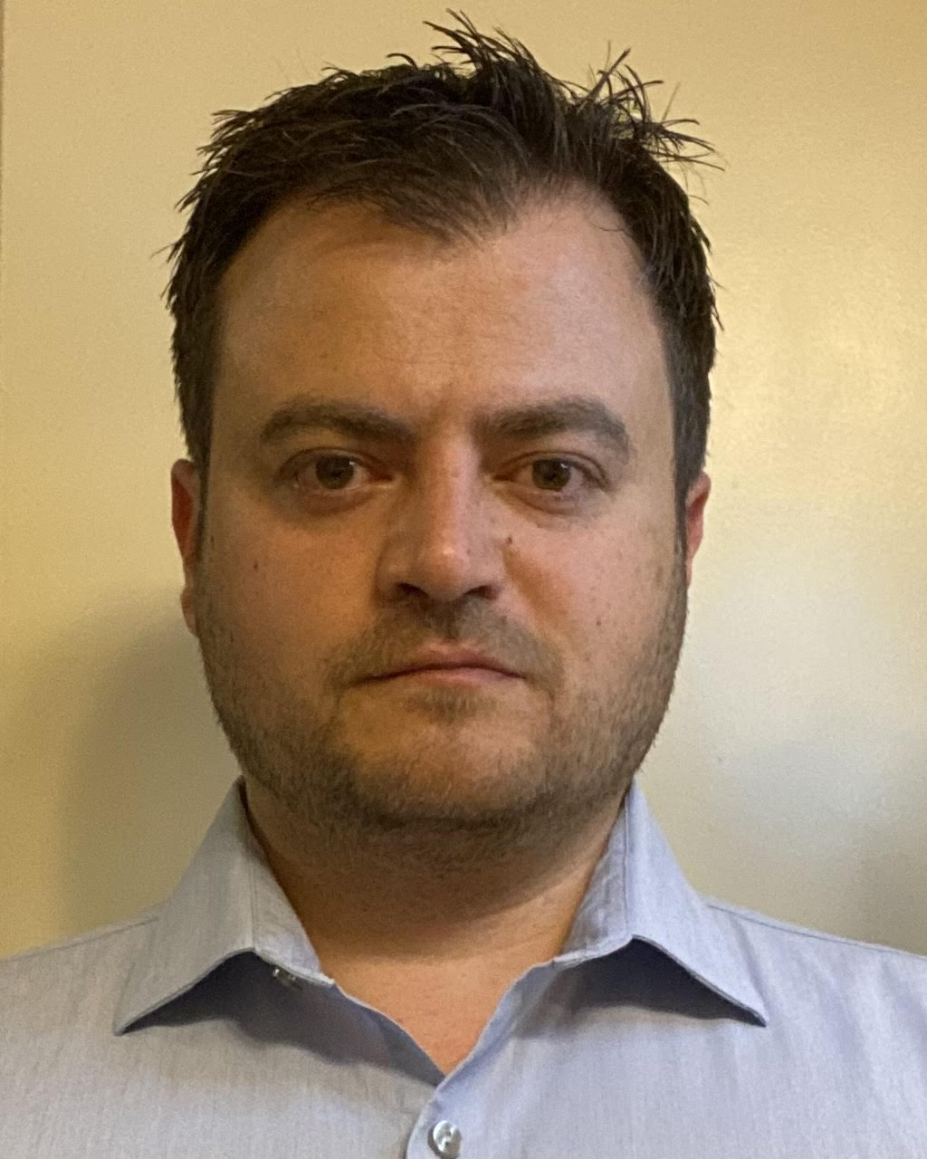

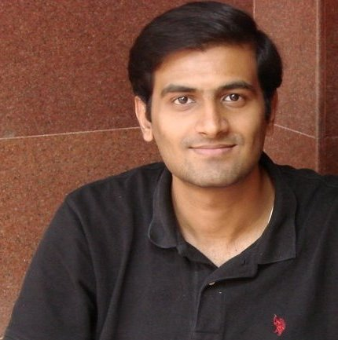
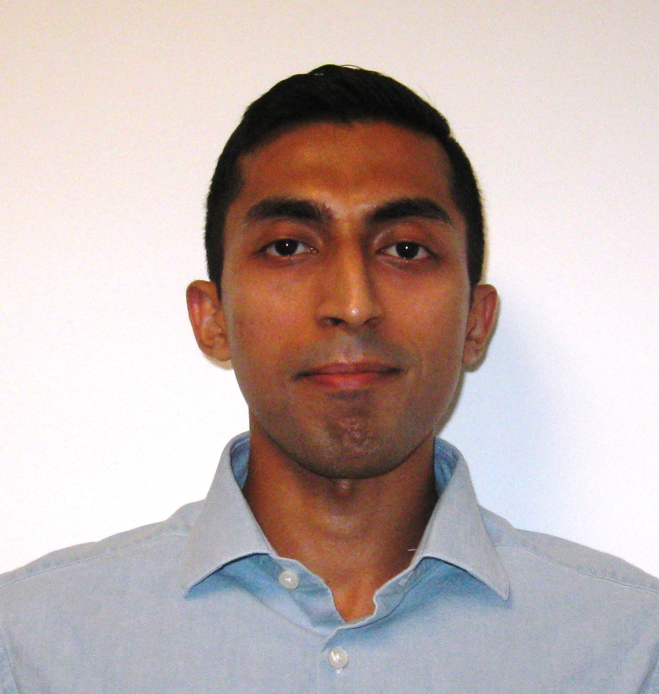
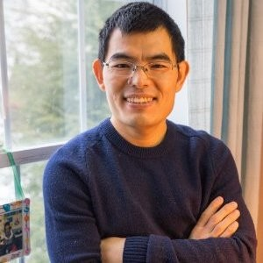
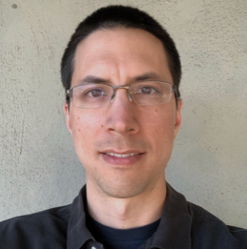
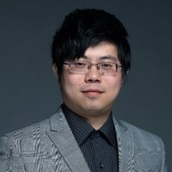
IOG Adv. Pathfinding
NVM Pathfinding
DerChang Kau, Fellow
SPICE Modeling
Technology CAD
Kalavathi Subramaniam
Device Technology
Santosh Raghavan
TBH
Ananth Kaushik
Lu Liu
Davide Fugazza Principal Engineer
Memory Cell
Dany Ly-Gagnon
Baofu Zhu
TBH
TBH
Admin: Dinah Gevedon
Admin: Marci Lane

