Slide 1
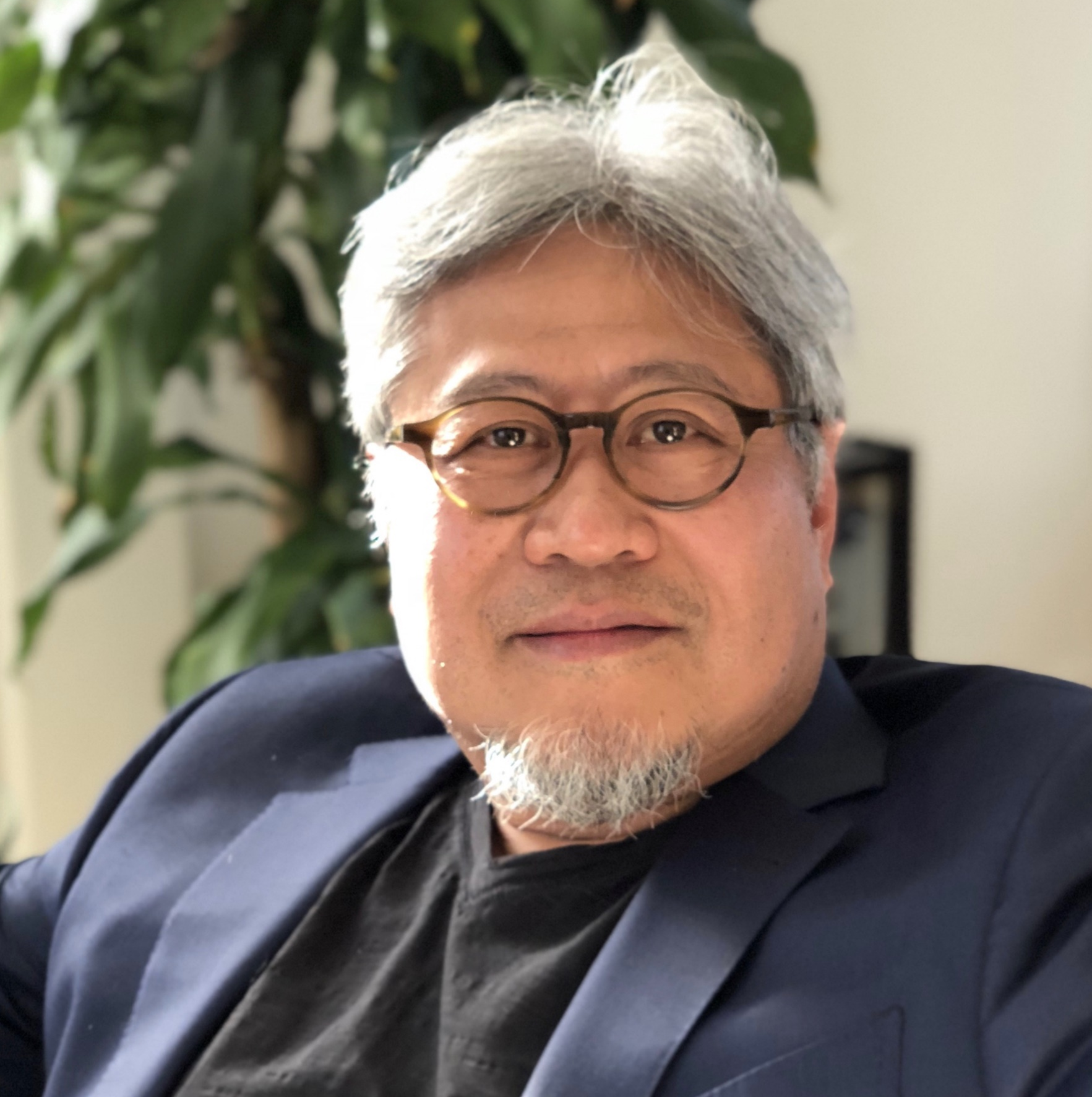
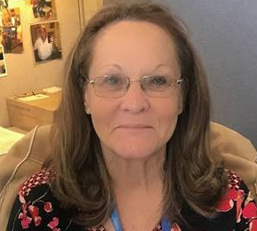

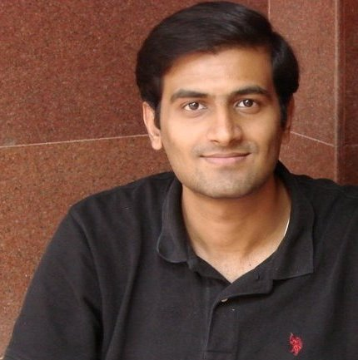
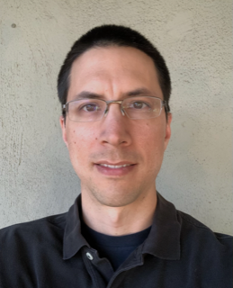
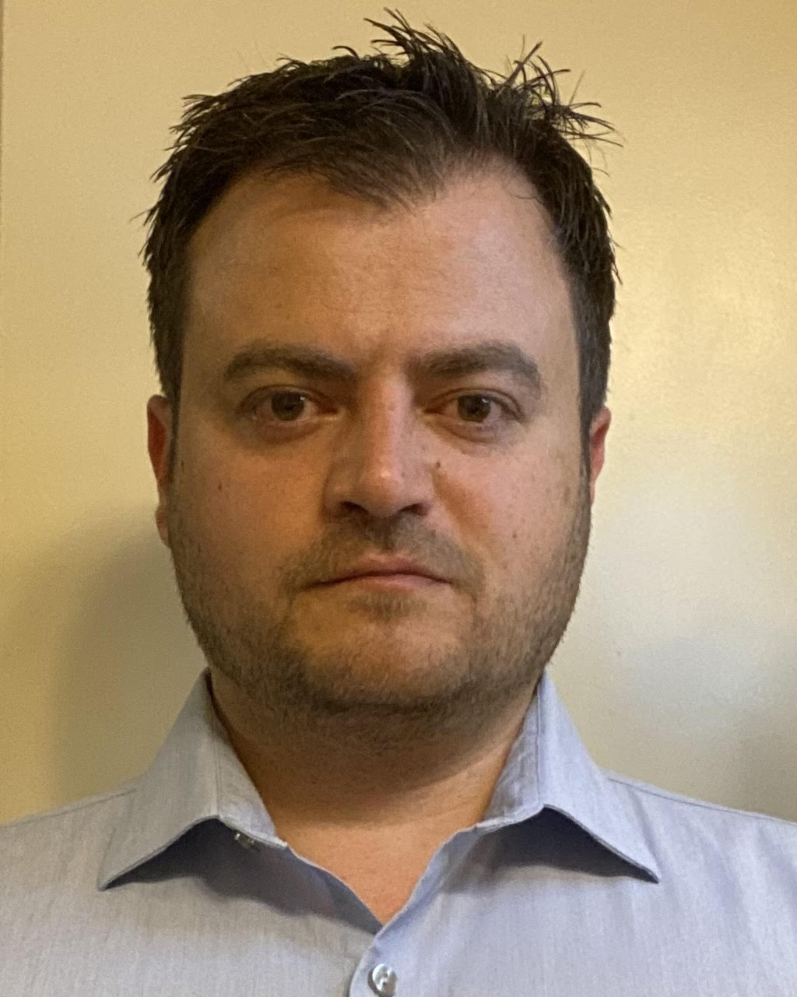

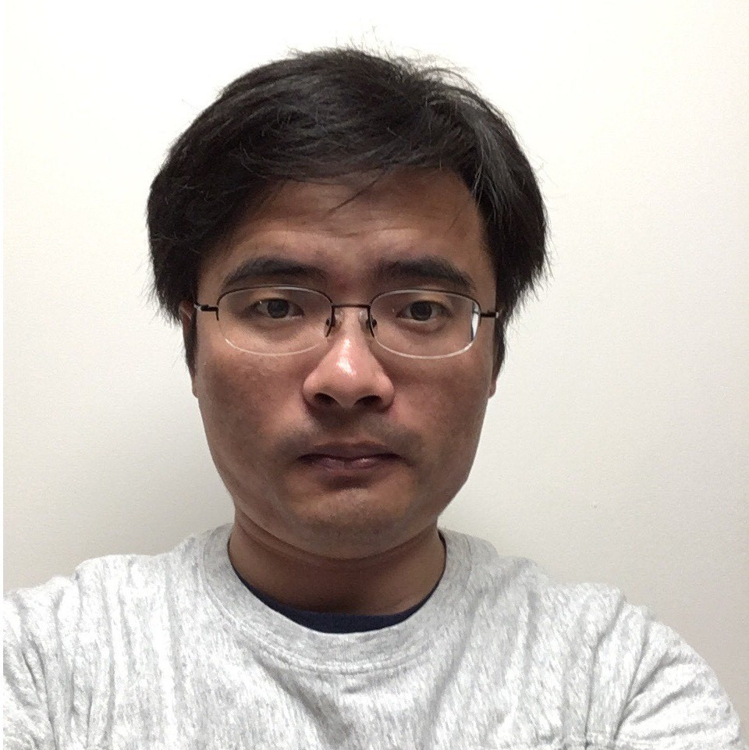

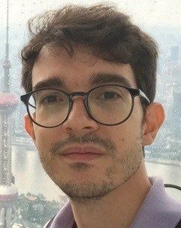
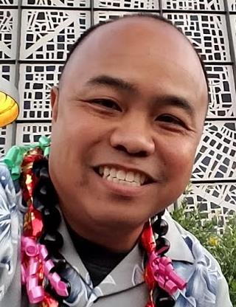


IOG Advanced Pathfinding/NVM Pathfinding
DerChang Kau
Fellow
Admin: Dinah Gevedon
Admin: Marci Lane
SPICE Modeling
Technology CAD
Device Technology
tbh
tbh
Ananth Kaushik
Leitao Liu
Dany Ly-Gagnon
Davide Fugazza
Principal Engineer
Lu Liu
Memory Cell
Hank Wang
Roberto Carboni
Art Tubera
Louis Luong

