Slide 1
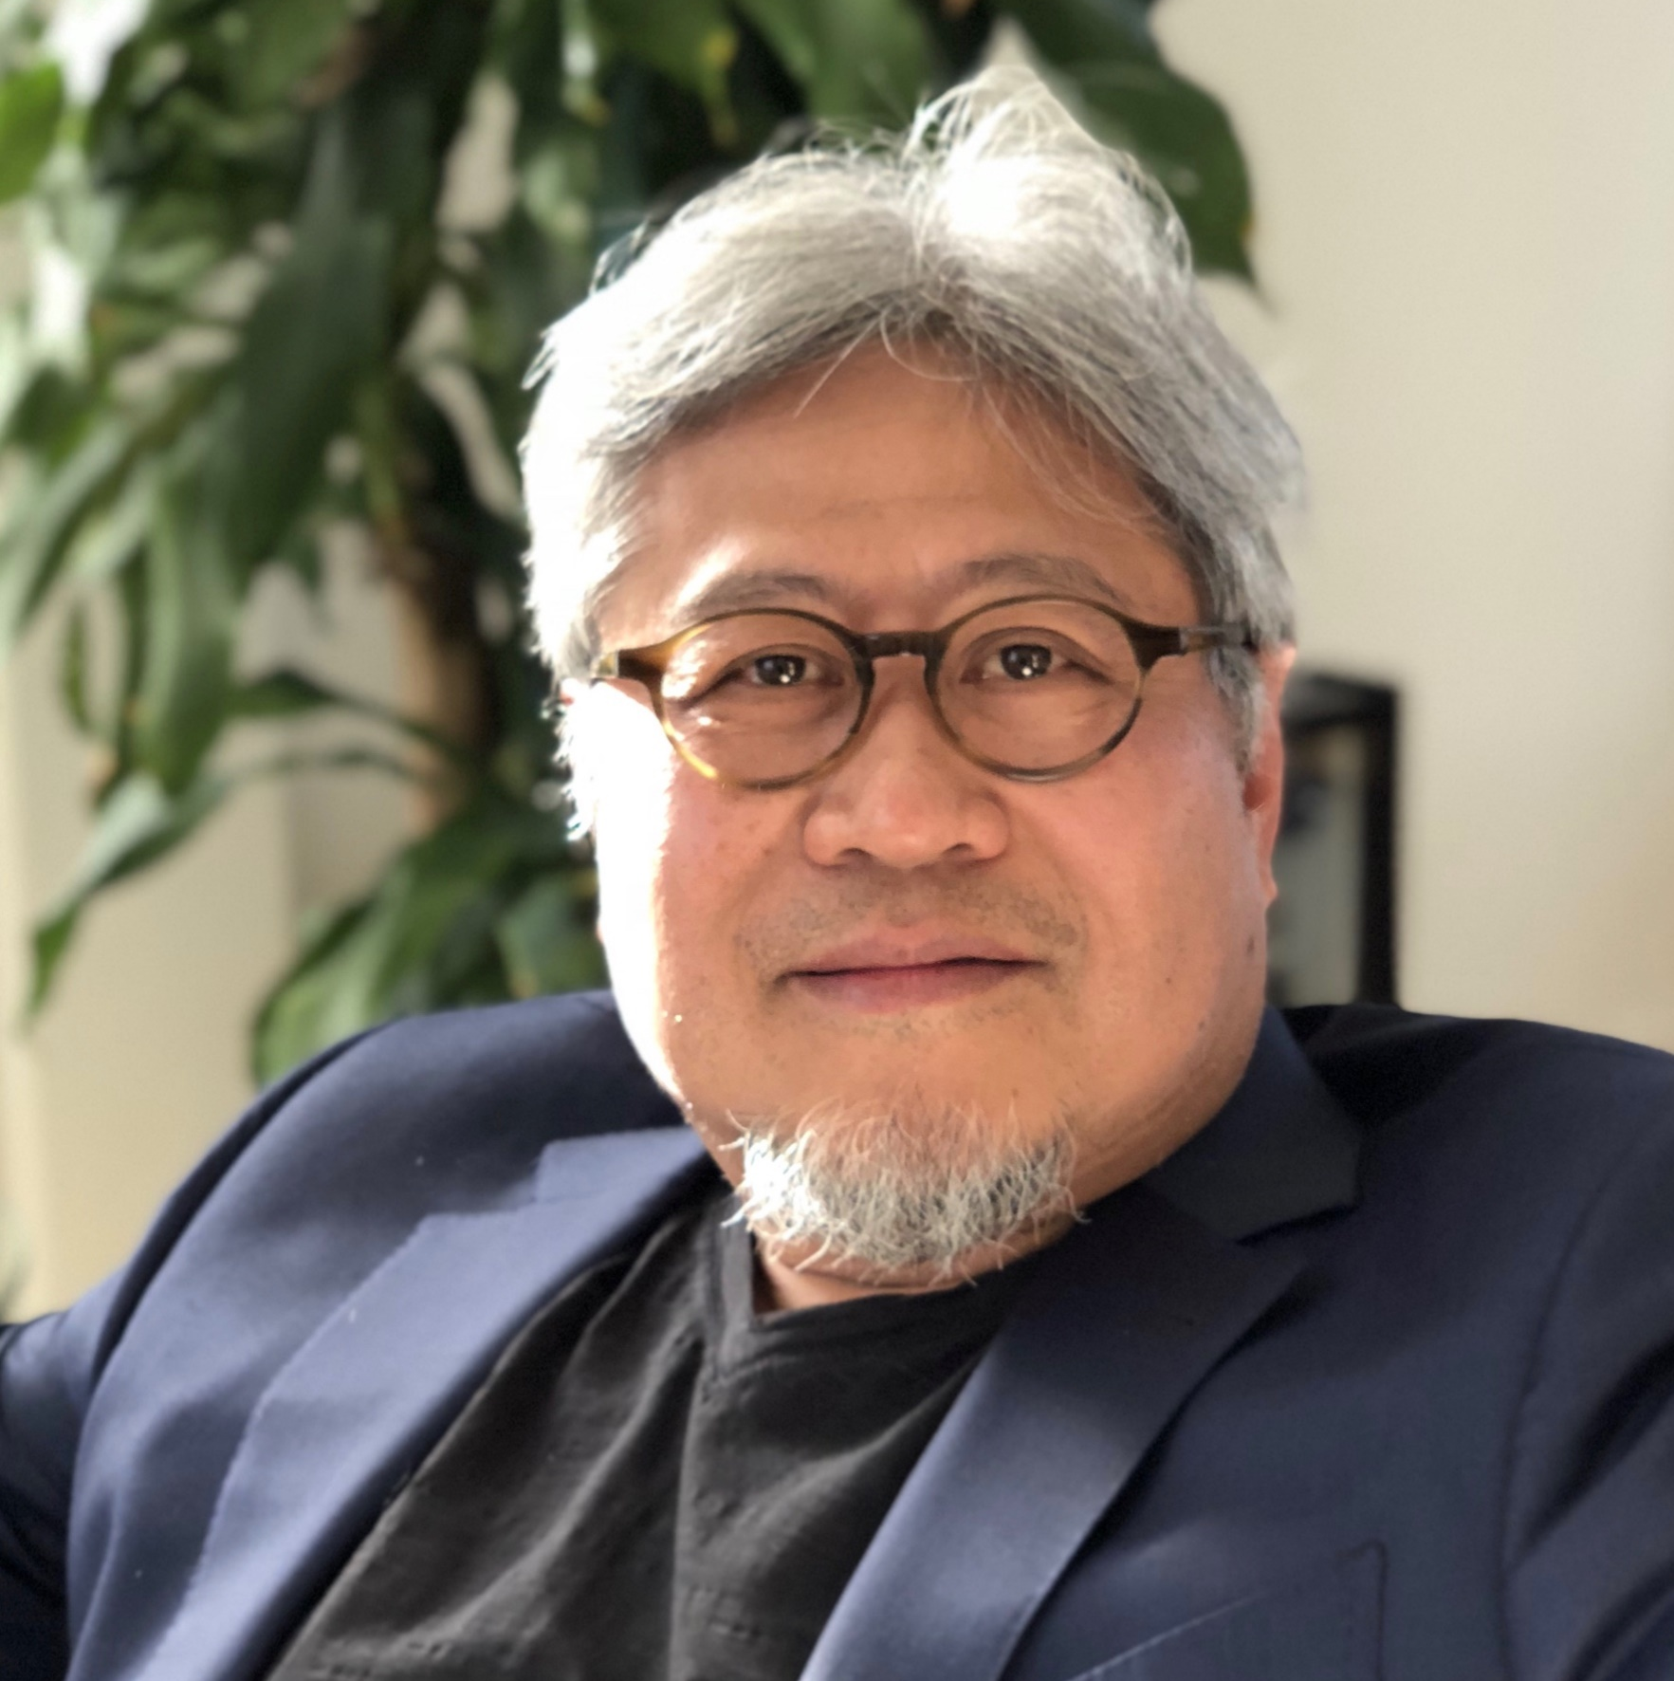
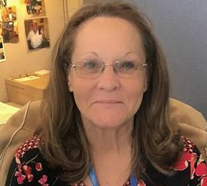


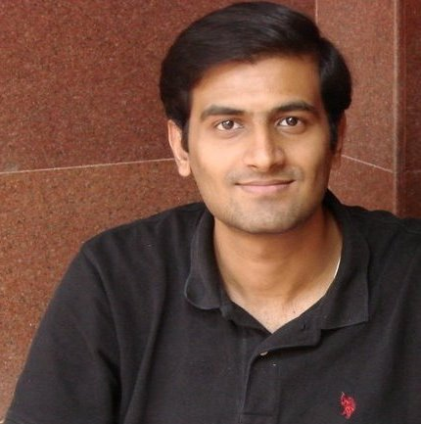
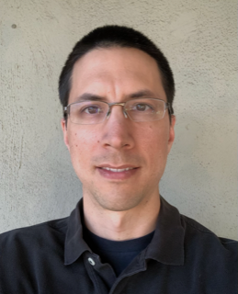
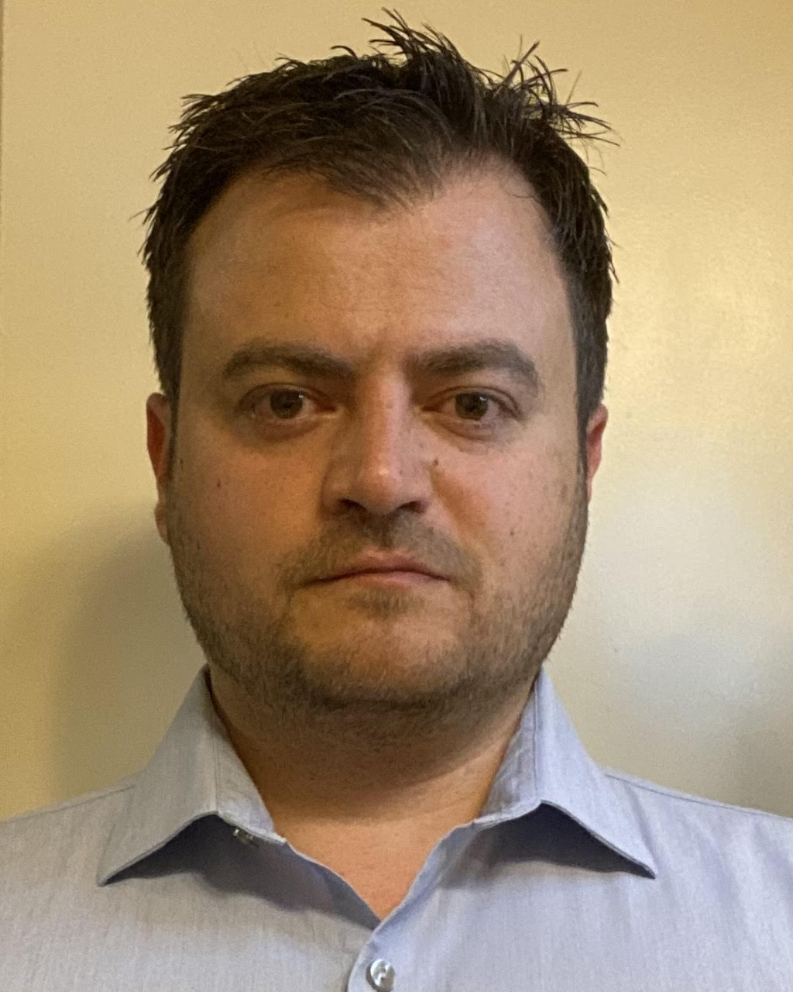
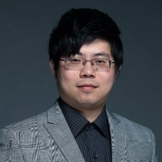
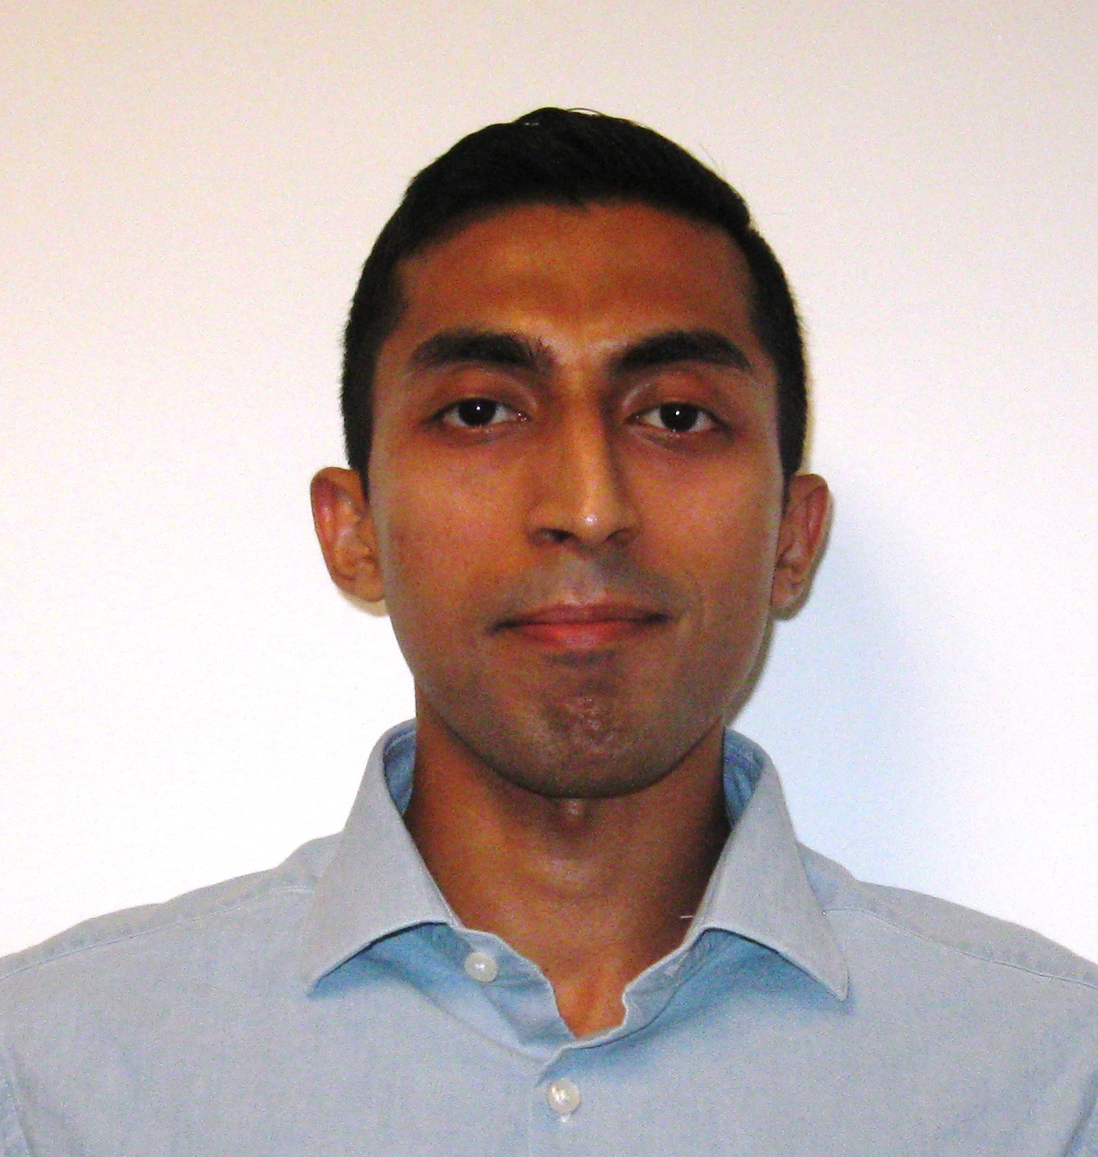
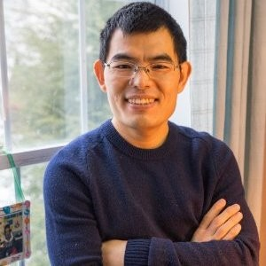

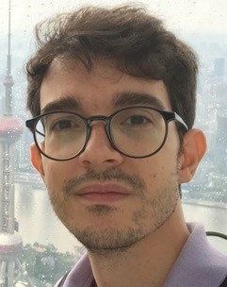
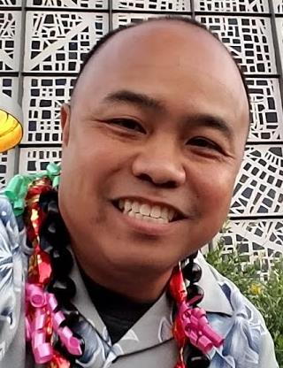


IOG Advanced Pathfinding/NVM Pathfinding
DerChang Kau
Fellow
Admin: Dinah Gevedon
Admin: Marci Lane
SPICE Modeling
Technology CAD
Device Technology
Kalavathi Subramaniam
Santosh Raghavan
Ananth Kaushik
Baofu Zhu
Dany Ly-Gagnon
Davide Fugazza
Principal Engineer
Lu Liu
Memory Cell
Hank Wang
Roberto Carboni
Art Tubera
Louis Luong

