Slide 1
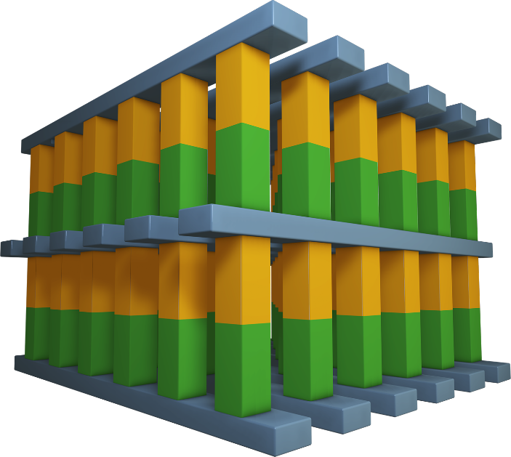
Wordlines
Bitlines
Memory & Selector Devices

