Slide 1
Selector, an essential device in a memory cell of cross point memory technologies
SRC Workshop on New Trajectories for Memory and Storage Technologies, Oct/27~29/2020
DerChang Kau
Intel Fellow
Director, 3D XPoint Memory Technologies

Slide 2

Cross Point Memory Array – ½ voltage biased scheme
0V
+½V
+½V
…
R_{BL}
…
…
R_{WL}
–½V
…
0V
–½V
The selected bit (•) is at the cross point of the selected bitline (BL) and wordline (WL)
Functionality –
A fully networked x-y resistive array ➔ Sneak paths thru all de-selected cells (•) connect the selected BL/WL
Reliability –
All bits on selected BL (•) and selected WL (•) are biased ➔ Read/Write disturbance and retention
A selector isolates memory cells in an array, improves access accuracy and strengthens reliability.

Slide 3
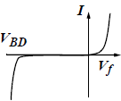
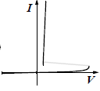
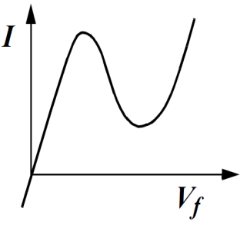
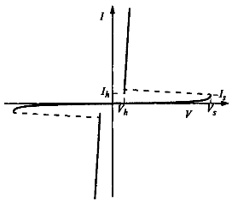
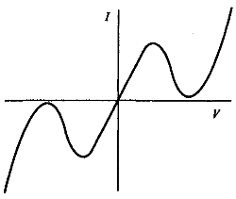
Selector of a cross-point memory cell is a diode
Diode: two terminals and exhibiting a nonlinear I-V, IEEE Standard Dictionary of Electrical and Electronics Terms, 1980
§
§
§
Unidirectional
Asymmetric
Unipolar
L-Shape
S-Shape
N-Shape
¶
§
§
Bidirectional
Symmetric Ambipolar
§ : Kowk K. Ng, Complete guide to semiconductor devices, 2nd ed., 2002
¶ :https://www.digikey.com/en/articles/design-in-tvs-diode-protection-enhance-can-bus-reliability

Slide 4

Random Access of a Memory in Cross Point Array
Unidirectional L-Shape Selector
Bidirectional S-Shape Selector
0
0 ➔ V
0
0 ➔± V
…
…
…
…
0
V
V ➔ 0
0 ➔$∓$V
A rectifying selector turns on one bit with forward bias and isolates others with reverse bias.
Selected BL/WL are toggled between 0V and V
All bits but selected WL/BL are reversed biasd
Subject to V_{drop} at each cross points, the selected bit is triggered, and the unselected bits are blocked.
Selected BL/WL are toggled between 0V and ±V
All bits but selected WL/BL are 0 biased

Slide 5
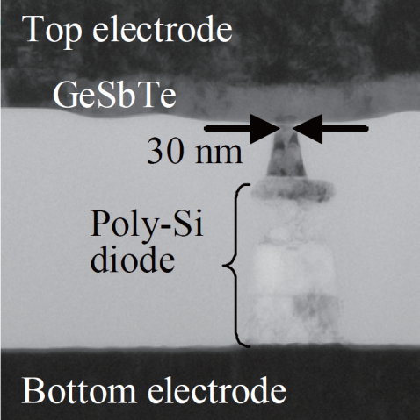
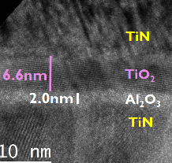
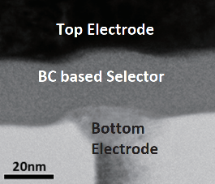
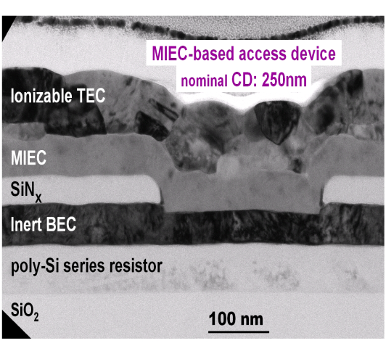
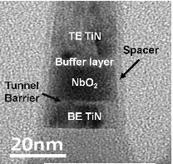
Thin Film Diode Candidates for Cross Point Memory
Y. Sasago, et. al.,
VLSI ’09. T2B-1
B. ﻿Govoreanu, et.al.,
IEDM’13. S10.2
S. Yasuda, et.al.,
VLSI, 2017. T2-4
OTS
K. Gopalakrishnan, et. al.,
VLSI ’10. TS19.41
S.G. Kim, et. al.,
IEDM ’15. S10.3
D. Kau, et. al.,
IEDM ’09. S27.1

Slide 6
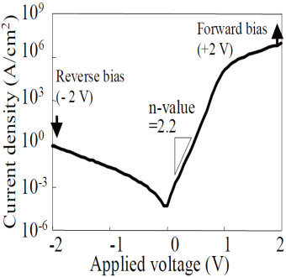
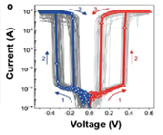
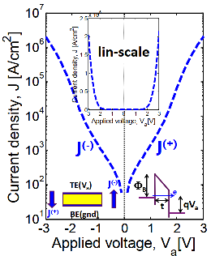
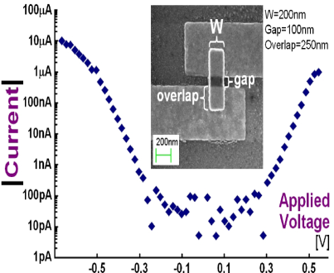
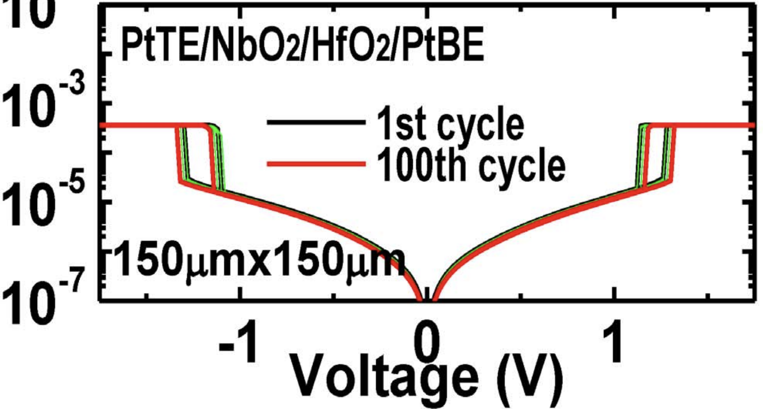
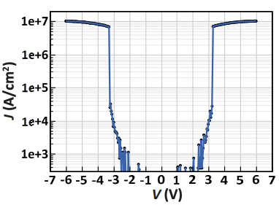
Threshold Switching Phenomenology & Mechanisms
Mechanism | Thermionic | Filamentation | Tunneling | MIEC | MIT | OTS
Construct. | P-N or M-S Jx | Ion (Ag⁺) in Ox | MIM | Cu⁺ in SE | NbO₂ | Chalcogenide
Switching | Electronic | Atomistic | Electronic | Atomistic | Atomistic | Electronic
Polarity | Unidirectional | Bidirectional | Bidirectional | Bidirectional | Bidirectional | Bidirectional
τ_{switch} | sub nsec | ns ~ 100s ns | ps or faster | ns ~ 100s ns | ns to 10s ns | sub ns
J_{MAX} | < 10MA/cm² | 1-10MA/cm² | < 1MA/cm² | ~10MA/cm² | > 10MA/cm² | > 10MA/cm²
J_{Inhibit} | <1A/cm² | <1KA/cm² | <1KA/cm² | <1KA/cm² | <1KA/cm² | <1KA/cm²
V_{Inhibit} | < 3V | < 1V | <3V | < 1V | < 3V | < 3V
I-V
Reference | Y. Sasago, et. al., VLSI ’09 | J. Yang, et.al., Adv Func Mtls (2018) | B. ﻿Govoreanu, et.al., IEDM’13. P10.2 | K. Gopalakrishnan, et.al., VLSI Symposium ’10. | X. Liu et.al., EDL Oct.’14 | S. Yasuda, et.al., VLSI symposium, ‘17,

Slide 7
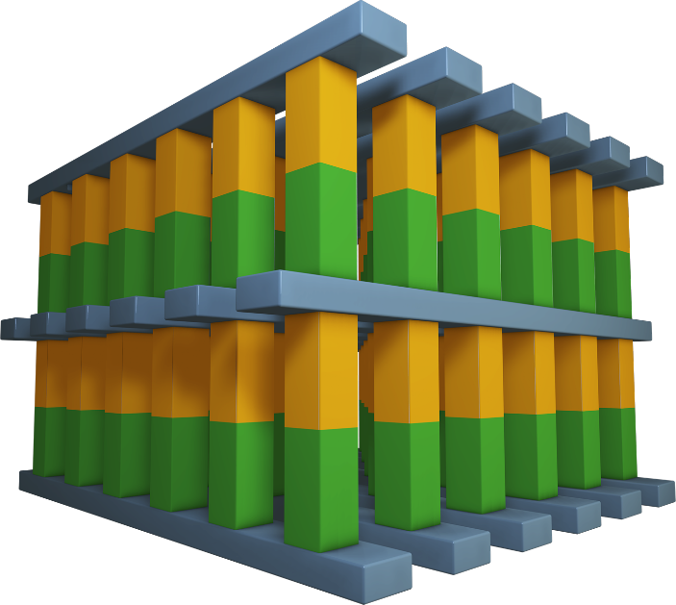
Consideration of architecting a cross point memory technology
Desirable Attributes: Nonvolatile, Low Cost, High Performance
Simple scalable, 3D stackable construction; low D·T, BEOL compatible with mainstream IC manufacturing
Memory switching in atomistic state (bulk); superior scalability than electrostatic memory switching physics
Individual cell access, small granularity
Fast switching materials + local low resistance metal interconnect
Challenge: to “mate” selector and memory in achieving a non-linear I-V for array access
Potential Memory Options:
  Spin polarization
  Phase change/segregation
  Ferroelectric hysteresis
  Interfacial barrier modulation
  Oxygen vacancy relocation
  Ionic transport
  NRAM (?)
Potential Selector Options:
  Unidirectional
  Homo/Heterogenous P/N Jx
  Schottky Barrier
  Bidirectional
  Mixed ionic-electronic conduction
  Tunneling barrier
  Metal–insulator transitions
  Ovonic threshold switching
Wordlines
Bitlines
Selector & Memory Devices
Wordlines

