Slide 1
Selector, an essential device in each cell of cross point memory technologies
SRC Workshop on New Trajectories for Memory and Storage Technologies, Oct/27~29/2020
DerChang Kau
Intel Fellow
Director, 3D XPoint Memory Technologies

Slide 2
Abstract
Selector, an access device, isolates memory cells in an array. It improves signal to noise ratio as well as memory access disturbance immunity. A selector of a cross-point memory cell is a two-terminal switch serially connected to a matching storage element. An effective selector technology is realized with a low thermal budget process integrated at the cross point of a pair metal straps, a.k.a. wordlines and bitlines. This backend memory process is compatible with mainstream semiconductor technology featuring CMOS under array with deck stacking for low cost memory products. In this review, prospective two-terminal switches exhibiting nonlinear I-V characteristics in a cross point memory array will be discussed. The phenomenology and switching speed with the underline mechanism as well as the compatibility to memory access will be benchmarked.

Slide 3
Outline
Why is selector needed in a cross-point memory array
Examples of two terminal selectors
Selector phenomenology and physics
Challenges

Slide 4
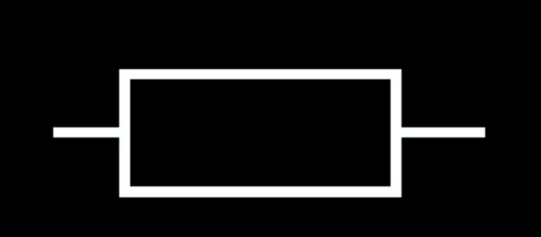
Cross Point Memory Array – ½ voltage biased scheme
0V
+½V
+½V
…
R_{bitline}
…
R_{wordline}
…
–½V
…
0V
–½V
The selected bit (•) is at the cross point of the selected bitline (BL) and wordline (WL)
Functionality –
A fully networked x-y resistive matrix ➔ Sneak paths thru all de-selected cells (•) connect the selected BL/WL
Reliability –
All bits on selected BL (•) and selected WL (•) are biased ➔ Read/Write disturbance and retention
A selector isolates memory cells in an array, improves access accuracy and strengthens reliability.

Slide 5
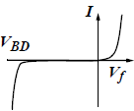
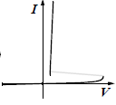
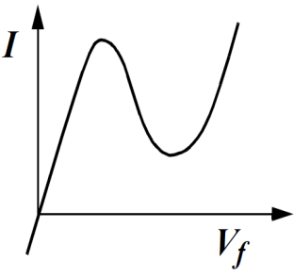
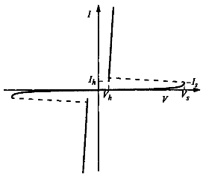
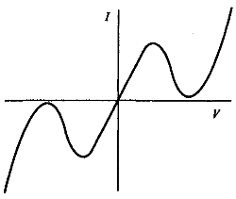
Selector of a cross-point memory cell is a diode
Diode: two terminals and exhibiting a nonlinear I-V, IEEE Standard Dictionary of Electrical and Electronics Terms, 1980
§
§
§
Unidirectional
(Unipolar)
L-Shape
S-Shape
N-Shape
¶
§
§
Bi-rectional
(Ambipolar)
§ : Kowk K. Ng, Complete guide to semiconductor devices, 2nd ed., 2002
¶ :https://www.digikey.com/en/articles/design-in-tvs-diode-protection-enhance-can-bus-reliability

Slide 6

Random Access of a Memory in Cross Point Array
Unidirectional L-Shape Selector
Bidirectional S-Shape Selector
0
0 ➔ V
0
0 ➔± V
…
…
…
…
0
V
V ➔ 0
0 ➔$∓$V
A rectifying selector turns on one bit with forward bias and isolates others with reverse bias.
Selected BL/WL are toggled between 0V and V
All bits but selected WL/BL are reversed biasd
Subject to V_{drop} at each cross points, the selected bit is triggered, and the unselected bits are blocked.
Selected BL/WL are toggled between 0V and ±V
All bits but selected WL/BL are 0 biased

Slide 7
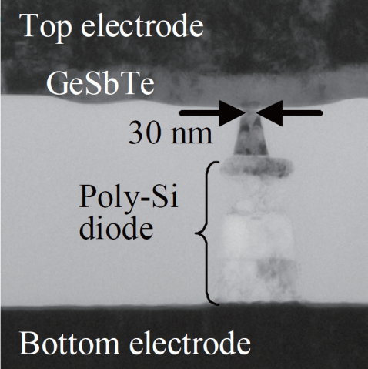
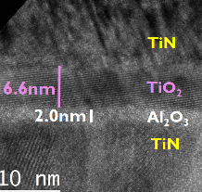
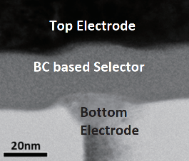
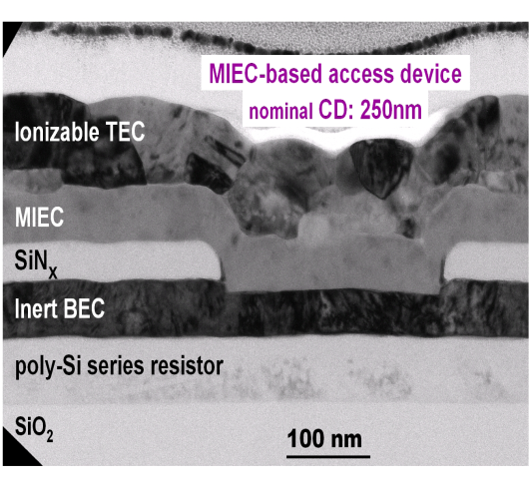
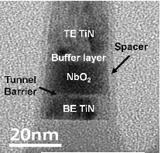
Thin Film Diode Candidates for Cross Point Memory
Y. Sasago, et. al.,
VLSI ’09. T2B-1
B. ﻿Govoreanu, et.al.,
IEDM’13. P10.2
S. Yasuda, et.al.,
VLSI, 2017, T2-4
OTS
K. Gopalakrishnan, et. al.,
VLSI ’10. TS19.41
S.G. Kim, et. al.,
IEDM ’15
D. Kau, et. al.,
IEDM ’09. S27.1

Slide 8
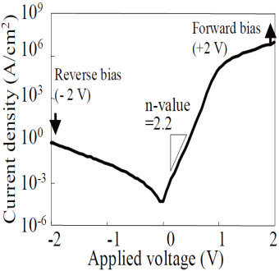
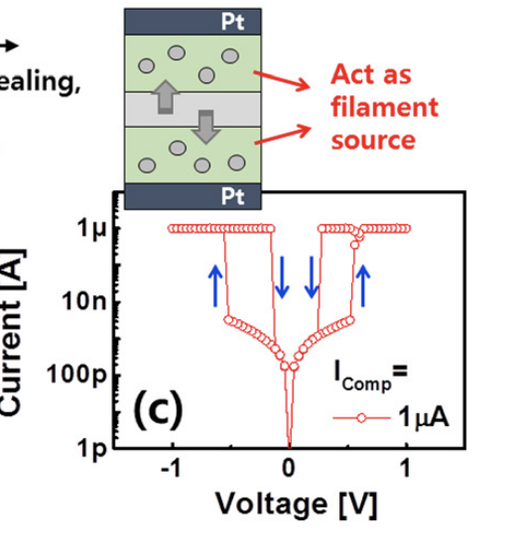
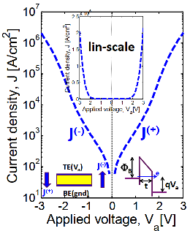
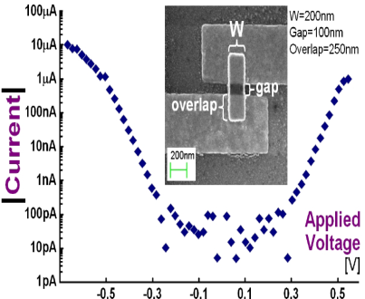
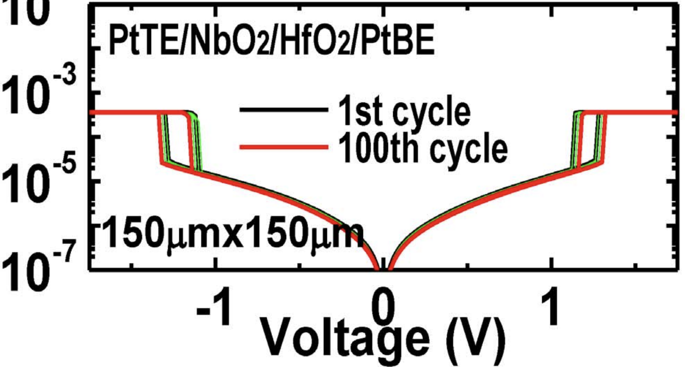
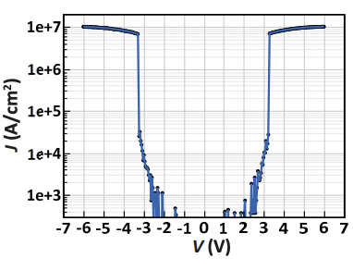
Threshold Switching Phenomenology & Mechanisms
Mechanism | Thermionic | Filamentation | Tunneling | MIEC | MIT | OTS
Construct. | P-N or M-S Jx | Ion (Ag⁺) in Ox | MIM | Cu⁺ in SE | NbO₂ | Chalcogenide
Switching | Electronic | Atomistic | Electronic | Atomistic | Atomic | Electronic
Polarity | Unidirectional | Bidirectional | Bidirectional | Bidirectional | Bidirectional | Bidirectional
τ_{switch} | sub nsec | ns ~ 100s ns | ps or faster | ns ~ 100s ns | ns to 10s ns | sub ns
J_{ON} | < 10MA/cm² | 1-10MA/cm² | < 1MA/cm² | >10MA/cm² | > 10MA/cm² | > 10MA/cm²
J_{OFF} | <1A/cm² | <10KA/cm² | <1KA/cm² | <1KA/cm² | <1KA/cm² | <1KA/cm²
V_{peak} | < 3V | < 1V | <3V | < 1V | < 3V | < 3V
I-V
Reference | Y. Sasago, et. al., VLSI ’09 | J. Song, et.al., APL 107, 113504 (2015) | B. ﻿Govoreanu, et.al., IEDM’13. P10.2 | K. Gopalakrishnan, et.al., VLSI Symposium ’10. | X. Liu et.al., EDL Oct.’14 | S. Yasuda, et.al., VLSI symposium, ‘17,

Slide 9
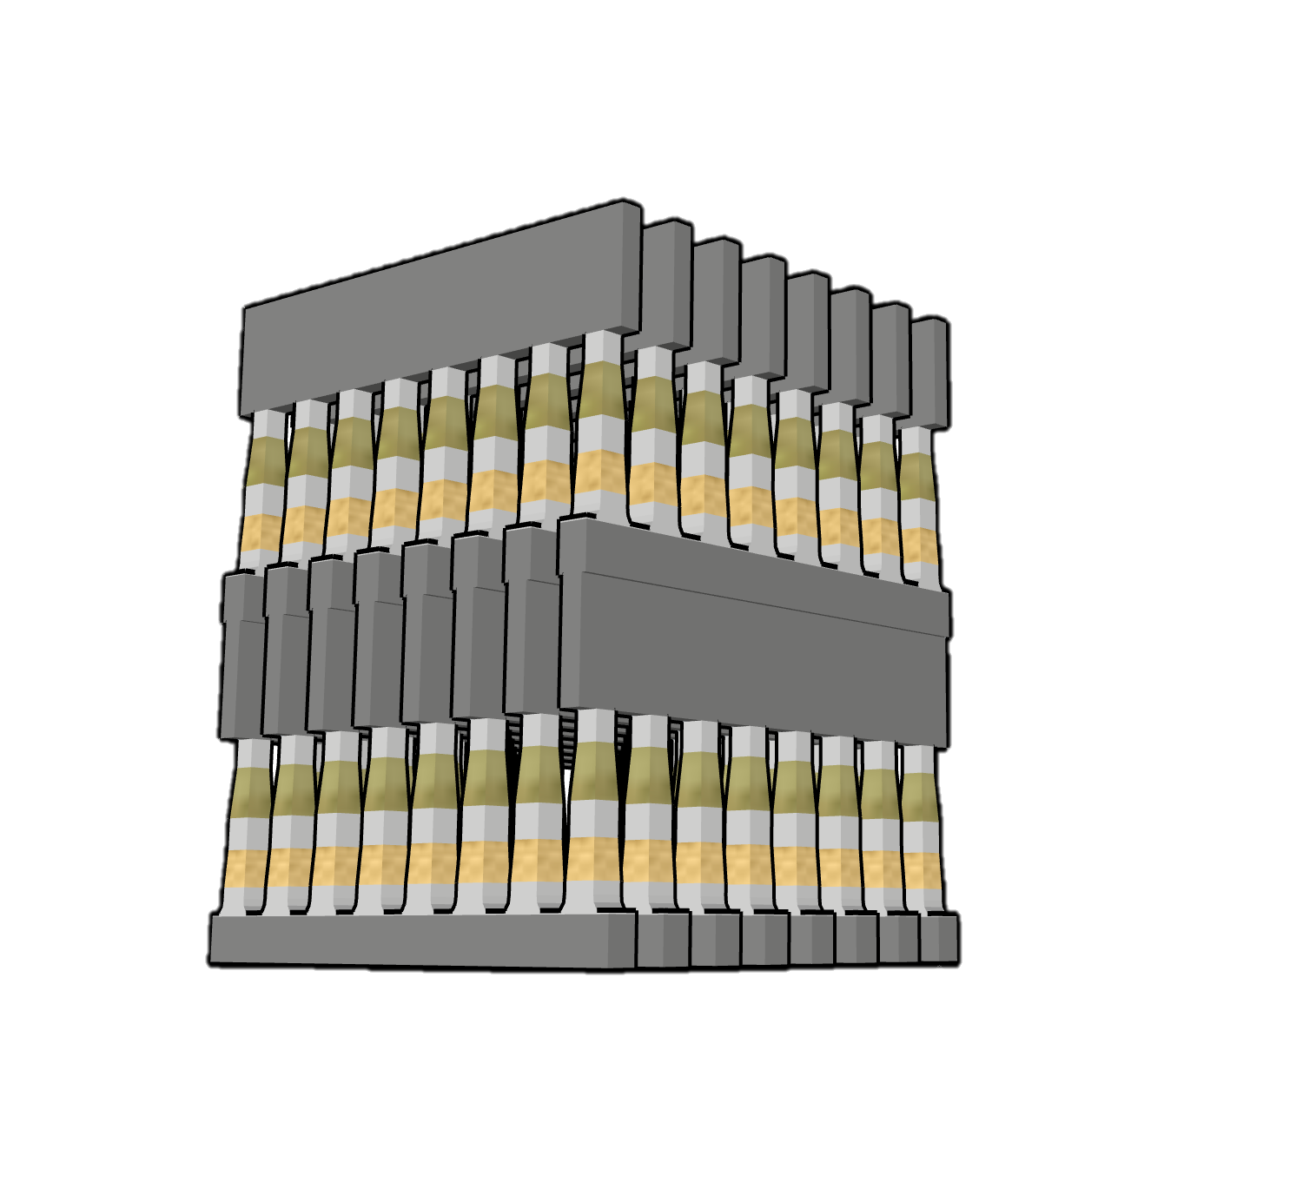
Consideration of architecting a cross point memory technology
Desirable Attributes: Non-volatile, Low Cost, High Performance
Simple scalable structure + 3D stackable technology
Memory in atomistic state
Individual Cell Access, small granularity
Fast switching materials + local low resistance metal interconnect
Challenge: to “mate” selector and memory in achieving a non-linear I-V for array access
Wordlines
Potential Memory Options:
  Spin polarization
  Phase change/segregation
  Ferroelectric hysteresis
  Interfacial barrier modulation
  Oxygen vacancy relocation
  Ionic transport
  NRAM (?)
Potential Selector Options:
  Unidirectional
  Homo/Heterogenous P/N Jx
  Schottky Barrier
  Bidirectional
  Mixed ionic-electronic conduction
  Tunneling barrier
  Metal–insulator transitions
  Ovonic threshold switching
Memory & Selector
Bitlines
Wordlines

