Slide 1
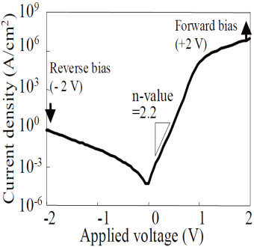
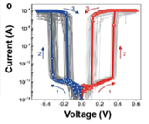
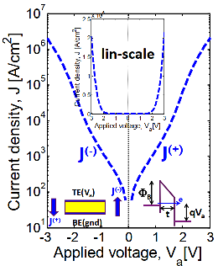
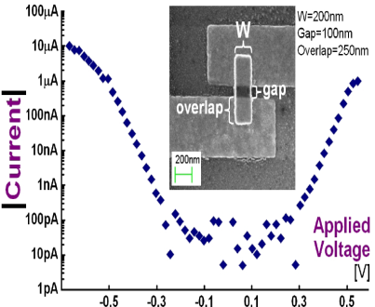
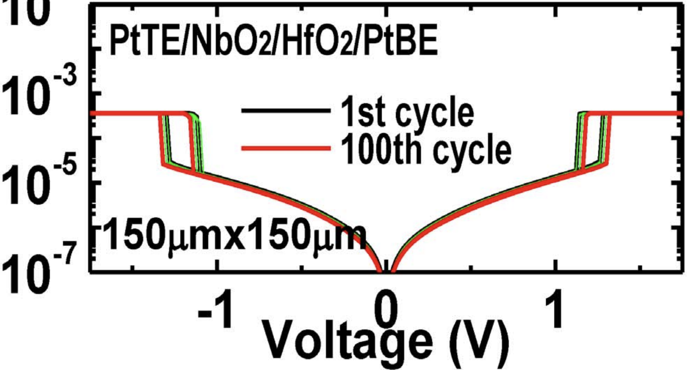
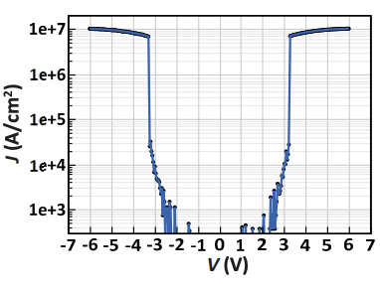
Threshold Switching Phenomenology & Mechanisms
Mechanism | Thermionic | Filamentation | Tunneling | MIEC | MIT | OTS
Construct. | P-N or M-S Jx | Ion (Ag⁺) in Ox | MIM | Cu⁺ in SE | NbO₂ | Chalcogenide
Switching | Electronic | Atomistic | Electronic | Atomistic | Atomic | Electronic
Polarity | Unidirectional | Bidirectional | Bidirectional | Bidirectional | Bidirectional | Bidirectional
τ_{switch} | sub nsec | ns ~ 100s ns | ps or faster | ns ~ 100s ns | ns to 10s ns | sub ns
J_{ON} | < 10MA/cm² | 1-10MA/cm² | < 1MA/cm² | >10MA/cm² | > 10MA/cm² | > 10MA/cm²
J_{OFF} | <1A/cm² | <1KA/cm² | <1KA/cm² | <1KA/cm² | <1KA/cm² | <1KA/cm²
V_{peak} | < 3V | < 1V | <3V | < 1V | < 3V | < 3V
I-V
Reference | Y. Sasago, et. al., VLSI ’09 | J. Yang, et.al., Adv Func Mtls (2018) | B. ﻿Govoreanu, et.al., IEDM’13. P10.2 | K. Gopalakrishnan, et.al., VLSI Symposium ’10. | X. Liu et.al., EDL Oct.’14 | S. Yasuda, et.al., VLSI symposium, ‘17,

