Slide 1
Emerging Memory: Competitive Landscape
Prashant Majhi, Derchang Kau, Al Fazio

Slide 2
Exec Summary
Emerging memories positioned as scaling option for SRAM, DRAM, SCM and NAND
Critical challenges (variability) in filamentary RRAM/CBRAM limiting its potential for high density NVM
Significant R&D on Cross-Point based alternative memories for Storage Class Memory
Emerging memory gaining traction for embedded NVM and ML/AI applications
INTEL CONFIDENTIAL

Slide 3
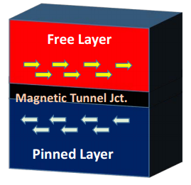
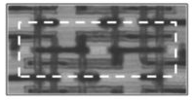
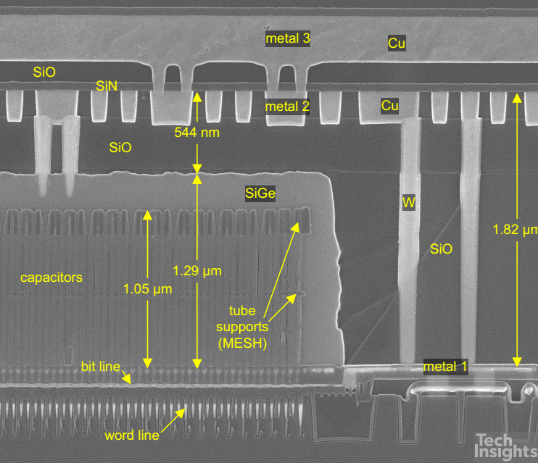
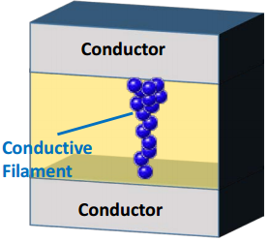
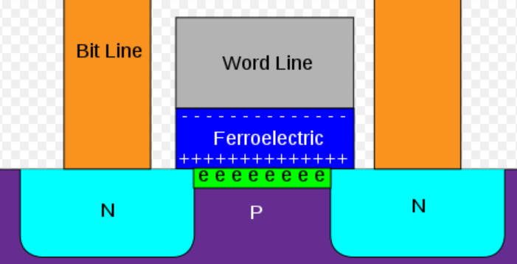
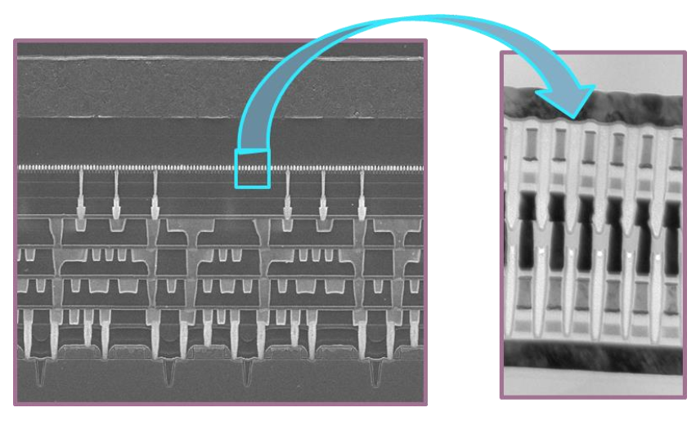
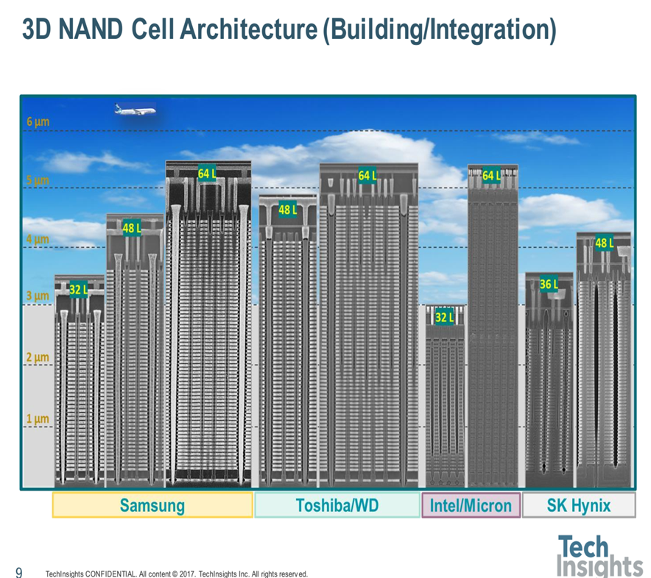
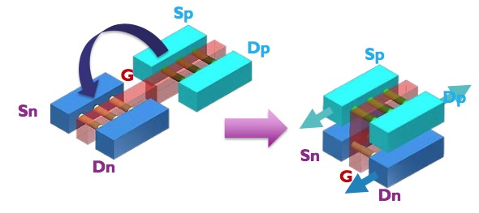
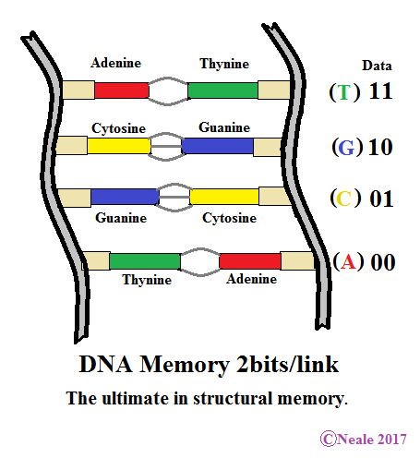
Memory Products Landscape and R&D
Emerging Memory R&D
Speed, Bandwidth, Endurance
Magnetic
[MRAM, STT(SOT)MRAM]
SRAM
Resistance Change ReRAM[1D, 2D], PCM [3D]
Intel 14nm SRAM
DRAM
Ferroelectrics
(FeRAM, FeFET)
Samsung 1x nm DRAM
3D SRAM (monolithic)
Storage Class Memory
3D DRAM (monolithic)
Intel 3D Cross-point
NAND
Intel 3D NAND
DNA inspired (Archival memory)
HDD
Cost, Capacity or Density, Retention
Mature R&D and early HVM
Early R&D
Concept Stage
Sources: Publications from Industry, Academia and Consortia R&D
INTEL CONFIDENTIAL

Slide 4
Memory Products Landscape and R&D
Emerging Memory R&D
Speed, Bandwidth, Endurance
Magnetic
[MRAM, STT(SOT)MRAM]
SRAM
Resistance Change ReRAM[1D, 2D], PCM [3D]
Intel 14nm SRAM
DRAM
Ferroelectrics
(FeRAM, FeFET)
Samsung 1x nm DRAM
3D SRAM (monolithic)
Storage Class Memory
3D DRAM (monolithic)
Intel 3D Cross-point
NAND
Intel 3D NAND
DNA inspired (Archival memory)
HDD
Cost, Capacity or Density, Retention
Mature R&D and early HVM
Early R&D
Concept Stage
Sources: Publications from Industry, Academia and Consortia R&D
INTEL CONFIDENTIAL

Slide 5
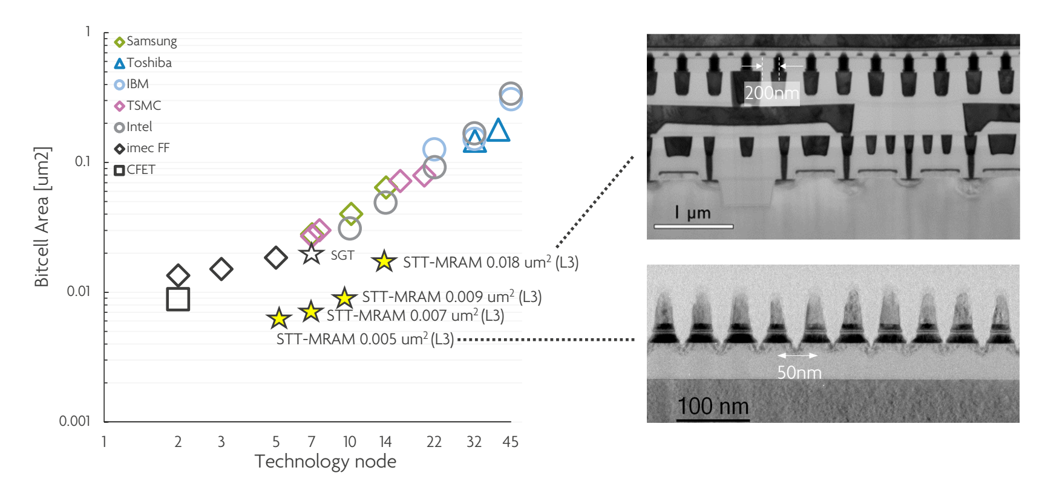
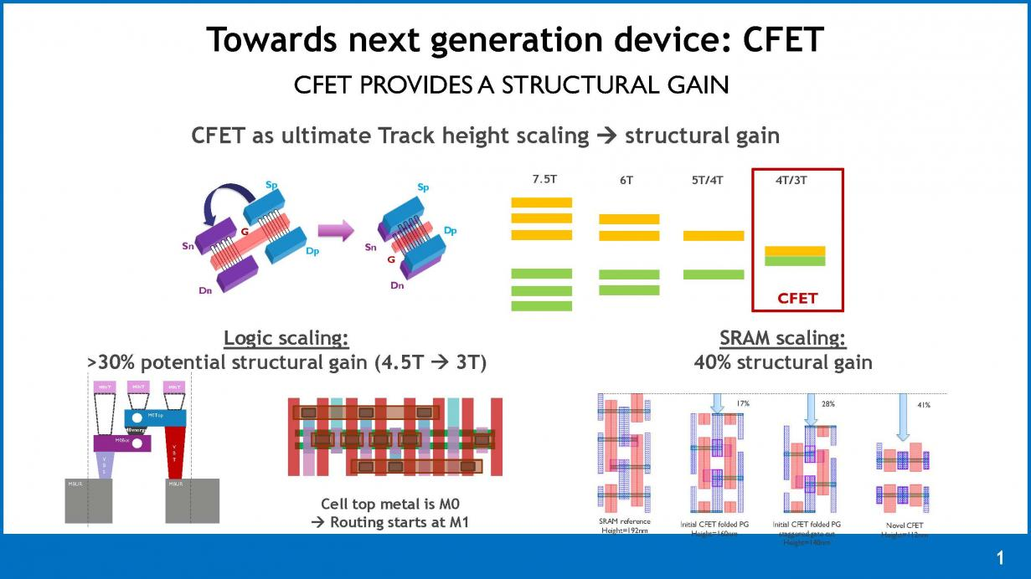
SRAM Scaling Slows.. Opportunity for Emerging Memory?
Ann Steegen, ITF 2017/18
SRAM Scaling Increasingly Challenging
Novel 3D architecture such as CFET enable scaling
STT/SOT-MRAM in research for LLC [challenge: scaling and reliability]
INTEL CONFIDENTIAL

Slide 6
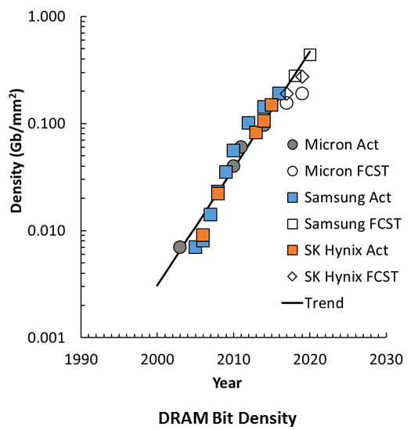
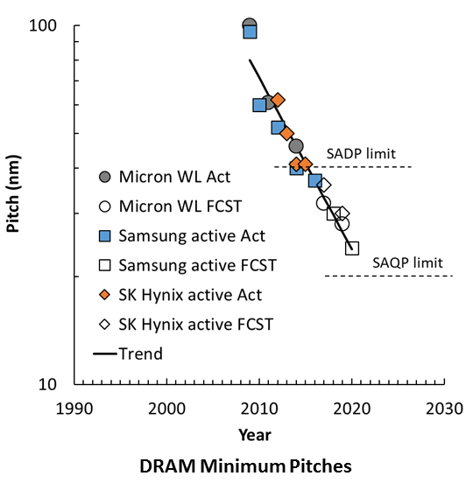
DRAM Scaling Also Slowing…
Opportunity for Emerging Memory?
1z
1Y
ICInsights
INTEL CONFIDENTIAL

Slide 7
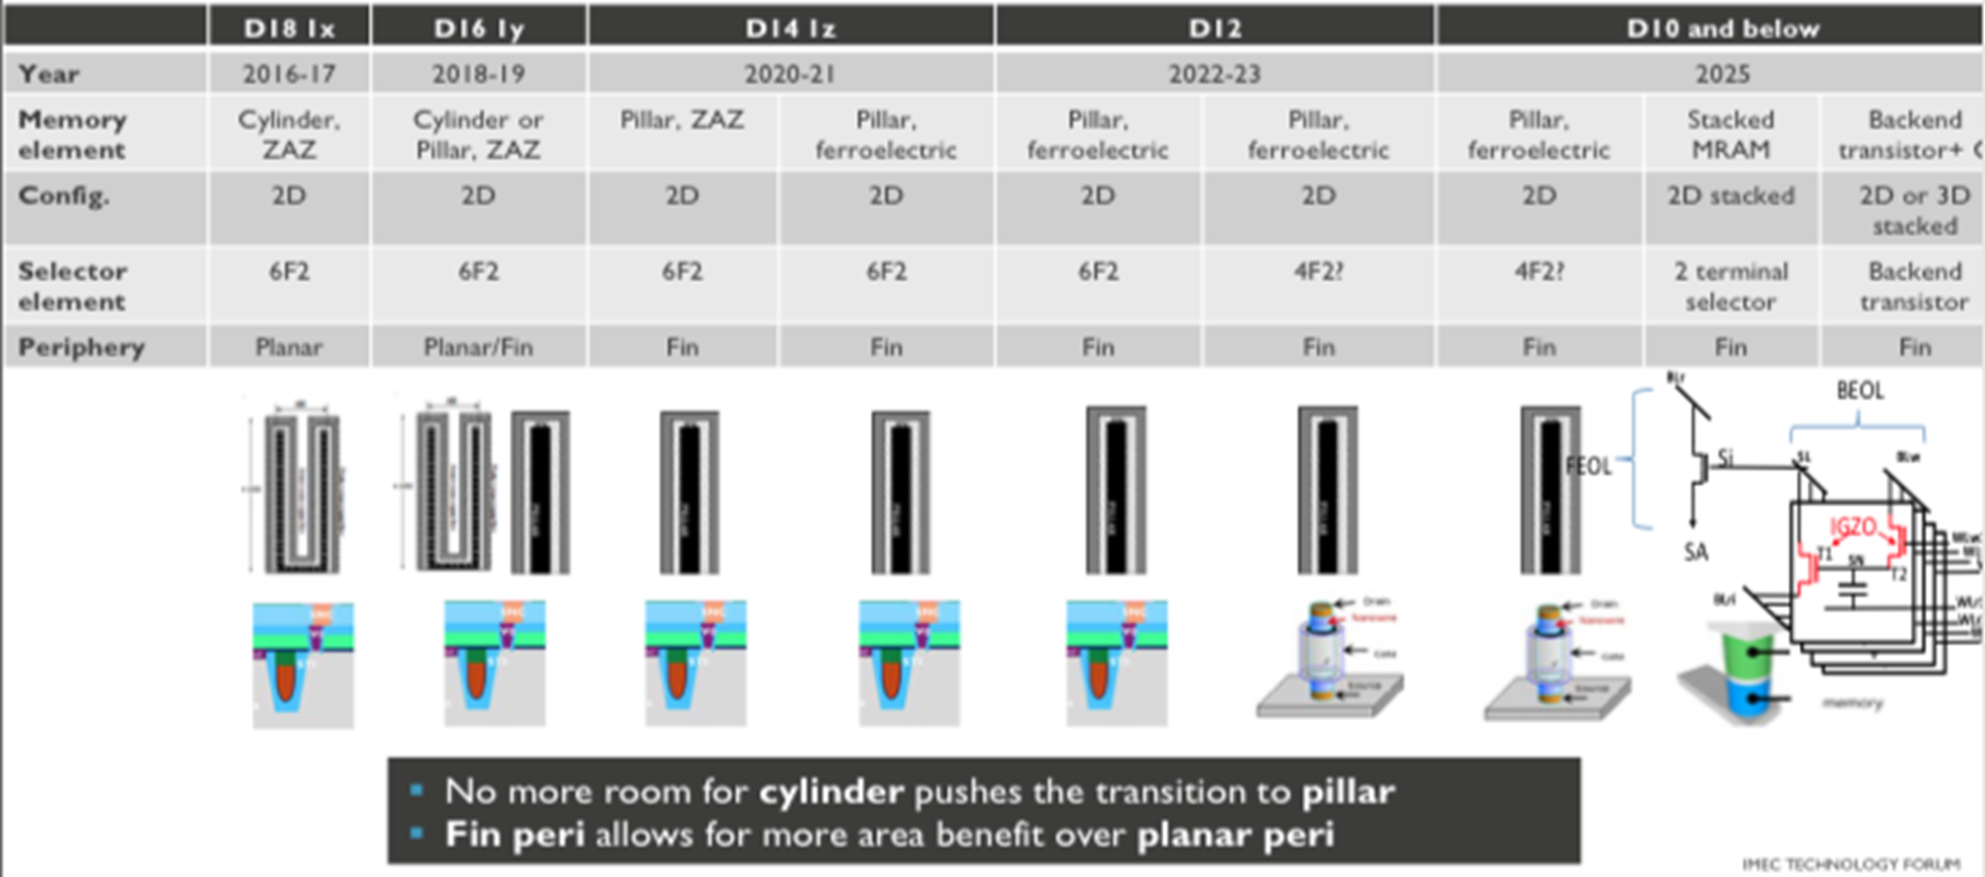
DRAM Scaling Options
Sources: ITF, Various Publications and Press Releases
Transistor Innovations
Vertical transistor (4f2)
Low leakage non-Si TFT
Capacitor Innovations
Cylinder to pillar
Higher K (perovskite?)
Ferroelectrics?
Periphery Innovations
Fin w/ HKMG
Structure Innovations
2D to 3D stacked (inc MRAM)
Note: Startups like TC labs (Thyristor based 3D) and Nantero (CNT based XP with 3D) also targeting DRAM
INTEL CONFIDENTIAL

Slide 8
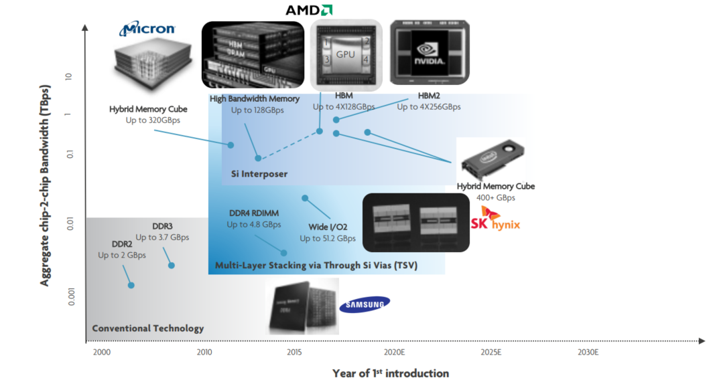
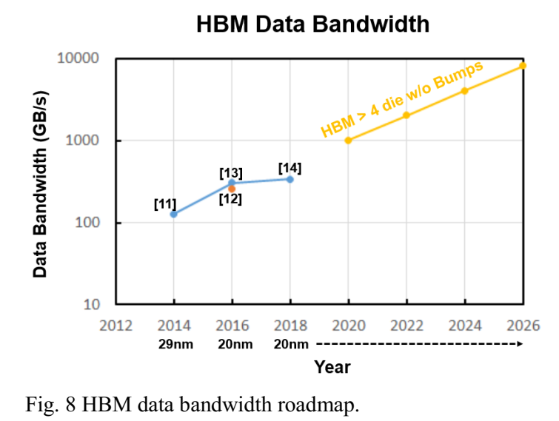
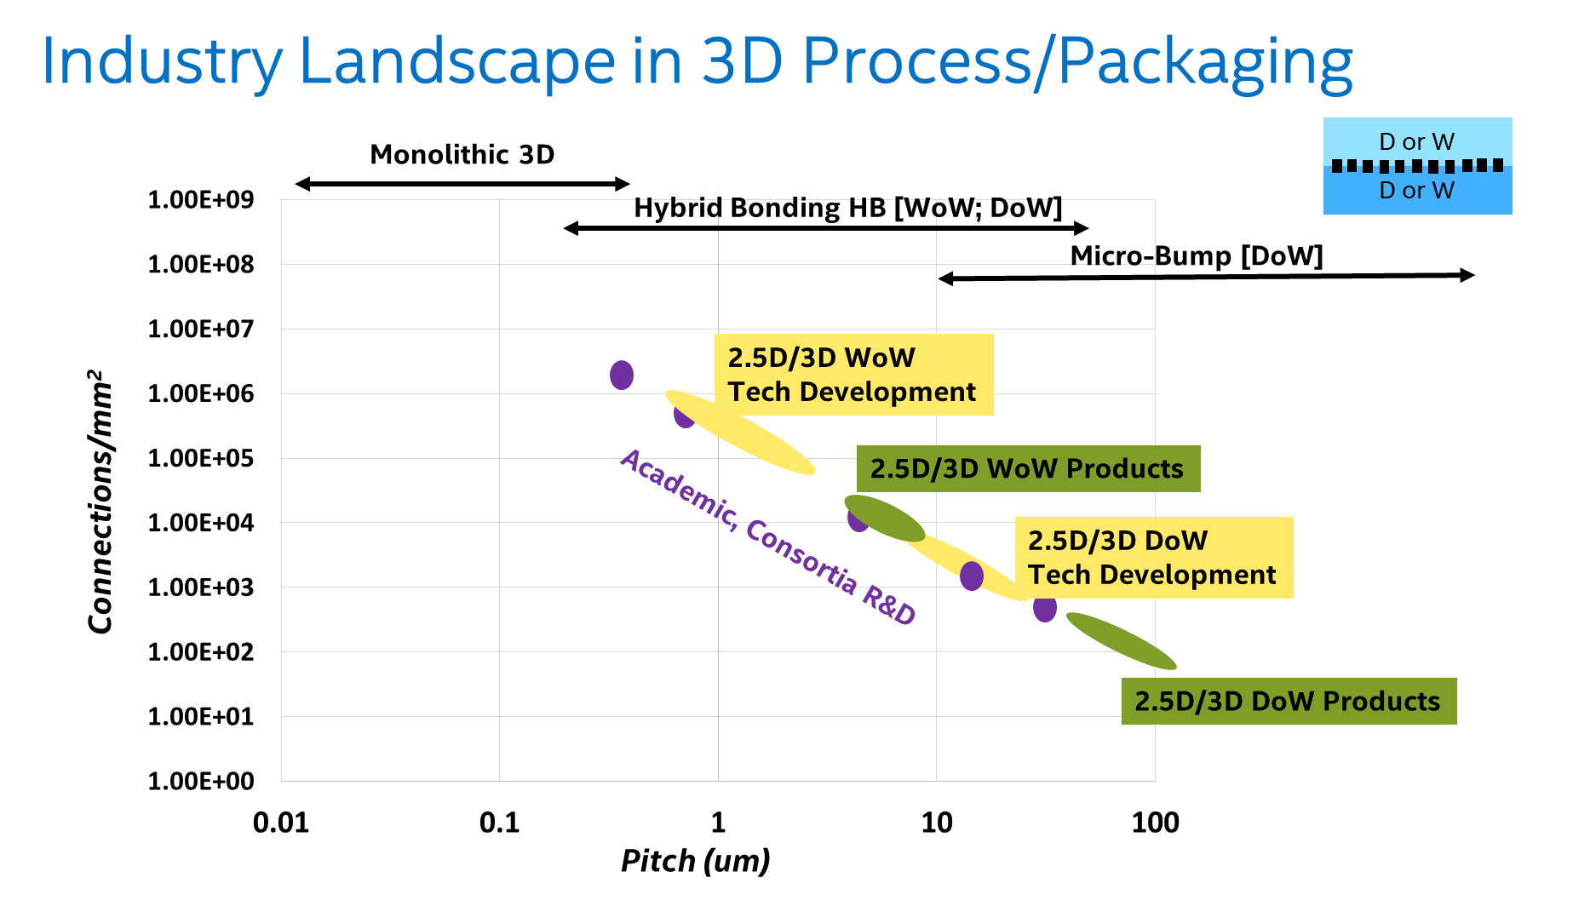
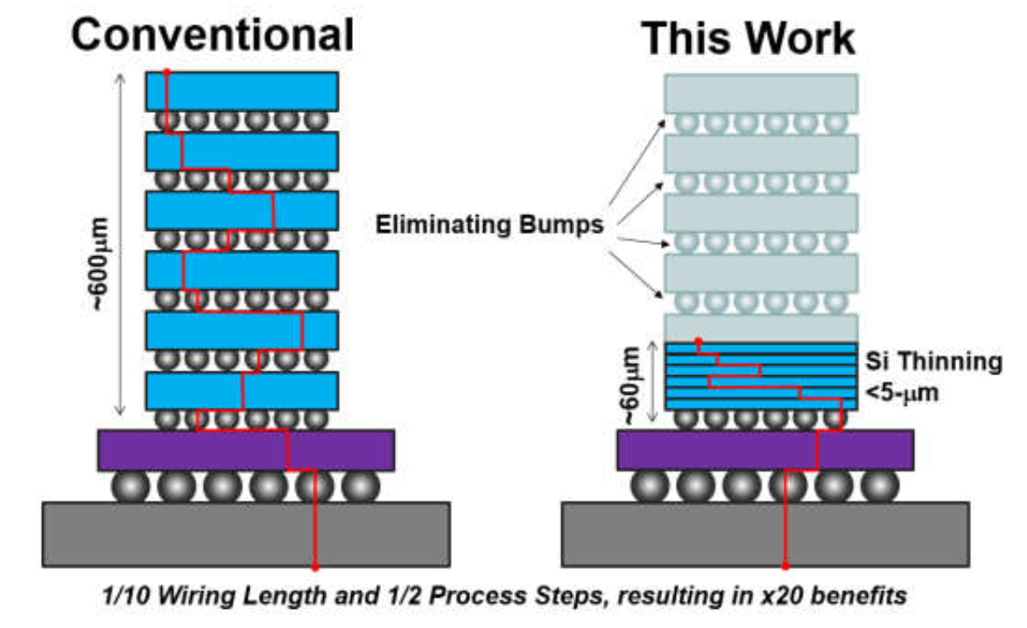
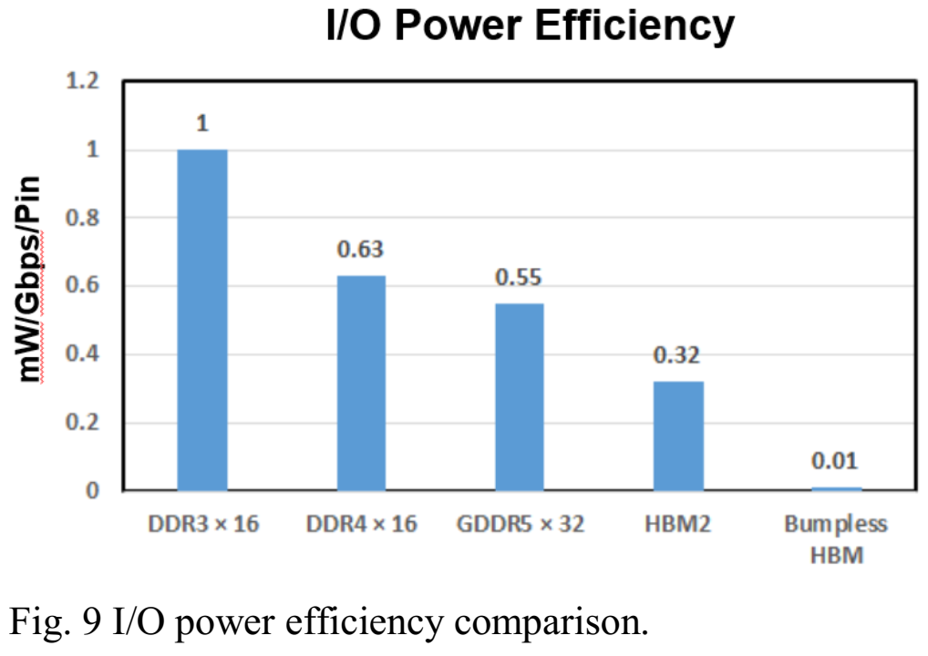
DRAM/SRAM Going 3D (Adv Packaging)
Product Landscape
3D Bumpless Value Proposition
Tokyo Ins Tech, IMW 2019
Bumpless Bonding Technology Readiness
INTEL CONFIDENTIAL

Slide 9
Memory Products Landscape and R&D
Emerging Memory R&D
Speed, Bandwidth, Endurance
Magnetic (MRAM, STTRAM)
SRAM
Resistance Change (RRAM)
Intel 14nm SRAM
DRAM
Ferroelectrics (FeRAM, FeFET)
Samsung 1x nm DRAM
3D SRAM (monolithic)
Storage Class Memory
3D DRAM (monolithic)
Intel 3D Cross-point
NAND
Intel 3D NAND
DNA inspired (Archival memory)
HDD
Cost, Capacity or Density, Retention
Mature R&D and early HVM
Early R&D
Concept Stage
Sources: Publications from Industry, Academia and Consortia R&D
INTEL CONFIDENTIAL

Slide 10
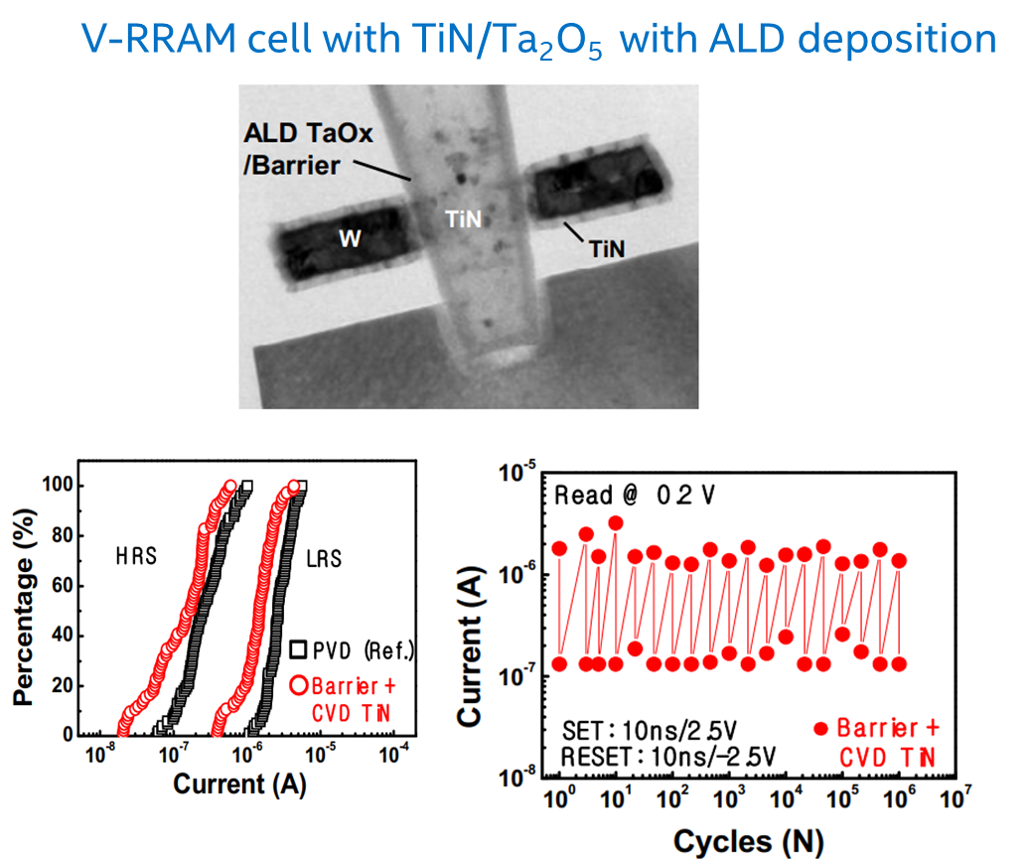
Emerging Memory (3D RRAM) for Beyond 3D NAND?
Samsung, International Workshop of Innovative Memory 2013
Samsung, IEDM, 2011

Slide 11
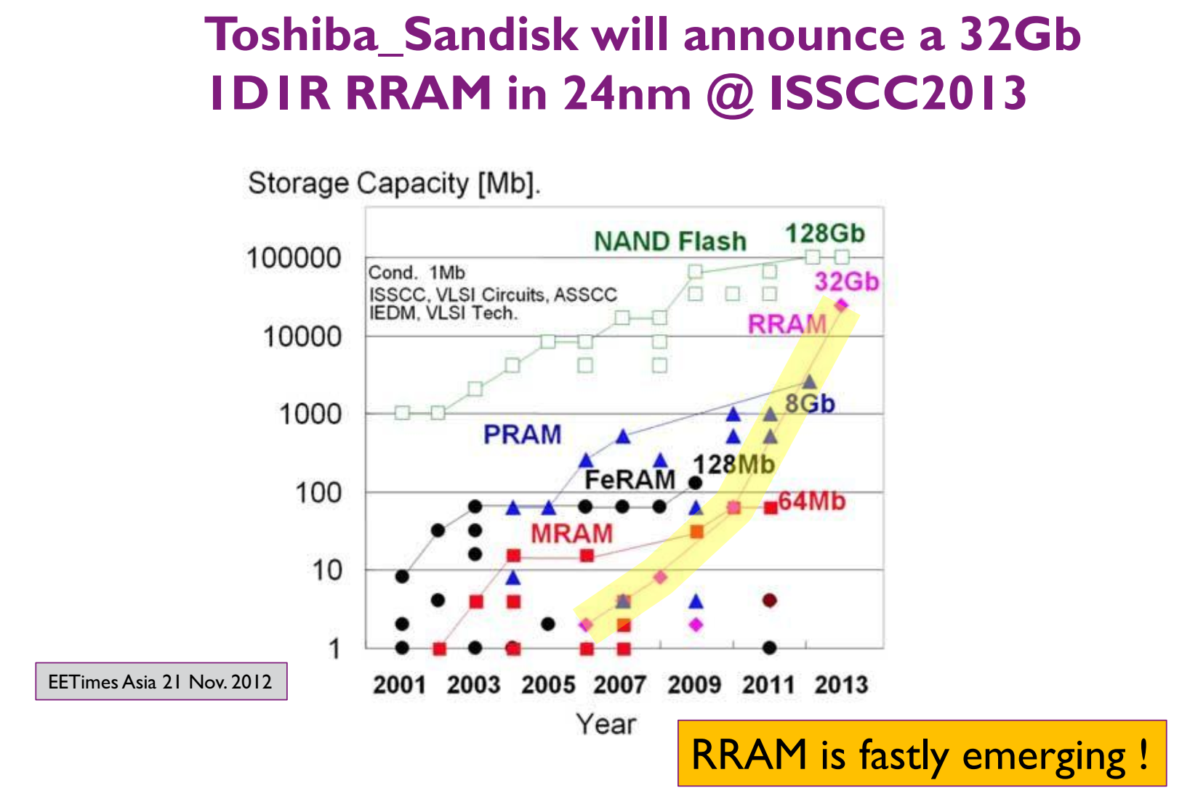
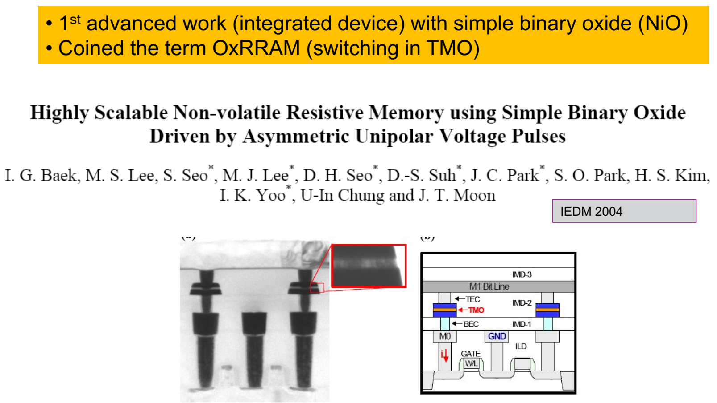
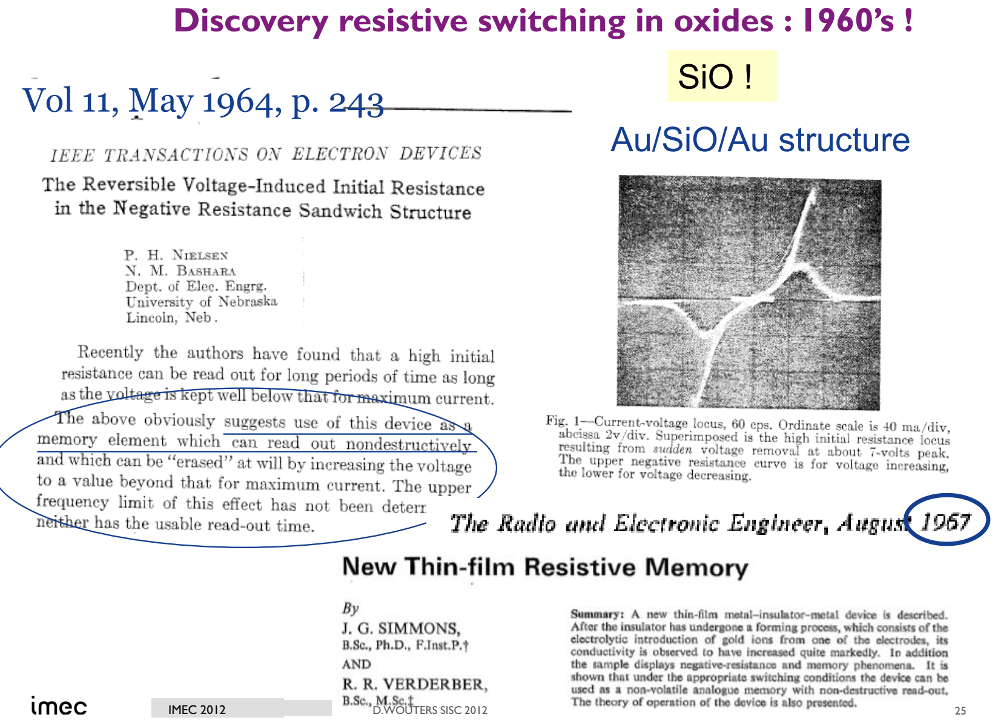
RRAM has Long History (Including Promises)
Samsung IEDM 2004
Samsung, IEDM, 2011
Several announcements, but no major high density NVM product …. yet

Slide 12
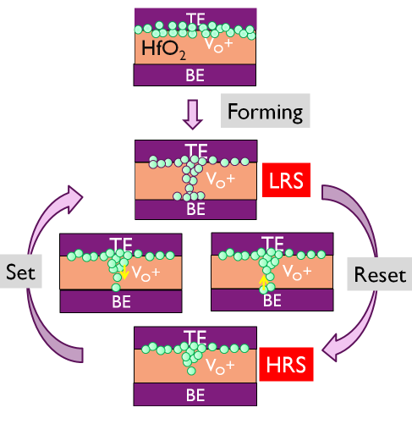
Operation & Characteristics of Filamentary RRAM
Oxygen vacancies
Oxide RRAM Cell (Filamentary): Typical Operation
I
1
I_{(Compliance)}
(D), (J)
(C)
I_{(SET…..stop)}
V_{(RESET..Start)}
3
I_{(SET…..start)}
(I)
1
I_{(read-ON)}
V_{(RESET..Stop)}
I_{(read-OFF)}
(B)
V
V_{(Read)}
V_{(SET)}
V_{(forming)}
2
(A), (E), (H)
3
(G)
I_{(RESET … stop)}
(F)
I_{(RESET….start)}
Need Sub-Stoichiometric Oxide
Forming (soft-breakdown) and First RESET very critical
Switching ➔motion of Oxygen Vacancy and Redox
2
INTEL CONFIDENTIAL

Slide 13
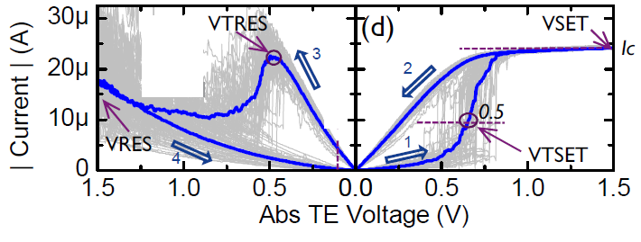
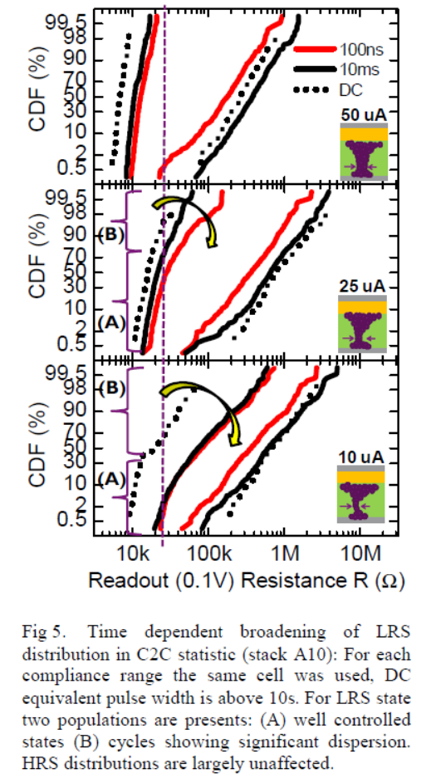
Operation & Characteristics of Filamentary RRAM
Significant Variability at Low Currents (Stochastic)
Ireset (max) variation
IMEC, IMW 2013
V(set) variation
HRS variation
LRS variation
Note: Variability/Instability in RRAM more critical in 1S1R [cross-point architecture]
INTEL CONFIDENTIAL

Slide 14
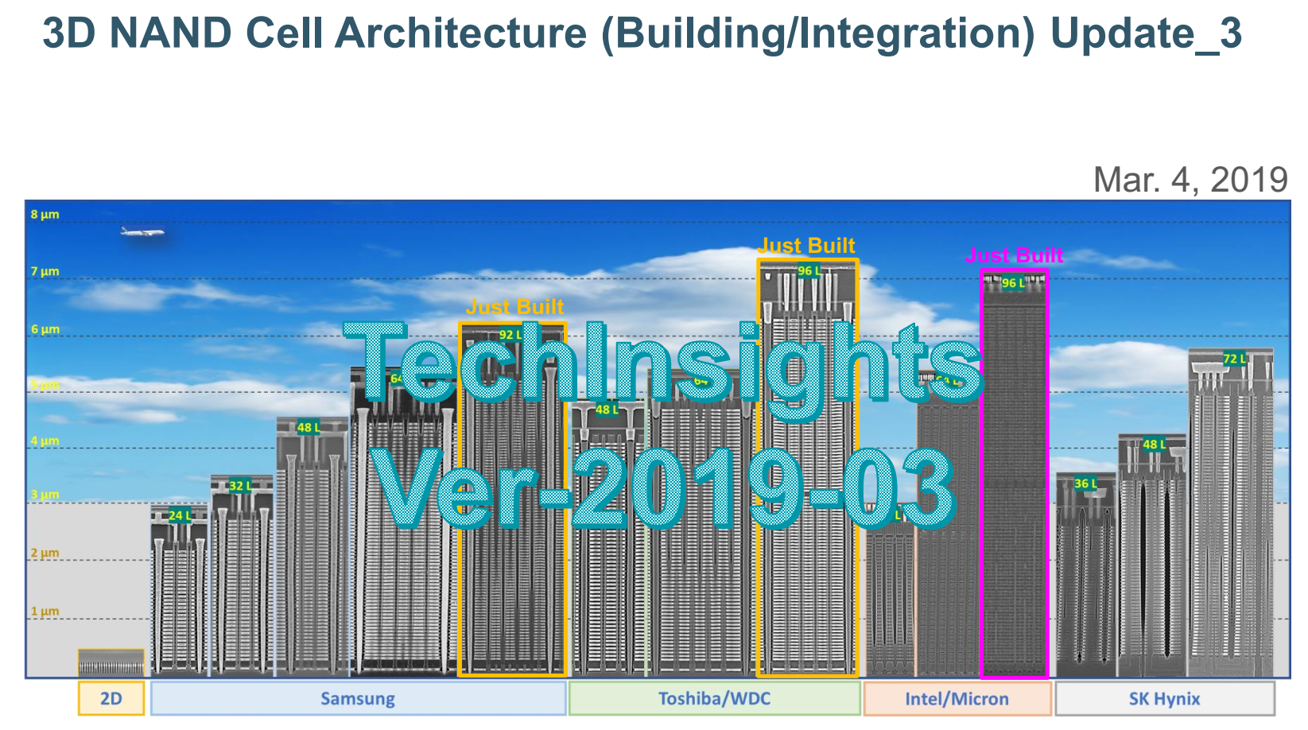
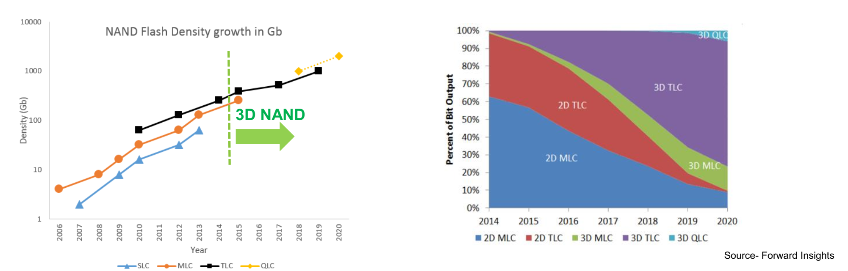
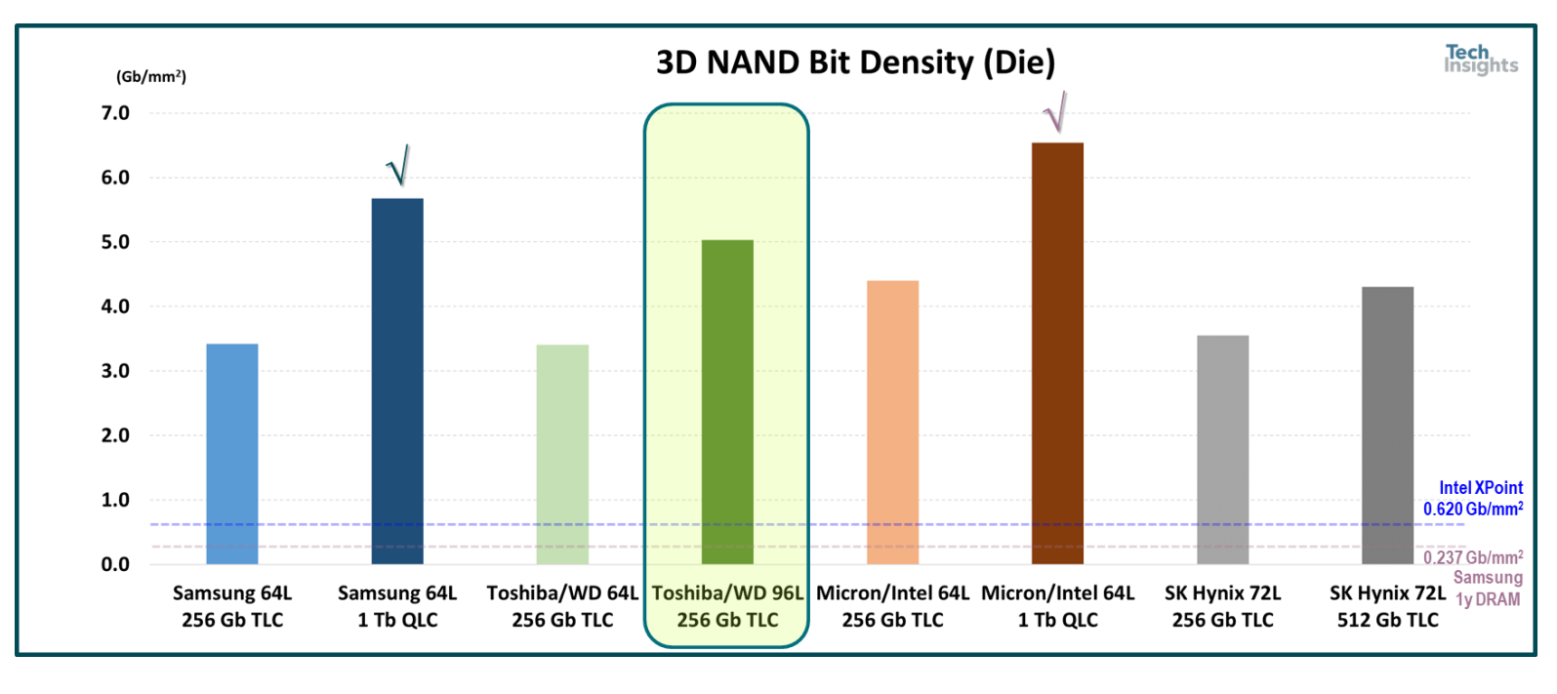
3D NAND Scaling Continues …. Scope for Emerging Memory?
Continued Bit Density Growth [2D => 3D ….]
Source: Techinsights
INTEL CONFIDENTIAL

Slide 15
Emerging Memory for Beyond 3D NAND?
Not Many Recent Publications Positioning 3D RRAM for Beyond 3D NAND Scaling
INTEL CONFIDENTIAL

Slide 16
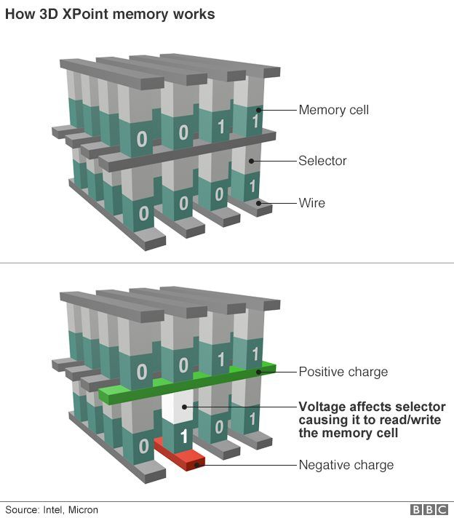
Emerging Memories for SCM in 3D XP Architectures
Speed, Bandwidth, Endurance
SRAM
DRAM
Magnetic
[MRAM, STT(SOT)MRAM]
Resistance Change ReRAM[1D, 2D], PCM [3D]
Ferroelectrics
Storage Class Memory
Thermionic
[diode, MIEC, ..]
Volatile filament
Metal-Insulator Transition
Ovonic Threshold
Intel 3D Cross-point
NAND
Key Challenge: Appropriate Memory+Selector Combination
HDD
Cost, Capacity or Density, Retention
INTEL CONFIDENTIAL

Slide 17
Many Industry Players Pursuing 3D XP Options (Select Examples of RRAM and OTS+PCM Based)
Company | Memory Type | Memory Mechanism | Pros | Cons?* | R&D Effort
Sandisk/WD/Unity/Rambus/4DS | 1R (filament / interfacial) | (Non) linear RRAM | Stackable 4f2; 3D RRAM (Selector-less) | Variability(stochastic); High R at scale | University Collab and internal R&D; Limited Array Demo
Hynix/HP | 1S1R | SiOx(S)/ ox-RRAM NbOx Selector | 3D RRAM; Scaled (filament) | Variability(stochastic); RRAM compatibility | Internal R&D; Array demo
Crossbar/SMIC | 1T-nR; 1S1R | Oxide (S) | Stackable 4f2; High NL; FAAST selector | Disturb; Variability; Integration Compatibility | Internal R&D; Array demo
Sony / Micron | 1T1R => 1S1R | OTS(s)+CBRAM | Stackable 4f2; High NL; | Complex integration for Cu; Disturb; Variability; | Internal R&D; device Level
Nantero | 1T-1R; 1R | CNT based RRAM | Selector-less 4F2; High Speed; | Low NL; Inhibit / Disturb; Variability; | Univ and Internal R&D; Limited Array Demo
RRAM
Company | Memory Type | Memory Mechanism | Pros | Cons?* | R&D Effort
IBM / Macronix | 1T1R => 1S1R | OTS+PCM | 3D stackable; Engineering composition for thermal stability | Limited operating window (Variability?) | Internal R&D; Small array demo
Hynix | 1S1R | OTS + PCM | 3D stackable; Engineering composition for RW | TBD | Internal R&D; Array demo
IMEC/ CEA-LETI | 1S1R 3DXP | OTS+PCM | 3D stackable; Binary alloys based OTS Selectors | Limited operating window (Variability?) | Internal R&D; device level
Multiple Univ | 3DXP | OTS + PCM | Materials engineering for Scalability, Reliability, Extendability | No array data | Device Level
OTS + PCM
* Perception based on understanding of memory switching mechanism and published data
INTEL CONFIDENTIAL

Slide 18
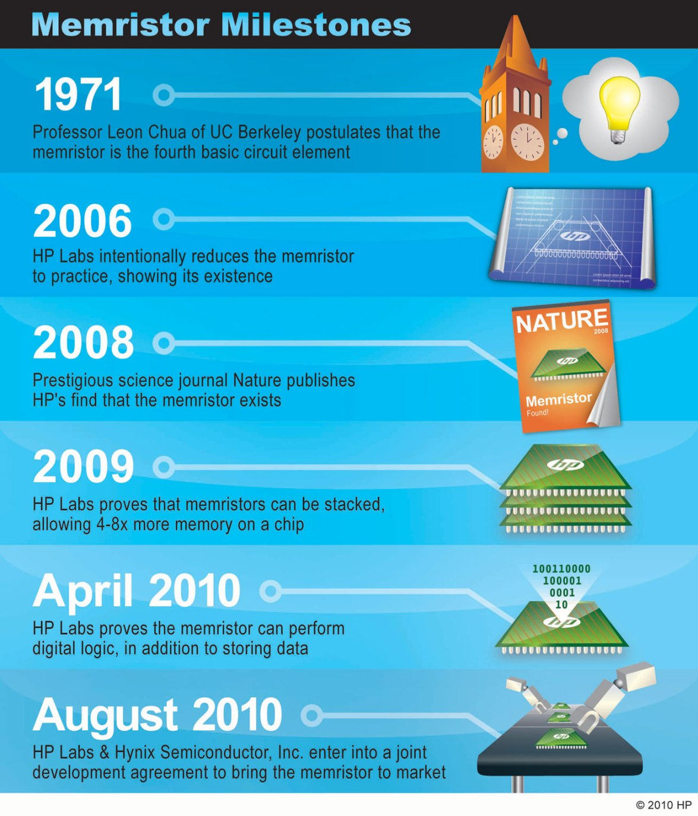
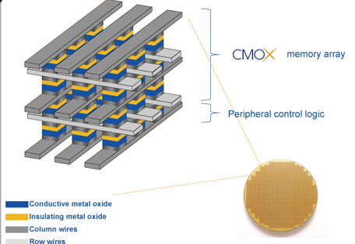
HP-Hynix-Sandisk/WD Memristor/RRAM Timeline
HP signs JDP with Sandisk for RRAM based SCM
Sandisk ➔ Western Digital;
HP continues JDP with WD;
WD has JDP with 4DS (2014+) and signs on Rambus (March 17) .. Interfacial RRAM approach?
Academic collaborations on 1T1R /1R1r on TiOx, AlOx
Unity => Rambus CMOx
2012
2014
2016
2018
HP Hynix VLSI 2014 on NbO2 selector for cross-point [5x nm]
HP Hynix IEDM 2015 on Cross-Point 1S1R with NbO2 selector [2x nm]
WD indicated, no future for NbO2 selector (Stanford RRAM workshop)
Hynix SiOx (As doped) Selector with RRAM for 4F2 (IEDM/VLSI)
HP JDP with Hynix .. For 2013 product!
INTEL CONFIDENTIAL

Slide 19
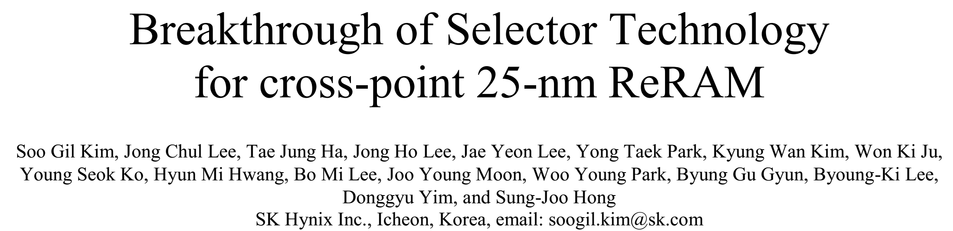
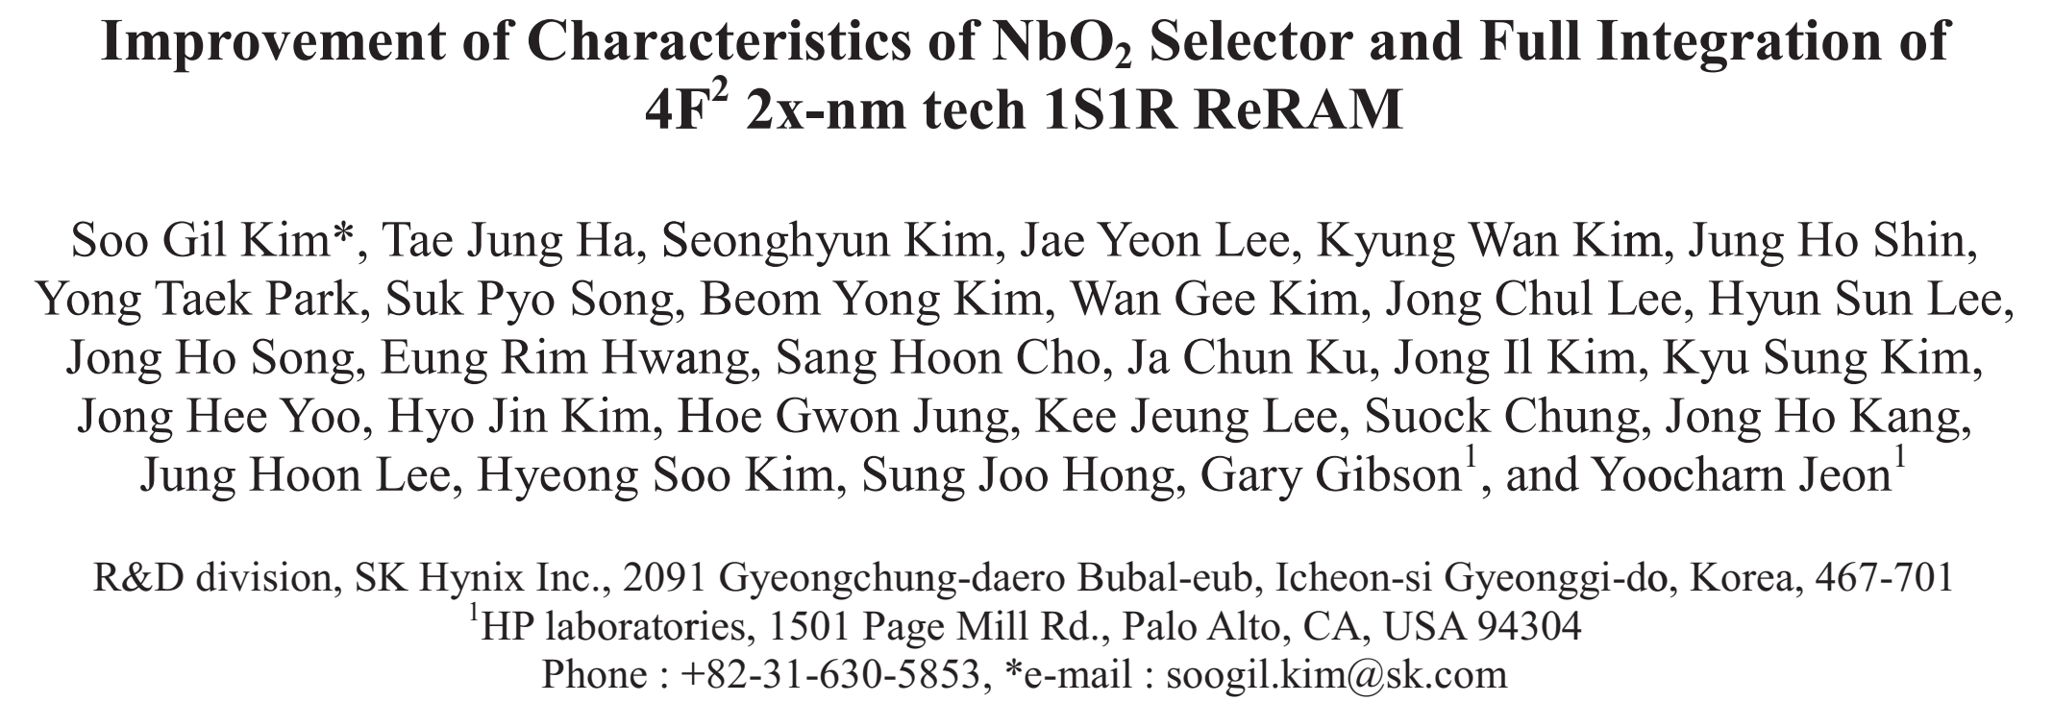
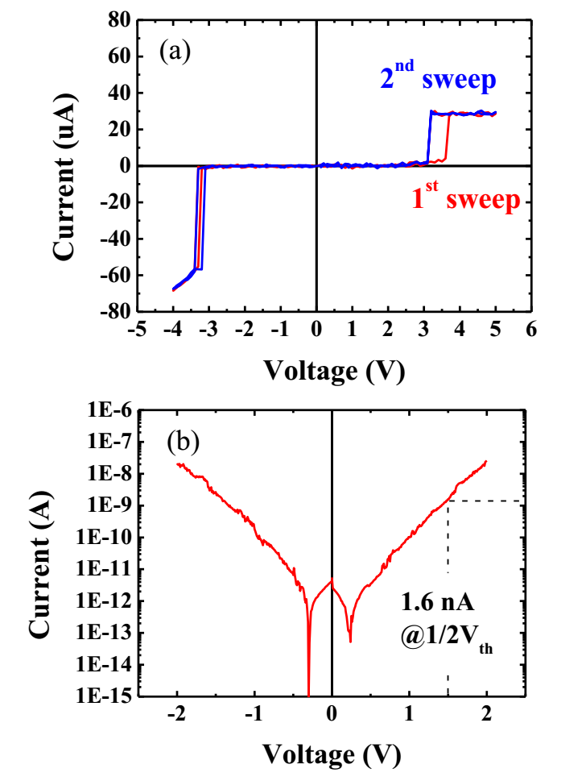
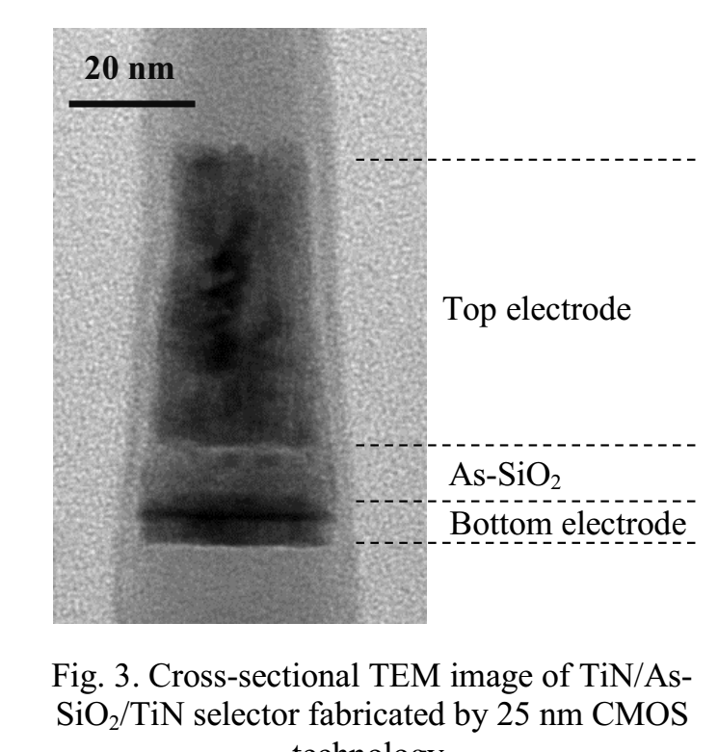
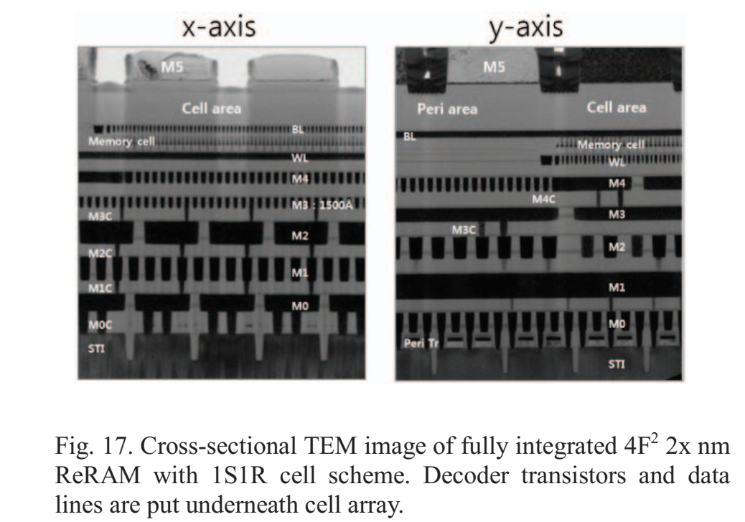
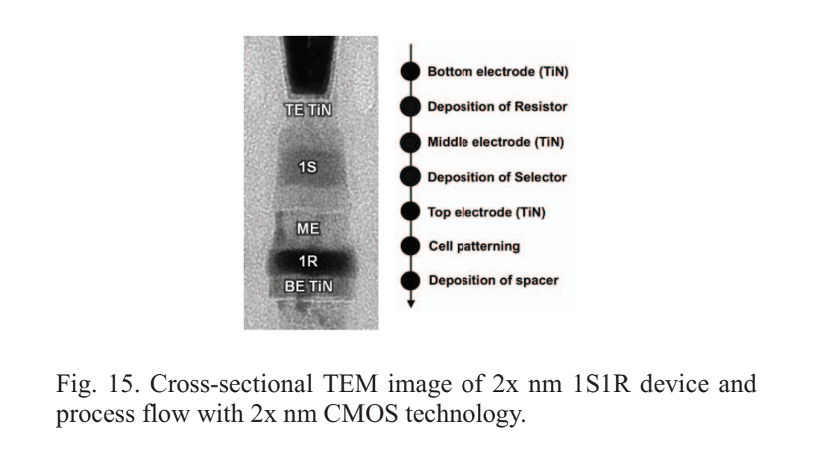
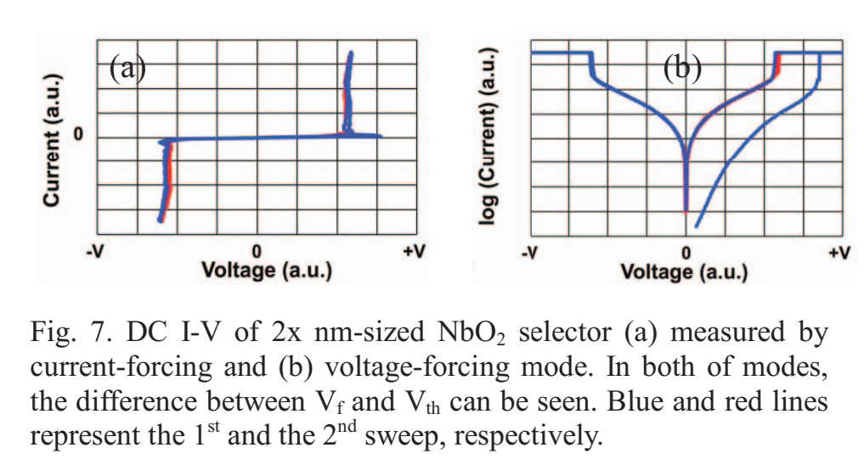
Hynix/HP on Cross Point 4F2 with 1S1R
IEDM 2017
IEDM 2015

Slide 20
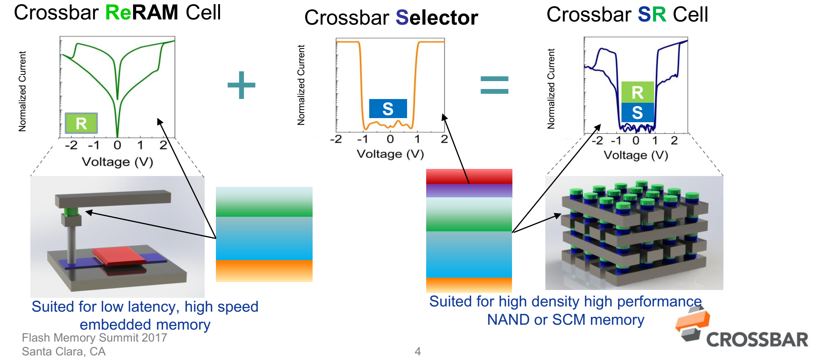
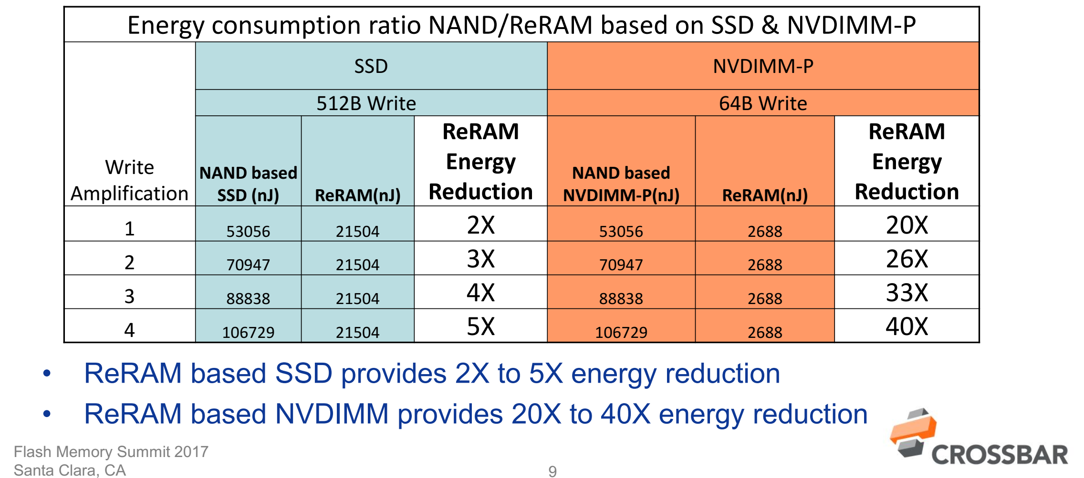
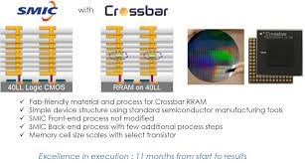
CrossBar: 1T1R and 1T nR [1S1R]
FMS, 2017

Slide 21
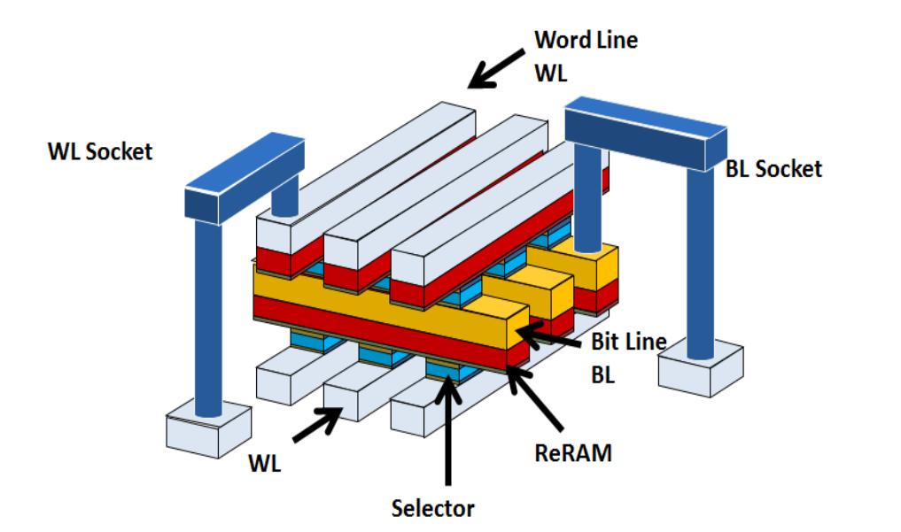
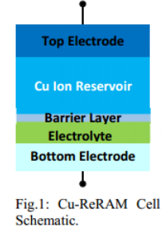
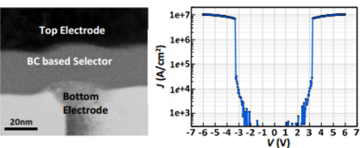
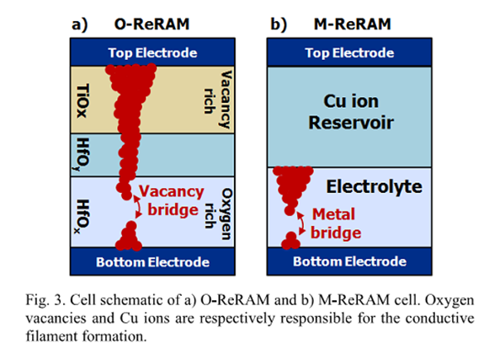
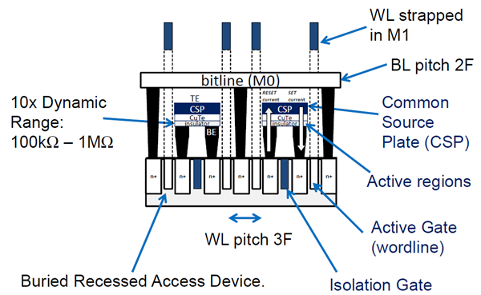
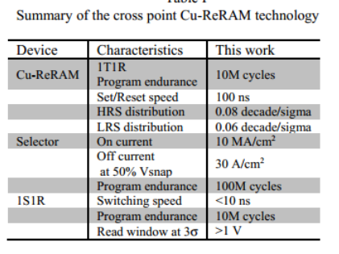
Sony Micron on CBRAM
Sony Cross-Point 1S1R (OTS + CBRAM)
IEDM 2017, IMW 2018’2019
Sony Micron 1T1R (CBRAM)
VLSI, IEDM, ISSCC (’14-’17)

Slide 22
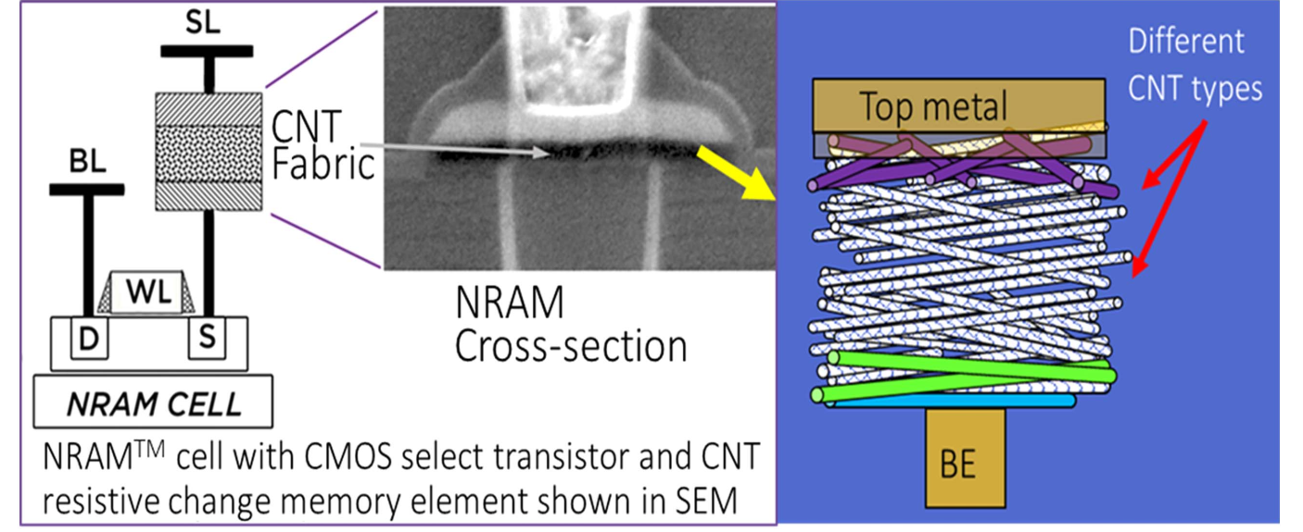
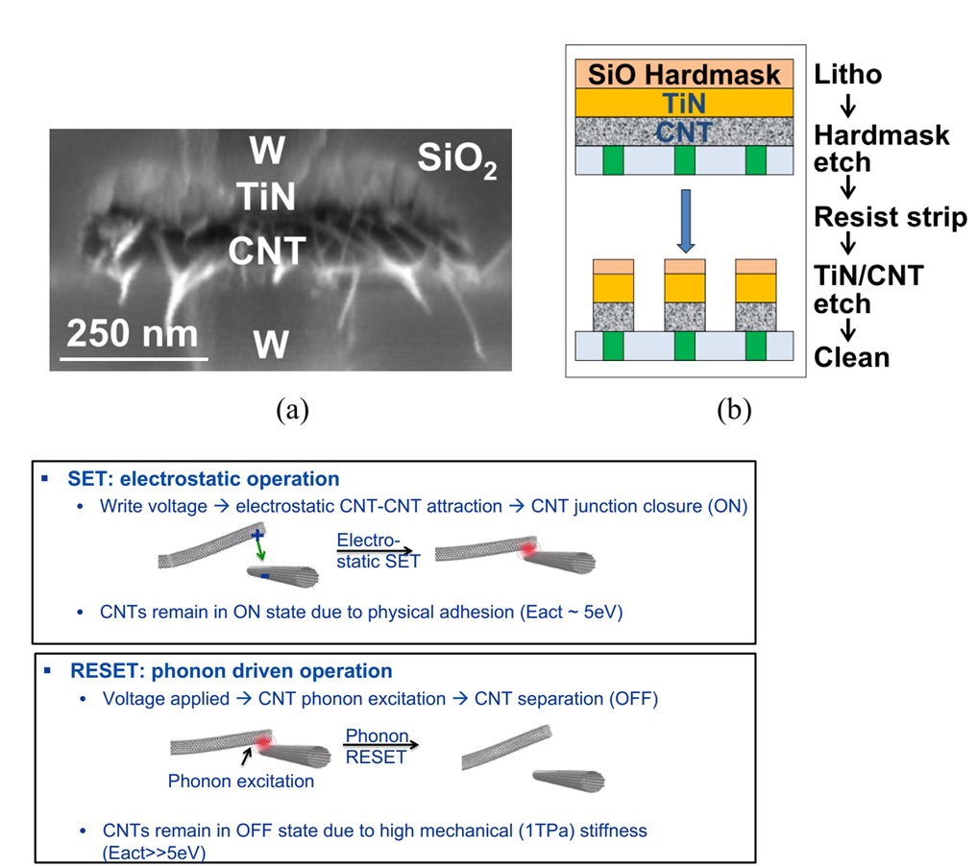


Nantero: Nanotube Based RRAM
Nanotechnology 2018
Nantero claims several engagements (license agreements?) with foundries
Nantero-IMEC JDP
(demonstrate on scaled structures)
2012
2014
2016
2018

Slide 23






IBM Macronix JDP on PCM Based NVM
2016 +
2012-2015
Started with PCM for Auto
Moved to 3D XP for Storage Class Memory
IEDM 2018; VLSI 2019

Slide 24





SK-Hynix @ IEDM 2018 ➔ 128Gb 3D XP (OTS + PCM)
IEDM 2018

Slide 25








IMEC and CEA LETI: OTS for 3D XP
CEA-LETI
VLSI 2017
IMEC
VLSI 2017
IMW 2019

Slide 26


IMEC R&D on 3D XP with OTS + PCM

Slide 27

Academic R&D on 3D XP Based on OTS
ASU, 2019
HU, NTU 2019
2019 Electron Devices Technology and Manufacturing Conference (EDTM)
Academic consortium,
Chinese Academy of Sciences
Univ of Grenoble,
MINATECH, France
POSTECH, SK Hynix, Korea

Slide 28
Many Industry Players Pursuing 3D XP Options (Examples of Non-RRAM Memories)
Company | Memory Type | Memory Mechanism | Pros | Cons?* | R&D Effort
Avalanche | 1S-1MRAM | MRAM with Threshold Selector | Stackable 4f2 ; High NL; Lo Ioff; | Disturb; Operating Window (Variability); | Internal R&D; limited array demo
Namlab/Global Foundries | FeFET | HfO2 based FerroFET | High Speed + Low voltage; CMOS compatible | Variability; Endurance; | Univ and Internal R&D; device level
IMEC 3D FeFET | 3D FeFET | HfO2 based FerroFET | High Density 3D NAND like; BE ALD process; | Variability; High Op Voltage; Endurance | Internal R&D; device level
Toshiba | 1FTJ | HfO2 based Ferro tunnel junction | Selector-less; 3D Stackable | Low NL; Variability | Internal R&D; device level
Kilopass / TC Labs | Thyristor (3D) | Vertical thyristor | 3D stackable; high speed; | Epi for abrupt junctions; | Internal R&D; mostly simulations
Sunrise | 3D NOR | NOR | --- | ---
Micron/Intel | 1X | Self Select Memory | --- | --- | Internal R&D
MRAM Based
Ferroelectric Based
T-RAM
NOR
* Perception based on understanding of memory switching mechanism and published data
INTEL CONFIDENTIAL

Slide 29








Avalanche [1S(oxide)-1MRAM]
IEDM 2017

Slide 30




Namlab /CNT/ Globalfoundries on HfO2 FeFET
CNT, IMW 2019
The Promise of Scalability
Demonstration at Scaled Node (28nm)
Multi-Domains?
GF, IEDM VLSI (2013-2017)

Slide 31


Ferroelectric Memory Company: HfO2 FeFET

Slide 32


Variability: Significant Challenge for Scaled FeFETs
Prof. S. Datta group (ND), VLSI 2019
Sayan, NIST, 2005
(Ferro)

Slide 33

IMEC Positioning 3D FeFET for High Density NVM
ITF 2018 and IEDM 2018

Slide 34




Toshiba Ferro-Tunnel-Junction (FTJ)
Toshiba (VLSI 2016): FTJ for High Density 3D Compatible NVM
Toshiba (SSDM’18): Performance Enhancement by
Template Induced Crystallization FTJ for 4F2
Improved FTJ from prior work (VLSI’16) by using template layer
NL is still somewhat limited
Claim good variability and scalability, but no data, especially on arrays

Slide 35


TC Labs : Vertical (Stackable) Thyristor
TC Labs Confidential, shared with Intel under CNDA

Slide 36
Exec Summary
Emerging memories positioned as scaling option for SRAM, DRAM, SCM and NAND
Critical challenges (such as variability/instability) in filamentary RRAM/CBRAM limiting its potential for high density NVM
Significant R&D on cross-point based alternative memories for Storage Class Memory
Need focused effort on critical challenges for emerging memory to transition from R&D to HVM
INTEL CONFIDENTIAL

Slide 37





Other Opportunities for Emerging Memory : eNVM, Machine Learning/AI/Neuromorphic Computing
3D SoC for Machine Learning
Stanford/MIT: ERI 2018
Feb 2019, ~ $2B investment
Ann Steegen, ITF 2018
e-NVM
(e-FLASH)

Slide 38
Emerging e-NVM: Industry Landscape -Slow/Steady Progress towards HVM, but primarily for low density e-FLASH replacement
Renesas, 2016
Renesas, TSMC,
Samsung
Renesas, IEDM’16
HVM
eFLASH
Development
Everspin, 2015-16
Samsung, TSMC, GF [2019?]
Research
STTRAM
Everspin, 2019
Panasonic, 2013
Panasonic, 2019?
Panasonic;TSMC [2019?]
RRAM
(Fujitsu 4Mb)
Adesto, 2019?
Adesto, Sony
CBRAM
Adesto, 2013-16
Micron, Samsung, 2014
IBM, Macronix, STMicro
PCM
Panasonic, TI, Ramtron, Cypress
GF, Namlab
FeRAM
SEL-UMC
SEL-xyz?
TFT based
180
130
90
60
40
28
16
Technology Node (nm)
Sources: Various Publications and Press Releases
INTEL CONFIDENTIAL

Slide 39


Dynamic Supply Chain for Memory R&D

Slide 40

Emerging Memory on Gartner Hype Cycle
* Perception based on published data
HfO2 based Ferroelectrics
RRAM/CBRAM for high density NVM
OTS + PCM for 3D XP SCM
Emerging memory for AI/Neuromorphic
STTRAM/RRAM for DRAM/SRAM
STTRAM / RRAM for e-NVM
Closely Monitoring Innovation/Breakthrough’s in Eco-System to Separate Myth/Hype from Reality
INTEL CONFIDENTIAL

Slide 41
Exec Summary
Emerging memories positioned as scaling option for SRAM, DRAM, SCM and NAND
Critical challenges (such as variability/instability) in filamentary RRAM/CBRAM limiting its potential for high density NVM
Significant R&D on cross-point based alternative memories for Storage Class Memory
Need focused effort on critical challenges for emerging memory to transition from R&D to HVM
Emerging memory gaining traction for embedded NVM and ML/AI applications
INTEL CONFIDENTIAL

