Slide 1
Emerging Memory Competitive Landscape
A snapshot in July/2020
Prashant Majhi & DerChang Kau

Slide 2
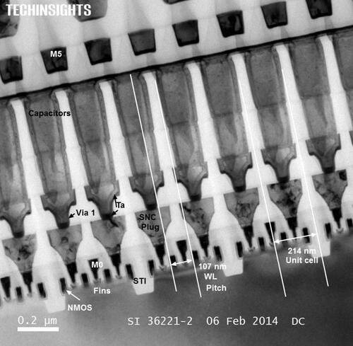






Emerging Memories for In Package Memory candidates
1T- 1X Array Architecture
Intel Gen 1 eDRAM [1T1C]
BL
SL
BL
SL
WL
WL
Y decoder
WL
Write Driver and Sense Amp
X –decoder and Multiplexer
Output driver and I/O
Access Transistor
Si channel planar / nonplanar XTOR
TFT channel planar / nonplanar XTOR
2T [independent read write] Option
High-k Capacitor
MRAM [STT/SOT]
Ferro-capacitor
Nano-structure change
Memory Element
Key Challenge: BW, Granularity
INTEL CONFIDENTIAL

Slide 3
Emerging Memories for embedded or in-package memory
Intel’s back-gated ADM/1C is exiting Pathfinding
  1st Gen (36Mb/mm^{2,} $12/GB) PRQ 2022; 2nd Gen (62Mb/mm^{2,} $7.5/GB) PRQ 2023
  Leading competitors (Samsung, Hynix and Micron) have some indications of ADM like technology interest but no public disclosure
Competitive landscape in 5 years (Ordered by technology maturity for productization)
  1T/STTM: in production capability. Some dropped due to competitiveness in the market segment
    Including Intel, Everspin/GF, Samsung, TDK/ TSMC, Avalanche, Hynix, Kioxia, Micron/IBM
    density and performance are not competitive to eDRAM solutions
    Seem more suitable for the embedded SRAM space
  1T/1FeCap : (Namlab JDP w/ DRAM incumbents, Micron, TI, Sony)
    Some in device and material research
    (New data, VLSI2020) Sony disclosed 130nm technology 64Kbit NVM array 2.5V/14ns/100min/1E11 cycles
    high voltage, still insufficient endurance (needed 1E14) for DRAM
  1FinFet ADM/1C – Early research @ CR. ⬅ Top candidate to succeed ADM/1C solution
    Cell size: [50nm]² ➔ [35nm]^{2.}; Dual deck, effective cell size beyond 1z DRAM.
    One BEOL process architecture: tentative product envelop is under development: Latency 10ns, Cost < $1/GB.
  1T/nFeCap: (Intel) in research stage, near passing capacitor research stage;
    Low voltage, high endurances (1E12). Developing landing zone definition and process and array architecture
  2T/SOT : (Intel, TSMC, IBM/Samsung, IMEC) embedded SRAM replacement

Slide 4
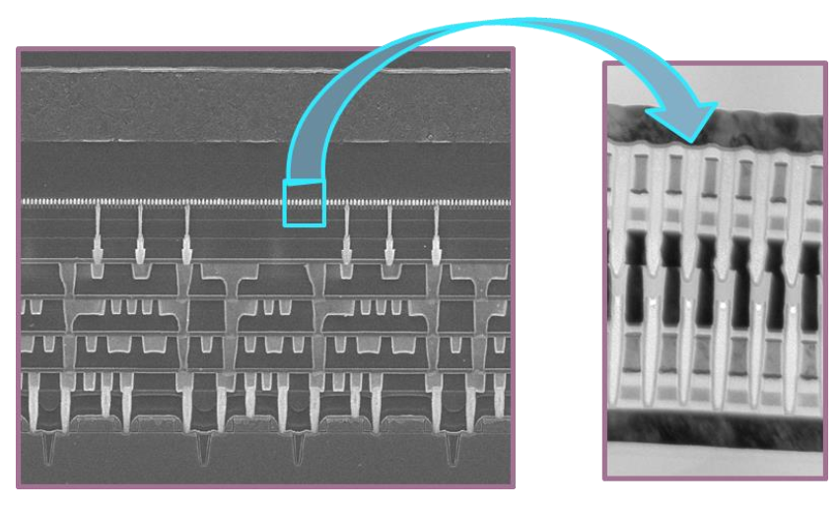
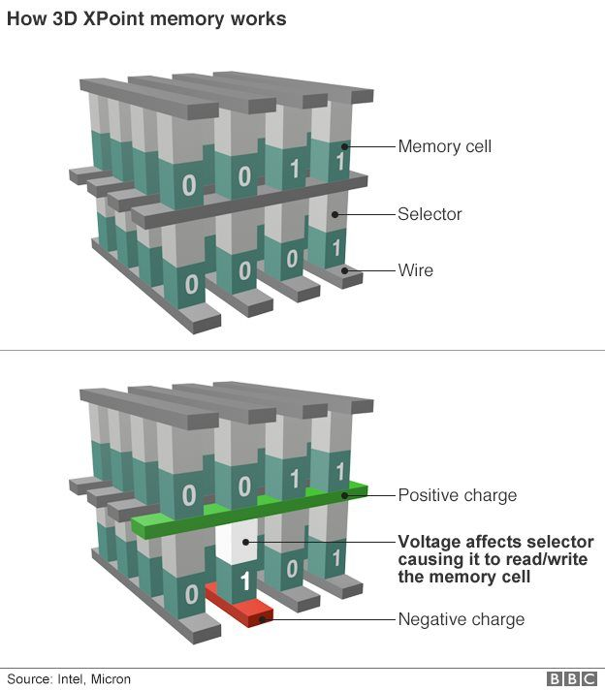
Emerging Memories for Persistent Memory in 3D Cross Point Architectures
Intel Gen 1 3D XPoint™
Magnetic
[MRAM, STT(SOT)MRAM]
Resistance Change ReRAM[1D, 2D], PCM [3D]
Ferroelectrics
Thermionic
[diode, MIEC, ..]
Volatile filament
Metal-Insulator Transition
Ovonic Threshold
Key Challenge: Matching Memory & Selector
INTEL CONFIDENTIAL

Slide 5
Emerging Memories for Persistent Memory
Intel’s offering and roadmap
  3rd Gen 3DXP (1.91Gb/mm^{2,} 22¢/GB) PRQ 2022; 4th Gen in LRP (2.93Gb/mm², 17¢/GB)
Leading Competitor
  Micron’s 1st Gen (0.62Gb/mm^{2,} 27¢/GB); sampled 2019 in storage space
Competitive landscape in 5 years (Ordered by technology maturity for productization)
  BiSM is a Build-in Selector Memory (Intel) ⬅ Top candidate to succeed OTS/PCM 3DXP solution
    Mb array @41nm pitch demo'd in 2018
    Silicon based scalability Q4/2020~Q1/2021
    On par of better than 4th Gen 3DXP
  SSM (BiSM @ Micron): MU favored due to simpler manufacturing (July/2018) ⬅ main competitor
  OTS+PCM: As exhibited in 2018 publication, Hynix is the closest follower to 1st Gen 3DXP with array demo
  OTS+PCM 1.5b/c: (Intel) BW density increase 1.5X, cost reduce to 1.5⁻¹x
  B/C doped OTS+CBRAM : Sony exhibited it internal R&D of 20nm product @ 0.6Gb/mm²
    Announced sample @ 2020; delay expected due to high drift, read induced over set;
    Other challenges include disturb, Cu integration, set/reset sigma; deemed low probability to success
  NRAM from Natero/Fujitsu indicating sample in 2020 with 40nm Logic process, 0.1Gb/mm² 25ns access latency
    Internal R&D, multiple venture backed, seeking M&A
    Low NL; no build-in selector evidence; self-select capability is unclear; deemed low probability to success without selector
  OTS+MRAM: Avalanche demonstrated very high NL single cell data; no array information; Disturb and sigma are likely showstoppers.

Slide 6
Backup Materials

Slide 7
Capacitive storage with access X’tor options for high BW memory
Company | X’tor | Memory | Maturity | Assessment | Density [Gb/mm²] | R/W BW [GB/s/GB] | R/W Latency [ns] | BER | Endurance
Intel | finfet | hiK | Production | · IPM with 22nm logic technology, PRQ 2013 | 0.013 | 800 | 12 | 1E-07 | 1E+14
Intel | ADM | hiK | exiting PF | · back gated, Gen 1 2022, Gen 2 2023 (metric quoted: Gen 2, 2-deck) · roadmap also include Gen 3 &4 each year @ density ~1.5X per generation | 0.060 | 6000 | 5 | 1E-06 | 1E+13
Intel | ADM | hiK | Pathfinding | · Finfet, 6F², 2025 + (metric quoted based on dual deck (50nm)² cell | > 0.27 | 6000 | 5 | 1E-06 | 1E+13
Samsung | 1T | 1C | Research | · Some indications of ADM like technology interest, but no public disclosure · Many DRAM flavors [DBM, HBM, DDR]; expect ~2023 (IGZO or or Si LT)
Hynix | 1T | 1C | Research | · Some indications of ADM like technology interest, but no public disclosure
Micron | 1T | 1C | Research | · Some indications of ADM like technology interest, but no public disclosure
Intel | ADM | n·FeCap | Research | · x'tor and FeCap electrical validated · 1T1FeC cell structure / array architecture and process integration in PF · 1TnFeC cell/array/integration is on drawing board | > 0.4 |  | 20/15 (destructive read) |  | 1E+12
Sony (Namlab) | 1T | 1FeCap | Pathfinding | · disclosed 64Kbit NVM array 2.5V/14ns/100min/1E11 cycles (VLSI2020) · 130nm BEOL Technology with array demo · high voltage, still insufficient endurance (needed 1E14) for DRAM |  |  | ?/15
Namlab/ DRAM | 1T | 1FeCap | Research | · Possibly JDP with all tier-1 DRAM manufacturer (Samsung and Hynix)
Micron | 1T | 1FeCap | Research | · Triangulation from supply chain interaction
TI | 1T | 1FeCap | Research | · TI work on HfO2 based FeCAP in collaboration with univ ; · TI has 1T1F embedded NVM product (PZT)

Slide 8
Resistive storage with access X’tor options for high BW memory
Company | X’tor | Memory | Maturity | Assessment | Density [Gb/mm²] | R/W BW [GB/s/GB] | R/W Latency [ns] | BER | Endurance
Intel | finfet | STTM | Production | · Embedded or standalone, 22nm logic base, PRQ 2019 | 0.006 | 1000/10 | 10 | 1E-05 | 1E+07
Everspin/GF | 1T | STTM | Production | · Standalone; GF 22FDX based MRAM technology PRQ - no products yet |  | 16.5 | 35
Samsung | 1T | STTM | Production | · embedded; 22nm FDSOI based product
TDK/ TSMC | 1T | STTM | Production | · embedded; TSMC technology PRQ @ 22nm [2019]. no product in HVM yet
Avalanche | 1T | STTM | Production | · embedded and standalone multiple products 4M to 64MB
Hynix | 1T | STTM | Pathfinding | · Array demo'd; 4Gb @ IEDM 2016; no press announcements of products
Kioxia | 1T | STTM | Pathfinding | · Toshiba was pursuing STTRAM for DRAM replacement (jointly w/ Hynix);
Micron/IBM | 1T | STTM | Dropped
Intel | 2T | SOT | Research | · CR assessment => SOTMRAM cell can scale ~0.01 um²
TSMC | 2T | SOT | Research | · TSMC SOT MRAM in collab with univ [Stanford, NTU, ITRI]; · unclear about internal R&D status
IBM/Samsung | 2T | SOT | Research
IMEC | 2T | SOT | Research | · IMEC SOT MRAM positioning for SRAM replacement; cell level R&D
Adesto | 1T | CBRAM | Production | · Adesto 4 generation of cell CBRAM materials change, · no scaled memory beyond 40nm logic node [microcontroller space]
Sony/Micron | 1T | CBRAM | Dropped
Nantero | 1T | NRAM | Pathfinding | · Internal R&D, multiple venture backed, seeking M&A · deemed feasible for 1T-array; unclear about variability for high density
(Many) | 1T | 1V_{O}⁺ | Dropped | · Showstopper: Variability at scaled dimensions and low operating currents

Slide 9
Top Tier 3DXP options for high density PM
Company | Selector | Memory | Memory | Maturity | Assessment | Density [Gb/mm²] | R/W BW [GB/s/GB] | R/W Latency [ns] | BER | Endurance
Intel | OTS | PCM | PCM | production | · 3rd Gen 3DXP, P1241/ATF, PRQ 2022, 4th Gen P1242/Bow Falls in LRP | 1.91 | .1/.034~.05 | 100/465 | 2E-04 | 4M
Micron | OTS | PCM | PCM | production | · 1st Gen, sample 2019, 2nd Gen passed storage qual, yet to be announced. | 0.62 | .1/.034 | 100/465 | 5E-04 | 130K
Intel | OTS |  |  | exiting PF | · Build-in Selector Memory, a.k.a. BiSM · Mb array @41nm pitch demo'd in 2018 · Silicon based scalability pending (as P1242 Bow-Falls candidates) | 2.93 | .075/.05 | 100/<320 | < 2E-4 | ~10M
Micron | OTS |  |  | exiting PF | · Self Select Memory (BiSM), IM JDP · Mb array @41nm pitch demo'd in 2018 · at the end of JDP (July/2018), MU favored due to simpler manufacturing
Hynix | OTS |  | PCM | exiting PF | · Internal R&D, 2z nm array demo'd (2018 publication) · die map, array organization, cell construct closely follow Intel S15 | ~0.6 |  | 100/300
Sony | OTS |  | CBRAM | exiting PF | · Internal R&D, 20nm Array demo'd; · sample @ 2020 (Jan/2019 PM summit announcement) · high drift, read induced over set problems; delay expected. · Other challenges: disturb, Cu integration, set/reset sigma · deemed low probability to success due to snapback read disturb | ~0.6 [128Gb/ 200mm²] | .2/.075 [3.2/1.2 GB/s] | 400/2000 |  | 1M
Nantero/ Fujitsu | NRAM |  |  | exiting PF | · Internal R&D, multiple venture backed, seeking M&A · indicating sample in 2020 with Fujitsu 40nm Logic process · Cell size [145nm]², 8Gb 4 deck, 80mm², 56% array efficiency. · Low NL; no build-in selector evidence; self-select capability is unclear. · deemed low probability to success without high NL or selector | 0.1 [8Gb/ 80mm²] | 1.33/1.33 [2.7GTps on 16Gb die] | 25/25 |  | 10B
IBM/ Macronix | OTS |  | PCM | Research | · Internal research on material and Cell construct @ ~100nm · small array demo'd
Avalanche | OTS? |  | MRAM | Research | · internal R&D, limited array demo · high NL, good for high density · disturb due to threshold switching
Ranked by technical maturity for productization

Slide 10
Other notable emerging memory cross point technologies for high density PM
Company | Selector | Memory | Maturity | Assessment
IMEC | OTS | PCM | Research | · early research on material exploration and single device char
CEA-LETI | OTS | PCM | Research | · early research on material exploration and single device char
Intel | ADM Schottky | iPCM | Research | · early research on material exploration and array definition
Micro | OTS | iPCM | Research | · early research on material exploration (EU Pastry project)
Crossbar/ SMIC | FAAST | V_{O}⁺ RRAM | Research | · Internal R&D @ Array level · high NL (don't know how it works and what are the material) · filament RRAM, high sigma, disturb, & read snapback over-set issue · deems low probability to success.
HP/Hynix | NbO_{x} | V_{O}⁺ | Dropped | · Filamentary, variability, endurance are showstopper (Sandisk/WD included)
Kioxia | FTJ |  | Research | · Internal research on Cell char · low NL can be a problem; bipolar selector may be required
Kioxia | CBRAM |  | Research | · Toshiba published cell level research work on Ag based CBRAM [variability still issue] · No press about products; Kioxia still has reference to Toshiba research on their website
Unity | Interface |  | Dropped | · CMOx (acquired by Rambus), variability, slow (mass transport)
Intel | FeFET |  | concept | · High density 3D array construct (3D NAND like) in concept stage · Silicon channel and ADM channel under evaluation;
Namlab/ GF | FeFET |  | Research | · 2D array of scaled FeFET; challenging to reach high density; significant variability (no window) · FMC (spin-off of Namlab) is seeking TSMC JDP
IMEC | FeFET |  | Research | · High density 3D array construct (NAND like) in research stage [cell level r&d]; · significant variability (no window @ 3s)
Micron | FeFET |  | ? | · 3D NAND architecture
Kilopass / TC Lab | T-RAM |  | Research | · Mostly simulations of cell level; volatile memory · significant risk on 3D construct - require high quality epi in high AR structures
Sunrise | NOR |  | Research | · In stealth mode; recently recruited FeFET expert Cal Prof Salahuddin of Cal (~1yr sabbatical)

