Slide 1
A Survey of Cross Point Phase Change Memory Technologies
DerChang Kau
Intel Corporation
Santa Clara, CA
Sematech International Symposium on Advanced Gate Stack Technology
Sep/30/2010
Hilton Garden Inn, Troy, NY

Slide 2
Outline
Overview and Motive
  Storage Elements
  Selector Elements
  Why thin film based Cross Point Array
Cross Point Phase Change Memory Array
  Thin film two-terminal switches
  Array operations
PCMS in Computing Memory Hierarchy
  PCMS characteristics
  Performance benchmark
Summary

Slide 3
Outline
Overview and Motive
  Storage Elements
  Selector Elements
  Why thin film based Cross Point Array
Cross Point Phase Change Memory Array
  Thin film two-terminal switches
  Array operations
PCMS in Computing Memory Hierarchy
  PCMS characteristics
  Performance benchmark
Summary

Slide 4
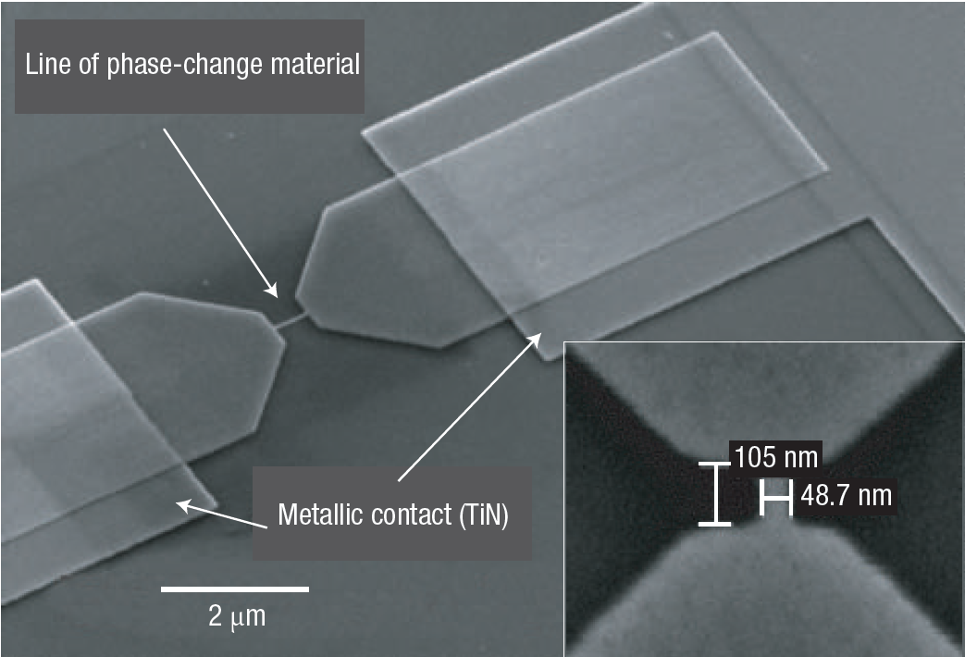
Storage Element
Martijn Lankhorst, et.al., Nature materials, 2005
Simple resistor 1-D steady state approximation:
Fourier’s Law .
Ohm’s Law .
+ Continuity Equation .
Structure
Temp, K
Line Position , nm
Material

Slide 5
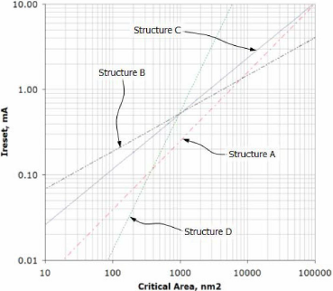
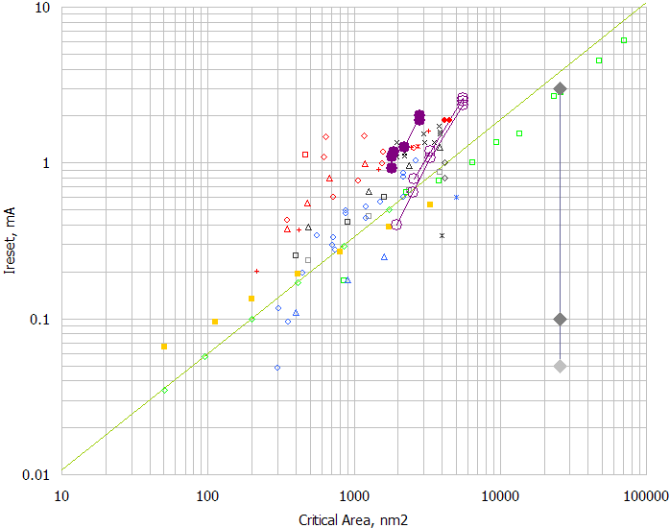
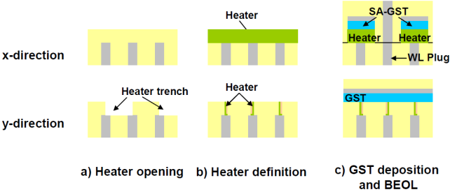
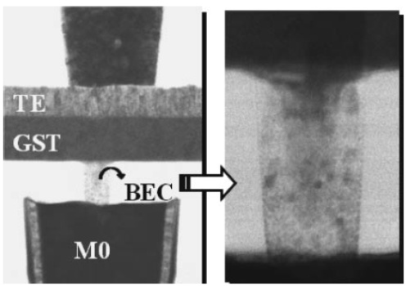
Structure Engineering
A. Schrott, et.al., VLSI-TSA, 2007
Chung Lam, LETI Workshop on MT, 2009
G. Servalli, IEDM 2009
C. Jeong, et.al., JJAP, 2006
Critical Area = [α•λ]²
λ: Technology half pitch
α: Sub-lithographic technique required
by the pairing selector

Slide 6
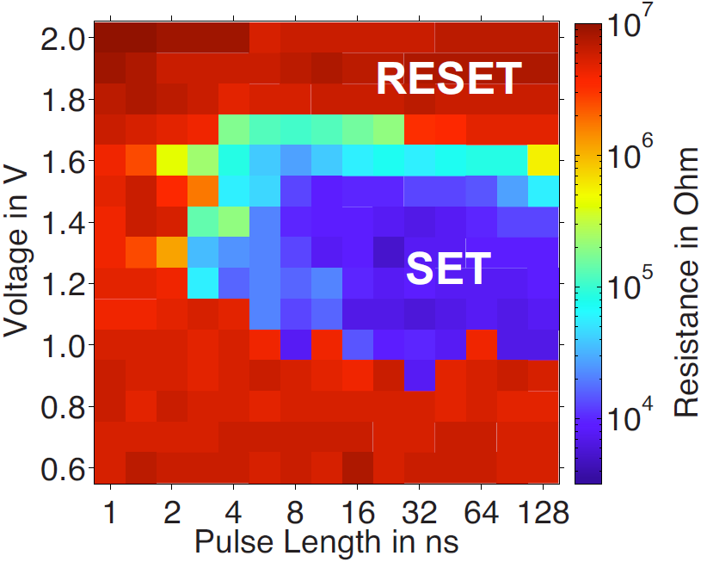
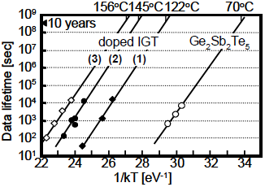
Phase Change Material Engineering
SET Energy-Bandwidth
Retention and Disturb
G. Bruns, et.al., APL July, 2009
Nanosecond switching in GeTe
T. Morikawa, et.al, iedm 2007,
Good Data Retention in In-Ge-Te

Slide 7
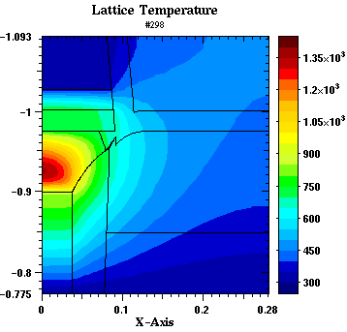
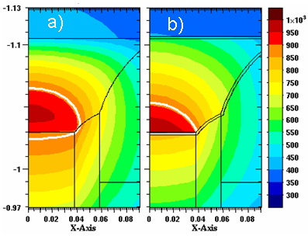
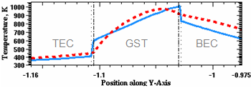
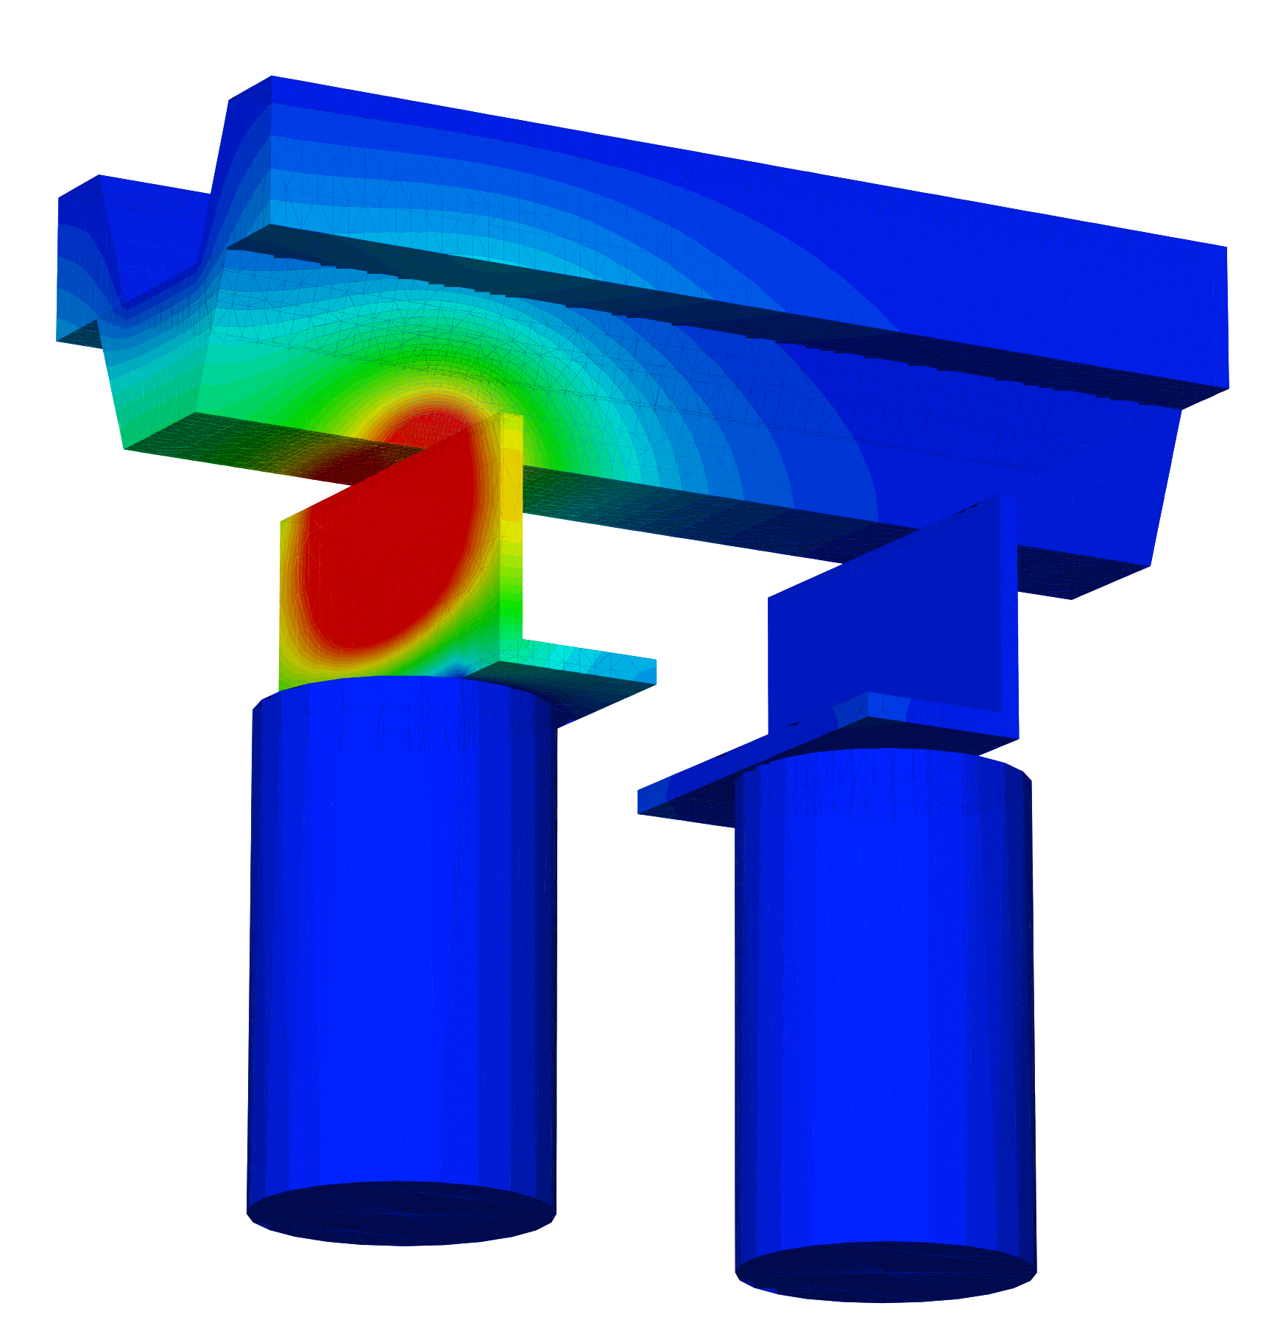
Heater, Electrode and Interface
Heater vs. Self-heat
Thermal Boundary Resistance and Electrical Interface Barrier
Reset temperature along center axis with (solid line) and without (dotted line) interfaces
David Kencke, et.al., IEDM 2007, The Role of Interfaces in PCM

Slide 8
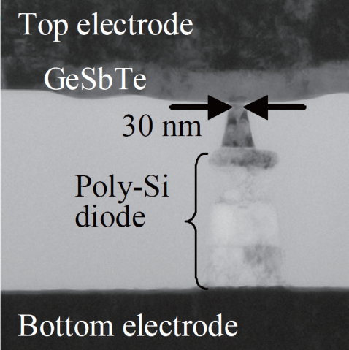
Vertically Integrated PCM
Y.N. Hwang, et. al.,
VLSI ’03, T12B3
F. Pellizzer, et. al.,
VLSI ’06, T15P3
J.H. Oh, et. al.,
IEDM ’06, S2P6
Column
Top electrode
Top Electrode
Chalcogenide
OTS
Middle Electrode
PCM
Bottom
electrode
Bottom Electrode
Y. Chen, et. al.,
IEDM ’03, S37P4
Y. Sasago, et. al.,
VLSI, ’09. T2B-1
D. Kau, et. al.,
IEDM ’09. S27.1

Slide 9
Why thin film Cross Point PCM Architecture
True Cross Point Array
  Cell dimension: 4 λ²
  Strapless to simplify routing and process
Stackable
  Low temperature process
  CMOS under the memory
  Compatible with mainstream
  backend process
  Multiple decks feasible
Bitline
Wordline
Wordlines
Bitlines

Slide 10
Outline
Overview and Motive
  Storage Elements
  Selector Elements
  Why thin film based Cross Point Array
Cross Point Phase Change Memory Array
  Thin film two-terminal switches
  Array operations
PCMS in Computing Memory Hierarchy
  PCMS characteristics
  Performance benchmark
Summary

Slide 11
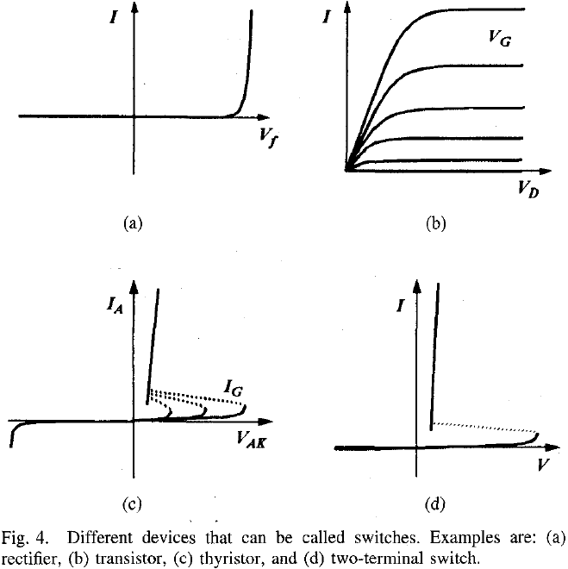
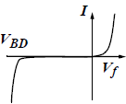
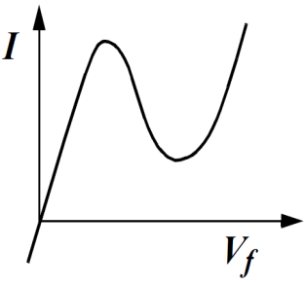
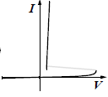
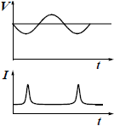
“A Survey of Semiconductor Devices”
Diode: two terminals and exhibiting a nonlinear I-V (IEEE Standard Dictionary)
Rectifiers
N-Shape
S-Shape
Transient
Kowk Ng, TED Oct., ’96 p1760
Kwok Ng, IEEE EDS Distinguished Lecture
SCV Chapter, 11/7/05

Slide 12
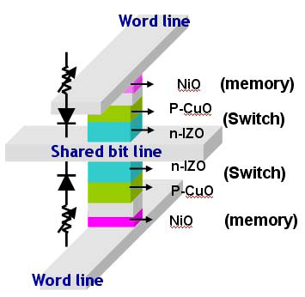
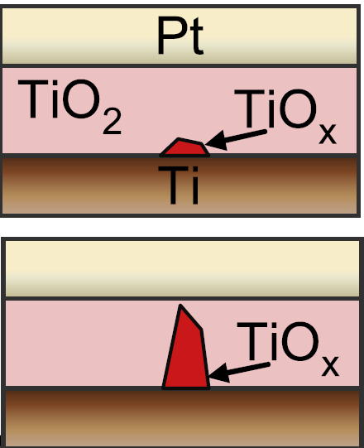
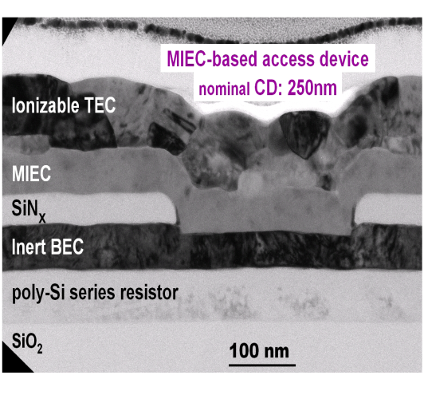
Thin Film Diode Candidates for Cross Point PCM
Y. Sasago, et. al.,
VLSI ’09. T2B-1
M. Lee, et.al.,
IEDM ‘07, S30.2
W Y Park, et.al., Nanotechnology 21 (2010) 195201
Column
Top Electrode
OTS
Middle Electrode
PCM
Bottom Electrode
K. Gopalakrishnan, et. al.,
VLSI ’10. TS19.41
D. Kau, et. al.,
IEDM ’09. S27.1

Slide 13
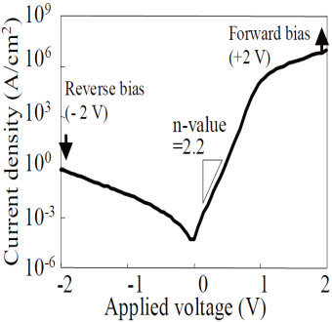
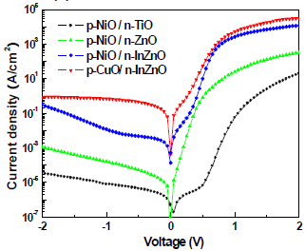
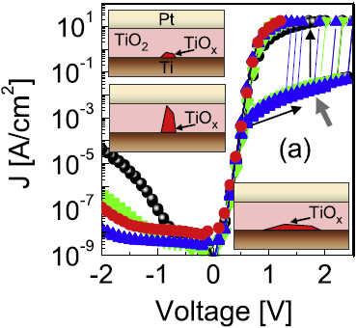
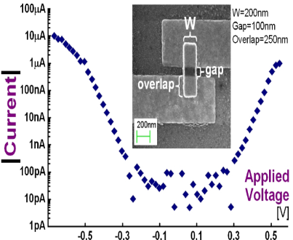
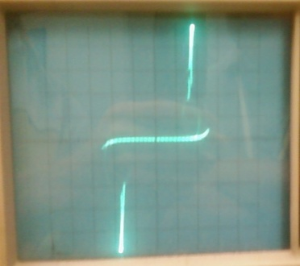
I-V Phenomenology
Poly Junction | Oxide Junction | Oxide Rectifier | MIEC | OTS
Si PN junction | Ox PN junction | Pt/TiO₂/Ti | Cu⁺ in SE | Chalcogenide
Minority carrier; drift + diffusion | Minority carrier; drift + diffusion | Schottky barrier + Filamentary | Schottky barrier modulated by Ionic motion. | Ovonic Threshold Switching
Sub nsec | 10 to 100 nsec* | Forming/dissolving required ? | ~100ns forming ~200ns dissolving | nsec switching & recovery
Unidirectional | Unidirectional | Unidirectional | Bidirectional | Bidirectional
< 10MA/cm² | < 0.1MA/cm² | < 1MA/cm² | 50MA/cm² | Match PCM
Y. Sasago, et. al., VLSI ’09. T2B-1 | M. Lee, et.al., IEDM ‘07, S30.2 | W. Park, et.al., Nanotechnology ’10 | K. Gopalakrishnan, et. al., VLSI ’10. TS19.41 | D. Kau, et. al., IEDM ’09. S27.1
*: Huang et.al., Sci. in China, Physics, Mechanics & Astronomy 2005 Vol.48 No.3 pp.381--384

Slide 14
Advances in Thin Film Switches
Beyond “Traditional Rectifier”
Competency – Semiconductor fabrication maturity improves device reproducibility and cumulative learning
Challenge – The switching transient such as filamentation requires proper DUT design using non-equilibrium characterization technique .
Novelty – The physics of resistive switching mechanisms fuel innovations on the new classes of selectors

Slide 15
Cross Point Array Operations: Access
Unidirectional Rectifier
Bidirectional Switch
0
V_{access}
½ V_{acces}
V_{access}
…
…
…
…
V_{access}
½ V_{access}
0
0
A rectifying selector turns on one bit with forward bias and isolates others with reverse bias.
Subject to the potential drop at each cross points, the selected bit is triggered and the unselected bits are blocked.

Slide 16
Reading a PCM in Cross Point Array
To interrogate PCM state, PN diode or MIEC is turned ON to sense the current
With a S-Shape Selector like OTS, threshold demarcation is used for Read
MLC is perceived easier with a non-NDR selector; however, variability of bias points needs to be carefully controlled due to superlinear I-V characteristics
Demarcation Read with a S-Shape Cell is inherently faster due to NDR
V_{DM}
PCM IV; 4 levels programmed
PCMS IV

Slide 17
Writing a PCM in Cross Point Array
Sub-lithographic features have been deployed to reduce I_{RESET}
  Manufacturing latitude of those innovations becomes increasingly restricted as technology scales.
  I_{RESET} is converging with various device structures
Areas of focus:
  Electrical interface and thermal boundary properties such as cell confinement and architecture
  SET Kinetics in Nano-geometry for energy efficiency
  PCM’s high speed vitrification capability must not be hindered by the thin-film selector in series.
  Selector and electrodes becomes the liability to endurance as RESET current density increases.

Slide 18
Array Parasitics
The parasitic R and C consume operating energy.
Displacement current during access is dissipated mostly on the intra layer capacitance and decoding circuit
Array consumes leakage power when unselected cells are biased
Example: Single deck Cross Point PCM array with “C” bit-lines and “R” word-lines
 | Unidirectional Rectifier |  |  | Bidirectional Switch
 | Sel. WL | Sel. BL | DeSel Cells | Sel. WL | Sel. BL | DeSel Cells
# of Cell | C-1 | R-1 | (C-1)•(R-1) | C-1 | R-1 | (C-1)•(R-1)
Switching | 0 | 1 col | (R-1) rows | 1 row | 1 col | 0
leakage | 0 | 0 | (C-1)•(R-1) | C-1 | R-1 | 0

Slide 19
Outline
Overview and Motive
  Storage Elements
  Selector Elements
  Why thin film based Cross Point Array
Cross Point Phase Change Memory Array
  Thin film two-terminal switches
  Array operations
PCMS in Computing Memory Hierarchy
  PCMS characteristics
  Performance benchmark
Summary

Slide 20
State of the Art Computing Memory Hierarchy
Imperatives on cost vs. performance in memory subsystem
  performance increases as it moves closer to processors
  Capacity of each subsequent level increases by roughly one order
Challenges to a disruptive innovation between NAND & DRAM
  DRAM latency will be sustained and throughput will improve.
  NAND will maintain or improve performance with cost leadership
Memory Subsystem | Normalized Parameters
 | Cost | Thruput | Latency
On-chip SRAM | > 10 | > 10 | < 0.01
Component DRAM | 1 | 1 | 1
SSD NAND | 0.1 | 0.1 | 1,000
Form factor HDD | < 0.01 | < 0.01 | > 100,000

Slide 21
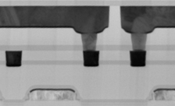
PCMS Array Construction
M2
M1
D. Kau, et.al.,
IEDM ’09, S27.1
Poly

Slide 22
PCM vs. PCMS
DOE Split:
with vs. without OTS
OTS improves PCM RESET effectiveness

Slide 23
PCMS Cross Point Array RESET Speed
High speed RESET capability is validated with Cross Point Array

Slide 24
PCMS Array Cycling Endurance
Degradation tails (3.5σ) developed after
1 million S/R cycles.

Slide 25
Program Distribution
A good candidate for high density components

Slide 26
Benchmark of Computing Memory
34nm NAND vs. DDR3 DRAM vs. projected 34nm PCMS
Memory |  | NAND | PCMS | DRAM
Normalized Cost |  | 0.1 | 0.1 | 1
Normalized Bandwidth | READ | 1 | 1 | 1
 | RESET | 0.05 | 0.5
 | SET | > 10 | 0.1
Normalized Latency | READ | 1K | 1 | 1
 | RESET | 20K | 3~5
 | SET | 60K | 10
Endurances (cycles) |  | 10K | > 1M | >1E15
Disturb (cycles) |  | 10K | > 1E12 | N/A

Slide 27
Summary
Thin film PCM Cross Point Arrays possess cost advantages
  “Cross Point” means 4 λ² / Cell for each deck of memory
  “Thin film” enables multi-deck to amortize cell size.
  “Thin-film-Cross-Point” array is stackable over CMOS to reduce die size
The Physics on resistive switching fuel innovations on thin-film diodes
  OTS is a strong contender among all the thin film diodes;
  It’s a bidirectional threshold switching element to isolate PCM cell;
  it scales with PCM, physically, chemically & electrically
Cross Point PCMS Array demonstrates
  Near DRAM performance with good NVM reliability
  Cost comparable to NAND
PCMS fits well between NAND & DRAM in computing memory hierarchy

Slide 28
Acknowledgement
I would like to thank to Intel NVM team for helpful discussions
I would also like to acknowledge the authors of the literature referred here

