Slide 1
A Survey of Cross Point Phase Change Memory Technologies
DerChang Kau
Intel Corporation
Santa Clara, CA, USA
(高 德昌, インテル株式会社)
SSDM2010
Sep/24/2010
The University of Tokyo
Tokyo, Japan

Slide 2
Outline
Overview and Motive
Storage Elements
Selector Elements
Why thin film based Cross Point Array
Cross Point Phase Change Memory Array
Thin film two-terminal switches
Array operations
PCMS in Computing Memory Hierarchy
PCMS characteristics
Performance benchmark
Summary

Slide 3
Outline
Overview and Motive
Storage Elements
Selector Elements
Why thin film based Cross Point Array
Cross Point Phase Change Memory Array
Thin film two-terminal switches
Array operations
PCMS in Computing Memory Hierarchy
PCMS characteristics
Performance benchmark
Summary

Slide 4
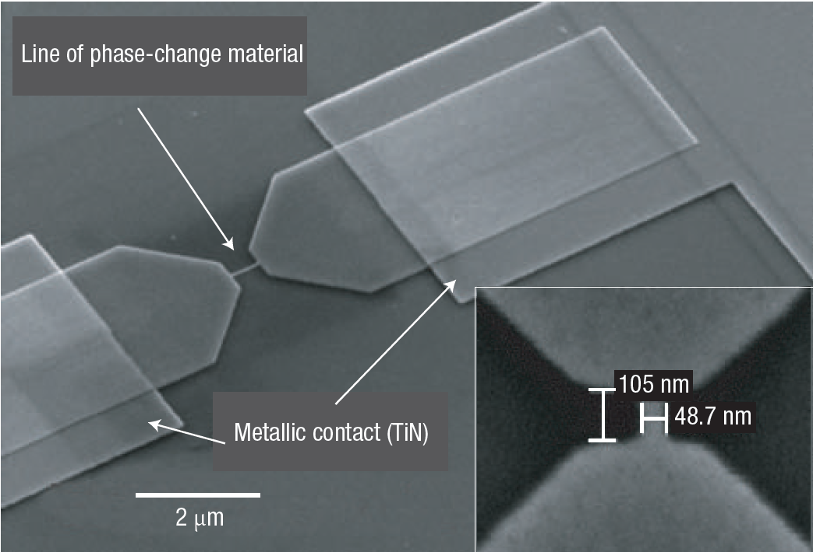
Storage Element
Martijn Lankhorst, et.al., Nature materials, 2005
Simple resistor 1-D steady state approximation:
Fourier’s Law .
Ohm’s Law .
+ Continuity Equation .
Structure
Temp, K
Line Position , nm
Material

Slide 5
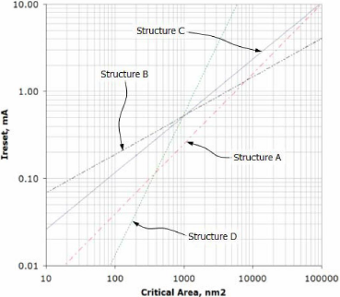
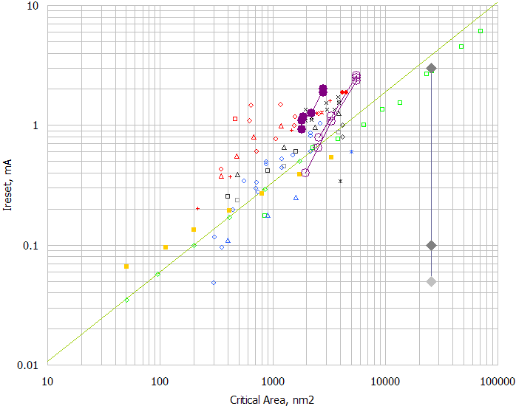
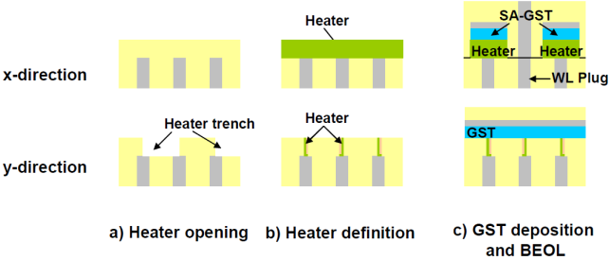
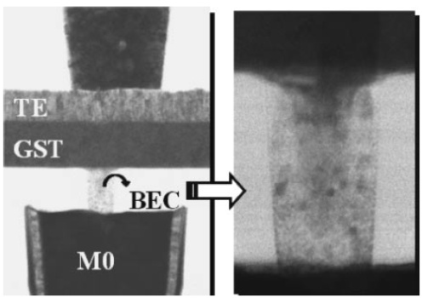
Structure Engineering
A. Schrott, et.al., VLSI-TSA, 2007
Chung Lam, LETI Workshop on MT, 2009
G. Servalli, IEDM 2009
C. Jeong, et.al., JJAP, 2006
Critical Area = [α•λ]²
λ: Technology half pitch
α: Sub-lithographic technique required
by the pairing selector

Slide 6
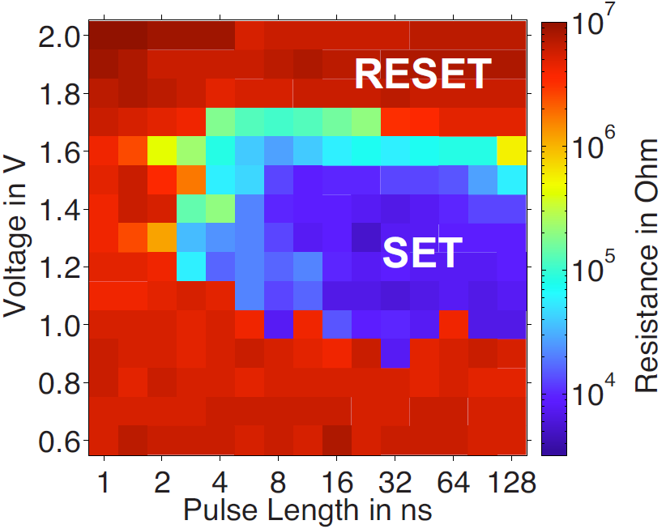
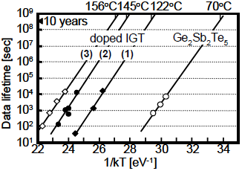
Phase Change Material Engineering
SET Energy-Bandwidth
Retention and Disturb
G. Bruns, et.al., APL July, 2009
Nanosecond switching in GeTe
T. Morikawa, et.al, iedm 2007,
Good Data Retention in In-Ge-Te

Slide 7
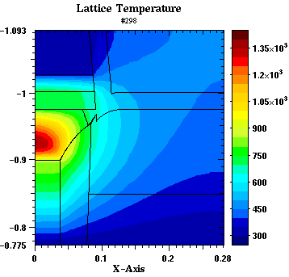
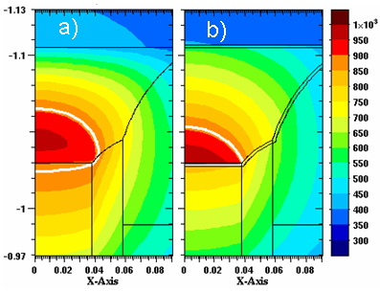
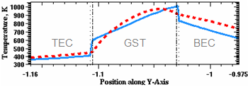
Heater, Electrode and Interface
Heater vs. Self-heat
Thermal Boundary Resistance and Electrical Interface Barrier
Reset temperature along center axis with (solid line) and without (dotted line) interfaces
David Kencke, et.al., IEDM 2007, The Role of Interfaces in PCM

Slide 8
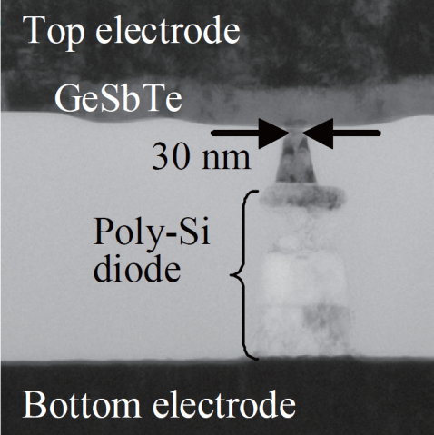
Vertically Integrated PCM
Y.N. Hwang, et. al.,
VLSI ’03, T12B3
F. Pellizzer, et. al.,
VLSI ’06, T15P3
J.H. Oh, et. al.,
IEDM ’06, S2P6
Column
Top electrode
Top Electrode
Chalcogenide
OTS
Middle Electrode
PCM
Bottom
electrode
Bottom Electrode
Y. Chen, et. al.,
IEDM ’03, S37P4
Y. Sasago, et. al.,
VLSI, ’09. T2B-1
D. Kau, et. al.,
IEDM ’09. S27.1

Slide 9
Why thin film Cross Point PCM Architecture
True Cross Point Array
Cell dimension: 4 λ²
Strapless to simplify routing and process
Stackable
Low temperature process
CMOS under the memory
Compatible with mainstream backend process
Multiple decks feasible
Bitline
Wordline
Wordlines
Bitlines

Slide 10
Outline
Overview and Motive
Storage Elements
Selector Elements
Why thin film based Cross Point Array
Cross Point Phase Change Memory Array
Thin film two-terminal switches
Array operations
PCMS in Computing Memory Hierarchy
PCMS characteristics
Performance benchmark
Summary

Slide 11
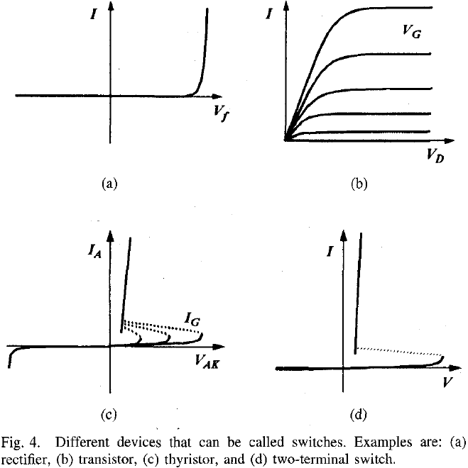
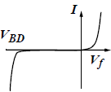
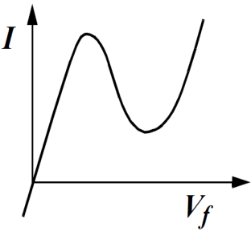
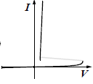
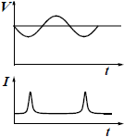
“A Survey of Semiconductor Devices”
Diode: two terminals and exhibiting a nonlinear I-V (IEEE Standard Dictionary)
Rectifiers
N-Shape
S-Shape
Transient
Kowk Ng, TED Oct., ’96 p1760
Kwok Ng, IEEE EDS Distinguished Lecture
SCV Chapter, 11/7/05

Slide 12

Esaki Diode

Slide 13
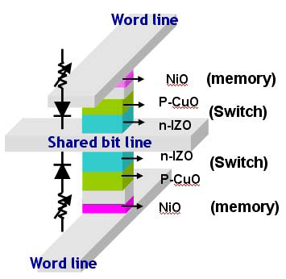
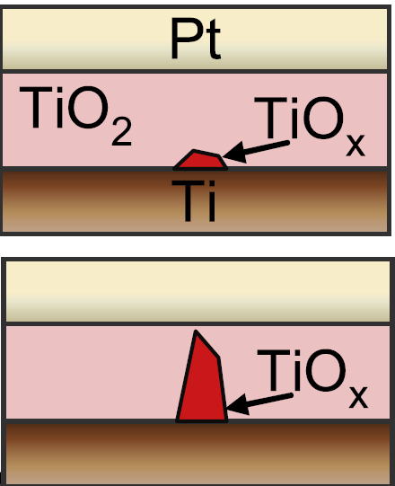
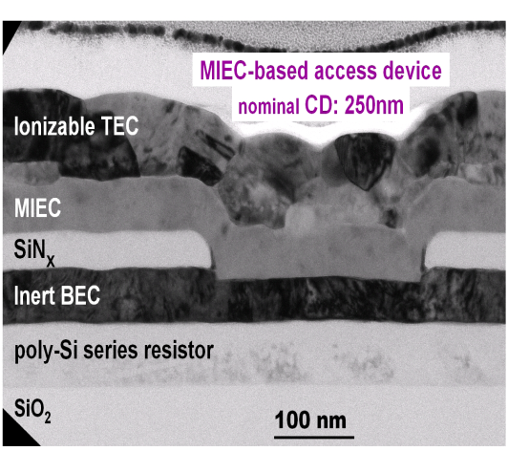
Thin Film Diode Candidates for Cross Point PCM
Y. Sasago, et. al.,
VLSI ’09. T2B-1
M. Lee, et.al.,
IEDM ‘07, S30.2
W Y Park, et.al., Nanotechnology 21 (2010) 195201
Column
Top Electrode
OTS
Middle Electrode
PCM
Bottom Electrode
K. Gopalakrishnan, et. al.,
VLSI ’10. TS19.41
D. Kau, et. al.,
IEDM ’09. S27.1

Slide 14
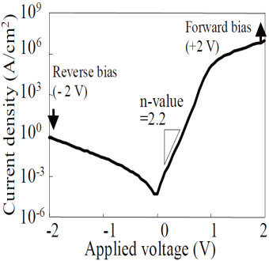
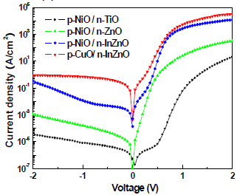
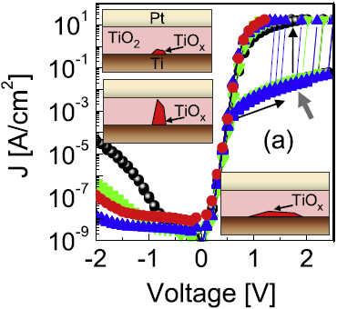
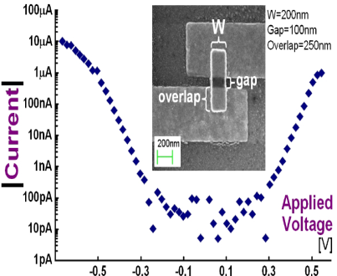
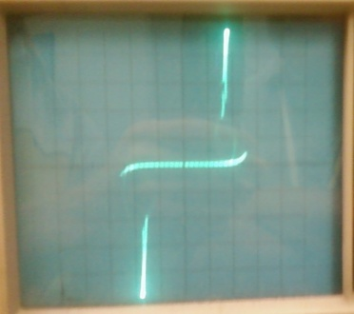
I-V Phenomenology
Poly Junction | Oxide Junction | Oxide Rectifier | MIEC | OTS
Si PN junction | Ox PN junction | Pt/TiO₂/Ti | Cu⁺ in SE | Chalcogenide
Minority carrier; drift + diffusion | Minority carrier; drift + diffusion | Schottky barrier + Filamentary | Schottky barrier modulated by Ionic motion. | Ovonic Threshold Switching
Sub nsec | 10 to 100 nsec* | Forming/dissolving required ? | ~100ns forming ~200ns dissolving | nsec switching & recovery
Unidirectional | Unidirectional | Unidirectional | Bidirectional | Bidirectional
< 10MA/cm² | < 0.1MA/cm² | < 1MA/cm² | 50MA/cm² | Match PCM
Y. Sasago, et. al., VLSI ’09. T2B-1 | M. Lee, et.al., IEDM ‘07, S30.2 | W. Park, et.al., Nanotechnology ’10 | K. Gopalakrishnan, et. al., VLSI ’10. TS19.41 | D. Kau, et. al., IEDM ’09. S27.1
*: Huang et.al., Sci. in China, Physics, Mechanics & Astronomy 2005 Vol.48 No.3 pp.381--384

Slide 15
Advances in Thin Film Switches Beyond “Traditional Rectifier”
Competency – Semiconductor fabrication maturity improves device reproducibility and cumulative learning
Challenge – The switching transient such as filamentation requires proper DUT design using non-equilibrium characterization technique .
Novelty – The physics of resistive switching mechanisms fuel innovations on the new classes of selectors

Slide 16
Cross Point Array Operations: Access
Unidirectional Rectifier
Bidirectional Switch
0
V_{access}
½ V_{acces}
V_{access}
…
…
…
…
V_{access}
½ V_{access}
0
0
A rectifying selector turns on one bit with forward bias and isolates others with reverse bias.
Subject to the potential drop at each cross points, the selected bit is triggered and the unselected bits are blocked.

Slide 17
Reading a PCM in Cross Point Array
To interrogate PCM state, PN diode or MIEC is turned ON to sense the current
With a S-Shape Selector like OTS, threshold demarcation is used for Read
MLC is perceived easier with a non-NDR selector; however, variability of bias points needs to be carefully controlled due to superlinear I-V characteristics
Demarcation Read with a S-Shape Cell is inherently faster due to NDR
V_{DM}
PCM IV; 4 levels programmed
PCMS IV

Slide 18
Writing a PCM in Cross Point Array
Sub-lithographic features have been deployed to reduce I_{RESET}
Manufacturing latitude of those innovations becomes increasingly restricted as technology scales.
I_{RESET} is converging with various device structures
Areas of focus:
Electrical interface and thermal boundary properties such as cell confinement and architecture
SET Kinetics in Nano-geometry for energy efficiency
PCM’s high speed vitrification capability must not be hindered by the thin-film selector in series.
Selector and electrodes becomes the liability to endurance as RESET current density increases.

Slide 19
Array Parasitics
The parasitic R and C consume operating energy.
Displacement current during access is dissipated mostly on the intra layer capacitance and decoding circuit
Array consumes leakage power when unselected cells are biased
Example: Single deck Cross Point PCM array with “C” bit-lines and “R” word-lines
 | Unidirectional Rectifier |  |  | Bidirectional Switch
 | Sel. WL | Sel. BL | DeSel Cells | Sel. WL | Sel. BL | DeSel Cells
# of Cell | C-1 | R-1 | (C-1)•(R-1) | C-1 | R-1 | (C-1)•(R-1)
Switching | 0 | 1 col | (R-1) rows | 1 row | 1 col | 0
leakage | 0 | 0 | (C-1)•(R-1) | C-1 | R-1 | 0

Slide 20
Outline
Overview and Motive
Storage Elements
Selector Elements
Why thin film based Cross Point Array
Cross Point Phase Change Memory Array
Thin film two-terminal switches
Array operations
PCMS in Computing Memory Hierarchy
PCMS characteristics
Performance benchmark
Summary

Slide 21
State of the Art Computing Memory Hierarchy
Imperatives on cost vs. performance in memory subsystem
performance increases as it moves closer to processors
Capacity of each subsequent level increases by roughly one order
Challenges to a disruptive innovation between NAND & DRAM
DRAM latency will be sustained and throughput will improve.
NAND will maintain or improve performance with cost leadership
Memory Subsystem | Normalized Parameters
 | Cost | Thruput | Latency
On-chip SRAM | > 10 | > 10 | < 0.01
Component DRAM | 1 | 1 | 1
SSD NAND | 0.1 | 0.1 | 1,000
Form factor HDD | < 0.01 | < 0.01 | > 100,000

Slide 22
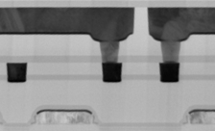
PCMS Array Construction
M2
M1
D. Kau, et.al.,
IEDM ’09, S27.1
Poly

Slide 23
PCM vs. PCMS
DOE Split:
with vs. without OTS
OTS improves PCM RESET effectiveness

Slide 24
PCMS Cross Point Array RESET Speed
High speed RESET capability is validated with Cross Point Array

Slide 25
PCMS Array Cycling Endurance
Degradation tails (3.5σ) developed after
1 million S/R cycles.

Slide 26
Program Distribution
A good candidate for high density components

Slide 27
Benchmark of Computing Memory
34nm NAND vs. DDR3 DRAM vs. projected 34nm PCMS
Memory |  | NAND | PCMS | DRAM
Normalized Cost |  | 0.1 | 0.1 | 1
Normalized Bandwidth | READ | 1 | 1 | 1
 | RESET | 0.05 | 0.5
 | SET | > 10 | 0.1
Normalized Latency | READ | 1K | 1 | 1
 | RESET | 20K | 3~5
 | SET | 60K | 10
Endurances (cycles) |  | 10K | > 1M | >1E15
Disturb (cycles) |  | 10K | > 1E12 | N/A

Slide 28
Summary
Thin film PCM Cross Point Arrays possess cost advantages
“Cross Point” means 4 λ² / Cell for each deck of memory
“Thin film” enables multi-deck to amortize cell size.
“Thin-film-Cross-Point” array is stackable over CMOS to reduce die size
The Physics on resistive switching fuel innovations on thin-film diodes
OTS is a strong contender among all the thin film diodes;
It’s a bidirectional threshold switching element to isolate PCM cell;
it scales with PCM, physically, chemically & electrically
Cross Point PCMS Array demonstrates
Near DRAM performance with good NVM reliability
Cost comparable to NAND
PCMS fits well between NAND & DRAM in computing memory hierarchy

Slide 29
Acknowledgement
I would like to thank to Intel NVM team for helpful discussions
I would also like to acknowledge the authors of the literature referred here

Slide 30
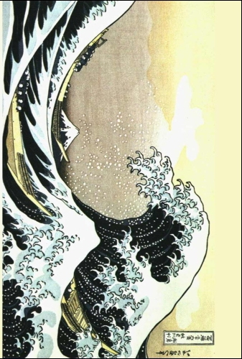
OTS Diode
V
I

