Slide 1
RTD Staff Debrief
NSG Transition
October 19, 2020

Slide 2
Agenda
Announcement Recap
Impacts to RTD
Next Steps
Q&A

Slide 3
Announcement Recap
Intel has signed an agreement to sell the NAND memory and storage business to SK hynix, a strategic player in the memory and storage market.
The transaction will close in two phases:
  Phase one (scheduled for late 2021) is the transfer of Intel’s 3D NAND memory and storage business which includes NAND SSD, NAND Component and wafer business, and Intel Dalian Memory Technology and Manufacturing Facility in Dalian, China.
  Phase two (scheduled for March 2025) includes NAND technology and component development along with fab operations. Until Phase 2 transfers to SK hynix in March 2025, Intel will continue developing NAND technology and components, manufacturing NAND wafers at the fab and retain manufacturing and design-related IP.
Notes:
We announced on October 19 that Intel has signed an agreement to sell the NAND memory and storage business to SK hynix, a strategic player in the memory and storage market, in a transaction valued at $XB.
The transaction includes the transfer of employees in two phases as well as Intel's NAND Memory Technology and Manufacturing facility in Dalian, China, which Intel will continue to operate, retaining related IP, until March 2025.
Phase one is the transfer of Intel’s 3D NAND memory and storage business, which includes NAND SSD, NAND Component and wafer business, and Intel Dalian Memory Technology and Manufacturing Facility in Dalian, China. Phase one is expected to close in late 2021, subject to regulatory approvals in the US, China, S. Korea and the EU as well as other customary conditions.
Phase two is the transfer of NAND technology and component development along with fab operations. Phase two is expected to close in March 2025. Intel will continue operating the fab and retain manufacturing IP until the phase two close.

Slide 4
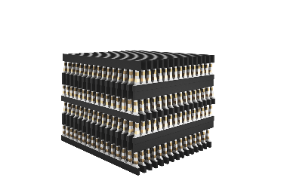
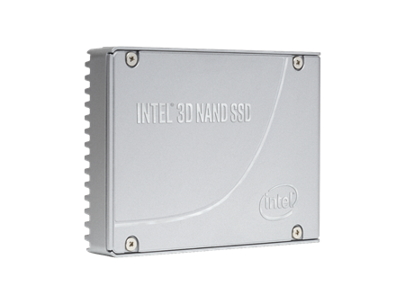
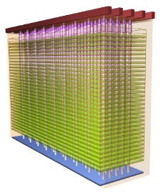
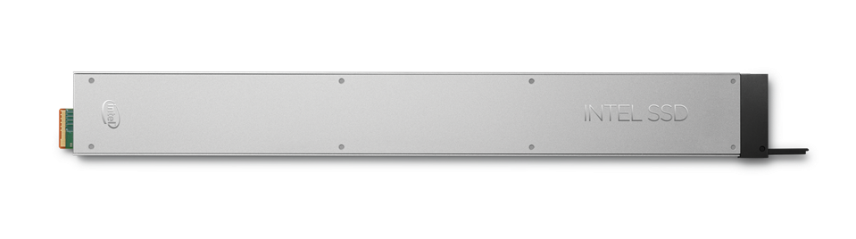

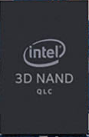

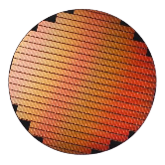
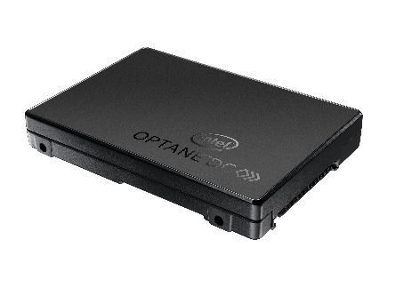

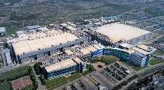




THE DEAL STRUCTURE
Optane Group
NAND Products &
Solutions Group
NAND Design, Technology & Manufacturing Group
GM: Rob Crooke (Acting)
GM: Rob Crooke
GM: Stephen Keeney
NAND SSD
Creation
NAND TD
TD, Mfg, DCPMM,
SSD (DC & Client Hybrid), Sales/Marketing
NAND Sales
& Marketing
NAND Design
NAND Biz Ops
& Planning
Fab Operations
to Wafer
Fab & Assets
ENSURING ANY MICRON & INTEL/MICRON JOINTLY DEVELOPED IP IS PROTECTED
CONTROLLED
LATE 2021
MARCH 2025
Notes:
Note: Optane DC SSD refers to Optane SSD only. NAND SSD goes with NPSG.
The Deal Structure (Talking Points for Leaders & Managers)
The deal with SK Hynix is made up of two distinct “closes”, one expected to close in “late 2021” due to regulatory approvals in 3 countries (US, Korea, and China), and the second, and final closing in March 2025.
There are 3 “Business Groups” that will be formed:
Optane Group (acting leader Rob Crooke)
Intel will retain its distinct Intel® OptaneTM business, and intends to continue investing, developing and scaling the Optane business. This includes existing Technology Development in Rio Rancho, NM, future manufacturing of Optane wafers, component development, Data Center Persistent Memory products (currently in DPG), Data Center SSD and Client Hybrid products (both currently in NSG), as well as sales and marketing for Optane products. The General Manager will be Rob Crooke, acting, until such time as a new GM is named.
NAND Design, Technology & Manufacturing Group (NAND-DTM) (led by Stephen Keeney)
After the first transaction closes in Late 2021, SK Hynix will own the Fab and Assets of the Dalian Memory Technology and Manufacturing Facility and provide the related working capital and expenditures. Intel will continue to manufacture NAND wafers at DMTM, retaining manufacturing-related IP until March 2025, to ensure that Intel/Micron jointly developed IP is protected. Approximately 4500 Intel employees will remain in the “Operating Company”, led by Stephen Keeney, until the expected transfer of that operation to SK Hynix in March 2025.
NAND Products & Solutions Group (NPSG) (led by Rob Crooke)
Upon closure of the first transaction in late 2021, SK Hynix will receive Intel’s NAND memory and storage business. This will include NAND SSD, NAND Component and wafer business, and the Dalian Memory Technology and Manufacturing Facility in Dalian, China. Intel will continue to manufacture NAND wafers until March 2025 to ensure Intel/Micron jointly developed IP is protected. At time of close, the transaction includes the transfer of employees in the 3D NAND memory and storage business, majority based in California.

Slide 5
Why This Is A Good Opportunity
Optane
  Provide focus necessary to grow nascent business while taking advantage of Intel’s platform and software ecosystem capabilities.
  Because Optane provides differentiated value to Intel’s platforms and customers, Intel intends to invest, develop and scale the business.
  The transaction will allow Intel to invest the proceeds to deliver leadership products and advance our long-term growth priorities including AI, 5G networking and the intelligent, autonomous edge.
NAND
  SK hynix is a leader in innovative memory and storage technologies that can scale the NAND business and is better positioned to support Intel’s customers as demand for 3D NAND-based SSD’s grows.
  SK hynix understands and appreciates the value of our talented teams and our strong portfolio of technology. We believe SK hynix is a great place for Intel employees who are working on innovative memory products to continue to grow their careers.
Notes:
While Intel’s 3D NAND business has produced steady growth, improved quality and increased Data Center market share in recent years, the NAND memory market has become cyclical and dependent on volume and scale to grow.
We believe that this transaction with SK hynix will:
Increase the scale of the NAND business and better support Intel's customers; and
Allows Intel to invest the proceeds from the transaction into its long-term growth priorities including the Intel Optane business, 5G networks and other next-generation technologies. This also continues to align Intel's portfolio towards our big bets and core as we strive to reach $100B.
SK hynix is the world's second largest memory chipmaker and offers a broad portfolio of memory and storage products. The company's expertise in memory and storage, and ability to scale the NAND business make it a compelling buyer. SK hynix is a strategic partner that can scale the NAND business and is better positioned to support Intel’s customers as demand for 3D NAND-based SSD’s grows.
This transaction recognizes the value of our talented teams that developed a strong portfolio of technology. We believe SK hynix is a great place for Intel employees who are working on innovative memory products to continue to grow their careers with a leading global company.
For those not aligned to a business group that will transition to SK hynix, you will continue to drive next generation memory technology with our Optane work.

Slide 6
Impacts to RTD
No change to:
  Optane and NAND Product Roadmaps
  RTD Business objectives and goals
  Partnership with NMDM, Labs & CQN, Automation, Construction, GSC, HR, Finance
  NAND Pathfinding in RTD, until 2nd close in 2025
  Your job – business as usual. Continue developing, innovating and growing the business!
  99% of RTD will align to Optane Group after business group alignment is complete
Goals | Qtr
Match PG3 and PG1 yields to WSA baseline for S26A | Q4'20
ATF DBR/Tech Readiness Gates lifted – DBR completed | Q4'20
ATF @ Pitch Test Chip 1-Deck Storage Yield Demonstration | Q4’20
Notes:
Note: Emphasize business as usual and importance for employees to continue doing exactly what they have been doing—developing, innovating and growing the business

Slide 7
Impacts to RTD
What will change:
  TD will split into two groups (Q4):
    NAND TD led by Giri, reporting to NDTM GM S. Keeney
    Optane TD led by Ted and Al, reporting to Optane Group GM R. Crooke (acting)
  At appropriate times, other shared organizations will similarly split into separate NDTM and Optane groups:
    Design, Prod Eng, Memory Architecture, CQN, TD Collateral, Manufacturing
    Note: GSC will stay integrated to keep One Intel voice to suppliers until 2nd close
  S26A CMOS supply will end at first close
  IP controls will be revisited to insure NAND & Optane IP is only shared on need to know basis
  RTD will integrate into a new consolidated DPG Optane Group including all aspects of the Optane business
Notes:
Optane single org will improve focus on Optane execution and business development.

Slide 8
Who / What is DPG?
Data Platforms Group
  Cloud, 5G, AI, Intelligent Edge
  Xeon, Atom, ASICs, SiP, Movidius/Habana Labs (AI)
  $30B+ / year revenue
    DCG: Data Center Group
    IOTG: Internet of Things Group
    PSG: Programmable Solutions Group
$16.7B
+30%
YOY
PSG $1.0B
$12.8B
IOTG $1.6B
PSG $1.0B
IOTG $1.9B
DCG $14.1B
DCG $9.9B
Notes:
Emphasize:
Heartbeat/core of the new Intel
Fastest growing group
All the exciting new applications! (5G, AI, IoT)

Slide 9
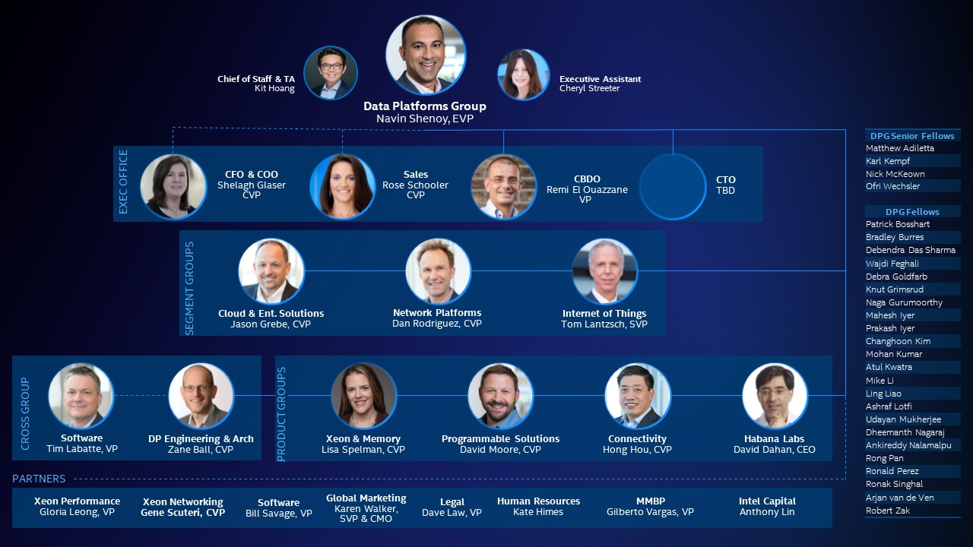
dpg.intel.com

Slide 10
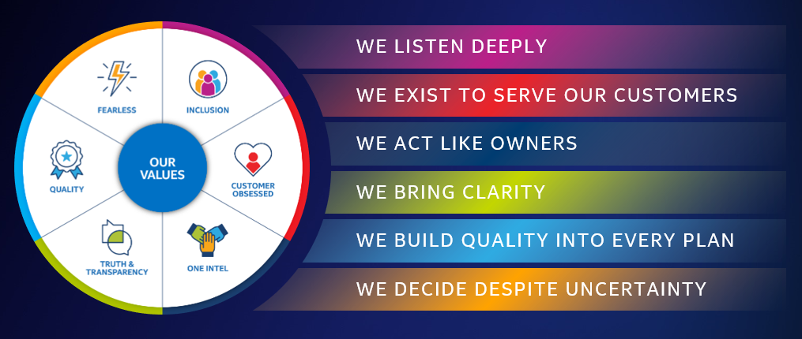
2020+ DPG Priorities
Accelerate Growth,
win in transition
Improve
product execution
Culture
Transformation
5G
AI
Edge
Cloud
Leadership Roadmap
Supply
Quality
Zone to Win
Customer NPS
World-class Talent

Slide 11
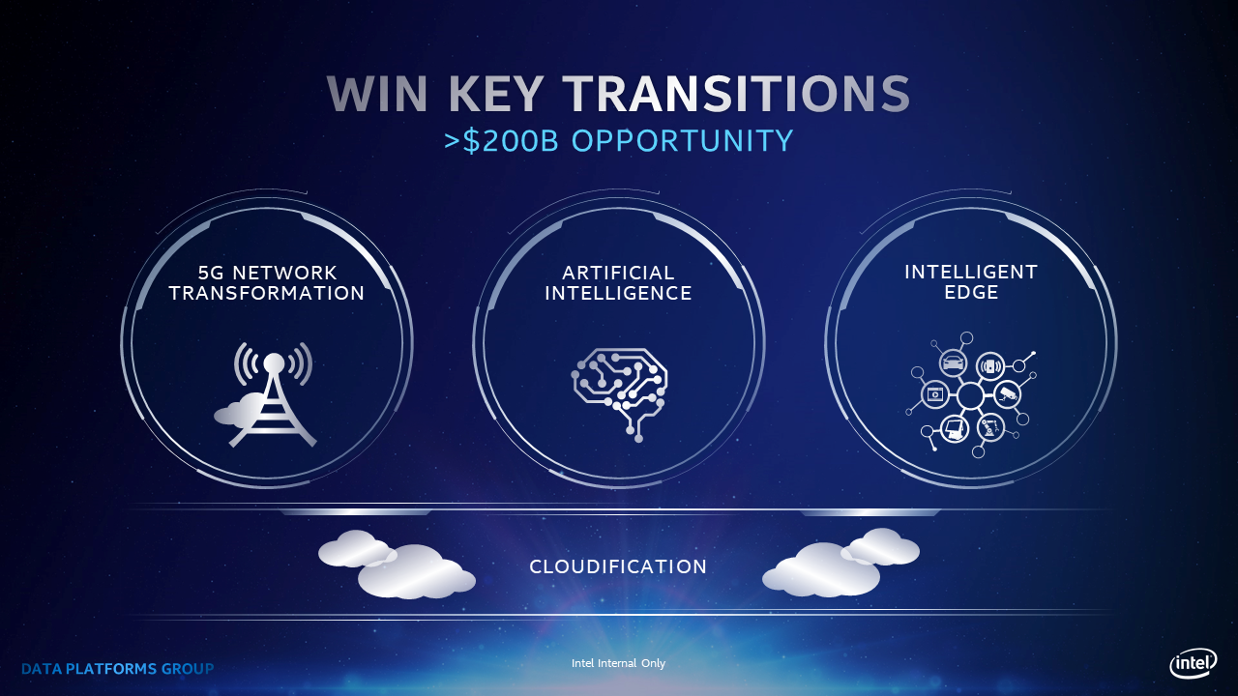

Slide 12
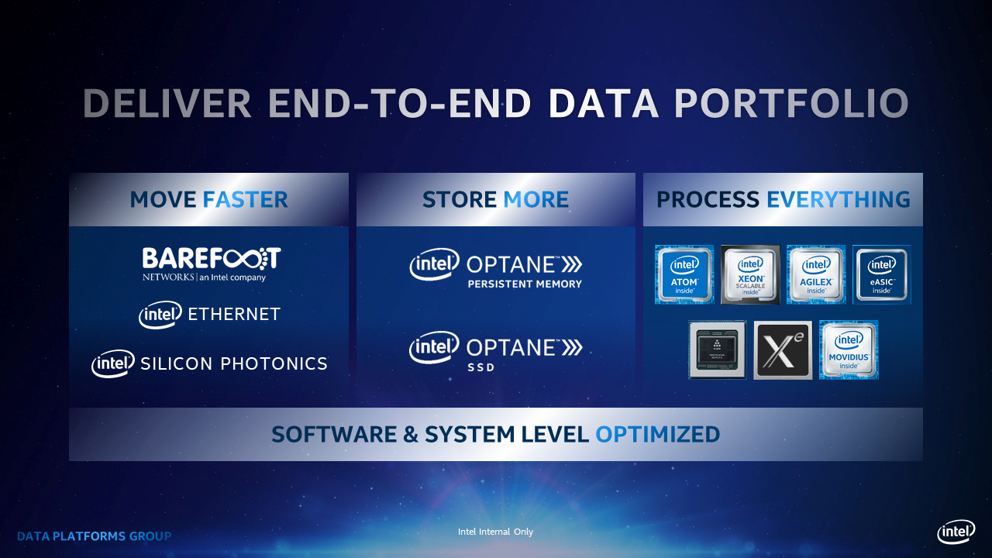

Slide 13
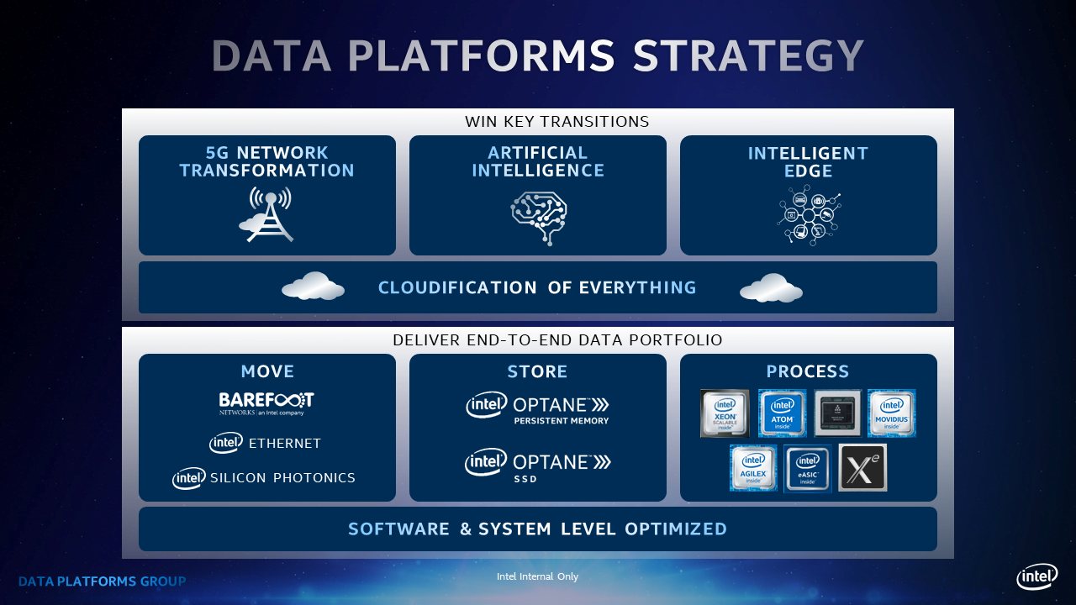

Slide 14
Announcement Activities
Date | Activity
October 20 - 23 | NSG Staff Leader-led Open Forums Leaders will hold forums for their organizations to discuss this announcement.
October 20 - 23 | Manager Readiness Training Sessions​ People managers will receive training on holding 1:1s with their employees to discuss the announcement and employees’ alignment to the transition. ​
October 26 | Employee Alignment Letters Employees will receive a letter via email with the future business group they align to: NPSG, NAND-DTM, or Optane Group.
October 26 | Email for Managers with the NSG Transition Employee Alignment File Managers will receive an email with a link and access instructions to the NSG Transition Employee Alignment file in order to review the alignment of their impacted employees.
October 26 | All Hands by Future Business Group Leaders aligned to NPSG, NAND-DTM, or Optane Group will hold separate forums for employees aligned to their organizations to discuss the transition and answer questions.
October 26 – November 6 | Manager/Employee 1:1s Managers will schedule time to meet with employees to discuss alignment letters and answer questions.
Notes:
We have a number of activities planned to support the announcement of the transaction, including NSG Staff leader-led open forums, manager/employee 1:1s, and All Hands sessions for each future business group.
One item I want to draw your attention to is the employee alignment letters.
On October 26, employees (whether directly aligned to NSG or in a support group such as SMG, HR, IT, GSC, or others) will receive a letter via email with details on how they will align to the transaction. This letter will outline their future business group, and, if they are aligned to a business group that will transition to SK hynix, which phase of the transaction they align to—Phase one (expected to close in late 2021) or Phase two (expected to close in March 2025). After these letters are delivered, managers will setup 1:1s with employees to review their alignment and answer questions.

Slide 15
Top 5 Anticipated Questions
Please review the Employee FAQ in entirety; the following are key FAQs to be clear on:
1. How do I know what business group I will align to?
On October 26, whether you align directly to NSG or provide support from a functional business group such as SMG, HR, IT, GSC or others, you will receive a notification letter via email with details on your alignment to the transaction. This letter will outline your future business group – NAND Products and Solutions Group (NPSG), NAND Design, Technology and Manufacturing Group (NAND-DTM), or Optane Group. If you are aligned to a business group that will transition to SK hynix, your letter will also include the phase of the transaction you are aligned to; phase one (expected to close in late 2021) or phase two (expected to close in March 2025). After the letters are delivered, your manager will hold a 1:1 with you to review your business group alignment and answer questions.
2. What factors were considered in my alignment?
An extensive review was completed by NSG staff and function GMs for all alignment decisions. Leaders considered many variables when assigning alignment, including current role, responsibilities, skills, experiences, and the work being performed by each employee.
3. Are my roles and responsibilities changing with this announcement?
At the present time, we remain Intel employees and our deliverables and customer commitments remain unchanged, so your roles and responsibilities do not change.
4. When will we transition to the new business groups (NPSG, NAND-DTM, and Optane Group) and how will this process work?
We plan to establish the new organization structures as quickly as possible (target is by January 2021). We plan to evolve the daily work and organizational design process at a rate that makes sense for the organization to ensure we maintain our customer commitments and minimize disruption as much as possible.
5. If I am aligned to a business group that will transition to SK hynix, will my cash compensation, commission plans, and benefits change after transitioning to SK hynix?
Details of SK hynix’s compensation and benefits offerings will be shared with individuals aligned to a business group that will transition to SK hynix at a future date yet to be determined. SK hynix has recognized that it is in SK hynix’s interest that the compensation package that it offers you be comparable to your current Intel compensation package. Keep in mind we will go through a rewards process as Intel employees in Q1 2021, and SK hynix will want to incorporate those changes into their offers.
Notes:
We have an Employee FAQ document that will be made available to employees after Rob’s first All Hands session. These are the top five questions and answers from the document that will be top of mind for employees.
1. How do I know what business group I will align to?
On October 26, employees, whether they align directly to NSG or provide support from a functional business group such as SMG, HR, IT, GSC or others, will receive a notification letter via email with details on their alignment to the transition.
2. What factors were considered in my alignment?
These factors include current role, responsibilities, skills, experiences, and the work being performed by each employee.
3. Are my roles and responsibilities changing with this announcement?
At the present time, our deliverables and customer commitments remain unchanged, so employees' roles and responsibilities do not change.
4. When will we transition to the new business groups (NPSG, NAND-DTM, and Optane Group) and how will this process work?
We plan to establish the new organization structures as quickly as possible (target is by January 2021).
5. If I am aligned to a business group that will transition to SK hynix, will my cash compensation, commission plans, and benefits change after transitioning to SK hynix?
Details of SK hynix’s compensation and benefits offerings will be shared with individuals aligned to a business group that will transition to SK hynix at a future date yet to be determined.
Again, these are just a few of the questions that we anticipate will be top of mind for employees. Please review the Employee FAQ document in its entirety to make yourself familiar with the content.

Slide 16
Employee Alignment Appeal Process
Employees may or may not be satisfied with their alignment to the transition, and can appeal their alignment by:
Meeting with their manager to discuss their rationale for an appeal
Submitting an appeal request via a form that will be made available on the NSG Transition Hub after alignment notifications are distributed.
Note: There may be employees who are not aligned to the transition but think they should be. Managers can reach out to NSG.Transition@intel.com for such cases.
Notes:
Employees may or may not be satisfied with their alignment to the transaction. We’ve developed an appeal process for those who believe their alignment should be revisited.
We ask that employees meet with their manager 1:1 to share their rationale and then submit an appeal request via a SharePoint form that will be made available on the NSG Transition Hub, a one-stop-shop for information related to the transition. From there, HR, NSG staff, an NSG governing body, and SK hynix will work to accept or reject the appeal.
If you have an employee who is not aligned to the transition but would like to be, you can reach out to the NSG.Transition@intel.com mailbox.
More detail on the appeal process is available in the backup of this deck.

Slide 17
Hiring Aligned Employees
Employees aligned to NPSG and NAND-DTM are not eligible for internal hiring opportunities out of their aligned business group, without GM approval.
Optane employees can apply to other jobs at Intel consistent with all other Intel employees.
  Optane employee transfers to NPSG and NAND-DTM will require Optane GM approval.
External job postings for open positions in NPSG and NAND-DTM will reflect that roles will convey to SK hynix at deal Close (pending regulatory approval of deal).
In general, NPSG and NAND-DTM employees that voluntarily terminate will not be rehire eligible for a period of one year.
Notes:
We believe that every employee is necessary for the success of the three future business groups, whether transitioning to SK hynix or staying with Intel. To ensure the success of the deal, a full freeze on internal people movement is in place for all employees through October 26 at which point you will learn more about your future business group alignment. After that, internal people movement restrictions are based on the future business group an employee aligns to.
At a high level, restrictions include:
NPSG employees: 1) Employees may apply and move to a new role within NPSG; 2) Employees may not move to a role outside of NPSG without GM approval; and 3) Employees may not apply to a role within NAND-DTM.
NAND-DTM employees: 1) Employees may apply and move to a new role within NAND-DTM; 2) Employees may not move to a role outside of NAND-DTM without GM approval; and 3) Employees may not apply to a role within NPSG.
Optane Group employees: The process to apply for internal open positions remains the same as normal, and employees may apply for another job at any time. However, please note that moving into a role within NPSG or NAND-DTM will require Optane Group GM approval.
Other restrictions apply to external hiring, rehire eligibility, org changes, and involuntary terminations. More details on internal people movement restrictions are included in the backup of this deck.

Slide 18
Our Commitment
We are committed to treating every employee with fairness and dignity throughout this transition
Transition updates will be shared regularly with employees
For more information and questions, employees have the following resources:
  NSG Transition Hub (to go live following announce)
  Mailbox for questions: NSG.Transition@intel.com
Notes:
Our commitment to Truth & Transparency:
We are committed to treating every employee with fairness and dignity throughout this transition, and we will share updates as quickly as information becomes available.
We are working with SK hynix on the transition details and will share updates once they are available.

Slide 19
Rules of the Road
Until the transaction closes, it is business as usual – continue to focus on the work and delivering on our customer commitments
Please be mindful that for legal and other reasons, both parties must continue to operate as two independent companies. ​
Information regarding the transaction, including transition details and associated timelines, must be kept strictly confidential
  Do not disclose transition information to external third parties
  Do not discuss the transaction in public places or on social media
  Do not engage with the media – refer all press/media inquiries to Stephanie Matthew, Intel PR
  You can refer customers and partners to the public announcement in our newsroom
Notes:
As mentioned, the deal with SK hynix is made up of two distinct “closes”, one in “late 2021” due to regulatory approvals in 3 countries (US, Korea, and China), and the second, and final closing in March 2025.
Until the transaction closes, it will be business as usual. It is critical to continue focusing on the work and delivering on our customer commitments until the deal closes.
Please be mindful that both parties must continue to operate as two independent companies. ​
Please also keep in mind that transition details and associated timelines are strictly confidential.
Do not share this information with third parties and be cautious about what you say in public places and on social media.
If you receive any inquiries from the press or media, contact Stephanie Matthew in Public Relations.
You can refer customers and partners to the public announcement in our newsroom and inform them that we are operating on a “business as usual basis”. For now, we ask that you please allow our dedicated team, managed by Laura Crone, NSG Sales and Marketing, to alert customers, partners and relevant stakeholders.

Slide 20
Questions?
Notes:
Internal People Movement:
A freeze on internal people movement is in place for all employees through October 26. After that, internal people movement restrictions are based on the future business group an employee aligns to.
NPSG employees: 1) Employees may apply and move to a new role within NPSG; 2) Employees may not move to a role outside of NPSG without GM approval; and 3) Employees may not apply to a role within NAND-DTM.
NAND-DTM employees: 1) Employees may apply and move to a new role within NAND-DTM; 2) Employees may not move to a role outside of NAND-DTM without GM approval; and 3) Employees may not apply to a role within NPSG.
Optane Group employees: The process to apply for internal open positions remains the same as normal, and employees may apply for another job at any time. However, please note that moving into a role within NPSG or NAND-DTM will require Optane Group GM approval.
Factors Considered re: Alignment Decisions:
An extensive review was completed by NSG staff and function GMs for all alignment decisions. Leaders considered many variables when assigning alignment, including current role, responsibilities, skills, experiences, and the work being performed by each employee.
Alignment Appeal Process:
Employees may or may not be satisfied with their alignment to the transaction. We’ve developed an appeal process for those who believe their alignment should be revisited.
We ask that employees meet with their manager 1:1 to share their rationale and then submit an appeal request via a SharePoint form that will be made available on the NSG Transition Hub. From there, HR, NSG staff, an NSG governing body, and SK hynix will work to accept or reject the appeal.
Roles and Responsibilities Following the Announcement:
At the present time, we remain Intel employees and our deliverables and customer commitments remain unchanged, so your roles and responsibilities do not change.
Timing of Transitioning to New Business Groups:
We plan to establish the new organization structures as quickly as possible (target is by January 2021). We plan to evolve the daily work and organizational design process at a rate that makes sense for the organization to ensure we maintain our customer commitments and minimize disruption as much as possible.
Compensation and Benefits after Transitioning to SK hynix:
Details of SK hynix’s compensation and benefits offerings will be shared with individuals aligned to a business group that will transition to SK hynix at a future date yet to be determined. SK hynix has recognized that it is in SK hynix’s interest that the compensation package that it offers you be comparable to your current Intel compensation package. Keep in mind we will go through a rewards process as Intel employees in Q1 2021, and SK hynix will want to incorporate those changes into their offers.
Please note that you are still an Intel employee with your Intel compensation and benefits.
Offer Process:
SK hynix owns the offer process; therefore, we cannot speak to the details of this. At this point, we ask that you be patient as we work with SK hynix to get you that information as quickly as possible.
Workers Councils (Germany, Singapore, Poland, etc.):
We will be engaging with the Works Councils in relation to this. If you have any questions on this, please reach out to your local Works Council members.
Compensation Equivalency
We expect SK hynix to provide a compensation package comparable to Intel’s; More detail will be shared at a future date yet to be determined.

Slide 22
Employee Alignment Appeal Process
Proposed process to manage employee appeal requests that may arise post distribution of alignment letters
Note: There will be a governing body consisting of NAND-DTM GM, NPSG GM, Optane GM, HR, and Legal that will provide final sign off to all alignment changes.
APPEAL PROCESS
Employee feels alignment is incorrect
Employee raises concern and rationale to manager and then employee enters appeal request in SharePoint form, available on the Transition Hub
HR Talent Lead pulls weekly report of appeals and provides to NSG staff member for disposition
NSG staff member determines disposition and sends report and disposition back to the HR Talent Lead
  4a. If NSG staff member believes alignment is correct, the decision stands and NSG staff communicates decision back to employee (HR Talent Lead to provide standard template for communications)
  Note: No legal review required and communication to employee can proceed
  4b. If the NSG Staff believes the alignment is incorrect, the HR Talent Lead reviews with HR Legal to determine if there is anything in the MPA that precludes this change
5. NSG Governing Body review occurs for final determination (weekly meeting occurrence)
  5a. If NSG Governing Body supports the disposition change request, HR Legal shares with SK hynix for review/awareness where required by the MPA
  5b. SK hynix provides feedback on the determination; if SK hynix disagrees with change in disposition recommendation, feedback is shared with NSG Governing Body for determination on next steps
  5c. HR Legal provides final determination to HR Talent Lead; HR Talent Lead provides approval to NSG staff with standard template to communicate; NSG Staff to communicate to employee
  Note: Legal review required where a change in disposition occurs per above process steps
7. If future state business group alignment is agreed to change, HR Talent Lead provides official update with the HR Census owner to update the census (and/or Workday as needed)
Note: There may be employees who are not aligned to the transition but believe they should be. Managers can contact NSG.Transition@intel.com for such cases.
Notes:
**Three GM governing body have the authority to change/evolve process as appropriate
Employees may or may not be satisfied with their alignment to the transaction. We’ve developed an appeal process for those who believe their alignment should be revisited.
We ask that employees meet with their manager 1:1 to share their rationale and then submit an appeal request via a SharePoint form that will be made available on the NSG Transition Hub. From there, HR, NSG staff, an NSG governing body, and SK hynix will work to accept or reject the appeal.

Slide 23
People Movement
Freeze on internal people movement through October 26. After that, the following applies:
Group | Deal Sign (October 19) – First Close (Late 2021) | First Close (Late 2021) – Second Close (March 2025)
NAND Products and Solutions Group (NPSG) | Internal Hires: No internal hires or transfers out of or into NPSG or NAND-DTM, without NPSG or NAND-DTM GM approval¹ Employees aligned to NPSG cannot be hired to fill an open position in NAND-DTM and employees aligned with NAND-DTM cannot be hired to fill an open position in NPSG Employees aligned to NPSG can be hired to fill open positions in NPSG and Intel employees aligned to NAND-DTM can be hired to fill open positions in NAND-DTM Note: Employees outside of NPSG and NAND-DTM can apply to fill NPSG and NAND-DTM open positions External Hiring: Job postings for open positions in NPSG and NAND-DTM will reflect that roles will convey to SK hynix at Deal Close (pending regulatory approval of deal)¹ Job postings reflect that NPSG open roles will convey to SK hynix upon First Close Job postings reflect that NAND-DTM open roles will convey to SK hynix upon Second Close Rehire Eligibility: NPSG and NAND-DTM employees that voluntarily terminate will not be rehire eligible at Intel for a period of one year Org Changes: NPSG and NAND-DTM GMs to provide final approval for NPSG and NAND-DTM org changes, respectively, that impact business execution Involuntary Terms: Under the Master Purchase Agreement, no involuntary terminations permitted except for cause (no Corporate People Movement action) | Internal / External Hiring: No coordination required between SK hynix (NPSG) and Intel for internal or external NPSG hiring needs If an Intel employee applies to a SK hynix NPSG role they will be treated like all other external candidates If a SK hynix NPSG employee applies to an Intel role they will be treated like all other external candidates Under the Master Purchase Agreement, Intel cannot directly solicit NPSG employees to return to Intel for one-year period following First Close. Applications in response to general advertisement during the one-year period would not violate this restriction
NAND Design, Technology and Manufacturing Group (NAND-DTM) |  | Internal Hires: No internal hires or transfers out of NAND-DTM into Intel, without NAND-DTM GM approval² Note: Intel employees outside of NAND-DTM can apply to fill NAND-DTM open positions Note: Business plan and spending budget for NAND-DTM approved by customer planning committee External Hiring: Intel and SK hynix align on critical roles to be hired/filled¹ Under the Master Purchase Agreement, Intel cannot directly solicit NAND-DTM employees to return to Intel for one-year period following Second Close. Applications in response to general advertisement during the one-year period would not violate this restriction Rehire Eligibility: NAND-DTM employees that voluntarily terminate will not be rehire eligible at Intel for a period of one year Involuntary Terms: Under the Master Purchase Agreement, no involuntary terminations permitted except for cause (no Corporate People Movement action)
Optane | Internal Hires: In general, Optane employees can apply to other jobs at Intel consistent with all other Intel employees. Due to the unique relationship of NPSG and NAND-DTM, Optane employee transfers to either of those business units (NPSG or NAND-DTM) will require Optane GM approval. Org Changes: Optane GM and future aligned Intel BU leader (e.g., group Optane is integrated within in Intel) provide final approval for org changes that impact business strategy execution | No coordination required between SK hynix and Intel for any processes
Notes:
We believe that every employee is necessary for the success of the three future business groups, whether transitioning to SK hynix or staying with Intel. To ensure the success of the deal, a full freeze on internal people movement is in place for all employees through October 26 at which point you will learn more about your future business group alignment. After that, internal people movement restrictions are based on the future business group an employee aligns to.
At a high level, restrictions include:
NPSG employees: 1) Employees may apply and move to a new role within NPSG; 2) Employees may not move to a role outside of NPSG without GM approval; and 3) Employees may not apply to a role within NAND-DTM.
NAND-DTM employees: 1) Employees may apply and move to a new role within NAND-DTM; 2) Employees may not move to a role outside of NAND-DTM without GM approval; and 3) Employees may not apply to a role within NPSG.
Optane Group employees: The process to apply for internal open positions remains the same as normal, and employees may apply for another job at any time. However, please note that moving into a role within NPSG or NAND-DTM will require Optane Group GM approval.
Other restrictions apply to external hiring, rehire eligibility, org changes, and involuntary terminations.
¹All decisions made must be in line with the overall cost basis of the business, which needs to be met when NPSG transfers at First Close and when NAND-DTM transfers at Second Close
²NAND-DTM leadership reserves the right to modify the process to ensure that the terms of the deal are met and that a competitive business is transferred upon Second Close

Slide 24
Technology Development
Optane TD ramped and operational in New Mexico Fab 11X
  S26A Qualified
  ATF CMOS and Array in development, Product DBR Q4
  Material pathfinding and Bow Falls definition underway
  Fully staffed, fully equipped and ready for Optane’s future!

Slide 25
OPTANE MANUFACTURING
We currently have plenty of fab manufacturing capacity
  Micron WSA for the Lehi, Utah fab continues through 2021 with ability to extend through 2022 (and beyond) for 10s/20s
  F11X in Rio Rancho, NM currently does our TD and some production wafer output. It will provide ATF CMOS/Array capacity. Also have the ability to expand beyond the 100K Sq Ft cleanroom space today to something larger if needed.
BE Assembly/Test/SSD/DIMMs
  Continue to have PTI for assembly, test, and SSD manufacturing
  Continue to use Kingston for DIMM manufacturing
We have time to secure additional HVM fab capacity when demand signal increases.
Notes:
We currently have plenty of fab manufacturing capacity
Micron WSA for the Lehi, Utah continues through 2021 with ability to extend through 2022 (and beyond) for 10s/20s
F11X in Rio Rancho, NM currently does our TD and some production wafer output. It will provide ATF CMOS/Array capacity. Also have the ability to expand beyond the 100K Sq Ft cleanroom space today to something larger if needed.
BE Assembly/Test/SSD/DIMMs
Continue to have PTI for assembly, test, and SSD manufacturing
Continue to use Kingston for DIMM manufacturing
We have time to secure additional HVM fab capacity when demand signal increases.

Slide 26
Optane Development
S26A/S25D Manufacturing
  All Micron F2 WSA contractual agreements met for product qualification and ramp
    Team delivering solutions keeping the ramp out of the critical path for committed shipment levels
  F11x O264 (aka S26A) PG4 qualified, tracking to PG1 mid Q4’20
  Additional opportunities to deliver performance enhanced S25D being investigated
    Opens up a better performing CPS-R DCPMM product
Atlantic Falls DBR on track to EOY’20
  Pre-Si development activities in full swing to intercept 1st Si
  Startup strategy forming to report PG1 yield/health trending at 1st Si
Bow Falls TO planned 1H’22
  Conceptual design architecture WIP, early design pathfinding work through Q1/Q2’21

