Slide 1
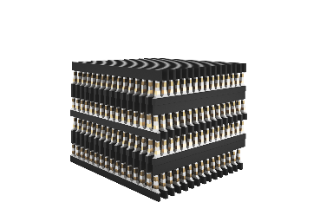
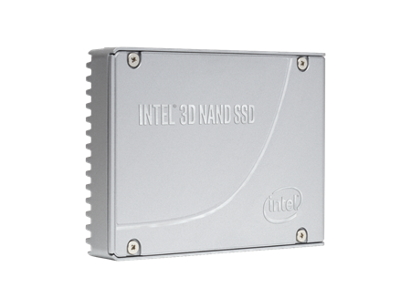
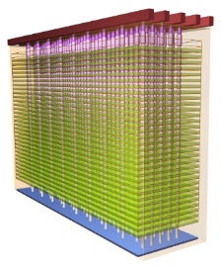
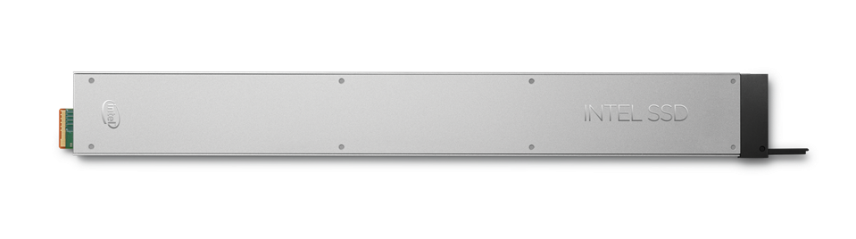

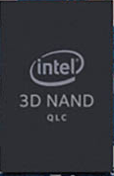

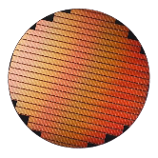
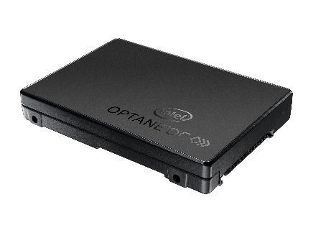

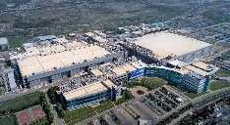




THE DEAL STRUCTURE
Optane Group
NAND Products &
Solutions Group
NAND Design, Technology & Manufacturing Group
GM: Rob Crooke (Acting)
GM: Rob Crooke
GM: Stephen Keeney
NAND SSD
Creation
NAND TD
TD, Mfg, DCPMM,
SSD (DC & Client Hybrid), Sales/Marketing
NAND Sales
& Marketing
NAND Design
NAND Biz Ops
& Planning
Fab Operations
to Wafer
Fab & Assets
ENSURING ANY MICRON & INTEL/MICRON JOINTLY DEVELOPED IP IS PROTECTED
CONTROLLED
LATE 2021
MARCH 2025
Notes:
Note: Optane DC SSD refers to Optane SSD only. NAND SSD goes with NPSG.
The Deal Structure (Talking Points for Leaders & Managers)
The deal with SK Hynix is made up of two distinct “closes”, one expected to close in “late 2021” due to regulatory approvals in 3 countries (US, Korea, and China), and the second, and final closing in March 2025.
There are 3 “Business Groups” that will be formed:
Optane Group (acting leader Rob Crooke)
Intel will retain its distinct Intel® OptaneTM business, and intends to continue investing, developing and scaling the Optane business. This includes existing Technology Development in Rio Rancho, NM, future manufacturing of Optane wafers, component development, Data Center Persistent Memory products (currently in DPG), Data Center SSD and Client Hybrid products (both currently in NSG), as well as sales and marketing for Optane products. The General Manager will be Rob Crooke, acting, until such time as a new GM is named.
NAND Design, Technology & Manufacturing Group (NAND-DTM) (led by Stephen Keeney)
After the first transaction closes in Late 2021, SK Hynix will own the Fab and Assets of the Dalian Memory Technology and Manufacturing Facility and provide the related working capital and expenditures. Intel will continue to manufacture NAND wafers at DMTM, retaining manufacturing-related IP until March 2025, to ensure that Intel/Micron jointly developed IP is protected. Approximately 4500 Intel employees will remain in the “Operating Company”, led by Stephen Keeney, until the expected transfer of that operation to SK Hynix in March 2025.
NAND Products & Solutions Group (NPSG) (led by Rob Crooke)
Upon closure of the first transaction in late 2021, SK Hynix will receive Intel’s NAND memory and storage business. This will include NAND SSD, NAND Component and wafer business, and the Dalian Memory Technology and Manufacturing Facility in Dalian, China. Intel will continue to manufacture NAND wafers until March 2025 to ensure Intel/Micron jointly developed IP is protected. At time of close, the transaction includes the transfer of employees in the 3D NAND memory and storage business, majority based in California.

Slide 2
Intel
NSG
DPG
CCG
Technology
Manufacturing
Design: CPU,GPU
Self-Driving Car
Sales & Marketing
Merger & Acquisition
HR, Legal, PR
Optane
Eng.
3D NAND
Eng/Mfg
Xeon
Memory
Accelerator
Photonic
AI
Biz
Solution
&
Shared IP
Biz
Solution
&
Shared IP

Slide 3
Intel
IOG
DPG
CCG
Technology
Manufacturing
Design: CPU,GPU
Self-Driving Car
Sales & Marketing
Merger & Acquisition
HR, Legal, PR
Optane
Eng.
Xeon
Memory
Accelerator
Photonic
AI
Biz
Solution
Biz
Solution
&
Shared IP

Slide 4
Collateral Team Functions Divided up into 3 Broad Areas
OPC & TO Todd Lukanc (Ted Taylor’s org) | Device Engineering Sanjay Rangan (Chuck Dennison’s Org) | PF / Modeling Derchang Kau (Al Fazio’s Org)
OPC | Design Rule | TCAD
Generator/DFM | Collateral Def’n | Compact Modeling
Scribe Integration | CMOS / Proc-Prod Interaction
Tape Out | Test Chip
Mask Engineering | Layout
Project Mgmt | Parametric Test
The Org changes will take place in January. However, the 1st priority is to deliver on all commitments for both Optane & NAND & then hiring/training so that both orgs can stand on its own as soon as possible:
Green line items ➔ Integrate into IOG Jan, ‘21 (No NAND-Optane resource conflicts expected)
White line items ➔ Full separation of tasks & deliverables requires hiring/training critical staff, next check-point at end-of-April, ’21 (and adjust plan if needed)

Slide 6
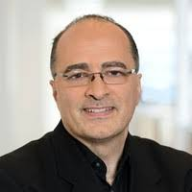
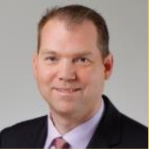
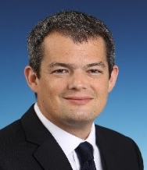

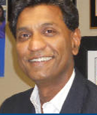


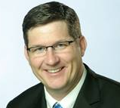

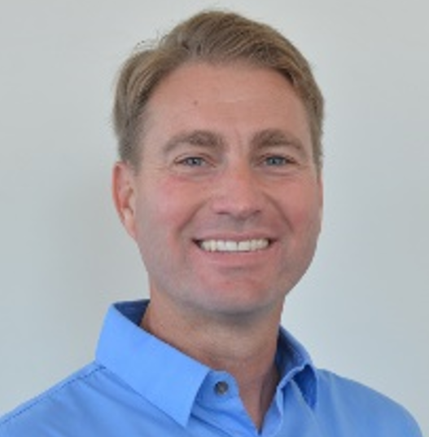
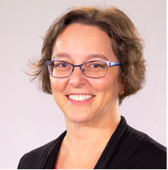
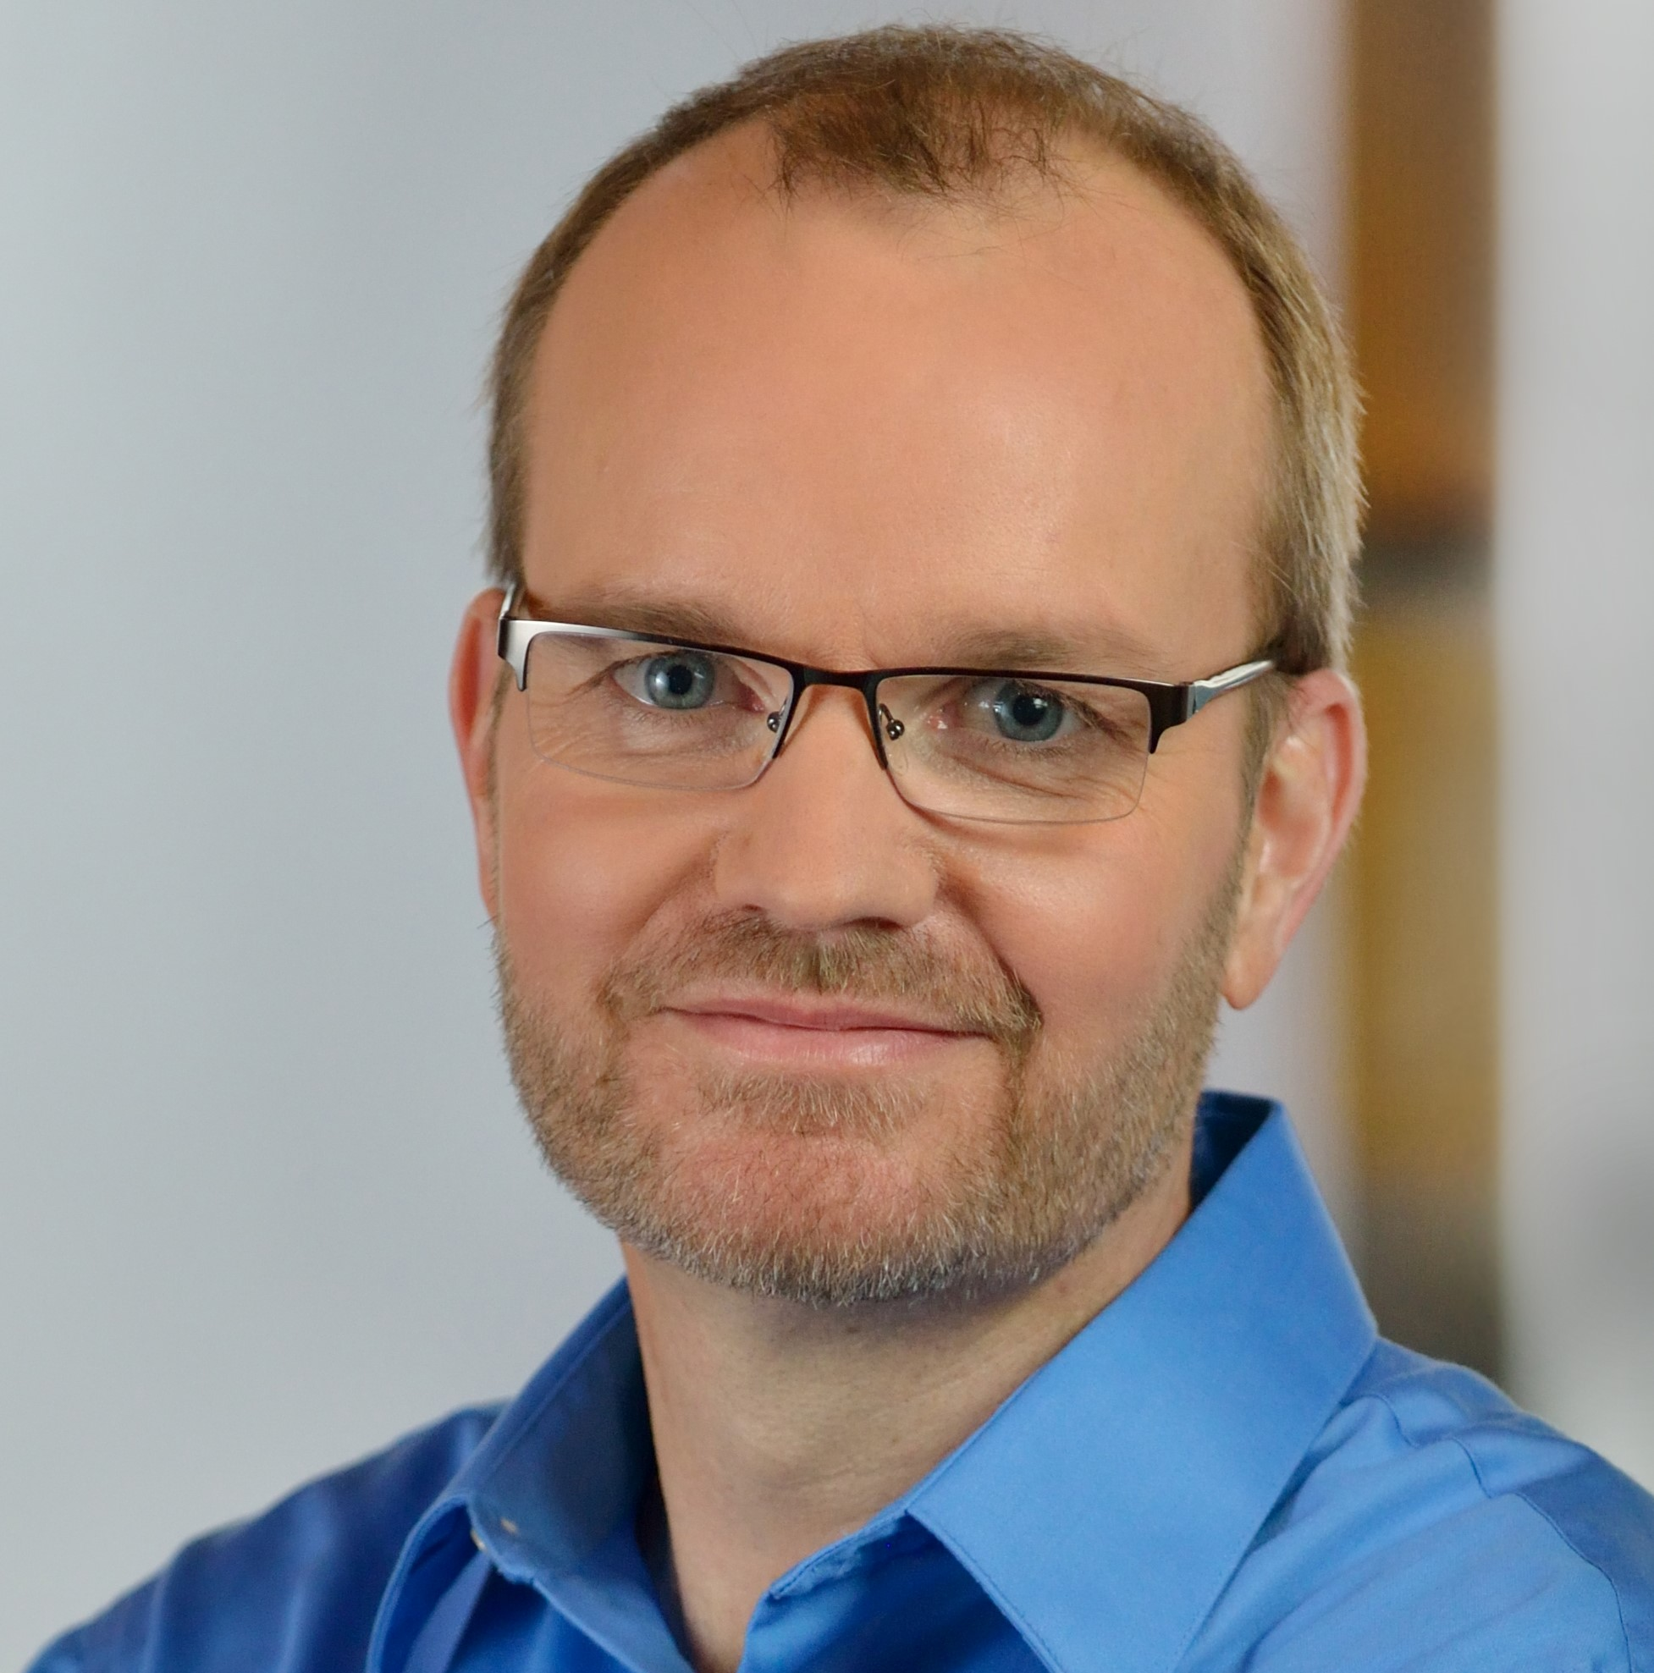
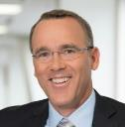
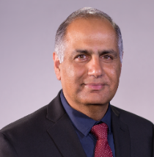
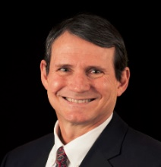
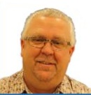
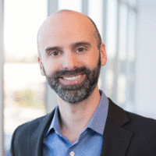
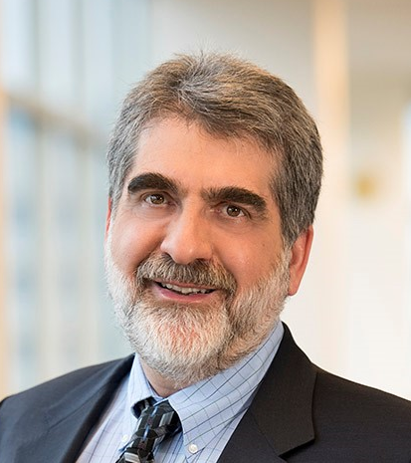

OPTANE GROUP
Alper Ilkbahar
VP, GM
(Acting)
PRODUCT DIVISIONS
CROSS GROUP FUNCTIONS
Tim Noonan
Operations
Jason Fedder
Sales & Marketing
(Acting)
Ivan Rosinol
Finance
Venkat Vasudevan
Quality & Reliability
Engineering
Genevieve Long
HR
TBD
Legal
Alper Ilkbahar, VP/GM
DPG Memory & Storage
SSD CORE ENGINEERING
David Tuhy, VP/GM
DC Optane SSD (DOD)
Tom Macdonald, VP
Storage SOC
Daniel Elmhurst, VP
Storage Firmware
(Acting)
Deb Stromberg
Val/HW/Int
(Acting)
Daniel Elmhurst, VP
Storage Tech
Frank Hady, Fellow
Chief Architect
Rick Coulson, Sr. Fellow
Technology Acceleration
MANUFACTURING, TECHNOLOGY AND COMPONENT DEVELOPMENT
Sanjay Talreja, VP/GM
Client Hybrid SSD
(Acting)
Bert Blaha, VP
Manufacturing
Ed Fozo
Media Engineering
(Acting)
Ted Taylor, VP
NVM Process
Development
Al Fazio, Sr. Fellow
Advanced Pathfinding

Slide 7
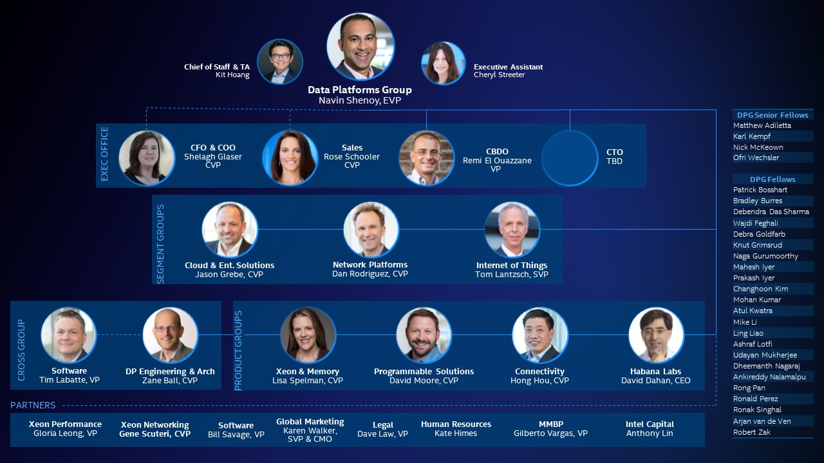
dpg.intel.com

Slide 8
Pathfinding/TCAD/Compact modeling team mission
 | TD Roadmap |  |  | Beyond Roadmap
Competency | S26 | P1241/ATF | P1250/BWF | CMOS | Cell/Array | Architecture
CMOS & Interconnect
Memory subsystem
Material synthesis & Physics
Cell & Construct
Array Media management
TCAD Model
Compact Model
Product Orientation with engineering core competency
Matrix integration for seamless collaboration
Leveraging technical adjacency for maximum results

