Slide 1
Org Design & Rewards Planning Update
Intel Optane Group
November 17, 2020
Ferris Partridge, Org Development Partner
Traci Young, Leadership Partner

Slide 2
Org Design – Focus thru EOY ‘20
Pre-Announcement:
L1 structure fully defined (top-level) + L2 structure ~80% defined
Direct & indirect NSG employees aligned to 1 of 3 entities (NPSG, NAND-DTM, or Optane)
Post-Announcement:
Focus → Quickly stabilize the environment & complete org/people transitions
Ensure every affected employee has clarity/certainty regarding their new manager, role, and team assignment prior to the new year
Define future state org structures (down to the lowest level → L3+) for each business group in readiness for transition
1/4/21: Transition to the new structure in WorkDay
2021+: Ongoing Org Design & Change Management to support transition to new operating model and drive org effectiveness

Slide 3
Org Design & System Change Timeline
Due Date | Actions
Dec 4 | All org structure & supervisory changes must be submitted to HR
Dec 11 | Final org structures and talent selection assessed by HR Legal
Dec 17 | Final org structures reviewed by GMs – Rob (NPSG & Optane); Stephen (NAND-DTM)
Dec 18 | Final census report submitted to Workday team
Jan 4 | Workday changes to reflect updated org structure & supervisory changes for direct NSG employees aligned to NPSG, NAND-DTM, and Optane Note: WorkDay effective date still TBD for indirect NSG employees in support functions (e.g. Sales, Finance, IT, HR, Legal, GSC, CQN)
Jan 4 | Workday changes to reflect updated cost centers for direct NSG employees aligned to NPSG, NAND-DTM, and Optane
Q2 ‘21 | Workday changes to reflect updated cost centers for indirect NSG employees aligned to support functions

Slide 4
NSG Rewards Planning Calendar
Date | Actions
Nov 9 – 20 | Rewards Planning – 2021 Manager Overview Training. A recording is available here. Please note, recording reflects Corporate calendar
Nov 20 | Deadline to provide BHR with employee change requests (job profiles, current organizational structure)
Nov 24 | Eligibility date for NSG Accelerated Rewards Planning: Employee job title, grade, pay, org structure frozen in Workday
Nov 29 | PeopleFluent (Rewards tool) opens
Dec 9 | PeopleFluent (Rewards tool) closes 12:00 PM PT
Jan 4 | PeopleFluent reopens with access to Rewards Statements; managers may begin delivering rewards decisions
TBD* | SK initial offer availability date
March 15 | Rewards effective date for non-exempt only. Blackout on job changes for non-exempt in U.S./CR ends. Managers must complete Rewards Conversations before this date.
April 1 | Rewards effective date. Blackout on job changes for exempt employees in U.S./CR ends. Managers must complete Rewards Conversations before this date.

Slide 5
NSG Gr10+ Talent Review
Objective: Align on promotions, socialize top talent for feedback
Structure: Each GM has 15 minutes to provide a brief overview of:
Promotions into Gr 10 (10%/45 EE) and Gr 11(3%/5 EE)
Staff-1 Top/Bottom Performers: what differentiates their performance, what's next in terms of career development
Prep Work:
Validate the list for your BU
Provide any updates to me by EOD Thursday 11/19

Slide 7
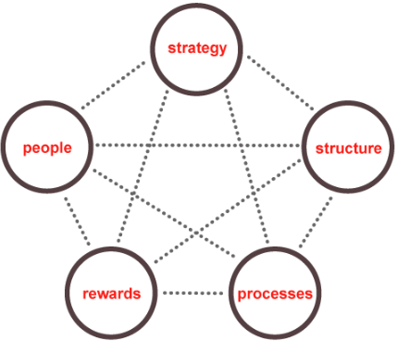
Org Design – Guiding Principles
Org Design Framework
Design an organization structure that supports a successful transition to the future state business/operating model.
Identify critical new roles needed to support the future state operating model or provide critical backfills for previous shared resources.
Drive a fair and transparent talent assessment and selection process based on skillsets, experience, career aspirations, performance history, etc.
Guidance: Post internal job req. if talent selection would result in a change to grade level, a shift from IC to Manager, or a significant change to job responsibilities (>50%)
Align talent selection decisions with site strategy and maintain continuity for customers (where possible).
Eliminate unnecessary layers and balance manager spans of control (generally recommended to be 6 to 10).

Slide 8
Pre-Announcement:
L1 structure defined (top-level)
L2 structure partially defined
Post-Announcement:
Focus: Quickly stabilize environment
Finalize/confirm L2 structure
Design L3+ org structures
Goal: Transition to new structure in WorkDay by 1/4/21
2021+: Ongoing OD & CTM to enable transition & drive org effectiveness
Org design framework Aligning strategy and org systems
Strategy
Org Capabilities
Organization
Diagnosis
INPUTS
People
Practices
Structure
Initial focus on structure
PROCESS
Org Design
Rewards
& Metrics
Processes
& Linkages
Change &
Transition Mgmt.
(CTM)
Behavior
OUTPUTS
Alignment = Effectiveness
Performance/
Results
Culture
Notes:
The STAR Model – Jay R. Galbraith
ALIGNMENT = EFFECTIVENESS
Organization PERFORMANCE and CULTURE are the result of employee behaviors, influenced by structure, processes, rewards, and people + leadership practices. The better aligned these elements are to the strategic direction of the organization, the more effectively the organization will perform and the healthier the culture will be.

Slide 9
Org Assessment & Design | The Star Model
STRATEGY What is the business trying to accomplish? What is the strategy to realize the objectives? What are the key elements of the strategy? How will we know when/if we achieve the strategy? Is the leadership team in alignment of the organization’s strategy?
STRUCTURE What is the work of your organization? Does the current structure help/hinder achieving your strategy? How are jobs/roles grouped and linked together to best drive the strategy? Are roles & responsibilities (including decision rights) clearly defined? How is the physical environment enabling the organization to achieve its strategy? (site strategy)
PROCESS How is work coordinated/integrated across work teams or groups? Do existing processes reinforce or get in the way of achieving the strategy? What are the mechanisms that allow the work to get done? (e.g. decision- making, staff meetings, communications, etc.). How does the work come in, get assigned, and get done? (workflow) How are your lateral connections helping/hindering getting the work done? How are hand-offs between organizations/roles functioning? How is knowledge and information shared across teams?
REWARDS How are employees being rewarded for achieving the strategy (goals & objectives)? (Consider: monetary and non-monetary motivators.) Are employees’ development plans aligned with organizational goals and objectives?
PEOPLE What are the core capabilities you need in your organization? Do you have the right capabilities and skills to deliver the business strategy? How would you assess the capability of the people in your organization? Do you have the right talent aligned to the critical capabilities? What people practices do you have in place currently? What development is available to grow your organization?
CAPABILITIES What do we need to be very good at to enable the strategy? What is the work required to enable the strategy? Which capabilities are most important?
19

Slide 10
Structures have two components Grouping and Linking
We tend to spend 90% of our energy on grouping but very little on linking… which is equally as (if not more) important!
Grouping
How jobs, functions, or work activities are differentiated or grouped
Optimizes information flow within the group but typically creates barriers with other groups
Linking
Mechanisms of integration used to coordinate and share information across groups (e.g. integrator roles, matrix structures, review committees, etc.)
Enables leadership to provide guidance and direction across the organization
Key Takeaway = Every org structure involves tradeoffs…
An optimal structure balances differentiation (through grouping) with integration (through linking)
Notes:
Linking involves the construction of devices connecting separate groups that have to coordinate their work. Regardless of the overall grouping patterns, groups within organizations must have some way to share and act upon essential information. Unlike grouping, which has a finite number of variables, linking mechanisms can assume a variety of forms, depending upon both the organizational setting and the availability of individuals suited to particular roles.
Examples:
Liaison roles: These linking mechanisms are generally taken by trusted and respected individuals, in addition to their normal duties.
Cross-unit groups: These devices can take the form of standing and ad hoc committees, and they can focus on processes, output, or customers or any combination of the three.
Integrator roles or departments: These mechanisms introduce general management functions into the linking process. Though people serving in integrator roles may not directly supervise the participants in a linking process, they are responsible for making sure the process works and that when necessary, those involved in the process stand by the decisions that are made.
Matrix structures: These arrangements involve linking through hierarchy, the most expensive, extreme, and difficult to manage of all the linking mechanisms. Nevertheless, the complexity of modern organizations, particularly those with geographically diverse operations have made matrix structures fairly common in today’s business environment.

Slide 11


How many direct reports? Reasons to increase/decrease the number of reports
Work of others
Standardized
Similar work
More experienced and independent
Clear strategy and owners across groups
MORE DIRECTS
How much time is the manager spending on their own work versus that of their directs?
Is the work standardized and formally structured?
What is the degree of similarity of work across directs?
How independent are the directs?
Is there excessive ambiguity across multiple orgs?
FEWER DIRECTS
Their own work
Irregular
Different work
More direction and coaching needed
Unclear strategy and misalignment across groups
There’s no such thing as the “right” number of direct reports
The optimal number of directs is based on business context & strategy
General guideline: 6-8 direct reports
Source: McKinsey & Company, 2017

Slide 12
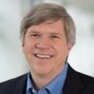
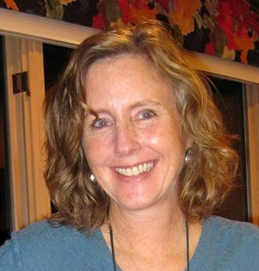

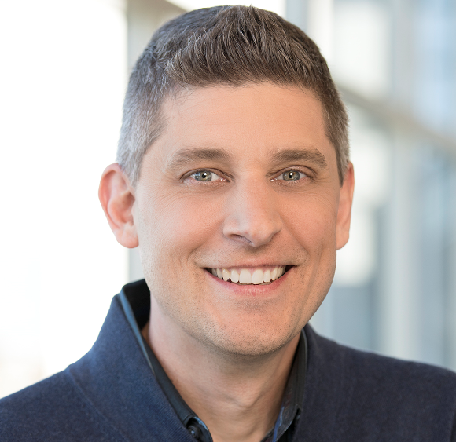
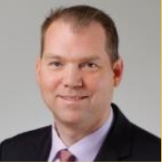
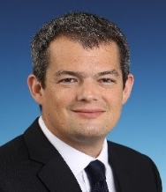

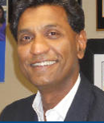


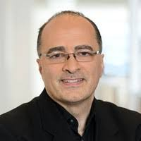
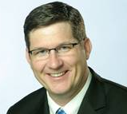

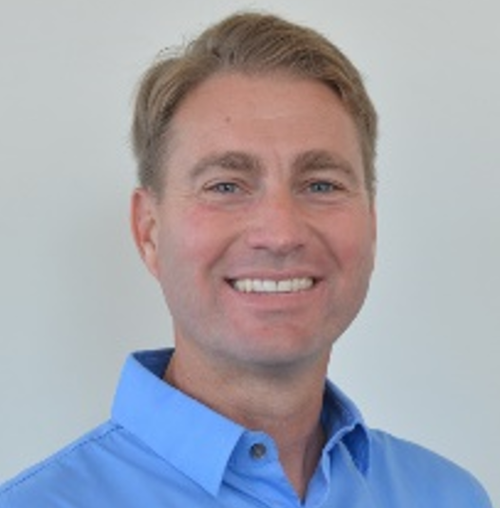
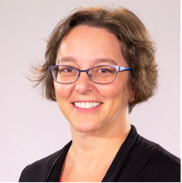
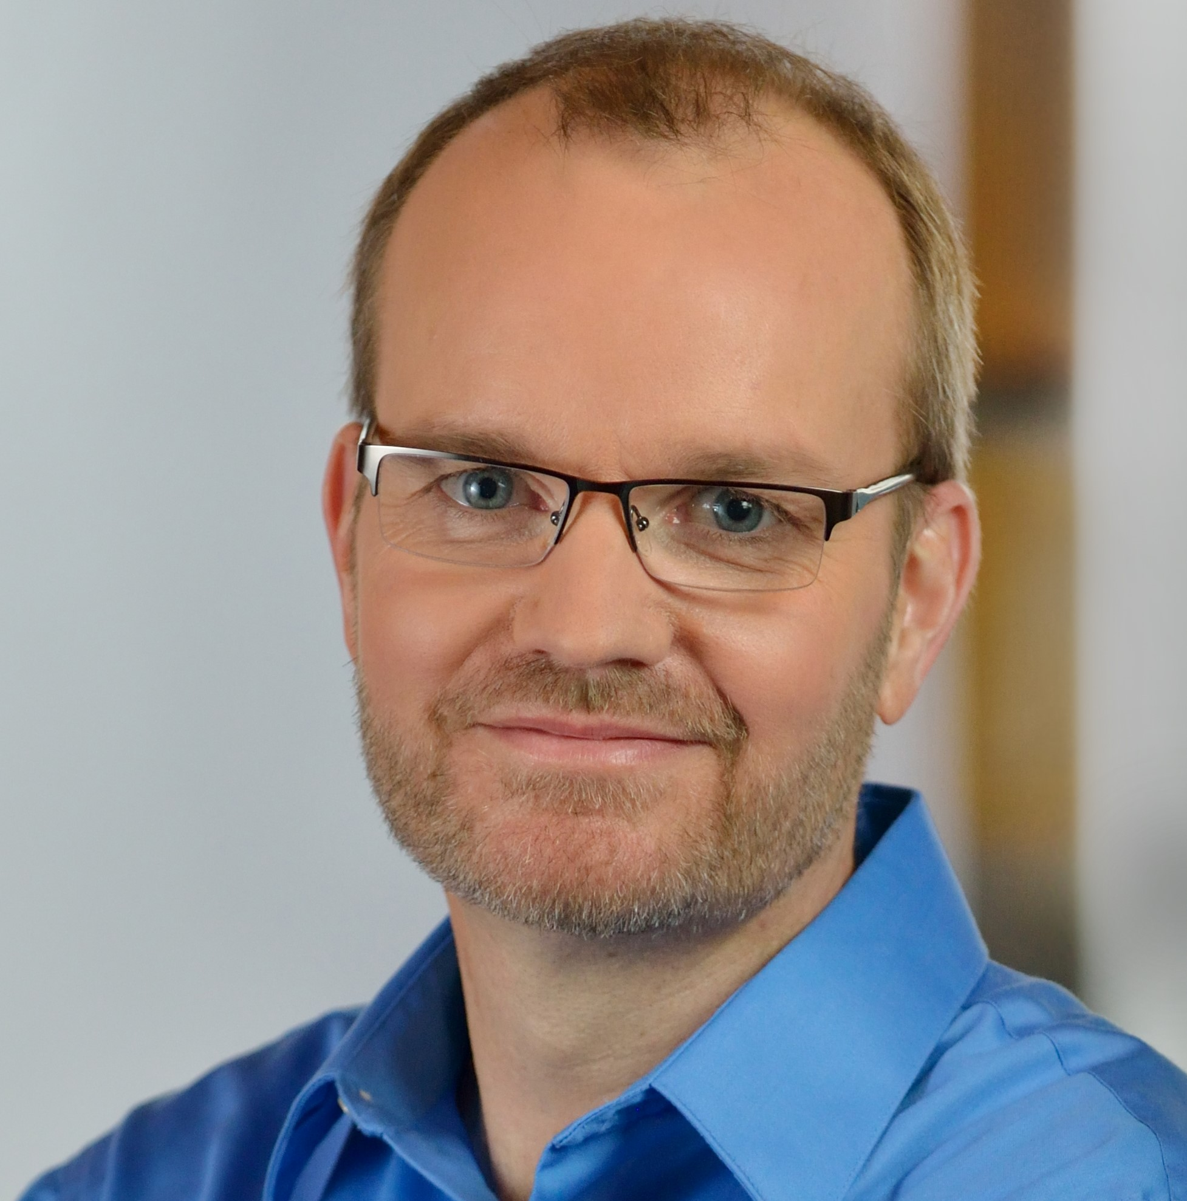
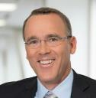
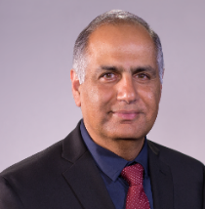
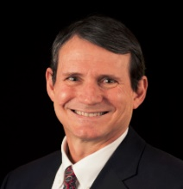
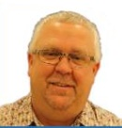
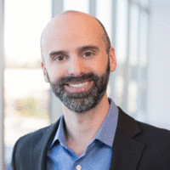
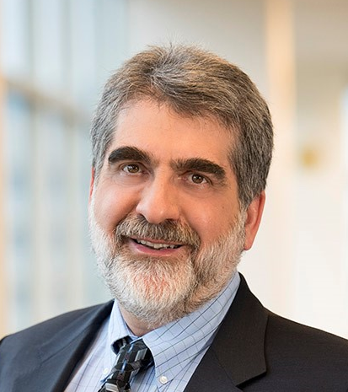

OPTANE GROUP
Rob Crooke
Senior VP, GM
(Acting)
EA: JENNIFER DAVIES
TA/COS: ERIK HAMMER
PRODUCT DIVISIONS
CROSS GROUP FUNCTIONS
Tim Noonan
Operations
Jason Fedder
Sales & Marketing
(Acting)
Ivan Rosinol
Finance
Venkat Vasudevan
Quality & Reliability
Engineering
Genevieve Long
HR
TBD
Legal
Alper Ilkbahar, VP/GM
DPG Memory & Storage
SSD CORE ENGINEERING
David Tuhy, VP/GM
DC Optane SSD (DOD)
Tom Macdonald, VP
Storage SOC
Daniel Elmhurst, VP
Storage Firmware
(Acting)
Deb Stromberg
Val/HW/Int
(Acting)
Daniel Elmhurst, VP
Storage Tech
Frank Hady, Fellow
Chief Architect
Rick Coulson, Sr. Fellow
Technology Acceleration
L1 = GM’s direct reports
L2 = Direct reports of L1 leaders
L3 = Direct reports of L2 leaders
MANUFACTURING, TECHNOLOGY AND COMPONENT DEVELOPMENT
Sanjay Talreja, VP/GM
Client Hybrid SSD
(Acting)
Bert Blaha, VP
Manufacturing
Ed Fozo
Media Engineering
(Acting)
Ted Taylor, VP
NVM Process
Development
Al Fazio, Sr. Fellow
Advanced Pathfinding

Slide 13

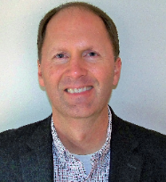
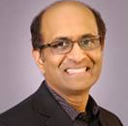
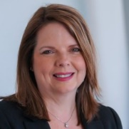
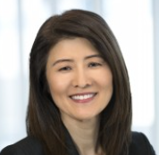
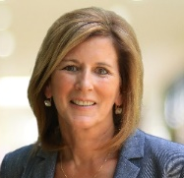
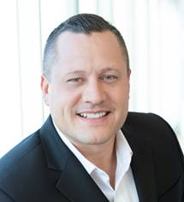


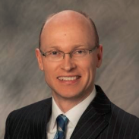
NAND PRODUCTS & SOLUTIONS GROUP
LATE 2021
Rob Crooke, SVP
GM
EA: JENNIFER DAVIES
TA/COS: ERIK HAMMER
David Dixon, VP
GM, Data Center
Sanjay Talreja, VP
GM, Client
Upendra Kulkarni, VP
Core Systems Engineering
Ellen Doller, VP
Operations
Chris Min, CVP
CFO
Laura Crone, VP
Sales & Marketing
Brian Fischer
HR
Steve Muller
Chief Legal Counsel
TBD
CIO
Stephen Keeney, VP
NAND Design, Technology & Manufacturing Group
L1 = GM’s direct reports
L2 = Direct reports of L1 leaders
L3 = Direct reports of L2 leaders

Slide 14
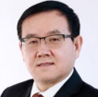

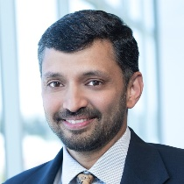
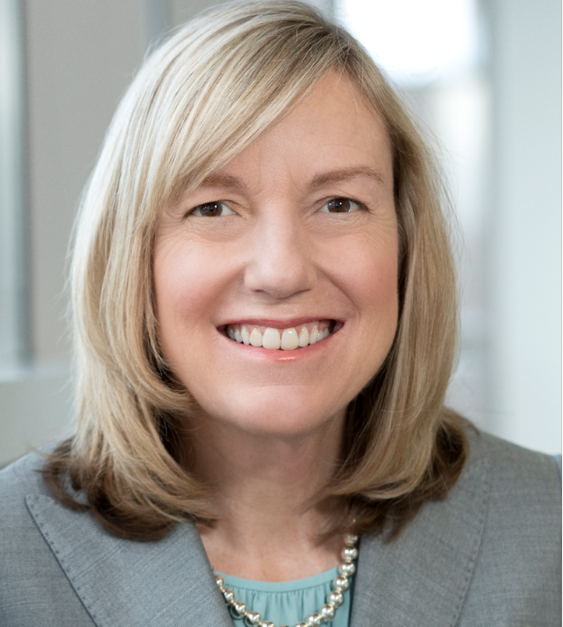
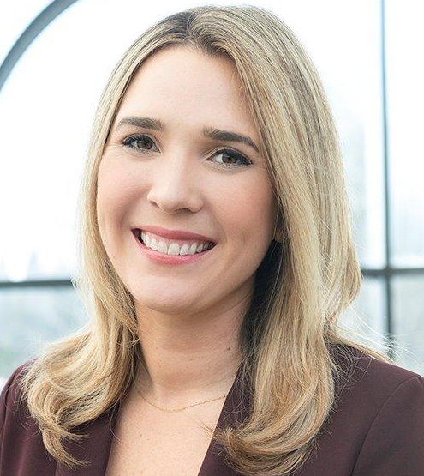
NAND DESIGN, TECHNOLOGY & MANUFACTURING GROUP
MARCH 2025
Stephen Keeney, VP
GM
Guangli Che, VP
Dalian Site GM
RV Giridhar, VP
Technology Development
Pranav Kalavade, Fellow
Memory Component Development
Pat McDonald, VP
Central MFG/QRE
Kaitlin Hansen
HR
TBD
Legal
TBD
Finance
L1 = GM’s direct reports
L2 = Direct reports of L1 leaders
L3 = Direct reports of L2 leaders

