Slide 1
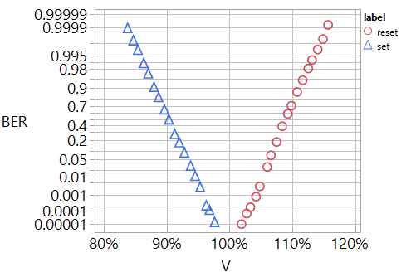
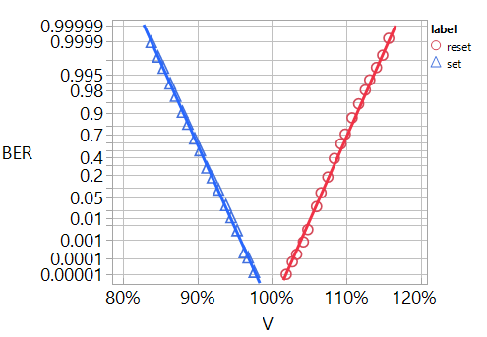
Window = Δx + Δy
Window = Δx + Δy
Δx
Δy
Δx
Δy
E1
E4
E1
E4
V_{inh}
V_{om}
V_{write}
V_{inh}
V_{om}
V_{write}
E2
E3
E2
E3

Slide 2
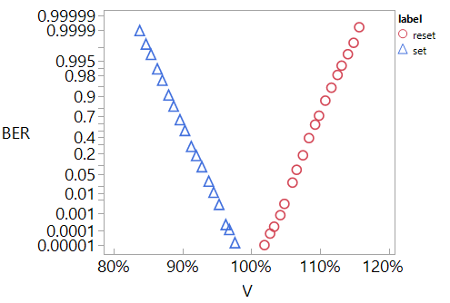
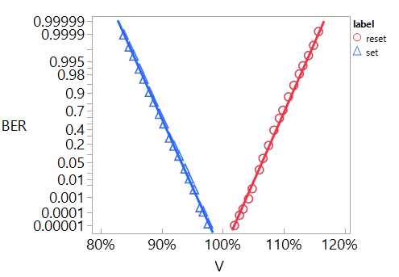

Slide 3
old

Slide 4
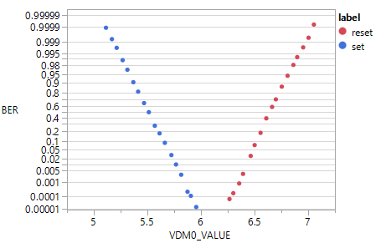
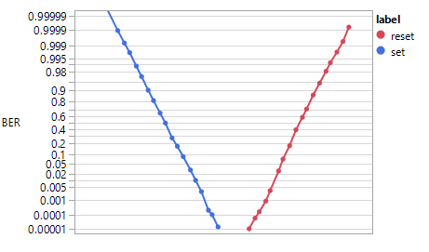
Material: W003X23:054:N03:P14
D0/ED1
Figure with x label (FYI)
Window = Δx + Δy
Δx
Δy
E1
E4
Figure without x label (to be published)
E2
E3
V_{inh}
V_{om}
V_{write}

