Slide 1
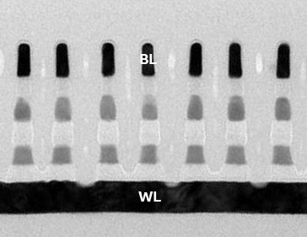
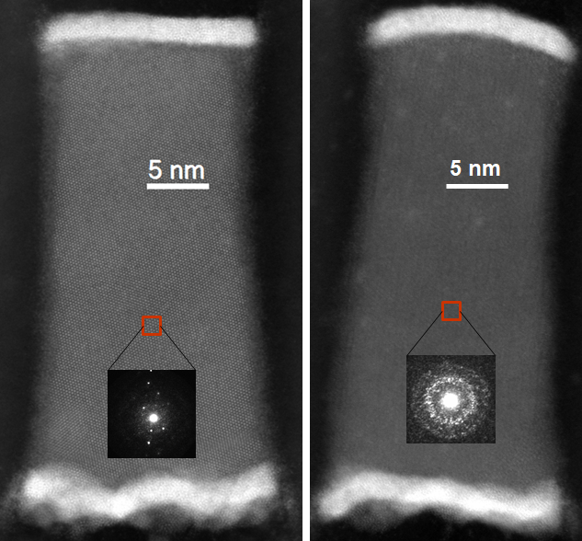
Bit Line
Memory
Selector
Word Line
BL
(a)
WL
New Figure 4.
Option -1
(b)
New Figure 4.
Option -2

