Slide 1
Wang, Raymond (Xiaolei)
NSG PE/SPE Candidate Profile
MCD
Role Nominated For | Principle Engineer
Current Position | SSD Test Team Leader
Technical Domain | Test Engineering (SSD) / Media Product Engineering
Manager Name | Jacky Chen
Staff Sponsor | Ed Fozo / Stephen Keeney
Grade | TIG | LOS | WWID
9 | 3 yr | 15 yrs (Apr’ Y2005) | 10696004
Country | CHINA | Repeat Nominee (Y/N) | N
Site | Shanghai
Nomination Form:
(Embed document here)
Career Highlights | Rationale for Promotion: Business Context & Future Impact
Technical Expertise Expertise across Media, System, Data Process & Visualization in establishing the whole MQ infrastructure SSD Test MRB Stress / Screen development Strategic Leadership Media Qual critical enabler SSD Test Efficiency, especially on Burn-in and Run-in. Auto Data Monitor & Analysis Role Modeling & Mentoring NSG-SH employee #1, mentored everyone of the 1st batch of ~10 engrs. Brought up 20+ next wave talents in SSD Test, NAND Media & MFW, MQ, Data Analysis, etc. Local go-to person on NAND Si-Sys issue, MQ, etc. | What has changed in the business environment, technology strategy or product roadmap to warrant a higher grade level? How has the scope and complexity of the work changed? Hynix integration requires Raymond to be the SSD Test representative for BKM sharing Expand usage of Big Data – monitoring quality before customers see them (Ali issues, Valley zero, etc) Expected/Future Contribution and Impact: Results, Culture & Learning (“What’s Next?”) NAND MQ Continuous Improvement through 130s & onwards, etc. ‘Confidence Flag’ for whole NPSG-SH team to Hynix Lead & Establish the Engineering Develop Infrastructure / Culture for NPSG-SH.
Notes:
INSTRUCTIONS:
Do not alter the slide.
For end-of-year and mid-year reviews:
Fill out this slide completely.
Fill out the next slide for repeat candidates or candidates not meeting performance guidelines as described in the Fellow Nomination Process document.
For mid-year pre-review:
Fill out p. 4 of this template

Slide 2
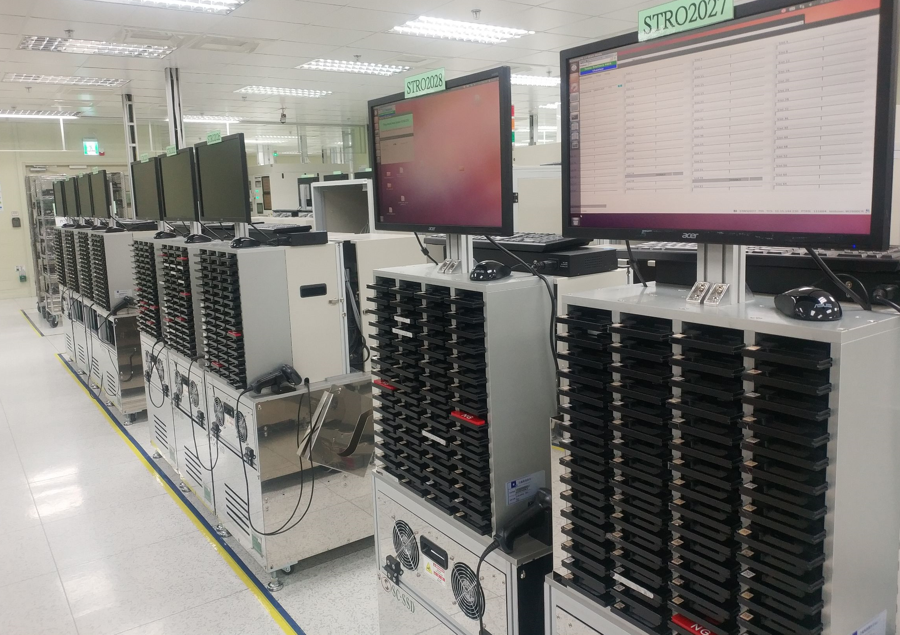
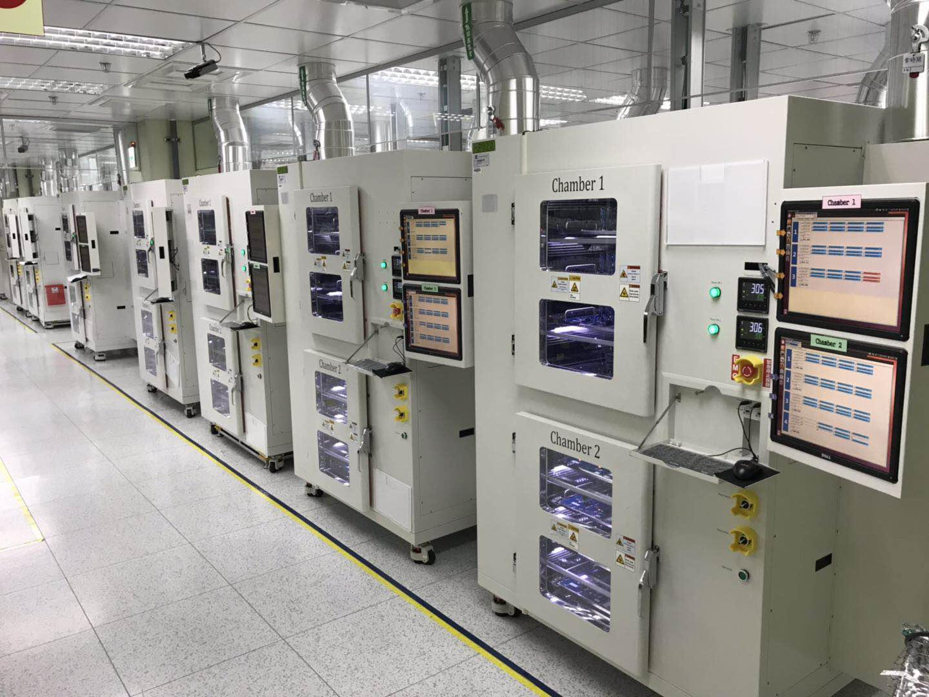
NSG PE/SPE Candidate Profile - Raymond Wang (10696004)
NAND Media Qual (Y18~ now):
Pioneer & Key enabler as MVP FW & Test architecture.
All 7 generations from Q2’18.
Independently enabled Test Feature, Auto-FA, and Dashboard.
Co-work with MI on MVP FW.
System platform detected 42 issues during 130s MQ, while PRQ on schedule…☺
Pioneer of SSD Test Methodology (Y09 ~now) & Innovator of Homegrown SSD Tester (Y13 ~ Y15)
Test developer from NSG’s 1st SSD (Ephraim).
To address the 3rd party tester’s limitation on debug, performance & feature, Raymond innovated the architecture of Homegrown SSD Tester (IPC), initiated the highly modulized software architecture of 1st (SATA) & 2nd (PCIe) of Mfg test tape.
21,152 PCIe 3.0 test ports installed at ODM by Y18, $47M cost saving .vs 3rd party testers..
This homegrown tester architecture is still being used today’s PCIe SSDs HVM, and on track for next generation (PCIe 5.0).
SATA
PCIe
Mentor / Technical Coach for whole NSG-SH/TW team.
NSG-SH employee No.1, mentored everyone of the 1st batch of ~10 NSG-SH engineers (Component / System TE/PE, Q&R).
Brought up 20+ of next wave talents in SH/TW, in SSD Test, NAND Media & MFW (Burn-in), MQ, Data Analysis, etc.
Local go-to person on NAND Si-Sys issues, Media Qual, Validation, Debug & FA, etc. Interface to global team.
From Y20, coach US Test Engineer to establish Optane Dashboard, proliferate NAND MQ BKM to Optane.
Notes:
Structure:
Manager Presents: 3 min
Q&A: 7 min
Discussion 10 min

Slide 3
NSG PE/SPE Candidate Profile - Raymond Wang (10696004)
Rational for Promotion:
On-going project: NAND MQ Continuous Improvement through 130s, 140s, etc;
New Scope: SSD Line Intelligence Monitor (SLIM) -- Auto HVM Media/SSD Baseline Data Performance Shift Monitor.
‘Expand usage of Big Data’: monitoring quality before customer sees issues, Valley 0, Alibaba High Media Failure, etc.
Top SSD Test Developer, Go-to person for ~30 global system test developers & ~70 PE/TE/QREs in NSG-SH/TW.
Why Now? ---- Aligned to NPSG.
Hynix integration requires Raymond to be the SSD Test representative for BKM sharing.
‘Confidence Flag’ to whole NPSG-SH team to Hynix.
Lead & Establish the Engineering Development Infrastructure / Culture for NPSG-SH/TW.
Notes:
Structure:
Manager Presents: 3 min
Q&A: 7 min
Discussion 10 min

Slide 4
Instructions for Completing NSG PE/SPE Candidate Profile
Summarize the nominee’s story on one slide including:
Career Highlights: Pull top examples from questions 1-3 on the application form
Examples of Technical Expertise and Leadership and the critical results achieved. What would not have happened at NSG/Intel without their leadership?
Examples of Strategic Leadership and the business impact.
Have they articulated a vision of future technology? How did they build alignment for their vision?
What was the impact? What does Intel do differently as a result of their leadership that we didn’t do 2-3 years ago?
Examples of role modeling Intel Culture and Technical Leader Practices.
How has this candidate role modeled Intel culture attributes?
How does this candidate demonstrate transfer of technical depth to others?
What skills/capabilities have been introduced or developed in others as a result of this candidate?
Rationale for Promotion: Business Context & Future & Impact
What has changed in the business environment, technology strategy or product roadmap to warrant a higher grade level? How has the scope and complexity of the work changed?
What is next in terms of their contribution?
Does your candidate have the on-going work/project scope to support the PE/SPE criteria on a longer-term basis?
Why now - what will a promo to PE/SPE deliver for NSG/Intel?
Notes:
Structure:
Manager Presents: 3 min
Q&A: 7 min
Discussion 10 min

Slide 5
NSG PE Candidate Pre-Review Session Structure
Candidate Pre-Review Sessions are 10 minutes.
Come prepared to present an executive overview of your candidate.
Candidate Profile will be presented from the facilitator’s laptop.
You will join the meeting precisely at your designated presentation time (if joining remotely you will be signaled by the facilitator).
You will have 2-3 minutes to present your key points for the nomination. You will be stopped at 3 minutes.
The NSG PE committee will use the remaining time to ask you questions.

