Slide 1

Executive Retirement Benefits Overview
We believe in supporting families. Yours. Amazing benefits here
rev. Sept 2024

Slide 2

Items covered in this presentation
Overview of Intel’s Retirement Program & Benefits
Some items to consider prior to your retirement
Paid Time Off at Retirement
How Retirement is initiated
COBRA
Accessing My Health Benefits Website
Intel Retiree Medical Plan (IRMP)
Sheltered Employee Retirement Medical Account (SERMA)
Fidelity Retirement Accounts (401K, Retirement Contribution Plan, & Minimum Pension)
Stock Acceleration
Other Retirement Benefits
Must do actions after your retirement date
Other Resources Available
Key Contacts
The information in this presentation is not intended to take the place of or change official plan documents in any way. In the event of any discrepancy between the information in this presentation official plan documents, the official plan documents will prevail. Intel reserves the right to modify, change, or discontinue benefit plans at its sole discretion.

Slide 3

Some items to consider prior to your retirement
Health benefits coverage
Active coverage continues through the end of the month
Rewards & Stock grants
Granted at the end of April/beginning of May each year
Only granted shares are eligible for acceleration (visible in E-Trade)
Stock Purchase Plan
Active through end of plan period or contributions refunded
Bonus Pro-ration
APB pro-rated based on full months during the year
QPB pro-rated based on earnings for quarter before retiring
Life events
Service anniversary date, children turning 26 years old, turning 60 years old, turning 65 years old (Medicare eligible), sabbatical eligibility
Additional information is covered in the upcoming slides

Slide 4


You’ll receive your eligible retirement benefits regardless how you leave.
Retiring From Intel
Leaving by Resigning
Leaving by Separation Action
Discuss with your manager your retirement decision 1- 6 months before you intend on leaving
Manager or BHR submits term event into Workday
Recommend timing: 60 days -14 days prior to retirement date
Note: Managers refer to Workday Job Aid
When leaving due to a separation action, a Separation team member (CPM, Strategic Transition) will communicate your term date
The Separation team member will enter the event into Workday
Entered 1-2 weeks prior to the separation date

Slide 5
Paid Time Off at Retirement
Paid Time Off
PTO Item | Work Location
 | California | Colorado, Montana, Nebraska, Illinois, Louisiana, Massachusetts, Maine, New Mexico, North Dakota, Oklahoma, and Rhode Island | All other states
Vacation | Accrued, unused vacation, max of 8 weeks, will be paid on final check | Accrued, unused vacation, max of 4 weeks, will be paid on final check | Not paid
 | Vacation proration: 1.67 days per month
Holiday | Earned, unused floating holiday(s) will be paid on final check, maximum of four (4) | Earned, unused floating holiday(s) will be paid on final check, at a maximum of two (2) | Not paid
Sabbatical | Unused accrued sabbatical time paid out as well as eligible time between eligibility periods |  | Earned but not taken sabbatical will be paid on final check
Additional Information: Chapter 13 – Paid Time Off

Slide 6
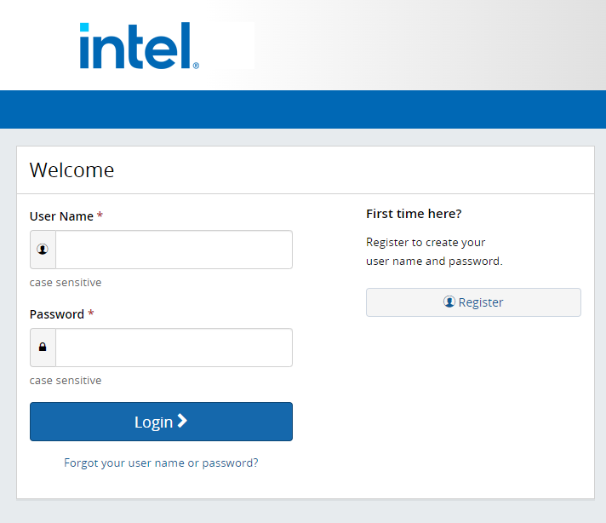
Accessing My Health Benefits Website:
Go to: www.intel.com/go/myben
Click on the link for “My Health Benefits”
Click on “Register”
Enter personal information
Select and answer security questions
Create username and password

Slide 7

COBRA
COBRA is a federal law that enables you & your enrolled dependents to continue medical, dental and vision coverage in the Intel Group Health Plan when you leave Intel.
Active coverage continues through end of termination month
Cobra enrollment continues your coverage
18 months* max
Effective first day of the month after leaving Intel date
Deductible continues (Does not restart with move to Cobra)
Enrollment Options:
Leaving through CPM or Strategic Transitions - automatic enrollment for employees under age 63.5/64, see your separation agreement for age & time allotment of Intel paid Cobra coverage
No action for employee to make, unless opting out, done through Intel Health Benefits
Employees resigning or age 63.5+/64 separating through CPM or Strategic Transitions program, must take action to be enrolled.
Enroll 7 - 60 days after term date w/ coverage staring the first day of lost active coverage.
Call the Intel Health Benefits Center at 1-877-466-9236 or Log in to the My Health Benefits website , or fill out and submit back mailed COBRA enrollment packet
First payment due within 45 days after enrollment (Cobra Premiums)
Health Savings Account and Flexible Spending Account – special considerations
HSA – funds are yours to keep or use or roll over, after-tax contributions accepted
FSA – can continue using funds by submitting claims through May 31st for expenses during coverage period (COBRA coverage included). 2% admin fee and balance will be applied.
*Additional Information: Chapter 11 - COBRA Continuation of Coverage

Slide 8
COBRA and Medicare
Medicare Part A & B becomes the primary payer upon the loss of your active group health plan. Your COBRA Plan will assume you are enrolled in Medicare (age 65+/disabled) and will reduce coverage accordingly (Cobra will not cover what Medicare would cover).
Cobra premiums don’t decrease if enrolled in Medicare and Cobra
To enroll in Medicare or check your current Medicare status contact Social Security at 1-800-772-1213. You can contact Medicare at 1-800-MEDICARE (1-800-633-4227)
Medicare eligible (age 65+) PRIOR TO COBRA
An individual who is eligible for Medicare may elect and retain COBRA coverage for the maximum period allowed if Medicare enrollment begins on or before the date on which the individual elects COBRA coverage.
Medicare eligible (age 65+) while on COBRA
If you or an eligible dependent become Medicare eligible while covered by COBRA, you have the option to end or continue your COBRA coverage.
NOTE: COBRA is not considered an active employer group plan. Delaying enrollment in Medicare due to your enrollment in COBRA will result in a Medicare premium penalty.
HSA Contributions & Medicare – If enrolled in Medicare Part A or B, you can no longer contribute to HSA. You can continue to use the HSA funds for eligible expenses but cannot contribute funds.
Consult with a tax advisor for more info
Update HSA contribution amount on the My Health Benefits website
Contact Fidelity for a Return of Excess Contributions if you’ve overcontributed
Medicare CMS-L564 Form – verification of health coverage form that is required for all Medicare enrollment applications for each individual enrolling in Medicare. Call the Intel Health Benefits Center at 1-877-466-9236.

Slide 9

Intel Retiree Medical Plan (IRMP) Options
IRMP provides eligible retirees access to comprehensive medical and prescription coverage (Anthem) and vision coverage (VSP) – IRMP Premiums
Anthem HDHP– Non-Medicare/under age 65
Anthem Medicare Preferred 15P and 25P (PPO)* options - Medicare/age 65+
VSP Vision Plan and VSP Vision Plus Plan - routine vision coverage
* Medicare Advantage Plan. Requires Medicare Part A and Part B and a US physical address. All enrollments are subject to Center for Medicare and Medicaid Services (CMS) approval.
Note: Dental coverage not provided through Intel Retiree benefits. MetLife Dental available or enroll in individual coverage through current dental provider
Multiple enrollment opportunities:
Within 30 days of: retirement date, end of COBRA, turning age 65 (becoming Medicare eligible)
Annual Enrollment
And many other qualified status changes
Contact the Intel Health Benefits Center at 1-877-466-9236 for additional information
Please refer to the 2023 Retiree Annual Enrollment Guide or IRMP Summary Plan Description for IRMP details

Slide 10

SERMA (Sheltered Employee Retiree Medical Account)
SERMA is a Health Reimbursement Arrangement subject to IRS rules*. SERMA is designed to help you pay the cost of eligible individual medical, dental and vision premiums for you and your eligible dependents upon retirement from Intel provided that you meet the retirement eligibility guidelines.
*See also IRS Publication 969, section on Health Reimbursement Arrangements - https://www.irs.gov/pub/irs-pdf/p969.pdf
2020 anniversary date is the last year to count towards SERMA calculation
Key Information
Hired or rehired prior to Jan 2014 US based service only $1500 for each complete eligible year of service** To use for Premiums only not out-of-pocket expenses like HSA No cash value and not taxable Annual T-Bill Interest Must access within 20 consecutive years Funded 45-60 days post-retirement Access account on My Health Benefits website
Eligible for reimbursement
Individual medical insurance premiums Individual dental insurance premiums Individual vision insurance premiums IRMP premiums other employer retiree group health plans COBRA premiums Medicare premiums Medigap premiums TriCare premiums Long-term care plan premiums International health plan premiums
**Note: Breaks in service, Part-time status could impact SERMA amount. If both you and your eligible spouse or domestic partner are retirees of Intel, each of you will have your own SERMA and the amount for each will be based on your individual years of service. Acquired company time is not typically included in SERMA service. See additional information below for details.
Additional Information: Section 8 of IRMP Summary Plan Description

Slide 11
SERMA OPT OUT:
Non-Medicare retirees with access to SERMA will not qualify to receive federal premium tax credits. If considering using federal premium tax credits to reduce the cost of health insurance purchased through the Affordable Care Act (ACA) Health Insurance Marketplace, you should seek advice from a tax advisor.
If you are not Medicare eligible and you determine you are eligible for the premium tax credit, you may choose to temporarily “Opt Out” of SERMA in order to qualify. When you “Opt Out,” your SERMA balance is frozen and you will not be able to use your SERMA to pay for Intel or non-Intel healthcare premiums for you or your dependents.
Your “Opt-Out” election will continue unless you “Opt-In” again. You may temporarily “Opt-In” or “Opt-Out” of SERMA prospectively. You must call to “Opt Out” or “Opt In” as it cannot be completed online.
Online tools available to help you identify if your income levels qualify for federal premium tax credits: http://www.healthcare.gov and http://kff.org/health-reform/.
Questions: call the Intel Health Benefits Center at 1-877-466-9236
To learn more about federal premium tax credits, speak with a Benefits Advisor at the Aon Retiree Health Exchange at 1-877-458-9659, or visit www.healthcare.gov

Slide 12
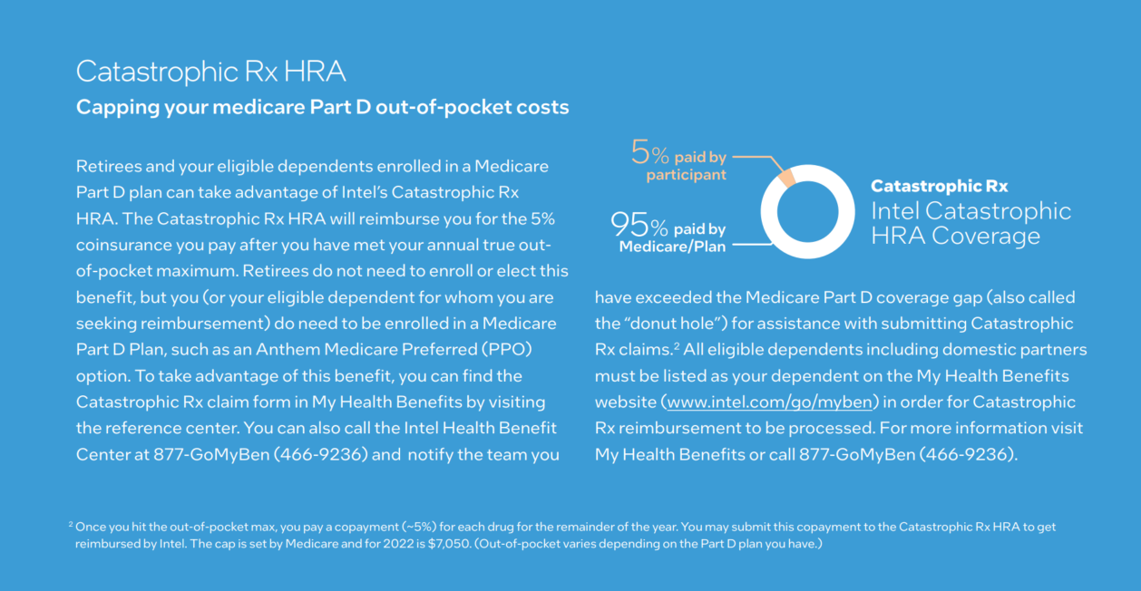
Catastrophic Rx Health Reimbursement Account (HRA) :
See: IRMP Summary Plan Description for more information on this program

Slide 13
Executive Health Program
14+ only
As a top executive at Intel, you have access to the following exclusive health program. This is in addition to your standard Intel Group Health Plan benefits and provide you with access to world class facilities and services in a way that suits your health, work and lifestyle needs.
Excluding paid travel, Grade 14+ Executives can continue to use this program while enrolled in Cobra in 2024.
Executive Health Program – a comprehensive physical examination
Get an annual customized examination from either Mayo Clinic or Oregon Health & Science University (OHSU).
Typical services, if applicable and clinically indicated, may include:
Medical history/physical
Comprehensive laboratory tests
Cardiac health evaluation
Pulmonary health evaluation
Auditory and vision tests
Schedule an appointment:
Mayo Clinic Website (locations outlined in Website)
OHSU Friends of the University 503-494-4908 FOU@ohsu.edu
2025: Program Suspended

Slide 14

Fidelity Retirement Accounts
401K
Employee and Intel matching contributions to 401(k) stop with final paycheck
Calculation completed at year end to determine if Intel contribution true up is needed
401(k) employee contributions are 100% vested
Continue to manage the investments post-retirement on Fidelity NetBenefits website (retain username and password)
Retirement Contribution Plan
Employer contributions are 100% vested after 6 years of service or at Age 60
Distribution Information:
Fidelity sends informational packet within 60 days of retirement
Multiple distribution options available – log into Fidelity NetBenefits, and click this link for the Special Tax and Distribution Notice
Funds cannot be distributed until 30 days following retirement date
Address changes should be made directly with Fidelity
Contact Fidelity distribution line at 1-877-902-0006 for any questions
Minimum Pension Fund
US Employees hired before 1/1/11 may be eligible to receive a benefit from the Minimum Pension Plan
Use pension calculator on Fidelity NetBenefits or contact Fidelity for a pension estimate
Decreased benefit amount if distributed prior to age 65
SERPLUS (grade 10+ only)
Distributions paid according to enrollment election for each participating year (no changes allowed)
Check Fidelity NetBenefits website for payout schedule
Dates updated within 7-10 days following retirement
Immediate distributions paid within 60-100 days and other distributions by March 31st the following year

Slide 15

Stock Account Information
Same website, username and password as used today
Account will remain open for you to access history, make transactions on remaining balances, get statements unless not accessed for 3 consecutive years
Address changes should be made directly with E-Trade
Trading Window Guidelines If you terminate your service with Intel during a closed window, it is recommended that you do not trade until the next open window. If you are aware of material non-public information when your service terminates, you should not trade Intel securities until that information has become public or is no longer material. Email insider.trading@intel.com for further questions

Slide 16
Stock Acceleration
 | Restricted Stock Units (RSUs)
Rule of 75 | One year of accelerated vesting Unvested RSU’s beyond one year are cancelled Acceleration takes 1 week (3-5 days)
Age 60 or older at retirement | One year of accelerated vesting for every 5 years of service Unvested RSU’s not accelerated are cancelled Acceleration takes 1 week (3-5 days)
Not Rule of 75 or over 60 years old at retirement | Unvested RSU’s are cancelled
Acceleration rules may not apply to all of your stock awards, such as special retention-based grants received outside of the Rewards process. Review the grant agreements to determine the acceleration rules.
Stock options and/or RSUs may qualify for accelerated vesting under either the Age 60 rule or Rule of 75, but not both.
For purposes of stock option/RSU-vesting acceleration (under either the “Age 60” or “Rule of 75” rules), in general, only Intel service counts. Intel service may include bridge-of-service from an acquired company or being rehired to Intel after a break in service.
M&A service (prior service with a company acquired by or merged with Intel) will count for purposes of determining whether you qualify for the applicable post-retirement exercise period (i.e., first anniversary of your retirement date) for Intel stock. The terms of each individual M&A dictate whether or not M&A service will count as length of service for purposes of determining if you qualify for stock option and/or RSU acceleration at retirement under the Rule of 75 or how many years of acceleration you may receive under the Age 60 rule.
Example:
Age 54 with 22 years of service = 1 year of acceleration
Age 61 with 12 years of service = 2 years of acceleration
Age 60 with 20 years of service = 4 years of acceleration
Age 55 with 15 years of service = no acceleration
Additional Information: How a Life Event Could Impact your Stock Awards
(review the information at the link above if you have Stock Options with an expiration date)

Slide 17
Follows Retirement rule of 75 or Age 60 + 5 years of Service
PSU At Retirement
Accelerated PSU’s will vest on normal vesting schedule, with performance criteria applied.
These will be included in your taxable income in the vested year
Tax documents from both Intel and E-Trade will be sent.
Review attached PDF for Exec RSU, PSU, & OSU retirement information
Notes:
the 2021 and 2022 PSU’s will vest fully on their normal vesting date in 2024 and 2025 and the 2023 grant will be pro-rated based on the departure date on its normal vesting date in 2026. All will have the normal performance criteria applied to determine the amount of shares that will vest and when each vest happens, it will be added to taxable income for that year and you’ll get tax documents from Intel and E-Trade for each year.

Slide 18
Financial Planning for Executive Officers
14+ only
As a top executive at Intel, you can take advantage of the Executive Financial Counseling benefit to help you get the most out of your rewards package.
This benefit allows you to receive reimbursement up to $20,000 USD per year in eligible expenses from a financial counseling provider of your choice, e.g. financial planner, CPA, attorney or similar professional.
Qualified expenses/fees from a financial planner, CPA, attorney or similar financial counseling provider are eligible for reimbursement:
Compensation and benefits planning, including:
Intel stock compensation (RSUs, PSUs, etc.) strategies, 401(k) deferral and investment options and elections, Deferred compensation elections and planning, & Benefit elections
Income tax planning and preparation (fees for preparation of individual, trust and/or estate income tax returns only)
Cash-ﬂow planning
Investment planning
Estate planning and preparation
Financial risk management strategies
The following expenses are not eligible for reimbursement:
Investment asset management commissions and transaction fees
Insurance fees
Mortgage/lender fees
Intel will reimburse eligible expenses up to $20,000 USD per year via a one-time payment in Q1 of the year after which expenses are incurred. Such expenses must be incurred while employed by Intel or a participating subsidiary. The Concur tool should not be used for any reimbursements related to this benefit.
The reimbursement process is as follows:
Nov./Dec. – you will receive an email to notify you that the window to submit expenses is open. Make sure your personal email is in Workday
Until Feb. 15* – submit eligible expense documentation via email to Executive.Financial.Services@intel.com. You will receive a confirmation of receipt after submission.
No later than Mar. 15 – payment will be completed
Documentation must include:
Clear description of services provided that meet the requirements of eligible expenses and the name of the provider
Dates when such services were provided - note that services need to be provided during the year for which reimbursement is being requested and when the participant was eligible to participate in the program
The amount paid for such services

Slide 19
Other Retirement Benefits
Annual Performance Bonus (APB) | Pro-rated pay-out by the end of the quarter following the quarter you retire in If active any day in the month, that month counts towards the APB calculation Paid as a direct deposit (depending on payment elections at retirement)
Quarterly Performance Bonus (QPB) | Pro-rated pay-out at the normal QPB distribution time based on eligible earnings in the quarter you retire Paid as a direct deposit (depending on payment elections at retirement)
Life Insurance | Option to convert basic, supplemental, & dependent life insurance coverage without Statement of Health medical exam Eligible to purchase coverage at competitive group rates Return the enrollment form with first month’s payment within 31 days of materials being mailed (post-retirement)
Securian Financial Supp Plans | Option to continue paying for policy directly to Securian for your Accident, Critical Illness, and Hospital Indemnity Insurance plans, post leaving Intel
Long Term Care | Option to fully port over and keep your policy as long as premiums are paid directly to Trustmark
MetLife Legal | Current coverage ends on retirement date with option to continue coverage within 30 days of retirement Available during Retiree Annual Enrollment to continue or begin coverage
Recognition Card | Check balance and use remaining funds on card Check balance: https://login.northlane.com/intel Lost cards: CustomerService@recognition.intel.com
Intel Badge | Retiree badge available by emailing badgeandkeyNM@intel.com and include name, WWID, and mailing address
Review the Retirement Checklist for all other benefits

Slide 20

Other Resources Available
Circuit > Pay and Benefits > Compensation > Retirement > Retirement from Intel
Retirement Kit
Retirement Checklist
Retirement Q&A Document
Retirement Key Dates to Remember
Retiree Benefits Directory
Encore Fellowship Program – apply before retiring (1000 volunteer hours over 1 year for $25K/$50K STEM paid by non-profit)
Sites available to access externally:
Intel Retiree Organization (www.intelretiree.com)
External Intel.com Website - http://www.intel.com/retiree (sign-in not needed)
Matching grant program, discount programs, enrollment guides, etc

Slide 21
Retirement Only Benefits
You’ll receive the following benefits because you are an Intel Retiree (not provided to non retirees departing Intel):
IRMP Option
SERMA (if you meet eligibility rules)
Catastrophic Rx
Stock Acceleration (rule of 75)
APB and QPB prorated payout
401k & SERPLUS EOY true-up
Retiree Intel Badge
Retain Hertz Presidents Circle

Slide 22

Remember to do actions
Before you leave
Add your personal email into Workday
Review Employee Termination Checklist
Review Retirement resources (slide 20)
Review U.S. CPM Program Circuit page for package details and Q&A (CPM or Strategic Transitions only)
Review & Sign all exit documents
Understand your benefits options & set up My Health Benefits website on personal computer
Review your SERPLUS to understand tax impacts
Medicare enrollment (Age 65+)
After You leave Intel
Cobra - Take any applicable actions
Port Life insurance (optional) – return the enrollment form within 31 days
Keep your contact info & bank account information up to date
Intel: Bonus payouts, tax documents, Benefits: Cobra, IRMP, SERMA, E*TRADE: Stock Fidelity: Retirement and HSA account
Submit Financial Planning invoice (gr 14+)

Slide 23

Ask HR-Executive Contact
Intel HR Executive Services – Departed execs can still use this service
Eligibility: Grade 12+
Includes Exec’s family members
Available: 8am – 5pm Pacific Time Mon – Fri
Email – hr.executive.services@intel.com
Message Line – 1-888-503-4686
Services Offered:
Single point-of-contact for all HR benefit and services related questions
Knowledge of exclusive executive benefits
Typical questions – pay, taxes, retirement, stock, health benefits, travel, expenses, employee and org data change
Other Exec Contacts:
Fidelity EPC Rep – Listed on your Fidelity account, or contact HR Executive Services
E-Trade Relationship Manager - Contact HR Executive Services if you do not recall your contact rep

Slide 24
Key Contacts
Name | For assistance with | Phone Number | Web site
Intel Health Benefits Center | COBRA, IRMP, HSA, FSA, SERMA | 1-877-466-9236 | www.intel.com/go/myben
MetLife Dental | Alternate dental option post COBRA | 1-866-832-5756
MetLife Legal | Convert or enroll in MetLife Legal (formerly Hyatt Legal) | 1-877-770-4638, option 1
Minnesota Life/Securian | Life Insurance Porting, premiums estimate | 1-877-494-1673
E-Trade | Stock (RSU, SPP, etc) | 1-800-387-2331 | https://us.etrade.com/home
Fidelity | 401k, Retirement, Pension, HSA, Rollover. | 1-888-401-7377 Distributions: 1-877-902-0006 | http://www.netbenefits.com/intel
Recognition Card | Balance, lost cards, replacement | 1-866-326-8689 | https://login.northlane.com/intel
AskHR | Option to use Exec services (slide 13) or Ask HR for benefits related questions | 1-800-238-0486
Intel Retiree Organization | Post Retirement benefit information |  | www.intelretiree.com

Slide 25


