Slide 1
CXi Initiative Summary
10/14/2021
Rob Munoz on behalf of rest of CXi Team (Jay Desai, Josh Fryman, Dave Kehlet, Tang Lai Guan, Kurt Lender, Ravi Mahajan, Anki Nalamalpu, Peter Onufryk, Gerald Pasdast, Sandeep Sane, Debendra Das Sharma, Tom Stachura, Steve Van Doren, Joe Wu, Swadesh Choudhary, Kemal Aygun, Narasimha Lanka)

Slide 2
7/19/21 TLT Meeting Executive Summary
Chiplets (die interconnected within a package) are used by single vendors today, but no broad scale general purpose chiplet ecosystem exists
  HBM is widely deployed, but application specific
A chiplet ecosystem is emerging driven by cloud customers and is key to Intel initiatives
  Foundry
  Intel products (e.g., Xeon, cloud/edge customers, FPGAs, eASICs, ASICs, and optical transceivers)
Adopted standards and volume attach point are holding back a broad scale chiplet ecosystem
  Internal to Intel there are many incompatible chiplet IPs and approaches
Intel is uniquely positioned to drive adoption of broad scale chiplet ecosystem
A number of industry initiatives are underway to jumpstart a chiplet ecosystem and a winner will likely emerge in 12 to 24 months
Objective: Approve the strategy to drive standardization and adoption of a broad scale chipset ecosystem

Slide 3
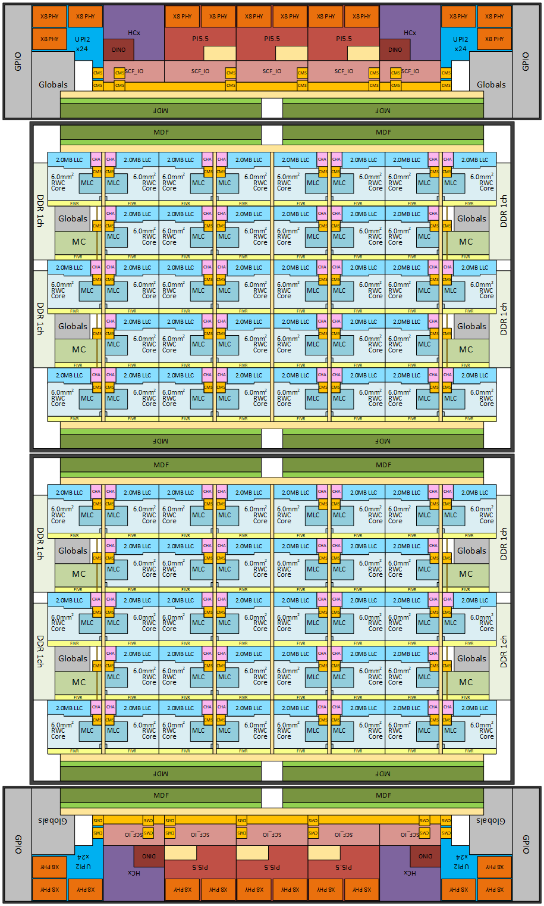
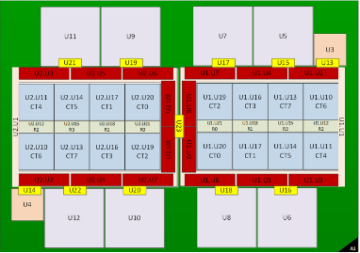
Die-to-Die Use Cases
z
Intel Product Construction
Customer Specific Products
PVC
GNR
Smart NICs for CSPs
(Details Redacted)
Xeon + Chiplets
(e.g., RAN and Cloud)
SoC + Optics
(Details Redacted)
Enables construction of SoCs that exceed maximum reticle size
Reduces time-to-solution (e.g., enables die reuse)
Lowers portfolio cost (both product and project costs)
  Enables die to use optimal process technologies
  Smaller die (better yield)
  Lowers product SKU cost, IP porting costs, etc.
Scales innovation (manufacturing & process-locked IPs)
Enables customers to customize a base product for a specific use
Core technology for Intel foundry
Requires widely adopted, open, and broad general-purpose chiplet ecosystem
The focus of this activity is on how to create a broad scale general-purpose chiplet ecosystem
Intel Top Secret

Slide 4
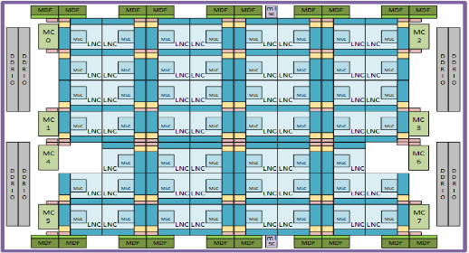
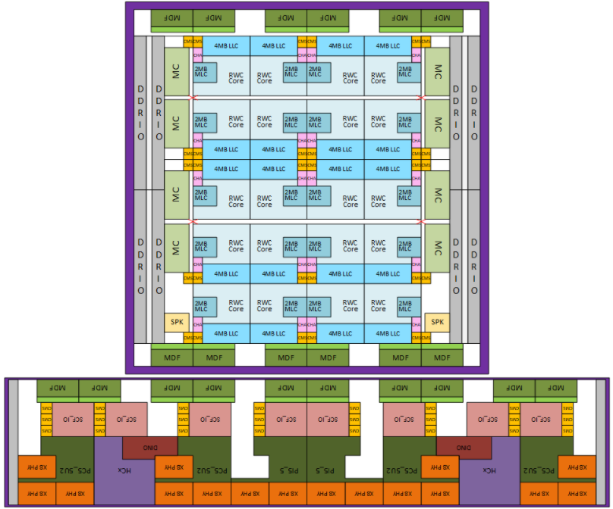
IFS x86 Adjacency Draft Solution Architecture
56/112/224 Optical Module
Platform & Package Solution
56/112/224
“Chiplet Chassis”
Customer Ready
Value: Ease of IO & Platform Integration
DRAM
IFS “Chiplet Chassis” (Intel4 or 3, Intel18A)
  Customer Ready for Accelerator Innovation.
  EMIB Packaging, 45um Bump Pitch
  Standard IP Ecosystem Compatible
  IP Available: LPDDR, DDR, PCIe, USB, Ethernet, CXL Device, RISC-V Cores
Xeon™ IO Hub Tile (Intel4 or 3)
  4X Performance (128GB/s->512GB/s)
  Both CXi and PCI supported
  100% Platform Compatible (BIOS, Platform Firmware, Security, etc.)
Xeon™ Die
  Supports all standard Datacenter Xeon™ SKUs (AP/SP, XCC, HCC, MCC, LCC) and roadmap: GNR->DMR->CYR
  100% SW Compatible
Bringing it all together, make it “easy” for the customer
  Platform Integration and Validation
Ethernet
PCIeG6
CXL
DRAM
Customer Non-Coherent IP
(AXI, AHB)
Customer
Innovative
IP (ex. AI, Security)
DRAM
Customer Coherent IP RISC-V (ACE, CHI)
DRAM
CXL/CXi @ 512 GB/s
High Performance IO Tile
Derivative CXI IO Hub Tile
CXL/PCIe @ 64 GB/s
Xeon™ DMR
MDFI
MDFI
MDFI
MDFI
DRAM
DRAM
DRAM
DRAM
DRAM
DRAM
DRAM
DRAM
POR Xeon ™ IO Tile
Notes:
Performance: 5-10X Bandwidth Density, 4X Bandwidth (128GB/s PCIeG5x16-> 512GB/s CXI), ~1/3rd Latency (Pipe-Pipe, ~5.5ns->~1.5ns)
Lower Power: 1/10th ~5pJ/bit->0.5pJ/bit
5-10X bandwidth density (roughly an order of magnitude)
10X lower power (an order of magnitude)
3X lower PHY latency

Slide 5
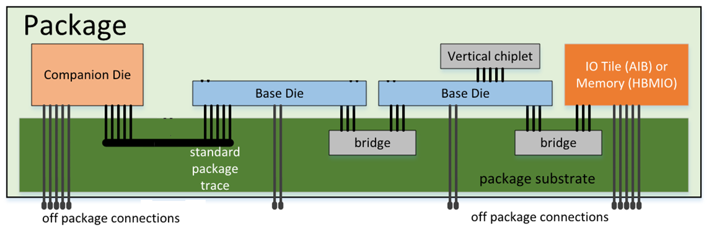
Die to Die Approaches
Packaging Technology
I/O Technology
Package Traces / 2D
Example: Stripline
3D Stacking
Example: Foveros
Many Wires (Parallel)
& Simple I/O
Few Wires (Serial)
& Complex I/O
Advantage
  Low latency & power
  Simple design
  Scales well with future bump pitch
Disadvantage
Die placement constraints
Examples
Intel AIB
Intel MDFI
Advantage
  Flexible die placement
  Low die shoreline (organic)
  Existing standards and IP (OIF)
Disadvantage
High latency
High power
Examples
OIF Very Short Reach (VSR)
OIF Ultra Short Reach (USR)
OIF Extra Short Reach (XSR)
Bridge / 2.xD
Example: EMIB
The initial scope of this activity is on 2D and 2.xD using a many wires & simple I/O approach

Slide 6
Components of Chiplet Interoperability
Chiplet Form Factor
  Die size
  Bump location
  Power delivery
  Thermal characteristics
SoC Construction (OSI: Application Layer)
  SoC Reset
  Initialization (e.g., fuses)
  Register access
  Security
Die-to-Die Protocols (OSI: Data Link to Presentation Layer)
  Link Layer, transaction Layer, etc.
Die-to-Die I/O (OSI: Physical Layer)
  Bump arrangement and characteristics
  Electrical & thermal characteristics
  Substrate or interposer characteristics
  Length budget, pJ/bit, bit error rate, …
  Reset, clocking, initialization, and data transfer
  Test and repair
We need more than a compelling die-to-die I/O for a chiplet ecosystem

Slide 7
Die-to-Die I/O Standards Landscape
 | AIB (Advanced Interface Bus) | BoW (Bunch of Wires) | OpenHBI
Organization | CHIPS Alliance Linux Foundation | Open Domain-Specific Architecture (ODSA) Open Compute Project
Objective | Die-to-Die I/O | Die-to-Die I/O | Die-to-Die I/O Leverage JEDEC HBM Specification
Status | Multiple Published Versions (1.0 & 2.0, draft 2.1) | Work in Progress | Work in Progress
Ecosystem Adoption | ~10 Chiplets with FPGA Powering Up | None | None
Primary Promoter(s) | Intel & US Government | Marvel and Broadcom | Xilinx
Observers | Facebook, Google, Microsoft, AMD
IP Availability | Synopsys, CEVA, Blue Cheetah
Other standardization activities: ODSA Chiplet Marketplace, OpenChiplet specification (Google)

Slide 8
Ingredients for Broad Chiplet Industry Adoption
Broad Market
Manufacturing,
Packaging
and Test
Intel has the pieces necessary to drive
a broad scale chiplet ecosystem
Packaging Leadership
Manufacturing and Test with Foundry
Volume Products with Chiplet Attach Points
World class IP
Ability to Drive Industry Standards
Business model
Chiplets &
Chiplet Based
Product Attach
Points
Die-to-Die
Standards
Die-to-Die
IPs

Slide 9
Die-to-Die Strategy Proposal
Create a new die-to-die I/O standard (CXi) that merges the best characteristics of AIB and internal die-to-die approaches
  AIB-O (organic), AIB 1.0 and AIB 2.0 continue while preserving interoperability
  New die-to-die I/O standard optimized for future KPIs
    We need to build a “combo” die-to-die I/O IP that is compatible with new standard and backward compatible with AIB-O, AIB 1.0, and AIB-2.0
  The intent is to converge future AIB applications to new die-to-die I/O standard
Standardize die-to-die protocols (initially CXL/PCIe)
Create a die-to-die consortium to drive the above and continue die-to-die standardization
Adopt new die-to-die standard in Intel products as the sole interface for customer visible chiplet attach (e.g., FPGA, optical, and Xeon)
  Adopt as the sole die-to-die interface for all customer visible in-package attach

Slide 10
CXi Standardization
Initial Focus
  Physical Layer: Die-to-Die I/O with industry leading KPIs
  Protocol: CXL/PCIe for near term volume attach
    SoC construction issues are addressed since CXL/PCIe is a board-to-board interface
    CXL/PCIe addresses common use cases
      I/O attach with PCIe/CXL.io
      Memory use cases are supported with CXL.mem
      Accelerator use cases are supported with CXL.cache
Future
  Other protocols
  SoC construction (part of other specs)
  Chiplet form factor
  Chiplet management

Slide 11
CXi Die-to-Die I/O Characteristics
Column1 | Lowest Cost (Organic) D2D I/O | Best KPIs (Advanced Packaging) D2D I/O
Bump Pitch | 100um to 130um | 25um to 55um
Data Rate (Gbps) | 4/8/16/32 | 4/8/12/16/32
BW/shoreline TX + RX (GB/s/mm) | 30.9/61.7/123.4/246.8 | 164/328/492/656/920
BW bump are TX + RX (GB/s/mm^2)* | 22/44/88/125 | 188/375/562/675/940
Energy Efficiency (pJ/b) * | 0.5 (4 GT/s, short reach) 1.0 (≤ 16 GT/s, long reach) 1.25 (32 GT/s, long reach) | 0.5 (≤ 12 GT/s) 0.6 (≥ 16 GT/s)
Raw BER | 1e-27 (≤ 8 GT/s) 1e-15 (> 8 GT/s) | 1e-27 (≤ 12 GT/s) 1e-15 (≥ 16 GT/s)
Latency end-to-end TX + RX (# clocks at GT/s ) * | 12 data rate clocks (1.5ns at 8 GT/s)
Idle entry/exit latency* | 1 cycle (≤ 12 GT/s) 2 cycles (≥ 16 GT/s)
Channel reach | 10mm (short reach) 25mm (long reach) | 2mm
* Representative parameters based on “good” implementation and not specification

Slide 12






Market | Die to Die Landscape | Why CXi?
Fragmentation -> Industry Consolidation around best standard technology
10/5/21 Marvell Extends Data Infrastructure Leadership with TSMC 3nm Platform
Enabling Unique Cloud-Optimized Silicon Solutions with Advanced IP and Packaging Technologies
“The OCP Open Domain-Specific Architecture (ODSA) Subproject Makes Significant Gains in Chiplet-based Architecture, Design and Industry Collaboration”
Why will the industry adopt CXi?
Open Standard (Foundry, OSAT, IP Ecosystem)
Xeon™ Platform – well integrated, validated, enabled
Best Performance/mm, Performance/mm2
Best Performance/Power (Pj/bit)
Strong History in aligning industry to platform standards
Organic
Proposed Organic
Advanced Packaging
Proposed Advanced Packaging

Slide 13
Possible IP Mapping
Specification
 | D2D I/O Specification
Column1 | Lowest Cost Organic | Best KPIs Advanced Packaging
Bump Pitch | 90um to 130um | 25um to 55um
Data Rate (Gbps) | 4/8/16/32 | 4/8/12/16/32
BW/shoreline (GB/s/mm) | 30.9/61.7/123.4/246.8 | 164/328/492/656/920
BW bump are (GB/s/mm^2) | 22/44/88/125 | 188/375/562/675/940
Energy Efficiency (pJ/b) | 0.5 (4 GT/s, short reach) 1.0 (≤ 16 GT/s, long reach) 1.25 (32 GT/s, long reach) | 0.5 (≤ 12 GT/s) 0.6 (≥ 16 GT/s)
Raw BER | 1e-27 (≤ 8 GT/s) 1e-27 (16 GT/s, short reach) 1e-15 (16 GT/s, long reach) 1e-15 (≥ 32 GT/s) | 1e-27 (≤ 12 GT/s) 1e-15 (≥ 16 GT/s)
Latency end-to-end (# clocks at GT/s ) | 12 data rate clocks (1.5ns at 8 GT/s)
Idle entry/exit latency | 1 cycle (≤ 12 GT/s) 2 cycles (≥ 16 GT/s)
Channel reach | 10mm (short reach) 25mm (long reach) | 2mm
Die-to-Die specification results in multiple potential IP implementations that interoperate
  Hard vs Soft IP
    Hard IPs for highest KPIs
    Soft IPs for simple process porting
  Advanced Packaging vs Organic
    Organic optimized
    Advanced packaging optimized
    General purpose organic and advanced packaging support
  New D2D optimized vs AIB/AIB-o backward compatibility
IP #1
IP #2
 | General Purpose D2D I/O IP
Column1 | Organic | Advanced Packaging
Bump Pitch | 110um | 45um
Data Rate (Gbps) | 4/8/16/32 | 4/8/12/16/32
BW/shoreline (GB/s/mm) | 30.9/61.7/123.4/246.8 | 164/328/492/656/920
BW bump are (GB/s/mm^2) | 22/44/88/125 | 188/375/562/675/940
Energy Efficiency (pJ/b) | 0.5 (4 GT/s, short reach) 1.0 (≤ 16 GT/s, long reach) 1.25 (32GT/s, long reach) | 0.5 (≤ 12 GT/s) 0.6 (≥ 16 GT/s)
Raw BER | 1e-27 (≤ 8 GT/s) 1e-27 (16 GT/s, short reach) 1e-15 (16 GT/s, long reach) 1e-15 (≥ 32 GT/s) | 1e-27 (≤ 12 GT/s) 1e-15 (≥ 16 GT/s)
Latency end-to-end (# clocks at GT/s ) | 12 data rate clocks (1.5ns at 8 GT/s)
Idle entry/exit latency | 1 cycle (≤ 12 GT/s) 2 cycles (≥ 16 GT/s)
Channel reach | 10mm (short reach) 25mm (long reach) | 2mm
Cost Optimized D2D I/O IP
Column1 | Lowest Cost
Bump Pitch | 110um
Data Rate (Gbps) | 4/8/16/32
BW/shoreline (GB/s/mm) | 30.9/61.7/123.4/246.8
BW bump are (GB/s/mm^2) | 22/44/88/125
Energy Efficiency (pJ/b) | 0.5 (4 GT/s, short reach) 1.0 (≤ 16 GT/s, long reach) 1.25 (32GT/s, long reach)
Raw BER | 1e-27 (≤ 8 GT/s) 1e-27 (16 GT/s, short reach) 1e-15 (16 GT/s, long reach) 1e-15 (≥ 32 GT/s)
Latency end-to-end (# clocks at GT/s ) | 12 data rate clocks (1.5ns at 8 GT/s)
Idle entry/exit latency | 1 cycle (≤ 12 GT/s) 2 cycles (≥ 16 GT/s)
Channel reach | 10mm (short reach) 25mm (long reach)

Slide 14
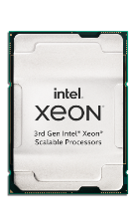


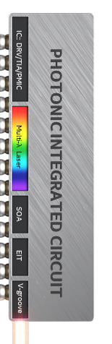
IFS CXL over CXi x86 Adjacent Value Proposition
CXL Memory |  | Performance: 10X Bandwidth Density (4X Platform BW), ~1/3rd Latency (Pipe-Pipe) Lower Power: 1/10th ~5pJ/bit->0.5pJ/bit Smaller Form Factor (-80% x-y-z) Software: OSV Kernel Compatibility Platform Integration & Validation
CXL Cache |  | Performance: 4X Bandwidth, ~1/3rd Latency (Pipe-Pipe) Lower Power: 1/10th ~5pJ/bit->0.5pJ/bit Smaller Form Factor (-80% x-y-z) Memory Hierarchy Rebalance for Performance/Power (ex. HBM->GDDR) Platform Integration & Validation
CXL I/O |  | Performance: 4X Bandwidth, ~1/3rd Latency (Pipe-Pipe) Lower Power: 1/10th ~5pJ/bit->0.5pJ/bit Smaller Form Factor (-80% x-y-z) Photonics Ease of Integration Platform Integration & Validation
Time To Market for Xeon™ Adjacent Accelerators (Memory, Cache, IO)

Slide 15
Possible Future Standardization
Chiplet Form Factor(s)
  Die size and bump definition
  Power, clocking, reset
  Thermal and power management
Management
  Interface and protocol (e.g., I3C and MCTP)
  “Plug and Play” chiplet discovery and provisioning
  Operational and environmental telemetry
  Debug
  Security (other than that provided by die-to-die protocol)
    Attestation
  Key management
Other protocols
  System buses
  Coherency extensions
  Ethernet (xMII)
  Video (HDMI, DP, MIPI)
  Optical (OIF-CEI)
  Telcom (OpenRAN)
  Memory (SRAM, FLASH, MRAM, ReRAM)

Slide 16
CXi Standards Timeline
 | June |  |  |  | July |  |  |  | August |  |  |  |  | September |  |  |  | October |  |  |  | November |  |  |  |  | December
 | 23 | 24 | 25 | 26 | 27 | 28 | 29 | 30 | 31 | 32 | 33 | 34 | 35 | 36 | 37 | 38 | 39 | 40 | 41 | 42 | 43 | 44 | 45 | 46 | 47 | 48 | 49 | 50 | 51 | 52
D2D TLT Kickoff
D2D I/O High-Level Proposal
D2D I/O Specification |  |  |  |  |  |  |  | 0.3 |  |  | 0.5 |  |  |  | 0.7 |  |  |  |  |  |  |  |  | 0.9
D2D CXL/PCIe Protocol Mapping |  |  |  |  |  |  |  |  |  |  |  | 0.3 |  | 0.5 |  |  | 0.7 |  |  |  |  |  |  | 0.9
Partner* D2D I/O Spec Review
Partner D2D CXL/PCIe Protocol Mapping Review
D2D Consortium Kick Off
CXi Industry SIG Kickoff
Proposed promoter list: Intel + two cloud + one semiconductor + one fab + one OSAT

Slide 17
CXi Consortium Roadmap (proposed; to be aligned on by consortium)
 | 2022 |  |  |  |  |  |  |  | 2023 |  |  |  |  |  |  |  | 2024
 | Q1 |  | Q2 |  | Q3 |  | Q4 |  | Q1 |  | Q2 |  | Q3 |  | Q4 |  | Q1 |  | Q2 |  | Q3 |  | Q4
Consortium Structure | Industry SIG |  |  |  | Incorporated Consortium
2D & 2.xD Die-to-Die I/O | 0.9 | 2D & 2xD Die-to-Die I/O Spec. Rev 1.0 |  |  |  |  |  |  |  |  |  |  |  |  |  |  |  | 2D & 2.xD Die-to-Die I/O Rev Spec. 2.0
3D Die-to-Die I/O |  |  |  |  |  |  |  |  |  | 3D Die-to-Die I/O Spec. Rev 1.0
CXL/PCIe Protocol | 0.9 |  |  | CXL/PCIe Protocol Spec. Rev 1.0 |  |  |  |  |  |  |  |  |  |  |  |  |  |  |  | CXL/PCIe Protcol Spec. Rev 2.0
Next Protocol (TBD) |  |  |  |  |  |  |  |  |  |  |  |  | Next Protocol Spec. Rev 1.0
Die-to-Die Managament |  |  |  |  |  |  |  |  | Die-to-Die Managemen Spec Rev 1.0
Die-to-Die Form Factor |  |  | Die-to-Die Form Factor Spec 1.0 |  |  |  |  |  |  | Die-to-Die Form Factor Spec 2.0

Slide 18
Summary
Chiplets are not new, but customer pull and industry activities will likely lead to a broad scale chiplet ecosystem in the next 12 to 24 months
Intel is uniquely position to drive a chiplet ecosystem
7/19/21 TLT Asks (approved at meeting with details to be worked offline)
  Adopt a single Intel die-to-die interface standard for all Intel customer visible in package applications
    Internal name for new interface: Chiplet Express Interconnect (CXi)
    We will need to provide a clear public continuity path between AIB and CXi
  Approve creation of a die-to-die consortium to drive chiplet standards and ecosystem
    Need to align on proposed cooperation model with OCP
  Prioritize investment to support adoption across Intel products in a timely manner (e.g., FPGA, optical, and Xeon)

Slide 19
Progress Since 7/16/21 TLT Meeting
Teams Channel has latest details

Slide 20
8/13/21 Update
Workstreams merged
  Electrical + Physical
  Logical + Protocol + PHY Interface
  Teams file structure updated to match
Logical + Protocol + PHY Interface update (see slides for details)
  0.5 and 0.7 priority list
  Cluster definition: x64 with advanced package, x16 with organic
  AIB interoperability requirements documented; working through details (see slides for details)
Electrical + Physical update (see slides for details)
  Unidirectional NRZ signaling
  Channel reach: 2mm with advanced packaging, 10mm with organic
  2 forwarded clock signals per slice allowing independent even/odd phase adjustment
  At 32 GT/s may need to tweak some of these decisions
  No per-bit clock recovery but per-block clock recovery
  Base spec will have DLL and phase adjust in Tx side
    Optional Rx DLL/phase adjust for AIB compatibility
  2 wire 400-800 MT/s sideband
  15V CDM (vs. BoW 50V; industry trending towards 5V and currently at ~35V)
  General observation: easier to relax spec later than tighten it so err in that direction

Slide 21
Priority List
List of Rev 0.5 and Rev 0.7
Appendix: AIB interop
0p5
kpi/configs (already there in slide deck)
functionality in PHY box, functionality in logPHY box
Reset/Training flow
Parameters negotiated during link training.
valid framing on main path
BER analysis - flit formats (maybe specific CRC comes in 0p7, for 0p5 just define 1B or 2B)
retry flow
clocking and byte to lane mapping
sideband generic format (details in 0p7)
d2d interface
0p7
PM support (retraining from L1) -- optional but defined.
protocol/framing enhancements beyond PCIe/CXL
link degradation/speed degradation support
lane repair flows
scrambling details (will put placeholders in 0p5)
PHY/logPHY register details, firmware flow for training.
dfx/dft
loopback patterns etc (will put placeholders in 0p5)

Slide 22
Functional Partitioning
CXL protocol shown as an example
D2D logPHY optional features can be bypassed in raw mode (for other protocols)
One Data slice signals per direction :
  16 lanes (64 lanes) for organic (advanced packaging)
  1 lane of valid1 + lane for background calibration (track)
  1 pair of forwarded clock
Sideband/Global slice signals per direction :
  2 sideband lanes
  Can be shared across multiple Data slices (up to 4)
  Fixed speed 400MHz from aux clock (always on)
CXi Specification will define the “Raw D2D Interface” and “Flit Aware D2D Interface”
  Simplified interfaces for D2D applications where BER is low
Low overhead CRC/Retry – this is optional because it is not needed when BER is 1e-27
Training flow is contained within the PHY Logic/AFE
  Simplifies LSM in D2D logPHY

Slide 23
Cluster Definition
Organic package: x16 Data
Advanced package: x64 Data
More details in electrical spec

Slide 24
ComboPHY proposal for interop with CXi & AIB
Mechanical
  Proposed solution would enable 100% wire connectivity with AIB and CXi
    40 data wires on advanced package and 14 data wires on organic package when in ComboPHY/AIB mode
    64advanced package, 16 organic when in ComboPHY/CXi mode
  Proposed solution would allow for 24 channel slice communication with independent clocks
Electrical
  First-pass shows SI LOS for 4GT/s interop with AIB2 – will share waveforms next week
  Max freq for ComboPHY interop with CXi TBD (at least 4GT/s, looking into higher freqs)
  Next steps:
    Need to work with PSG KIT team on trending/updated AIB2.0 and AIB-O specs (need BW from that team)
Logical
  This shouldn’t cause roadblocks…it can be built

