Slide 1
3DIC Optionality &
Decision Tree
Building Common Metrics through Modularity
Jan 25, 2022
Prashant, Max, Jason and DerChang
Contains or derived from supplier Confidential Information

Slide 2
3DIC High Level Scope
(Under Development)
3DIC Cookbook –
  Develop common metrics-based ingredients book to quantify 3DIC modularity
  Apr/2022
STCO – Design Automation to shrink wrap 3DIC Cookbook
  SPICE Model development reflect MTS and DTS in 3DIC cookbook
  Aug/2022
“Hard IP” development – Library cell standardization (power and size scaling)
  CXi extension (from mm of 2.xD to µm of 3D)
  I/O protocol vs. signal signal propagation
  ECD tbd

Slide 3
Executive Summary:
Setup framework for 2.5D/3DIC Pathfinding
  2.XD
      benchmarked key 2.XD internal/external options
      developing insights on scalability based on key metrics for modular designs
  3D
      Identified key 3D internal/external options to benchmark (WIP)
      developing insights on scalability based on key metrics for modular designs (WIP)
This meeting to discuss strategy, framework, status…

Slide 4
2.XD/3DIC Pathfinding: Objective and Key Results
Objective: Develop common metrics-based ingredients book and use it to quantify 2.xD and 3DIC modularity
Key Results:
Produce common metric cook book and benchmark options
Test chip design using learnings from cookbook to evaluate/validate KPI
Guide product exploration of 3dic technology choice (ex: bzm, arn, cor, ptl, flatrock, lch-ecf, …)
KPI (D2D connection density, delay, bandwidth density, energy/bit, thermal and power routing) based scoring of 2.xD and 3DiC options for improved D2D and D2Package connectivity

Slide 5
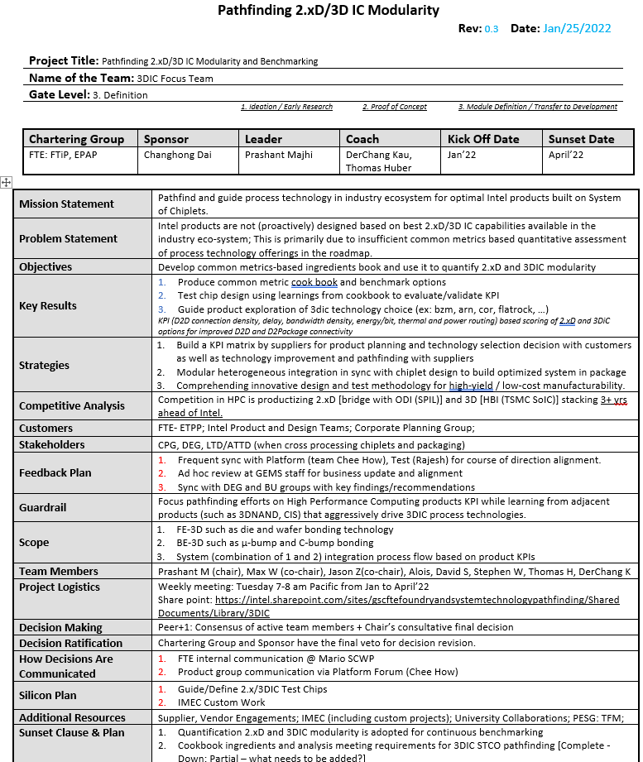
2.XD/3DIC Pathfinding Focus Team: Charter, Milestones

Slide 6
Chips/Chip, Wafer
3D Stacking
(FE 3D connects chiplets by stacking)
Chips/Substrate
2.X D Stacking
(BE 3D is an adaptor technology in Packaging)
3DIC
Memory
Interconnects
Transistors
Adaptor
Bonding Interface
Transistors
Logic
Interconnects
Memory
Si
Bonding Interface T
Substrate
CoWoS
Transistors
Interconnects
Memory
Interconnects
Transistors
Transistors
Logic
Interconnects
Interconnects
Bonding Interface B
Transistors
Si
Adaptor (TSV)
Substrate
EFB
Logic
Memory
Interconnects
Transistors
Bonding Interface B-S
Substrate
Transistors
Logic
Interconnects
Si
Substrate
EMIB

Slide 7
Ingredients of BE 3D (2.x D Stacking)

Slide 8
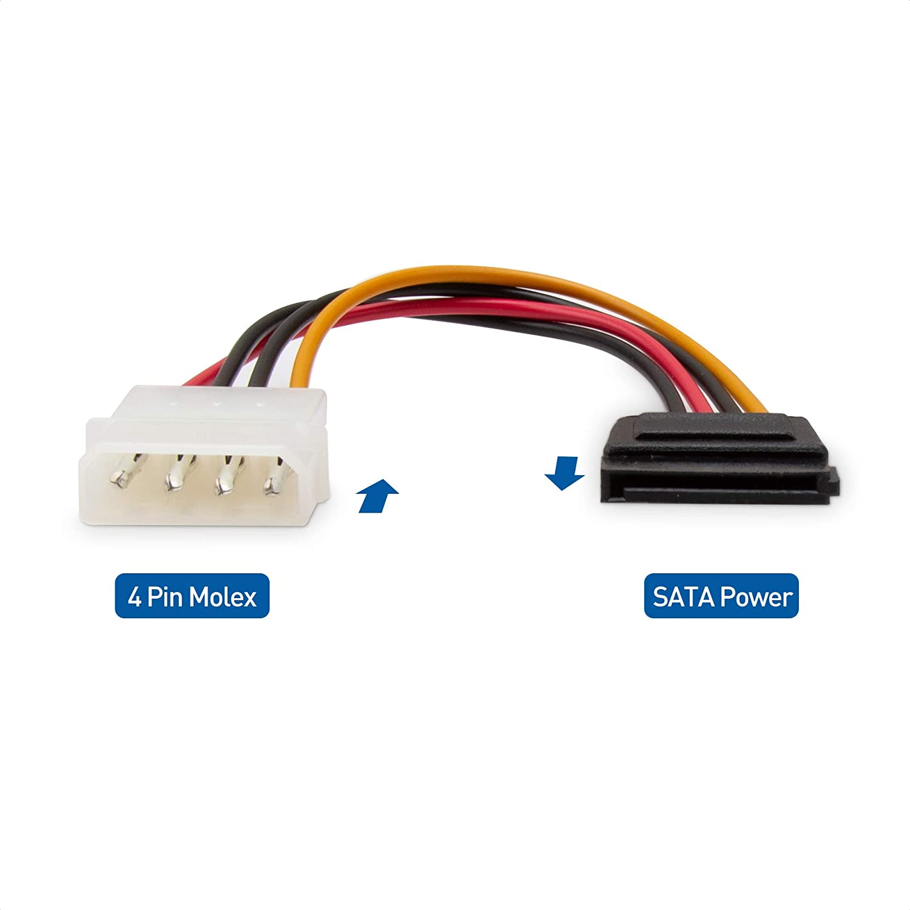
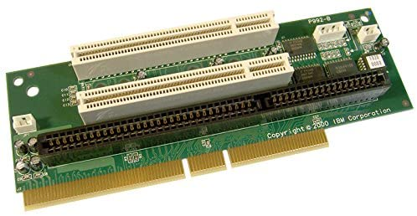
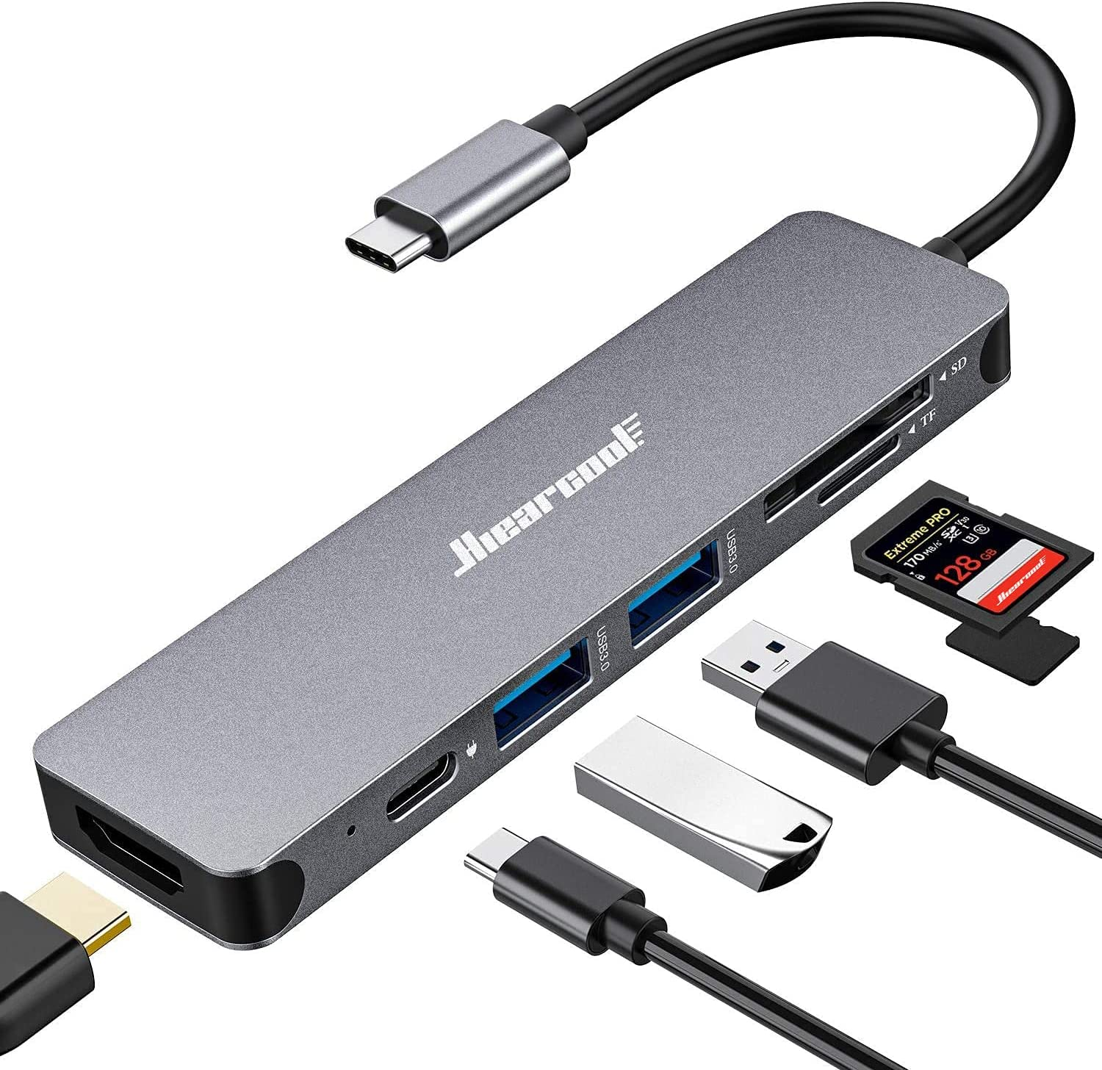
Connectivity for Electronic Components
Each adaptor possesses two basic functions
Bonding Interface (and/or Plug) serves an interface of the component connecting to the other
Connector serves for
  Wiring for signal and power routing (parasitics),
  Impedance matching or signal filtering (passives) Function augmentation (passives and/or active)

Slide 9
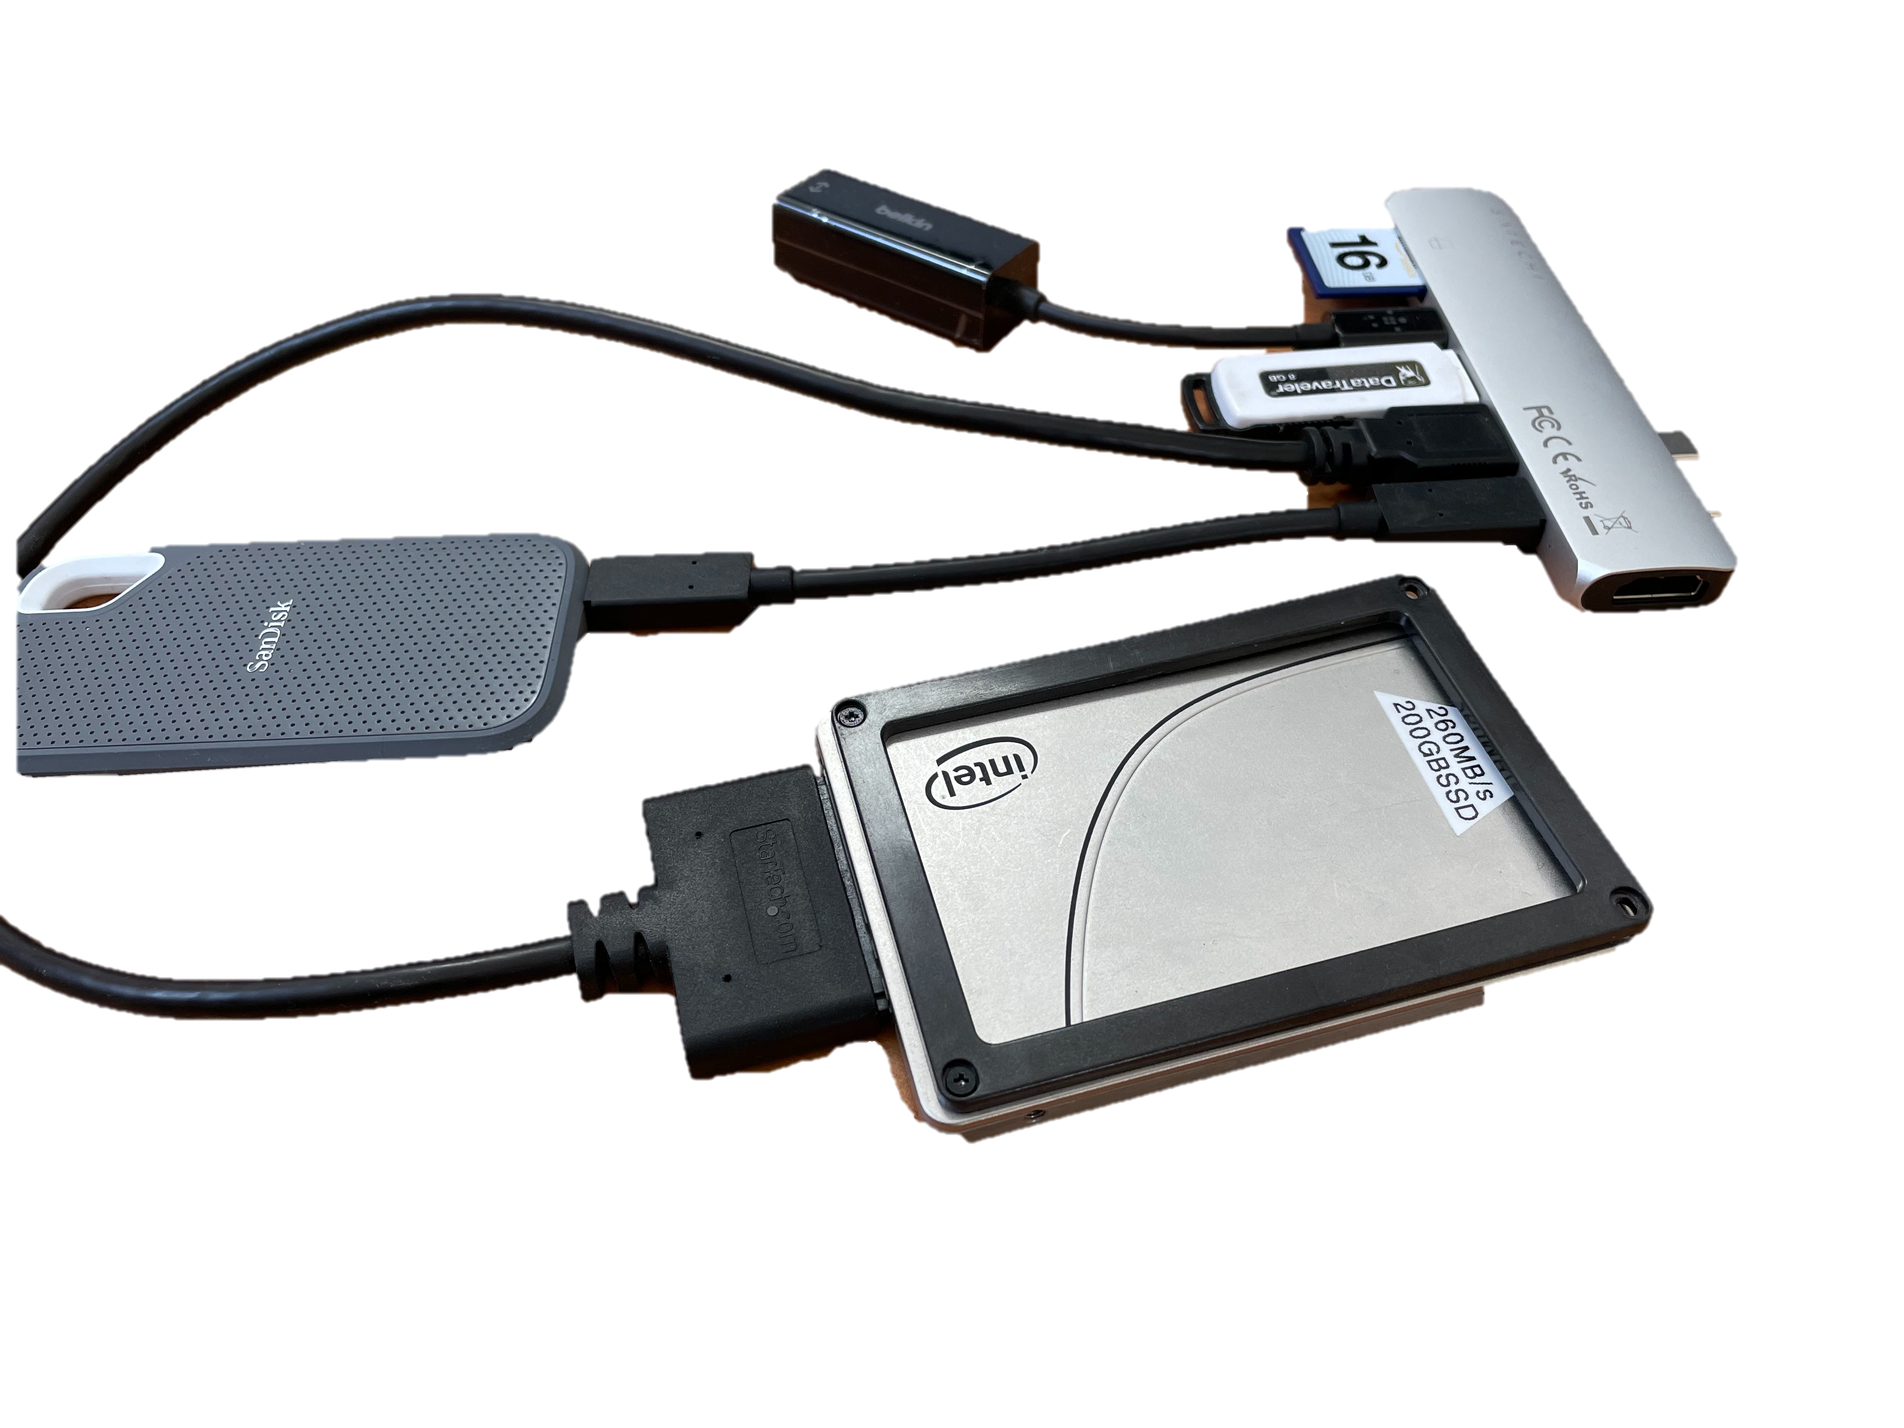
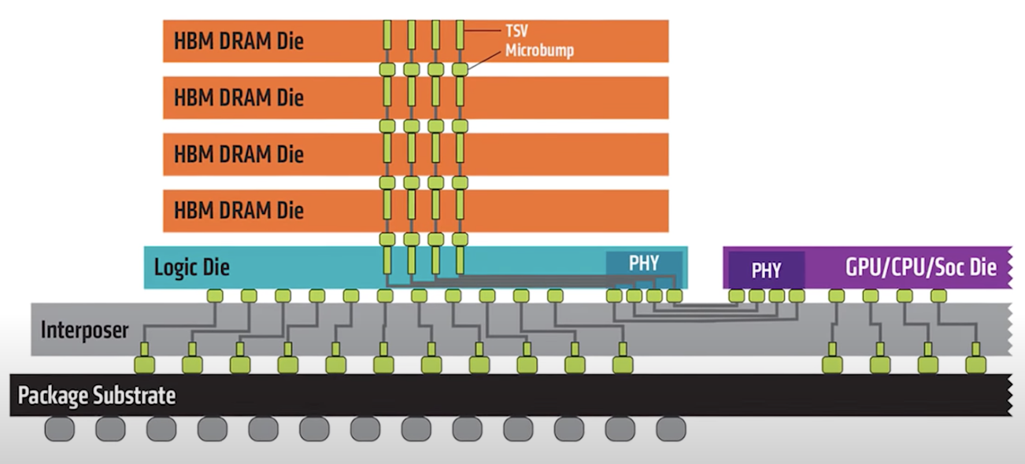
A Parallel to 3DIC
IP Blocks
Adaptor

Slide 10
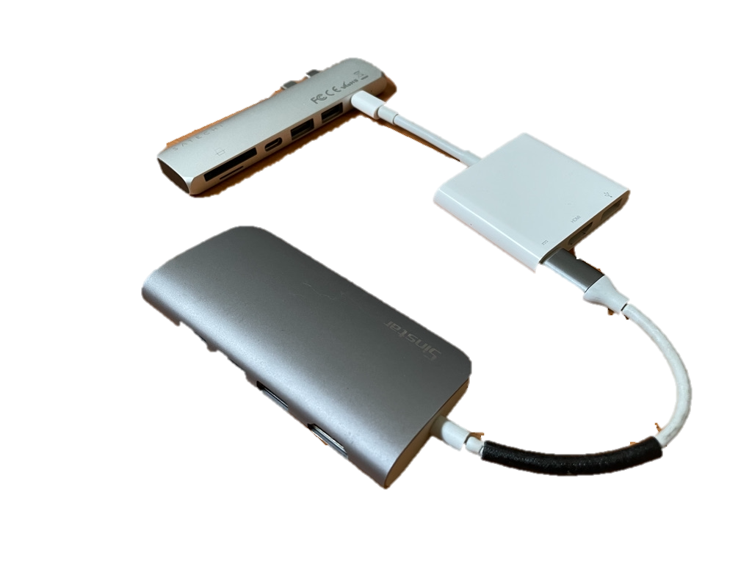
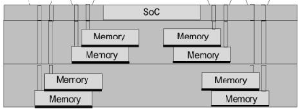
Yet another parallel to 3DIC
Adaptor-on Adaptor
Memory
Memory
Memory
Memory
Memory
Memory
Memory
Memory
SoC
AJ Su, et.al., ECTC 2019 (https://ieeexplore.ieee.org/document/8811022)

Slide 11
Features of “Adaptor” for 3DIC connectivity
Bonding Interface: front and back interfaces (ie. C4, µB and HB) connecting chiplets and substrate
Stacking: lateral and vertical layering capability
Interconnect: wiring (ie. ReDistribution Layer and Thru-Mold-Via) for signal and power routing
Embedding: including
  bridges for fine pitch routing
  passives for impedance balancing and/or signal filtering
  actives for functionality augmentation

Slide 12
Genealogy of 2.x D
Si Interposer
2.5D
Substrate
Embedded Bridge
Bridge-Less
Elevated Bridge
EMIB
2.3 D
FO-EB-T

Slide 13
Genealogy of 2.x D
FOV-ODI
Start [Cu Post => Emb-Chip => RDL => Chiplets]
Finish
FO-EB-T
Chiplet 1
Chiplet 2
Emb-Chip
Cu Post
RDL
Substrate
Start [RDL => Cu Post => Emb-Chip => RDL => Chiplets]
Finish
INFO-L
Chiplet 1
Chiplet 2
bridge
Cu
Substrate
Start [Chiplets => Emb-Chip => Cu Post => RDL => Substrate]
Finish

Slide 14
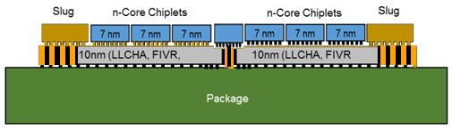
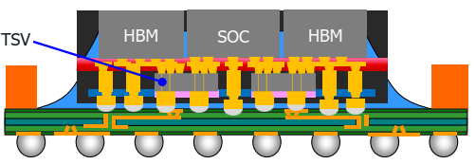
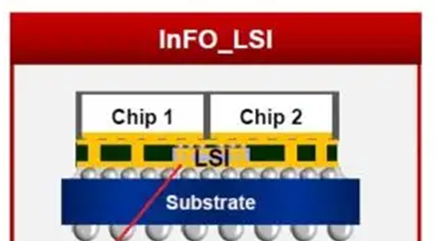
Adaptor (2.x D) Cookbook
Adaptor 2.xD Technology | Name | Foveros Omni | FO-EB-T | InfO_LSI
 | Supplier | Intel | SPIL | TSMC
 | Substrate Size | 100·100mm² | 100·100mm² | 65·65mm²
 | Readiness (yield trajectory TBD) | 2025 | 2024 | 2021
Bonding Interface | Module Size | 700mm² | 3000mm² | 1700mm²
 | Process | Chip Last | Chip Last | Chip First
 | Chiplet i/f | µB | µB | µB / Cu Via
 | Pitch [µm] | 25 | 20 | 25
 | Subst i/f | C4 | C4 | C4
 | Pitch [µm] | 110 | 80 | 90
 | distance_{max} to edge_{mold} | 750µm
Stacking | # of Die placement | No Limitation | No limitation | No limitation
 | thickness | 160 µm | up to 700µm (HBM) | 100µm
Interconnect | RDL material | Cu in PBO or Polyimide | Cu in Polyimide | Cu in Polyimide
 | # of RDL layers | 1 top Layer No bottom Layer | 3 Top layers 2 bott layers | No Top RDL 2 bott Layers
 | RDL Design Rules | 5/5µm L/S | 5/5µm L/S 7/14µm via/landing | 5/5µm L/S
 | Post material | Cu | Cu | Cu
 | Post Diameter | 70/64/58 µm | 60µm
 | Post Pitch | 110µm | 90µm
 | Post height | 112µm | 105µm
 | Post keep out zone | 40µm
Embedding capability | Integrated Passives | Cache, VR etc | MiMCap, StackCap | DT Cap, MiM cap, Inductor
 | Lateral aspect ratio | <10 | <4 | <10
 | Chiplet min. spacing | 40µm
 | Materials | Si | Si/Oxide
 | Thickness | 50µm | 50µm
 | TSV | YES | Yes
Foveros Omni
FO-EB-T

Slide 15
Key Takeaways from 2.x D Cookbook Analysis
Key Metrics for Modular Designs: Scalability for (A) # of chiplets/package and (B) connectivity [improved d2d (and d2package) connection density, BW and Energy/Bit]
For (A) ➔ All 3 options (FV-ODI, FO-EB-T, Info-L) are scalable for large #dies/package
For (B) ➔ Which of these options provide best scaling for connection density and is compatible to HBI? ➔ Post First or Post Last [a.k.a Chip-First or Last]?
Other considerations: FV-ODI total stack thickness <300um complicates HBM like integration
Follow-up’s: Identify dependency (and flexibility) based on integration flow
  Chip-First vs Chip-Last
  Cu Post before (or after) base Chip attach
  Flexible control of base chip and top chip thickness
  …

Slide 16
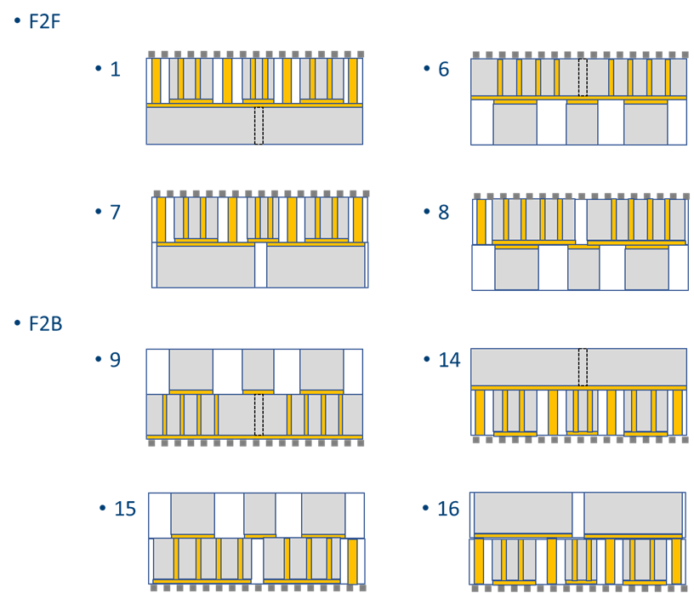
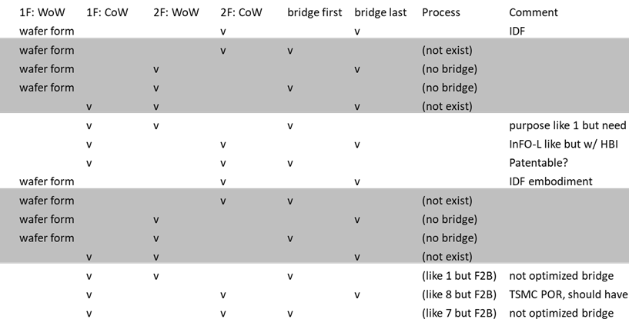
Can 2.xD Support Hybrid Bonding?
Chiplet 1
Chiplet 2
Scaling Connection density and energy via hybrid bonding?
bridge
Cu
Substrate
WIP: Max’s First Pass Assessment

Slide 17
Ingredients of FE 3D (Chiplet Stacking)

Slide 18
3DIC: Decision Tree
Key Takeaways
Multiple configurations of 3D stacking possible
Power, Signal and Thermals are key considerations
3DIC Hybrid Bonding is Front-End Process and hence RDL (routing) is Cu DD process
Base/Bottom Die is critical for 3DIC configs
  Die thickness, TSV and HB Pitch critical
  Need to quantify
    Bonding Layer: uBump/HB [R, C, L]
    TSV [R, C, L]
    Consider 1st and 2nd order impact based on complete routing path [Elmore]
Assess pros/cons of different stacking to guide high ROI modular designs
3DIC Decision Tree
Logic-Logic; Logic-Memory
3D Stacking
Same node; Mixed Node
Memory/Logic
F2F, F2B; TD > = < BD
Routing [dedicated for HB; Testing pad KGD]
Transistors
Bonding Interface T
Interconnects
ubump
L0
Hybrid bonding
Res
Bonding Interface B
Cap
Interconnects
CD/H; AR
Ind
Transistors
TSV
Isolated, Bundle
Integration: Mid, Last
Si (Bottom):
Bonding Interface D2P/S
Die Last
L1
Die First
Substrate/Package

Slide 19
3D Stacking (Chiplet Technology) Cookbook
3D Technology | Name | Foveros Direct (F2F) | SoIC-CoW (F2B) | SoIC-CoW (F2F) | SoIC-WoW (F2F)
 | Supplier | Intel | TSMC | TSMC | TSMC
 | Die Size (Max/Min for Top or Base)
 | Readiness (Yield trajectory) | 2025 | 2022 | 2022 | 2017
Surface Bonding Interface (Top to Base) | Process (T2B) | F2F | F2B | F2F | F2F
 | Chiplet i/f | HB | HB | HB | HB
 | Pitch [µm] | 9 | 9 (21), 6(22), 4.5(24) | TBD | TBD
 | RDL Top Surface | Cu DD | Cu DD | Cu DD | Cu DD
 | RDL Base Surface | Cu DD | -- | Cu DD | Cu DD
Stacking | # of Die placement (Top) | No Limitation | No limitation | No limitation | 1
 | # of Die placement (Base) | No Limitation | No limitation | No limitation | 1
 | Die thickness (Top) | 50-100 | Scalable down to ~10um | TBD | No limitation
 | Die thickness (Base) | 50-100 | Scalable down to ~10um | TBD | Scalable < 2 um
 | Chiplet min. spacing and gap fill | ?, mold | 1-5 um?, oxide
 | Embedding capability | Yes | Yes | Yes | NA
Base Die Characteristics | TSV CD | 8? | 2 (21), XYZ (22+) | TBD | Scalable to n-TSV
 | TSV Pitch | 15? | = HB Pitch (9, 6, 4.5) | TBD | Scalable
 | TSV Height | 80? | 8 (21), XYZ (22+) | TBD | Scalable
 | TSV Material | Cu | Cu | Cu | Cu, W
 | TSV Process (First, Mid, Last) | Mid | Mid | Mid | Mid and Last
 | TSV KOZ | 8? | TBD | TBD | Scalable
Base Die capability | BD Function | Logic, Cache, DRAM | Logic, Cache, DRAM | Logic, Cache, DRAM | DTC, Logic, Cache, DRAM, NVM
 | Size or Shape Restriction
WIP

Slide 20
Advanced Process Node Readiness for 3D
Chiplet | Technology | P1222 | 10FV | 7FV | Intel 4 | Intel 3 | Intel 20A | Intel 18A | N7 | N5 | N3B | N3E | N2 | 3GAP | 4LP
 | Supplier | Intel | Intel | Intel | Intel | Intel | Intel | Intel | TSMC | TSMC | TSMC | TSMC | TSMC | Samsung | Samsung
 | Technology type | logic/edram/ms | logic/ms | logic/ms | Logic | Logic | Logic | Logic | logic/SRAM | Logic/SRAM | Logic | Logic | Logic | Logic | Logic/SRAM
 | Bonding Side | Surface + Back | Surface +Back | Surface + Back | Surface | Surface | Surface | Surface | Surface/Backside | Surface/Backside | Surface | Surface | Surface | Surface | Surface/Backside
 | Chiplet thickness | ~80 µm | ~70 µm | ~50 µm | TBD | TBD | TBD | TBD | Scale ~ 10 µm | Scale ~ 10 µm | TBD | TBD | TBD | TBD | TBD
 | Readiness | 2020 | 2022 | 2023 | 2023 | 2024 | 2025 | 2025 | 2021 | 2022 | 2024 | 2024 | TBD | TBD | TBD
Surface bonding | Bonding Interface | µB | µB | µB | µB | µB | µB/HB | µB/HB | µB/HB | µB/HB | HB | HB | HB
 | Pitch [µm] | 25 | 25 | 25 | 25 | 25 | 25/9 | 25/9 | 9 µm | 6 µm | 4.5 µm | 4.5 µm | TBD
 | # of RDL layers
 | RDL Design Rule
 | KGD capability | Yes | Yes | Yes | Yes | Yes |  |  | Yes | Yes | Yes | Yes
Back Side bonding | Bonding Interface | µB | µB | µB |  |  |  |  | HB | HB | TBD | TBD | TBD
 | Pitch [µm] |  |  |  |  |  |  |  | 9 µm | 6 µm | 4.5 µm | 4.5 µm | TBD
 | # of RDL Layers
 | RDL Design Rule
 | TSV material
 | TSV Diameter
 | TSV Pitch
 | TSV Height
 | Keep Out
WIP
Captured in Chiplet Technology Cookbook

Slide 21
3DIC-HBI Options to Benchmark
F2F(std)
F2B(std)
F2F (ODI)
F2B (ODI)
F2F (BS-PDN)
RDL like Routing to HB pads
Si (Top):
Si (Top):
Si (Top):
Si (Top):
Bonding Interface T
Transistors
Si (Top):
Interconnects
Transistors
Transistors
Transistors
Bonding Interface B
Interconnects
Interconnects
Transistors
Interconnects
Interconnects
Interconnects
Interconnects
Transistors
Interconnects
Transistors
Si (Bottom):
Transistors
Si (Bottom):
Transistors
Si (Bottom):
Transistors
Si (Bottom):
Interconnects
Interconnects
Bonding Interface B-S
Substrate
Substrate
Substrate
Substrate
Substrate
Feature | F2F (std) | F2B (std) | F2F (ODI) | F2B (ODI) | F2F (BS-PDN)
Bonding Interface T | Bump/Pad [R,L,C] | Bump/Pad [R,L,C] | Bump/Pad [R,L,C] | Bump/Pad [R,L,C] | Bump/Pad [R,L,C]
Adaptor T-B | --NA-- | TSV (B): micro-TSV | --NA-- | TSV (B): micro-TSV | --NA--
Bonding Interface B | Bump/Pad [R,L,C] | Bump/Pad [R,L,C] | Bump/Pad [R,L,C] | Bump/Pad [R,L,C] | Bump/Pad [R,L,C]
Additional routing T-S | TSV (B) | TSV (B) | TMV | TMV | nano-TSV(B) + IC(B)
Adaptor B-S | TSV (B) | --NA-- | TSV (B) | --NA-- | nano-TSV (B)
Bonding Interface B-S | C4 bump | C4 bump | C4 bump | C4 bump | C4 bump
prashant majhi, FTE

Slide 22
Key Takeaways from 3DIC HBI Cookbook Analysis
Key Metrics for Modular Designs: Scalability for (A) # of chiplets/package and (B) connectivity [improved d2d (and d2package) connection density, BW and Energy/Bit]
3DIC focused on (B); while (A) is supported by 2.xD in combination with 3D
Scaling bond pitch and TSV size critical to improve d2d connectivity => HBI and thin dies
Backside PDN has noteworthy implications to 3D stacking
Quantification of pros/cons between options is WIP …. Need more rigorous assessment ➔ DTS/MTS/IP/Logic-Memory/Test/Cost
Follow-up’s: Identify dependency (and flexibility) based on integration flow
  CoW vs WoW
  CoW: Collective vs Pick n Place; Re-constituted with RDL into wafer form?
  F2F, F2B, process flows with temporary carriers;
  Yield dependence on process flow
  …
Contains or derived from supplier Confidential Information

Slide 23
Building the 3DIC PF Framework and Ingredient Book
Scope | Topics to address | Resources
MTS | Design rules for HB as f(Pitch) Pad size/shape; F2F/F2B; TSV DR and KOZ; Wafer/Die thinning and spec for CoW (direct or collective) and WoW | Internal Assessment; Process Vendor engagements; IMEC simulations/Experiments; PTD/ATTD assessment;
DTS | Interconnect density; HB and TSV parasitics for different F2F/F2B configurations; Stack d2d signal latency from Tx-to-Rx; power/bit; | Internal Assessment; EDA Vendor engagements; IMEC simulations/Experiments; PTD/ATTD assessment;
IP & Collaterals for Library | I/O-Free or I/O-light based routing considerations; HB pad as f(Mx) and KOZ for routing considerations; HB vs uBump D2D connectivity benchmarking (CXI in 3D) | Internal Assessment; EDA/Foundry engagements;
Memory and Sub-System | SRAM cache sub-system disaggregation; DRAM cache or memory sub-system disaggregation; PMEM NVM-Storage | Internal Assessment; EDA Vendor engagements; IMEC simulations/Experiments; PTD/ATTD assessment;
3DIC Cost and Yield Analysis | Process Cost Analysis from bottom-up; Total Cost of Ownership including Yield impact | Internal Assessment; Sponsored engagements; IMEC assessments;
Note: Did not include test considerations and TFM with EDA readiness for 3D APR, although they are critical components for 3DIC ecosystem

Slide 24
3DIC Modularity Scorecard
Use the common metrics of the ingredients book to quantify 3DIC modularity
A Modular system consists of independent modules with clearly defined interfaces that can be specified and verified.
Besides benchmarking the technical merit of the common metrics, we should use a modularity scorecard to address
  Cohesion – dissimilarity of functions in one module, ie. function overload (ADM in MTL)
  Coupling – interaction within and between modules
Other Figures of Merit in modularity¶ include
  Change Control – Reconfigurability, Adaptability.
  Latitude & Roadmap – Reusability, Alterability, Scalability
  Cost & Projection – Complexity, Standardization.
  Compatibility – Commonality, Customization, Substitutability
  ¶: https://ieeexplore.ieee.org/document/7069975, Regine Dörbecker et.al., 2015 48th Hawaii International Conference on System Sciences

Slide 25
Backup

Slide 26
F2F(Std)
F2B(std)
F2F (ODI)
F2B (ODI)
F2F (BS-PDN)
RDL like Routing to HB pads
Si (Top):
Si (Top):
Si (Top):
Si (Top):
Socket T
Transistors
Transistors
Si (Top):
Interconnects
Interconnects
Transistors
Transistors
Socket B
Interconnects
Interconnects
Key Process Features | Electrical Spec | Physical Spec | Comments
Bonding Pads | R, L, C as f(Pitch) | # connections/mm2; DR layout
TSV for F2F | R, L, C as f(Size) | # TSV/mm2; AR; KOZ
TSV (micro) for F2B
TDV/TMV (for ODI) | R as f(Pitch/Size) | # TDV/mm2;
RDL like layer for HB
Interconnects
Transistors
Interconnects
Transistors
Interconnects
Interconnects
Transistors
Si (Bottom):
Transistors
Si (Bottom):
Si (Bottom):
Transistors
Transistors
Si (Bottom):
Interconnects
Interconnects
Socket B-S
Substrate
Substrate
Substrate
Substrate
Substrate
Feature | F2F (std) | F2B (std) | F2F (ODI) | F2B (ODI) | F2F (BS-PDN)
Socket T | Bump/Pad [R,L,C] | Bump/Pad [R,L,C] | Bump/Pad [R,L,C] | Bump/Pad [R,L,C] | Bump/Pad [R,L,C]
Adaptor T-B | --NA-- | TSV (B): micro-TSV | --NA-- | TSV (B): micro-TSV | --NA--
Socket B | Bump/Pad [R,L,C] | Bump/Pad [R,L,C] | Bump/Pad [R,L,C] | Bump/Pad [R,L,C] | Bump/Pad [R,L,C]
Additional routing T-S | TSV (B) | TSV (B) | TMV | TMV | nano-TSV(B) + IC(B)
Adaptor B-S | TSV (B) | --NA-- | TSV (B) | --NA-- | nano-TSV (B)
Socket B-S | C4 bump | C4 bump | C4 bump | C4 bump | C4 bump

Slide 27
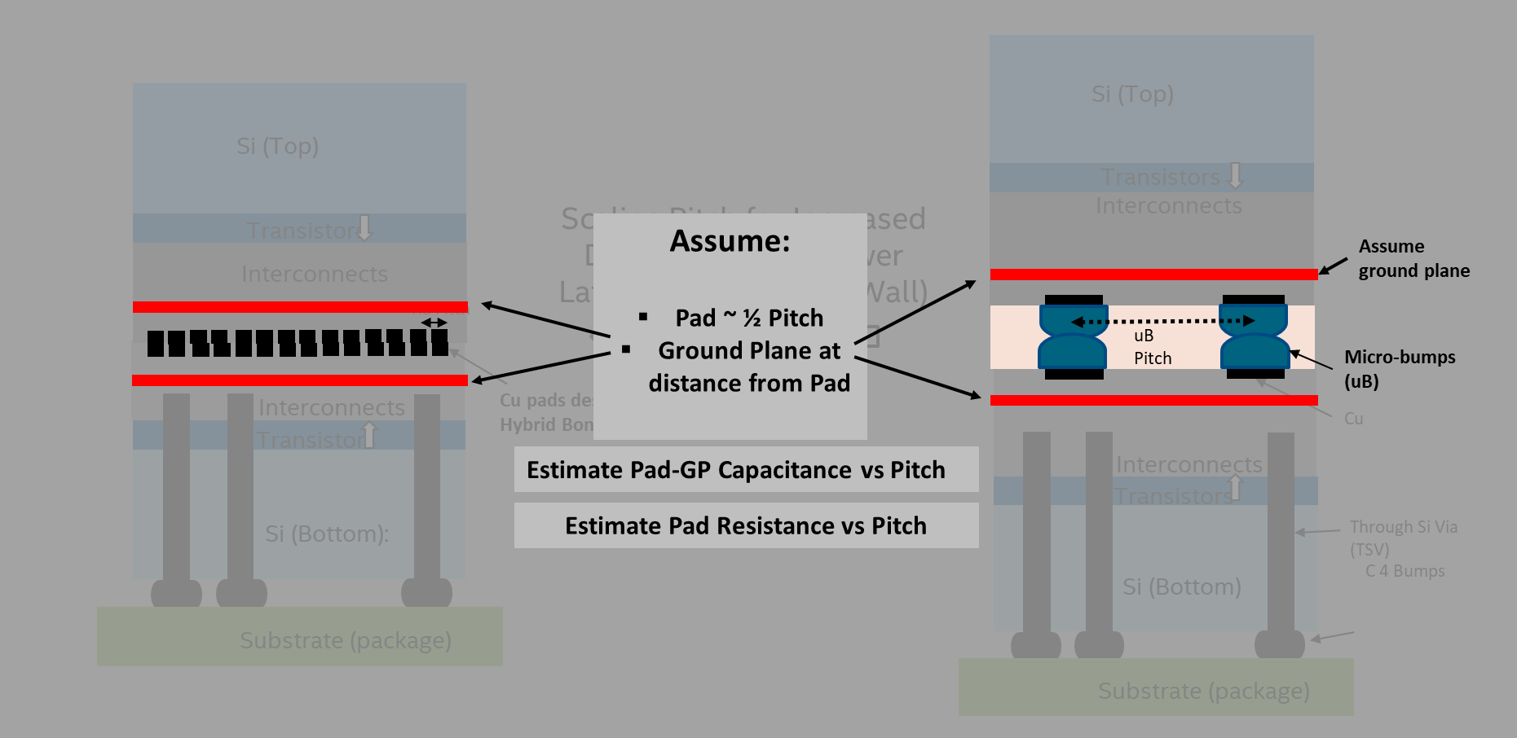
Bonding Layer: uBump / HB Considerations
R, L, C as function of Pitch
Routability [especially for fine P]
Testing for KGD?
ESD need/strategy?

Slide 28
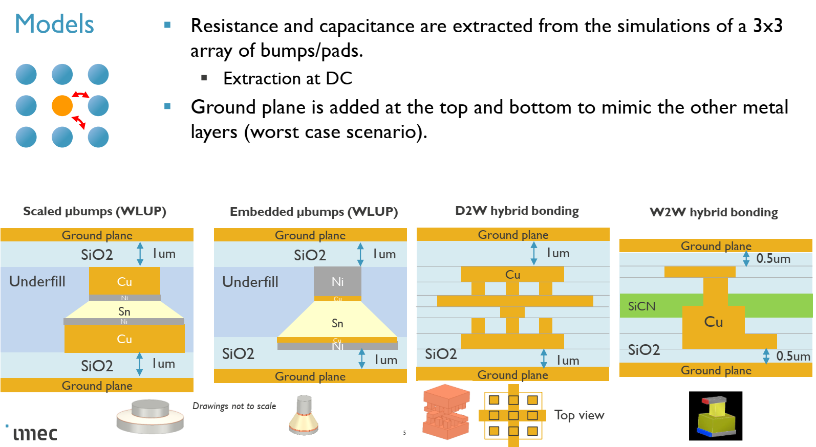
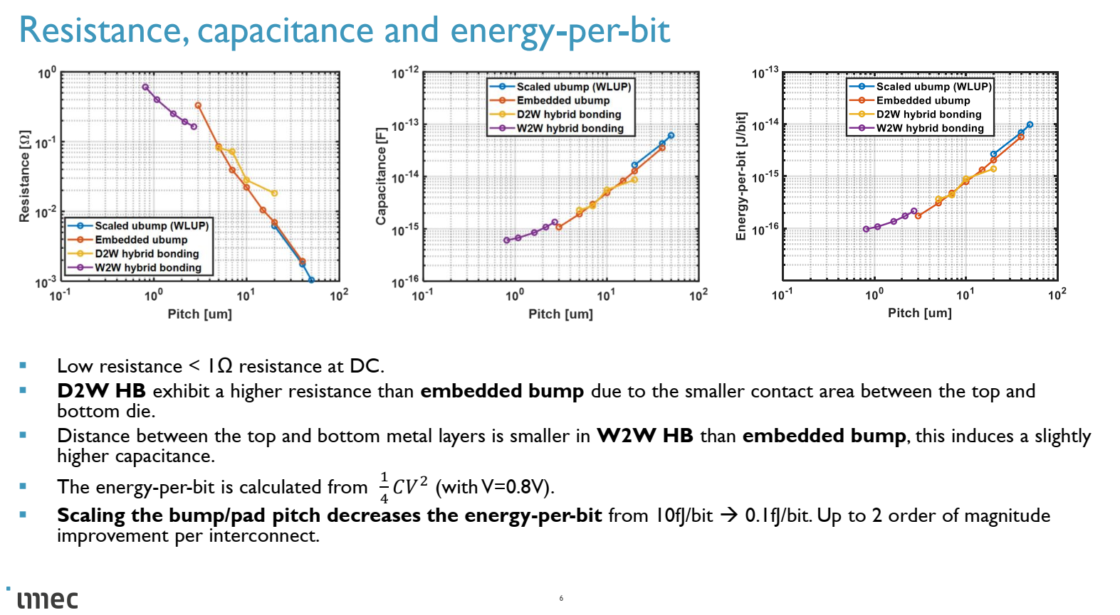
3DIC: uBump ➔ HB: Guesstimating Parasitics [Only Pads]
Crude: Excel Math
IMEC Simulations (Partial Calibration)
 |  | E0 (F/cm) = | 8.85E-14 | E0 (fF/um) = | 8.85E-03
 |  | Capacitance= | A*E0*Er/D
 | Square Pad | Simple Math
 | P | CD | A | D | Er | Pad C
 | Pad Pitch (um) | Pad Size (um) | Pad Area (um2) | Pad to Ground Plane Thickness (um) | Dielectric K | Pad Capacitance (fF) | Total Pad Capacitance (fF)
 | 1 | 0.5 | 0.25 | 1 | 3.9 | 8.63E-03 | 1.73E-02
 | 2 | 1 | 1 | 1 | 3.9 | 3.45E-02 | 6.90E-02
 | 4 | 2 | 4 | 1 | 3.9 | 1.38E-01 | 2.76E-01
 | 6 | 3 | 9 | 1 | 3.9 | 3.11E-01 | 6.21E-01
 | 9 | 4.5 | 20.25 | 1 | 3.9 | 6.99E-01 | 1.40E+00
 | 10 | 5 | 25 | 1 | 3.9 | 8.63E-01 | 1.73E+00
 | 16 | 8 | 64 | 1 | 3.9 | 2.21E+00 | 4.42E+00
 | 20 | 10 | 100 | 1 | 3.9 | 3.45E+00 | 6.90E+00
 | 26 | 13 | 169 | 1 | 3.9 | 5.83E+00 | 1.17E+01
 | 36 | 18 | 324 | 1 | 3.9 | 1.12E+01 | 2.24E+01
 |  | Resistance = | r*L/A | Cu rho (ohm.um)= | 1.70E-02
 |  | CD | L
 | Pad Pitch (um) | Pad Size (um) | Pad Height (um) | Metal rho (ohm.um) | Pad Resistance (ohm) | total Pad R (ohm)
 | 1 | 0.5 | 1 | 1.70E-02 | 6.80E-02 | 1.36E-01
 | 2 | 1 | 1 | 1.70E-02 | 1.70E-02 | 3.40E-02
 | 4 | 2 | 1 | 1.70E-02 | 4.25E-03 | 8.50E-03
 | 6 | 3 | 1 | 1.70E-02 | 1.89E-03 | 3.78E-03
 | 9 | 4.5 | 1 | 1.70E-02 | 8.40E-04 | 1.68E-03
 | 10 | 5 | 1 | 1.70E-02 | 6.80E-04 | 1.36E-03
 | 16 | 8 | 1 | 1.70E-02 | 2.66E-04 | 5.31E-04
 | 20 | 10 | 1 | 1.70E-02 | 1.70E-04 | 3.40E-04
 | 26 | 13 | 1 | 1.70E-02 | 1.01E-04 | 2.01E-04
 | 36 | 18 | 1 | 1.70E-02 | 5.25E-05 | 1.05E-04
 | Pad Pitch (um) | Total Pad Capacitance (fF)
 | 1 | 0.0172575
 | 2 | 0.06903
 | 4 | 0.27612
 | 6 | 0.62127
 | 9 | 1.3978575
 | 10 | 1.72575
 | 16 | 4.41792
 | 20 | 6.903
 | 26 | 11.66607
 | 36 | 22.36572
 | Pad Pitch (um) | total Pad R (ohm)
 | 1 | 0.136
 | 2 | 0.034
 | 4 | 0.0085
 | 6 | 0.003777778
 | 9 | 0.001679012
 | 10 | 0.00136
 | 16 | 0.00053125
 | 20 | 0.00034
 | 26 | 0.000201183
 | 36 | 0.000104938
 | Pad Pitch (um) | RC Delay (fs)
 | 1 | 0.00234702
 | 2 | 0.00234702
 | 4 | 0.00234702
 | 6 | 0.00234702
 | 9 | 0.00234702
 | 10 | 0.00234702
 | 16 | 0.00234702
 | 20 | 0.00234702
 | 26 | 0.00234702
 | 36 | 0.00234702
Cap reduces significantly with Pitch scaling
R increases with Pitch scaling but still lower than 1ohm
Energy/bit reduces significantly (~CV2)
RC delay not limiting (<1fs)
Pitch(um)
prashant majhi

Slide 29
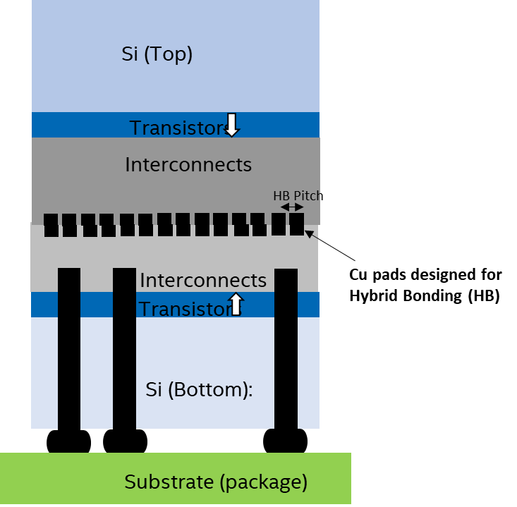
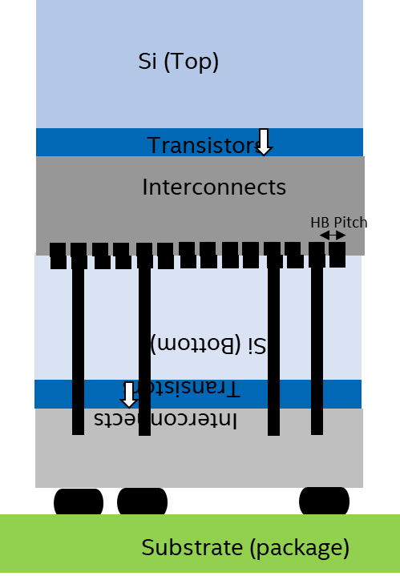
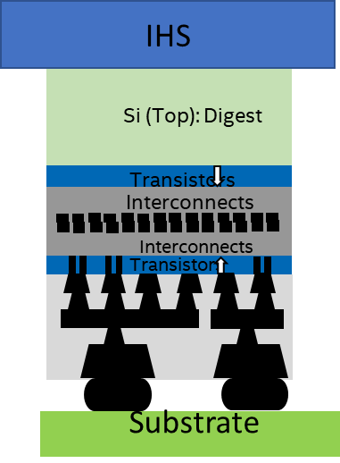
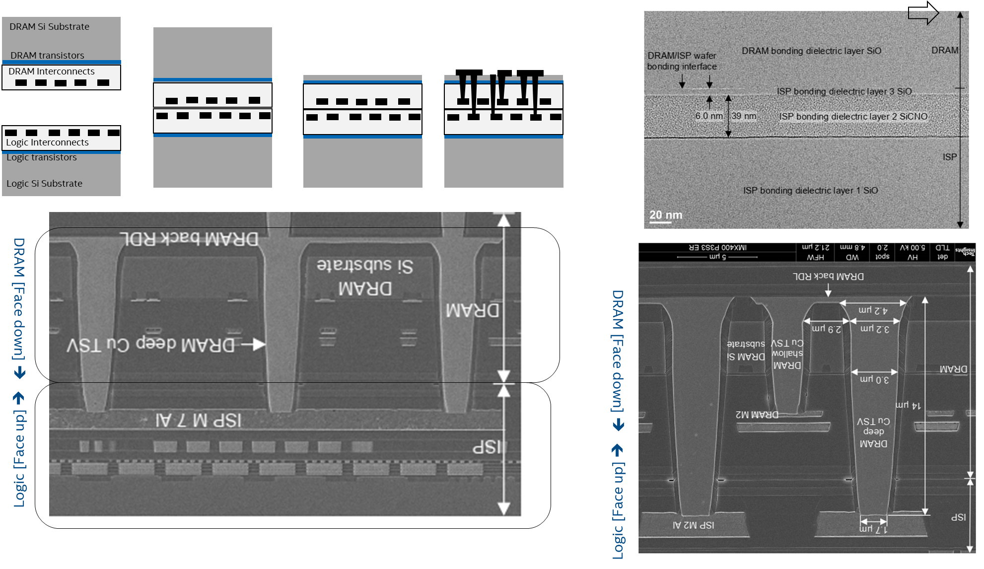
TSV Considerations
F2F
F2B
F2F-Tyche
TSV 1st/Mid/Last Options [F2F, F2B]
R, L, C as function of Dimensions and Materials
KOZ considerations and its impact on density-loss for base die
Bumpless (only TSV: multi height) option
TSV free: With Tyche as base die

Slide 30
TSV Parasitics: R & C
Property | Unit | Tungsten | Copper
Bulk Resistivity | uohm.cm | 6 | 1.7
Microscale Resistivity | uohm.cm | 10 | 3
Process |  | CVD/ALD | EP
Process Temp | oC | ~400 | RT
Aspect Ratio Fill | H/CD | ~30 | ~10
CTE [Note Si = 2.6] | ppm.K-1 | 4.6 | 17
Barrier/Liner |  | TiN | TaN/Cu Seed
Thermal Stability |  | good | poor
Electro Migration |  | good | ok
Melting Point | oK | 6000 | 2000
TSV resistance low [compared to MEOL] even for W (lower for Cu)
TSV Resistance not limiter – need to analyze for Reliability
 | Resistance (ohm): Cu |  |  | rho | 3.00E-02 | Height (Micron)
 |  | 2 | 4 | 6 | 8 | 10 | 12 | 14 | 16 | 18 | 20 | 22 | 24 | 26 | 28 | 30 | 50
CD (Micron) | 1 | 7.64E-02 | 1.53E-01 | 2.29E-01 | 3.06E-01 | 3.82E-01 | 4.58E-01 | 5.35E-01 | 6.11E-01 | 6.88E-01 | 7.64E-01 | 8.40E-01 | 9.17E-01 | 9.93E-01 | 1.07E+00 | 1.15E+00 | 1.91E+00
 | 2 | 1.91E-02 | 3.82E-02 | 5.73E-02 | 7.64E-02 | 9.55E-02 | 1.15E-01 | 1.34E-01 | 1.53E-01 | 1.72E-01 | 1.91E-01 | 2.10E-01 | 2.29E-01 | 2.48E-01 | 2.67E-01 | 2.86E-01 | 4.77E-01
 | 3 | 8.49E-03 | 1.70E-02 | 2.55E-02 | 3.40E-02 | 4.24E-02 | 5.09E-02 | 5.94E-02 | 6.79E-02 | 7.64E-02 | 8.49E-02 | 9.34E-02 | 1.02E-01 | 1.10E-01 | 1.19E-01 | 1.27E-01 | 2.12E-01
 | 4 | 4.77E-03 | 9.55E-03 | 1.43E-02 | 1.91E-02 | 2.39E-02 | 2.86E-02 | 3.34E-02 | 3.82E-02 | 4.30E-02 | 4.77E-02 | 5.25E-02 | 5.73E-02 | 6.21E-02 | 6.68E-02 | 7.16E-02 | 1.19E-01
 | 5 | 3.06E-03 | 6.11E-03 | 9.17E-03 | 1.22E-02 | 1.53E-02 | 1.83E-02 | 2.14E-02 | 2.44E-02 | 2.75E-02 | 3.06E-02 | 3.36E-02 | 3.67E-02 | 3.97E-02 | 4.28E-02 | 4.58E-02 | 7.64E-02
 | 6 | 2.12E-03 | 4.24E-03 | 6.37E-03 | 8.49E-03 | 1.06E-02 | 1.27E-02 | 1.49E-02 | 1.70E-02 | 1.91E-02 | 2.12E-02 | 2.33E-02 | 2.55E-02 | 2.76E-02 | 2.97E-02 | 3.18E-02 | 5.31E-02
 | 7 | 1.56E-03 | 3.12E-03 | 4.68E-03 | 6.24E-03 | 7.80E-03 | 9.35E-03 | 1.09E-02 | 1.25E-02 | 1.40E-02 | 1.56E-02 | 1.72E-02 | 1.87E-02 | 2.03E-02 | 2.18E-02 | 2.34E-02 | 3.90E-02
 | 8 | 1.19E-03 | 2.39E-03 | 3.58E-03 | 4.77E-03 | 5.97E-03 | 7.16E-03 | 8.36E-03 | 9.55E-03 | 1.07E-02 | 1.19E-02 | 1.31E-02 | 1.43E-02 | 1.55E-02 | 1.67E-02 | 1.79E-02 | 2.98E-02
 | 9 | 9.43E-04 | 1.89E-03 | 2.83E-03 | 3.77E-03 | 4.72E-03 | 5.66E-03 | 6.60E-03 | 7.55E-03 | 8.49E-03 | 9.43E-03 | 1.04E-02 | 1.13E-02 | 1.23E-02 | 1.32E-02 | 1.41E-02 | 2.36E-02
 | 10 | 7.64E-04 | 1.53E-03 | 2.29E-03 | 3.06E-03 | 3.82E-03 | 4.58E-03 | 5.35E-03 | 6.11E-03 | 6.88E-03 | 7.64E-03 | 8.40E-03 | 9.17E-03 | 9.93E-03 | 1.07E-02 | 1.15E-02 | 1.91E-02
 | Resistance (ohm): W |  |  | rho | 1.00E-01 | Height (Micron)
 |  | 2 | 4 | 6 | 8 | 10 | 12 | 14 | 16 | 18 | 20 | 22 | 24 | 26 | 28 | 30 | 50
CD (Micron) | 1 | 2.55E-01 | 5.09E-01 | 7.64E-01 | 1.02E+00 | 1.27E+00 | 1.53E+00 | 1.78E+00 | 2.04E+00 | 2.29E+00 | 2.55E+00 | 2.80E+00 | 3.06E+00 | 3.31E+00 | 3.57E+00 | 3.82E+00 | 6.37E+00
 | 2 | 6.37E-02 | 1.27E-01 | 1.91E-01 | 2.55E-01 | 3.18E-01 | 3.82E-01 | 4.46E-01 | 5.09E-01 | 5.73E-01 | 6.37E-01 | 7.00E-01 | 7.64E-01 | 8.28E-01 | 8.91E-01 | 9.55E-01 | 1.59E+00
 | 3 | 2.83E-02 | 5.66E-02 | 8.49E-02 | 1.13E-01 | 1.41E-01 | 1.70E-01 | 1.98E-01 | 2.26E-01 | 2.55E-01 | 2.83E-01 | 3.11E-01 | 3.40E-01 | 3.68E-01 | 3.96E-01 | 4.24E-01 | 7.07E-01
 | 4 | 1.59E-02 | 3.18E-02 | 4.77E-02 | 6.37E-02 | 7.96E-02 | 9.55E-02 | 1.11E-01 | 1.27E-01 | 1.43E-01 | 1.59E-01 | 1.75E-01 | 1.91E-01 | 2.07E-01 | 2.23E-01 | 2.39E-01 | 3.98E-01
 | 5 | 1.02E-02 | 2.04E-02 | 3.06E-02 | 4.07E-02 | 5.09E-02 | 6.11E-02 | 7.13E-02 | 8.15E-02 | 9.17E-02 | 1.02E-01 | 1.12E-01 | 1.22E-01 | 1.32E-01 | 1.43E-01 | 1.53E-01 | 2.55E-01
 | 6 | 7.07E-03 | 1.41E-02 | 2.12E-02 | 2.83E-02 | 3.54E-02 | 4.24E-02 | 4.95E-02 | 5.66E-02 | 6.37E-02 | 7.07E-02 | 7.78E-02 | 8.49E-02 | 9.20E-02 | 9.90E-02 | 1.06E-01 | 1.77E-01
 | 7 | 5.20E-03 | 1.04E-02 | 1.56E-02 | 2.08E-02 | 2.60E-02 | 3.12E-02 | 3.64E-02 | 4.16E-02 | 4.68E-02 | 5.20E-02 | 5.72E-02 | 6.24E-02 | 6.76E-02 | 7.28E-02 | 7.80E-02 | 1.30E-01
 | 8 | 3.98E-03 | 7.96E-03 | 1.19E-02 | 1.59E-02 | 1.99E-02 | 2.39E-02 | 2.79E-02 | 3.18E-02 | 3.58E-02 | 3.98E-02 | 4.38E-02 | 4.77E-02 | 5.17E-02 | 5.57E-02 | 5.97E-02 | 9.95E-02
 | 9 | 3.14E-03 | 6.29E-03 | 9.43E-03 | 1.26E-02 | 1.57E-02 | 1.89E-02 | 2.20E-02 | 2.52E-02 | 2.83E-02 | 3.14E-02 | 3.46E-02 | 3.77E-02 | 4.09E-02 | 4.40E-02 | 4.72E-02 | 7.86E-02
 | 10 | 2.55E-03 | 5.09E-03 | 7.64E-03 | 1.02E-02 | 1.27E-02 | 1.53E-02 | 1.78E-02 | 2.04E-02 | 2.29E-02 | 2.55E-02 | 2.80E-02 | 3.06E-02 | 3.31E-02 | 3.57E-02 | 3.82E-02 | 6.37E-02
prashant majhi

Slide 31
TSV Parasitics: R & C
TSV Capacitance dependent on dimensions (and insulator thickness) and can get high
TSV Capacitance can be limiter/decider
 | TSV |  | insulation thk (um) |  | 0.2
 | Capacitance (fF) |  |  |  |  | Height (Micron)
 |  | 2 | 4 | 6 | 8 | 10 | 12 | 14 | 16 | 18 | 20 | 22 | 24 | 26 | 28 | 30 | 50
CD (Micron) | 1 | 0.3 | 0.5 | 0.8 | 1.1 | 1.4 | 1.6 | 1.9 | 2.2 | 2.4 | 2.7 | 3.0 | 3.3 | 3.5 | 3.8 | 4.1 | 6.8
 | 2 | 1.1 | 2.2 | 3.3 | 4.3 | 5.4 | 6.5 | 7.6 | 8.7 | 9.8 | 10.8 | 11.9 | 13.0 | 14.1 | 15.2 | 16.3 | 27.1
 | 3 | 2.4 | 4.9 | 7.3 | 9.8 | 12.2 | 14.6 | 17.1 | 19.5 | 22.0 | 24.4 | 26.8 | 29.3 | 31.7 | 34.2 | 36.6 | 61.0
 | 4 | 4.3 | 8.7 | 13.0 | 17.3 | 21.7 | 26.0 | 30.4 | 34.7 | 39.0 | 43.4 | 47.7 | 52.0 | 56.4 | 60.7 | 65.1 | 108.4
 | 5 | 6.8 | 13.6 | 20.3 | 27.1 | 33.9 | 40.7 | 47.4 | 54.2 | 61.0 | 67.8 | 74.5 | 81.3 | 88.1 | 94.9 | 101.7 | 169.4
 | 6 | 9.8 | 19.5 | 29.3 | 39.0 | 48.8 | 58.6 | 68.3 | 78.1 | 87.8 | 97.6 | 107.3 | 117.1 | 126.9 | 136.6 | 146.4 | 244.0
 | 7 | 13.3 | 26.6 | 39.8 | 53.1 | 66.4 | 79.7 | 93.0 | 106.3 | 119.5 | 132.8 | 146.1 | 159.4 | 172.7 | 186.0 | 199.2 | 332.1
 | 8 | 17.3 | 34.7 | 52.0 | 69.4 | 86.7 | 104.1 | 121.4 | 138.8 | 156.1 | 173.5 | 190.8 | 208.2 | 225.5 | 242.9 | 260.2 | 433.7
 | 9 | 22.0 | 43.9 | 65.9 | 87.8 | 109.8 | 131.7 | 153.7 | 175.7 | 197.6 | 219.6 | 241.5 | 263.5 | 285.4 | 307.4 | 329.4 | 548.9
 | 10 | 27.1 | 54.2 | 81.3 | 108.4 | 135.5 | 162.6 | 189.8 | 216.9 | 244.0 | 271.1 | 298.2 | 325.3 | 352.4 | 379.5 | 406.6 | 677.7
prashant majhi

Slide 32
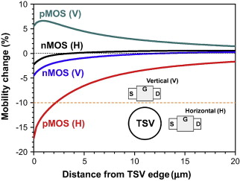
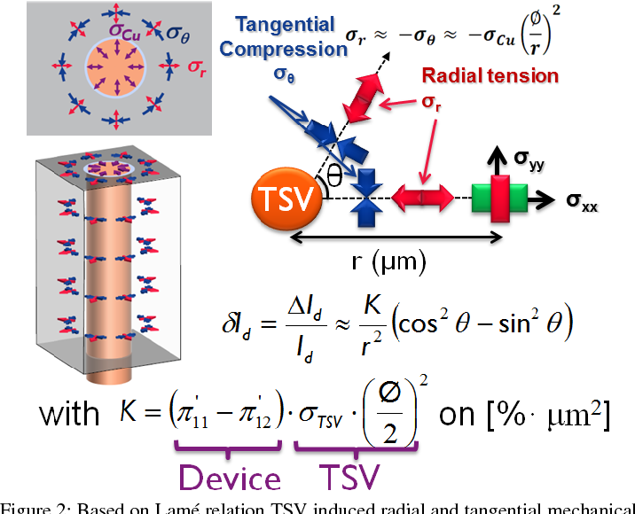
TSV Considerations
TSV 1st/Mid/Last Options [F2F, F2B]
R, L, C as function of Dimensions and Materials
KOZ considerations and its impact on density-loss for base die
  WIP in progress to quantify KOZ… but for now assume KOZ ~ TSV CD [IMEC recommendation]
Bumpless (only TSV: multi height) option
TSV free: With Tyche as base die

Slide 33
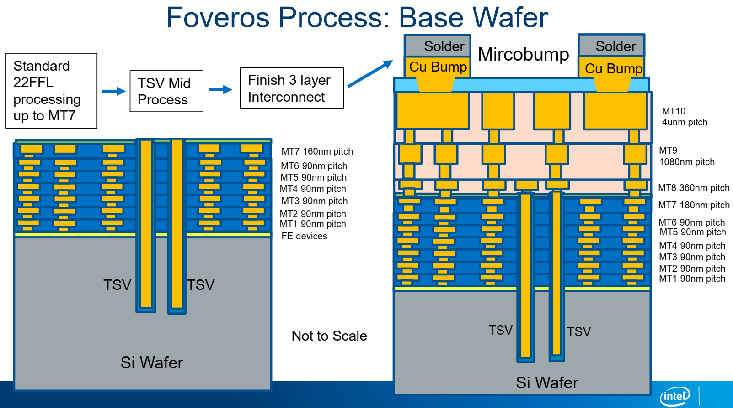
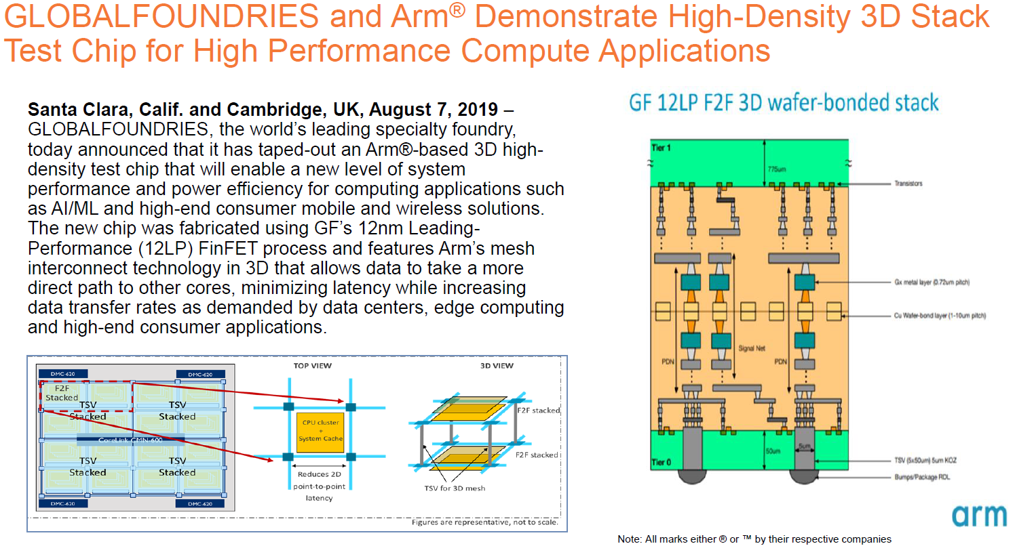
Closer Look at TSV Connection Options
TSV @ M7 of Base
TSV @ M1 of Base

Slide 34
How can elements of 3DIC decision matrix help?
Case studies:
  BZM:
    Logic+Logic
    WoW or CoW?; F2F or F2B?; TSV-free with BS-PDN?;
  COR:
    3D: SRAM+XPU; DRAM+SoC;
    2.xD: XPU stack with I/O Hub
    WoW or CoW?; F2F or F2B?; TSV-free with BS-PDN?;
  Networking Chip: Flatrock (Tofino 4+)
    Logic(HP)+SRAM(&LP logic)
    WoW or CoW?; F2F or F2B?;
  3DIC for MIM+XPU/GPU [Power Integrity]: DG case
    Monolithic –vs- 3DIC DTC/ISC
    WoW or CoW?;
  CCG-LCH ECF: Logic to NVM
    2.xD Logic to NVM (MRAM)
    3D Logic to NVM (NOR)
  3D-NAND:
    CMOS + Array
    New considerations with CoW

