Slide 1
N2P efuse wrapper For DDG/IPG/FTE Bluejay Creek testchip
F. Wei

Slide 2

BlueJayCreek Test Chip
eFuse

Slide 3



Top Level Diagram for TSMC efuse wrapper

Slide 4
Current Status
DDG database is in ZSC10 domain
Applied a 500G disk for efuse work: /nfs/site/disks/nvl_ipo_fwei_wa_01/
We port 2 HIP’s from an existing N3 design:
ipn3fuserosc & ipn3fusevld
Have ported these HIP’s to N2P cheetah workarea:
/nfs/site/disks/nvl_ipo_fwei_wa_01/users/fwei/opuslib/ipn2fuserosc
/nfs/site/disks/nvl_ipo_fwei_wa_01/users/fwei/opuslib/ipn2fusevld
SIP RTL codes & HIP models & IG/collaterals & documents were downloaded from IPX and will be reused:
/nfs/site/disks/nvl_ipo_fwei_wa_01/users/n3_nvl_efuse/fuse_hip.arlca0/ARLCA0_FUSEHIP_PROD_22WW17.2/fusehiptopwrapper
Will begin to run simulations to validate the ported N2P designs
Need layout resource to get familiar with N2P design rules and start layout work soon

Slide 5
Supporting Materials

Slide 6
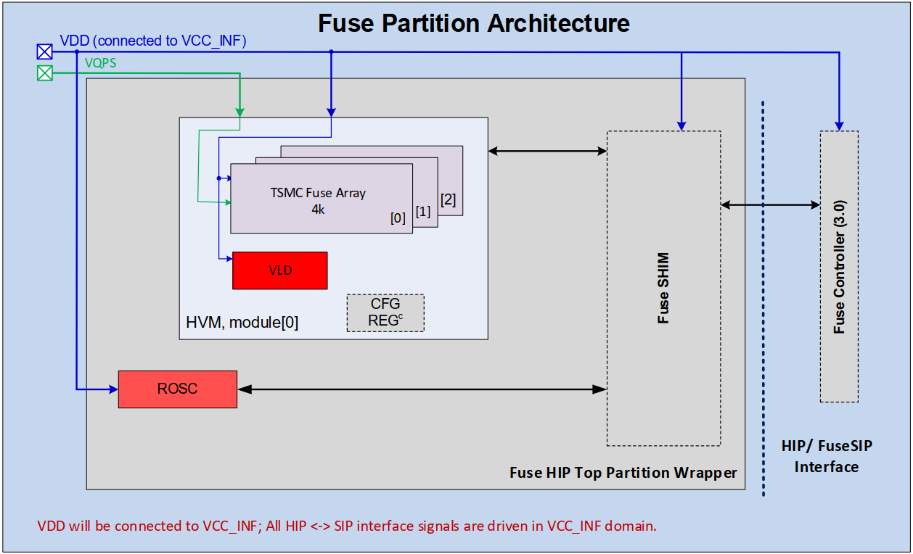


Fuse Partition Diagram

Slide 7
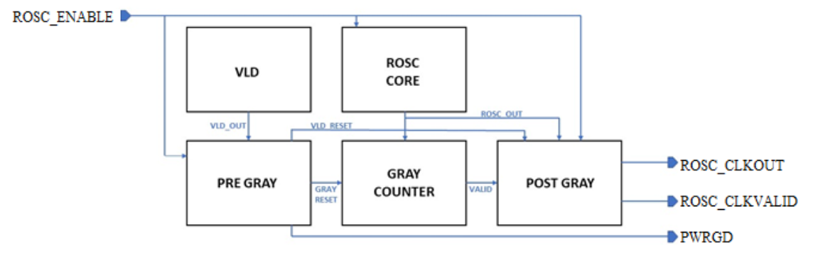
Top Level Diagram for Ring Oscillator
Ipn3fuserosc provides the clock for the fuse partition during fuse sense operation.
This HIP acts as a secure clock for fuse operation since it exhibits wide variance with PVT, is not synchronous with any other clocks, and is not accessible from any pin.
This HIP contains a ring oscillator which generates the clock, an always-on VLD, which helps reset the ring oscillator upon boot-up, and a counter circuit to help filter poor duty cycle before releasing the clock signal from the HIP.
Through additional sequential and combinational logic, this HIP meets ROSC requirements in clocking HAS, and requirements in fuse HAS.

Slide 8
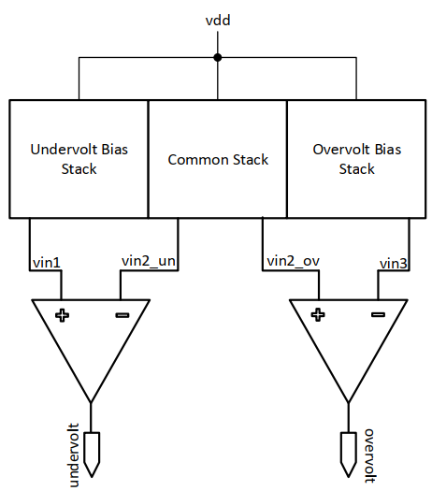
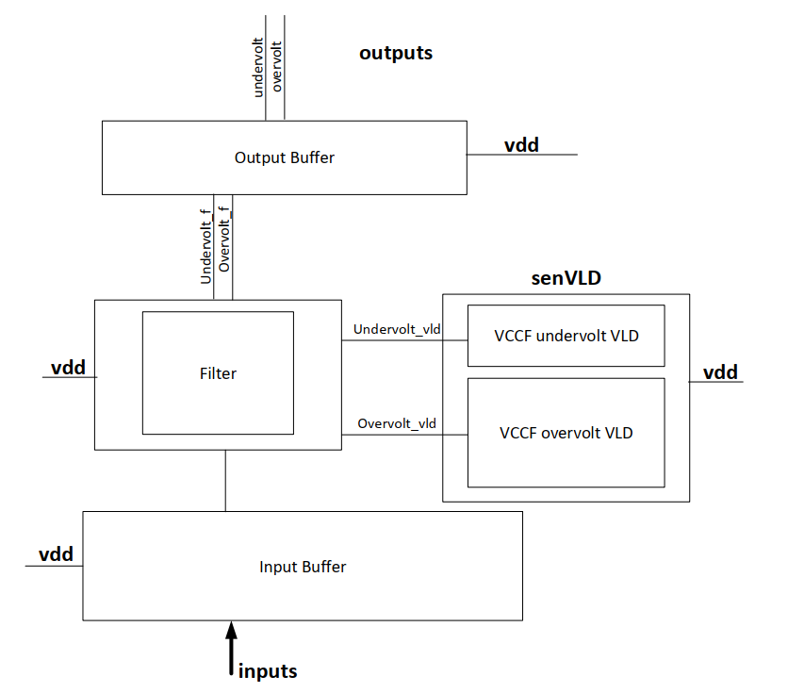
Top Level Diagram for Voltage Level Detector (VLD)
The ipn3fusevld HIP provides voltage-level security for a fuse module during a fuse sense operation.
This HIP monitors vdd voltage rail to ensure it is within the allowed voltage range. If vdd is ‘too low’ or ‘too high’ to safely perform fuse sensing, then ipn3fusevld outputs ‘undervolt’ and ‘overvolt’ are asserted, respectively, which will cause fuse sensing to stop (given that the HIP outputs are not ignored).
There is a digital filter integrated into this HIP to help the VLD filter out transients which do not represent legitimate voltage attacks, and there are power-gates to shut off the VLDs when not in use.
The HIP generates a power-good signal which is a delayed version of undervolt, overvolt, and difference attack, and indicates all supplies to the HIP are within spec.
This HIP also has register inputs as a debug feature, which set the VLD trip points, enable/disable the difference detector, filter, and VLDs, and control the filter bandwidth.
This HIP meets requirements laid out in the Chassis Fuse HAS.

