Slide 1
SRF

Slide 2
Shared between GNR and SRF
Same TFM (Cheetah2)
Same Intel 10nm IO die
Same platform
  Birchstream SP and AP
Same voltage rails
  Might adjust some voltage values
Same clocks
  Scale some ship freq & cycle time targets

Slide 3
Compute Die Roadmap
Note that all of these products are multiple die on multiple process versions. This table is only for the compute die.
Computer Die Process | P1276 | N3 | P1276-E | N3P
Client | Meteor Lake (MTL) (Redwood Cove + Crestmont) | Arrow Lake (ARL) (Lion Cove + Skymont) | Meteor Lake Refresh (MTL-R) (Redwood Cove + Crestmont) | Lunar Lake (LNL) (Lion Cove ST + Skymont + GFX)
Big Core Xeon | Granite Rapids (GNR) (Redwood Cove) | Diamond Rapids HBM (DMR-HBM) (Lion Cove) | Diamond Rapids (Panther Cove) | None
Atom Core Xeon | Old Sierra Forest (Crestmont) | New Sierra Forest aka Sierra Branch (Skymont (SKT) aka Oak Glenn, OGL) | None | Clearwater Forest (CWF) (Darkmont)
 | Low Mem BW | High Mem BW
Low Latency | SPR GNR DMR | SPR-HBM DMR-HBM
Throughput | SRF CWF | KNL

Slide 4
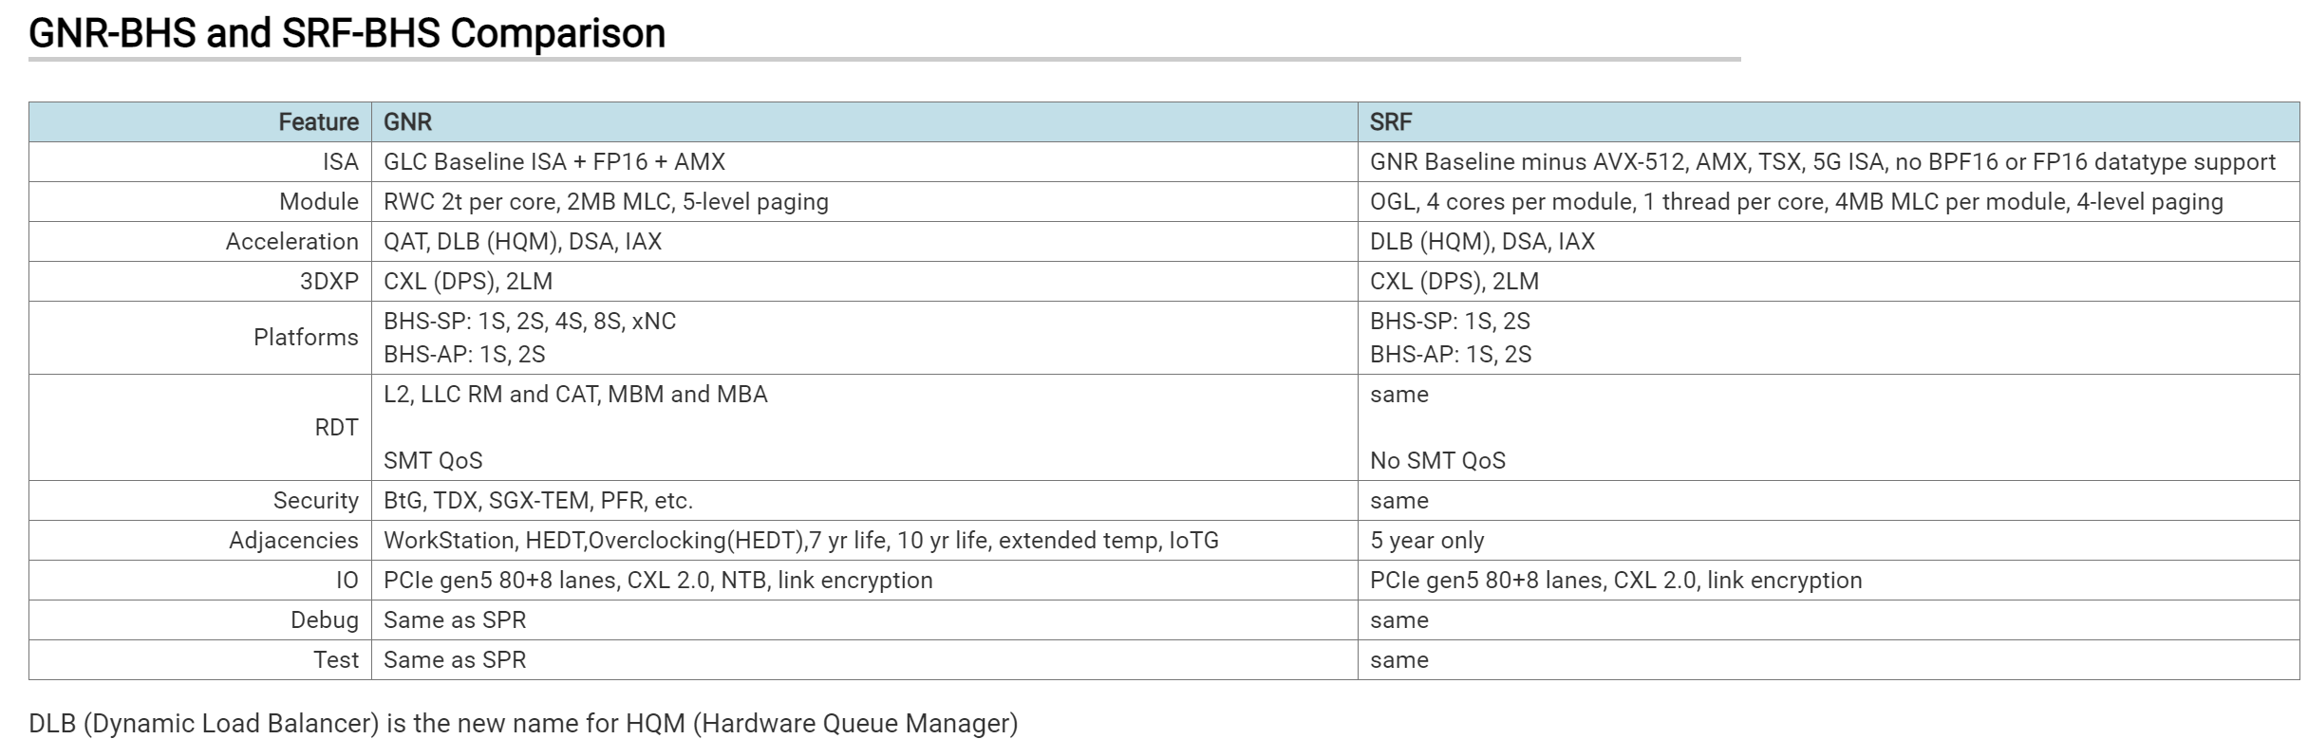
GNR and SRF Comparison
SRF supports only 5 year lifetime with no support for extended temp or IoTG or functional safety (FUSA)

Slide 5
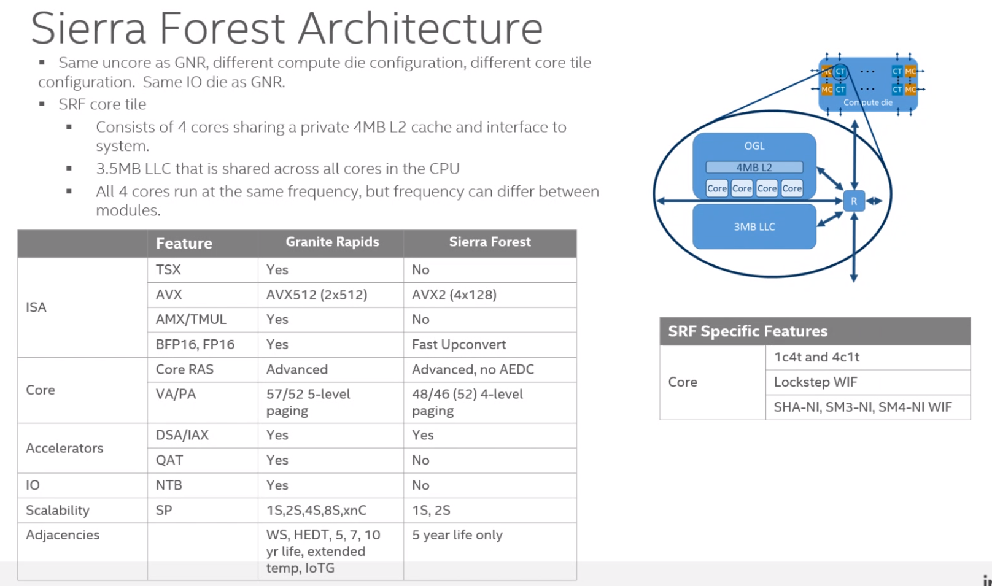
4.0MB LLC that is shared across all cores in the CPU

Slide 6
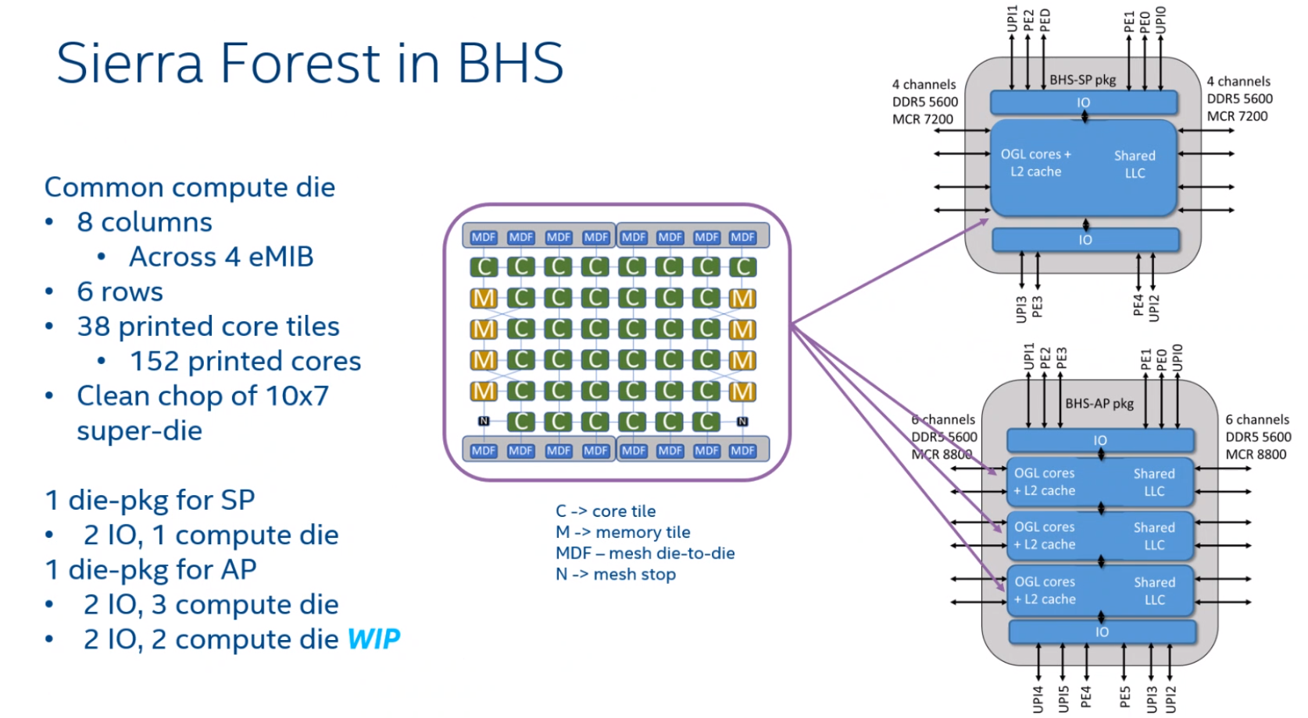

Slide 7
Platform Requirements
Platform | Birchstream-SP Low Cost Variant | Birchstream-SP | Birchstream-AP
Max TDP to Socket | 86W | 350W | 500W – Liquid Cooling 450W – Air Cooling
Socket | LGA 4189 | LGA 4189 | LGA 7529
Num DDR5 ch | 6 | 8 | 12
Max DDR Speed | 4.8GT/s 5.6GT/s (stretch Goal) | up to 5.6GT/s DDR5 ask for 6.4GT/s DDR5 up to 7.2GT/s MCR | up to 5.6GT/s DDR5 ask for 6.4GT/s DDR5 up to 8.8GT/s MCR
Max DIMMs per channel (DPC) | 2 | 2 | 1
PCIe Gen5, CXL 2.0 Lanes | 4x16 | 5x16 | (96 total) 6x16
FlexBus (FxB) 2.0 Lanes | 0 | 4x24 | 6x24
Max UPI Speed | NA | 24GT/s | 24GT/s
Max PCIe Speed | 32GT/s | 32GT/s | 32GT/s
DMI Gen4 Lanes | 0 | 0 | 0
Boot | Integrated-Boot | Integrated-Boot | Integrated-Boot
1S PCIe Lanes w FlexUPI | 56 | 8x16 | 8x16
Birchstream-SP package is planned to be physically identical to Eaglestream package but does not need to be pin compatible!
Intel Confidential – Product Design Information

Slide 8
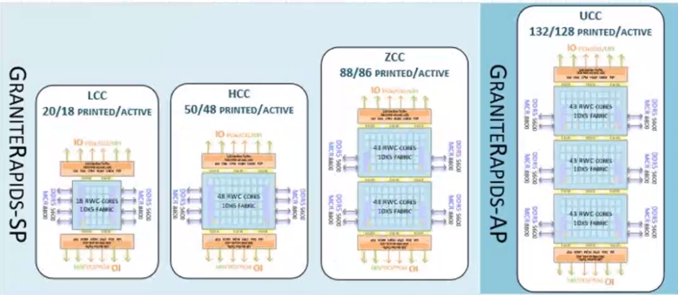

Slide 9
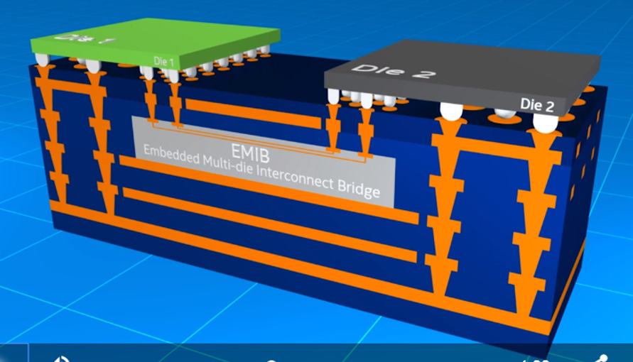
EMIB Technology
Embedded Multi-die Interconnect Bridge (EMIB) enables tighter pitch interconnect between die in package for higher bandwidth communication.
Without requiring tighter pitches from package substrate
Without preventing die from also having IOs and power delivery connected directly to the package.

Slide 10
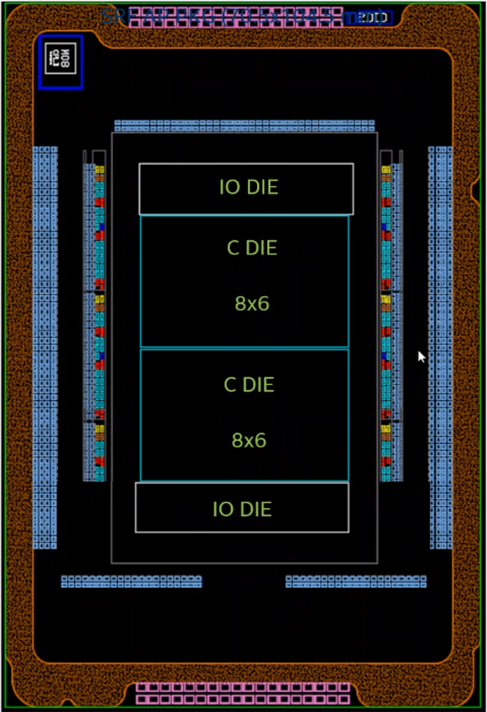
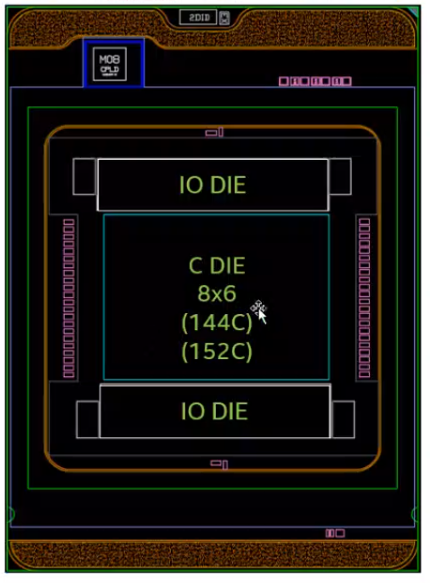
SRF Skus
SRF-AP
76/304 Printed Mod/Cores
Birchstream-AP, 12 DDR ch
Pkg (7529 pins, 70.5mmx104.5mm)
SRF-SP
38/152 Printed Mod/Cores
Birchstream-SP, 6 or 8 DDR ch
Pkg (4189 pins, 56.5mmx77.5mm)
Two different SRF die package combos use identical IOdie (shared with GNR) and a single Cdie design.
SRF-SP pkg is 0.96 pins/mm².
SPR-AP pkg is 1.02 pins/mm².
Intel Confidential – Product Design Information

Slide 11
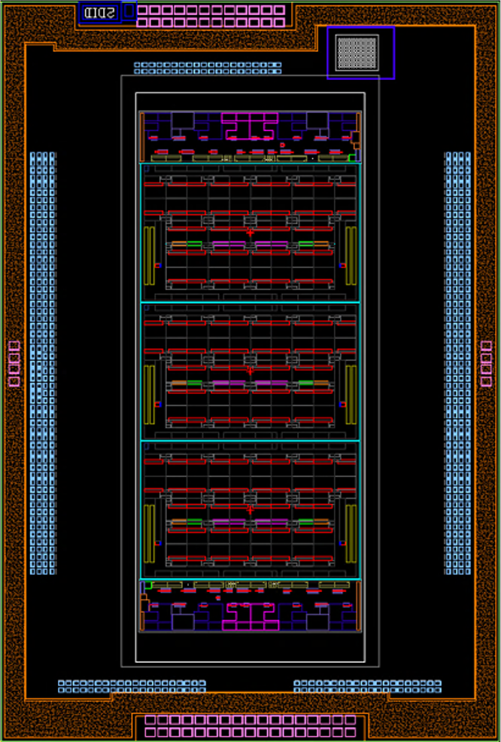
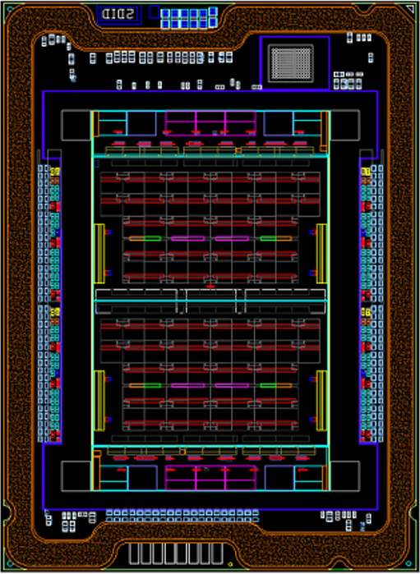
SRF Skus
SRF-AP
76/304 Printed Mod/Cores
Birchstream-AP, 12 DDR ch
Pkg (70.5mmx104.5mm)
SRF-SP
38/152 Printed Mod/Cores
Birchstream-SP, 6 or 8 DDR ch
Pkg (56.5mmx77.5mm)
CPLD
IOdie
CPLD
EMIB1
EMIB2
8x6 SRF Cdie
Two different SRF die package combos use identical IOdie (shared with GNR) and a single Cdie design.
IOdie
EMIB3
EMIB4
EMIB1
EMIB2
8x6 SRF Cdie
8x6 SRF Cdie
EMIB1
EMIB2
IOdie
EMIB1
EMIB2
IOdie
Intel Confidential – Product Design Information

Slide 12
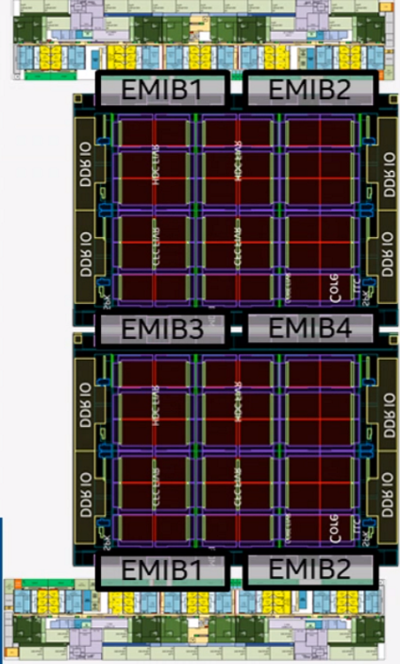
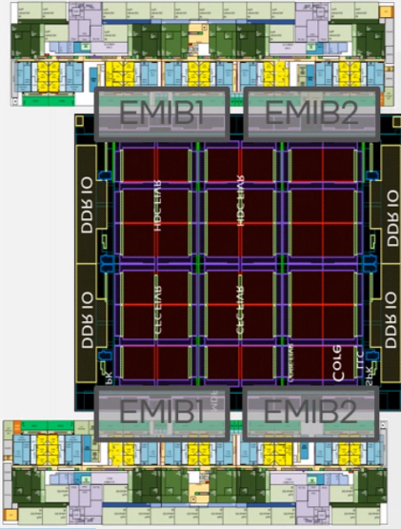
SRF Skus
SRF-AP
Die Complex 31.67mm x 54.76mm
Die Complex Limit: 50mm x 80.5mm
EMIB: 6 total (4 unique)
SRF-SP
Die Complex: 31.67mm x 34.46mm
Die Complex Limit: 32mm x 38.6mm
EMIB: 4 total (2 unique)
CPLD
IOdie
CPLD
EMIB1
EMIB2
8x6 SRF Cdie
Compute Die: 21.5mm x 25.6mm
IO Die: ~31.7mm x ~7.2mm
IOdie
EMIB3
EMIB4
EMIB1
EMIB2
8x6 SRF Cdie
8x6 SRF Cdie
EMIB1
EMIB2
IOdie
EMIB1
EMIB2
IOdie
Intel Confidential – Product Design Information

Slide 13
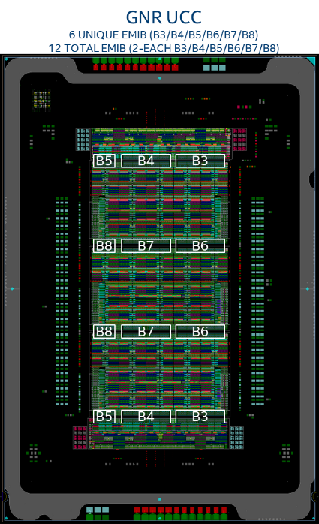
Granite Rapids (GNR) and Sierra Forest (SRF)
Intel P1274
PCIe & UPI
“Flex Bus” Units can act as PCIe or UPI
128 Core GNR
IOdie
IOdie
EM
EMIB
EMIB
Intel Embedded Multi-die Interconnect Bridge
Wires only (no transistors) keeps cost low
Provide high BW connection between die
Pkg only needs to support standard pitches
GNR
Cdie
EMIB
EM
EMIB
EMIB
GNR
Cdie
Intel P1276
44 Redwood Cove Cores
2MB L2 per core plus 176MB shared LLC
DDRIO up to 8.8GT/s
GNR
Cdie
EM
EMIB
EMIB
GNR
Cdie
EM
EMIB
EMIB
TSMC N3
38 Oak Glenn Modules (with 4 cores each)
4MB L2 per module plus 152MB shared LLC
DDRIO up to 8.8GT/s
IOdie
SRF
Cdie

Slide 14
Granite Rapids (GNR) and Sierra Forest (SRF)
Intel P1274
PCIe & UPI
“Flex Bus” Units can act as PCIe or UPI
288 Core SRF
IOdie
Intel Embedded Multi-die Interconnect Bridge
Wires only (no transistors) keeps cost low
Provide high BW connection between die
Pkg only needs to support standard pitches
IOdie
EMIB
EMIB
EMIB
SRF
Cdie
Intel P1276
44 Redwood Cove Cores
2MB L2 per core plus 176MB shared LLC
DDRIO up to 8.8GT/s
EMIB
EMIB
GNR
Cdie
SRF
Cdie
EMIB
EMIB
IOdie
TSMC N3
38 Oak Glenn Modules (with 4 cores each)
4MB L2 per module plus 152MB shared LLC
DDRIO up to 8.8GT/s
SRF
Cdie

Slide 15
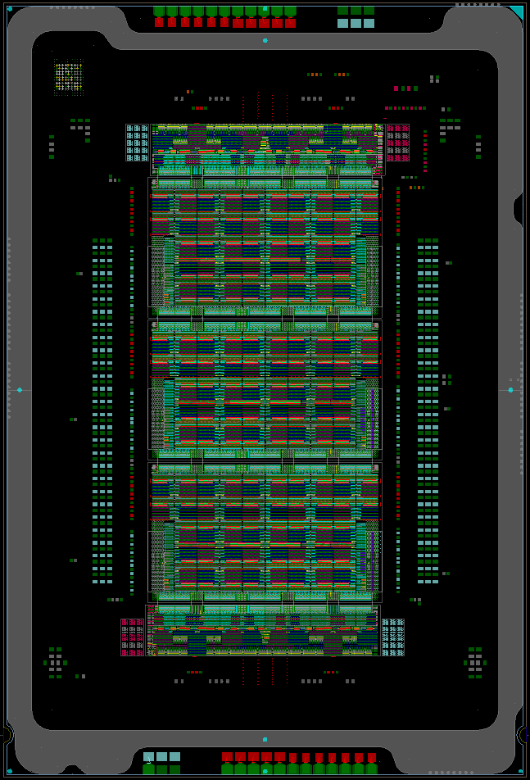
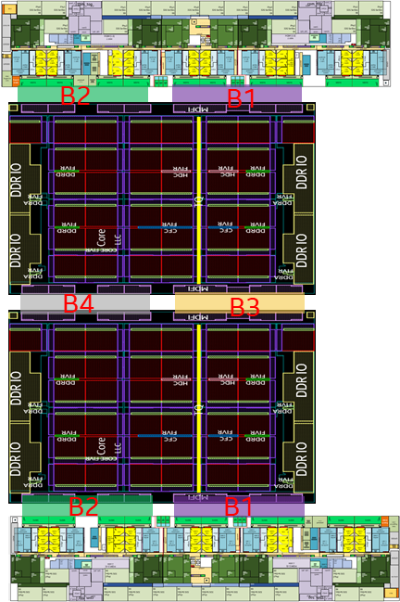
SRF ZCC
4 UNIQUE EMIB (B1/B2/B9/B10)
6 TOTAL EMIB (2-B1/2-B2/1-B9/1-B10)
GNR UCC
6 UNIQUE EMIB (B3/B4/B5/B6/B7/B8)
12 TOTAL EMIB (2-EACH B3/B4/B5/B6/B7/B8)
CPLD
CPLD
B5
B4
B3
B1
B2
B8
B7
B6
B9
B10
B8
B7
B6
B1
B2
B5
B4
B3

Slide 16
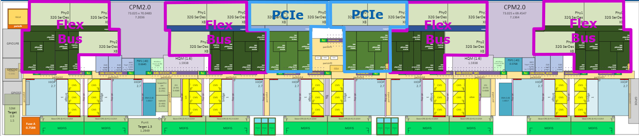
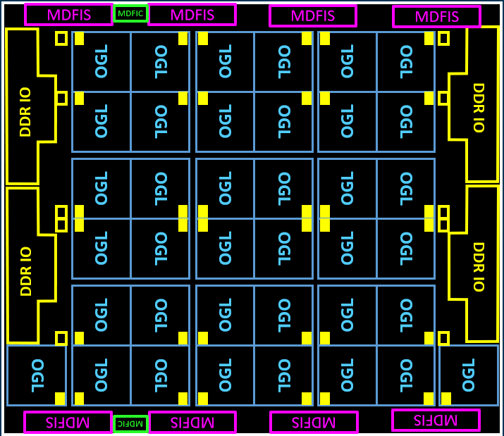
IO die at bottom of package is rotated. Because MDFIC is not in the center of the IO die there are two instances of MDFIC on IO die one used on top IO die and the other used on bottom IO die.
Intel Confidential – Product Design Information

Slide 17
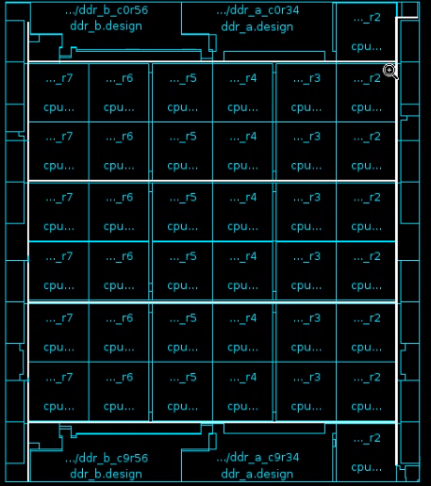
SRF 8x6
Compute
die
DDR IO
DDR IO
OGL
MDFIS
MDFIS
OGL
OGL
OGL
OGL
OGL
OGL
Core tile is 3mm x 3mm = 9mm² so 38 take up 342mm2 and about 65% of the active area.
However, SKT module inside core tile is only ~2.5mm x ~2.4mm = 6mm² so 38 take up 228mm² and about ~43% of the overall die.
OGL
OGL
OGL
OGL
OGL
OGL
38 Printed Modules
(with 4 cores each)
(for 152 cores total)
Active Area with EDM but with no scribe
Xdim (OGD) ~21.4mm
Ydim (PGD) ~24.7mm
~527mm²
With Scribe
~550mm²
MDFIS
MDFIS
OGL
OGL
OGL
OGL
OGL
OGL
OGL
OGL
OGL
OGL
OGL
OGL
MDFIS
MDFIS
OGL
OGL
OGL
OGL
OGL
OGL
MDFIC
MDFIC
OGL
OGL
OGL
OGL
OGL
OGL
MDFIS
MDFIS
DDR IO
DDR IO
OGL
Intel Confidential – Product Design Information

Slide 18
SRF 8x6
Compute
die
DDR IO
DDR IO
OGL
MDFIS
MDFIS
OGL
OGL
OGL
OGL
OGL
OGL
Core tile is 3mm x 3mm = 9mm² so 38 take up 342mm2 and about 65% of the active area.
However, SKT module inside core tile is only ~2.5mm x ~2.4mm = 6mm² so 38 take up 228mm² and about ~43% of the overall die.
OGL
OGL
OGL
OGL
OGL
OGL
38 Printed Modules
(with 4 cores each)
(for 152 cores total)
Active Area with EDM but with no scribe
Xdim (OGD) ~21.4mm
Ydim (PGD) ~24.7mm
~527mm²
With Scribe
~550mm²
MDFIS
MDFIS
OGL
OGL
OGL
OGL
OGL
OGL
OGL
OGL
OGL
OGL
OGL
OGL
MDFIS
MDFIS
OGL
OGL
OGL
OGL
OGL
OGL
MDFIC
MDFIC
OGL
OGL
OGL
OGL
OGL
OGL
MDFIS
MDFIS
DDR IO
DDR IO
OGL
Intel Confidential – Product Design Information

Slide 19
SRF 8x6
Compute
die
Mesh
DDR IO
DDR IO
OGL
MDFIS
1 cycle
MDFIS
OGL
OGL
OGL
OGL
OGL
OGL
2 cycle
OGL
OGL
OGL
OGL
OGL
OGL
Hmesh connects DDRIO, Hmesh is drawn vertically in SRF and called VHmesh
Vmesh connects MDF, Vmesh is drawn horizontally in SRF and called HVmesh
MDFIS
1 cycle
MDFIS
OGL
OGL
OGL
OGL
OGL
OGL
2 cycle
OGL
OGL
OGL
OGL
OGL
OGL
MDFIS
1 cycle
MDFIS
OGL
OGL
OGL
OGL
OGL
OGL
1 cycle
2 cycle
1 cycle
2 cycle
1 cycle
MDFIC
2 cycle
MDFIC
OGL
OGL
OGL
OGL
OGL
OGL
MDFIS
1 cycle
MDFIS
OGL
Intel Confidential – Product Design Information
DDR IO
DDR IO

Slide 20
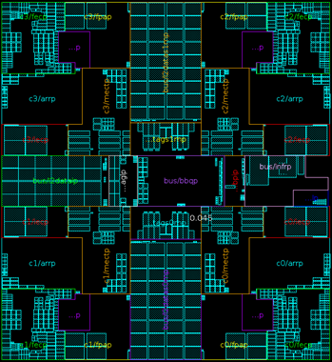
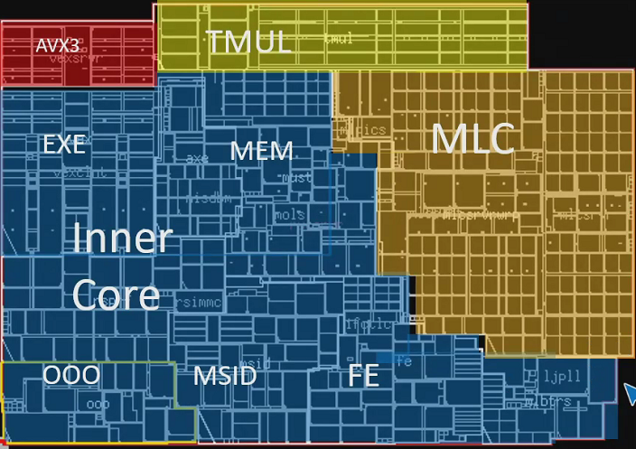
GNR & SRF Core Tiles
Hmesh connects DDRIO, Hmesh is drawn vertically in SRF and called VHmesh
Vmesh connects MDF, Vmesh is drawn horizontally in SRF and called HVmesh
GNR Core Tile (P1276)
SRF Core Tile (N3)
Hmesh
LLC Data
and LSF
CHA
CHA
HVmesh
LLC (4MB) Data/Tag
and SF
FIVR
1.5MB L2
OGL
OGL
LLC Tag
RSF
LLC Data
FIVR
IDI
BGF
1MB L2
Bus
IDI
1.5MB L2
OGL
OGL
~2.95mm x ~3.15mm
Vmesh
~3.08mm x ~3.00mm
VHmesh
LLC uses HDC cell and VccHDC rail
L2 uses HDC cell and VccHDC rail
Intel Confidential – Product Design Information

Slide 21
SRF 8x6
Compute
die
GPIO_L
DDR IO
DDR IO
OGL
SPK
MDFIS
MDFIS
OGL
OGL
OGL
OGL
OGL
OGL
EPR_Punit
CGU
EPR_Mu
EPR_Reset
OGL
OGL
OGL
OGL
OGL
OGL
Sierra Peak (SPK) is an aggregator for debug trace fabric used in silicon debug
EPR_Punit contains power control unit which reads and executes Pcode and PLL for power management clock
EPR_Mu is the manageability unit for reliability, accessibility, serviceability (RAS) features
GPIO_L and GPIO_R are general purpose IOs communicating on VccVnn (1.0V) and named L=left and R=right assuming die is rotated left in package.
CGU is clock generation unit that contains 4 PLLs. Other PLLs are in CoreTile, DDR Tile, and EPR_Punit
EPR_Reset contains hardware reset sequencer
EPR_Fuse contains programmable fuse ROM
MDFIS
MDFIS
OGL
OGL
OGL
OGL
OGL
OGL
OGL
OGL
OGL
OGL
OGL
OGL
MDFIS
MDFIS
OGL
OGL
OGL
OGL
OGL
OGL
MDFIC
MDFIC
OGL
OGL
OGL
OGL
OGL
OGL
MDFIS
MDFIS
SPK
DDR IO
DDR IO
OGL
EPR_Fuse
Intel Confidential – Product Design Information
GPIO_R

Slide 22
SRF 8x6
Digital
Thermal
Sensors
(DTS)
GPIO_L
DDR IO
DDR IO
OGL
SPK
MDFIS
MDFIS
OGL
OGL
OGL
OGL
OGL
OGL
EPR_Punit
CGU
EPR_Mu
EPR_Reset
OGL
OGL
OGL
OGL
OGL
OGL
MDFIS
MDFIS
1 DTS per Core Tile (38 Total)
1 DTS per DDR Tile (4 Total)
1 DTS in CGU
6 DTS outside the tiles
49 Total Per Cdie
OGL
OGL
OGL
OGL
OGL
OGL
OGL
OGL
OGL
OGL
OGL
OGL
MDFIS
MDFIS
OGL
OGL
OGL
OGL
OGL
OGL
MDFIC
MDFIC
OGL
OGL
OGL
OGL
OGL
OGL
MDFIS
MDFIS
SPK
DDR IO
DDR IO
OGL
EPR_Fuse
Intel Confidential – Product Design Information
GPIO_R

Slide 23
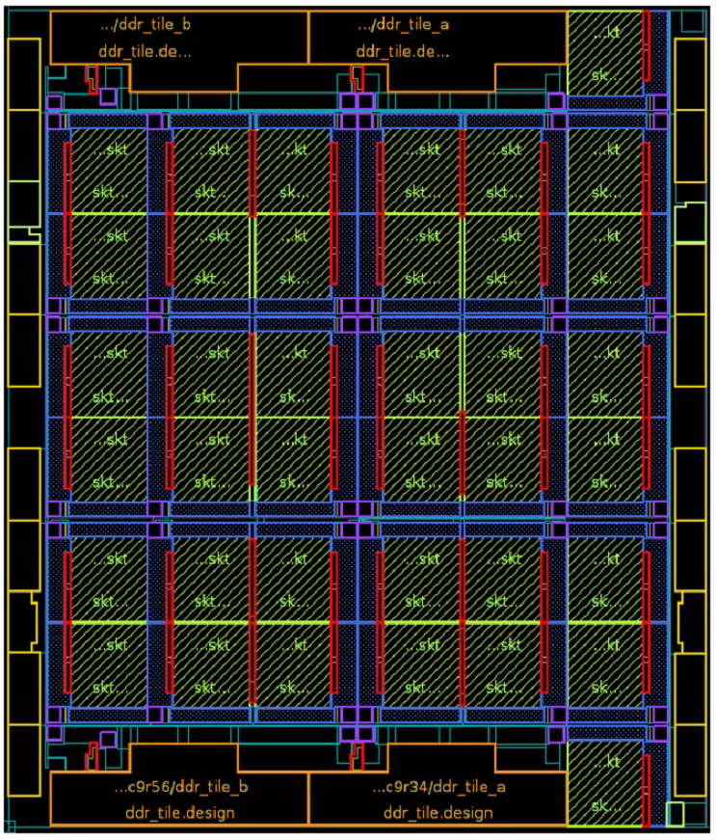
SRF 8x6
Compute
Die
Intel Confidential – Product Design Information

Slide 24
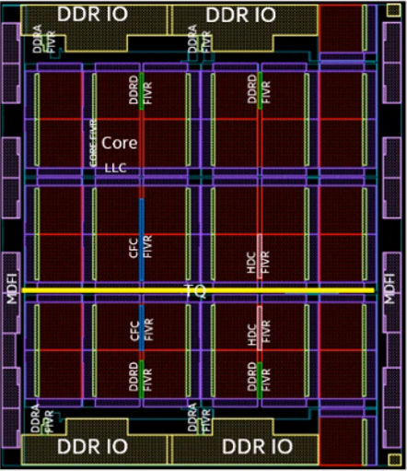
SRF 8x6
Compute
Die FIVR
Intel Confidential – Product Design Information

Slide 25
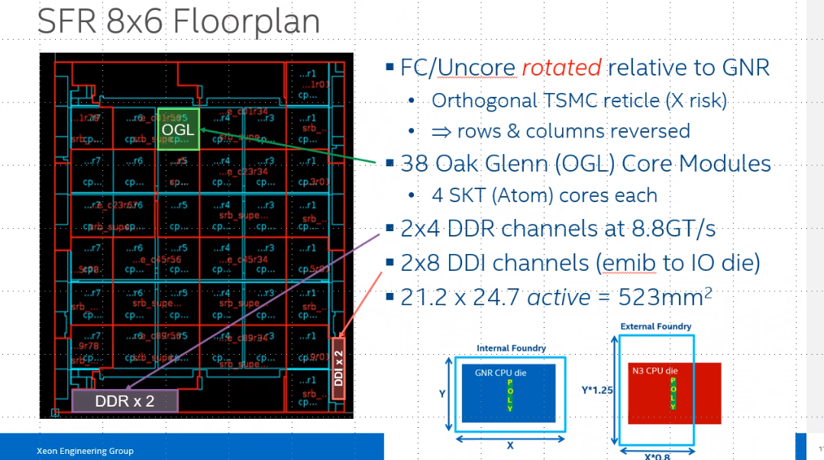

Slide 26
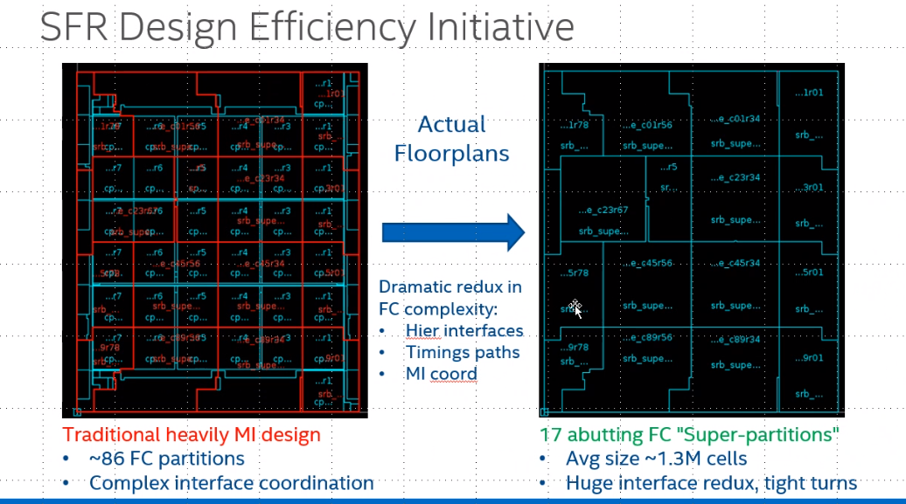

Slide 27
GNR & SRF Core Tiles
Hmesh connects DDRIO, Hmesh is drawn vertically in SRF and called VHmesh
Vmesh connects MDF, Vmesh is drawn horizontally in SRF and called HVmesh
GNR Core Tile (P1276)
SRF Core Tile (N3)
Hmesh
LLC Data
and LSF
CHA
CHA
HVmesh
LLC (4MB) Data/Tag
and SF
FIVR
1.5MB L2
OGL
OGL
LLC Tag
RSF
LLC Data
FIVR
IDI
BGF
1MB L2
Bus
IDI
1.5MB L2
OGL
OGL
~2.95mm x ~3.15mm
Vmesh
~3.08mm x ~3.00mm
VHmesh
LLC uses HDC cell and VccHDC rail
L2 uses HDC cell and VccHDC rail
Intel Confidential – Product Design Information

Slide 28
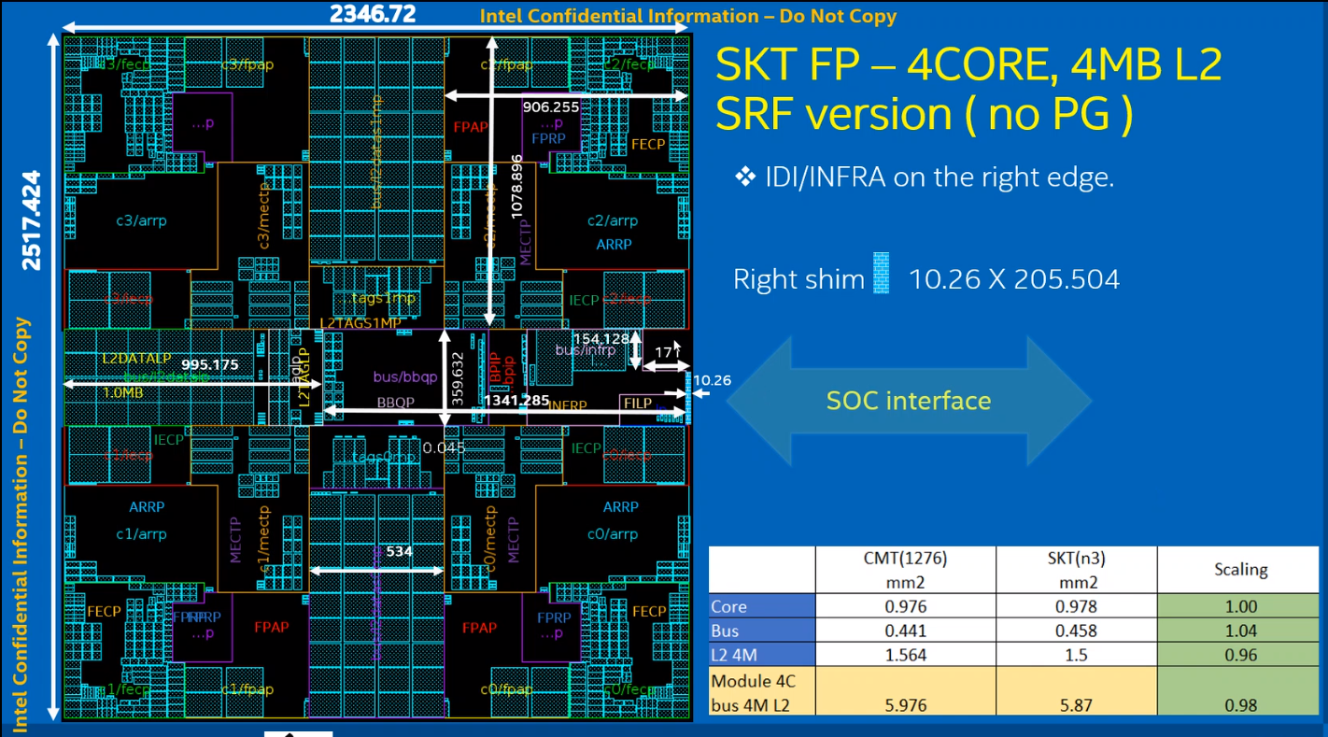

Slide 29
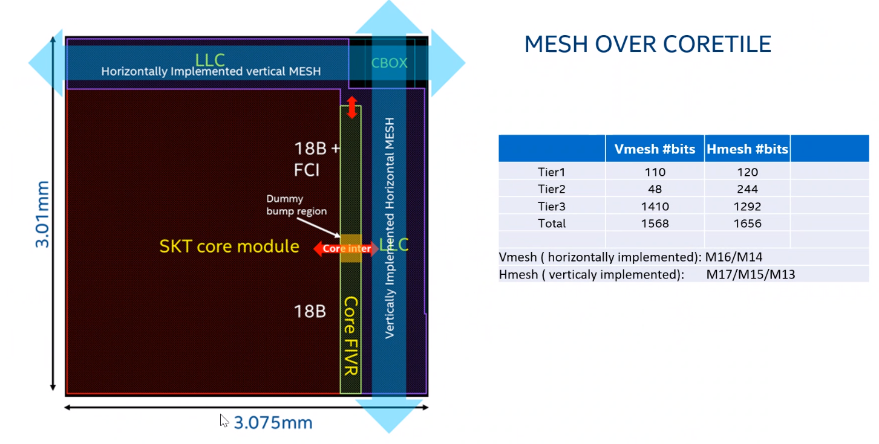
Intel Confidential – Product Design Information

Slide 30
Core Tile Array Capacities
Array sizes in the two different core tiles are different in part because the two core tiles are built to have identical dimensions but the 4 core OGL module requires more area than a single RWC, and therefore there is less area left over for LLC.
As a simplification of power manangement and power delivery the smallest HDC SRAM cell which requires a separate voltage rail is not used for both the L2 and the LLC (which are on different clock domains). Instead HDC is used for the largest array in each coretile which is the LLC array in the RWC coretile and the L2 in the OGL coretile.
Array | SRF Core Tile (OGL Core) | GNR Core Tile (RWC Core)
L2 | 4MB (4Kx16), HDC Mclk and VccHDC/VccCore | 2MB (2Kx16), HCC Mclk and VccCore
LLC | 4MB (4Kx16), HCC Uclk and VccCFC | 4MB (4Kx16), HDC Uclk and VccHDC/VccCFC
RSF | “1.0MB” (4Kx4), HCC Uclk and VccCFC | “6MB” (4Kx24), HCC Uclk and VccCFC
LSF | “7MB” (4Kx28), HCC Uclk and VccCFC | “4MB” (4Kx16), HCC Uclk and VccCFC
Can calculate data size based on 64B cache line:
4k sets x 16 ways x 64B/line = 4MB
Of course this does not include tag and state.
Note that Remote Snoop Filter (RSF) and Local Snoop Filter (LSF) are often described by the data size they provide coverage for rather than their actual size, but SF arrays do not contain data bits, only tag and state bits.
For example, a “6MB” RSF that contains 4K sets and 24 ways with 35b Tag and 5b of state provides coverage for 6MB of 64B cache lines but is actually:
4K set × 24ways × (35b + 5b) ≈ 0.5MB
So the “6MB” RSF actually contains ~0.5MB of cells.
Note that in the OGL core tile it appears that the L2 is larger than the LLC. This is true looking at a single core tile, however the L2 is exclusive to a single core tile and the LLC is shared across all the core tiles. Therefore for the SRF Cdie with 38 core tiles the true architectural sizes are 4MB L2 and 3.5MB×38=133MB LLC.
Intel Confidential – Product Design Information

Slide 31
SRF N3 Cdie HIPs and Test Chips
All HIPs coming from Intel or TSMC
SRF HIP | Source | Test Chip (TI) | Shared with ARL | Shared with Server #2 | Notes
Oak Glenn Module (aka Skymont Module) | DDG | Arrow Lake | Yes | No | Includes 4 cores plus 4MB L2 and Bus interface Will strip off outer power gates and short inner power gates/mux
MDFIS, MDFIC | IPG | No test chip | No | Yes | Communicates over passive EMIB. Drawn “vertical”.
Fuse 4K ROM | TSMC |  | No | Yes | 4K Fuse ROM from TSMC part of design package, ARL uses 12K Fuse ROM
Pmax Detector | XPG |  | No | Yes | Detects VccIN Droops
Gen3 DDR5 PHY | IPG | Olivia Creek (TI Q1’21) | No | No | Supporting 8.8GT/s (MCR) or 5.6GT/s (DDR5). DMR will use Gen4 PHY.
FIVR & BGR | IPG |  | No | Yes | All FIVRs drawn “vertical”. DMR will add horizontal core FIVRs.
LJPLL | DDG/HPG |  | Yes | Yes | Ver3.5 Low Jitter PLL for core and uncore clocks
GPIO | IPG |  | No | Yes | Compute die uses only 1.0V GPIO but IPG IO on test chip enabled up to 1.2V
DTS & Thermal Diode | IPG |  | Yes | Yes | Digital Thermal Sensor
SOC_Viewpin | IPG |  | Yes | Yes | For post-silicon debug of analog signals
ODI, VDM | IPG |  | Yes | Yes | On-die Droop Inducer and Voltage Droop Monitor
RNG | IPG | Kapoli Springs (TI Q1’21) | Yes | Yes | Gen4 Random Number Generator HIP (also on OLC), placed in EPR_Fuse
SRAM/RF/ROM | TSMC, DDG, XSD |  | No | No | Arrays come from TSMC, Atom memory team, XSD memory team
SMP | TEG |  | Yes | Yes | SpeedMont Plus, in-die variation process monitor (also on OLC and KGS)
CRO | XNE (Axxia) | Koenigssee (TI Q1’21) | No | Yes | Controlled Ring Oscillator used for secure boot, placed in GPIO for VccVNN
EDM | TEG |  | No | No | Edge Damage Monitor, detects cracks in die edge after singulation
CADNAV Fiducial | TEG |  | Yes | Yes | Used as reference points to guide probing and inspection tools
ESD | TEG |  | Yes | Yes | ElectroStatic Discharge protection, comes as part of Design Package
Intel Confidential – Product Design Information

Slide 32
Cdie SIPs
Hardened
by SOC Team
(not including
DFX!)
IP | Description | Unit
B2IDI | Bridge from SCF to IDI | CPU_Tile
CHA | Cache box and Home Agent (for OGL CPU Tile) | CPU_Tile
LLC/SF | Last Level Cache and Snoop Filter (for OGL CPU TIle) | CPU_Tile
CGU Ctrl | Clock Generation Unit Controller | CGU
CRS | Common Ring Stop | DDI_MB_Tile
D2D_Br | Die2Die Bridge | DDI_MB_Tile
DDI_MB Ctrl | Contains MDFIS | DDI_MB_Tile
SBO | Switch Box | DDI_MB_Tile
DDI_MISC Ctrl | Contains MDFIC | DDI_MISC_Tile
B2CMI | Bridge to Converged Memory Interface | DDR_Tile
MC | Memory Controller | DDR_Tile
MCCMI | Memory Controller to Converged Memory Interface | DDR_Tile
MSE | Memory Security Engine | DDR_Tile
SPK Ctrl | SierraPeak (Debug Trace across Mesh) | SPK
CMS_SA | Stand alone Common Mesh Stop (without turn agent) | DDR_Tile & SPK
Fuse Cntrl | Fuse Controller | EPR_fuse
IEH | Integrated Error Handler | EPR_pmu
OOBMSM | Out-of-Band Main State Machine | EPR_pmu
Punit | Power Management & Control Unit | EPR_pmu
DRNG | SIP wrapper for RNG HIP | EPR_reset
HWRS | Hardware Reset Sequencer | EPR_reset
S3M | Secured Startup Services Module (2.0 Security Unit) | EPR_reset
GPIO Unit | General Purpose IOs | GPIO Unit
FSA | Fabric Sideband Adapter | Global
Fuse Endpoint | IP interface for fuses | Global
Fuse Puller | Logic to read needed fuses | Global
I3C_SW | I3C Secondary Wrapper | Global
IDV Ctrl | IDV Controller | Global
IOSF_Bridge | IOSF SB Bridge | Global
IOSF_Router | IOSF SB Router | Global
ISOF_EP | IOSF SB Endpoint used to send/receive traffic. | Global
ODI/VDM Ctrl | ODI and VDM Controller | Global
Q_CH_Agg | Q-channel and P-channel Aggregators | Global
RC | Resource Controller | Global
RCM | R-something C-something M-something | Global
RTB | Regional Trigger Block | Global
Intel Confidential – Product Design Information

Slide 33
SRF Compute Die Clocks
Clock Domain | Ship Freq (GHz) | dynamic freq | Note | Standard Cell Logic Voltage Domains
uclk | 1.0-2.7 | Yes | mesh clock | VccCFC (0.60V to 1.10V) (CHA/Mesh)
mclk | 1.0-4.0 |  | core clock (Generated per core tile) | VccCore (0.60V to 1.10V) VccHDC (0.75V to 1.10V) (L2)
dclk | 2.2 (MCR 8800) 1.4 (DDR5 5600) (Set per sku) | No | For DDR memory controller hclk = dclk/2 flyby = dclk*2 (Generated per mem channel) | VccDDRD (~0.70V MCR, ~0.60V DDR5) VccDDRA (0.85V)
bclk | 0.1 |  | reference clock | VccVNN VccFuse VccFuse_HV (1.0V) VccINF (0.8V Boot, 0.7V Operation)
fivrclk | 0.09-0.20 (Set per sku) |  | fivr clock
x8clk | 0.8 |  | IOSF/DTF and VISA
fclk | 0.8 |  | power management clock
croclk | 0.4 |  | Ring oscillator clock to S3M, fuse unit for secure boot
ref400 | 0.4 |  | Ref clock for cores & chassis fabric to cores
rscclk | 0.025 |  | used with reset bus (bclk/4)
xtalclk | 0.025 |  | crystal clock
scanclk | 0.4 |  | scan clock
tclk/stfclk | 0.1 |  | TAP clock
Intel Confidential – Product Design Information

Slide 34
SRF Voltage Domains
Die in Pkg | Rail | Nom Ship Vcc | VR Type | Blocks | ITD
CPLD-Only | V3P3 | 3.3V | MBVR | CPLD | No
CPLD, Compute, & IO Die | VccVNN | 1.0V | MBVR | CPLD, IO die S3M, CRO GPIO on Compute & some GPIO on IO Die | No
Compute & IO Die | VccFA_EHV | 1.8V | MBVR | Analog (PLL, DTS, IOs, FIVR Quiet) Some GPIO on IO Die | No
 | VccFA_EHV_FIVRA | 1.55V to 1.9V | MBVR | FIVR Power Analog Domains
 | VccIN_EHV | 1.55V to 1.9V | MBVR | FIVR Power Digital Domains
 | VccINF | 0.70V | MBVR | Chassis Infrastructure (0.85V at boot then go to 0.70V)
Compute Die Only | VccCore* | 0.60V to 1.10V | FIVR | 1 Domain per Core Tile | Yes
 | VccHDC* | 0.75V to 1.10V | FIVR | OGL L2 2 Domains per Cdie
 | VccCFC* | 0.60V to 1.10V | FIVR | Compute die Mesh/CHA 2 Domains per Cdie
 | VccMDIrx | 0.60V to 1.10V | FIVR through EMIB | Small bit of logic in MDI receiver powered through the EMIB by the driver die
 | VccDDRD | 0.70V (MCR 8800) 0.60V (DDR5 6400) | FIVR | DDR Controller (One per DDR)
 | VccDDRA | 0.825V TT (0.78V FFG 0.88V SSG) | FIVR | DDRIO Analog Supply (One per DDR) (Semi-binnable) | No
 | VccDDR_HV | 1.1V | MBVR | DDRIO
 | VccDDQ_HV | 1.1V | MBVR | DDRIO Quiet Supply
 | VccFuseTSMC_HV | 0V | NA | TSMC Fuse ROM Vqps This is driven to 1.8V for programming but tied to Vss in customer platform
 | VccBGRef | 0.80V | On-Die BGR | Compute Die FIVR
IO-Die Only | VccCFC | 0.60V to 1.10V | FIVR | IO Die Mesh | Yes
 | VccMDIrx | 0.60V to 1.10V | FIVR through EMIB | Small bit of logic in MDI receiver powered through the EMIB by the driver die
 | VccCFN | 0.70V | FIVR | HSIO Ctrl
 | VccIO | 1.00V | FIVR | HSIO | No
 | VccFuse_HV | 1.0V | MBVR | Intel P1274 Fuse ROM VccHV This is driven to 1.8V for programming but tied to VccVNN in customer platform.
 | VccBGRef | 1.0V | On-Die BGR | IO Die FIVR
Intel Confidential – Product Design Information

Slide 35
SRF Voltage Rail Ordering
Boot Order | Voltage Rail | VR Source
1 | V3P3 | MBVR
2 | VccFA_EHV | MBVR
3 | VccVNN (S5 state is here) | MBVR
4 | VccDDR_HV, VccDDRQ_HV | MBVR
5 | VccFA_EHV_FIVRA | MBVR
6 | VccINF | MBVR
7 | VccIN_EHV | MBVR
8_0 | VccBGRef | On-die BandGap Ref
8_1 | VccCFC | FIVR
8_2 | VccIO | FIVR
8_3 | VccCFN | FIVR
8_2 | VccDDRD | FIVR
8_3 | VccDDRA | FIVR
8_4 | VccHDC | FIVR
8_5 | VccCore (can dynamical turn off, or disabled for defects) | FIVR
Boot order is a simple ordering notation. Smaller numbers power up before larger numbers. When two supplies have the same boot order number, they are concurrent (they happen in any order within the number/group.) In reset there is no coordination among the die in the socket to create an ordering. The boot order for the fivr supplies uses two numbers to represent this. The first number is the die level boot order (all die are concurrent). The second number is the ordering with a die (this entry cannot imply an ordering between the die).
https://intel.sharepoint.com/:x:/r/sites/2020_1/XDie/Power_Delivery/GNR%20CCRD.xlsx
Assume that power-down order is reverse of power-up order (last rail up is first rail down). Assume that if power is suddenly removed from the system that board has sufficient cap to continue to provide power and Bclk for some minimum time (ex: 2us) after powergood signals go low. When powergood signals go low, die will execute a power failure flow to bring down all rails together which doesn’t guarantee a particular order but limits the time rails could be in a state that is normally not allowed to some maximum time (ex: 300ms) so DPM impact of this scenario can be estimated.
Intel Confidential – Product Design Information

Slide 36
Package C6 (PC6)
GNR/SRF have in general ZBB’ed turning off voltage rails during PC6
https://docs.intel.com/documents/pm_doc/src/server/GNR/Globals/NewGNR_Idle_Flow/NewGNR_PkgC_Flow.html#pkgc-simplification
PkgC Attribute | Previous Flow | New GNR/SRF Flow | GNR/SRF POR
Vret | Additonal idle power savings | WW41’20: Vret support Zbb'd PkgC simplification; reduce voltage to Vmin only | No Support
Voff | Implemented only for DDR IO | WW41’20: DDRIO C6 support Zbb'd No support for analog domains to go to 0 voltage | No Support
Vmin | Default behavior - try to go to this state even in PC2 | Retain it - this is the fall back for all voltages that cannot be taken to retention or off | Supported
After the reset flow is complete all voltage rails except VccCore will always stay up.
VccCore will be turned off per module when individual modules enter module C6 (MC6).
VccHDC will stay up even if all modules are off (in MC6) so L2 does not need to be flushed

Slide 37
High Level Clock Arch
xxbclk0/1 are coming from IO die. Xxbclk0 is overclocked while xxbclk1 is not
All PLLs are are in tight loop. They reside in CGU and core/DDR tiles
All crossings between clock domain is based on async FIFO’s (no usync)
Calibrated ring osc clock is used for early IOSF that controls the PLLs as well as key blocks like fuse, S3M, DFX_agg and DBG_en
Intel Confidential

Slide 38
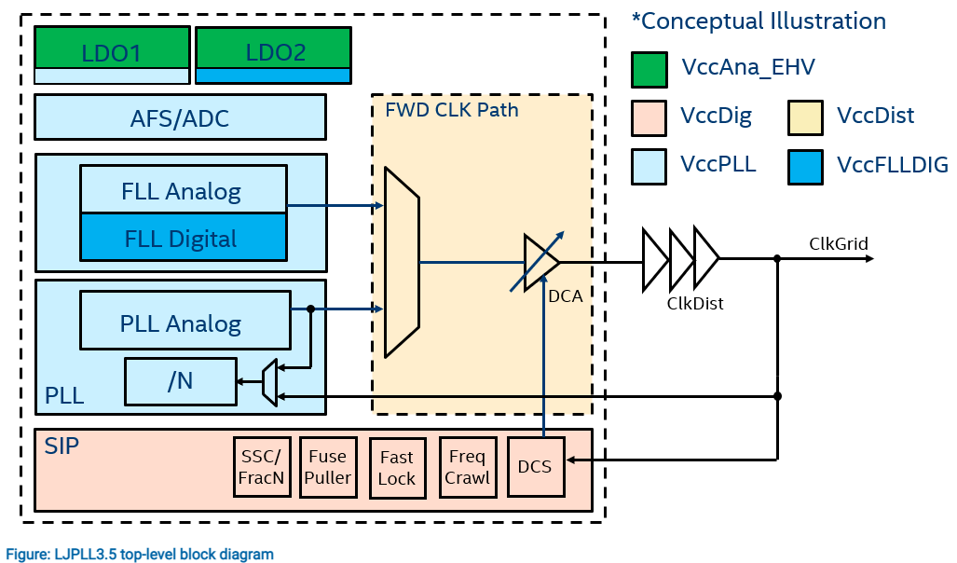
LJPLL Integration
IP Rail | Core PLLs | DDR PLLs | CGU PLLs
Output Clocks | Mclk | FlyByClk/Dclk | Uclk, FIVRclk, x8clk, Fclk
VccAna_EHV | VccFA_EHV (1.8V)
VccDig/VccSt | VccINF (0.85V Boot) (0.70V Operation)
VccDist | VccCore (0.6V to 1.1V) | VccDDRD (0.7V MCR) | VccINF (0.85V Boot) (0.70V Operation)

Slide 39
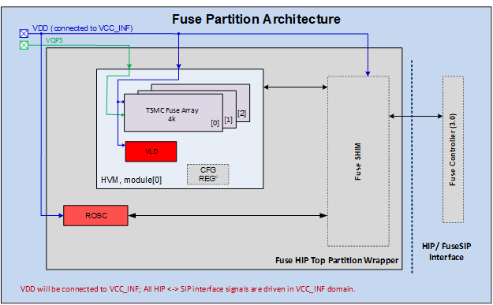
Fuse ROM Integration
1) TSMC delivers 4K Fuse ROM HIP as part of the N3 PDK
2) IPG delivers “Fuse HIPtop” which contains 3 instances of
Fuse ROM as well as ROSC HIP, VLD HIP, and fuse shim SIP
3) SOC team hardens both Fuse shim SIP and fuse controller SIP into EPR_Fuse tile
Possible to have a glitch on PowerState (PS) input to Fuse ROM as VccINF powers up but no risk of accidental write of fuse ROM because Vqps will up and held low before VccINF in programming platform and tied to Vss in customer platform.
IP | Component | IP type | Comment
Fuse Hiptop Partition | tef05f128x32hd18_phrm_* | HIP | TSMC 4k fuse memory (owned by TSMC).
 | Ipn3fuserosc | HIP | Internal clock generator (owned by DE).
 | Ipn3fusevld | HIP | Voltage Level Detector for detecting voltage glitch attacks (owned by DE).
 | Fuse Hiptop Partition wrapper includes SHIM (SIP) | SIP | SIP wrapper embedding all the above-mentioned components that interacts with the 3.0 Chassis Fuse Controller.
Fuse ROM IP Rail | SOC Rail
Vdd | VccINF (0.85V Boot, Fuse ROM only read at this voltage) (0.70V Operation)
Vqps | Driven to 1.8V for programming In customer platform tied to Vss

Slide 40
GNR/SRF
Fuse ROM
GNR
Cdie
GNR
Cdie
P1276 Fuse ROM
P1276 Fuse ROM
Vinf
Vnn
Vqps
GNR
Fuse
Read
Vinf
Vnn
Vqps
GNR
Fuse
Program
GNR
PKG
GNR
PKG
Vinf
Vnn
GNR_FHV
Vinf
Vnn
GNR_FHV
Socket
Socket
Vinf
Vnn
GNR_FHV
SRF_FHV
Vinf
Vnn
GNR_FHV
SRF_FHV
Vinf VR = 0.85V
to 0.7V
Vnn VR = 1.0V
1.8V
Vinf VR = 0.85V
to 0.7V
Vnn VR = 1.0V
Vss
Vss
SRF
Fuse
Program
SRF
Cdie
SRF
Fuse
Read
SRF
Cdie
N3 Fuse ROM
N3 Fuse ROM
Vinf
Vnn
Vqps
Vinf
Vnn
Vqps
SRF
PKG
SRF
PKG
Vinf
Vnn
SRF_FHV
Vinf
Vnn
SRF_FHV
Socket
Socket
Vinf
Vnn
GNR_FHV
SRF_FHV
Vinf
Vnn
GNR_FHV
SRF_FHV
Vinf VR = 0.85V
to 0.7V
Vnn VR = 1.0V
Vss
Vinf VR = 0.85V
to 0.7V
Vnn VR = 1.0V
1.8V
Vss

Slide 41
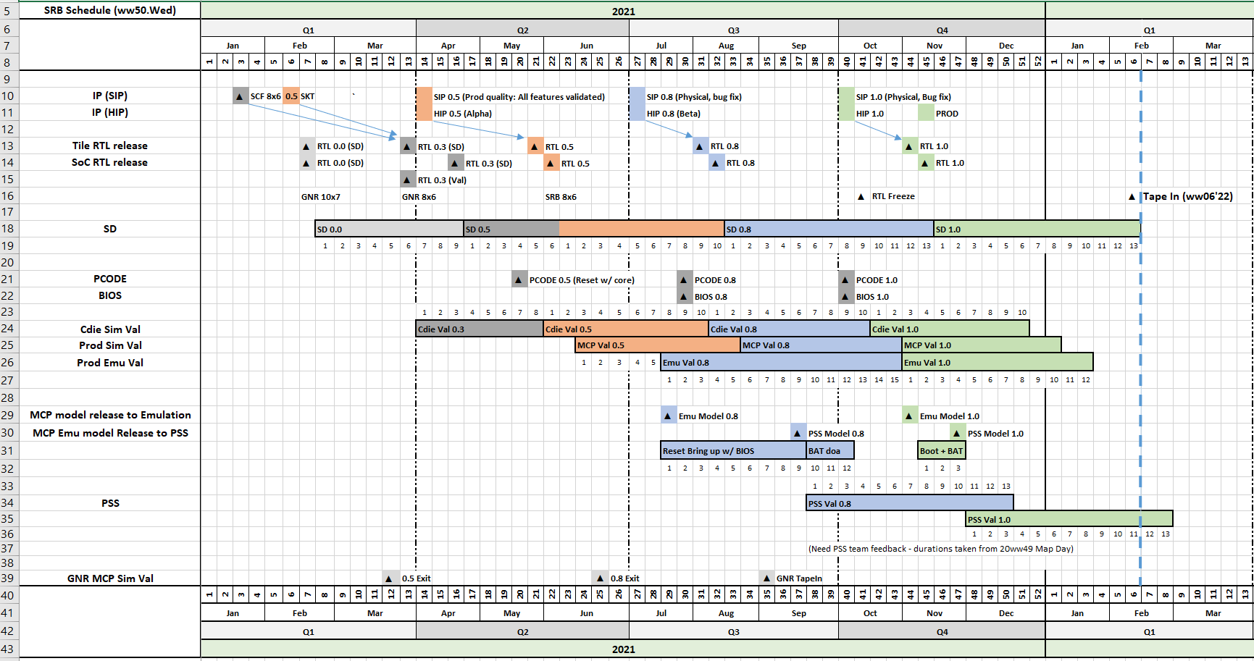
SRF HLS (ww50.WED)

Slide 42
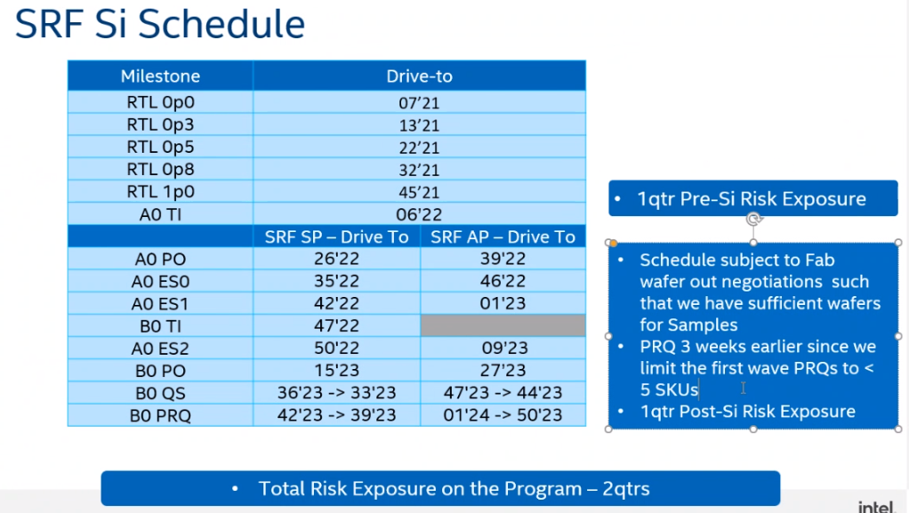
Intel Confidential – Product Design Information

Slide 43
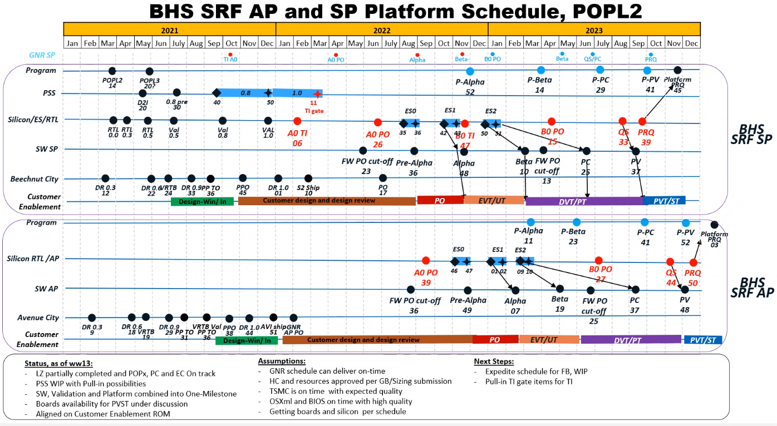
Intel Confidential – Product Design Information

Slide 44
GNRIO die

Slide 45
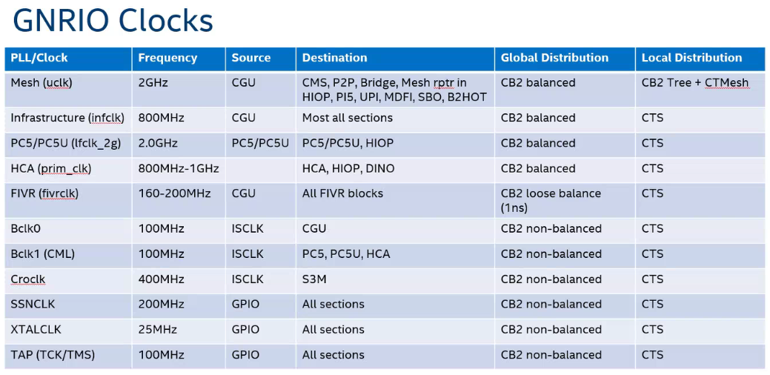
Robert Etter WW15.4’20

Slide 46
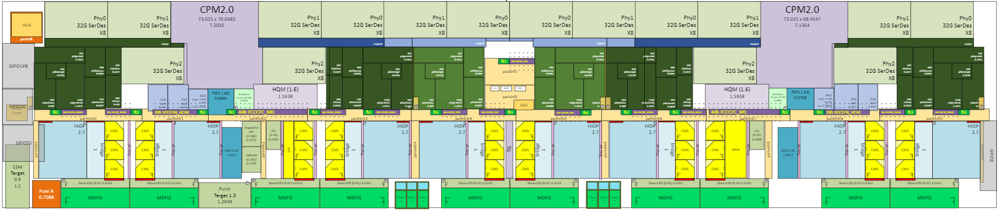
IO die Floorplan (WW26’20)
PCIe
PCIe
Flex
Bus
Flex
Bus
Flex
Bus
Flex
Bus
WW34’21 Size
Xdim 31.579mm
Ydim 7.194mm
Area 227mm²
Flex Bus complexes can act as x16 PCIe @ 32GT/s or x24 UPI @ 24GT/t
Birchstream LP | Birchstream SP (Skt E) | Birchstream AP (Skt EX)
4x16 PCIe Gen5 4 PCIe from one IO die | 5x16 PCIe Gen5 4x24 UPI 2 UPI and 2 or 3 PCIe from each IO die | 6x16 PCIe Gen5 6x24 UPI 3 UPI and 3 PCIe from each IO die
https://intel.sharepoint.com/sites/2020_1/IO%20Tile%20SD/Forms/AllItems.aspx
GNRIO_floorplan folder

Slide 47
Backup

Slide 48
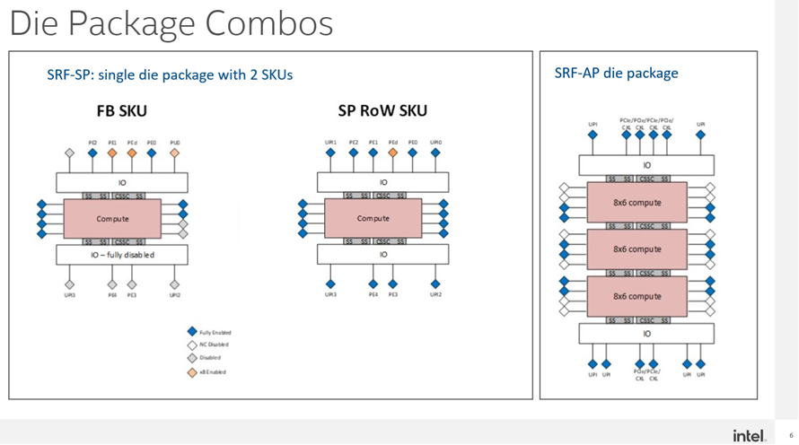
Intel Confidential – Product Design Information

Slide 49
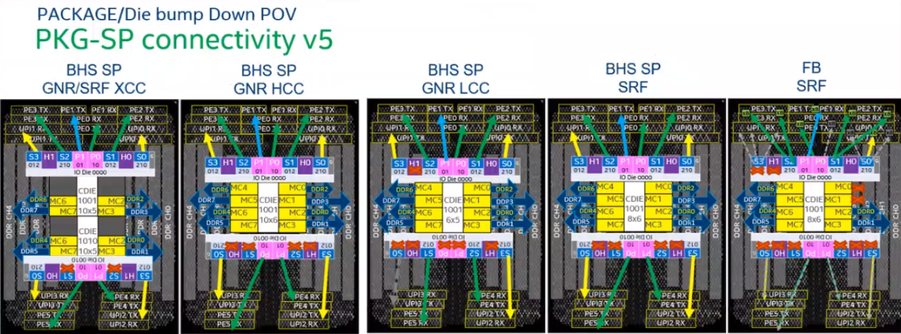
Intel Confidential – Product Design Information

Slide 50
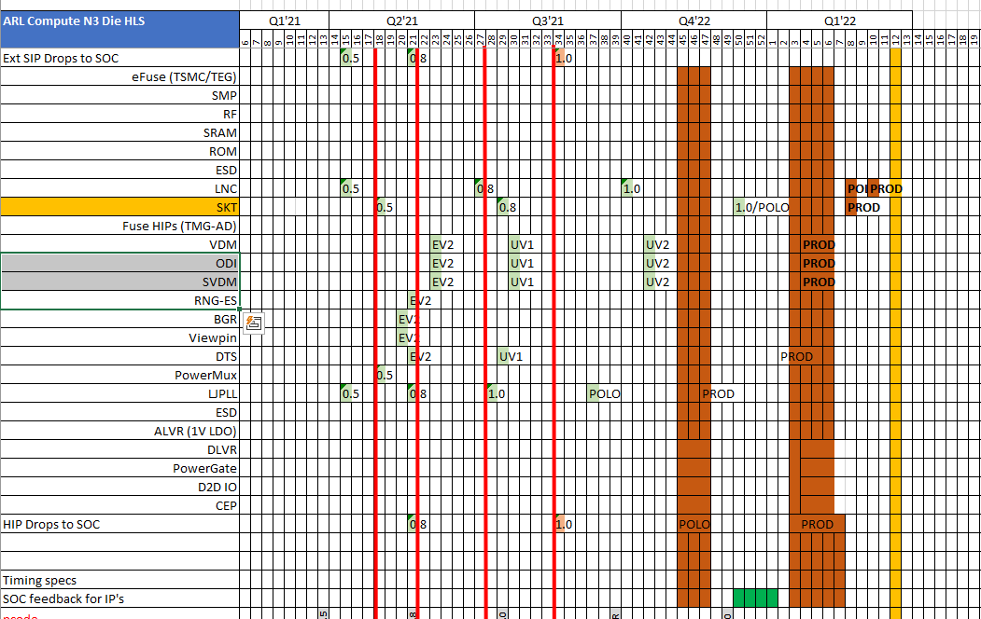
Arrow Lake Compute Die Schedule
Intel Confidential – Product Design Information

Slide 51
GNR EMIB
Bridge | Type | Name | Size (mm)
B3 | IO Die to Cdie | Matlock Bridge 12 | 8.5 x 2.49
B4 |  | Matlock Bridge 22 | 10.4 x 2.49
B5 |  | Matlock Bridge 21 | 4.3 x 2.49
B6 | Cdie to Cdie | Matlock Bridge 17 | 8.5 x 2.7
B7 |  | Matlock Bridge 19 | 10.4 x 2.7
B8 |  | Matlock Bridge 18 | 4.3 x 2.7
Space between die is 240um
SRF does not use B5 and B8

