Slide 1

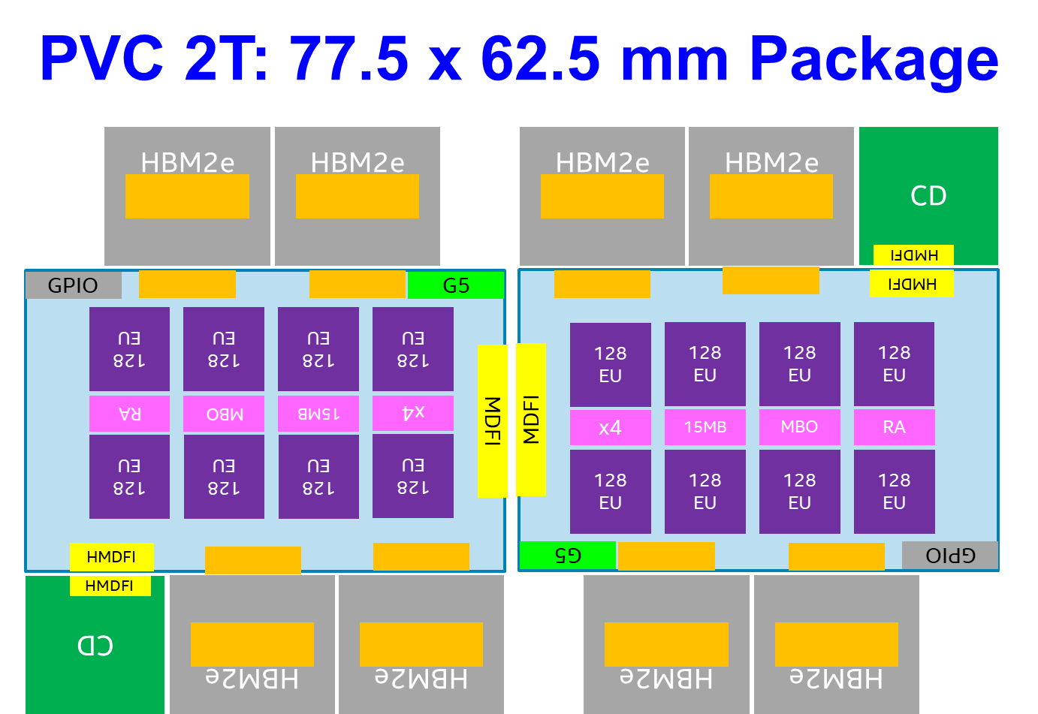
Ponte Vecchio (PVC) Program
First Exascale design for HPC-AI/ML market
8 unique pieces of silicon: HBM2E memory, Base Die, Compute tile, SRAM, Connectivity die, and 3 unique EMIBs
4 SOCs + EMIBs developed in parallel by Intel on 6 unique process nodes: 7nm (lead)/TSMC n5p (lead), TSMC n7, 10+++, 10FV, and 1225.5+1226 (eMIB)
First target customer: US DOE (A21) for 2T config
PRQ: Q4’21 in TDPs ranging from 75 to up to 800 Watts; air and liquid cooling options
PVC-XT (with GFX CT on TSMC n5p) added to the roadmap to overcome i7 challenges and be competitive at PRQ (WW09’22)

Slide 2
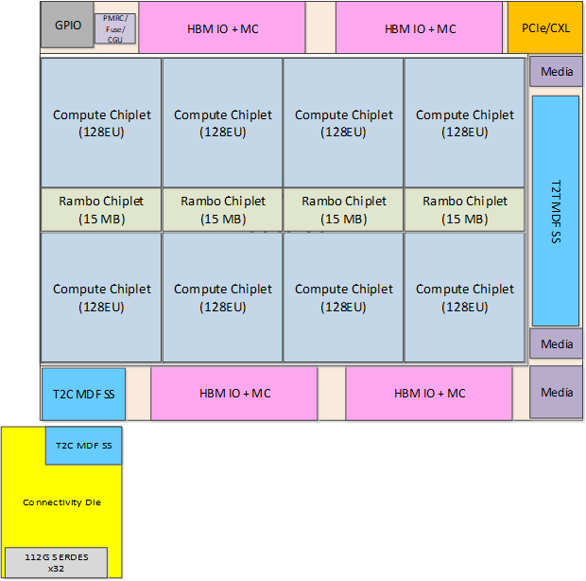
PVC at a Glance
Single Tile Floorplan (4 Unique Dice + 3 unique eMIBs)
Composition of the 4 Dice
Chip | Node | Area | Functionality
Compute die | P1276 or TSMC n5p | ~40 mm2 | EU complex, L1 $
SRAM die | 10nm | ~15 mm2 | Some L3 $ banks
Base Die | 10 FV | ~650 mm2 | L3 fabric, some L3 $ banks, misc globals
Connectivity Die | TSMC N7 | ~75 mm2 | Scale-up serdes, Internal switch
Package + Assembly scope of challenge
PVC Configuration | EU Chiplet count | RAMBO count | Base die count | Connectivity die count | HBM Stack count | Emib count | Total pieces to assemble (w/o incl. dummy die)
1 Tile | 8 | 4 | 1 | 1 | 4 | 5 | 23
2 Tile | 16 | 8 | 2 | 2 | 8 | 11 | 47
PVC is the first product to provide wafer level assembly with multiple dice for a complex silicon disaggregated product

Slide 3
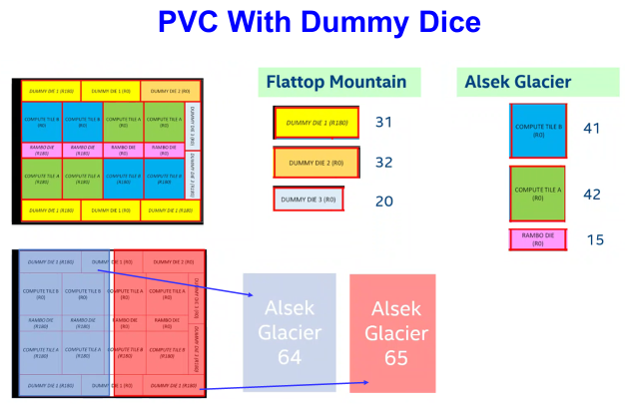

Slide 4
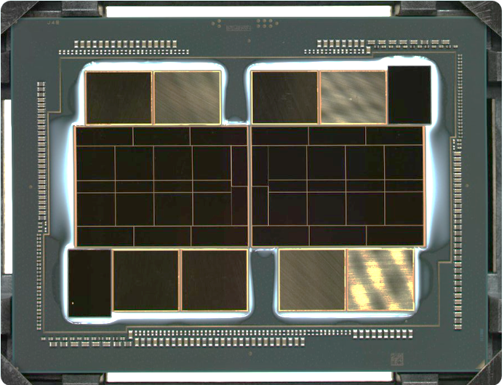
16x TSMC 5nm compute tiles
8x Intel 10nm RAMBO tiles
16x Intel shield die
2x Intel 10nm base die
11x EMIB’s
8x 8H HBM’s
(Samsung or SK Hynix)
2x TSMC 6nm “Arno River”

