Slide 1
Ponte Vecchio Learnings for MTL

Slide 2

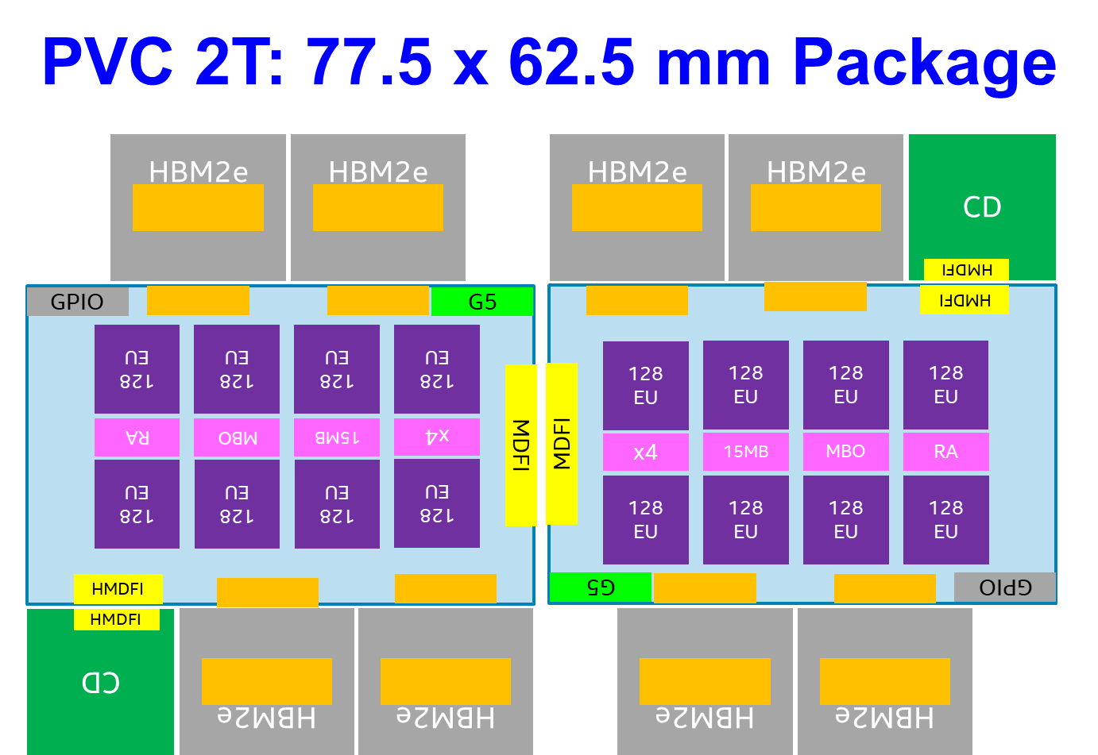
Ponte Vecchio (PVC) Program
First Exascale design for HPC-AI/ML market
8 unique pieces of silicon: HBM2E memory, Base Die, Compute tile, SRAM, Connectivity die, and 3 unique EMIBs
4 SOCs + EMIBs developed in parallel by Intel on 6 unique process nodes: 7nm (lead)/TSMC n5p (lead), TSMC n7, 10+++, 10FV, and 1225.5+1226 (eMIB)
First target customer: US DOE (A21) for 2T config
PRQ: Q4’21 in TDPs ranging from 75 to up to 800 Watts; air and liquid cooling options
PVC-XT (with GFX CT on TSMC n5p) added to the roadmap to overcome i7 challenges and be competitive at PRQ (WW09’22)

Slide 3
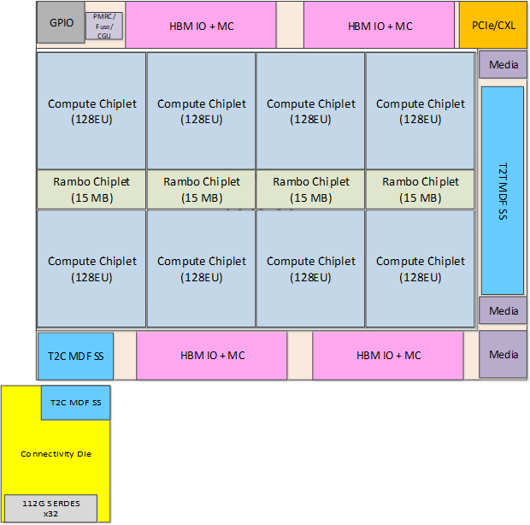
PVC at a Glance
Single Tile Floorplan (4 Unique Dice + 3 unique eMIBs)
Composition of the 4 Dice
Chip | Node | Area | Functionality
Compute die | P1276 or TSMC n5p | ~40 mm2 | EU complex, L1 $
SRAM die | 10nm | ~15 mm2 | Some L3 $ banks
Base Die | 10 FV | ~650 mm2 | L3 fabric, some L3 $ banks, misc globals
Connectivity Die | TSMC N7 | ~75 mm2 | Scale-up serdes, Internal switch
Package + Assembly scope of challenge
PVC Configuration | EU Chiplet count | RAMBO count | Base die count | Connectivity die count | HBM Stack count | Emib count | Total pieces to assemble (w/o incl. dummy die)
1 Tile | 8 | 4 | 1 | 1 | 4 | 5 | 23
2 Tile | 16 | 8 | 2 | 2 | 8 | 11 | 47
PVC is the first product to provide wafer level assembly with multiple dice for a complex silicon disaggregated product

Slide 4
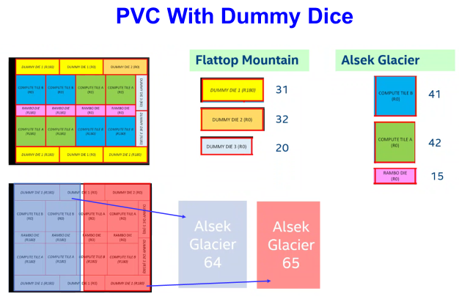

Slide 5
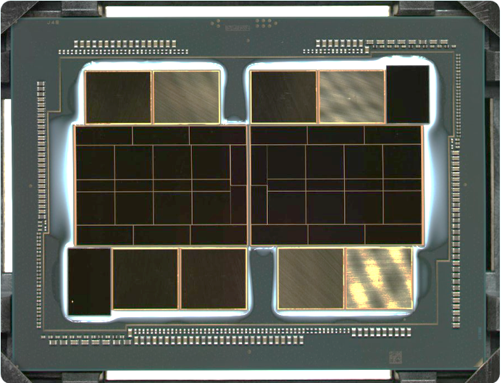
16x TSMC 5nm compute tiles
8x Intel 10nm RAMBO tiles
16x Intel shield die
2x Intel 10nm base die
11x EMIB’s
8x 8H HBM’s
(Samsung or SK Hynix)
2x TSMC 6nm “Arno River”

Slide 6
PVC MFG TEST FLOW and Current Yield
LTD owns socket and MPE owns Content + Test Program
ATD owns pkg assembly +AHM T socket MPE owns Content + Test Program
Assembly step 1
Wafer level (WLA)
Assembly step 2
Package level
Yield data (actual vs plan)
MPE owns CLASS and PPV
External Die
GFx CT
(7nm)
16 / unit
SDS Cold
SDT Hot
SRAM
(10nm)
8 / unit
SDS Cold
SDT Hot
Base
(10nm)
2 / Unit
S-SDT Stacked die SDT Hot
Assembly Health
Monitor
Class Hot
PPV
Finish
HOP Cold
Foveros Wafer Bonding
HBM Attachment / EMIB
(RTD)
Arno River (TSMC 7nm)
2 / unit
SDS Cold
SDT Hot
HBM2e Die
8 per 2T unit
Singulated Die Test
Wafer sort
Stacked die SDT
MCP Package Test
System
Test
Notes:
19 parts between S-SDT and assembly start ?? What happened??
Put the proper calss hot number for qty out.

Slide 7
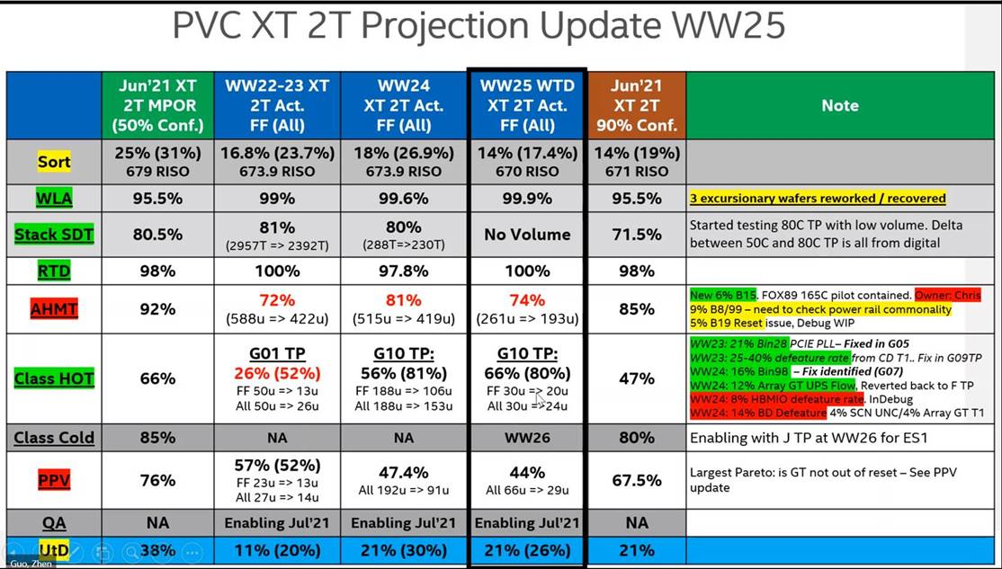
UtW (2Tile Units) | 11.8% | 1.85% (3.7%) | 3% (6.5%) | 3% (4.5%) | 2% (2.7%)
With class cold

Slide 8
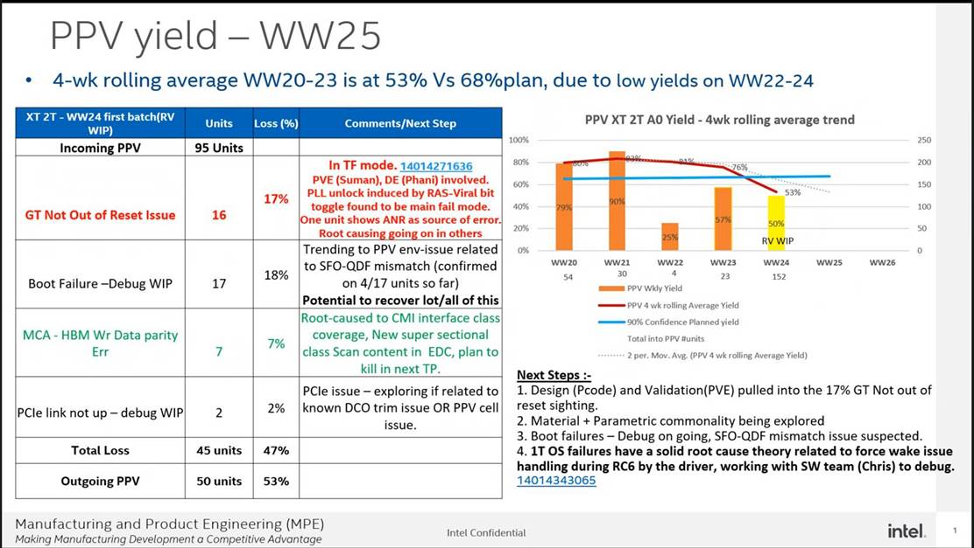

Slide 9
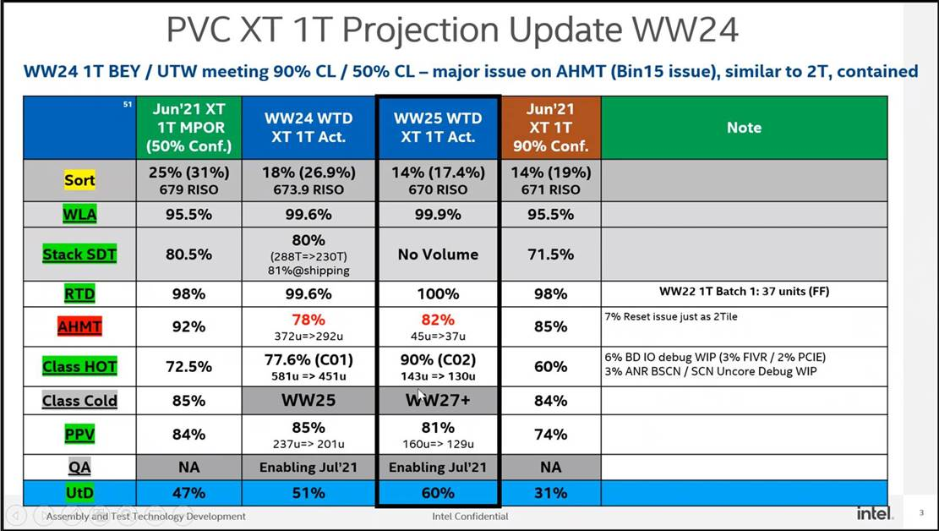

Slide 10
PVC XT Projection Update WW21
Stack SDT: major yield fall out due to Bin8 issue – ATTD in TF. Owner: Michael / Pat. ECD: WW25
BE Yield is meeting expectation (90% and 50% confidence Level)
 | May’21 XT MPOR (50% Conf.) | WW18 XT Actual | WW19-20 XT Actual FF (All) | WW21 WTD XT Act. FF (All) | May’21 XT 90% Conf. | Note
WLA | 98% | 86.2% | 99.2% | 100% | 98% | WLM cracking for one Si vendor. TF in place. Prioritize the other vendors. Owner: Greg
Stack SDT | 75% | 85% | 76% | 65% (81.7% @ shipping) (505T => 411T) | 62% | Bin8 loss 25% (PIYL~20% + MIM impact) 12.3% at shipping excluding zero yield wafers. ATTD in TF mode to assess line healthy. 2 week TPT. Owner Michael. ECD: WW21.5
RTD | 98% | 100% | 98.0% (97u=>95u) | 100% (81u=>81u) | 98% | WW20 Batch 1: 22 units (DF) WW20 Batch 2: 75 units (FF) WW21 Batch 3: 60 units (FF) WW21 Batch 4: 21 units (DF)
AHMT | 94% 6.5% PIYL | Skipped | 82% (95u=>78u) | 82% (81u => 66u) | 80% | 12% PIYL vs. BSL 8% 6.7% Reset vs. BSL 1% – New Signal. Debug WIP. 5% FIVR / IO vs. BSl 1% – New Signal
Class HOT | 50% | 50% (8u) 3u Bin97 1u scan | 55% (72%) FF 58u => 32u All 78u => 54u | 61% (65%) FF: 46u => 28u All: 46u => 30u | 30% | FF => FF (32+28) / (58+46)= 58% FF => FF+DF (40+30) / (58+46) = 67%
PPV | 70% | 56% using XL data | 78% (79%) FF 32u => 25u All 54u => 43u | 96% (93%) FF 28u -> 27u All 30u => 28u | 65% | WW20: Produced 25 FF / 43 All units WW21: Produced 27 FF / 28 All units
UtD | 32% | 28% | 33% (44%) | 45% (47%) | 15% | WW21 Goal: 1 FF / 4 All units

Slide 11
Major PVC-XT Yield Detractors
PVC | Applicability to MTL
Base Die (active interposer) = 25% (21) GDPW at 680 RISO (includes ~ 5 Defeatured dice) | N/A (MTL on passive interposer) (CPU dice on i7 (RISO TBD) likely yield limiter)
Stacked SDT (17% VCC cont, + 8% other) under debug | Yes
Emib attach (5% out of 18% overall AHMT loss) | N/A (no emibs in MTL)
Class Test program (~35%) various issues under debug | TBD
Several of the initial yield issues in assembly were related to excursions and one time occurrences

Slide 12
Key Post-silicon Learnings and Opportunities
Manufacturing Test
Stacked Singulated Die Test (hot): improve quality of stacked KGD before pairing with HBM and other dice in the package
Foveros interconnect: Validate FBIST technology on a complex product with large number of Foveros interconnects
Sort with micro-bumps
Binning and recovery (power, perf, EUs) and use of dummy dice
Opportunistic learning for Merged sort (pilot for MTL): sort at multiple temperatures (cold & hot) without re-socketing → Improves TPT/test time
Yield
I7 yield learning vehicle
Lead vehicle (@intel) for TSMC N5
Wafer level assembly with multiple active and dummy dice. Also, provides assembly health feedback with Foveros attach
Power delivery issues from active base die for high TDP products

Slide 13
Backup

Slide 14
AHMT / Class Pareto
Major Yield Perato – 18% Bin899 (17 units) at AHMT and Class caused by Fast Skew ANR wafers. TP optimization completed. All units are recovered from Bin899
 | Units | Loss (%) | Lead Model | Next Step
Incoming AHMT | 95 Units
ANR Bin899 | 11 | 12% | FF Skew ANR | TP optimization / Sort tightening
PIYL | 5 | 5% | PIYL | Need to enable Repair for EMIB loss
IO / FIVR | 1 | 1% | TP / Defect | Baseline 1-5% TP optimization (50%)
Total Loss | 17 units | 18%
Incoming Class | 78 units | 82%
 | Units | Loss (%) | Lead Model | Next Step
ANR Bin899 | 6 | 7% | FF Skew ANR | TP optimization / Sort tightening
ANR SERDES | 7 | 9% | ANR related | 80% Marginal failure => TP calibration
Digital Base Die | 6 | 7% | Debug / TP optimization | Array GT0 DOA port7. CD Debug Sighting Scan GT0 (EID) bypassing to match HOP.
Analog Base Die | 3 | 4% | Debug | PCIE / DTS / FIVR / Reset
Hardware | 2 | 3% | Hardware | Bin97 / 99 Enable 3A / 4A / PCS Role
Total Loss | 24 units | 31%
Outgoing Class | 54 units | 69%

Slide 15
WW21 PVC Stacked SDT(50C) PARETO @ shipping
 |  | OUTGOING | INCOMING |  | OVERALL YIELD | COMMENT
 |  | IB | DF | FF
 | FF | 1 | - | 80.6% | 59.1%
 | DF | 3 | 74.6% | 3.2% | 22.3%
 | Total Yield | GDPW | 74.6% | 83.8% | 81.4%
PIYL | VCC | 8 | 17.2% | 10.8% | 12.3% | zero yield wafers excluded ; if included Bin8 loss is 25+% with PIYL related ~20%
 | SIUP | 88 | 0.0% | 0.8% | 0.6%
 | HW | 99 | 0.8% | 0.3% | 0.4%
 | FBIST | 36 | 1.5% | 0.3% | 0.6%
DIGITAL | SCN_GT | 82 | 2.2% | 2.2% | 2.1%
 | ARR_GT | 65 | 0.8% | 1.1% | 1.0%
 | SCN_UNC | 47 | 0.0% | 0.3% | 0.2%
 | GT0 | 86 | 1.5% | 0.3% | 0.6%
 | SCN_UNC | 42 | 1.5% | 0.0% | 0.4%
OTHER | RESET | 19 | 0.0% | 0.3% | 0.2%

Slide 16
Estimated 10nm (Base Die) Wafer Starts
Base Die is the yield limiter on PVC – Not applicable to MTL which has passive interposer
CPU die on I7 likely to be the major yield limiter for MTL

Slide 17
Key Post-silicon Learnings and Opportunities (for MTL)
Manufacturing Test
Stacked Singulated Die Test (hot): improve quality of stacked KGD before pairing with HBM and other dice in the package
Foveros interconnect: Validate FBIST technology on a complex product with large number of Foveros interconnects
Sort with micro-bumps
Binning and recovery (power, perf, EUs) and use of dummy dice
Opportunistic learning for Merged sort (pilot for MTL): sort at multiple temperatures (cold & hot) without re-socketing → Improves TPT/test time
Yield
Yield learnings from Arno River TSMC 7nm
Lead vehicle (@intel) for TSMC N5
Wafer level assembly with multiple active and dummy dice. Also, provides assembly health feedback with Foveros attach
Power delivery issues from active base die for high TDP products

Slide 18
WW21 PVC Stacked SDT(50C) PARETO @ shipping
 |  | OUTGOING | INCOMING |  | OVERALL YIELD | COMMENT
 |  | IB | DF | FF
 | FF | 1 | - | 80.6% | 59.1%
 | DF | 3 | 74.6% | 3.2% | 22.3%
 | Total Yield | GDPW | 74.6% | 83.8% | 81.4%
PIYL | VCC | 8 | 17.2% | 10.8% | 12.3% | zero yield wafers excluded ; if included Bin8 loss is 25+% with PIYL related ~20%
 | SIUP | 88 | 0.0% | 0.8% | 0.6%
 | HW | 99 | 0.8% | 0.3% | 0.4%
 | FBIST | 36 | 1.5% | 0.3% | 0.6%
DIGITAL | SCN_GT | 82 | 2.2% | 2.2% | 2.1%
 | ARR_GT | 65 | 0.8% | 1.1% | 1.0%
 | SCN_UNC | 47 | 0.0% | 0.3% | 0.2%
 | GT0 | 86 | 1.5% | 0.3% | 0.6%
 | SCN_UNC | 42 | 1.5% | 0.0% | 0.4%
OTHER | RESET | 19 | 0.0% | 0.3% | 0.2%

Slide 19
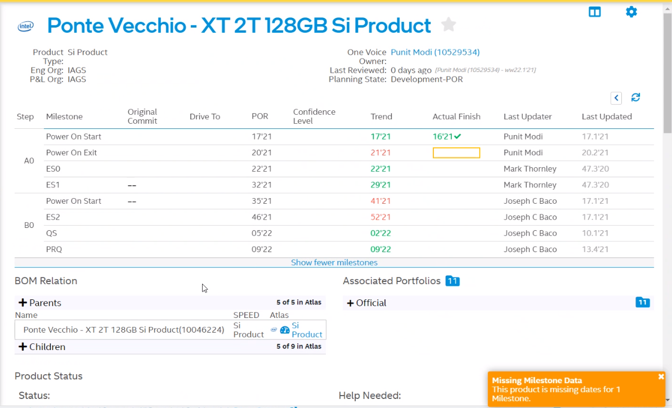

Slide 20
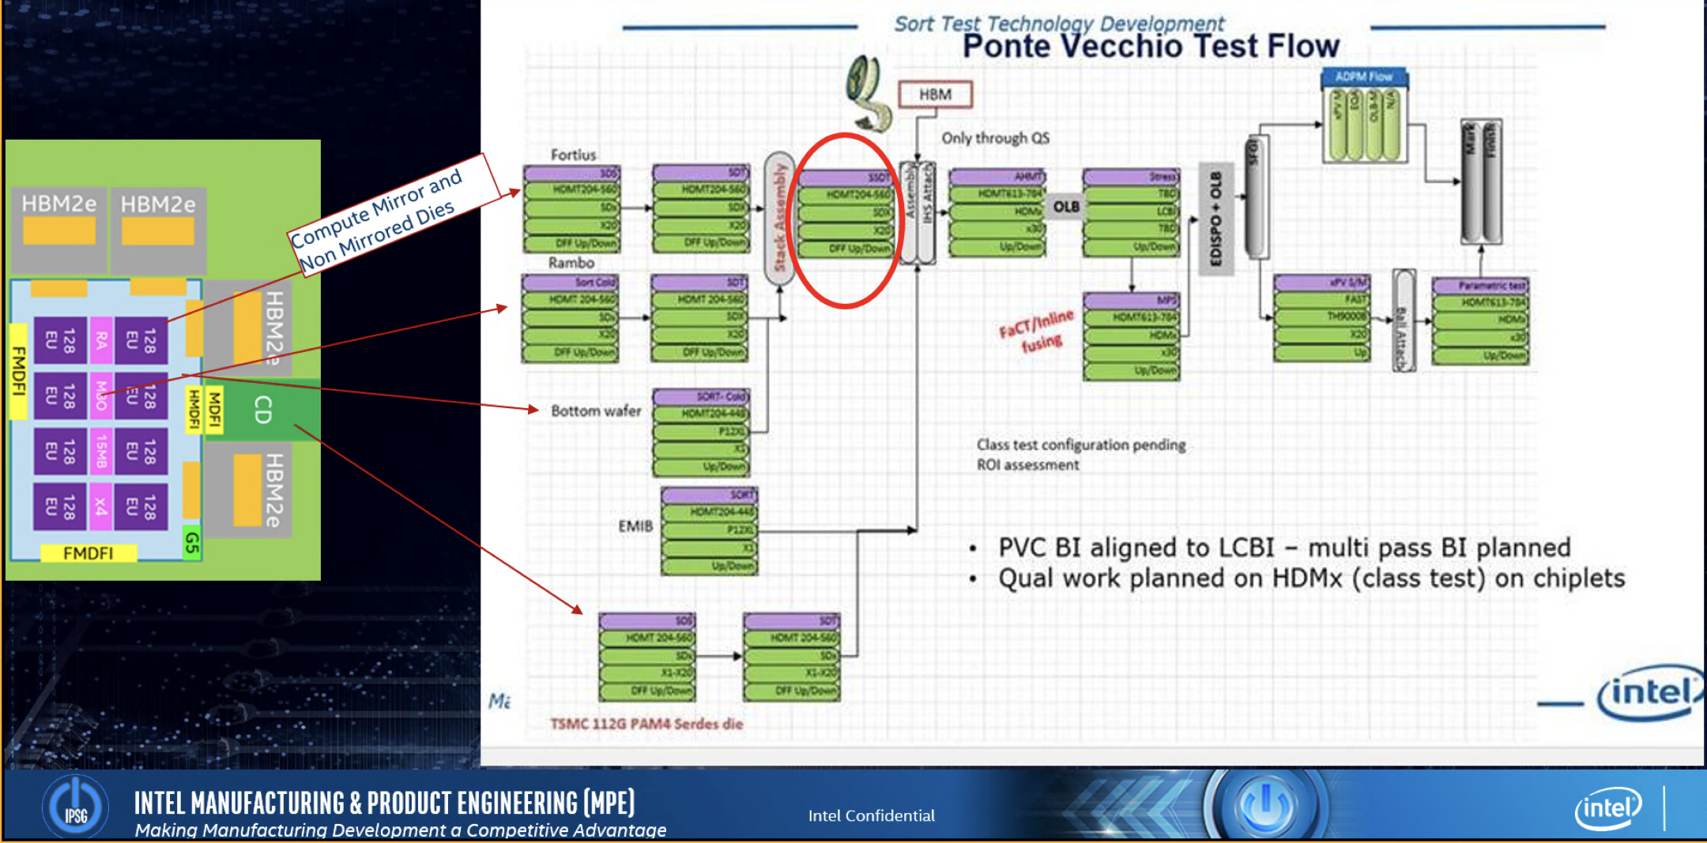
PVC Mfg Test Flow

Slide 21
MTL Test Flow
Operation
Tester
Handler
Parallelism
Core die
SDx Cold
SDx Hot
SDx Cold
HDMT
Singulation
HDMT
HDMT
-10C
110C
-10C
X2/X40
X2/ x40
X2 / x40
Speed and Power Binning, DLVR, PLL, analog Trim, IO Test
Cold marginality
Fusing
GT die
SDx Cold
SDx Hot
DPM- catcher
Pass Fail ONLY
No Binning
SDx Cold
HDMT
Singulation
HDMT
HDMT
-10C
110C
No Test
-10C
X2/X40
X2/ x40
Burn In
Fusing
OLB
X2 / x40
SDSDT
Class Cold
HDMT
PPV-S
EQA
HDMT
LCBI/HBI
Class Hot
NA
NA
HDMT
Singulation
HDMT
25C
Stacking
Pkg Assy
Pkg Assy
Finish
SOC die
SDX
Pkg Assy
Hot
HDMT
xxx
STHI
HDMX: 25C
SDx Cold
X1/X20
X12
HDMX: -10C
X1/X30
0
HDMX: 100C
xx
x1 / x30
SDx Hot
X1 / x30
SDx Cold
HDMT
X1 / x30
Singulation
HDMT
QA:
ES1 intercept
Eliminate @ PRQ+1Q
HDMT
-10C
110C
-10C
X2/X20
Stacked die SDT:
Engineering only
Eliminate @ QS
BI only for QUAL:
Eliminate
@ PRQ+2
X2/ x20
PPV-M
X1 / x20
NA
IO die
STHI
Sort Cold
Sort Hot
xx
HDMT
HDMT
HOP: -10C
HOP: 100C
x8
x8
ADM/PI die
Sort Cold
Sort Hot
HDMT
HDMT
HOP: -10C
HOP: 100C
X4, X3
X4, x3
21
Notes:
Sort test and class test:
Singulation at sort, then grouping and followed by package test
Advantages with Singulation: parallelism, ease to switch cold-hot-cold
Weed out parts at sort exhibiting big vmin excursions and also fallout of the regular tests possible at sort
After stacking, test again, kill before packaging
Limited burnin followed by class test at hot and cold.
Per part validation as it was established to be valuable for screening parts further
Create the best KGD at sort and reduce the burden on Package test
Create a characterization flow that establishes the value of each step and benefit when manufacturing process improves and set a stage to eliminate as many steps as possible
Work closely with MPE during PO and characterization to establish a plan upfront, gather and analyze data and ensure optimal and justified flow is setup for HVM

Slide 22
PVC Yield and Supply Update
WW21

Slide 23
PVC XT Projection Update WW21
Stack SDT: major yield fall out due to Bin8 issue – ATTD in TF. Owner: Michael / Pat. ECD: WW25
BE Yield is meeting expectation (90% and 50% confidence Level)
 | May’21 XT MPOR (50% Conf.) | WW18 XT Actual | WW19-20 XT Actual FF (All) | WW21 WTD XT Act. FF (All) | May’21 XT 90% Conf. | Note
WLA | 98% | 86.2% | 99.2% | 100% | 98% | WLM cracking for one Si vendor. TF in place. Prioritize the other vendors. Owner: Greg
Stack SDT | 75% | 85% | 76% | 65% (81.7% @ shipping) (505T => 411T) | 62% | Bin8 loss 25% (PIYL~20% + MIM impact) 12.3% at shipping excluding zero yield wafers. ATTD in TF mode to assess line healthy. 2 week TPT. Owner Michael. ECD: WW21.5
RTD | 98% | 100% | 98.0% (97u=>95u) | 100% (81u=>81u) | 98% | WW20 Batch 1: 22 units (DF) WW20 Batch 2: 75 units (FF) WW21 Batch 3: 60 units (FF) WW21 Batch 4: 21 units (DF)
AHMT | 94% 6.5% PIYL | Skipped | 82% (95u=>78u) | 82% (81u => 66u) | 80% | 12% PIYL vs. BSL 8% 6.7% Reset vs. BSL 1% – New Signal. Debug WIP. 5% FIVR / IO vs. BSl 1% – New Signal
Class HOT | 50% | 50% (8u) 3u Bin97 1u scan | 55% (72%) FF 58u => 32u All 78u => 54u | 61% (65%) FF: 46u => 28u All: 46u => 30u | 30% | FF => FF (32+28) / (58+46)= 58% FF => FF+DF (40+30) / (58+46) = 67%
PPV | 70% | 56% using XL data | 78% (79%) FF 32u => 25u All 54u => 43u | 96% (93%) FF 28u -> 27u All 30u => 28u | 65% | WW20: Produced 25 FF / 43 All units WW21: Produced 27 FF / 28 All units
UtD | 32% | 28% | 33% (44%) | 45% (47%) | 15% | WW21 Goal: 1 FF / 4 All units

Slide 24
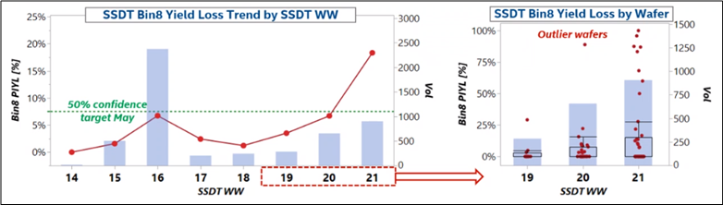
Bin8 TF status
SSDT Bin8 TF:
Bin8 uptick WW19-21 at SSDT driven by very poor yielding single wafers
Strong GFA to within die location, but independent of top die rotation.
Leading models:
Contamination at DTA or nozzle at TCW → increased cleaning in place WW21.
Incoming SnAg volume or SIB bumps → inspection on retained wafers from highest yield loss lots.
Discussed commonality:
most incidents from TCW104 (OWLA), but 1 wafer from Chandler WLA and 3 wafers from TCW105.
Yield loss seems to track more with base die than top die (i.e. wafer level).

Slide 25
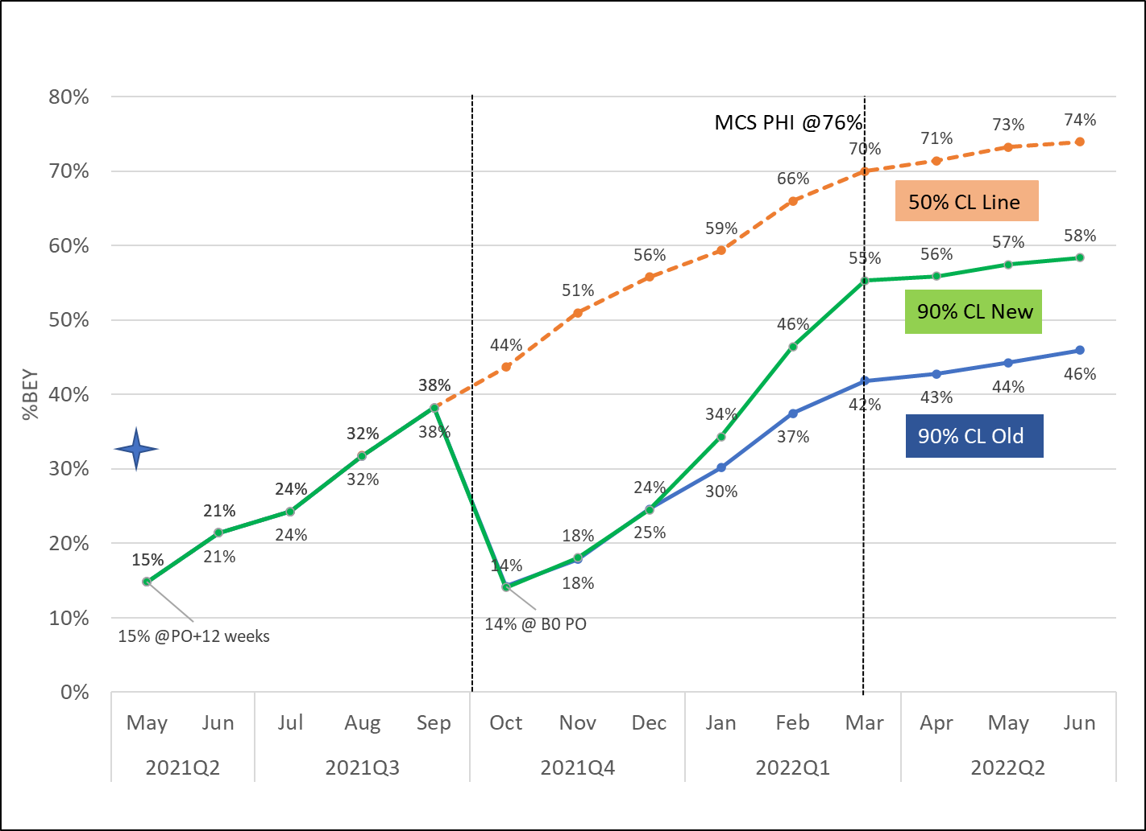
PVC XT B0 90% CL recommendation – Green Line
Key Assumptions:
B0 is PRQ stepping and schedule will not allow additional stepping to address design related yield loss.
Changes from WW20.2
XT PPV yield (not full content yet, but matching XL) at ~79% vs. 54% XL base line. [link]
Assuming 15% for potential B0 screens required in PPV. [link]
Will try to push to Class -> stacked SDT opportunistically
B0 PO
B0 PRQ
Notes:
Initial Yield 96.9 -> now 80%.
UtD at PRQ for new confidence line is at 55%, which is about 15% lower than 50% confidence line and in the middle of 50% confidence line (70%@PRQ) and old 90% confidence line (42% @ PRQ)
From orange line to new green line
There is no class hot degradation at all
PPV degraded from 97% to 80% -- This is more or less with 15% degradation as well and Rama is OK with this PPV proposal
He said he will put the following assumptions
Assume B0 is PRQ stepping and it has major design issue like LKF
Assume this design issue can only captured by PPV (like LKF) -- no structural test in class or stack SDT can catch that like LKF.
That is what he wanted to commit
In engineering phase, first 3 months will be still low (also due to PPV) and then it will pick up at ES2 and QS and then PRQ at middle point
This will trigger about 20K total wafer start vs. 50% confidence line of 15K wafers start and old blue line of 25K wafer start

Slide 26
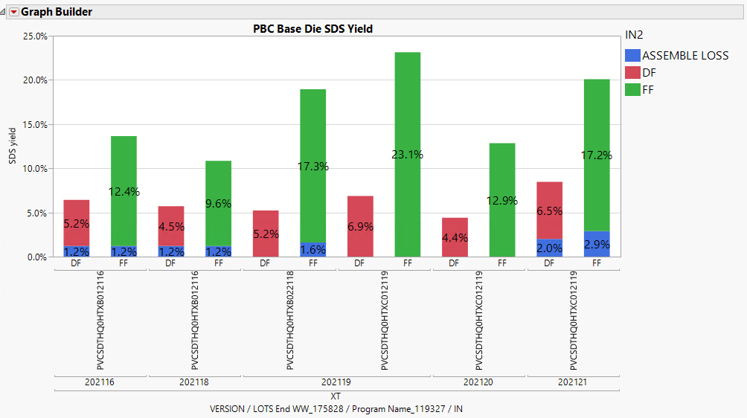
PVC XT Stacked SDT(50C)
HOP SORT shipping yield:
FF: 20.1%; DF: 8.5%
SSDT tested 505 tiles, yield is 81.4%
FF (371) → FF: 80.1% (297)
Incoming |  | Outgoing |  | Yield
Config | Tiles | Config | Tiles
FF (4Q + 8x8) | 371 | FF (4Q + 8x8) | 297 | 80.1% | Bin1
 |  | CD DF (4Q + 8X7) | 2 | 0.5%
 |  | BD DF (3Q + 8X7) | 12 | 3.2% | Bin3
 |  | Reject | 60 | 16.2% | Loss
DF (3Q + 8X7) | 134 | BD DF (3Q + 8X7) | 100 | 74.6% | Bin3
 |  | Reject | 34 | 25.4% | Loss
Total | 505 |  | 411 | 81.4%

Slide 27
WW21 PVC Stacked SDT(50C) PARETO @ shipping
 |  | OUTGOING | INCOMING |  | OVERALL YIELD | COMMENT
 |  | IB | DF | FF
 | FF | 1 | - | 80.6% | 59.1%
 | DF | 3 | 74.6% | 3.2% | 22.3%
 | Total Yield | GDPW | 74.6% | 83.8% | 81.4%
PIYL | VCC | 8 | 17.2% | 10.8% | 12.3% | zero yield wafers excluded ; if included Bin8 loss is 25+% with PIYL related ~20%
 | SIUP | 88 | 0.0% | 0.8% | 0.6%
 | HW | 99 | 0.8% | 0.3% | 0.4%
 | FBIST | 36 | 1.5% | 0.3% | 0.6%
DIGITAL | SCN_GT | 82 | 2.2% | 2.2% | 2.1%
 | ARR_GT | 65 | 0.8% | 1.1% | 1.0%
 | SCN_UNC | 47 | 0.0% | 0.3% | 0.2%
 | GT0 | 86 | 1.5% | 0.3% | 0.6%
 | SCN_UNC | 42 | 1.5% | 0.0% | 0.4%
OTHER | RESET | 19 | 0.0% | 0.3% | 0.2%

Slide 28
AHMT / Class Pareto
Major Yield Perato – 18% Bin899 (17 units) at AHMT and Class caused by Fast Skew ANR wafers. TP optimization completed. All units are recovered from Bin899
 | Units | Loss (%) | Lead Model | Next Step
Incoming AHMT | 95 Units
ANR Bin899 | 11 | 12% | FF Skew ANR | TP optimization / Sort tightening
PIYL | 5 | 5% | PIYL | Need to enable Repair for EMIB loss
IO / FIVR | 1 | 1% | TP / Defect | Baseline 1-5% TP optimization (50%)
Total Loss | 17 units | 18%
Incoming Class | 78 units | 82%
 | Units | Loss (%) | Lead Model | Next Step
ANR Bin899 | 6 | 7% | FF Skew ANR | TP optimization / Sort tightening
ANR SERDES | 7 | 9% | ANR related | 80% Marginal failure => TP calibration
Digital Base Die | 6 | 7% | Debug / TP optimization | Array GT0 DOA port7. CD Debug Sighting Scan GT0 (EID) bypassing to match HOP.
Analog Base Die | 3 | 4% | Debug | PCIE / DTS / FIVR / Reset
Hardware | 2 | 3% | Hardware | Bin97 / 99 Enable 3A / 4A / PCS Role
Total Loss | 24 units | 31%
Outgoing Class | 54 units | 69%

Slide 29
WW21 PVC XT 2T ClassHot Yield
139u tested on RevB02 Class TP, Yield 69.1% => 77% WW21
~6% ARR_GT0 + ~3% SCN_GT0 debug WIP, need close sighting ECD. CP: WW21.4
~4% ANR SERDES related fallout need debug (out of total 8%) to understand SORT-CLASS_XT marginality analysis
2T ClassHot (105C) | Rev0B02 139u | Leading Model | Action Plans | Owner
Bin1 | 96u (69.1%)
B65_ARR_GT0 | 6.5% | Debug | 8u DOA T0/T1 Port7, debug with CD. Need ECD | Shashank
B81_SCN_GT0 | 5.0% | Debug | 3% (4u) GT0 due to PARB COMMON (EID 2063); Masking to match HOP in next TP 5u GT0 due to ATPG PARB/TAPTG PARBE COMMON other EID, pending debug | Arun
B54_ANR_SERDES | 5.0% | Debug | 4% (5u) AFE/53G_TX failure, enable 3A/4A in next TP before new FW verified. 1u REG_RW 1u SERDES_LCPLL pending debug | Edwin
B97_PTH/B99 | 2.8% | HW | Dieforce, HWCA X3423_A401 | Eric
B42_ANR_SCN | 1.4% | Debug | 1u EXTEST, 1u CA1TF_SERDES – New Sightings | Ben F.
B20_ANR_ARR | 1.4% | Debug | 1u CPORT, 1u SERDES – New Sighting | Neelima
B61_ARR_MBIST_Base | 1.4% | Debug | Same on XL | Damodhar
B27_FIVR | 2.1% | Debug | IMONAVPCPS, CPSTRIM(preamble)/TRIM, same on XL | Mark
B19_RESET | 1.4% | Debug | PHASE5, new sighting | Linda/Wai Loon
B18_SICC | 1.4% | TP Fix | 1% Limit optimization in next TP for XT | Aravindaraj
Other | ~3% | Debug | FUN_DRNG (HOP screen); B15_EDM, DTS

Slide 30
PPV Pareto
Major Yield Perato – 15% HBM related with with multiple Sighting filed
Roadmap 79% => 81%
 | Units | Loss (%) | Next Step
Incoming PPV | 54 Units
MCA - HBM Wr / Assess Data parity Err | 6 | 11% | New Signature. Debug WIP (Different than item below)
GT_Fatal_7 (Not NR sensitive) - HBM data wr parity err | 2 | 4% | Same bucket but Better than Expected from previous BSL (~10%). Reason TBD
Driver load failure + OS fails + MCA OS | 1 | 2% | XT Kernel (latest XT version) + FF Si symmetry (HSD shown) Still better than expected from previous BSL (16%)
Pcie fails | 1 | 2% | > Same fallout rate
Memory scrubbing Errs/HBM repair | 1 | 2% | > fixed in latest XL Class TP in WW20 (hard repair check - content added), XT WIP – is not hard repair related, in debug
Total Loss | 11 units | 21%
Outgoing Class | 43 units | 79%

Slide 31
PPV data
 | WW20 (XT) | WW18-WW15 (XL) | Comments/Leading Models
Pass | (43) 79% | 54%
GT_Fatal_7 (Not NR sensitive) - HBM data wr parity err | (2) 4% - ↓ | 10% | > Same bucket but Better than Expected this Week (reason TBD)
GT Fatal 7 UR (unsupported request) + Driver load failure + OS fails + MCA OS workloads | (1) 2%- ↓ | 16% | > Better than Expected this Week - XT Kernel (latest XT version) + fixes (18015520619) + FF Si symmetry (HSD shown)
MCA - HBM Wr Data parity Err | (3) 6% - ↑ | 0% | > New signature (Not flagged as GT Fatal 7 )
MCA - HBM Address parity Err | (3) 6% - ↑ | 0% | > New signature (Not flagged as GT Fatal 7 )
Pcie fails | (1) 2% - ↔ | 2% | > Same fallout rate
Memory scrubbing Errors/HBM repair | (1) 2% - ↓ | 4% | fixed in latest XL Class TP in WW20 (hard repair check - content added) XT WIP – is not tied to lane repair. Needs further debug
GT Fatal 7 NR_sensitive | 0% | 6% | > Expected since no NR
MCA-Punit | 0% | 5% | > PPV HW resolved, But bin-swicthed to GT_fatal 7 and other bins in XL
Boot fail | 0% | 2% | > recovered in 2A (Better than expected)
Notes:
MCA – HBM Wr .. These were driver load failures (all 12%)!!!
GT FATAL 7 - UR – unsupported required. Root caused to SW. Driver load failure MCA.

Slide 32
Back up

Slide 33
PVC XT Projection Update WW20
WW20 PVC xT BE Yield is meeting expectation (50% confidence number) with limited volume
 | May’21 XT MPOR (50% Conf.) | WW18-19 XT Actual | WW20 XT Actual FF (All) | May’21 XT 90% Conf. | Note
WLA | 98% | 86.2% | 99.2% | 98% | WLM cracking for one Si vendor. TF in place. Prioritize the other vendors. Owner: Greg
Stack SDT | 75% | 85% | 76% | 62% | Total shipped 76%. One lot yield at 69% with 26% Bin8 loss vs. 1.5% BSL; total 157 base dies missed inking all from RA4 (The other lot at 95%)
RTD | 98% | 100% | 98.0% (97u=>95u) | 98% | Batch 1: 22 units Batch 2: 75 units
AHMT | 94% 6.5% PIYL | Skipped | 82% (95u=>78u) | 80% | 11.6% Bin899 failure trace back to ANR FF skew wafers. (Total 18% loss between class and AHMT) All recovered from Bin899 with new TP
Class HOT | 50% | 50% (8u) 3u Bin97 1u scan | 55% (69%) FF 58u => 32u All 78u => 54u | 30% | Class TP at Power-on stage – Need to enable Vmin VF search at high frequency.
PPV | 70% | 56% using XL data | 78% (79%) FF 32u => 25u All 54u => 43u | 65% | PPV TP currently matching PVC xL. Content enabling and TP addition marching to PO exit goals
UtD | 32% | 28% | 33% (44%) | 15% | 23 FF actual vs. 10 FF units target 43 All units actual vs. 23 units target
Notes:
POE is 4 weeks from package power. Trending WW23. 30% of POE goals for PPV. Class enabling additional VF points.

Slide 34
WW20 - 2T AHMT XT Yield (105C)
95u tested RevB0 TP at AHMT
82.1% overall yield: 12% B899_VCCANR_DIG due to FF SKEW materials
2T AHMT (105C) |  | RevB02 | Leading Model | Action Plans
 | Bin1 | 78u (82%)
PIYL | B899_VCC_ANR | 11.6% | Incoming Materials | ANR FF skew materials
 | B838_VCCIN | 3.1% | Defect | 1-2% BSL
 | B34_MDFI | 2.1% | Defect | 2% BSL, T2T LLOOP
Testing | B27_FIVR | 0.5% | Debug | 1% BSL, IMONAVPOFFSET under debug

Slide 35
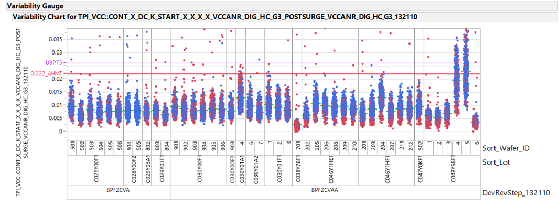
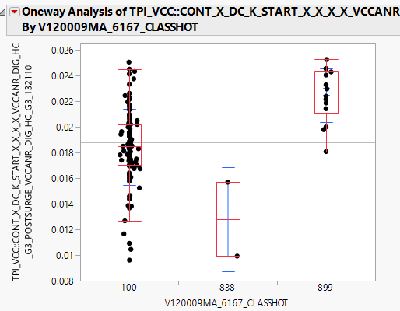
ANR_VCC_SDS

Slide 36
CLASS Defeature
32u FF of 40u Bin1 (2nd XT)
3u defeatured due to BASEDIE ARR
5u defeatured due to Compute
2u SSDT already incoming
3u SCN_tATPG F1 Sectional
Unit | VPO | Class DF Reason | Class DF Content
D1FF576600001 | V120009MA | T0 MC2 | Array KS long algo/TTR for T0 Base
D1FF576600008 | V120009MA | T1 C7 7DSS | Array KS TTR and P1 for T1 C7
D1FF576600016 | V120009MA | T0 C6 7DSS | Scan ATPG/tTAPG F1 Sectional for T0 C6
D1FF576600021 | V120009MA | T0 C1 7DSS | Already incoming 7DSS for T0 C1
D1FF576600029 | V120009MA | T0 C7 7DSS | Scan tATPG F1 Sectional for T0 C7
D1FF576600036 | V120009MA | T1 C7 7DSS | Scan tATPG F1 Sectional for T1 C7
D1FF576600046 | V120009MA | T0 C7 7DSS | Already incoming 7DSS for T0 C7
D1FF576600061 | V120009MA | T0 MC3 | Array KS long algo/TTR for T0 Base

Slide 37
PVC-XL 2T PPV Yield (25C)
WW15-18 4wk rolling average Yield is ~54% vs. target of 65%
Identified ~13% yield recovery fixes towards May target of 65%.
In debug:
HBM parity GT_Fatal 7 = 8% (DFx/Design team)
UR/GUC load SW err GT_Fatal 7 = 2% (SW team)
Punit MCA = 5% - initial signature root caused to thermal issue, next – debug of Bin-switching (PPV team)
10 different fail buckets with 1 to 2 units per bucket - WIP via sysdebug (Val team)
Risk of identify potential design issues as A0 yield sighting debug progresses
Line of Sight- High confidence items | % Yield recovery | ETA
NR sensitive recovery causing GT fatal7 – not POR for XT | 6% | W21
PCIE HSPHY FW per lane tuning | 2.60% | W21
Kernel fix w version updates | 5% | W20
Notes:
Check the last number 54 or 56.
Kernel fix (22012990038) helped recovered 20% raw yield in WW18, but in WW19 expect 6%
Org. inputs:
Manual RV is expected to recover yield – range of 8 to15% (Kernel fix (22012990038) + PPV thermal HW fix)
WW19 raw yield is 44% in 63u – RV in WIP

Slide 38
PVC XL 2T Yield Daily Update WW19
PVC XL WW19 WTD No volume at major testing socket. WW18 BE Yield is at 27% vs. Target 60%.
Reset issue confirmed fixed at class and AHMT.
Gap at Class Hot is mainly due to hardware issue / ANR die – will be fixed in next TP
PPV platform instability in daily TF with Design / Validation Owner: Arvind / Bob / Suresh
 | Q2’21 XL MPOR | Last 4WW (WW14-17) | WW18 Actual | WW19 Actual | May’21 Projection | Note
WLA | 98% | 97.6% (4.1ku) | 99.7% (330T) | 100% (37T) | 98%
Stack SDT | 73.6% | 74.2% (4.0ku) | No Volume | No Volume | 82% | Latest TP yielded at ~79% → 82% roadmap (WW19)
Assembly | 97.9% | 97.6% (1038u) | 98.9% (641u) | 100% (101u) | 98%
AHMT | 94% | 62.8% (637u) 15% reset | 87% (457u) 5.3% PIYL | 84% (243u) 8.2% PIYL | ~90% | Reset fix demonstrated. ~8% PIYL: Owner Michael Remaining 4% in debug, 4% fix in next TP (Bin94 / 90)
Class HOT | 80% | 36% (278u) 34% reset 10% B15 | 56% (219u) 14% Hardware 6% ANR BSCAN 3% B64 | No Test out Volume | ~75% 5% BSL Bin15 | 14% Hardware includes: 7% B15/B8/B97 due to hardware. Owner: Eric 2% B98 due to TOS/DPS setup. Owner: Eric 5% B65/81 pass in manual RV. Enabled 3A/4A for RCS. 6% B11/25 ANR VIH / BCSN TP fixed WW18.5 3% B64 due to 25C test. Fixed in WW18 back to 70C.
PPV | 82% | 58% (45u) 16% GT Fatal7 | 56% (25u) | 44% (63u) RV Pending | ~60% | Major Yield Loss (from WW14-17): 38% Platform / ingredient / Silicon sighting in debug. 16% GT Fatal 7 loss 11% OS fails – 3% can be fixed with New Kernell release
UtD | 60% | 13% | 27% | TBD | ~40%

Slide 39
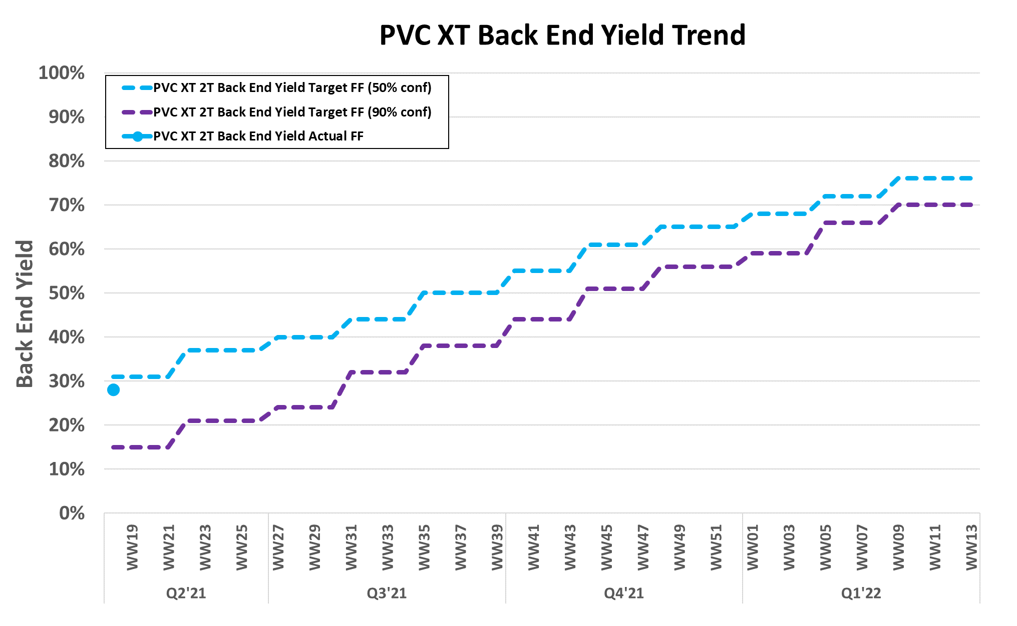

Slide 40
Problem Statement
SBL – Statistical Binning Limits
EDC – Engineering Data collection
TCW – Thermal Compression wafer bonding
HOP – Sort Probing Tool
DP – Die Prep
MIM leakage seen due to defects in MIM layer from a process related issue in fab. WW10-14.5 Test program was in a engineering data collection mode b/w WW10-WW14.5 An uptick was seen post WW15 when SBL was established and line was taken down at Fab. Fab integration owns the TF for the MIM layer.
RA4 OWLA
RA4 TCW
DDUI is able to talk to TCW @ CH and units were terminated at 2060.
Units @ RA4 TCW – 90u continued to be good @ TCW in RA4 and got bonded. ULT did not get updated
PVC Base Wafer Level HOP
EDC/DDUI – Die Kill
OTD DP
MIM Test – Test Program
CH ADI
CH TCW
WW10-14.5 No SBL Limits EDC Mode
578u Identified
> W15 SBL Limits in Place
90 were not flagged at OWLA ULT due to it being on a different database. AQS team sent out new process to broadcast manual die kill and has removed OTD from the down menu.

Slide 41
59u
WATD Post Mold Grind
90u
Not Rejected
3u
CH – Tape and Reel
28u
Fab – PSB Loop

Slide 42
PVC-XL 2T PPV Yield (25C) - Fail pareto
Row Labels | WW12 | WW13 | WW14 | WW15 | WW16 | WW17 | WW18 | Grand Total
Debug WIP | 1 | 7 | 2 | 4 | 5 | 6 | 10 | 35
1a. MCA - GT Fatal 7 - BaseGT Tile1 |  |  |  |  |  |  | 2 | 2 | > NR silicon + SBFT content
1b. MCA - GT Fatal 7 - LNGP unit |  |  |  | 1 | 1 |  |  | 2 | > NR silicon + SBFT content
1c. MCA - GT Fatal 7 - LBCF unit |  | 1 |  |  |  |  |  | 1 | > NR silicon + SBFT content
1d. MCA - GT Fatal 7 - HBM err |  |  |  |  | 1 | 2 | 2 | 5 | > IN TF debug, new DFX content WIP
1e. MCA - GT Fatal 7 - UR/GUC load |  |  |  |  | 1 |  |  | 1 | > In SW TF, Root cause pending
2. OS fails |  |  | 2 | 1 |  | 2 |  | 5 | > New kernel fixes helping. Recovery WIP
3. MCA - OS |  |  |  | 1 |  |  | 2 | 3 | > debug WIP
4a. MCA - Punit |  | 1 |  |  | 1 | 2 | 1 | 5 | > 3/5 recovery expected with PPV thermal HW fix
4b. MCA - Punit/ MCA - GT Fatal 0 |  | 1 |  |  |  |  |  | 1 | > debug WIP
5. MCA- Memory scrubbing errors |  | 2 |  |  |  |  | 1 | 3 | > In TF, new DFX content being identified
6. MCA - during driver load |  |  |  |  | 1 |  | 1 | 2 | > debug WIP
7. MCA - Memory request Timeout |  |  |  | 1 |  |  |  | 1 | > debug WIP
8. DPM | 1 | 1 |  |  |  |  |  | 2 | > debug WIP
flaky part OR IM |  | 1 |  |  |  |  |  | 1 | > debug WIP
PCIE link not up |  | 2 |  |  |  |  | 1 | 3 | > HSPHY FW has the fix, awaiting WW20
Boot failure |  |  |  |  |  |  | 1 | 1 | > debug WIP

Slide 43
PVC-XL 2T PPV Yield (25C) - WW19.4
GT Fatal breakdown – debug pending on 2 units to confirm Tape-in un-gate
Debug WIP | WW15-WW18 (% Yield from 59u) | NR or Regular | Suggested fix/Next stepc | ETA/Checkpoint
1a. MCA - GT Fatal 7 - BaseGT Tile1 | 3% | NR | New NR rules and/or SBFT functional | XL – WW20 (Not POR for XT)
1b. MCA - GT Fatal 7 - LNGP unit | 3% | NR | New NR rules and/or SBFT functional | XL – WW20 (Not POR for XT)
1c. MCA - GT Fatal 7 - LBCF unit | 0% | NR | New NR rules and/or SBFT functional | XL – WW20 (Not POR for XT)
1d. MCA - GT Fatal 7 - HBM err | 8% | Regular | New test for HBM coverage- DFX/MPE TF | ETA WW20
1e. MCA - GT Fatal 7 - UR/GUC load | 2% | Regular | SW issue – TF ongoing. | Checkpoint WW20
2T BD SKU PPV yield trends
Quad count+ NR | Total units | Passing Units | Passing Yield
All Quads + all types | 99 | 54 | 55%
Quad 6 - 8 + Regular | 43 | 28 | 65%
Quad 6 - 8 + NR | 13 | 5 | 38%
Quad 1- 5 + Regular | 10 | 5 | 50%
Quad 1- 5 + NR | 33 | 19 | 58%
Parts with 3 or 4 quad per tile and no Node-recovery is @ 65% from the WW12-18 data.
This is without 222 Kernel, DrmVirtualEnginesForCcs fix (3%) + HBM (8%) , Punit/DTS(4%), PCIE fixes(2%) in the pipeline

Slide 44
Line Of Sight
Cumulative yield is 54% (down from 58%), High confidence LOW items show a path to 68% yield
 | Actions | Team/s responsible | Owner | Yield recovery expected | Priority | Confidence | Need by Date/POR ETA in (EDC/KILL) | Details/Next steps | Help Needed to move to High
1 | HBM repair miss screened at class | Class HBM team | Pauline D | 1.3% | 1- High | 1- High | WW18/WW19 – done | Test check is integrated in the TP | -
2 | PCIE link needs per lane DCO | EV/IVE | Shanshan Su/Troy L/BH | 2.6% | 1- High | 1- High | WW20 | EV team needs to procure and deliver the HSPHY FW | This has slipped, need help to expedite.
3 | MCA - GT Fatal 7 – NR sensitive – fix by NR rule change + SBFT adds in class | TFs in PPV, Class-digital, SV, DFX | Suman (SV), Suresh (DFX), Brian (Class), Arvind(PPV) Pattabhi,JPS(Arch) | 6% |  | 1- High | WW20 | TF to root cause the 2 remaining anomalies DE/DFX to give decision on NR rule change. DFX/Class- Digital team to implement SBFT functional tests | Need high priority help from DE/DFX/PVE/IVE to close on fix
4 | MCA – GT Fatal 7 – HBM Err – DFX/MPE team to plug this test hole | TFs in PPV, Class-digital, SV, DFX | Same as above | 8 % | 1- High | 2-Medium | WW20 | TF needs to root cause and add new tests to plug this gap. | Need high priority help from DE/DFX/PVE/IVE to close on fix
5 | MCA – GT Fatal 7 – UR/GUC fail – SW TF on-going + ATPG pattern being added. | SV+Class Scan | Suman (SV) | 2 % | 1- High | 2-Medium | WW20 | SW | Need high priority help from DE/DFX/PVE/IVE to close on fix
6 | MCA – Punit, - PPV Intec thermal system issue fixed to prevent ¾ fails from this bucket | PPV+PTH | Harold(PPV)+ Mike Hemena (PTH) | 3% | 1- High | 1- High | WW20 | PPV Intec HW need a Feedback check prior to screening. Class rescreen at 70C hence forth.
7 | MCA- Memory scrubbing errors – 2% fallout - Root cause and fix in DFX coverage | SV team | SOC Sysdebug (Jyothi) |  | 2- Medium | 2- Medium |  | Only 1 unit in debug – active debug ongoing
8 | MCA - during driver load 2% fallout – Root Cause and fix in Kernel/DFX/DE | SV team | GT Sysdebug (Imran) |  | 2- Medium | 2- Medium |  | Active debug – trending to be GT fatal 7 or 0 or kernel FPU known issues
9 | MCA – Other Misc.20% - Root cause and fix in Kernel/DFX/DE | SV team | GT Sysdebug (Imran) |  | 3- Low | 3- Low |  | Only 1 unit each remains from each bucket, lower priority

