Slide 1
Chiplets –
Memory chiplet/placement/utilization
PHW

Slide 2
Memory chiplets integration
Existing products ARL-PX/ELASTI G3 family engagement using ADM – should not be worse than AMD- 7nm V-cache offering.
    Existing products all can be launched w/o ADM using GDDR5/6 options, just no (10%-20%) performance gain at same power.
    Poor ADM memory implementation ~60-70% further reduction than original plan
        Datablock choice/optimization
        Drop its interposer need for other chiplets. Right package solution – ODI for future LNL solution, future iHIP idea in forming.
    Internal 3D HB ADM stacking (Memory Cube) work started. Any external 3D-SRAM/3D-DRAM/CoWoS-L product engagement should be started?
TCM using commodity DRAM wafers, approaches are like existing commodity HBM DRAM ’s concept thru further CH/banks partition.
    Existing DRAM BW can be further improved thru further CHs/Banks partition. Most likely it will be cheaper than ADM’s offering.
      DRAM shrinkage path roadmap is clear and predictable.
    If it is still 2.5D integration w/ CPU or GPU like HBM – CoWoS-R + HBMs roadmap already in place for this unique application (Similar to Intel’s eMIB + HBMs).
    For true 3D DRAM wafers w/ XPU chiplet bonded directly
        Define a clear customized DRAM wafer spec/goal to deliver; more options/more customization/less volume/more expensive.
        Clear ownership definition (Intel vs. suppliers) for POC demo
        Intel side - Memory controller/PHY at which chips and how to finalize the success/true cost structure.
        3D-Interposer “TAX” for memory and controller chips.
                Fast execution both internal and external, do we want to delay project for HB ? (no DRAM wafer/vendors is capable of HB yet).

Slide 3
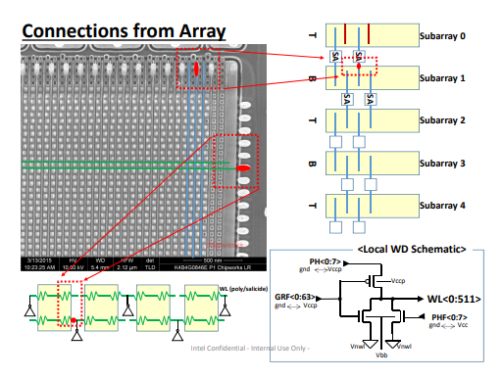
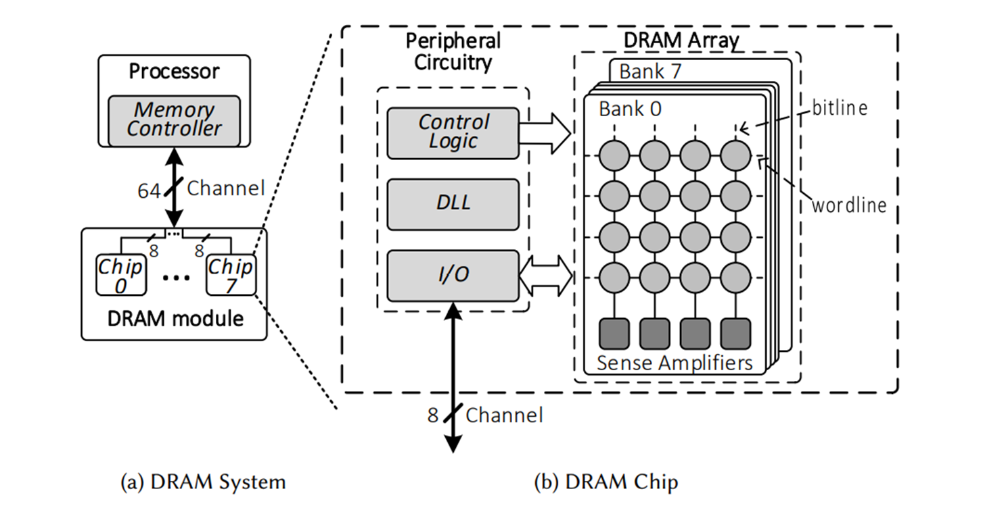
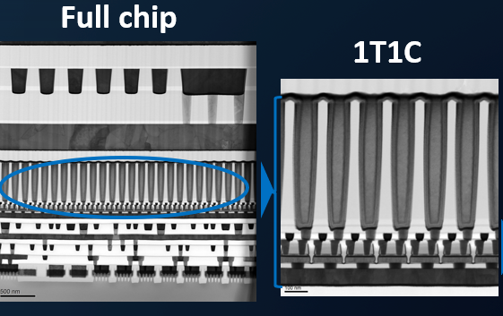
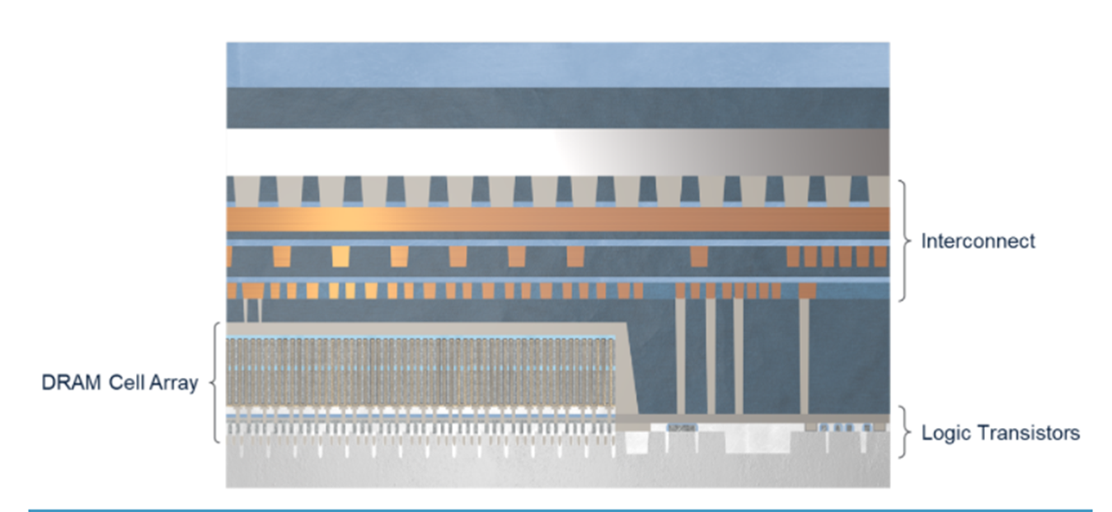
ADM vs. conventional DRAM & HBM DRAM
DRAM bitcell access transistor difference – IGZO ADM vs. traditional Si.
DRAM peripheral R/W, addressing, clocking circuits difference – P1222 (ADM) vs. DRAM’s own CMOS processes
Commodity HBM (High Bandwidth Memory) DRAM
    1st 3D active DRAM stacking (4Hi) dies using TSV/uBump
      More Channels/Banks for parallel accessing
      TSV to enable lower RC and lower power consumption
    Memory area efficiency/die will be reduced, so >20% area impact is expected.
    Separate out MC/PHY into a bottom die (like SOC IC die) will be needed
If control & I/O logics separated into a different chip; TC-DRAM is just like ADM DRAM (So far, none of proposals are doings so). ADM starts with 1222 mainly because it is cheapest logic processes at Intel for a stand-alone eDRAM implementation.
1T1C
R/W/addressing Si circuits
R/W/addressing Si circuits
ADM DRAM
Traditional DRAM

Slide 4
TCM choices - two kinds of memories SRAM or DRAM
ARL-px/ELASTI X3 family ADM implementation should not be worse than AMD-V cache
  ARL-px additional 640MB L3/L4 cache vs. AMD’s V-cache 64MB*2
  Cost – should still cheaper unless 1222/ADM/FOVERO yield crashed
    ADM MB/mm2 still better even w/ poor implementation
    ADM wafer w/ all added interposer need, price is about same/cheaper as compared to N7 SRAM wafer w/o any CoWoS cost.
CPU clock freq~ 3-4.2 GHz
ADM Clock freq~1.6 GHz
Commodity DRAM 3D stacking
DRAM BW improvement w/o TSV yet
Cost per bit > 60x delta DRAM vs. SRAM
13x bitcell area delta
>20x array capacity delta
2-3x wafer cost delta
>3x wafer cost delta

Slide 5
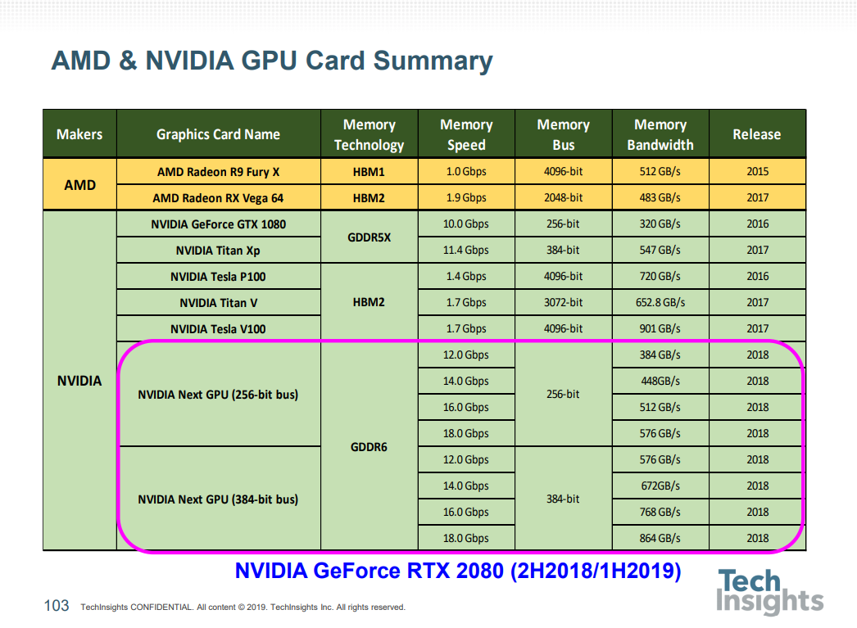
TCM memory design is strongly linked w/CPU memory pipeline/bus design for overall system performance/power design
TCM performance improvement
  Latency (SRAM, ADM)
    Speed is critical (closer to XPU)
  Increase peak burst bandwidth (TC-DRAM).
    If latency is fixed, capacity matters.
      HBM2/3
      Customized HBM DRAM wafer further thru bank/channel re-designing for even more parallel accessing

Slide 6
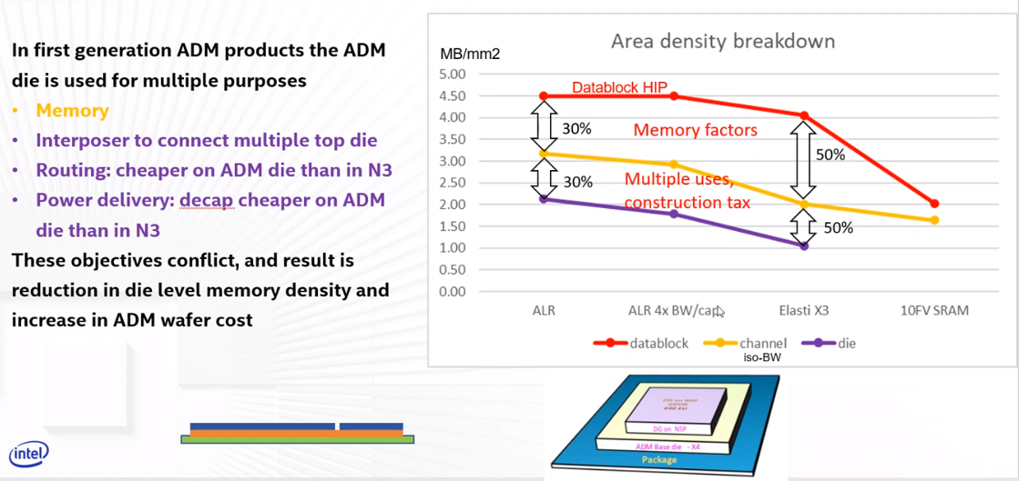
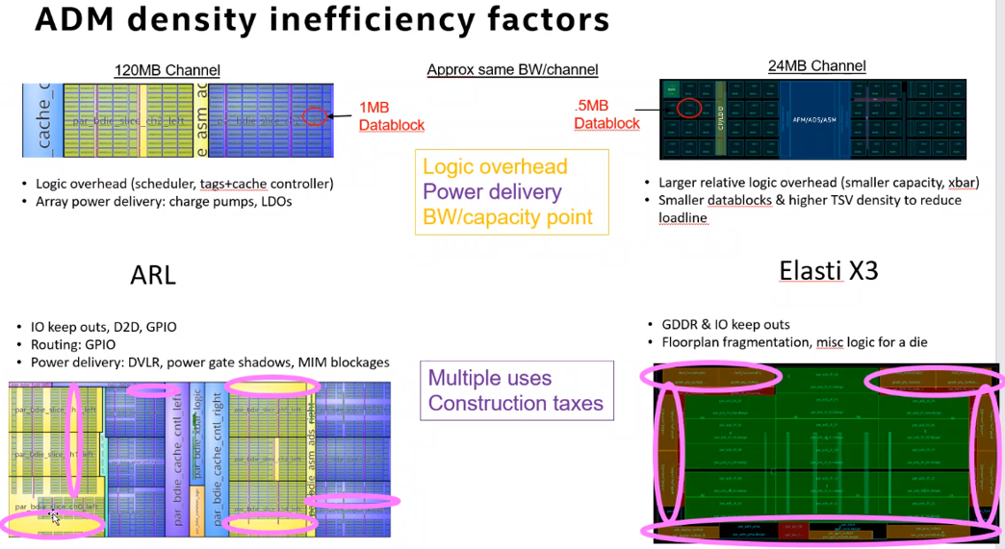
Low ADM memory utilization issues for 1st generation ADM product
~20% density improvement
Require packaging & FP innovation
From : Osborne, Randy’s ADM implementation tutorial to Chiplets WG

Slide 7
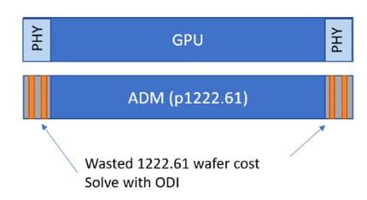
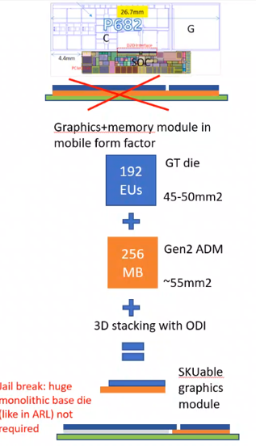
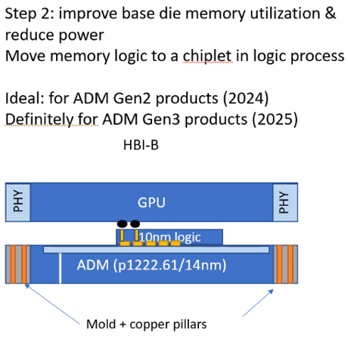
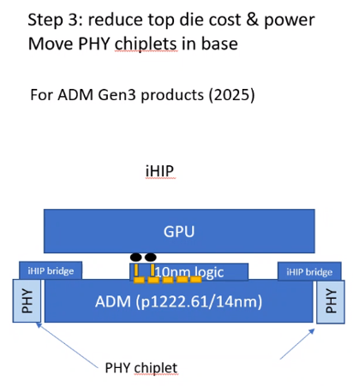
Next LNL 3D packaging proposal
Step 1: ODI, ADM only in most needed GT die only
LNL packaging-ODI
From : Osborne, Randy’s ADM implementation tutorial to Chiplets WG

Slide 8
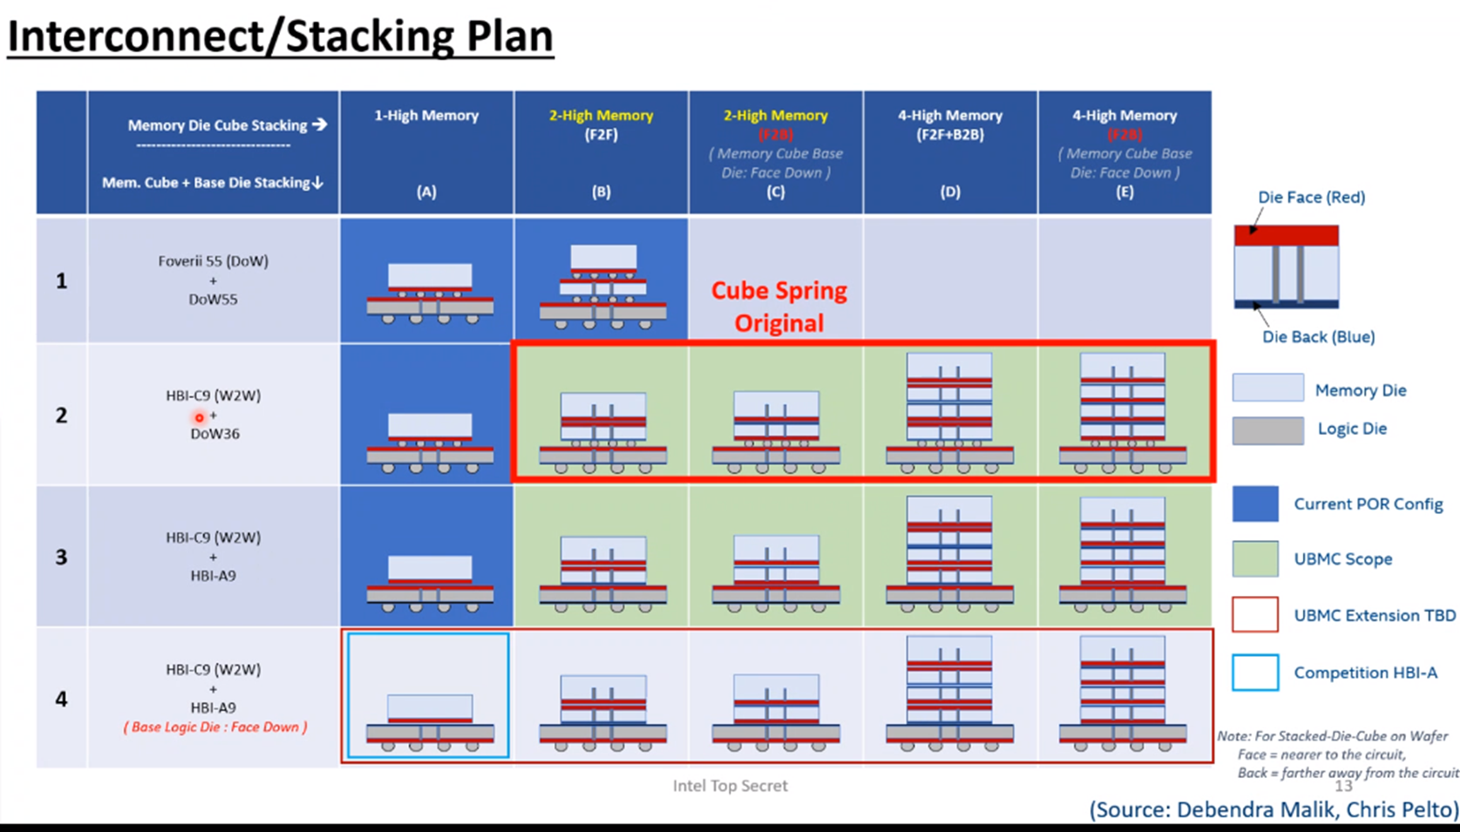
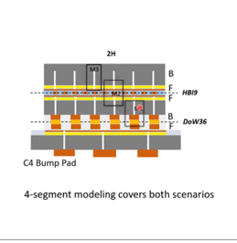
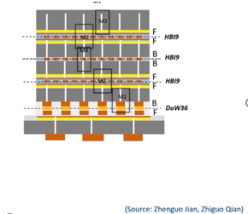
Memory Cube using ADM WTW HB stacking has been funded and kicked off July/2021, TO ~Q1/2022

Slide 9
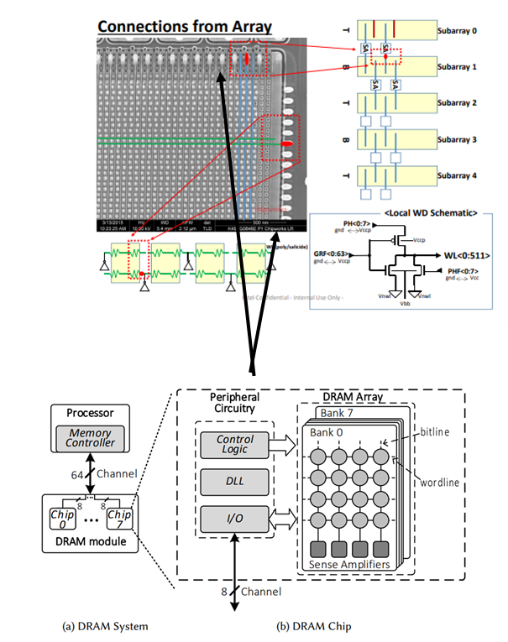
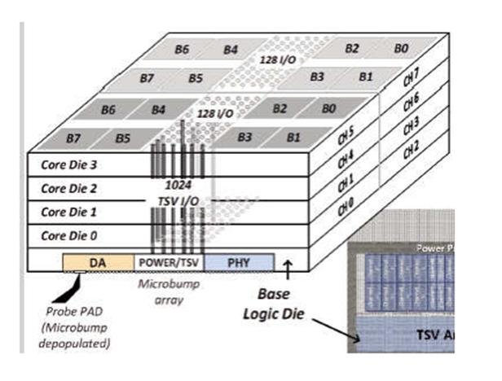
TCM using 3D packaging w/ re-designed DRAM wafer
HBM can be further optimized for even higher peak bandwidth than commodity offering
    HBM is High Bandwidth Memory; more Channels/Banks for parallel accessing; lower RC & lower power.
      Memory area efficiency/die will be reduced, so 10-20% additional increase in area/die is expected.
      No deviation from vendor’s mature DRAM processes, also no fundamental DRAM latency improvement
    Separate out memory controller /PHY into a bottom die (like SOC IC die)
    Cache capacity need (~1-2GB) still requires 3D stacking like HBM DRAM. TSV overhead still needed.
    It will NOT be cheaper than commercial HBM type DRAM but most likely cheaper than ADM.
    What is the right DRAM specs? Ownership across vendors & Intel for POC and product realization
      DRAM layout/floorplan is not exactly flexible.
1T1C
Stand-alone or can be merged into other chiplets?

Slide 10
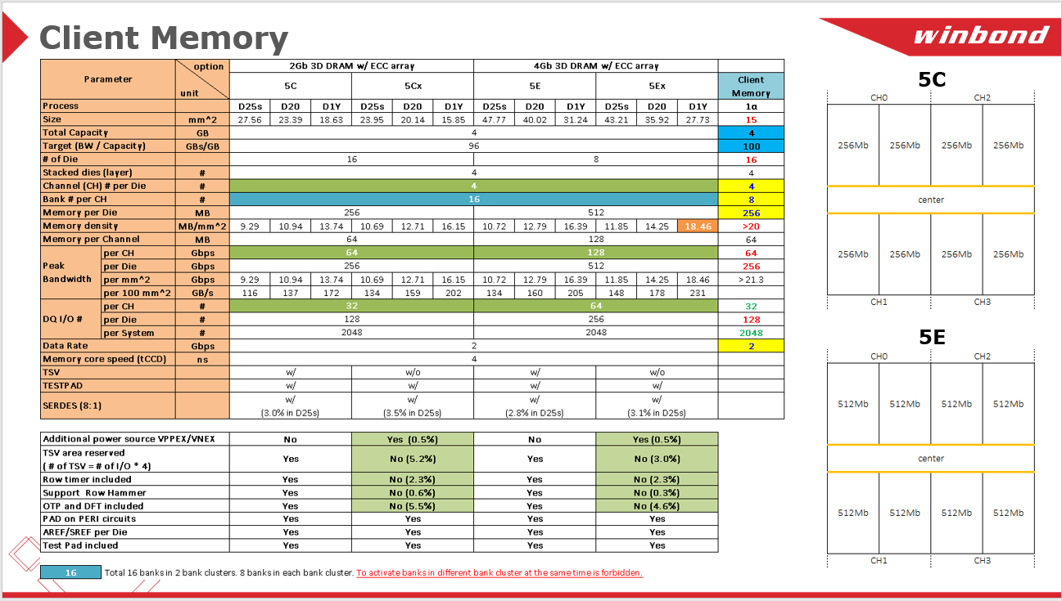
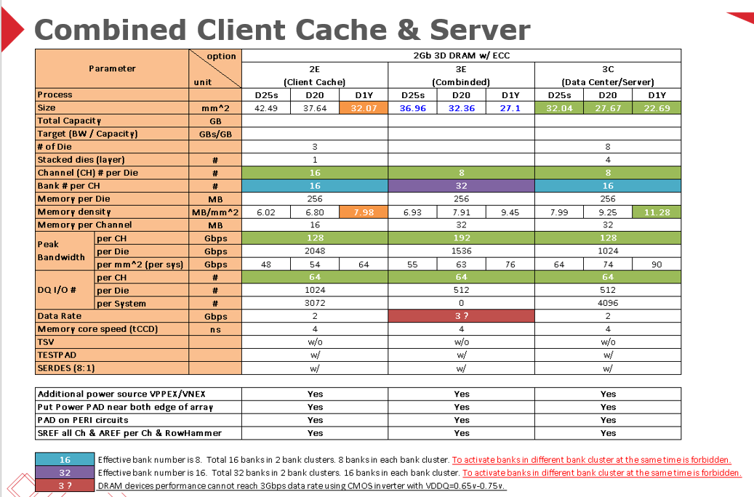
TCM – Tightly coupled DRAM approaches
Poof of concept - 2nd tier DRAM foundries like Winbond – proactive response
  Each individual DRAM die/wafer still a functional DRAM die/wafer
  Re-partitioning Channel/Bank for BW requirement and further command/sequence details for further area saving.
    IO counts still in 1E3-1E4 /mm2 (using CoWoS 36 um bump pitch), HB discussion (Al vs. Cu for power layers) is hard for existing 2nd tier players.
  A great start to learn DRAM limits - detail area partition for BW gain/TSV OH/Interface –SERDES/PHY area impact.
    Interposer penalty –DRAM floorplan is not exactly flexible and PDN/IO pins arrangement with XPU.
    What ultimate BW can be achieved by parallel/sequential accessing.
  3D-stacking/TSV processes and 3D DRAM design are new to these vendors (2nd tier DRAM)
1st tier DRAM house SKH – still negotiation (Sept/E, CEO meetings)

Slide 12
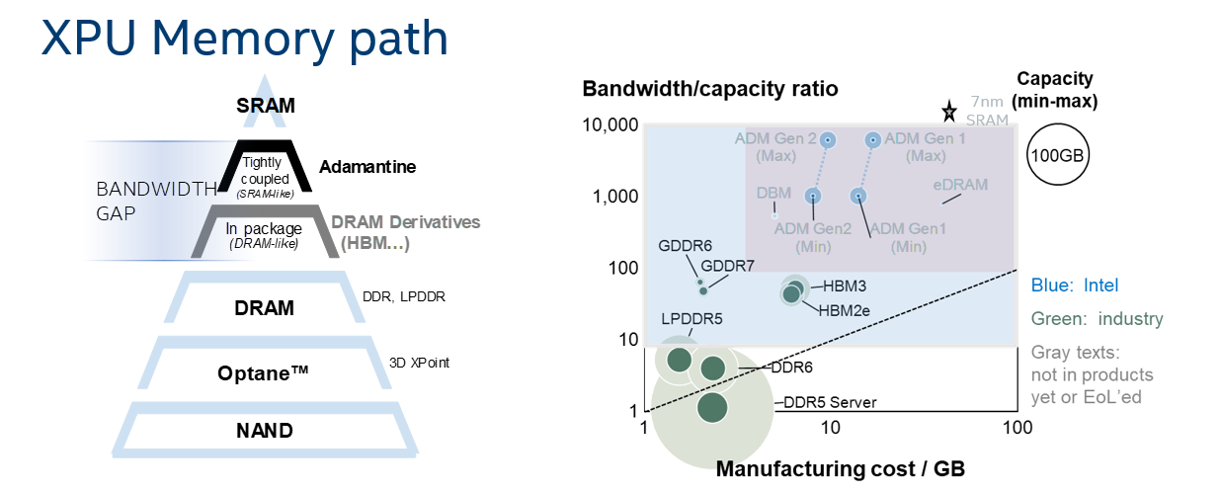
Memory CSD decision
Strengthen XPU product leadership by establishing a differentiated cache strategy
  Invest and deliver Adamantine technology roadmap for a differentiating 1s of Gigabytes cache
  Commit to employing that solution for AI/Graphics/Xeon products (Elasti G3/ARL-px)

Slide 13
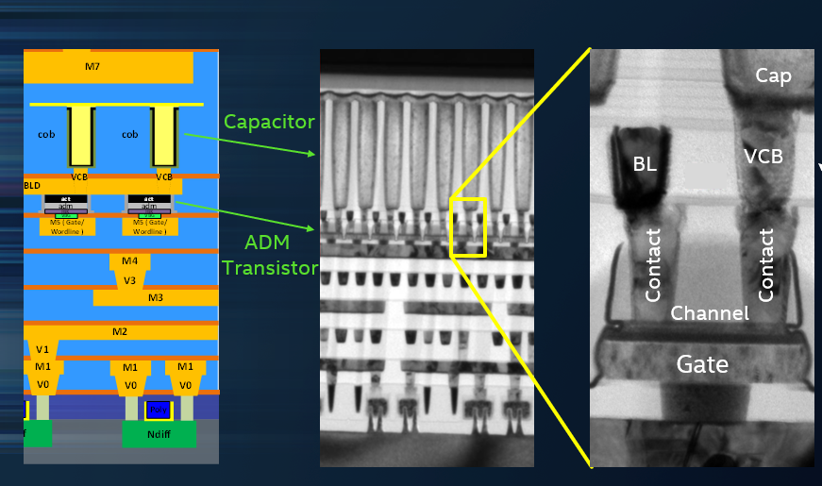
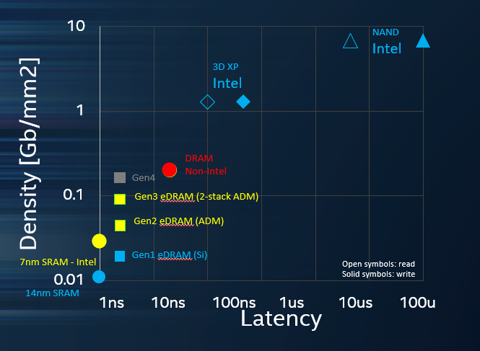
What is ADM? It is a new DRAM technology
DRAM cell (1T1C) shrinkage has been limited by Si transistor leakage for last 10 yrs; Capacitor optimization is approaching its limits.
ADM is to replace Si transistor w/ high bandgap semiconductor material; >3 order leakage difference.
  A buried DRAM bitcell array between MT5 to MT7
  Memory R/W controller circuits still using traditional Si logic technology; however, it can be buried underneath bitcell array
    Latency <5 ns, capacity >500MB/cm2
Notes:
Main driver she noted was to economically address die size growth
While EMIB is the most famous embedded bridge, others also have embedded bridges

Slide 14
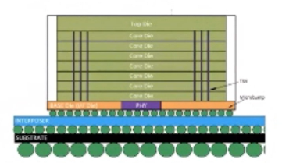
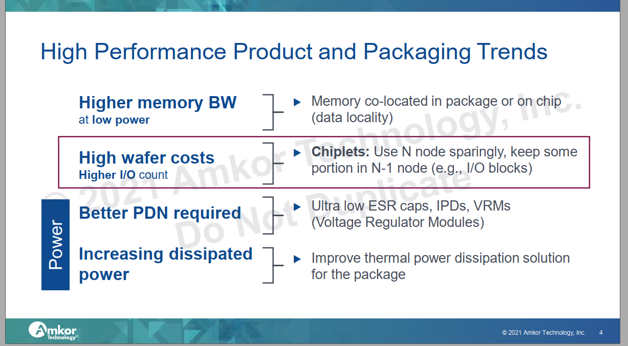
Why chiplets and how? HBM is 1st product meeting all aspects…
System level going chiplets disaggregation for various reasons.
Memory hierarchy allocation impacts performance (particularly BW)/power/cost
  HBM type DRAM 1st true commercial Known Good Stacking die
  CoWoS biggest customer is to handle HBM/GPU or CPU connection today
Commodity HBM DRAM chiplet (KGSD-stacking die) achieved all aspects
Process (legacy DDR4/5 )
Additional DRAM memory controller/packaging re-design
Typical 3D packaging OH –TSV, extra MC/interface….
CoWoS-R 2.5D roadmap is all for HBM integration w/ CPU/server (huge chip interposer size/reticle stitch)
DRAM Commodity price Reference
DDR5/6 ~$7/GB
HBM2 ~$11/GB
Notes:
Ira Feldman kicked off
Ravi, Jaspreet (Xilinx), and 2 independent people were the “program committee”
Ravi moderated day 1, Greg Taylor moderated day 2

Slide 15
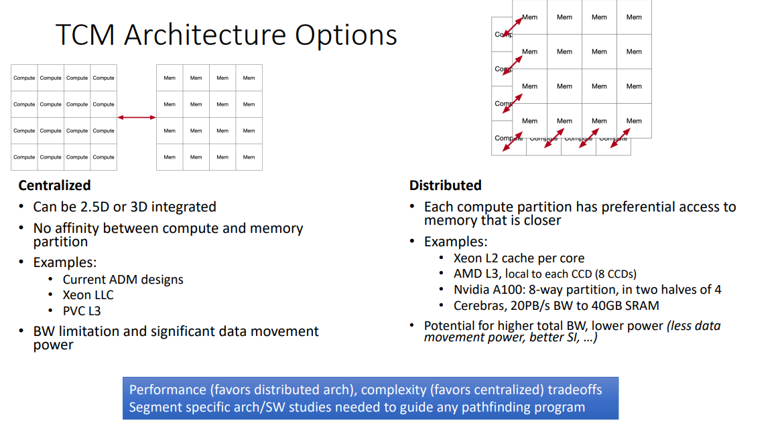
Tightly Coupled Memory - architecture choice
From CSD discussion
Notes:
Main driver she noted was to economically address die size growth
While EMIB is the most famous embedded bridge, others also have embedded bridges

Slide 16
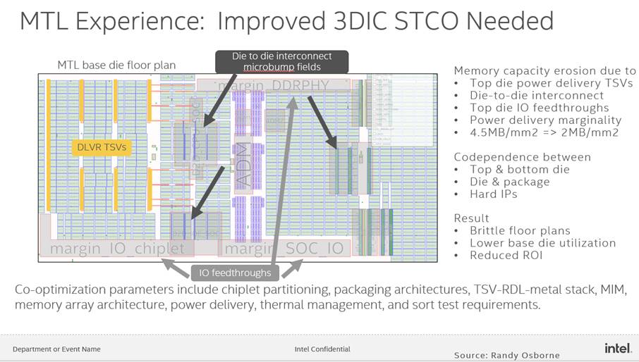
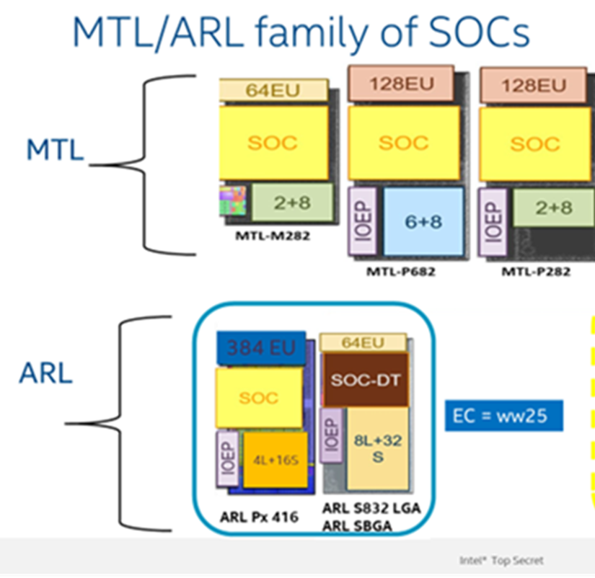
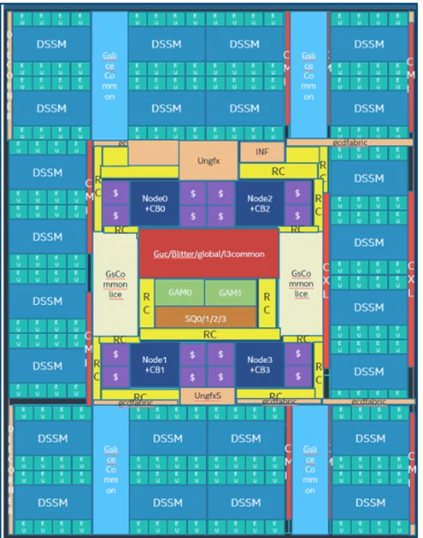
Memory utilization is poor from 1st generation ADM product implementation – It is not just adding cache memory but also served as an active interposer to “connect” all chiplets
ADM is not like a typical DRAM IP, more like SRAM compiler – “soft” IP
  Semi-flexible, so it will not be perfect for area optimization like commodity DRAM
1st MTL implementation; Memory utilization <50% .
  One ADM bottom base die wafer price is 5-6x higher than typically Si passive interposer
  >50% area can be replaced by passive interposer to serve its 2.5D Si interposer purpose
ARL-PX-GFX -1st run of 384EU w/ 6x CXL interface
Notes:
Main driver she noted was to economically address die size growth
While EMIB is the most famous embedded bridge, others also have embedded bridges

Slide 17
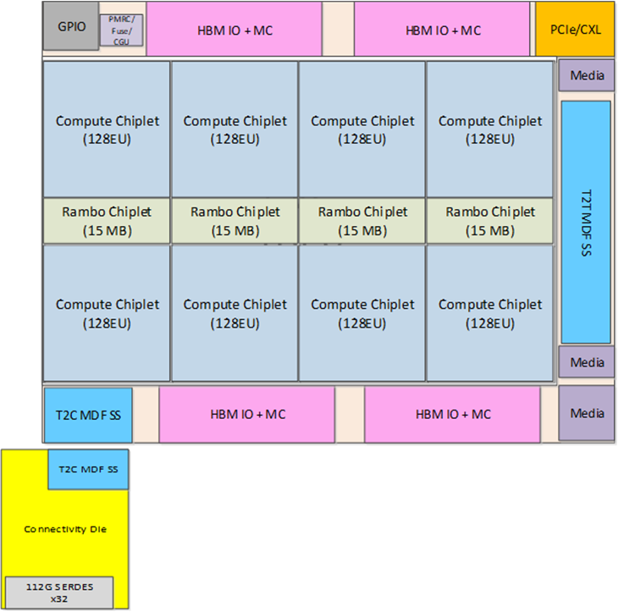
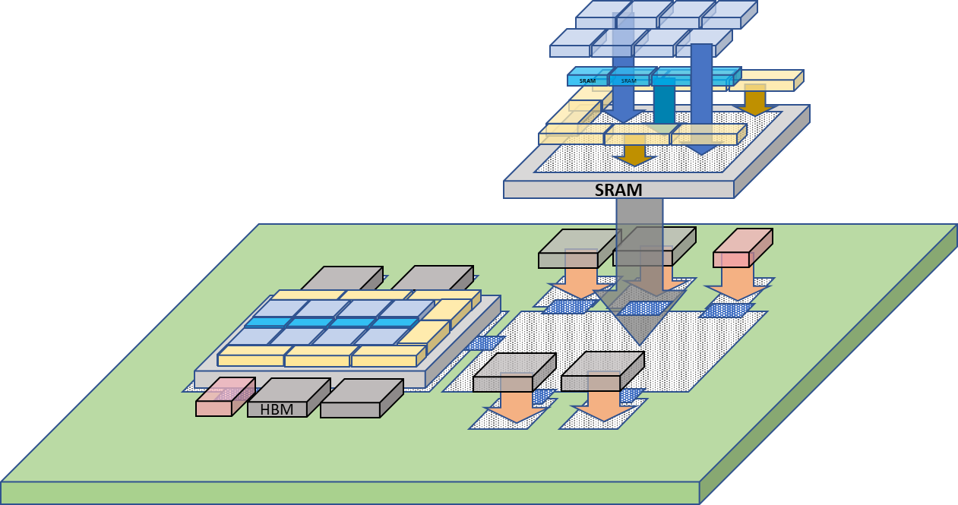
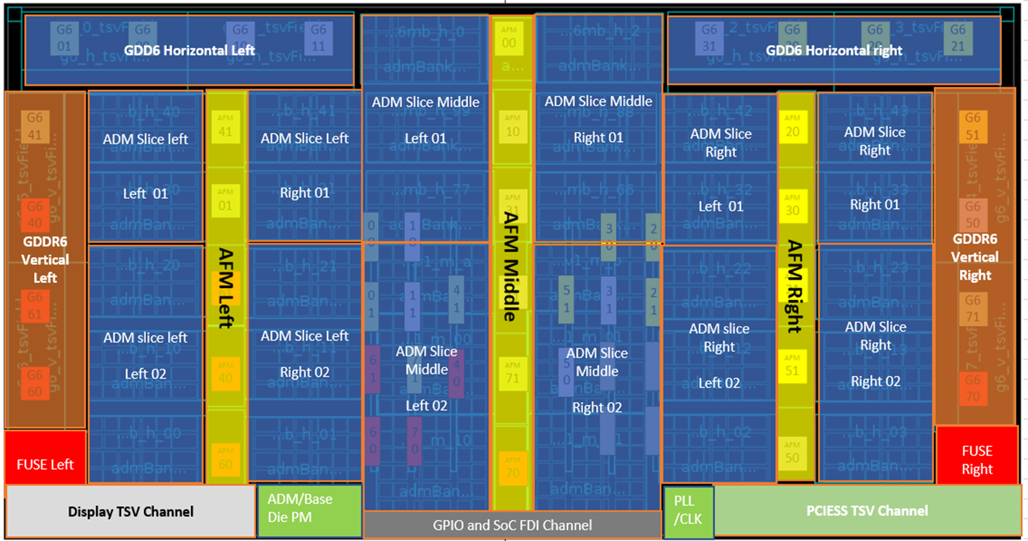
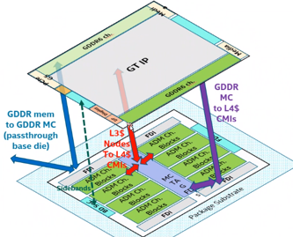
Two TCM utilization cases in near future products –
PVC – high end graphic product
ARL-px/Elasti-G3 family
All targeted for GFX memory accelerator
ADM function as L4 cache btw L3 and GDDR6
Chip | Node | Area | Functionality
Compute die | P1276 or TSMC n5p | ~40 mm2 | EU complex, L1 $
SRAM die | 10nm | ~15 mm2 | Some L3 $ banks (3.75MB*4)
Base Die | 10 FV | ~650 mm2 | L3 fabric, some L3 $ banks, misc globals (156MB SRAM)
Connectivity Die | TSMC N7 | ~75 mm2 | Scale-up serdes, Internal switch
Notes:
Main driver she noted was to economically address die size growth
While EMIB is the most famous embedded bridge, others also have embedded bridges

Slide 18
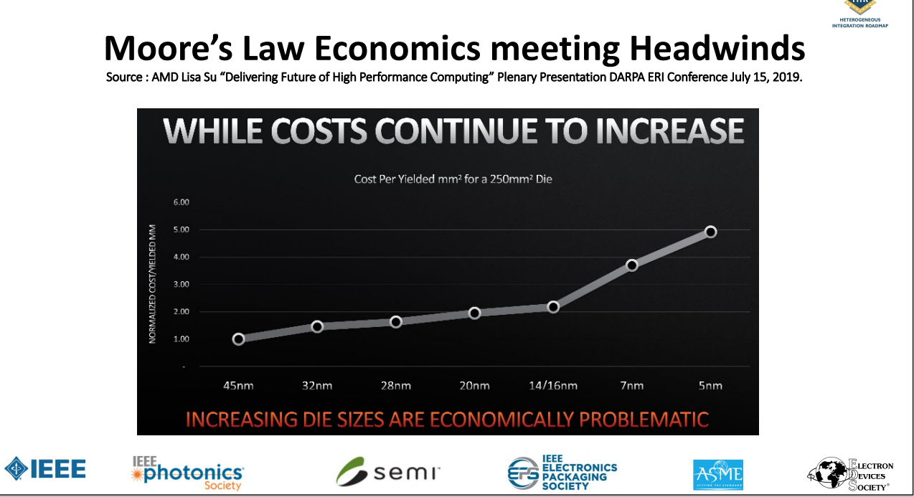
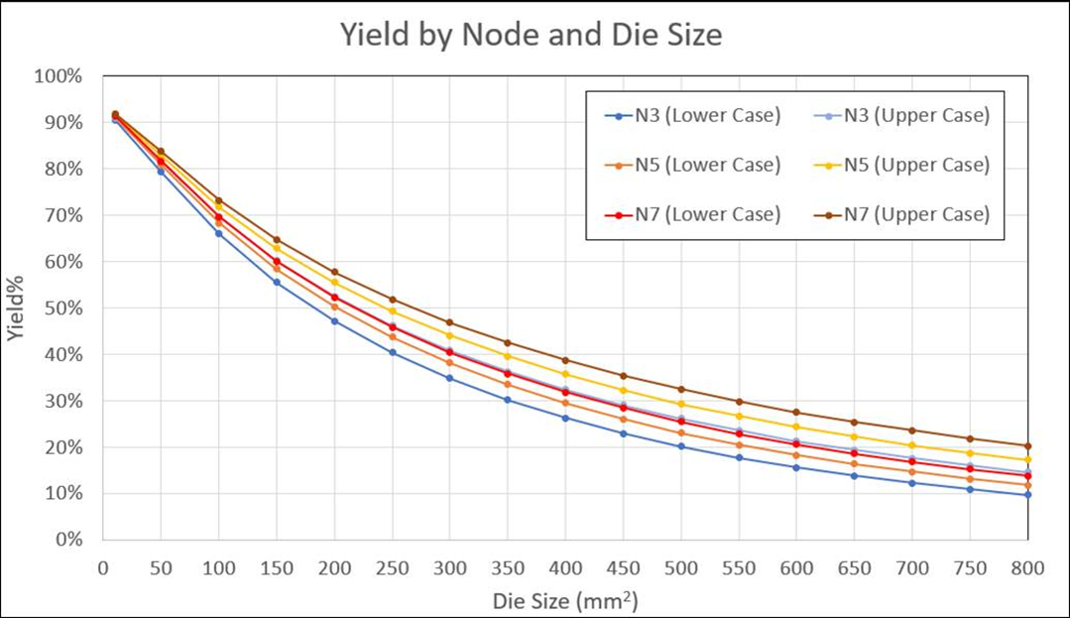
Memory implementation
PPA extreme case w/commodity cost boundary
Intel’s choice of TCM implementation- extremely expensive => niche/showcase
Even with 10% ECC(redundancy), cannot cover large die yield loss
>40x SRAM $MB/mm2 cost if we use N7
AMD 7nm die 36mm2
For 64MB SRAM
PVC 10+ die 650mm2 for 156MB SRAM
~$7000-8000/W SRAM (w/o TSV/CoWoS….)
How much more redundancy memory need to cover such big die yield impact?
HBM2 DRAM 20nm
single die (250MB)
71-82mm2
ADM 322mm2/640MB(ARL)
366mm2/374MB (Elasti)
Notes:
Main driver she noted was to economically address die size growth
While EMIB is the most famous embedded bridge, others also have embedded bridges

Slide 19
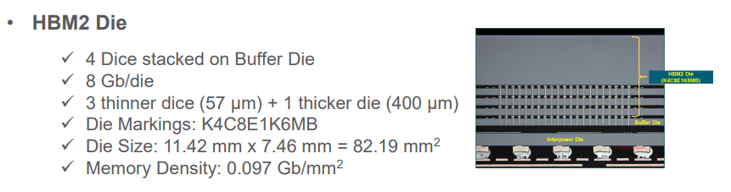
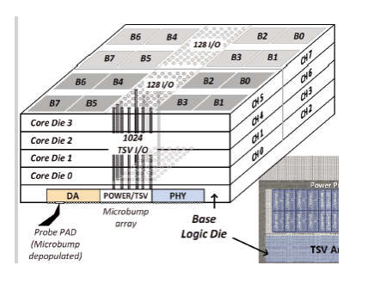
What is high bandwidth DRAM -HBM2 type DRAM
HBM – world’s first 3D TSV active dies product
  Parallel accessing thru TSV I/O (BW > 10 GBps)
  Lower pJ/bit as compared to its DDR version
    Lower Vdd-Vpp/clock frequency to achieve similar BW
    Power management thru various channels/banks
Capacity – stacking using smaller footprint to start with.
  Increase peripheral area/die, lower memory utilization (-)
    More Controller circuits
    TSV OH
  But peripheral circuits can be stacked (+).
Total chip area ->4*(1GB/die)> 4GB/die (current estimate >20%)
HBM Industry standard
  HCM->HBM1->HBM2->HBM2E->HBM3

Slide 20
What future technology implications for memory solution
Hybrid-bonding for ADM to de-couple memory peripheral circuits w/ memory array
  Hybrid-bonding for stacking GEN3 ADM (2 ADM layers) w/ other chiplets – always the example for HB future roadmap
    GEN II (1st generation of ADM) - 3 layers (2 minimum metal pitch layers)
    GEN III (Stacking ADMs) -6 layers of metals (4 minimum metal pitch in each technology node) to relax to right metal bonding pitch
Backside power rail implication for memory
    Power coming from Si chip bottom
      Hub for all chiplets PMIC/CLK?
    BL/WL metal connection splits (one go up, one go down)? Stacking ADM not processing ADM sequentially
Centralized memory hub
  Please DO NOT use any large “active” die as interposer
    Learning from HBM, die size needs to be <100mm2 for long-term meaningful volume production even for memory. Si Interposer – by default, yield needs to be >95%.
    Memory is not exactly flexible enough for floorplan adjustment
      Companion chips connection flexibility?
      Best performance for hub concept?
  What’s right balance? Any input? Should be determined by true latency along memory pipeline.
Notes:
Main driver she noted was to economically address die size growth
While EMIB is the most famous embedded bridge, others also have embedded bridges

Slide 21
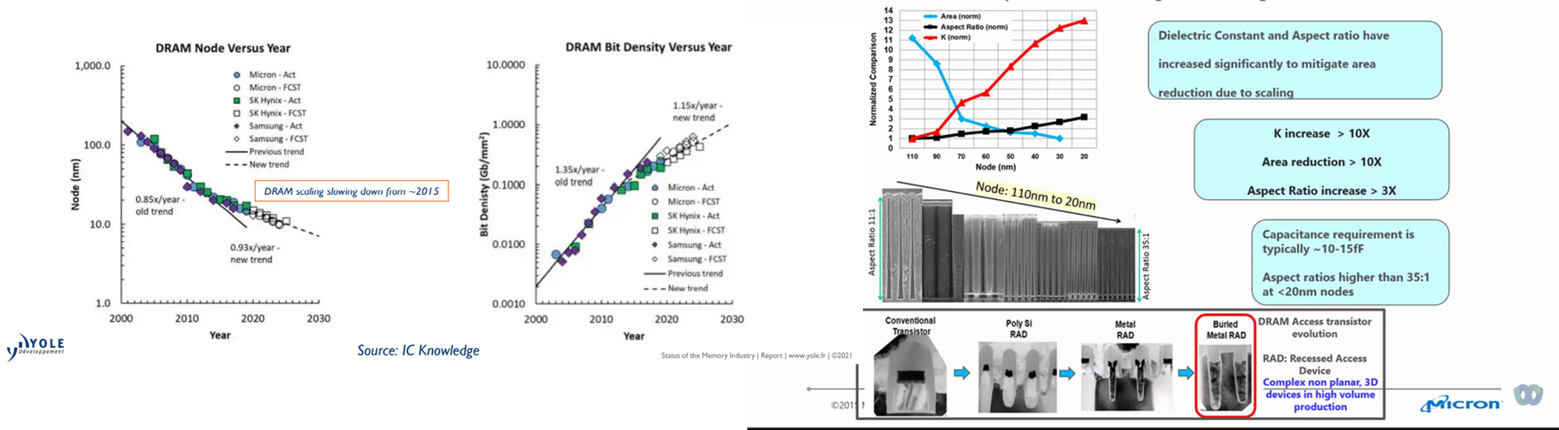
DRAM technology evolution slows down.
  Technology encountered both access transistor/capacitor limits
    1a eUV intro; 1x/1y/1z shrinkage slow down
    Latest technology starts looking into peripheral improvement
Notes:
Main driver she noted was to economically address die size growth
While EMIB is the most famous embedded bridge, others also have embedded bridges

Slide 22
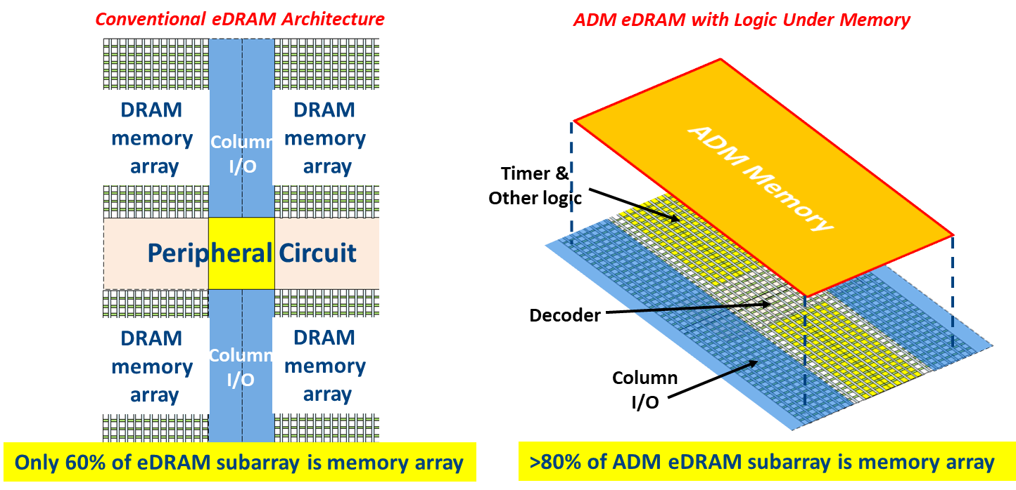
ADM DRAM vs. traditional DRAM
Free ADM memory from logic technology and connected (bond) together w/o losing bitcell’s tight pitch
  BEOL TF transistor process flow – so cheap/fast compared to FEOL Si transistor flow.
  Stacking (20% additional cost) for 40% area reduction (Concept already proven on Si)
  Bitline pitch <108nm (too big already)
Will tightly coupled DRAM chiplet (IPM) disaggregation eventually make DRAM more like ADM approach?
  GDDR6/GDDR5 performance trend
  Multi-die memory controller and communication interface like PCIe/
    Bitcell area still > peripheral area
    What can extra bottom “active” space be used for? Any idea?
      SRAM? (any other choice w/ less overhead?) MRAM/RRAM?
      Memory controller hub for all chiplets (SOC IC)
      PM/clock IC for all chiplets (SOC IC)
Notes:
Main driver she noted was to economically address die size growth
While EMIB is the most famous embedded bridge, others also have embedded bridges

Slide 23
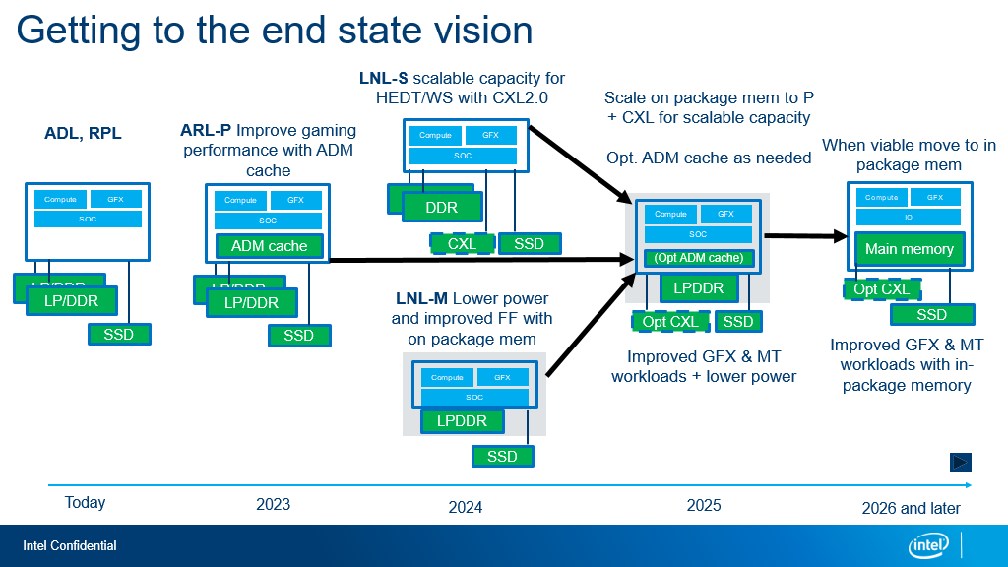
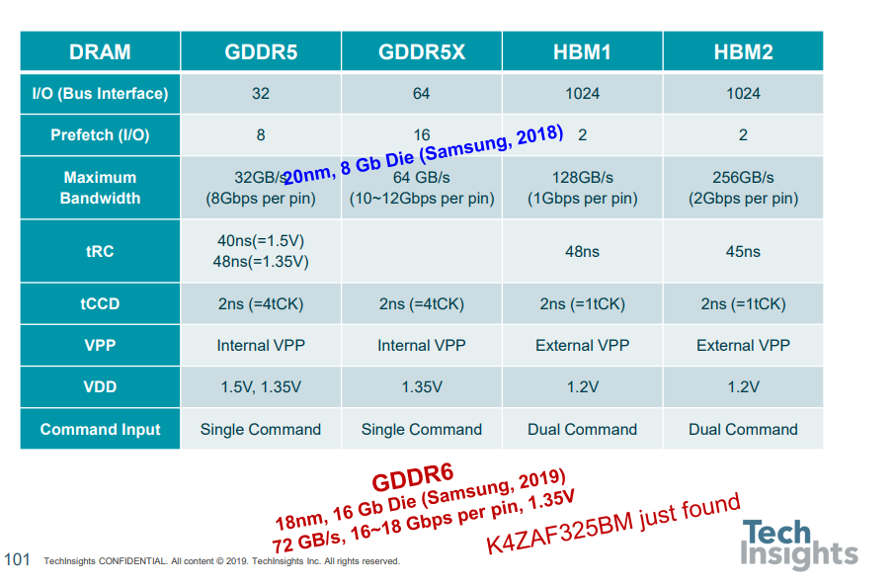

Slide 24
