Slide 1
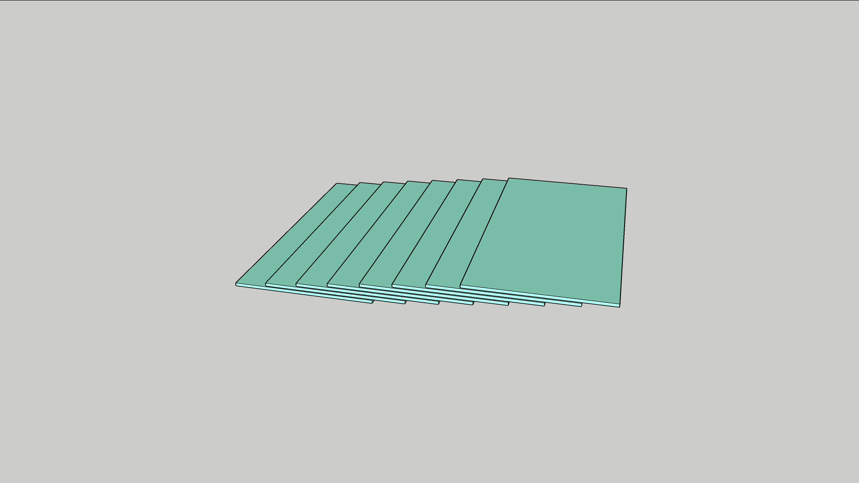

Slide 2
Terraced Memory Cube for High Bandwidth Memory
Team TMC
Objective: Low Cost High Bandwidth Memory to displace/replace HBM4+ and beyond
Key Enablers:
  Relocate TSV from HBM to improve $/bit
    DRAM and TSV wafer cost reduction (12% reduction to nonTSV DRAM wafer and 80% for TSV wafer)
    MB/mm² improvement: (from HBM’s 35% array efficiency to LPW’s 45%)
  3D stack mainstream DRAM (ie LPW) on the dedicated TSVs for Low Power/High bandwidth transfer
Critical path and Milestone:
  2024: Ideation/Vetting concluded with DRAM/OSAT collaborator id’d
  2025: TM-TV and IC-TV validated
  2026: TMC at HBM4+ class demonstrated
 | Q2'24 | Q3'24 | Q4'24~Q1'25
Milestone | TMC flow, cost | Electrical and Thermal Analysis | MTV vehicle Design
Gate | Cost, Packaging Feasibility | BW/Power & Thermal on par with HBM
Decision | Power and Thermal Analysis | PoC TMTV funding with BU sponsorship

Slide 3
Critical Path (Fast Fail), WiP
Product-Technology Co-Pathfinding
2024: Ideation/Vetting concluded with DRAM/OSAT collaborator id’d
TMC process flow and capability meeting scalability and cost success criteria
  OSAT short list
  Cubing module TMTV supplier selected for TMTV Tapeout
Memory Module Electrical, Mechanical and Thermal assessed defined to support product datasheet
  Memory Supplier engagement starts
2025: TM-TV and IC-TV Tapeout, PoC validated
TM-TV assessment against success criteria
  Memory cubing module supplier selected for ICTV Tapeout
Technology performance and reliability assessed using ICTV
‘27 Product PrePOR success criteria established for HBM4E replacement
  Test Chip planned starts (C-Spec, T-Spec, do we need MAS equivalent?)
‘TMC-LPW6’ spec & roadmap aligned; secure pre-POR position
2026: TMC at HBM4+ class demonstrated
Product intercept decision made

Slide 4
Terraced Memory Cube (TMC) Focus Team – WiP
1. Ideation 2. Vetting 3. PoC
4. Definition 5. Change Control
5/31/2024
Rev 1.1
Apr’24 to Jun’24
Scope and Plan
Problem Statement | HBM’s low silicon utilization on all layers of DRAM chips due to shared TSV and low-density logic circuits in base die as a high-cost interposer. MoP formfactor constraint due to WB footprint scalability and # DQ as well as long trace length and variability impose data transfer limit in BW and power.
Key Results | VWB and TMC process flow and capability meet scalability and cost goal
Team and Expertise | Team members’ disicipline covers MT, design enabling, DRAM & system. FT sizes of ~10 persons for Idea vetting stage
Strategy | Critical Path Fast fail base firstly to pass 3C criteria for a scalable solutions to co-define and to deliver for product plan 2027 and beyond
Logistics and Funding needs | Force team technical repository share point: TMC Weekly meeting: Thursday 9-10pm cal time zone.
Decision Process | Consensus within FT before Sponsors’ final ratification.
Feedback Plan Communication | Weekly FT mission-oriented meeting for technical feedback and alignment. Monthly Ops review to solicitate from and to align with Customers and stakeholders Ad hoc process-oriented meeting with sponsors for status update the ratification.
Guard Rail | These are constraints or expected conditions that should be met in project execution. Calling out assumptions and boundary conditions explicitly to prevent scope creep.
Sunset Clause & Sunset Plan | When graduate, (passing gate level, meeting success criteria), team will move on to Phy analysis and vetting, seeking to understanding of technology scaling capability and technology line of sight limitation as well as and seek for the customers support for TMTV and ICTV sponsorship. Or else, revisit landing and project direction for sunset postmortem..
“Technology-driven disruption” to displace incumbent
“Market creation disruption” as a potential compute memory hierarchy redefinition as in AI (Client to Cloud)
On-Board memory modules such as xDIMM and LPx are reaching scaling limit. In-package memory (IPM) enables bandwidth improvement while boosting capacity growth. SoA IPMs include LPx-MoP and HBM as well as custom eDRAM from Intel, APM, PSMC, SEC and SKH as well as many proprietary memory technology R&D.
The Objective of this project is to define and to deliver
IPM solutions for ’27 product and roadmap intercept to displace xDIMM, xCAMM and HBMx by exploiting mainstream DRAM technology and collaborating with tier-1 OSAT to deliver a low-cost low-power high-availability 3D packaged memory subsystem with bandwidth on par with HBMx
Charter Group: FTE and MIO
Sponsors: Changhong Dai
Customer: Dimi Ziakas
Other Tentative Customers: (Mid Q3)
CCG: Konika Ganguly, Chris Mozak
DC: Jim Mccall
(yet to be finalized)
Suppliers: ASE (Cool Creek)
Tentative Collaborators/Supplier: Debendra Mallik (Memory, Substrate, EMIB, Q4)

Slide 5
LP-HB IPM using mainstream DRAM for xDIMM/xCAMM/HBMx displacement
DerChang Kau and FTE IPM team, Apr. 9, ’24
Challenges in state-of-the-art In-Package-Memory
Solution Space
Project Proposal

Slide 6
In-Package Memory – Current Art
JEDEC memory
  LDPPRx MoP
Custom memory
  Intel e-DRAM
  Intel-SKH TCCD
  AP Memory
  SEC LLC
  SEC LPW
  HMB
  Intel ADM
  Intel-SEC TCM
  SKH WIO
  SEC LLW
Type | AE% | pJ/b | DQ | GT/s
DDR5 | ~60 | 20 | 8 | 8.4
LP5 | ~60 | 5 | 16 | 8.4
HBM3E | ~35 | 3.70 | 128 | 9.2
LPW | ~50 | 1.9 | 128 | 3.2
Benchmark Metric
Technology |  | Design | Cost (Density) Based FoM
Half Pitch | Cell Size | Array Efficiency | Capacity | BW | Power
nm | nm² | % | MB/mm² | (GB/s)/mm² | mW/mm²

Slide 7
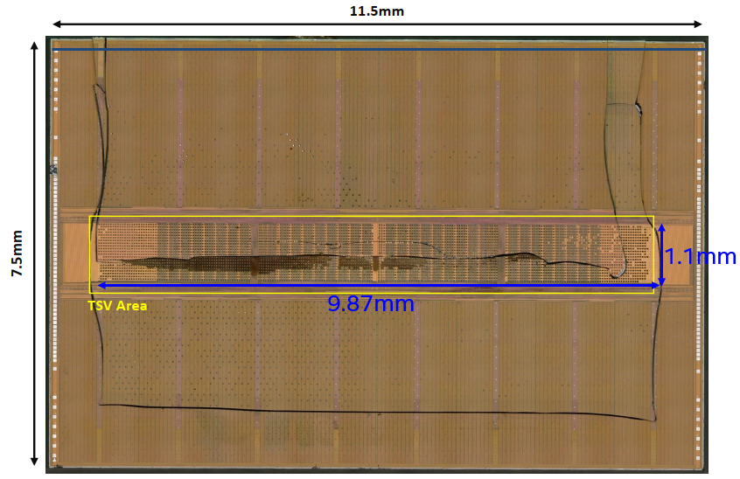
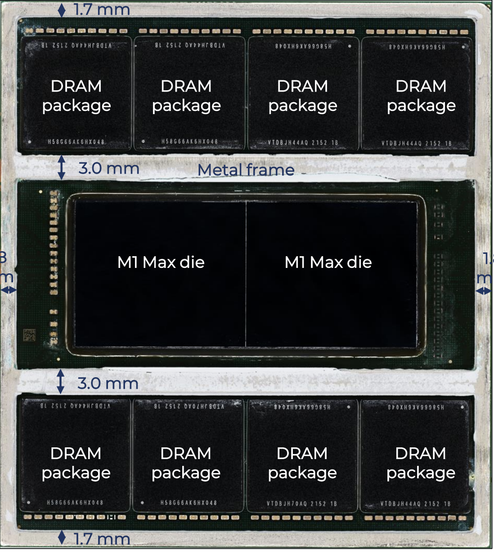
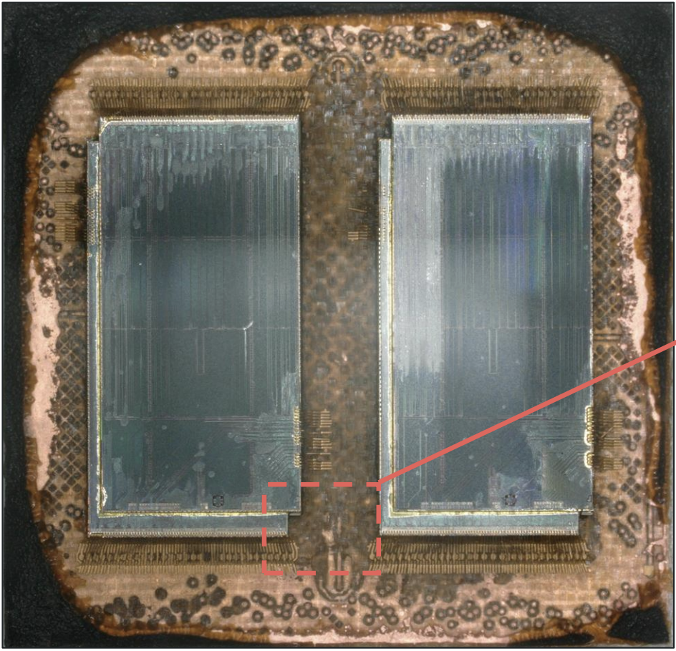
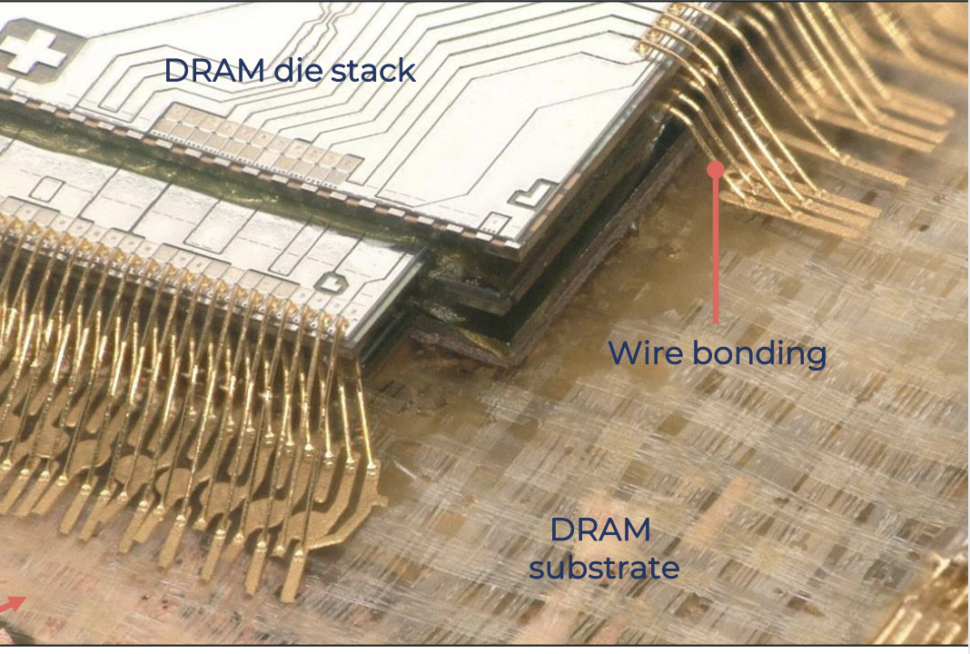
Challenges in state-of-the-art IPM
HBM low silicon utilization
  Shared TSV footprint in DRAM with dedicated vertical Interconnect, worsened when capacity and bandwidth advanced
  Active Si Interposer with <20% active circuits (DDR Phy, MBIST)
MoP formfactor constraint
  WB footprint scalability and # DQ (BW)
  Long trace length and variability impose data transfer limit in BW and power;
  2pF, 10nH per cm at 1V/10MT/s DDR is
  2pJ, 1pJ per cycle or 15mW
Thermal management
  HBM Phy consumes >80% of Power at worst thermal conductivity
Per die >5000 TSVs in HBM2 (8 stacks)
TSV occupied area ~10.9mm² (12.7%) in real HBM2 DRAM die
TSV bundle
TSV bundle
MOS
Cu line
μ-bump

Slide 8
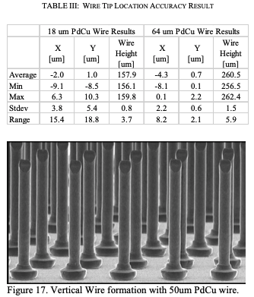
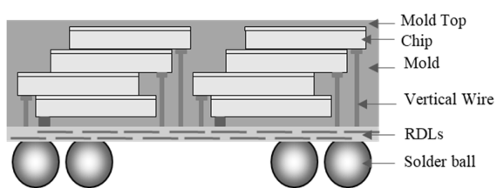
Solution Direction – Terraced Memory Cube
High parallelism without sharing TSV in active silicon
  Vertical Wire Bonding, VWB
  Terraced Chiplet Cubing, TCC (IDF pending)
Memory 4th Tier
Memory 3rd Tier
Memory 2nd Tier
Memory 1st Tier
Hynix Vertical Fanout EDTM23 ﻿
K&S Capability: ETCT2017
Reduce Trace Lenth with 3D-Direct or 3D-Fanout Packaging
0.2pJ/bit is achieved with Muddy Creek Test Chip (IDF pending) in 3D-Fanout PoC Package
0.25pJ/DDR transfer adder @ 10mm RDL (0.2fF/µm@0.7V) with 50% bit twiddling pattern sequencing, ie. (00110011…) Tx/Rx.

Slide 9
Terraced Memory Cube (TMC) for xDIMM/xCAMM/HBM displacement
Assumptions:
Node: Micron D1ß
LPW Array Efficiency based on SEC D1a LPW
DDR
10mm or less of DQ trace length between TMC module and compute chiplet
➔ 0.5pJ/bit
P_{act} [nm] | P_{WL} [nm] | P_{BL} [nm] | Cell Size [nm²]
24 | 34 | 39 | 1330
Type | capacity [Gb] | die size [mm2] | pJ/b | DQ | GT/s
HBM3E | 24 | 100 | 3.70 | 128 | 9.2
TMC-LPW | 24 | 66 | 0.5 | 128 | 7.6
LP5 | 16 | 37 | 5 | 16 | 8.4
TMC-LP5 | 16 | 37 | 0.5 | 16 | 9.2

Slide 10
Critical Path (Fast Fail), WiP
Product-Technology Co-Pathfinding
VWB and TMC process flow and capability meeting scalability and cost success criteria
  OSAT short list
Memory Module Electrical, Mechanical and Thermal assessed co-defined with GEMS/FTE and product owners.
  Memory Supplier engagement starts
‘27 Product PrePOR success criteria established for DDR6, HBM4E replacement
  Test Chip planned starts (C-Spec, T-Spec, do we need MAS equivalent?)
  Cubing module TMTV supplier selected for TMTV Tapeout
TMTV assessment against success criteria
  Memory cubing module supplier selected for ICTV Tapeout
Technology performance and reliability assessed using ICTV
LP-HB-IPM spec & roadmap aligned
Product intercept decision made

Slide 11
Partnership in Product and Architecture
(with Prashant Damle’s Suggestion)
MIO: Dimi Ziakas
Accelerator (FS-II): Mark Davis
Low cost accelerator (FS PCIe, POR LPDDR): Randy Osborne
CCG: ➔ Konika Ganguly, Chris Mozak
DCAI (Server memory architect): Rajat Agarwal, Jim Mccall

Slide 12
Supporting Materials

Slide 13
Terraced Chiplet Cubing Process Flow
Memory
Memory
Memory
Memory
Memory
Memory
Memory
Memory
Memory
Memory
Memory
Memory
Memory
Memory
Carrier
Carrier
Carrier
Carrier
Carrier
Carrier
Carrier

Slide 14
Team TMC
Chair: DerChang Kau
Technology and Design Enablement
Architecture & Product Definition
Memory Tech and Array: Dany Ly-Gagnon
SoC/MAS (Digital System): Jiajing Wang
Comm Channel(Analog design): Ping-Chen Liu
DDR/SDR Interface (Electrical): Po-Yao Ke
D2D Interconnect (physical): CC Kuo
TCC Module: CC Kuo
VWB Module: ZBB’d
MIO: Prashant Damle
LPx/LPW/HBM: Victor Cho (JEDEC)
Client:
Dataenter
Accelerator:

Slide 15
Project Proposal (Draft)
ECD | Milestone & Decision | Owner | Stakeholder
Q2’24 | VWB and TMC process flow and capability assessment meeting scalability and cost success criteria Technology Decision made | Klaus Goebel, CC Kuo | FTE, MIO, CCG
Q3’24 | Memory Cube Module Electrical, Mechanical and Thermal assessed, defined. ‘27 Product PrePOR success criteria established for DDR6, HBM4E replacement | FTE assignees | CCG, MIO, DCAI
Q4’24 | Cubing module TMTV supplier selected, TMTV Tapeout | FTE+BU+Lab
Q1’25 | TMTV assessment against success criteria | FTE | CCG, MIO, DCAI
Q2’25 | Cubing module ICTV Tapeout | FTE+BU+Lab
Q4’25 | Technology performance and reliability assessed LP-HB-IPM spec & roadmap aligned with BU Product intercept decision made

Slide 16
Scratchpad

Slide 18
Terraced Memory Cube (TMC) Focus Team – WiP
1. Ideation 2. Vetting 3. PoC
4. Definition 5. Change Control
4/9/2024
Rev 0.9
Apr’24 to Sep’24
Scope and Plan
Problem Statement | HBM’s low silicon utilization on all layers of DRAM chips due to shared TSV and low-density logic circuits in base die as a high-cost interposer. MoP formfactor constraint due to WB footprint scalability and # DQ as well as long trace length and variability impose data transfer limit in BW and power.
Key Results | VWB and TMC process flow and capability meet scalability and cost goal Memory Module Electrical, Mechanical and Thermal meet product requirement
Team and Expertise | Team members’ disicipline covers MT, design enabling, DRAM & system. FT sizes of ~10 persons for Idea vetting stage
Strategy | Critical Path Fast fail base firstly to pass 3C criteria for a scalable solutions to co-define and to deliver for product plan 2027 and beyond
Logistics and Funding needs | Force team technical repository share point: TMC Weekly meeting: Thursday 9-10pm cal time zone.
Decision Process | Consensus within FT before Sponsors’ final ratification.
Feedback Plan Communication | Weekly FT mission-oriented meeting for technical feedback and alignment. Monthly Ops review to solicitate from and to align with Customers and stakeholders Ad hoc process-oriented meeting with sponsors for status update the ratification.
Guard Rail | These are constraints or expected conditions that should be met in project execution. Calling out assumptions and boundary conditions explicitly to prevent scope creep.
Sunset Clause & Sunset Plan | When graduate, (passing gate level, meeting success criteria), seek for the customers support for TMTV and ICTV sponsorship. Or else, revisit landing and project direction for sunset postmortem..
“Technology-driven disruption” to displace incumbent
“Market creation disruption” as a potential compute memory hierarchy redefinition as in AI (Client to Cloud)
On-Board memory modules such as xDIMM and LPx are reaching scaling limit. In-package memory (IPM) enables bandwidth improvement while boosting capacity growth. SoA IPMs include LPx-MoP and HBM as well as custom eDRAM from Intel, APM, PSMC, SEC and SKH as well as many proprietary memory technology R&D.
The Objective of this project is to define and to deliver
IPM solutions for ’27 product and roadmap intercept to displace xDIMM, xCAMM and HBMx by exploiting mainstream DRAM technology and collaborating with tier-1 OSAT to deliver a low-cost low-power high-availability 3D packaged memory subsystem with bandwidth on par with HBMx
Charter Group: FTE and MIO
Sponsors: Changhong Dai and Dimitrios Ziakas
Customers:
DCAI: Rajat Agarwal
CCG: Konika Ganguly
Accelerator, FS-II: Mark Davis
Accelerator, FS-LPx/PCIe: Randy Osborne
Stakeholders:
Commodity Sourcing – Mimi Ocampo
(yet to be finalized)

Slide 19
Team TMC
Chair: DerChang Kau
Technology and Design Enablement
Architecture & Product Definition
Memory Tech and Array: Dany Ly-Gagnon
SoC/MAS (Digital System): Jiajing Wang
Comm Channel(Analog design): Ping-Chen Liu
D2D Interconnect (physical): CC Kuo
TCC Module: CC Kuo
VWB Module:
DRAM and IO: Prashant Damle
Client:
Dataenter
Accelerator:

Slide 20
1. Ideation 2. Vetting 3. PoC
4. Definition 5. Change Control
Apr’24 to Sep’24
Scope and Plan
Problem Statement | HBM’s low silicon utilization on all layers of DRAM chips due to shared TSV and low density logic circuits in base die for interposer. MoP formfactor constraint due to WB footprint scalability and # DQ as well as long trace length and variability impose data transfer limit in BW and power.
Key Results | Measure what matters; necessary and sufficient quantifiable metric; Stretched yet realistic time-bounded measurables (S.M.A.R.T)
Team and Expertise | Team members include technology, design enabling, memory & system architects Team category: TF: 4~6. FT: 8~10 WG: 12~15, JET: <20
Strategy | Critical Path Fast fail base firstly to pass 3C criteria for a scalable solutions meeting Product 5+ years requirement
Logistics and Funding needs | Including meeting schedule, share point and other expenses to project execution, such as hardware, software, IP, license, tests, EFA/PFA, labs, tapeout, silicon.
Decision Process | The process used within the team to make decisions. This can be either: consensus, consultative, voting, or authoritative.
Feedback Plan Communication | To communicate to the ecosystem, with the team’s activities to ensure continual buy-in or forking to appropriate direction.
Guard Rail | These are constraints or expected conditions that should be met in project execution. Calling out assumptions and boundary conditions explicitly to prevent scope creep.
Sunset Clause & Sunset Plan | The completion point such as date and goal achieved to end the project Upon the completion and objectives met, describes what, when, where, and how to step up, down, change direction or terminate.

Slide 21
Memory 4th Tier
Memory 3rd Tier
Memory 2nd Tier
Memory 1st Tier
Memory

Slide 22
Strategy for In Package Memory
Exploration, Development and Deployment
Choosing Right Success Criteria – “pick on someone your own size”
  Universal memory often sought, but
  hierarchy always existed and likely always will be
  FoM must be benchmarked with respect to the corresponding hierarchy of memories of a computer architecture
In Package Memory Subsystem
  Power/Thermal conscious: Energy of moving bits back and forth becoming limiting
  Pair memory tech with compute architecture/hierarchy.
  Modular, Modular, Modular

Slide 23
Disruptive market valuation categories and examples
Disruptive innovation impact incumbent products and their valuation:
incremental improvement vs. markets transformation
Low-End Disruption: a solution is “good enough” and more affordable than existing offerings.
  Airbnb disrupted the hospitality industry by offering affordable accommodations (often spare rooms or apartments) to travelers. Initially, hotels considered this a niche market, but Airbnb’s success led to significant market share shifts
Market Creation Disruption: creating entirely new markets or serving previously untapped customer segments.
  Example: Tesla disrupted the automotive industry by creating a market for electric vehicles (EVs). Initially, traditional automakers didn’t take EVs seriously, but Tesla’s success forced them to adapt and invest in electric technology
Competitor Disruption: encroach on the mainstream market occupied by incumbents, gradually eroding their market share
  Example: Netflix disrupted the video rental and cable TV industry by offering streaming services. Initially, traditional cable companies ignored this threat, but as Netflix gained subscribers, they had to rethink their business models.
Technology-Driven Disruption: Leverages advancements to make previously expensive or complex products accessible.
  Example: The shift from physical music CDs to digital music downloads disrupted the music industry. Companies like Apple’s iTunes made music more accessible and affordable, challenging traditional CD sales ⁵.

