Slide 1
TMC for AI-PC
DerChang Kau and Team TMC, Aug. 16, '24
Terraced Memory Cube for small form factor IPM
Chiplet Cubing Innovation: Heterogenous 3D Integration
Low Power Wide-IO DDR: Mainstream DRAM Technology
800GB/s Mockup
Packaging Risk Assessment (Risk Management Pending)
“Drive-To” Schedule

Slide 2
Why Terraced Memory Cube (TMC) to replace HBM
3D Packaging innovation remixed with mainstream DRAM technologies
TMC = Terraced Chiplet Cubing (TCC) + Low Power Wide-IO DDR DRAM (LPW)
TCC disaggregates vertical connectivity from active silicon in 3D stacking
➔ smaller DRAM die size
LPDDR interface deploys simplest connectivity with minimum overhead
➔ no base die required with energy optimized data transfer
Wide-IO improves parallelism of mainstream DRAM product (DDR or LPDDR)
➔ 4X LPDDR DQ width with Samsung’s lead product @ 2027;

Slide 3
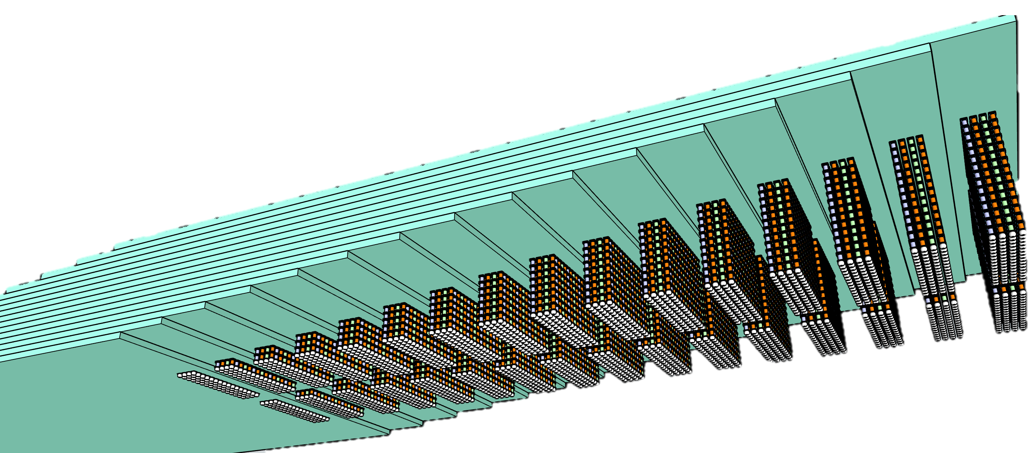
Terraced Memory Cube with TCC
16 tiers of 32Gb LPW
64GB TMC 2K DQ
TMC – terraced stacking of memory chips interconnected vertically using low cost TSV chips to widen data width in a Terraced Chiplet Cubing (TCC) construction.
A TMC example for
3D stack of Low-Power wide-IO, LPW, DRAM chips

Slide 4
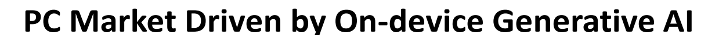
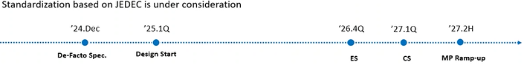
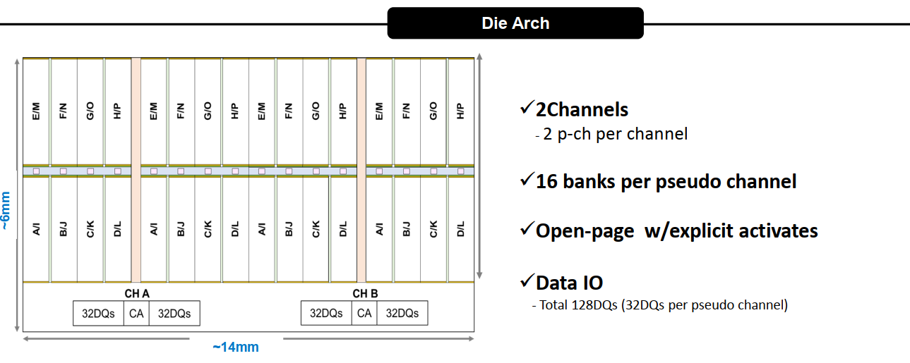
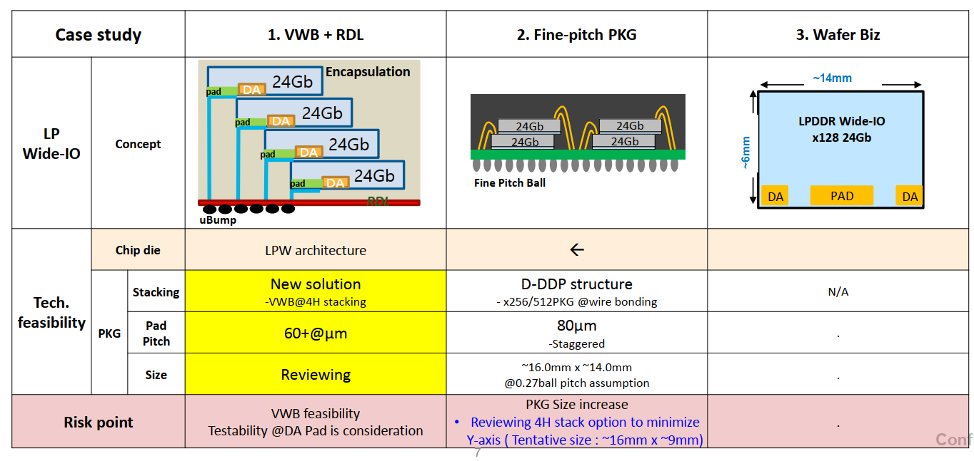
Intel-Samsung Meeting
(Feb'24, Aug’24)

Slide 5
Mockups of Memory Cube and Cost Breakdown
Input Information |  |  | 1b-process w/ 2GB-die
 |  |  | TMC – 4Hi 8GB |  | TMC – 8Hi 16GB |  | TMC – 12Hi 24GB |  | TMC – 16Hi 32GB
Memory | Memory component |  | LPWIO-1b-2GB/die
 | Size |  | 7 x 7 mm²
 | Gross die/wafer |  | 1301
 | Yield |  | 85.7%
 | Incoming wafer $$ |  | $ 3586
 | $$ / die |  | $3.2
TSV die | Scheme |  | 0P1M + TSV
 | Size |  | 2.05 x 5.2 mm² |  | 2.4 x 5.2 mm² |  | 3.83 x 5.2 mm² 2.04 x 5.2 mm² |  | 5.26 x 5.2 mm² 2.4 x 5.2 mm²
 | Gross die/wafer |  | 5867 |  | 5023 |  | 3161 5867 |  | 2313 5023
 | Incoming wafer $$ |  | $ 450
 | $$ / die |  | $ 0.077 |  | $ 0.090 |  | $ 0.143 (need 6ea) $ 0.077 (need 5ea) |  | $ 0.195 (need 8ea) $ 0.090 (need 7ea)
Assembly | Stack Height |  | 0 + 4 Hi |  | 0 + 8 Hi |  | 0 + 12 Hi |  | 0 + 16 Hi
 | Size |  | 9.9 x 7 mm² |  | 11.7 x 7 mm² |  | 12.8 x 7 mm² |  | 14.9 x 7 mm²
 | Gross die/wafer |  | 871 |  | 725 |  | 663 |  | 569
 | Process cost/wafer |  | $ 2776.5 |  | $ 4393.3 |  | $ 6057.0 |  | $ 7367.9
 | Process cost/unit |  | $ 3.27 |  | $ 6.45 |  | $ 10.13 |  | $ 15.22
 | Yield |  | 97.6% |  | 94.0% |  | 90.2% |  | 85.1%
Memory Cube Module Cost |  |  | $ 16.6 |  | $ 34.4 |  | $ 54.1 |  | $ 78.0
64GB Build Cost |  | # of modules | $ 133 | 8 | $ 138 | 4 | $ 163 | 3 (72GB) | $ 156 | 2

Slide 6
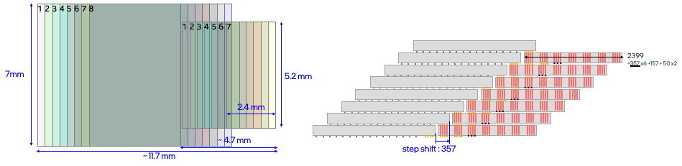
800GB/s modules and Benchmark
TMC Moc-2
TMC Mock-3
800GB/s Module | Package | Size [mm²] | Cost | Ch | GB | pJ/b | BW/mm | Node | Gb/Die | # Module | Height | # Die
TMC Mock-1 | TMC | 8x ( 9.9X7) | $133 | 32 | 64 | 1.9 | 14.3 | 1b | 16 | 8 | 4 | 32
TMC Mock-2 |  | 4X (11.7x7) | $138 |  |  |  | 28.6 |  |  | 4 | 8
TMC Mock-3 |  | 2x (14.9x7) | $156 |  |  |  | 57.1 |  |  | 2 | 16

Slide 7



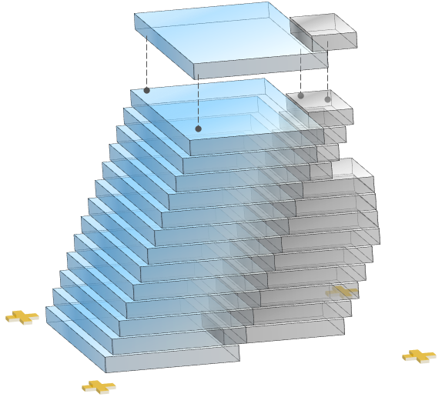



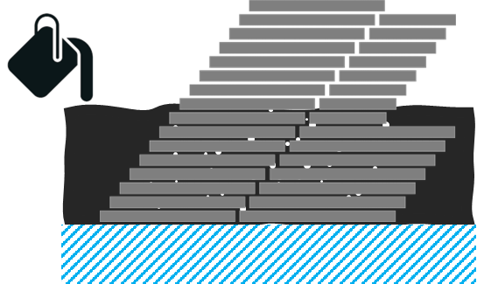
TMC Technical Risk Assessment
Difficulty for die height control
Non-bonded
Memory die
Stacking across 2 die with large z-height gap cause non-bond or crack. Z-height gap results from:
  TTV within wafer from thinning process
  Intrinsic co-planarity variation of μ-bump
  Cumulative gaps after multiple tiers stacking
…
crack
THK variation
bump co-planarity
TSV die
TCB for thin die handling
Die stacking is processed with its final thickness of 40~50um, which is close to capability limitation of TCB process. The thin die is fragile to cause yield loss, especially under compression.
thin die
crack
Die bond alignment
Wafer warpage
Die-bond accuracy will decrease while high-tier die use ground alignment marks due to large level difference of focal plane. As well, accuracy of overlay shift metrology is impacted.
Thick EMC with high molding ratio may cause high warpage in final TMC wafer to fail final bumping process.
Voids in die gap filling
Risk definition
Irregular die-gap space makes EMC filling incomplete more easily to cause voids trapped.
Narrow vertical die-gap may block MUF filling capability or make NCF bleeding at die edge.
Low
Concern with existing solutions.
Medium
Issue with confident mitigation plan.
void
Med-High
Issue need several DOEs to explore solutions.
Showstopper
Foreseen issue w/o any potential solutions.

Slide 8
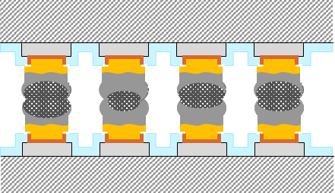
TMC Technical Risk Assessment Summary
Risk Level | Risk Item | Fail Mode | Root Cause | Mitigation Plan
High | Difficulty for die height variation control | Non-bonded Die crack | Intra- or inter- wafer TTV by thinning Bump height variation Cumulative variation after multi-tier joint | Improve die THK control: Die binning by inline THK for CoW recon Enhance thinning performance by adding metal reflection layer(like Ta) before ILD Absorb variation impact: TSV cube stacking first High solder volume Mold+grind per 4-tier stack TCB for die-bond with new nozzle design NCF as gap control
Med ~ High | High IMC volume by process thermal budget | Solder brittle Higher R | High thermal budget due to long TCB process time. | Decrease thermal budget: Partial TCB + 1x MR + MUF FCB+MR with MUF TCB + MUF (backup) Full IMC joint (backup) Optimize IMC barrier metal/THK
Low | Stacked wafer warpage too high | Wafer reject by tools | High molding-to-Si ratio | Low modulus MUF material selection 2nd carrier for C4 bump + high modulus carrier selection
Non-bonded
…
crack
THK variation
bump co-planarity
IMC (Cu₆Sn₅ or Cu₃Sn)
solder
Risk definition
* Underline : Primary solution to mitigate risk.
Low
Concern with reference data
High
No data but guessed mitigation plan
Medium
No data but experienced mitigation plan
Showstopper
Foreseen issue w/o any potential solutions.

Slide 9
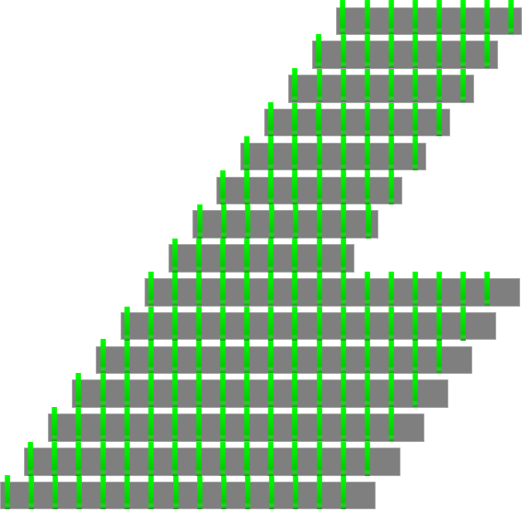
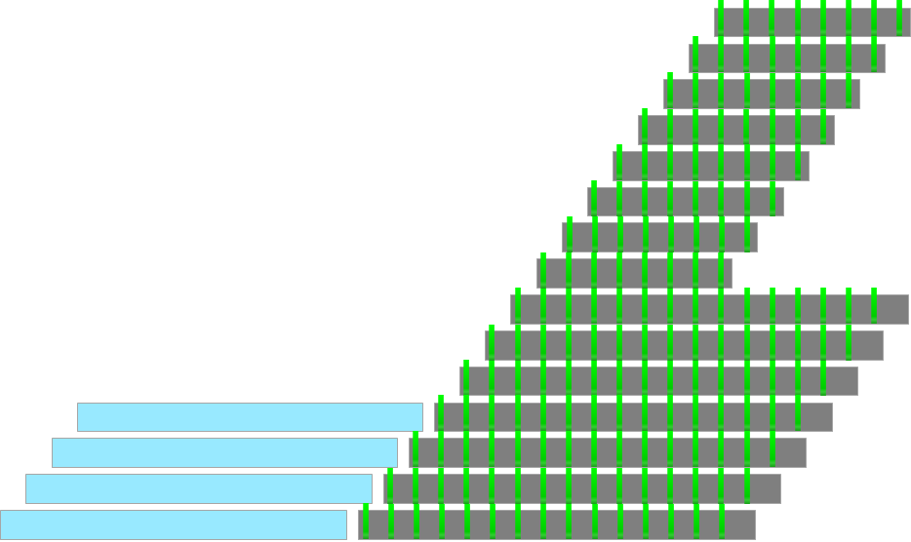
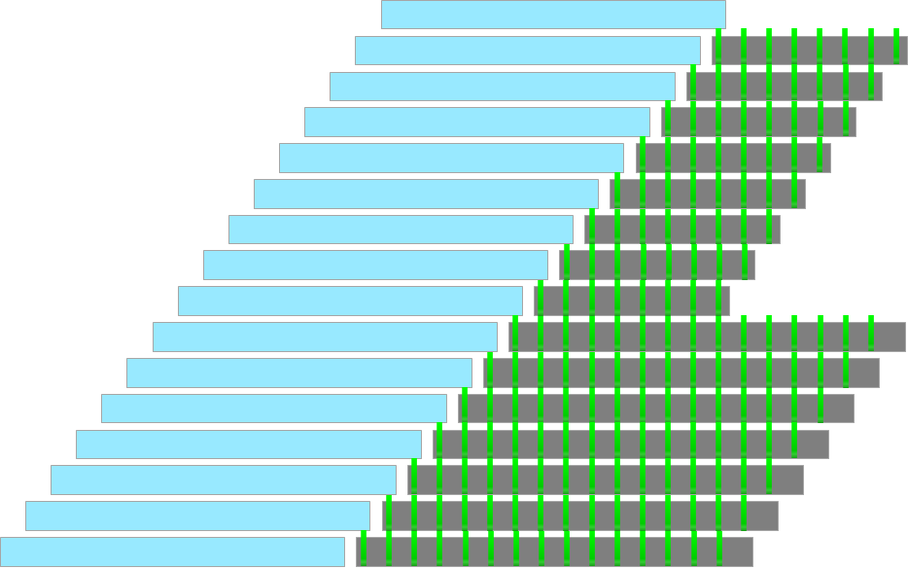
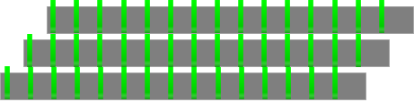


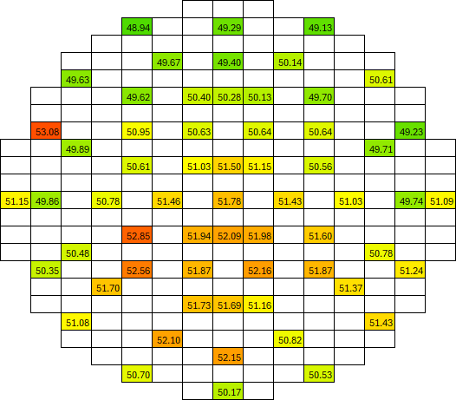
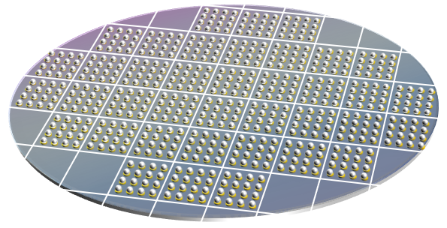
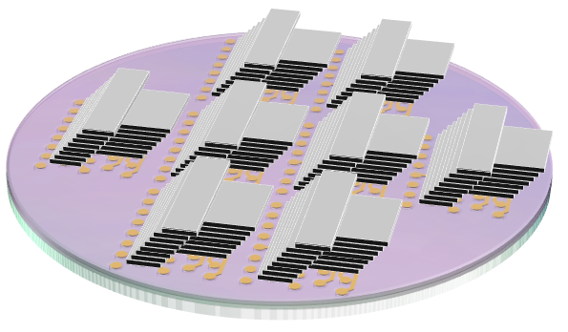

TMC Mitigation Plan
Mitigation Plan 1 – TSV cube first
Mitigation Plan 2 – THK binning
THK Bin
…
(example)
48-51 um
Inline THK
inspection
Equally-distributed
die-attach
Binning
51-54 um
54-57 um
…

Slide 10
TMC Mitigation Plan for TRA
Risk Level | Risk Item | Fail Mode | Root Cause | Mitigation Plan
Med-High | Difficulty for die height control | Non-bonded Die crack | Pre-tier is not flat due to cumulative variation from die THK or bump stand-off height.
Med | TCB for thin die handling | Die crack | Die THK is too thin, resulting in insufficient rigidity, then out of TCB handling capability.
Low | Die bond alignment inaccuracy | Die overlay shift | Different z-level between die placement and focal plane of alignment mark induces camera inaccuracy.
Med | Voids in die gap filling | Void-induced popcorn effect | Irregular die gap . Thin bump height because of total module height limitation. NCF or NCP bleeding blocks EMC fluidity.
Low | Stacked wafer warpage too high | Out of machine capability in: LIT or PLAT Transfer-mount | Molding ratio is too high with thick EMC height.

Slide 11

TMC Development Timeline
Year |  | 2024 |  |  |  |  |  |  |  |  |  |  |  |  |  |  |  |  |  |  |  | 2025 |  |  |  |  |  |  |  |  |  |  |  |  |  |  |  |  |  |  |  |  |  |  |  |  |  |  |  |  |  |  |  |  |  |  |  | 2026
Month |  | August |  |  | September |  |  |  | October |  |  |  |  | November |  |  |  | December |  |  |  | January |  |  |  |  | February |  |  |  | March |  |  |  | April |  |  |  |  | May |  |  |  | June |  |  |  | July |  |  |  |  | Aug | Sep | Oct | Nov | Dec | Jan | Feb | Mar
WW |  | 33 | 34 | 35 | 36 | 37 | 38 | 39 | 40 | 41 | 42 | 43 | 44 | 45 | 46 | 47 | 48 | 49 | 50 | 51 | 52 | 1 | 2 | 3 | 4 | 5 | 6 | 7 | 8 | 9 | 10 | 11 | 12 | 13 | 14 | 15 | 16 | 17 | 18 | 19 | 20 | 21 | 22 | 23 | 24 | 25 | 26 | 27 | 28 | 29 | 30 | 31
Key milestone
Supplier engagement
DCTV development
 | Memory mimic die
 | TSV die
 | Interposer
 | Process BSL setup
 | CIP
 | Reliability
 | Characterization
IPTV developing
Jaguar Shores EC??
Jaguar Shores TO
PDK v0.01
PDK v0.1
PDK v0.5
Supplier scouting
Kick-off + SOW
TRA + design rule pre-define
JDA
** Assume JDA not gate engagement
TO
Layout design
Wafer fabrication
Layout design
Wafer fabrication
Layout design
Mask fabrication
Tooling preparation
Process development
CIP
RA
Disclaimer:
  Schedule is estimated by engineering experience.
  Real timeline should be confirmed by OSAT after kick-off.
E-test
Memory design
Milestone Definition :
PDK v0.01 –
Pure paper-guess & simulation
PDK v0.9 –
T0 yield > 90% + Pre-Qual pass
PDK v0.1 –
Prototype build & process baseline
PDK v1.0 –
Full-Qual pass
PDK v0.5 –
T0 yield > 50%

