Slide 1
Intro to TMC
July/15/2024
DerChang Kau

Slide 2
Why Terraced Memory Cube (TMC) to replace HBM
3D Packaging innovation
remixed with
mainstream DRAM technologies
TMC = TCC + LPW
LPW = LPDDR Interface + WideIO
LPW is Tier-1 DRAM supplier’s response to address market demands in AI
TCC disaggregates vertical connectivity from active silicon in 3D stacking
➔ smaller DRAM die size
LPDDR interface deploys simplest connectivity with minimum overhead
➔ no base die required with energy optimized data transfer
WideIO improves parallelism of mainstream DRAM product (DDR or LPDDR)
➔ 8X LPDDR DQ width; on-par with HBM die

Slide 3
Introduction to Terraced Memory Cube
DerChang Kau & Team TMC, July/1/24
Objective: Low Cost High Bandwidth Memory to displace/replace HBM4E and beyond
Key Enablers:
  Relocate TSV from HBM, 30% cost reduction in $/bit at the same GB/s and pJ/bit
    DRAM process cost reduction (12% reduction from TSV module)
    MB/mm² improvement: (Array efficiency LPDDR: 60%, LPW: 48%, HBM: 40%)
  Low Power Wide IO mainstream DRAM + standalone TSVs for LP/HB data transfer
Fast fail strategy, critical path and milestone:
  2024: Ideation/vetting concluded; known unknown prioritized; DRAM/OSAT collaborator id’d
  2025: TM-TV and IC-TV validated; risks assessed; component datasheet established (product PrePOR)
  2026: TMC at HBM4E class demonstrated; Roadmap intercept committed.
 | Q2'24 | Q3'24 | Q4'24~Q1'25
Objectives | TMC Process flow develop, cost | MTS and DTS covering Process, Electrical and Thermal characteristics | TM-TV Tapeout
Tech Gate | Technology feasible Cost Lower than HBM | Mockup datasheet on par with HBM | MTS committed by OSAT

Slide 4
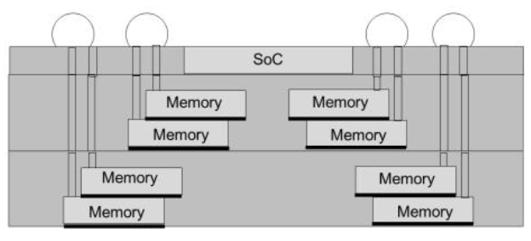
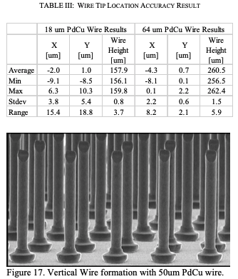
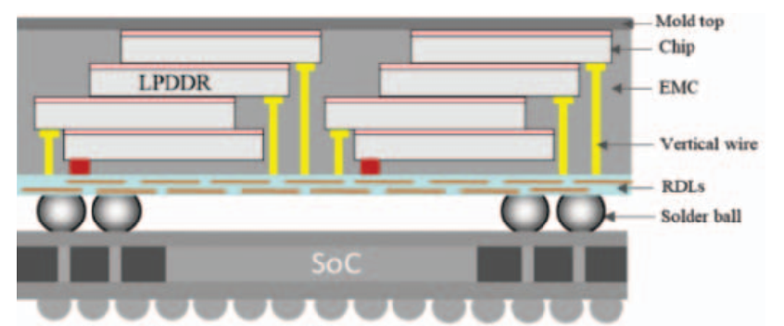
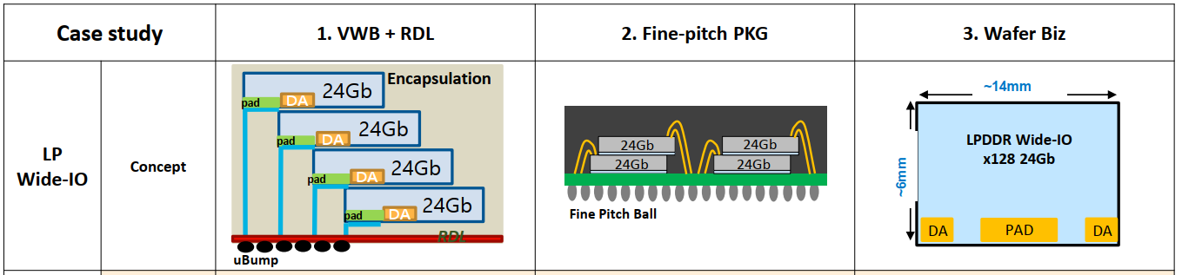
Best Known IPM Alternatives
  Vertical Wire Bonding
  K&S Capability: ETCT2017
  TSMC 3D MiM ECTC2020
  Multistack-in-Multistack
  Hynix VFO
  Vertical Fanout EDTM23 ﻿
  Vertical Fanout ECTC2024
  Samsung (Intel-Samsung Meeting, Feb/2024)

Slide 5
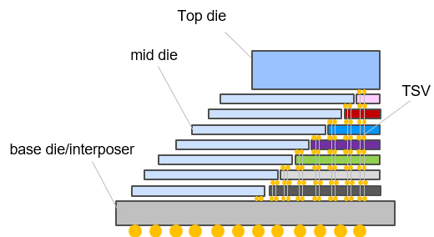
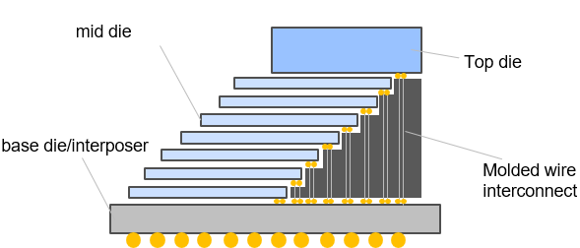
Terraced Chiplet Cubing without embedded TSV
  Disaggregated Through Silicon Via (D-TSV)
  CC Kuo et.al.
  Molded Wire Interconnect (MWI)
  Xiang Li et.al.

Slide 6
Terraced Memory Cube with TCC
TMC – terraced stacking of memory chips interconnected
vertically using low cost TSV chips to widen data width
in a TCC construction.
A TMC example for 3D stack of Low Power wide-IO, LPW, DRAM chips

Slide 7
TMC-LPW vs. HBM4E and LPDDR6
PAT/IF | GB | Size [mm²] | Cost | GB/s | $/GB | ¢/(GB/s) | Node | Gb/Die | # Module | Height | # Die
3DS HBM4E | 64 | 14.5x11.0 | $280.95 | 3276.8 | $4.39 | ¢8.57 | 1c | 32 | 1 | 17 | 17
TMC LPW6 | 64 | 14.9x10.5 | $156.35 | 3276.8 | $2.44 | ¢4.77 | 1c | 32 | 1 | 16 | 16
TMC LPW6 | 64 | 12.1x21.0 | $133.46 | 3276.8 | $2.09 | ¢4.07 | 1c | 32 | 2 | 8 | 16
TMC LPW6 | 64 | 12.5x22.0 | $123.28 | 6553.6 | $1.93 | ¢1.88 | 1c | 16 | 4 | 8 | 32
TMC LPW6 | 32 | 12.1x10.5 | $66.73 | 1638.4 | $2.09 | ¢4.07 | 1c | 32 | 1 | 8 | 8
TMC LPW6 | 32 | 12.5x11.0 | $61.64 | 3276.8 | $1.93 | ¢1.88 | 1c | 16 | 2 | 8 | 16
TMC LPW6 | 16 | 10.6x10.5 | $31.44 | 819.2 | $1.97 | ¢3.84 | 1c | 32 | 1 | 4 | 4
TMC LPW6 | 16 | 12.5x5.5 | $30.82 | 1638.4 | $1.93 | ¢1.88 | 1c | 16 | 1 | 8 | 8
TMC LPW6 | 8 | 11.0x5.5 | $14.94 | 819.2 | $1.87 | ¢1.82 | 1c | 16 | 1 | 4 | 4
WB LPDDR6 | 16 | 14.0x9.0 | $21.43 | 307.2 | $1.34 | ¢6.98 | 1c | 32 | 1 | 4 | 4
64GB TMC mockup (16x 32Gb stack) – 45% lower cost
30% lower $/bit
  No TSV in DRAM process (12% wafer cost saving)
  22% higher density
  Smaller die, higher yield
Base die eliminations (~$20, 10% saving)
Higher packaging cost (larger module size, more chips, 2~5% adder)
Better packaging yield (~8% saving)
All mockups are superior to HBM4E
With yield loss reduction at ½ stack height and ½ of die density, 16GB component (8x 16Gb stack) is the most optimal built on density and cost
> 50% lower cost

Slide 8
Backup Material

Slide 9
Terraced Memory Cube (TMC) for xDIMM/xCAMM/HBM displacement
Assumptions:
Node: Micron D1ß
LPW Array Efficiency based on SEC D1a LPW
DDR
10mm or less of DQ trace length between TMC module and compute chiplet
➔ < 0.5pJ/bit
P_{act} [nm] | P_{WL} [nm] | P_{BL} [nm] | Cell Size [nm²]
24 | 34 | 39 | 1330
Type | capacity [Gb] | die size [mm2] | pJ/b | DQ | GT/s
HBM3E | 24 | 100 | 3.70 | 128 | 9.2
TMC-LPW | 24 | 66 | 0.5 | 128 | 7.6
LP5 | 16 | 37 | 5 | 16 | 8.4
TMC-LP5 | 16 | 37 | 0.5 | 16 | 9.2

Slide 10
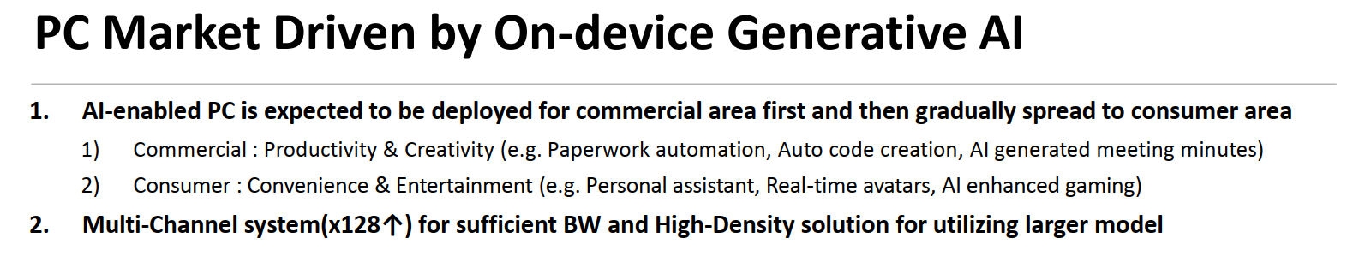
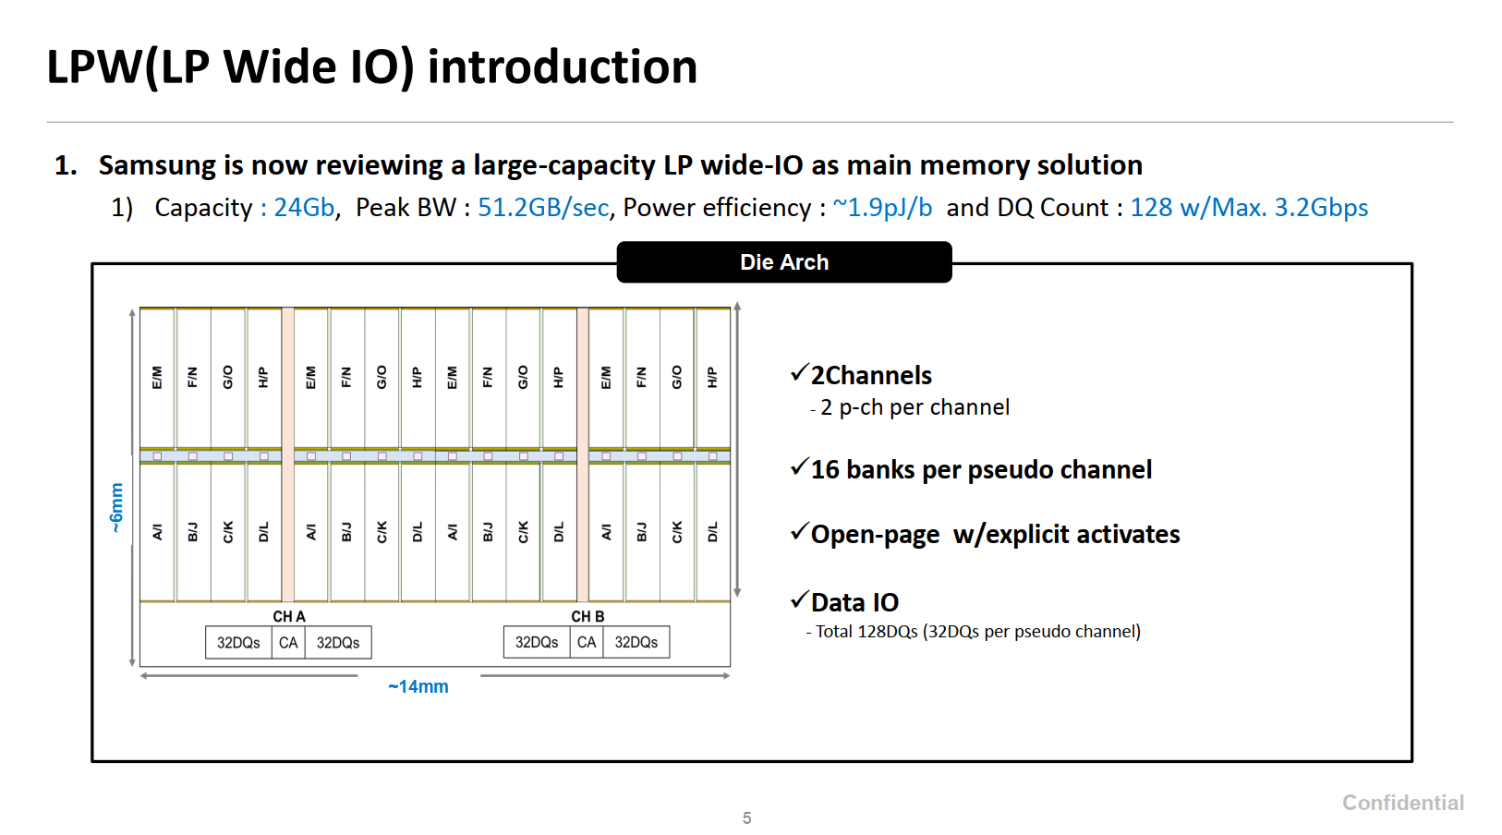
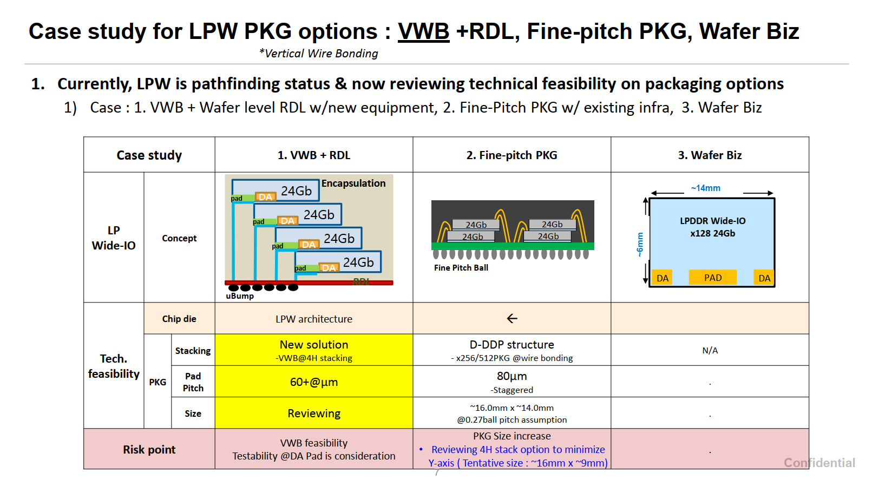
Intel-Samsung Meeting
Feb'24

Slide 11
1-1, Rajat, Konika, Bob, Dimi (WW29)
Formfactor – MOP package size limited by Solder Ball footprint
  Fine Pitch BGA Ball pitch is ~0.4mm ➔ 4K pins in (1”)²
  µBump pitch in 2.xD package is 20~40µm ➔ 4K pins in (0.05~0.1”)²
  Why HBM3/4 µB pitch stays @ ~75µm?
Client System interested at 8~16GB @ 800GB/s
  4x 16Gb @800GB/s (x512 DQ 12.5GT/s)
< 1pJ/b anticipated
[Dimi]: Stack yield loss ➔ 16t/75% vs. 8t/85% vs. 4t/>95%
[Rajat]: Low cost option where HBM is used ➔ Jaguar Shores intercept candidate
[Konika]: Memory pathfinding technology for TTL/HML ➔ segments/options tbd
[Bob]: Cost Sensitive ➔TMC-LPW vs. WB-LPx: 1.5X $/GB and 25%~50% $/BW

