Slide 1
Current Edge/Client architecture comparison and requirements
Nilesh Jain, Tanay Karnik, RS Srivatsa, Jainaveen Sundaram, Prerna
Notes:
How is datacenter different from Edge and Client in terms of µArch, memory configuration, data access and path?

Slide 2
DMR-D Competitive Landscape
Notes:
Is Intel late? Why?

Slide 3
Client TTL Context
Notes:
What are the metric (definitions, metrology and measurement)

Slide 4
Client TTL Targets
Notes:
What is TTL?

Slide 5
Nvidia
NVIDIA GPUs | Process (nm) | Transistors (Million) | Die Size (mm2) | Max frequency (MHz) | SRAM frequency (MHz) | Tensor cores | L2 (MB) | Memory (GB) | Memory Bus width (bit) | Bandwidth (GB/s) | TDP (W) | FP32 TFLOPS
AD103 | TSMC 5 | 45900 | 379 | 1695 |  | 320 | 64 | 16 | 256 (GDDR6) | 576 | 120 | 32.98
AD104 | TSMC 5 | 35800 | 294 | 2040 | ~1500 | 240 | 48 | 24 | 192 (GDDR6) | 300 | 72 | 31.33
AD106 | TSMC 5 | 22,900 | 188 | 1695 |  | 144 | 32 | 8 | 128 (GDDR6) | 256 | 115 | 15.62
AD102 | TSMC 5 | 76,300 | 609 | 2490 |  | 568 | 96 | 48 | 384 | 864 | 300 | 90.52
H100 CNX | TSMC 4 | 80,000 | 814 | 1845 | ~1593 | 456 | 50 | 80 | 5210 (HBM) | 2039 | 350 | 53.84
https://www.e2enetworks.com/blog/nvidia-l4-vs-a40-which-gpu-better-suits-your-requirement
https://www.cisco.com/c/dam/en/us/products/collateral/servers-unified-computing/ucs-c-series-rack-servers/nvidia-l4-gpu.pdf
https://www.nvidia.com/content/dam/en-zz/Solutions/Data-Center/l4/PB-11316-001_v01.pdf
https://www.techpowerup.com/gpu-specs/l4.c4091
Notes:
What is AD?

Slide 6
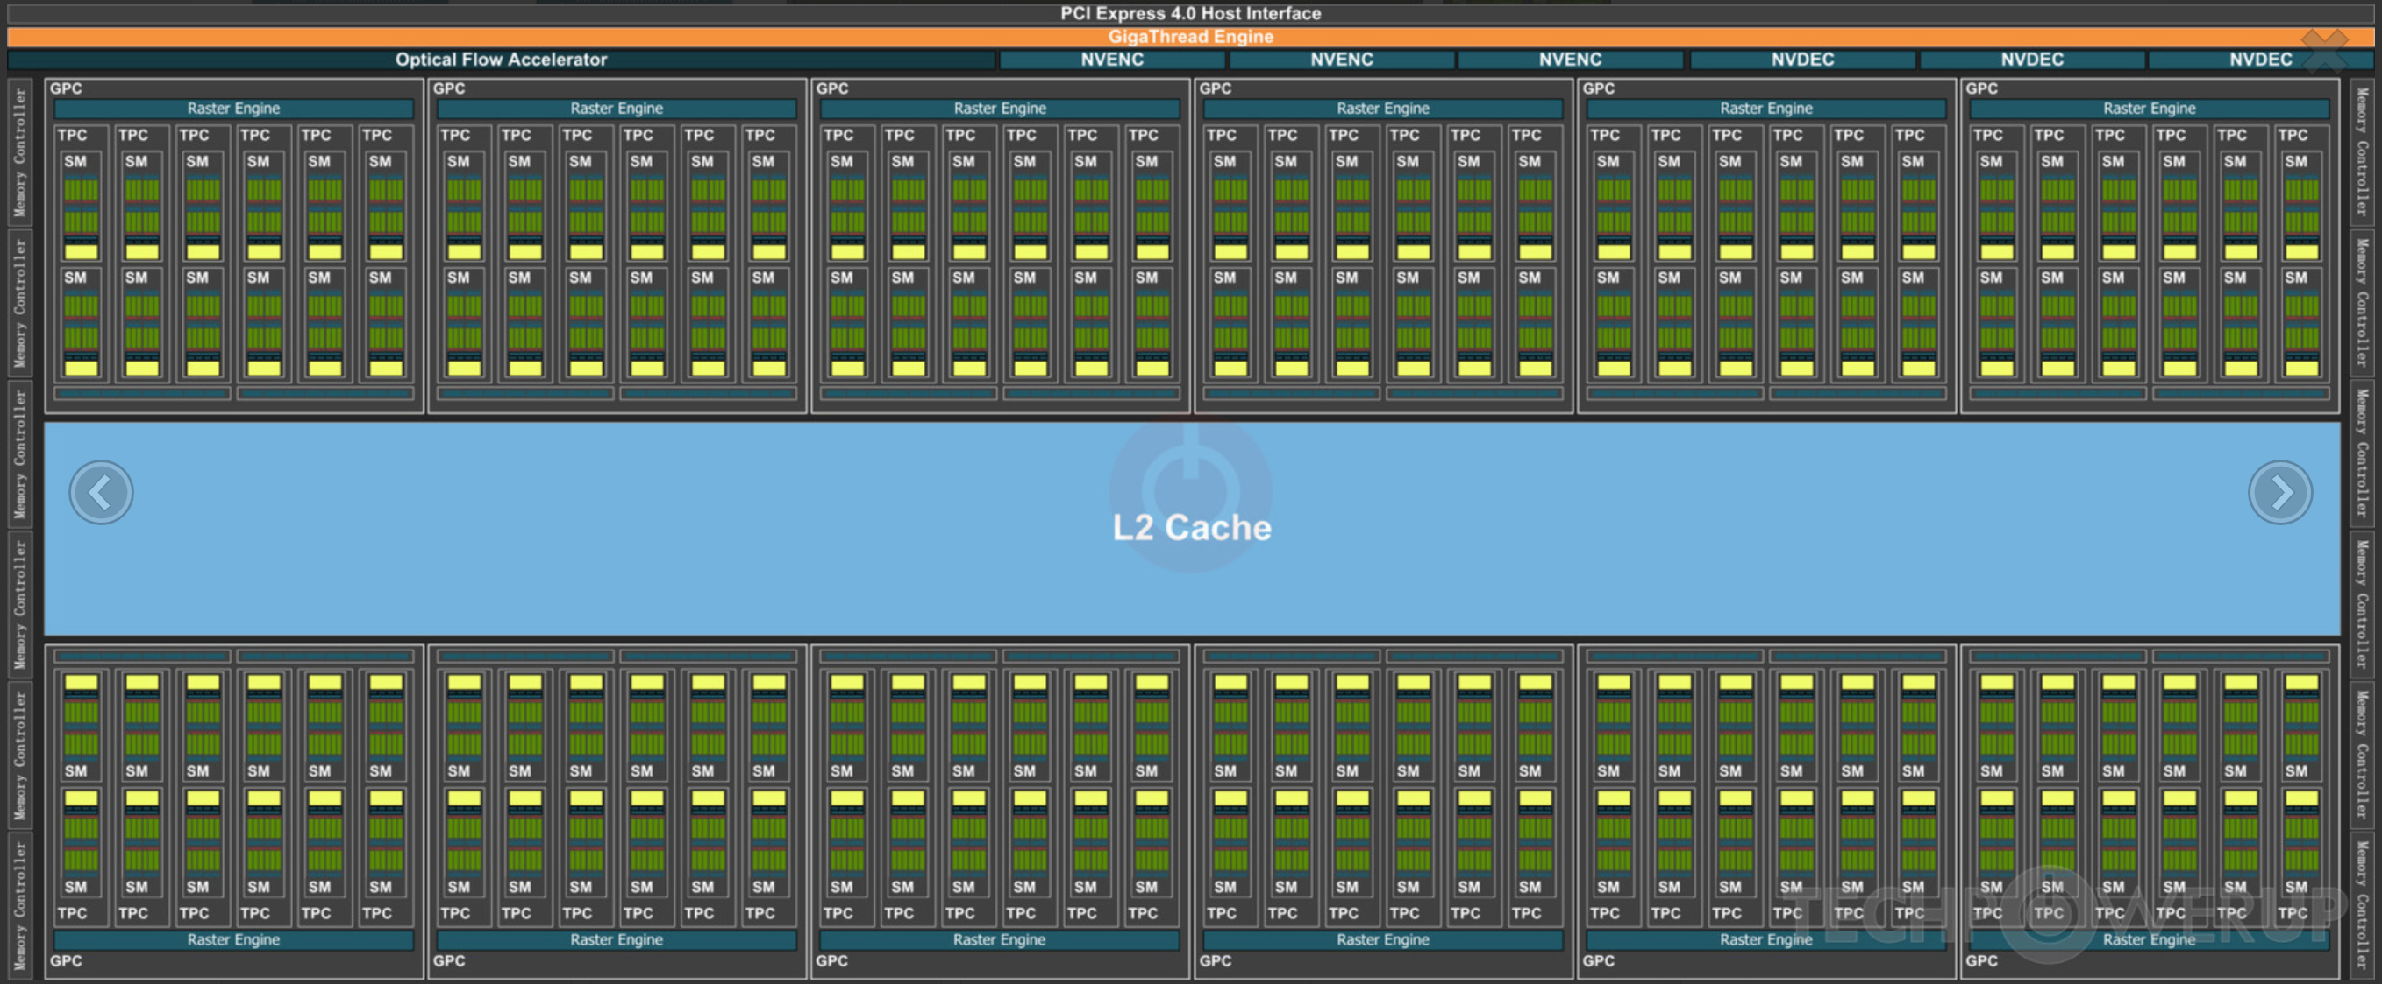
Parallelism in Nvidia AD103
Notes:
The corresponding block diagram with capacity, path width and footprint annotated.

Slide 7
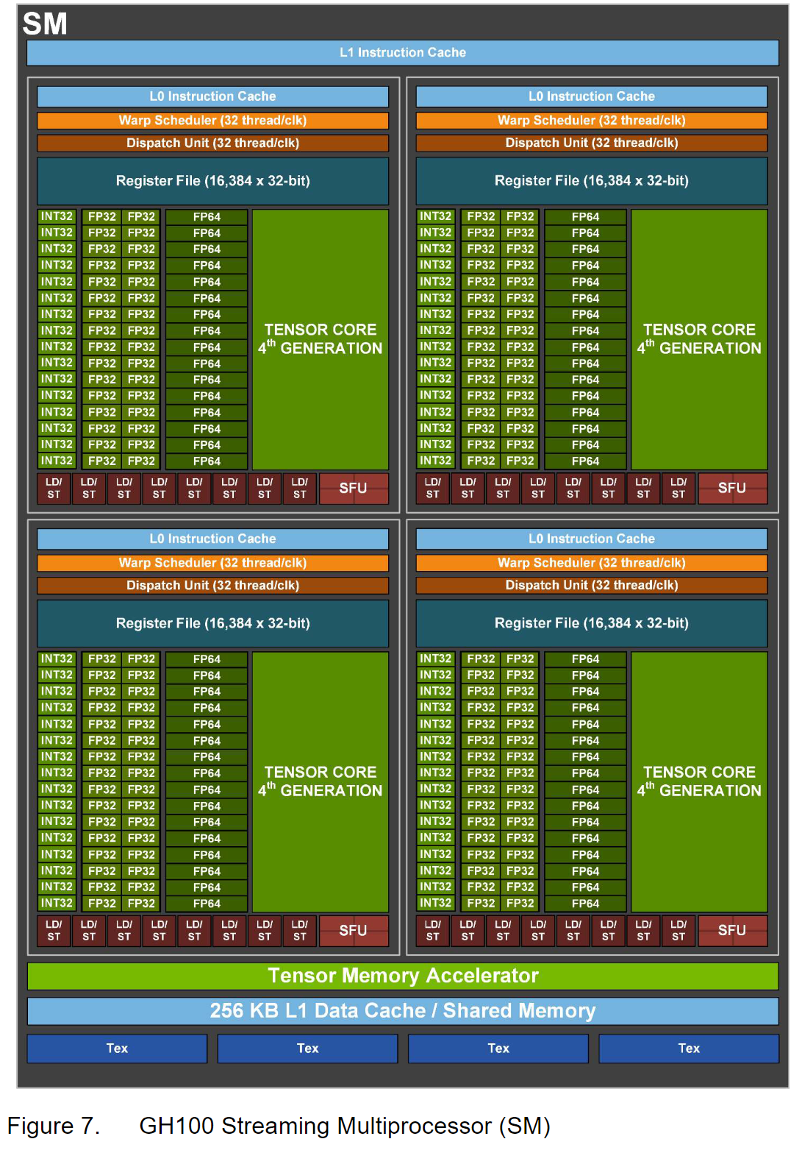
https://resources.nvidia.com/en-us-tensor-core
Notes:
Same as previous page

Slide 8
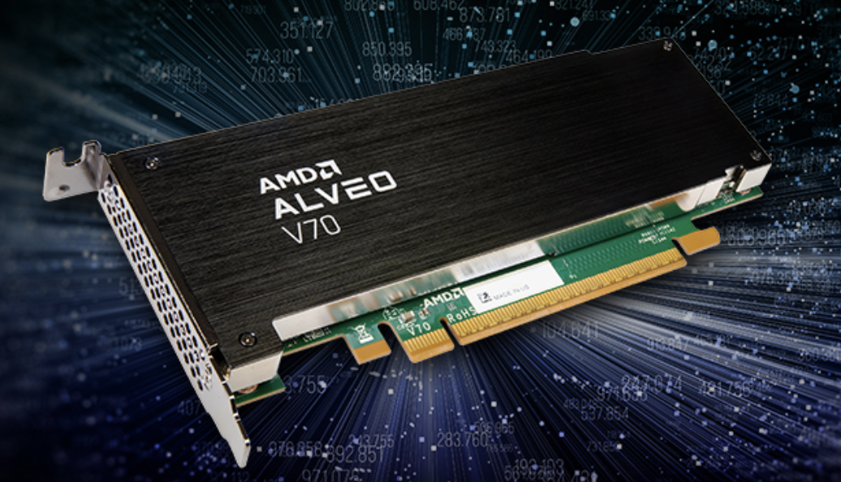
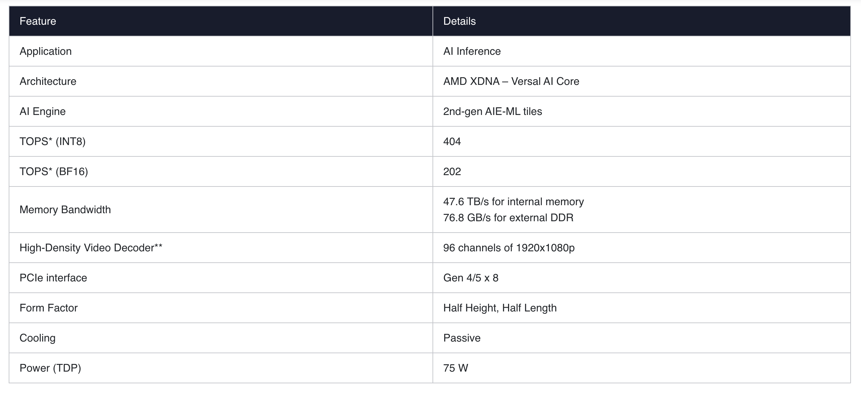
AMD

Slide 9
Google TPU
 | First deployed | Train/Infer? | Process | Die Size (mm2) | On chip cache (MB) | HBM Capacity (GB) | HBM BW (Gb/s) | Peak BF16 Tera Flops | Idle Watts | TDP Watts
TPU v3 | Q4 2018 | Y/Y | 16nm | 700 | 32 | 32 | 900 | 123 | 84 | 450
TPU v4i | Q1 2020 | N/Y | 7nm | 400 | 144 | 8 | 300 | 138 | 55 | 175
TPU v4 | Q4 2021 | Y/Y | 7nm | 780 | 288 | 32 | 1200 | 275 | ?? | 300
TPU v5e | Q4 2023 | Y/Y | ?? | 325 | ?? | 16 | 819.2 | 197 | ?? | ??
Edge TPU | Q4 2018 | N/Y | ?? | ~10 | 8 | NA | NA | 2 | 200m | 1
References: TPU detailed Comparison, TPUv4i paper, TPUv4 paper, Semi Analysis TPU5e, Coral Edge TPU
"Though lesser BF16 TOPS compared to TPUv4, for every dollar spent, the TPU v5e is up to two times faster in training and 2.5 times inferencing times (than v4). The TPU v5e is priced at $1.2 per chip hour, while the TPU v4 is about $3.2 per hour."
Notes:
Where are Google TPUs deployed?
$1.2 per chip hour : what is the CoO metric? Applicable to all AI Accelerators?

Slide 10
Loogson – Tanay
LG200 available in 2024
Ten times weaker than Nvidia H100, performance comparable to a Radeon RX 550
INT8 data format for AI workloads and FP32 / FP64 for graphics workloads
256 GFLOPS to 1 TFLOPS per node, 1.2 TFLOPS of FP32
No disclosure on power
OpenCL 3.0

Slide 11
Competition
Nvidia – 4 Series - https://www.microway.com/knowledge-center-articles/comparison-of-nvidia-geforce-gpus-and-nvidia-tesla-gpus/
Google – TPU (edge)
AMD’s APU (edge version)
Loogson - https://www.tomshardware.com/news/loongson-launches-3a6000-cpu-matches-14600k-ipc

Slide 12
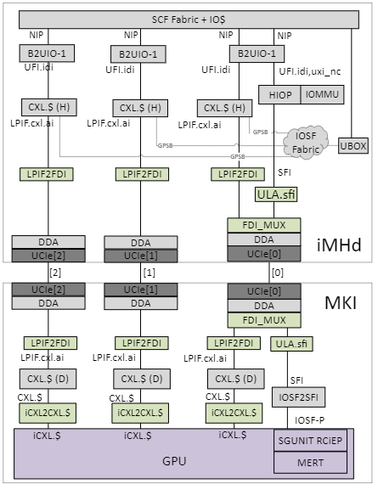
CMB Platform: DMR-Edge 8ch 96/48/24C LGA
48C PNC CBB
1
48C PNC CBB
24C PNC CBB
Dummy
2
iMHd
8 CH DDR5
64L G6 + 4L G4 + 3x UCIe.D
iMHd
8 CH DDR5
64L G6 + 4L G4 + 3x UCIe.D
Package Design | 1-New 2-New 1d-(Simple*) derivative 2d-(Simple*) derivative
SoC Config (WIP) | 1-New 2-Derivative w/ new CBB 1d-Derivative w/ depop 2d-Derivative w/depop
Core Count | 1, 1d - Up to 96/48C PNC, Foveros 2, 2s – Up to 24 PNC, Planar
DDR5 Mem Channels | 8Ch – RDIMM, MCR
PCIe Lanes Target*** | 48L G6 + 16L G5/6 + 4L G4
Ethernet (Ports, TPT) | No SoC integrated Eth
Pkg Size, Pin-Pitch | 77.5 x 56.5 , 33x37mils
Accelerators / IPs | iMHd: DLB, DSA MKI: AI, Media
Market Segments | Media, Edge
PO / PRQ Timing | 1-Q2’27 2-Q1’27 1d-Q4’27 2d-Q1’28
CBB
CBB
CBB
CBB
CBB
UCIe.Device
CBB
CBB
UCIe.Device
CBB
UCIe.Device
UCIe.Device
MKI AI / Media
512EUs + 32 Xe Cores + 6xVdbox + 96MB SRAM
MKI AI / Media
512EUs + 32 Xe Cores + 6xVdbox + 96MB SRAM
Last Updated: WW44’23
48C PNC CBB
1d
Dummy
24C PNC CBB
2d
Dummy
iMHd
8 CH DDR5
64L G6 + 4L G4 + 3x UCIe.D
iMHd
8 CH DDR5
64L G6 + 4L G4 + 3x UCIe.D
CBB
CBB
CBB
CBB
CBB
UCIe.Device
CBB
CBB
UCIe.Device
CBB
UCIe.Device
UCIe.Device
MKI AI / Media
512EUs + 32 Xe Cores + 6xVdbox + 96MB SRAM
Dummy
Die-package combinations
Config
UCIe.Device
MKI IO Stack diagram
* Treat almost like depop for platform arch/design/SI/PI/PD, RP, SoC/platform validation, etc. Simple derivative for package, assembly, manufacturing, etc.
Notes:
Need help

Slide 13
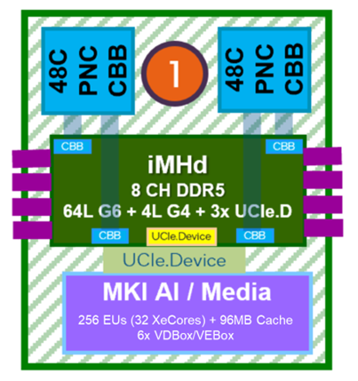
ARs & Opens
We should do INT4 and INT8. Find Nvidia target for FP8 support. Then we decide if we do FP8.
  Current SOTA are weight only quantization for INT4 with some accuracy degradation.
  Nvidia has FP8 support in L4 - https://nvdam.widen.net/s/rvq98gbwsw/l4-datasheet-2595652
286GBps - Is it L2 BW or memory BW to L2?
  It is memory BW to L2: 3x UCIe… so it is ~300GBps R + 70GBps W.
How does this MKI connect to DMR? Where is DDR? There has to be a parallel memory interface.
  Our understanding is correct, MKI has 3x UCIe and it connecs to IMH-D.. the Mem Ctrl and DDR are on the IMH.
Can we reuse VD boxes? No redesign required.
  I couldn’t confirm but based on my prior experience with GNR-D media integration.. We should be able to reuse

Slide 14
Summary Table
Product | INT8 TOPS (Frq) | Power envelope (Card/SoC/IP) | Memory BW GBps | Precision Support | Media Support | Time frame
Nvidia B4 | 492 (2.2GHz) | 75W (Card) | 448 | FP8/INT8/INT4 ? | Yes | 2H’24
Nansen Sound | 492(?) | 72W(card) | 432 |  | ? | 1H’27
DMR-D APU | 450(?) | 30-65W (SOC) | 286 | FP8/INT8 | 6-8 streams 4K60FPS | 2027
TTL | 40 (?)/20 (?) | 350-700mW/1W (SOC) | 40/10 |  | No | 2027
AMD Alveo v70 | 404 | 75W (Card) | 76 | INT8 | No | 2023/24

Slide 15
Key differences/requirements in the MAC datapath
Input Data format support
  Beyond INT8 and FP32: popular formats are BF16, FP8 and FP4
    Below link to the paper from Intel Labs on fused MAC which is now part of Falcon shores
Latency in MAC
  Falcon shores MAC path is a 4-stage pipeline and higher CDYN power
Support to sparse data format.
  Each workloads have unique sparse information and “A single format” might not be suitable to
  take advantage and accelerate the MAC computation
  2. Next gen *rapids family architecures incorporate support to multiple sparse input formats and
  dynamically switch between the format depending upon the workload.

Slide 16
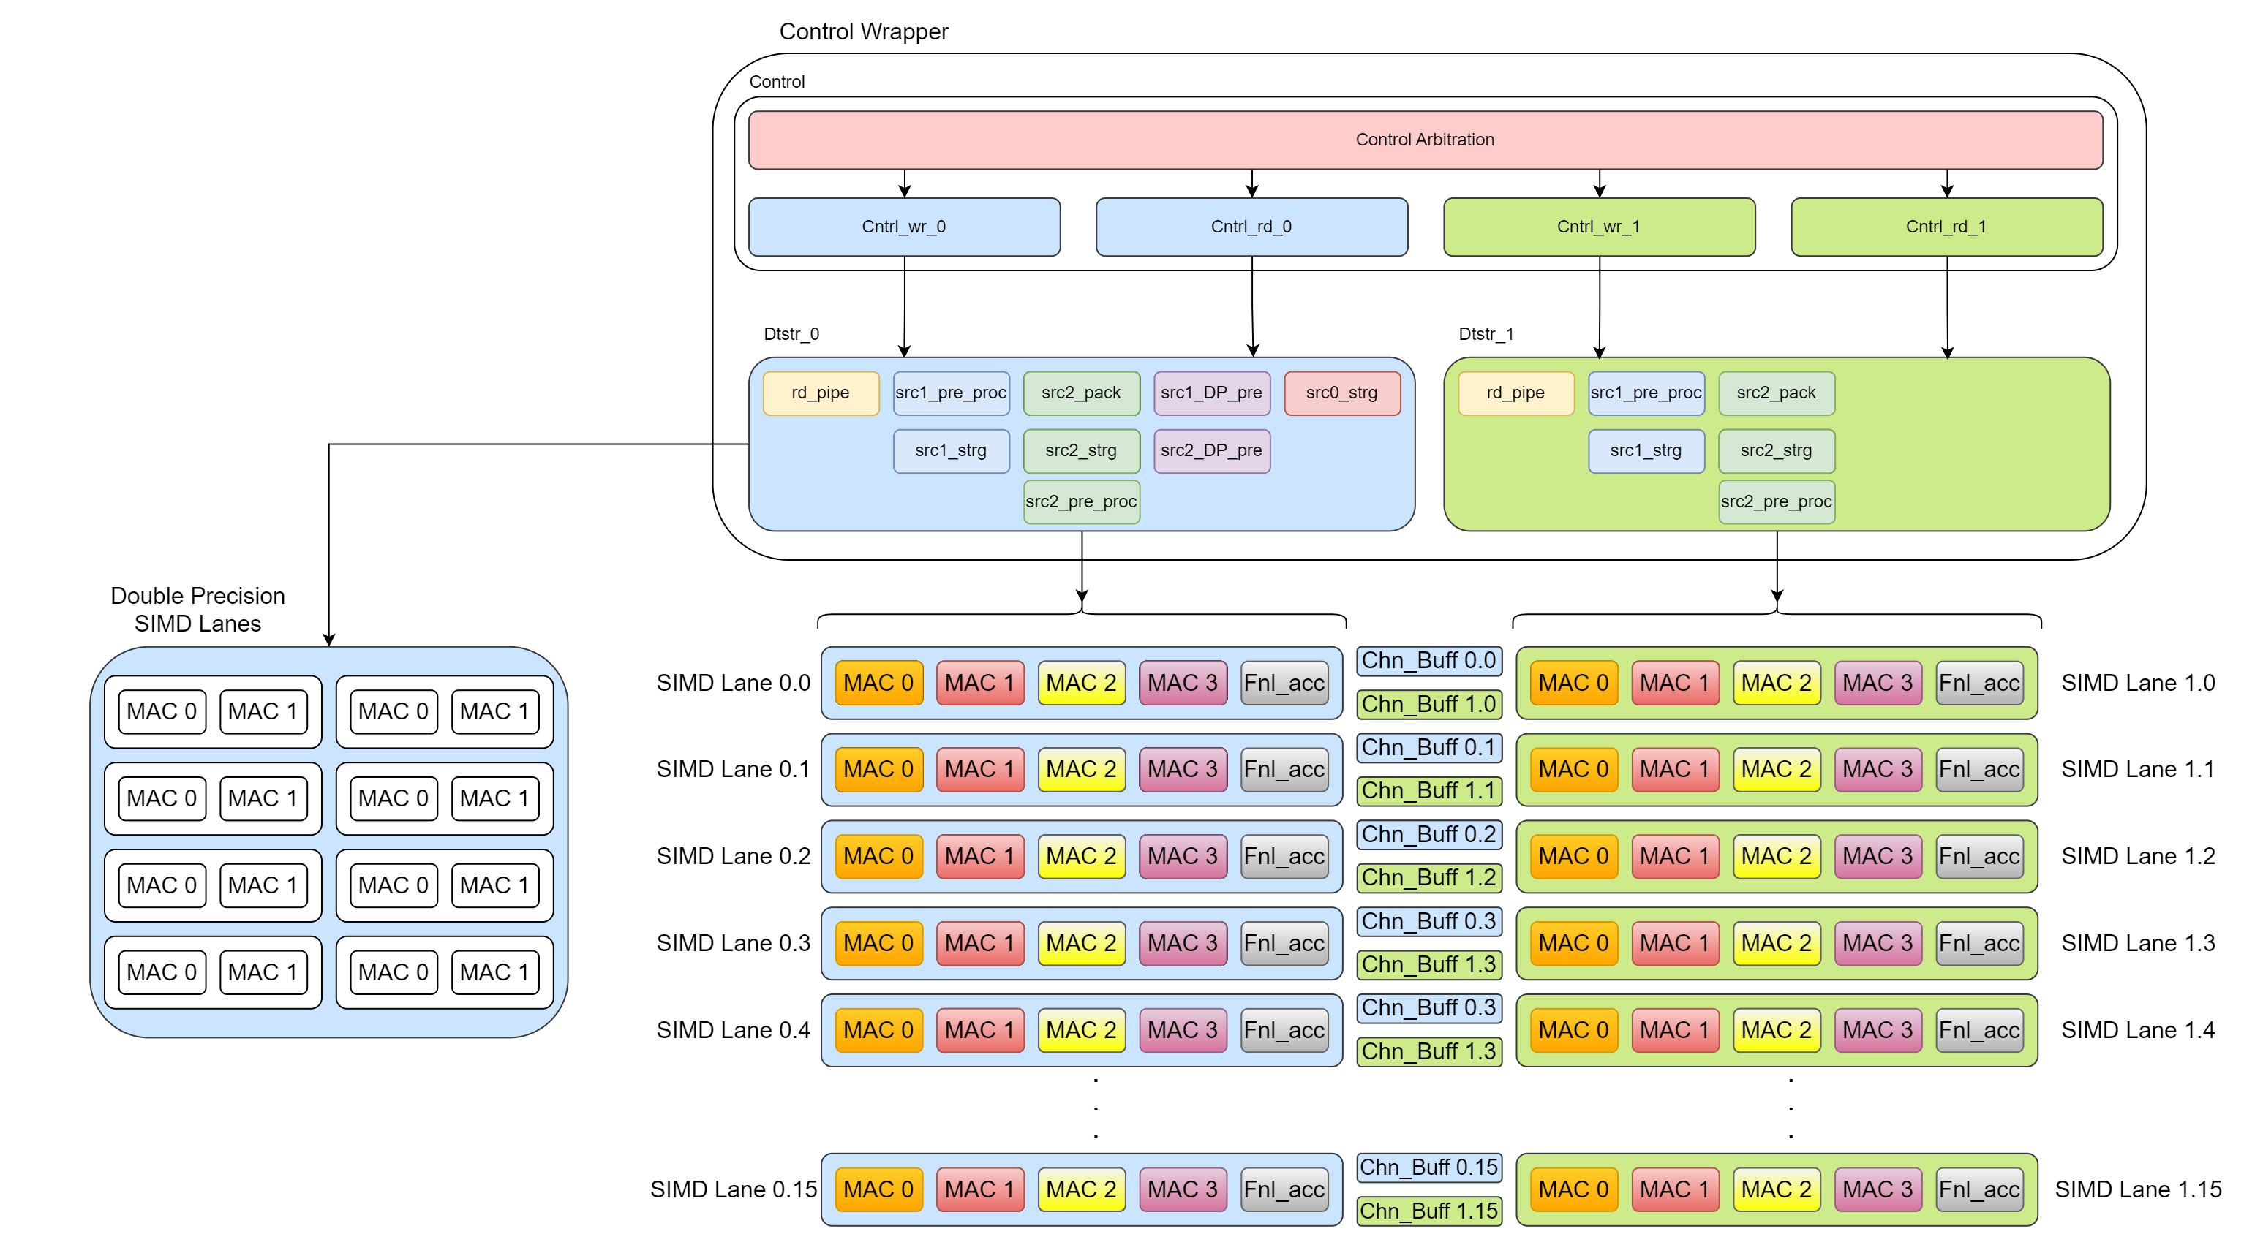
2. Latency in MAC
  Falcon shores MAC path is a 4-stage pipeline and higher CDYN power
Falcon Shores MAC architecture
Notes:
Data, path and flow?
Slide 17 and Slide 18?

Slide 17
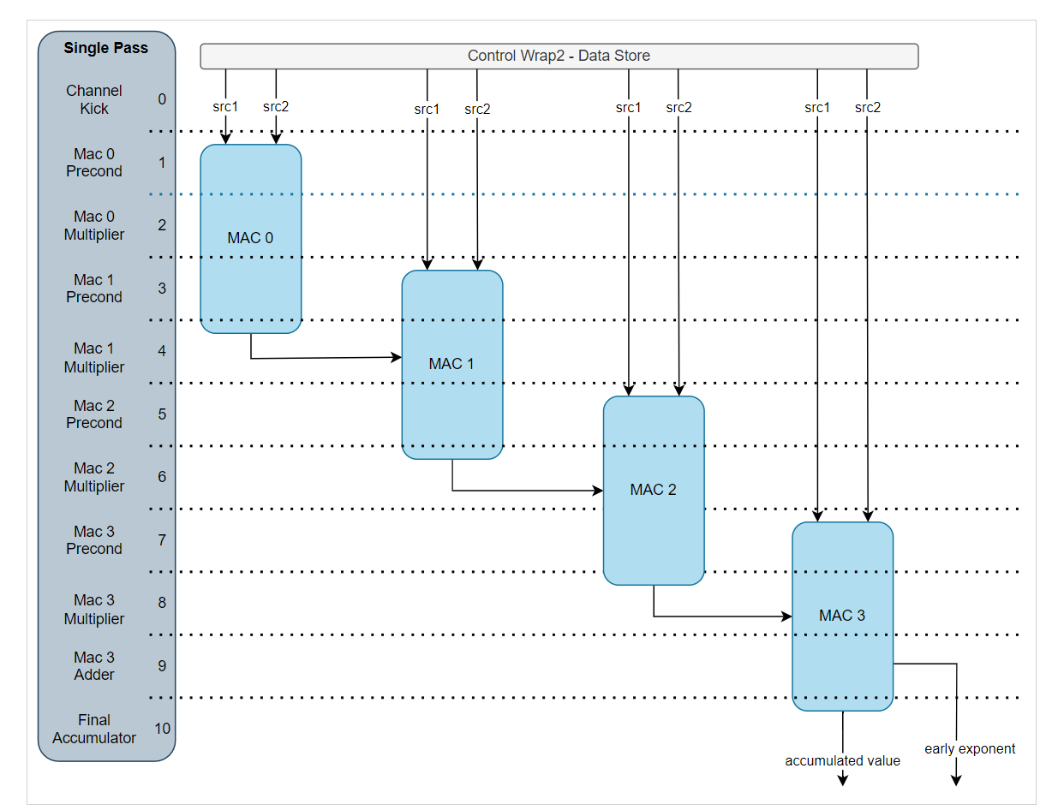
Falcon Shores graphics MAC pipeline

Slide 18
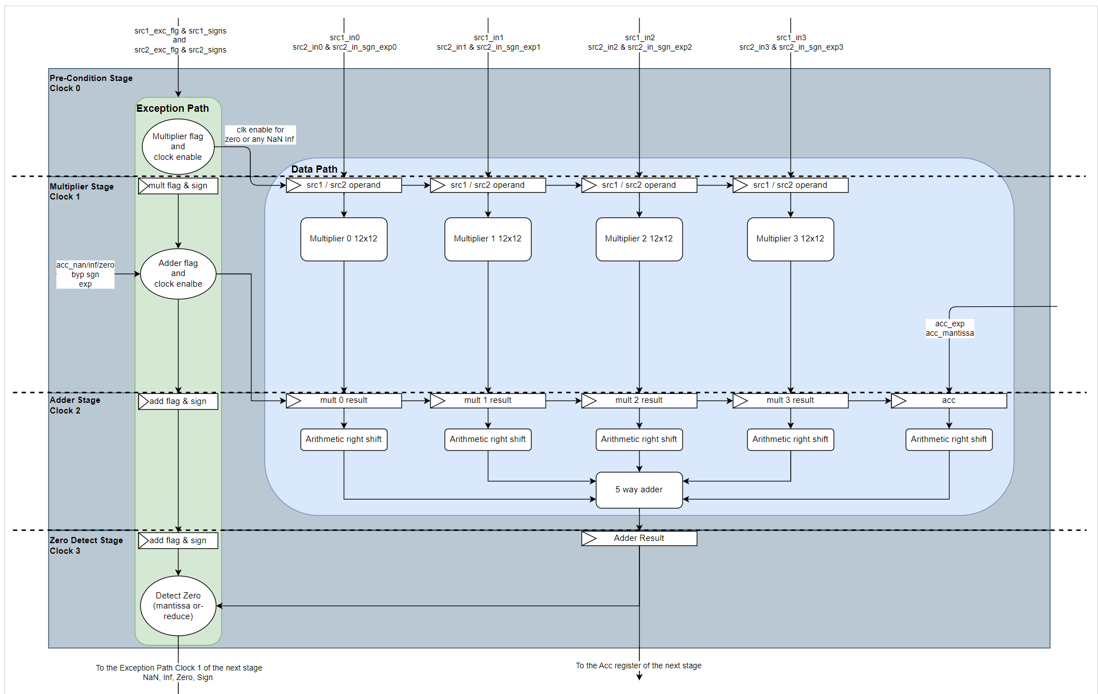
4 stage MAC architecture

Slide 19
Softmax operation is the key bottleneck in several AI workloads beyond MATMUL

Slide 20
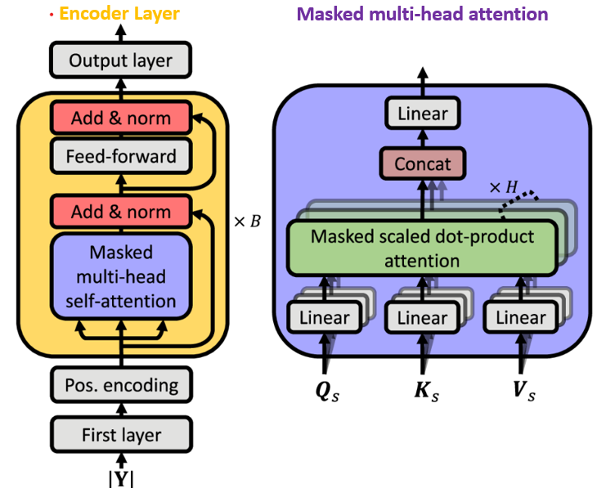
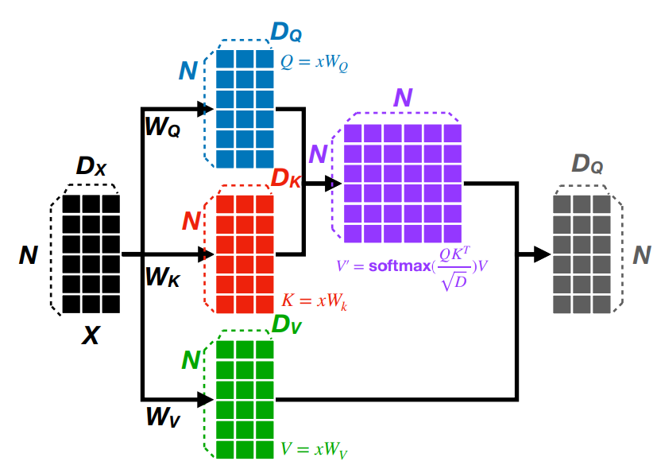
Transformer model architecture
x H
Notes:
Input is feeded into the first layer we get a vectorized form of each token called as encodings
These encodings are fed into multi-head attention
Multi-attention head is bunch of matrix multiplication and softmax
Before building any hardware we want to understand the bottlenecks on other platforms
What are the matrix and operator : the operations

Slide 21
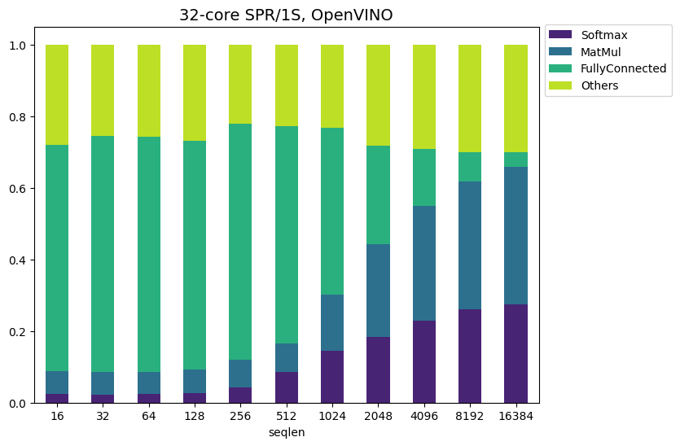
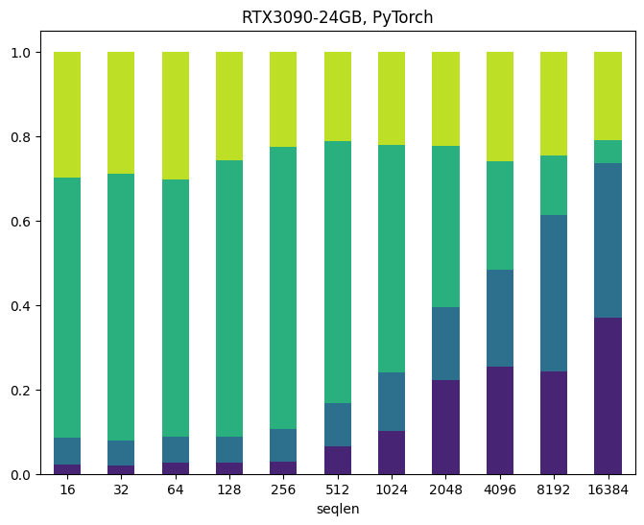
Profiling BERT across HW platforms – CPU/GPU
As sequence length grows, Softmax continues to take up more share of normalized runtime across platforms.
For seq. len > 4K, Softmax takes up about 20-40% of overall runtime, only behind Matmul.
Notes:
We profiled BERT which is a popular NLP model by google.
At lower sequence lengths – FC dominates

Slide 22
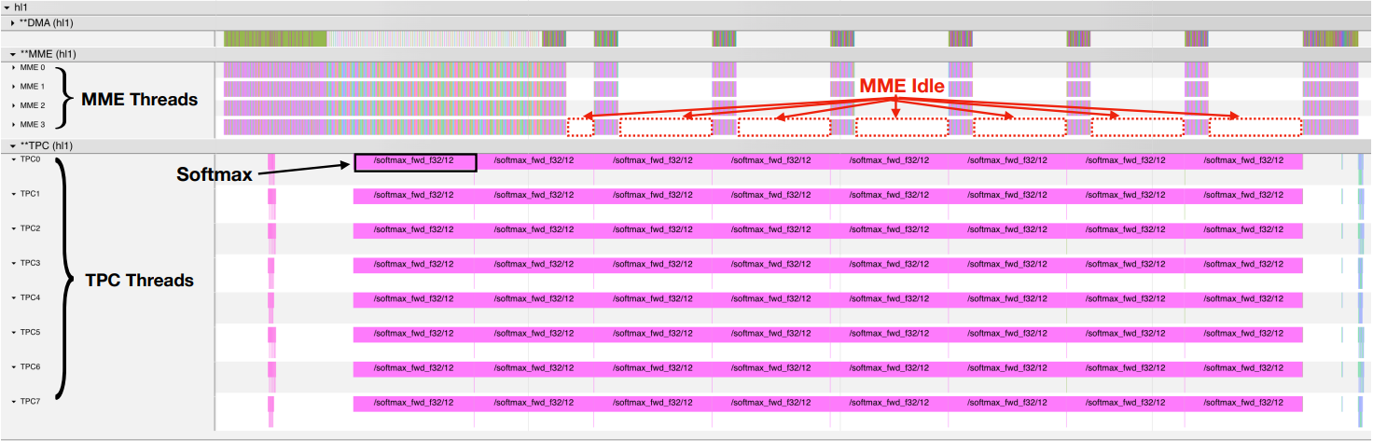
Profiling BERT across HW platforms - Gaudi
Config: input sequence length = 2048, batch size = 128, number of heads =6, and the hidden size per head = 64. Softmax exceeds 80% of the total runtime in the running region of TPC.
Published: Benchmarking and In-depth Performance Study of Large Language Models on Habana Gaudi Processors, SC’23
Notes:
We perform our experiments on one Habana Labs System 1 AI training system. The HLS-1 incorporates eight GAUDI processors and two Gen 4.0 PCIe switches. External Host CPU is used to manage HLS-1 via PCIe switches. Each GAUDI processor is equipped with 32 GB on-chip memory. All experiments are on a single GAUDI processor.
Profiler Trace of the transformer with softmax attention. DMA is direct memory access engine that manages data transfer/copy between MME and TPC.
We observe that executing softmax operations on TPC results in MME idle time (i.e., gaps between MME operations).

Slide 23
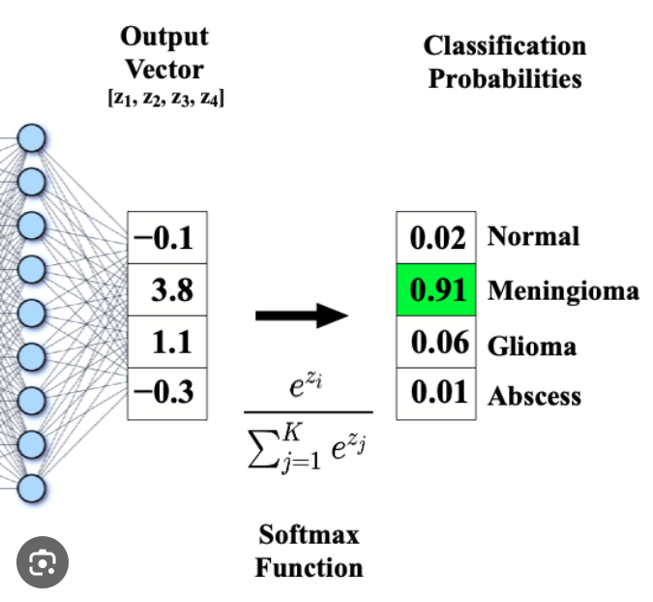
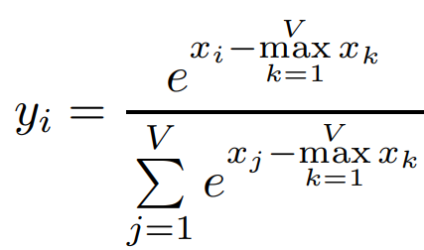
Why is Softmax hard?
Softmax is a mathematical function that converts a vector of real numbers into a probability distribution
1. Needs at least a two-pass algorithm –
O(n) to calculate max/rolling sum
_{O(n) to calculate yi}
_{2. e}^{x} is a costly hardware component (latency, area, energy)
Input/Output (x, attention scores) are floating point. Floating point divisions are costly.
3. This operation is repeated quite often, with a quadratic complexity against sequence length, repeated across batch size and number of heads.
4. Needs visibility to the entire vector (V = Sequence Len.), how do you break-into-chunks/parallelize/pipeline the computation?
We propose a novel compute flow for Softmax – which builds on the 2-pass approach and saves N² divisions/layer.

Slide 24
Our (HPL) approach:
softmax = e^{(xi - max)} / ∑(e^{(xi – max)})
Typically, you do two passes on the data,
First pass calculates the max and ∑(e^{(xi – max)}) [referred to as d]
Second pass calculates e^{(xi - max)} / d
Our approach - First calculate ln(Softmax). And then exponentiate it to get regular Softmax.
i.e., First calculate ln(softmax), and then do e^{ln(softmax)} resulting in Softmax.
We show this approach overall saves amount of computation required to calculate Softmax.
softmax = e^{(xi - max)} / ∑(e^{(xi – max)})
ln(softmax) = ln(e^{(xi - max)}) – ln(∑(e^{(xi – max)}))
= x_{i} – max – ln(d)
Hence softmax = e^{ln(softmax)} = e^{xi – max – ln(d)} (notice the lack of any division in this approach)

Slide 25
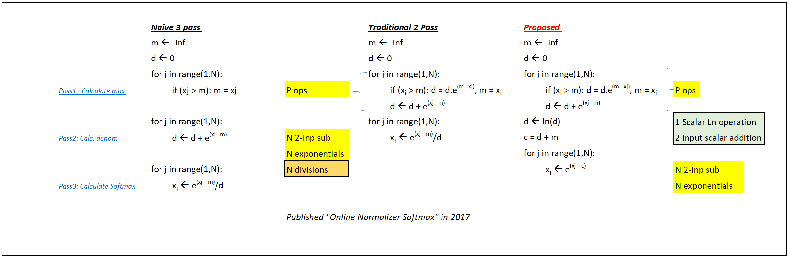
Computation steps – traditional vs ours
Naïve Implementation vs Traditional 2-pass. As shown, our approach saves on N² divisions, at the expense of adding 2N scalar operations (shown to the right).

Slide 26

Hardware Accelerator Design:
  Key focus - Ability to parallelize both Pass1 and Pass2
  This approach lets us save 1/3 of the data movement between the HW cores and the memory.
Different HW cores work on different segments of data, computing max and rolling sum. Different max-es and rolling sums are combined using:
Just e^{x}. Different HW units can read different
Memory rows independently computing e^{x}.
Notes:
1/3 of th data movement becomes more dominant for longer sequence length.

Slide 27
SoftestMax Dataflow
64 x 2B elements/cycle
x N
Pass 1: Calculate Max & ln(Sum)
X0
X1
X2
Xi
Xj
Xk
X29
X31
Max Tree
Normalize
X0- max_{run}
X1- max_{run}
X2- max_{run}
Xi- max_{run}
Xj- max_{run}
Xk- max_{run}
X14- max_{run}
X31- max_{run}
e_{norm}=
e ^{max_run-curr_max}
Rolling_Sum
e^{diff}
e^{diff}
e^{diff}
e^{diff}
e^{diff}
e^{diff}
e^{diff}
e^{diff}
X
Sum_{r} = Adder Tree (sum(xi-max_{run}))
+
x M
X0
X1
X2
Xi
Xj
Xk
X29
X31
Pass 2: Calculate Softmax Probabilities
X0- C
X1- C
X2-C
Xi- C
Xj- C
Xk- C
X14-C
X31- C
e^{diff}
e^{diff}
e^{diff}
e^{diff}
e^{diff}
e^{diff}
e^{diff}
e^{diff}
Notes:
Number of elements are bounded by the bandwidth
Normalize the previous sum w.rt to the current max.

Slide 28
Gordon Creek Test Chip
2 pass algorithm
  Pass 1 : calculate sum and max
  Pass 2: calculate softmax probabilities
Normalize:
Gordon Creek test chip, scheduled to be taped-in WW’08
(Sum, Max)
Tile 0
Sequence Length processed in parallel = N/M
Tile 0
Sequence Length processed in parallel = N/M
32B
Sequence Length processed in parallel = N/M
L0
L1
L2
Lm
MHA Accl
L0
L1
L2
Lm
L0
L1
L2
Lm
1MB
S
M
E
M
Pass 1
Inst 0
Pass 1
Inst 1
Pass 1
Inst 2
Pass 1
Inst M
Buffer
Array
48KB
MHA +
Softmax
Logic
Tile
Pass 1
Inst 0
Pass 1
Inst 1
Pass 1
Inst 2
Pass 1
Inst M
Pass 1
Inst 0
Pass 1
Inst 1
Pass 1
Inst 2
Pass 1
Inst M
Max0,
Sum
Max1,
Sum
Max2,
Sum
Max_{m},
Sum
256GB
/s/mm
Channel
Max0,
Sum
Max1,
Sum
Log_Normalizer
Max2,
Sum
Max_{m},
Sum
Max0,
Sum
Max1,
Sum
Max2,
Sum
Max_{m},
Sum
Normalize
Normalize 0
Normalize 0
L0
L1
L2
Lm
L0
L1
L2
Lm
Pass 2
Inst 0
Pass 2
Inst 1
Pass 2
Inst 2
Pass 2
Inst M
L0
L1
L2
Lm
32B
Pass 2
Inst 0
Pass 2
Inst 1
Pass 2
Inst 2
Pass 2
Inst M
Pass 2
Inst 0
Pass 2
Inst 1
Pass 2
Inst 2
Pass 2
Inst M
C= ln(Sum)+Max

Slide 29
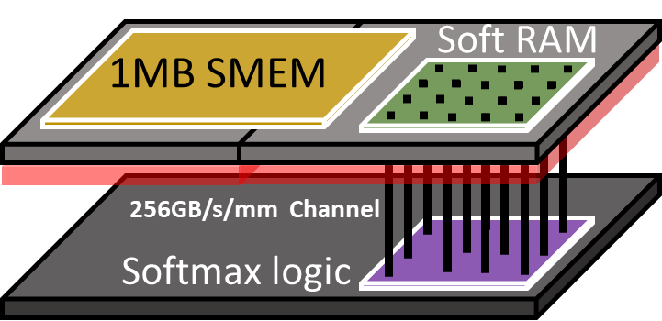
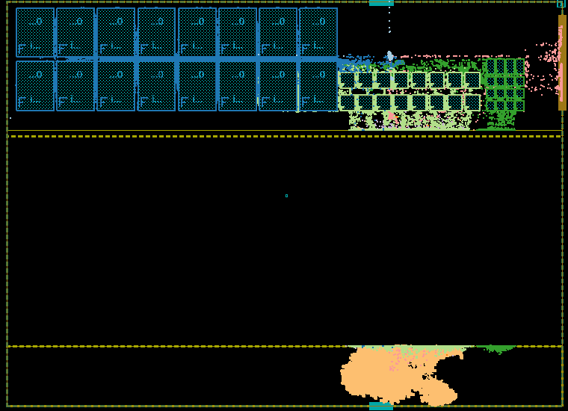
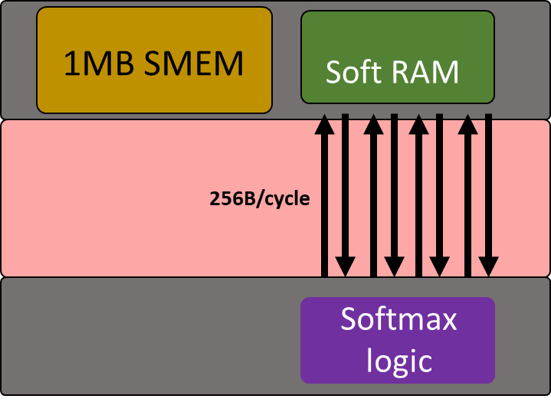
Softmax Layout
1850 um
1MB SMEM
48KB RAM
150um
400um
48KB
256B/cycle
Communication
Channel
(model <5um HBI)
1350 um
390k cells
Logic
(~390k cells)
180um
Notes:
This 1 Tile is part of a scalable MHA architecture includes softmax activation
We have built a 3D compliant solution in 2D (P1276.4 process)
Channel models a <5um HBI through 700um M15 and M17 metal layers
Showcase 256B/cycle/mm Bandwidth between logic and SRAM
5. Architecture Throughput: 64G softmax Ops /s running at 1GHz?

Slide 30
Performance and Comparison
Design | Cycles | Delay (us) | Power (mW) | Area scaled
Design with LUT, max freq (294MHz) | 201 | 0.67 | 1.712* | 47,011*
Design with DW, max freq (250MHz) | 199 | 0.79 | 1.408* | 47,614*
Design with LUT, iso freq (250MHz) | 201 | 0.80 | 1.15* | 37,005*
Proposed Design with DW max freq (500 MHz) | 129 | 0.09 | 35.96 | 23,662
Proposed Design with DW iso freq (250 MHz) | 129 | 0.51 | 35.96 | 23,662
Proposed Softmax Architecture is 2x area and 8x performance efficient (@max freq) at the cost of higher power consumption
*Reported at 45nm, scaled down to 3nm
Published Design Space Exploration for Softmax Implementations, ASAP’20

Slide 31
Power Consumption - Breakdown
Architecture Implementation generously uses Synopsys DW components.
e^{x} → 56% (including pass1 and pass2),
Subtractors → 31%,
Adder Tree →12%

Slide 32
Sparsity support for AI workloads.

