Slide 1
ASSY/PKG Analysis for NVL Sk

Slide 2
POR NVL-Sk
External opportunity :
GMH
GMH
UC P15 u-bump + TSV die :
PCD
FDIO
PCD
eLLC
FDIO
C-Die
P15 u-bump
C-Die
FDIO
FDIO
C-Die
C-Die
`
`
Passive TSV die
FDIO
eLLC
FDIO
SoIC-P :
P25~18 u-bump
TMV
SoIC-X :
?
?
?
P9 HBI
TDV
Internal solution :
C-die
FO-3D :
P9 HBI
P25 u-bump
eLLC effective region
TMV

Slide 3
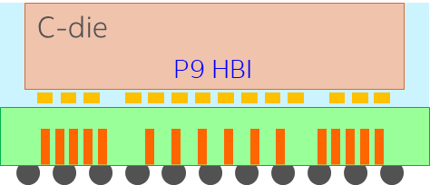
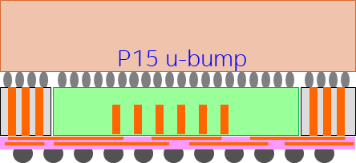
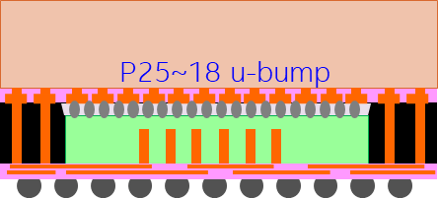
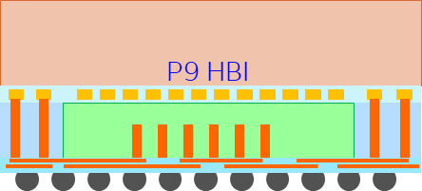
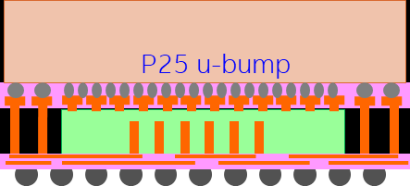
Performance vs Cost Analysis
Internal / External |  | Internal Approach |  | External Approach
Stacking Tech. |  | Foveros Direct |  | 3D u-bump (ASE) |  | SoIC-P (TSMC) |  | SoIC-X (TSMC) |  | FO-3D (SPIL)
 |  | Bond pitch : 9 um |  | Bond pitch : 15 um |  | Bond pitch : 18 um |  | Bond pitch : 9 um |  | Bond pitch : 25 um
Production Site | Cdie | Internal (1278) |  | Internal 1278 or TSMC N2 |  | TSMC N2 |  | TSMC N2 |  | Internal 1278 or TSMC N2
 | eLLC | Internal (1276) |  | Internal 1276 or TSMC N3 |  | TSMC N3 |  | TSMC N3 |  | Internal 1276 or TSMC N3
 | Assembly | P9 HBI / F2F / large eLLC |  | P15 uB / F2F / TSV die |  | P18 uB / F2F / TMV |  | P9 HBI / F2F / TDV |  | P25 uB / F2F / TMV
 | Mix-foundry | O |  | O |  | X |  | X |  | O
Die2Die Talk Performance Assume same HBI para for Intel & TSMC Estimated, not real Si data | Bond Pitch | 9 um | 833 bit/pJ | 15 um | 235 bit/pJ | 18 um | 190 bit/pJ | 9 um | 833 bit/pJ | 25 um | 80 bit/pJ
D2D Talk Performance Assume same HBI para for Intel & TSMC Estimated, not real Si data Energy eff. Is at 1V | Resistance / bond | 77 mΩ |  | 12.3 mΩ |  | 12.3 mΩ |  | 77 mΩ |  | 17.6 mΩ
 | Capacitance / bond | 2.7 fF |  | 8.5 fF |  | 10.5 fF |  | 2.7 fF |  | 25 fF
 | Imax DN% | 1X | 247 A/mm² | 0.2X | 57 A/mm² | 0.2X | 50 A/mm² | 1X | 247 A/mm² | 0.2X | 48 A/mm²
Cost Judgement is based on engineer sense, not cost model. | Sum | $$$$$ |  | $$ |  | $$ |  | $$$ |  | $
 | eLLC die | High |  | Fair
 | KGD sorting | High HDMT + Recon + sRDL rmv |  | Fair Double bumping + WLCP |  | Fair Sac-Pad + WLCP + Pad rmv |  | Low WLCP |  | Low Cluster-bump + WLCP
 | Assembly | High |  | Fair |  | Fair |  | High |  | Fair

Slide 4
NVL System Integration
twice a week NVL Package WG started for GEMS’ internal alignment.
Four external packaging solutions PrePOR (TSMC, SPIL and ASE) are reviewed for ATTD HBI-9 change candidates,
All with stacking options using either 2.5D Si Interposer or 2.3D organic Fanout (at 30% lower cost).
Low cost eLLC alternatives will be pursued (N6, N4, SF5, SF4) for P1276 replacement.
While a potential sort issue on ATTD HBI-9 was identified, a scalable uniform bumping/bonding test solution (being validated at TSMC and SPIL) was proposed to replace hybrid bumping (ATTD DOW-x POR).
GMES interface to DEG/CCG will add Mike Goldsmith to augment technology coverage.

