Slide 1
From Graphic Memory (component) to Client Compute (system)
Mike & DerChang, WW16.2’22
Problem Statement – The flag and the hindsight
The Engagement – some good going but some not so successful
Dual Drive initiative – Client Compute
Call of Duty – Platform, Technology, Design & Packaging

Slide 2
What is not Working
How it starts – Insufficient ADM capacity addressed by CapEx; cost doubles
The hindsight problem is package Integration – (our visibility of problem statement)
  Active Foveros: Large base die size with low utilization of high cost embedded active functionality
N6 vs. ADM
Component | Technology | Cell Size [µm²] | Die Size [mm²] | $/Wafer | Yield | Die Cost
BMG G10 448eu/512MB Q3’23 | P1222.61 (LRP’21) | 0.01458 | 366 | $ 8.0K | 77.3% | $ 69
 | P1222.61 (LRP’22) | 0.01458 | 366 | $16.6K | 77.3% | $143
 | TSMC N6 | 0.02736 | 274 | $10.5K | 82.5% | $ 62
GPU
GPU
1. N6 for 16nm SOC + ADM
2. ODI-like for Foveros
GPU
GPU
36µm µB FOV + 16nm SoC + ADM + MiM
TSMC 6nm SoC
Substrate
Substrate
Processing cost:
ADM: ¢15/mm²
Logic/SRAM: ¢25/mm²
+ Interposer: ¢ 1/mm²
Active Foveros: ¢41/mm²
Foveros base die
ADM: 100mm²
SOC: 100mm²
+ Interposer: 100mm²
Active FOV: $123 on 300mm²
Fan Out mold with Embedded SRAM
SRAM: 100mm²
LOGIC: 100mm²
+ ___ Interposer: 100mm²
Fan Out mold : $51 on 300mm²
+ Emb. Chiplet

Slide 3
Update to GEMS-SOTU
P1222.61/P1222.7 dual-drive initiative: Alternative SOC + HD SRAM + 3DIC technology
  TSMC N6 with ODI-like packaging is pursued due to 3Cs’ superiority
  Evaluating Samsung 5LPP as a strategic maneuver
Kick-off sessions with product owners and memory architects from AxG and CCG.
  Gen 1 dual-drive is deemed too late to be cost-effective for 2023 PRQ intercept
  Both teams seem understanding foundry capability but SoA packaging ignorant
  Team PTL/NVL actively seek for dual-drive solutions for eRAM/packaging alternatives but do not have resources to commit to supporting dual drive initiative.
Expected to close go-nogo Task Force by mid Q2
  Feasibility deep dive, managing risks and developing dual-drive strategy for 2024+ intercept
This engagement leads a path to compute memory scaling and disaggregation strategy development for 3nm and beyond.

Slide 4
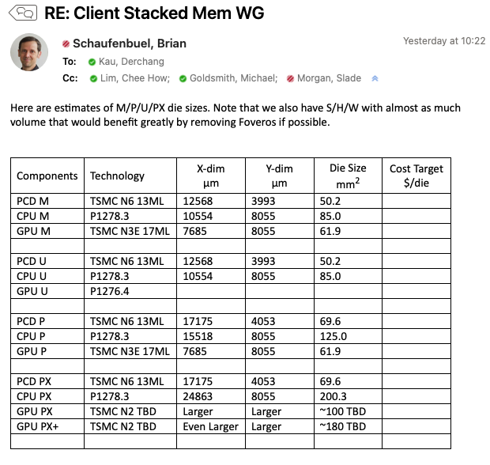
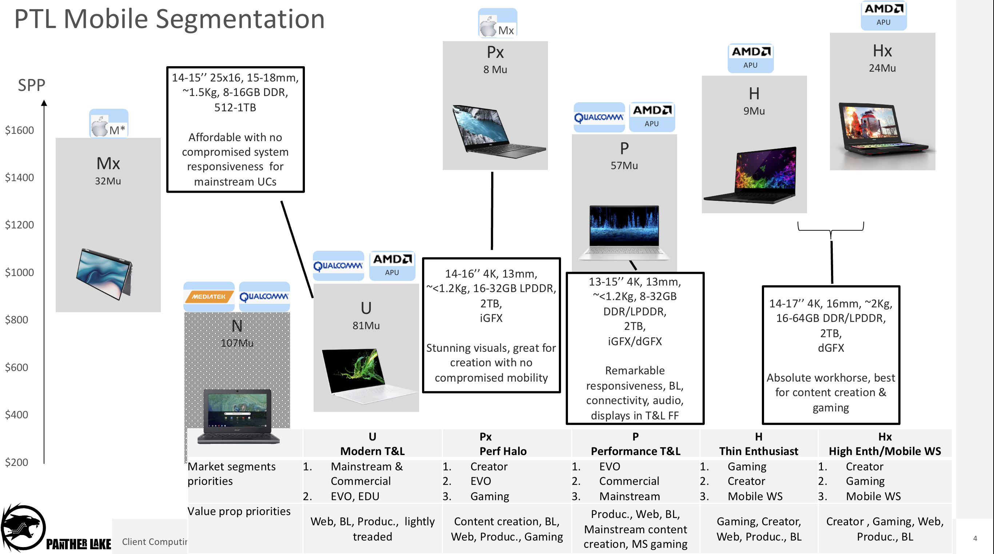

Slide 5
Estimate Die layouts (per Brian 04/11 ’22)
~12.4
P1222 Interposer
CPU 18A 8.1x24.9
PTL-M
PTL-PX/PX+
~12.4
26mm
A
A
P1222 Interposer
Reticle
CPU 18A 8.1x10.6
P1222 Interposer
(PLT-M)
P1222 Interposer
CPU 18A
B
B’
SOC N6 12.9x4.1
33mm
P1222 Interposer
SOC N6 17.2x4.1
P1222 Interposer
P1222 Interposer
GPU N3E 8.1x7.7
GPU N3E
~18.5
A’
GPU N3E ~12.1x8.3
~33
A’
PX+: GPU N3E ~12.1x14.9
SOC N6
CPU 18A
Full-Si Interposer has low LFU on p1222; PX+ exceeds reticle
P1222 Interposer
B
B’

Slide 6
Call of Duty –
Dual Drive for CCG 2024~2025
Dual Drive Initiative 1: N6 SRAM for ADM
Dual Drive Initiative 2: ODI-like OSAT 3C for Foveros
Dual Drive Initiative 3: DTC (and beyond) for MiM

Slide 7
InFO-LSI Mockup Flow
A
SOC N6
1
Carrier Prep
Die Reconst.
RDL, Cu Pillar Platting
Em. Chiplets Attachment
Bridge
GPU N3E
CPU 18A
WoW
10 µm
HB
SOC N6
GPU N3E
N6 SOC
25µm µB
2
N6 SOC
5
N6 SRAM
DTC
DTC
N6 Memory
DTC
Bridge
N6 SRAM
DTC
6
Bridge
25µm µB
A
B
A’
B’
N3E GPU
3
N3E GPU
DTC
DTC
WoW
10 µm
HB
Mold, RDL, Bumping
A’
4
18A CPU
SOC N6
CPU 18A
C4
80µm C4
DTC
N6 SRAM
B
B’

Slide 8
FO-EB-T Mockup Flow
2
N6 SRAM
A
GPU N3E
CPU 18A
3
N6 SOC
B
SOC N6 12.9x4.1
B’
1
Carrier Prep
RDL, Cu Pillar
Em. Chiplets Attachment
Mold, RDL
GPU N3E
DTC
N6 Memory
WoW
10 µm HB
N6 SOC
N6 SRAM
N3E GPU
25µm µB
A
A’
4
N3E GPU
Micro Bumping
DTC
DTC
A’
5
18A CPU
GPU N3E
CPU 18A
Top Die Attachment
DTC
C4
Top Carrier Bond,
Back Carrier Debond.
Bumping
SOC N6
B
B’
80µm C4

Slide 9
Packaging Flow Comparison
Passive Foveros: High cost process tools for TSV and Interconnect in Fab
Active Foveros: Large base die size with low utilization of high cost embedded active functionality
C4
Base wafer
TSV
Logic, SoC and/or ADM
Interconnect,
µBump
Chiplets attachment
Carrier bond, TSV Reveal
Bumping
InFO-L: lowest cost of making but higher price judged due to SiFO vs. OSAT margin delta + chip first yield loss vulnerability
C4
Carrier Prep
Die Reconst.
RDL, Cu Pillar Platting
Em. Chiplets Attachment
Mold, RDL, Bumping
FO-EB-T: Cost of making slightly higher than InFO-L due to one additional wafer bonding and debonding processes.
Top Carrier Bond,
Back Carrier Debond.
Bumping
C4
Carrier Prep
RDL,
Cu Pillar
Em. Chiplets Attachment
Mold, RDL
Micro Bumping
Top Die Attachment

Slide 10
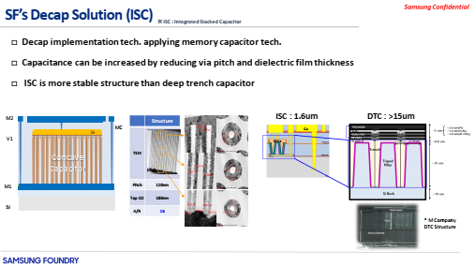
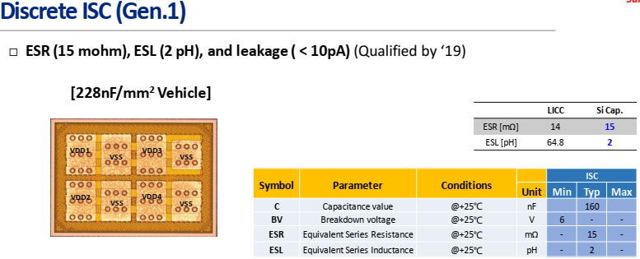
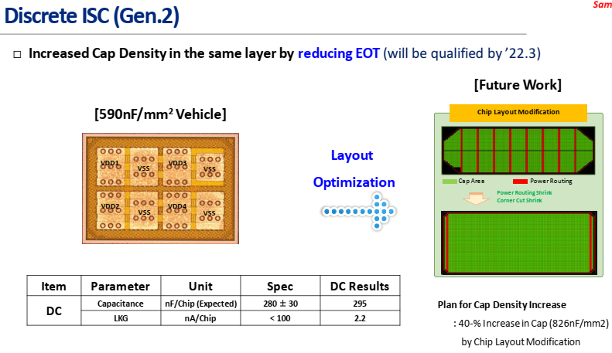
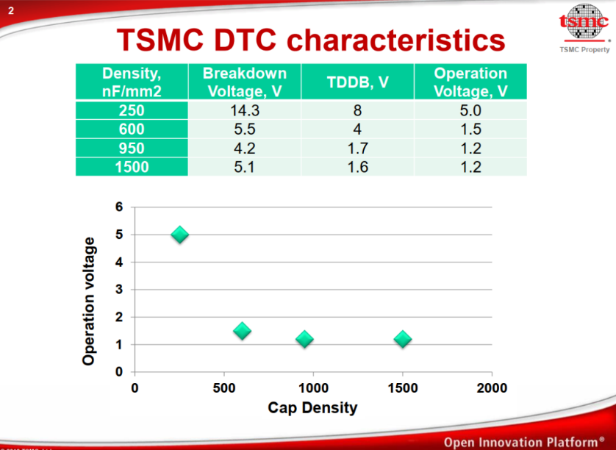
DTC vs. ISC

Slide 11

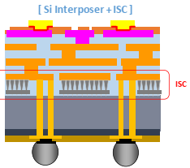

De-cap flow options
Wafer Start
FEOL
MiM in BEOL
Fab-Out
Inteconnect
Substrate +DTC
Wafer Start
DTC in FEOL
BEOL
Fab-Out
Inteconnect + MiM or SC
Substrate
Fab-Out
Sort
Inteconnect
Stacking
Substrate
DTC, MiM, SC
Inteconnect + MiM or SC
Substrate + DTC
Fab-Out
Sort
ow-SC or sc-MiM
Pad

Slide 12
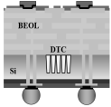
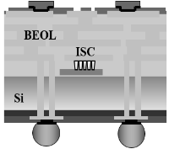
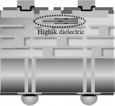
Estimated Cost of making: MiM, Trench Cap, Stacked Cap
TSMC DTC
HB: based on 3DNAND -- $30
Grinding: $ ~50
TSV: ~$100
High dope CZ wafer: ~$100
DTC: ~¢10 per nF/mm²
Market Intelligence:
Graphcore price low $1000
Samsung ISC :
ECTC20
OSAT
SPIL QTR roadmap ’24
BE-MIM
WoW DTC/ISC
Cost Adder [$/wfr]
Supplier Engagement needed
On-Wafer ISC from Tier-1 DRAM suppliers
Tier-2 DRAM : Nanya, PSMC, Winbond
Staircase MiM 3D AND suppliers
Tier-1 NAND : Solidigm (NSG)
Tier-2 NAND: Macronix
On-Wafer ISC, Staircase MiM (idea stage)
Cap Density [nF/mm²]

