Slide 1
Disaggregated Cache Memory Solutions for Performing Client Compute
Dany Ly-Gagnon, Jason Zhang & DerChang Kau
Team FTE Pathfinding, Jan/27/23
Electric Pond: A 2MB one channel cacheline access test chip and scalability in pJ/b, τ_{acc} vs. capacity
Disaggregated SRAM and Packaging aggregation choices
Benchmark – SRAM and Advanced Fanout Package
Foundry Engineering Group Content Expertise

Slide 2
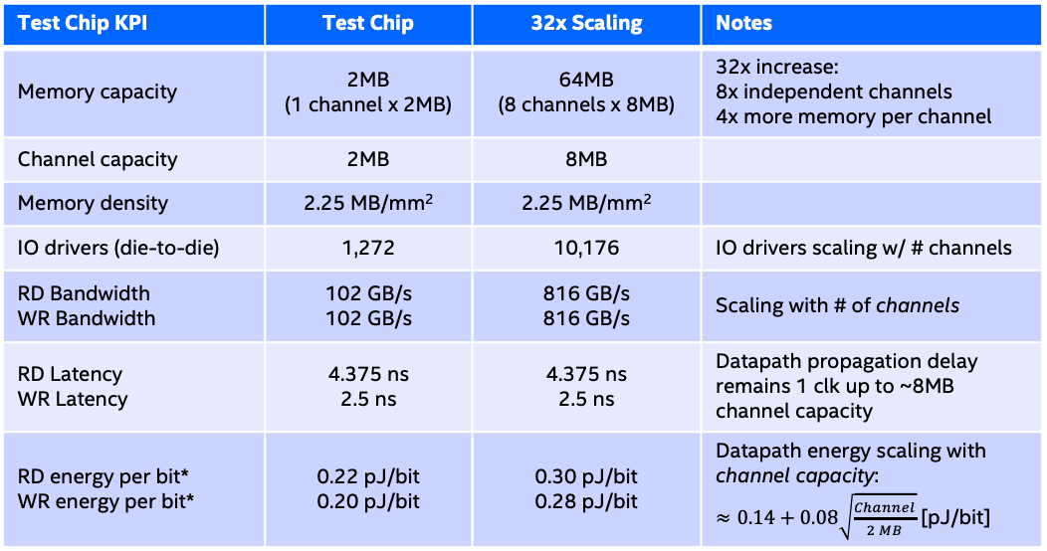
Electric Pond - Summary
Top Die
(Controller)
Controller
SRAM
SRAM
MUX
SRAM
SRAM
RDL layer
SRAM
Substrate
Embedded Die
(SRAM)
SRAM
SRAM
SRAM
SRAM
Power & test signals to bottom die
Power & test signals to top die
Drivers
Drivers
Test Chip KPI | Test Chip | 32x Scaling | Notes
Memory capacity | 2MB (1 channel x 2MB) | 64MB (8 channels x 8MB) | 32x increase: 8x independent channels 4x more memory per channel
Channel capacity | 2MB | 8MB
Memory density | 2.25 MB/mm² | 2.25 MB/mm²
IO drivers (die-to-die) | 1,272 | 10,176 | IO drivers scaling w/ # channels
RD Bandwidth WR Bandwidth | 102 GB/s 102 GB/s | 816 GB/s 816 GB/s | Scaling with # of channels
RD Latency WR Latency | 4.375 ns 2.5 ns | 4.375 ns 2.5 ns | Datapath propagation delay remains 1 clk up to ~8MB channel capacity
RD energy per bit* WR energy per bit* | 0.22 pJ/bit 0.20 pJ/bit | 0.30 pJ/bit 0.28 pJ/bit | Datapath energy scaling with channel capacity: $≈0.14+0.08\sqrt{\frac{Channel}{2 MB}}$ [pJ/bit]
Electric Pond Testchip
Technology: TSMC N6
Memory density: 2.25 MB/mm²
Databus width: 64B cache line
Die-to-die link (data, cmd, red): 1272 pads @ 1.6GT/s
Package Assembly
Technology: SPIL FO-EB (Fan-Out, Embedded Bridge)
Face-to-Face integration between top die and embedded die
Micro-bump pitch @ 25µm, 1.78K bumps per mm² in HCP
RDL layer: 1 layer for routing test signals & power
(*) preliminary

Slide 3


Disaggregated SRAM & Back End 3D Packaging Aggregation
Cost
CPU
(FE-3D Chiplets)
GPU
(FE-3D Chiplets)
CPU
(FE-3D Chiplets)
GPU
(FE-3D Chiplets)
SRAM
(single layer or Cube)
Top ➔
Base ➔
SRAM+TSV
DTC
RAM + TSV w/ Opt. IPD (MiM/DTC etc.)
Adv. monolithic Logic tech (CPU, GPU) with TSV or Tyche
Substrate
Substrate
Substrate
Top | I18A, N3E/N2, SF2P | I18A, N3E/N2, SF2P | I3, N4P/N6, SF4/SF5
Base | N4P/N6(DTC/MiM), SF4/SF5(ISC) | ADM(MiM), N4P/N6 (DTC/MiM), SF4/SF5 (ISC) | I18A?, N3E/N2, SF2P?
Package | SPIL/ASE/Amkor/JCET, TSMC | Intel/TSMC/SF, SPIL/ ASE/Amkor/PTI/JCET | TSMC/SF/Intel
Advanced logic technologies; chiplets including single layer and heterogeneously stacked (HBI)
Mainstream matured technologies; active chiplets, bridge, and/or passives with TSV
Mainstream matured technologies; chiplets with TSV, cubing using hybrid bond integration

Slide 4
0.0200
20
0.0233
6
100
40
1.2
0.0267
75
1.1
9
80
40
1.0
0.0300
12
50
80
160
1.25
0.07
4
3
2
1
160
80
40
1
0.06
3
16
0.75
0.05
2
6
8
0.5
0.75
0.04
4
4
9
1.0
6
2
1.25
8

Slide 5
Who are We
Foundry Technology & Engineering (FTE by Changhong Dai) is the engineering branch of Global External Manufacturing and Sourcing (GEMS by Hai Wang) under Stu Pann’s Corporate Planning Group (CPG)
FTE provides end to end engineering coverage and handshake to external suppliers from pathfinding to PRQ. Once PRQ’d, External Manufacturing & Production (EMP by Angelo Pinto, manufacturing branch of GEMS) will pickup the ownership for product delivery.
External technology team on disaggregated cache memories
Pathfinding – DerChang Kau
Platform – Mike Goldsmith
Logic – Andy Wei
Memory – Dany Ly-Gagnon
Packaging – Jason Zhang
Design – Ping Liu, Jiajing Wang

