Slide 1
Disaggregated Cache Memory Solutions for
Performing Client Compute
Team FTE Pathfinding, Jan/27/23
Electric Pond: A 2MB one channel cacheline access test chip and scalability in pJ/b, τ_{acc} vs. capacity
Disaggregated SRAM and Package aggregation choices
Benchmark – SRAM and advanced Fanout Package
Foundry Engineering Group Content Expertise

Slide 2
Electric Pond - Summary
Top Die
(Controller)
Controller
SRAM
SRAM
MUX
SRAM
SRAM
RDL layer
SRAM
Substrate
Embedded Die
(SRAM)
SRAM
SRAM
SRAM
SRAM
Power & test signals to bottom die
Power & test signals to top die
Drivers
Bank groups
Drivers
Electric Pond Testchip
  Technology: TSMC N6
  Memory density: 2.25 MB/mm²
  Die-to-die link (data, cmd, red) : 1272 pads @ 1.6GT/s
Package Assembly
  Technology: SPIL FO-EB (Fan-Out, embedded bridge)
  Face-to-Face integration between top die and embedded die
  Microbump pitch: 25um
  Microbump density: >1.7k/mm²
  RDL layer: 1 layer for routing test signals & power
Test Chip KPI | Test Chip | 32x Scaling | Notes
Memory capacity | 1 channel x 2MB | 8 channels x 8MB | 32x capacity
Bank Groups | 2 | 2
Memory banks | 4 | 16 | 4x banks
Memory density | 2.25 MB/mm² | 2.25 MB/mm²
IO drivers (die-to-die) | 1,272 | 10,176 | IO drivers scaling w/ # channels
RD Bandwidth WR Bandwidth | 102 GB/s 102 GB/s | 816 GB/s 816 GB/s | 8x higher bandwidth
RD Latency WR Latency | 4.375 ns 2.5 ns | 4.375 ns 2.5 ns | Using same pipeline
RD energy per bit* WR energy per bit* | 0.22 pJ/bit 0.20 pJ/bit | 0.30 pJ/bit 0.28 pJ/bit | Datapath energy scaling: 0.08 pJ/bit → 0.16pJ/bit (SRAM, IO drivers not scaling)
(*) preliminary

Slide 3

Disaggregated SRAM & Back End 3D Packaging Aggregation
  Cost
CPU
(FE-3D Chiplets)
GPU
(FE-3D Chiplets)
CPU
(FE-3D Chiplets)
GPU
(FE-3D Chiplets)
SRAM
(single layer or Cube)
Top ➔
Base ➔
SRAM+TSV
DTC
RAM + TSV w/ Opt. IPD (MiM/DTC etc.)
Adv. monolithic Logic tech (CPU, GPU) with TSV or Tyche
Substrate
Substrate
Substrate
Top | I18A, N3E/N2, SF2P | I18A, N3E/N2, SF2P | I3, N4P/N6, SF4/SF5
Base | N4P/N6(DTC/MiM), SF4/SF5(ISC) | ADM(MiM), N4P/N6 (DTC/MiM), SF4/SF5 (ISC) | I18A?, N3E/N2, SF2P?
Package | SPIL/ASE/Amkor/JCET, TSMC | Intel/TSMC/SF, SPIL/ ASE/Amkor/PTI/JCET | TSMC/SF/Intel
Advanced logic technologies; chiplets including single layer and heterogeneously stacked (HBI)
Mainstream matured technologies; active chiplets, bridge, and/or passives with TSV
Mainstream matured technologies; chiplets with TSV, cubing using hybrid bond integration

Slide 4
0.0200
20
0.0233
6
100
40
1.2
0.0267
75
1.1
9
80
40
1.0
0.0300
12
50
80
160
1.25
0.07
4
3
2
1
160
80
40
1
0.06
3
16
0.75
0.05
2
6
8
0.5
0.75
0.04
4
4
9
1.0
6
2
1.25
8

Slide 5
Who are We
Foundry Technology & Engineering (FTE by Changhong Dai) is the engineering branch of Global External Manufacturing and Sourcing (GEMS by Hai Wang) under Stu Pann’s Corporate Planning Group (CPG)
FTE provides end to end engineering coverage and handshake to external suppliers from pathfinding to PRQ. Once PRQ’d, External Manufacturing & Production (EMP by Angelo Pinto, manufacturing branch of GEMS) will pickup the ownership for product delivery.
External technology contributors to disaggregated cache memories for CCG
  Pathfinding – DerChang Kau
  Platform – Mike Goldsmith
  Logic – Andy Wei
  Memory – Dany Ly-Gagnon
  Packaging – Jason Zhang
  Design – Ping Liu, Jiajing Wang

Slide 6
Supporting Materials

Slide 7
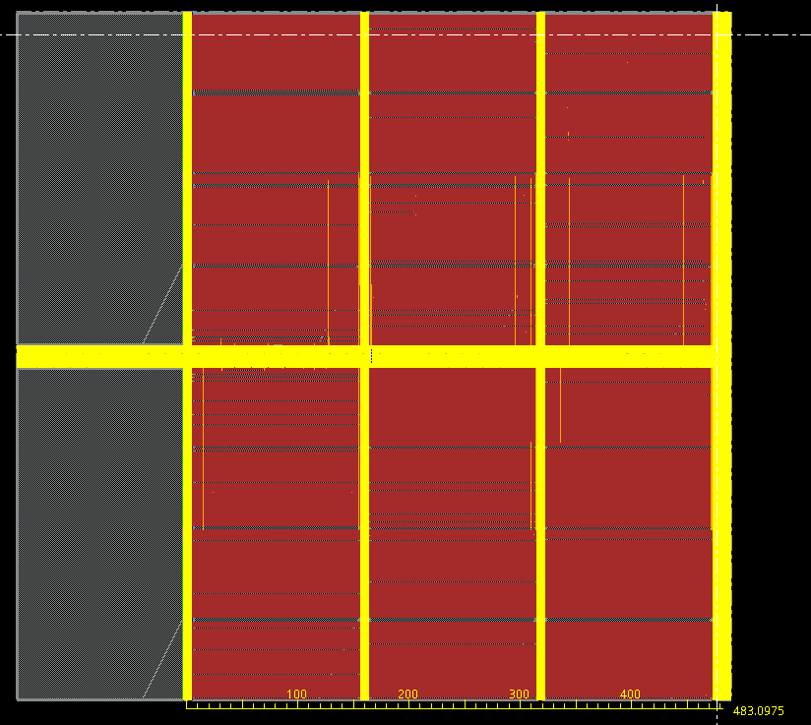
Energy & Latency
~600um
CTRL
Test engine / MBIST
TX/RX
SRAM
MUX
TX
RX
IO driver
ff
ff
uB
uB
1 cyc
0.044 pJ/bit
RX
TX
1 cyc
0.075 pJ/bit
IO driver
ff
ff
~540um (~200ps)
GIO
1 cyc
0.080 pJ/bit
MUX
MUX
ff
ff
~10gates + ~500um
(~370ps)
2 cyc
0.080 pJ/bit
BK
ff
Latency | Cycles delay (@1.6GHz) |  | Latency (ns)
 | Read | Write | Read | Write
Latency (pad-to-pad) | 7 | 4 | 4.375 | 2.5
SRAM
D
Q
2 cyc
RD: 0.064 pJ/bit
WR: 0.074 pJ/bit
SRAM
RD/WR latency
  RD latency is 4.375ns (7 cycles at 1.6GHz)
  WR latency is 2.5ns (4 cycles at 1.6GHz)
  SRAM using 800MHz clk (2 cycles per memory operation)
  2 Bank Groups alternating access
RD/WR energy per bit (prelim estimates)
  Projecting 0.22 pJ/bit
  SRAM macro energy is ~30-40%
 | Energy per bit [pJ/bit] |  | Notes
 | Read | Write
Driver | 0.075 (TX only) | 0.044 (RX only) | Best / Worst: 0.047 / 0.070 pJ/bit TT/0.75V/105C
Datapath | 0.080* | 0.080* | Estimate (scaled for full datapath) TT/0.75V/85C
SRAM (Macro) | 0.064 | 0.074 | Active power TT/0.75V/85C
Total | 0.219 | 0.198

Slide 9
Disaggregated SRAM & Back End 3D Packaging Aggregation
Cost
CPU
(FE-3D Chiplets)
GPU
(FE-3D Chiplets)
CPU
(FE-3D Chiplets)
GPU
(FE-3D Chiplets)
SRAM
(single layer or Cube)
SRAM+TSV
DTC
RAM + TSV w/ Opt. IPD (MiM/DTC etc.)
Adv. monolithic Logic tech (CPU, GPU) with TSV or Tyche
Substrate
Substrate
Substrate
Top | I18A/I16A, N3E/N2, SF2P | I18A/I16A, N3E/N2, SF2P | I3, N4P/N6, SF4/SF5
Base | N4P/N6(DTC/MiM), SF4/SF5(ISC) | ADM(MiM), N4P/N6 (DTC/MiM), SF4/SF5 (ISC) | I18A/I16A, N3E/N2, SF2P
Package | SPIL/ASE/Amkor/JCET, TSMC | Intel/TSMC/SF, SPIL/ ASE/Amkor/PTI/JCET | TSMC/SF/Intel

Slide 10
Cost Comparison
Active Foveros: Large base die size with low utilization of high cost embedded active functionality
GPU
GPU
1. N6 for 16nm SOC + ADM
2. ODI-like for Foveros
GPU
GPU
36µm µB FOV + 16nm SoC + ADM + MiM
TSMC 6nm SoC
Substrate
Substrate
N6 SRAM vs. ADM
Component | Technology | Cell Size [µm²] | Die Size [mm²] | $/Wafer | MB/mm² | Yield | Die Cost
BMG G10 448eu/512MB Q3’23 | P1222.61 (LRP’22) | 0.01458 | 366 | $16.6K | 1.40 | 77.3% | $143
 | TSMC N6 | 0.02736 | 274 | $10.5K | 1.87 | 82.5% | $ 62

Slide 11
Package Selection
Cost
IP Integration Scheme (connectivity, speed, energy)
Capability

Slide 12
InFO-LSI Mockup Flow
A
SOC N6
1
Carrier Prep
Die Reconst.
RDL, Cu Pillar Platting
Em. Chiplets Attachment
Bridge
GPU N3E
CPU 18A
WoW
10 µm
HB
SOC N6
GPU N3E
N6 SOC
25µm µB
2
N6 SOC
5
N6 SRAM
DTC
DTC
N6 Memory
DTC
Bridge
N6 SRAM
DTC
6
Bridge
25µm µB
A
B
A’
B’
N3E GPU
3
N3E GPU
DTC
DTC
WoW
10 µm
HB
Mold, RDL, Bumping
A’
4
18A CPU
SOC N6
CPU 18A
C4
80µm C4
DTC
N6 SRAM
B
B’

Slide 13
FO-EB-T/CoWoS-LSI Mockup Flow
2
N6 SRAM
A
GPU N3E
CPU 18A
3
N6 SOC
B
SOC N6 12.9x4.1
B’
1
Carrier Prep
RDL, Cu Pillar
Em. Chiplets Attachment
Mold, RDL
GPU N3E
DTC
N6 Memory
WoW
10 µm HB
N6 SOC
N6 SRAM
N3E GPU
25µm µB
A
A’
4
N3E GPU
Micro Bumping
DTC
DTC
A’
5
18A CPU
GPU N3E
CPU 18A
Top Die Attachment
DTC
C4
Top Carrier Bond,
Back Carrier Debond.
Bumping
SOC N6
B
B’
80µm C4

Slide 14
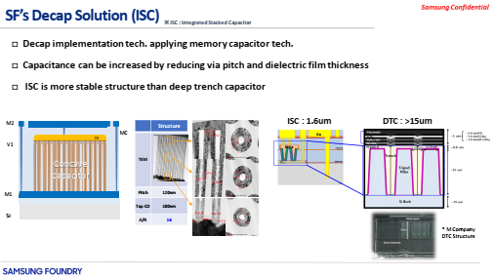
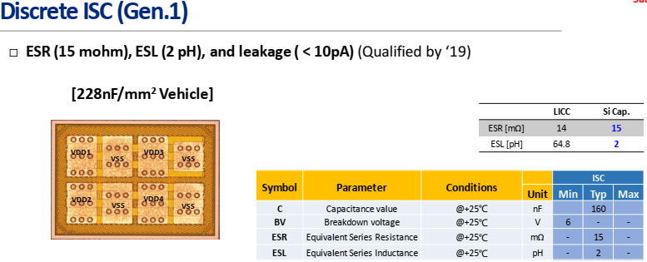
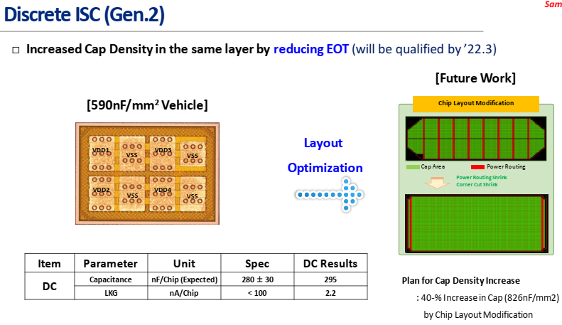
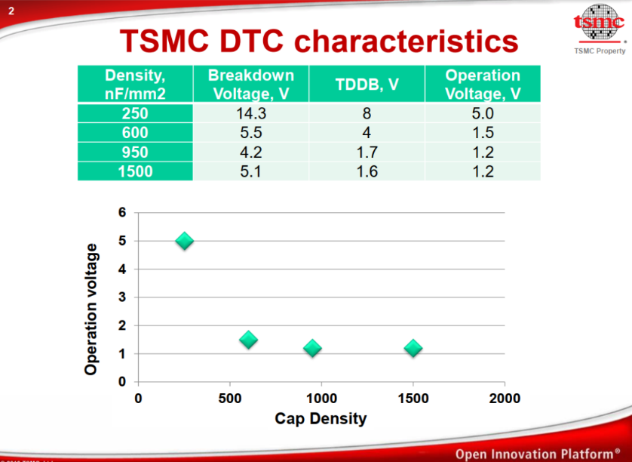
DTC vs. ISC

Slide 15
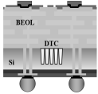
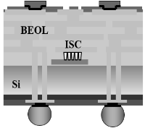
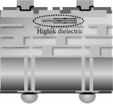
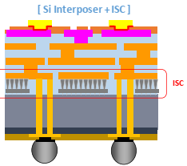

Estimated Cost of making: MiM, Trench Cap, Stacked Cap
TSMC DTC
HB: based on 3DNAND -- $30
Grinding: $ ~50
TSV: ~$100
High dope CZ wafer: ~$100
DTC: ~¢10 per nF/mm²
Market Intelligence:
Graphcore price low $1000
Samsung ISC :
ECTC20
OSAT
SPIL QTR roadmap ’24
BE-MIM
WoW DTC/ISC
Cost Adder [$/wfr]
Supplier Engagement needed
On-Wafer ISC from Tier-1 DRAM suppliers
Tier-2 DRAM : Nanya, PSMC, Winbond
Staircase MiM 3D AND suppliers
Tier-1 NAND : Solidigm (NSG)
Tier-2 NAND: Macronix
On-Wafer ISC, Staircase MiM (idea stage)
Cap Density [nF/mm²]

Slide 17
From Graphic Memory (component) to Client Compute (system)
Mike & DerChang, WW16.2’22
Problem Statement – The flag and the hindsight
The Engagement – some good going but some not so successful
Dual Drive initiative – Client Compute
Call of Duty – Platform, Technology, Design & Packaging

Slide 18
Update to GEMS-SOTU
P1222.61/P1222.7 dual-drive initiative: Alternative SOC + HD SRAM + 3DIC technology
  TSMC N6 with ODI-like packaging is pursued due to 3Cs’ superiority
  Evaluating Samsung 5LPP as a strategic maneuver
Kick-off sessions with product owners and memory architects from AxG and CCG.
  Gen 1 dual-drive is deemed too late to be cost-effective for 2023 PRQ intercept
  Both teams seem understanding foundry capability but SoA packaging ignorant
  Team PTL/NVL actively seek for dual-drive solutions for eRAM/packaging alternatives but do not have resources to commit to supporting dual drive initiative.
Expected to close go-nogo Task Force by mid Q2
  Feasibility deep dive, managing risks and developing dual-drive strategy for 2024+ intercept
This engagement leads a path to compute memory scaling and disaggregation strategy development for 3nm and beyond.

Slide 19
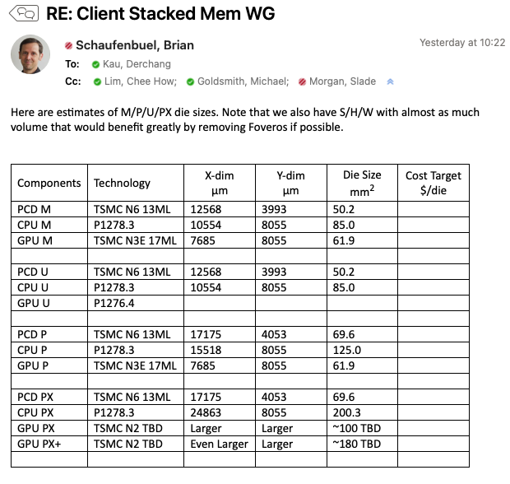
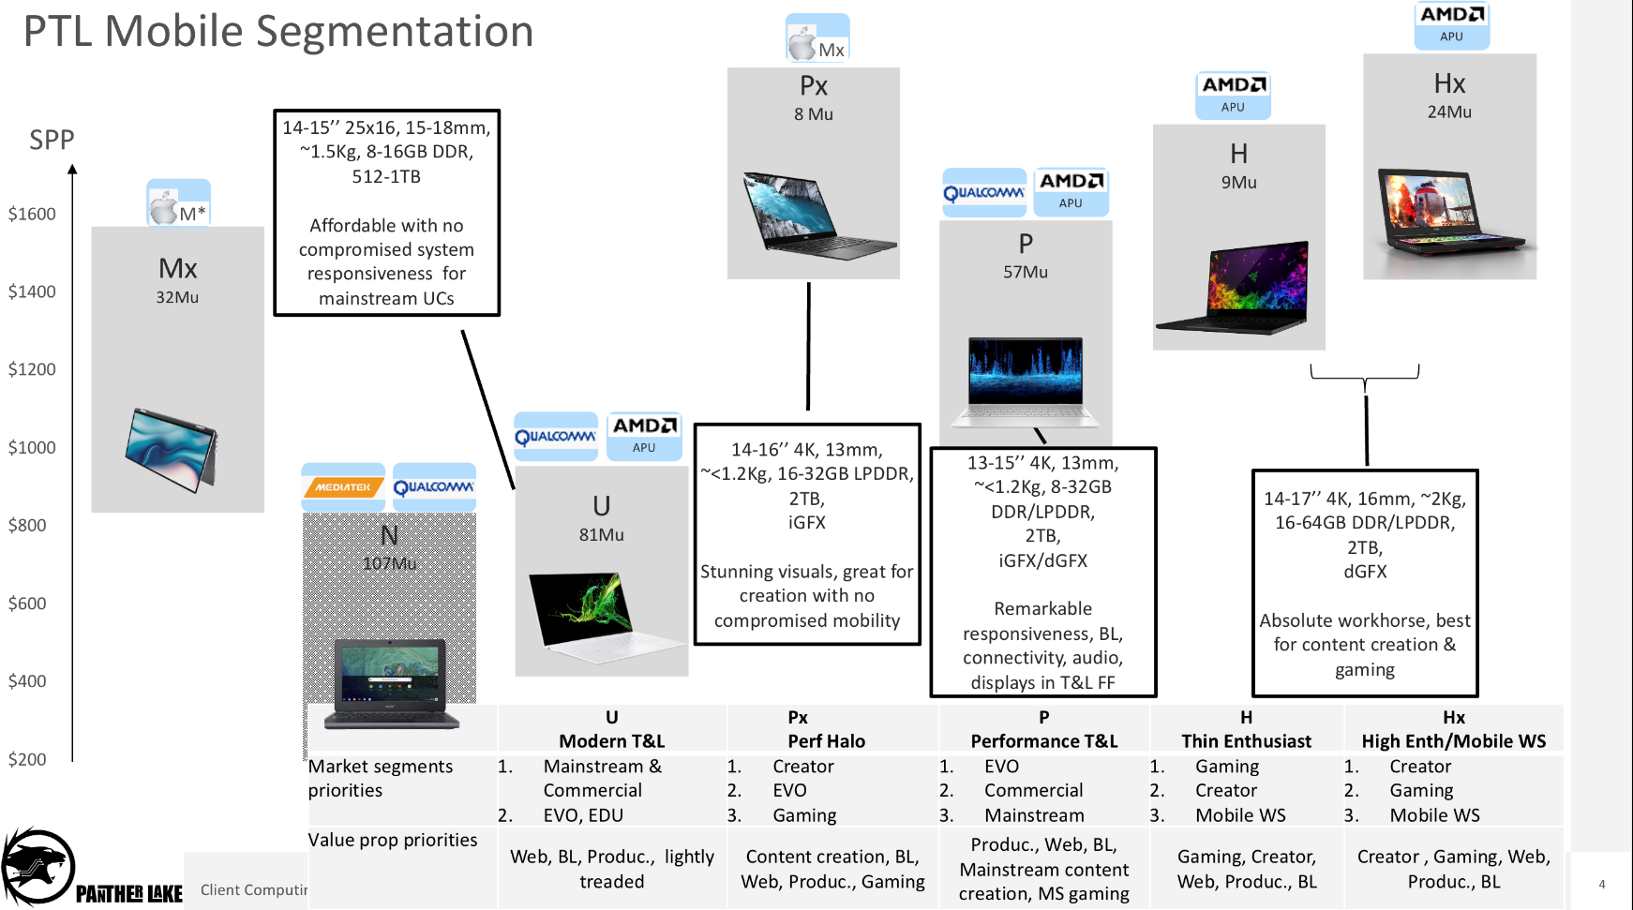

Slide 20
Estimate Die layouts (per Brian 04/11 ’22)
~12.4
P1222 Interposer
CPU 18A 8.1x24.9
PTL-M
PTL-PX/PX+
~12.4
26mm
A
A
P1222 Interposer
Reticle
CPU 18A 8.1x10.6
P1222 Interposer
(PLT-M)
P1222 Interposer
CPU 18A
B
B’
SOC N6 12.9x4.1
33mm
P1222 Interposer
SOC N6 17.2x4.1
P1222 Interposer
P1222 Interposer
GPU N3E 8.1x7.7
GPU N3E
~18.5
A’
GPU N3E ~12.1x8.3
~33
A’
PX+: GPU N3E ~12.1x14.9
SOC N6
CPU 18A
Full-Si Interposer has low LFU on p1222; PX+ exceeds reticle
P1222 Interposer
B
B’

Slide 21
Call of Duty –
Dual Drive for CCG 2024~2025
Dual Drive Initiative 1: N6 SRAM for ADM
Dual Drive Initiative 2: ODI-like OSAT 3C for Foveros
Dual Drive Initiative 3: DTC (and beyond) for MiM

Slide 22
InFO-LSI Mockup Flow
A
SOC N6
1
Carrier Prep
Die Reconst.
RDL, Cu Pillar Platting
Em. Chiplets Attachment
Bridge
GPU N3E
CPU 18A
WoW
10 µm
HB
SOC N6
GPU N3E
N6 SOC
25µm µB
2
N6 SOC
5
N6 SRAM
DTC
DTC
N6 Memory
DTC
Bridge
N6 SRAM
DTC
6
Bridge
25µm µB
A
B
A’
B’
N3E GPU
3
N3E GPU
DTC
DTC
WoW
10 µm
HB
Mold, RDL, Bumping
A’
4
18A CPU
SOC N6
CPU 18A
C4
80µm C4
DTC
N6 SRAM
B
B’

Slide 23
FO-EB-T Mockup Flow
2
N6 SRAM
A
GPU N3E
CPU 18A
3
N6 SOC
B
SOC N6 12.9x4.1
B’
1
Carrier Prep
RDL, Cu Pillar
Em. Chiplets Attachment
Mold, RDL
GPU N3E
DTC
N6 Memory
WoW
10 µm HB
N6 SOC
N6 SRAM
N3E GPU
25µm µB
A
A’
4
N3E GPU
Micro Bumping
DTC
DTC
A’
5
18A CPU
GPU N3E
CPU 18A
Top Die Attachment
DTC
C4
Top Carrier Bond,
Back Carrier Debond.
Bumping
SOC N6
B
B’
80µm C4

Slide 24
Packaging Flow Comparison
Passive Foveros: High cost process tools for TSV and Interconnect in Fab
Active Foveros: Large base die size with low utilization of high cost embedded active functionality
C4
Base wafer
TSV
Logic, SoC and/or ADM
Interconnect,
µBump
Chiplets attachment
Carrier bond, TSV Reveal
Bumping
InFO-L: lowest cost of making but higher price judged due to SiFO vs. OSAT margin delta + chip first yield loss vulnerability
C4
Carrier Prep
Die Reconst.
RDL, Cu Pillar Platting
Em. Chiplets Attachment
Mold, RDL, Bumping
FO-EB-T: Cost of making slightly higher than InFO-L due to one additional wafer bonding and debonding processes.
Top Carrier Bond,
Back Carrier Debond.
Bumping
C4
Carrier Prep
RDL,
Cu Pillar
Em. Chiplets Attachment
Mold, RDL
Micro Bumping
Top Die Attachment

Slide 25

De-cap flow options
Wafer Start
FEOL
MiM in BEOL
Fab-Out
Inteconnect
Substrate +DTC
Wafer Start
DTC in FEOL
BEOL
Fab-Out
Inteconnect + MiM or SC
Substrate
Fab-Out
Sort
Inteconnect
Stacking
Substrate
DTC, MiM, SC
Inteconnect + MiM or SC
Substrate + DTC
Fab-Out
Sort
ow-SC or sc-MiM
Pad

