Slide 1
Roadmap Discussion
WW12’22

Slide 2
Client CPU IP Roadmap WW50’21
IP Name (POR Process Node)
ST Peak Freq (PV Push) | Width | Vector Size | Hyperthreading
L1 D / L1 I Capacity | L2 Capacity |  | L3 Slice per Core
ST /MT IPC CAGR | ST Cdyn G2G CAGR | MT Cdyn G2G CAGR | Inner Core Area G2G CAGR
Salient Feature | IP VTI |  | Lead SoC PRQ
Left edge roughly aligned to SoC launch
2019 | 2020 |  | 2021 |  | 2022 |  | 2023 |  | 2024 |  | 2025
2H | 1H | 2H | 1H | 2H | 1H | 2H | 1H | 2H | 1H | 2H | 1H
Core
Sunny Cove (10+)
4.1GHz | 5 | AVX512 | SMT2
48/32kB | 0.5MB/C |  | 2MB
1.15x | 1.29x |  | 1.35x
IPC, width | Q1’17 |  | ICL Q2’19
Willow Cove (10++)
4.8GHz | 5 | AVX512 | SMT2
48/32kB | 1.25MB/C |  | 3MB
1.04x | 0.95x |  | 1.0x
Freq, MLC | Q1’18 |  | TGL Q2’20
Golden Cove (10+++)
5.1GHz | 6 | AVX512 | SMT2
48/32kB | 1.25M/C |  | 3MB
1.11x | 1.15x |  | 1.16x
IPC, width | Q4’19 |  | ADL Q3’21
Redwood Cove (1276.31)
5.5GHz(3%) | 6 | AVX512 | SMT2
48/64kB | 2MB/C |  | 3MB
1.03/1.06x | 0.85 /0.85x |  | 1.03x
Cdyn | Q2’21 |  | MTL Q1’23
Lion Cove(T-3/1278.2)
6.4GHz | 8 | AVX512 | SMT2
64/64kB | 3MB/C |  | 3MB
1.15/1.15x | 1.0/1.0x |  | 0.98x
IPC, Cdyn | Q2’22 (N3) |  | ARL Q4’23
Panther Cove (1278.3)
6.3GHz (-5%) | 10 | AVX512 | SMT2
64/64kB | 3MB/C |  | 4MB
1.15/1.20x | 1.10/1.15x |  | 1.10x
IPC | Q3’23 |  | PTL Q1’25
Atom
Tremont (10+)
3.6GHz (3%) | 2x3 | SSE | No
32/32kB | 1.5MB/4C |  | 2.5MB
1.30x | 1.45x |  | 1.52x
IPC, LLC | Q4’17 |  | LKF Q4’19
Gracemont (10+++)
3.8GHz(5%) | 2x3 | AVX2 | No
32/64kB | 2MB/4C |  | 3MB
1.24x | 1.36x |  | 1.69x
IPC, Cache | Q4’19 |  | ADL Q3’21
Crestmont (1276.31)
4.5GHz(-2%) | 2x3 | AVX2 | No
32/64kB | 2MB/4C |  | 3MB
1.08x | 1.1x |  | 1.05x
IPC | Q2’21 |  | MTL Q1’23
Skymont (T-3/1278.2)
5.1GHz/3% | 3x3 | AVX2 | No
48/64kB | 4MB/4C |  | 3MB
1.15x | 1.20x |  | 1.30x
IPC, width | Q2’22 (N3) |  | ARL Q4’23
Darkmont (1278.3)
5.3GHz | 3x3 | AVX256+ | No
48/64kB | 4MB/4C |  | 3MB
1.05x | 0.95x |  | 1.0x
IPC | Q3’23 |  | PTL Q1’25
AMD
Zen 2 (T-7)
4.7GHz | 4 | AVX2 | SMT2
32/32kB | 0.5MB/C |  | 4MB
1.12x | 1.42x |  | 1.18x
Single up, AVX2 | Q2’18 |  | Matisse Q3’19
Zen 3 (T-7)
5.0GHz | 4 | AVX2 | SMT2
32/32kB | 0.5MB/C |  | 4MB
1.23x/1.12x | 1.27/1.12 |  | 1.2x
IPC, L3 layout | Q3’19 |  | Vermeer Q4’20
Zen 3+ (T-7)
5.0GHz | 4 | AVX2 | SMT2
32/32kB | 0.5MB/C |  | 4MB
1.03x/1.03x | 1.27/1.12 |  | 1.2x
3D V-cache | Q3’19 |  | Warhol Q4’21
Zen 4 (T-5P)
5.5GHz | 6 | AVX512 | SMT2
64/64KB | 1MB/C |  | 4MB
1.09/1.09x | 1.07 /1.07x |  | 1.21x
ML, AVX512, 3D V-cache | Q1’21 |  | Raphael Q3’22
Zen 5 (T-3E)
5.8GHz | 6 | AVX512 | SMT2
64/64KB | 1.5MB/C |  | 4MB
1.20/1.21x | 1.14/1.15x |  | 1.24x
MLC, LLC, 3D V-cache | Q2’22 |  | Zen5 Q4’23
Zen 6 (T-3EM)
6.2GHz | 8 | AVX512 | SMT2
64/64KB | 1.5MB/C |  | 4MB
1.12/1.12x | 1.06/1.06x |  | 1.16x
IPC, 3D V-cache | Q4’23 |  | Zen6 Q4’24
Apple
F7_A12X (T-7P)
3.2GHz | 8 | 128 | No
128/192KB | 8MB |  | 16MB SLC
1.15x | 1.07x |  | 1.37x
IPC, L1, AMX | Q4’17 |  | A13 Q1’19
Firestorm M1P (T-5)
3.6GHz | 8 | 256 | No
128/192KB | 12MB/4C |  | 8MB SLC
1.04x | 1.25x |  | 1.20x
IPC, ARMv9a | Q4’18 |  | A14 Q1’20
Avalanche M2P (T-5P)
3.9GHz | 10 | 512 | No
192/192KB | 12MB/4C |  | 12MB/4C
1.15x | 1.18x |  | 1.15x
IPC, ARMv9a | Q4’19 |  | M2 Q4’21
M3P (T-3B)
4.0GHz | 12 | 512 | No
192/192KKB | 12MB/4C |  | 12MB/4C
1.15x | 1.18x |  | 1.15x
IPC | Q4’20 |  | M3 Q4’22
M4P (T-3E)
4.0GHz | 12 | 512 | No
256/256KB | 12MB/4C |  | 16MB
1.15x | 1.18x |  | 1.15x
IPC | Q4’21 |  | M4 Q1’23
M5P (T-2)
4.3GHz | 14 | 512 | No
256/256KB | 12MB/4C |  | 24MB
1.10x | 1.12x |  | 1.10x
IPC | Q4’21 |  | M5 Q1’24
V1 (T-7 / T-5)
1.2/1.4GHz | 5 | ARMv8.4a, bf16, SVE 2x256 | No
64/64KB | 1MB/C |  | 4MB
1.45x | 2.08x |  | 1.68x
SVE, bf16 | 2H’20 |  | GVT HPC1 Q4’21
V2 (T-5 / T-3)
1.5GHz | 6 | ARMv9a | No
128/64K | 1MB/C |  | 10MB/4C
1.3x | 1.45x |  | 1.45x
MatMUL | 1H’22 |  | GVT HPC2 Q1’23
V3 (T-3+)
1.6GHz | TBD | TBD | No
128/64K | 1MB/C |  | 10MB/4C
1.3x | 1. 45x |  | 1.45x
TBD | 1H’24 |  | GVT HPC3 Q1’25
ARM V
N1 (T-7)
1.2GHz | 4 | ARMv8.2a + LDAPR | No
64/64KB | 1MB/C |  | 2MB/4C
NA | NA |  | NA
L2 | TBD |  | GVT2 KP920
N1 to V1:
High IPC
N2 (T-5P)
1.5GHz | 5 | ARMv8.5a, bf16, SVE 2x128 | No
64/64KB | 1MB/C |  | 6MB/4C
1.35x | 1.46x |  | 1.44x
IPC, SVE, bf16 | TBD |  | GVT3 Q1’22
N3 (T-3 / T-3+)
1.6GHz | TBD | ARMv9 | No
64/64KB | 1MB/C |  | 6MB/4C
1.15x | 1.18x |  | 1.15x
ARMv9 | TBD |  | GVT4 Q1’24
ARM N
N1 to N2:
Power Efficiency
ª Red text: Uncertainties or changes; bolded texts : Improvement from prior generation
^{b} Frequency: 50% material for IA ^{c} All frequencies are bust frequency prior to thermal density limitation
^{d} AMD VTI → PRQ assumed 7Q; Apple VTI -> PRQ is 6Q
Notes:
MTL-H, Arrow Lake
LNC/SKT
POR PRQ is Q3’23, but may delay to Q4’23
Likely on TSMC N3
TI on Q1’22 ARL for Q3’22 PRQ: 6Q?
Decision to be made by CCG. 10Mu
Cypress Lake
Likely on TSMC N3
SKT-based entry part with PRQ of Q3’23
TI on Q1’22
N series 6-10W
Prior gen is ADL-N GRT – PRQ Q3’22

Slide 3
Server CPU IP Roadmap WW50’21
IP Name (POR Process Node)
Freq~0.65V_{cc gate} (PV Push) | Width | Vector Size | Hyperthreading
L1 I / L1 D Capacity | L2 Capacity |  | L3 Slice per Core
ST /MT IPC CAGR | ST Cdyn G2G CAGR | MT Cdyn G2G CAGR | Inner Core Area G2G CAGR
Salient Feature | IP VTI |  | Lead Server SoC PRQ
Left edge roughly aligned to lead SoC launch
2020 | 2021 |  | 2022 |  | 2023 |  | 2024 |  | 2025
2H | 1H | 2H | 1H | 2H | 1H | 2H | 1H | 2H | 1H | 2H
Sunny Cove (10+)
1.6GHz | 5 | AVX512 | SMT2
32/48kB | 1.25MB/C |  | 1.5MB
1.15x | 1.29x |  | 1.35x
IPC, width | Q1’17 |  | ICX Q1’21
Golden Cove (10+++)
2.7GHz | 6 | AVX512 | SMT2
32/48 kB | 2MB/C |  | 3MB
1.15x | 1.09x |  | 1.16x
TMUL^{g}, Width, IPC | Q4’19 |  | SPR XCC Q1’22
Redwood Cove (1276.4)
2.9GHz/3% | 6 | AVX512 | SMT2
64/48kB | 2MB/C |  | 4MB
1.05/1.08x | 0.86/0.86x |  | 1.03x
Cdyn | Q2’22 |  | GNR AP Q3’23
Lion Cove(1276.4)
3.3GHz | 8 | AVX512 | SMT2
64/64kB | 2MB/C |  | 4MB
1.15/ 1.165x | 1.0/1.12x |  | 0.98x
IPC, SMT4 | TBD |  | TBD
Panther Cove (1278.3)
3.6GHz | 10 | AVX512 | SMT2
64/64kB | 2MB/C |  | 4MB
1.15/1.20x | 1.10/1.15x |  | 1.10x
IPC | Q3’23 |  | DMR AP Q3’24
Core
Tremont (10+)
1.8GHz (3%) | 2x3 | SSE | No
32/32kB | 4.5MB/4C |  | 2.5MB
1.30x | 1.45x |  | 1.52x
IPC, LLC | Q3’20 |  | SNR Q3’21
Gracemont (10+++)
2.0GHz /5% | 2x3 | AVX2 | No
64/32kB | 4MB/4C |  | 3MB
1.24x | 1.36x |  | 1.69x
IPC, Cache | Q4’19 |  | NA
Crestmont (1276.4)
2.3GHz/-2% | 2x3 | AVX2 | No
64/32 kB | 4MB/4C |  | 4MB/3MB
1.08x | 1.1x |  | 1.05x
IPC | Q1’22 |  | SRF 72-288C Q3’23
Skymont (1276.4)
2.9GHz/3% | 3x3 | AVX2 | No
64/48 kB | 4MB/4C |  | 4MB
1.15x | 1.20x |  | 1.30x
IPC, width | Q1’22 |  | TBD
Darkmont(1278.3)
3GHz | 3x3 | AVX256+ | No
64/48 kB | 4MB/4C |  | 4MB
1.05x | 0.95x |  | 1.1x
IPC, width | Q3’23 |  | CWF Q1’25
Atom
Zen 2 (T-7)
2.0GHz | 6 | AVX2 | SMT2
32/32kB | 0.5MB/C |  | 4MB
1.12x | 1.42x |  | 1.18x
Single uOP AVX2 | Q1’18 |  | Rome Q3’19
Zen 3 (T-7)
2.0GHz | 6 | AVX2 | SMT2
32/32kB | 0.5MB/C |  | 4MB
1.23x/1.12x | 1.27x/1.12x |  | 1.2x
IPC, L3 Layout | Q2’19 |  | Milan Q4’20
Zen 4 (T-5P)
2.5GHz | 6 | AVX512 | SMT2
64/64KB | 1MB/C |  | 4MB
1.12/1.12x | 1.07/1.07x | 1.07x | 1.21x
ML, AVX512 | Q1’21 |  | Genoa Q3’22
Zen 5 (T-3)
2.7GHz |  | 6 | AVX512 | SMT2
64/64KB |  | 1.5MB/C |  | 4MB
1.20x | 1.21x | 1.14x | 1.15x | 1.24x
MLC, LLC |  | Q4’22 |  | Genoa2 Q2’24
Zen 6 (T-3+)
2.8GHz | 8 | AVX512 | SMT2
64/64KB | 1.5MB/C |  | 4MB
1.12/1.12x | 1.06/1.06 |  | 1.16x
IPC | Q4’23 |  | Genoa3 Q2’25
AMD
V1 (T-7 / T-5)
1.2/1.4GHz | 5 | ARMv8.4a, bf16, SVE 2x256 | No
64/64KB | 1MB/C |  | 4MB
1.45x | 2.08x |  | 1.68x
SVE, bf16 | 2H’20 |  | GVT HPC1 Q4’21
V2 (T-5 / T-3)
1.5GHz | 6 | ARMv9a | No
128/64K | 1MB/C |  | 10MB/4C
1.3x | 1.45x |  | 1.45x
MatMUL | 1H’22 |  | GVT HPC2 Q1’23
V3 (T-3+)
1.6GHz | TBD | TBD | No
128/64K | 1MB/C |  | 10MB/4C
1.3x | 1. 45x |  | 1.45x
TBD | 1H’24 |  | GVT HPC3 Q1’25
ARM V
N1 (T-7)
1.2GHz | 4 | ARMv8.2a + LDAPR | No
64/64KB | 1MB/C |  | 2MB/4C
NA | NA |  | NA
L2 | TBD |  | GVT2 KP920
N1 to V1:
High IPC
N2 (T-5P)
1.5GHz | 5 | ARMv8.5a, bf16, SVE 2x128 | No
64/64KB | 1MB/C |  | 6MB/4C
1.35x | 1.46x |  | 1.44x
IPC, SVE, bf16 | TBD |  | GVT3 Q1’22
N3 (T-3 / T-3+)
1.6GHz | TBD | ARMv9 | No
64/64KB | 1MB/C |  | 6MB/4C
1.15x | 1.18x |  | 1.15x
ARMv9 | TBD |  | GVT4 Q1’24
ARM N
N1 to N2:
Power Efficiency
Redwood Cove and Crestmont native process changed to 1276.4 however PnP modeling is with 1276.31 until we get the bottoms-up VF and Cdyn for these IPs on 1276.4
ª Red texts denote uncertainties or update from last package; bolded texts denote upgrade from prior gen
^{b} Frequency: 50% material for IA ^{c} ST Peak frequency target prior to thermal density limitation; ^{d} System Cache;
^{f} AMD and Apple VTI -> PRQ is 5Q. IA is ~5Q-9Q ^{g}TMUL area not included in the inner-core area CAGR, ^{h} GNR LLC POR 4MB (IPC/Cdyn impact TBD)

Slide 4
Close Competition between Leading Edge Foundries
Leading edge silicon competitiveness will be neck-and-neck between 3 remaining suppliers
RESTRICTED USE: This slide contains or is derived from External Foundry Confidential Information and may only be used to enable or improve the manufacture of Intel Products at the External Foundry. Do not share.
RESTRICTED USE: This slide contains or is derived from External Foundry Confidential Information and may only be used to enable or improve the manufacture of Intel Products at the External Foundry. Do not share.

Slide 5

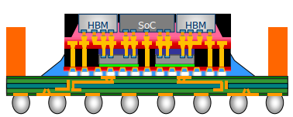
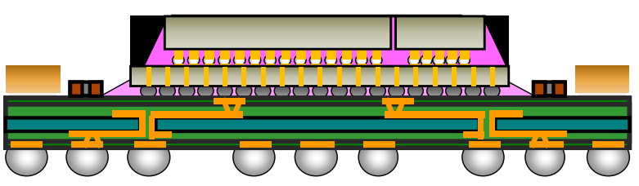
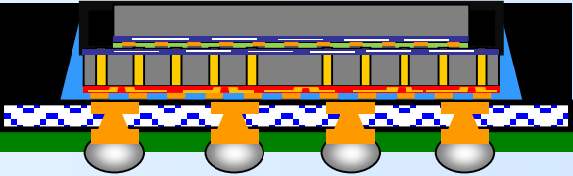
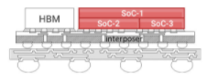







Suppliers are Innovating on Advanced Packaging
Package Technology |  | 2.3D | 2.3D w/ Si bridge | 2.5D Si interposer | 3D µbump | 3D HB
Internal Ref.: |  |  | ODI in Foveros Omni (‘24) | EMIB, local bridge embedded in SBT | Foveros, TD < BD | Foveros Direct (‘24)
 |  |  | ODI (‘23) |  | Foveros Omni, TD > BD (‘24)
OSAT |  | FOCoS-CF | FOCoS-B | 2.5D | 3D IC | 3D IC
 |  | FOCoS-CL
 |  | FO-MCM | FO-EB | 2.5D | 3D IC | 3D IC
 |  | S-SWIFT | S-Connect | 2.5D | 3D IC
SiFo |  | InFO-R (CF) | InFO-L (CF) | CoWoS-S |  | SoIC CoW F2B, TD < BD
 |  | CoWoS-R | CoWoS-L |  |  | SoIC CoW F2F, TD > BD
 |  | R-Cube |  | I-Cube | X-Cube Gen1, TD < BD | X-Cube Gen. 2
 |  |  |  |  | X-Cube Gen1, TD > BD
GmC PoC
MI200
Milan-X Vermeer
M1 Ultra
Suppliers are catching-up and outpacing Intel innovations
CF: Chip First, CL: Chip Last, TD: Top Die, BD: Bottom Die
F2B: Face to Back, F2F: Face to Face
From supplier perspectives:
Engineering
Qualified
Production
Sources: Teardowns, System Plus, Yole, TechSearch, Forecast Group, supplier talks, conferences

Slide 6
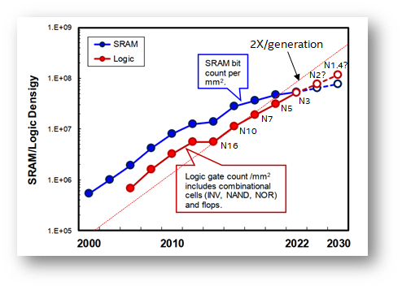
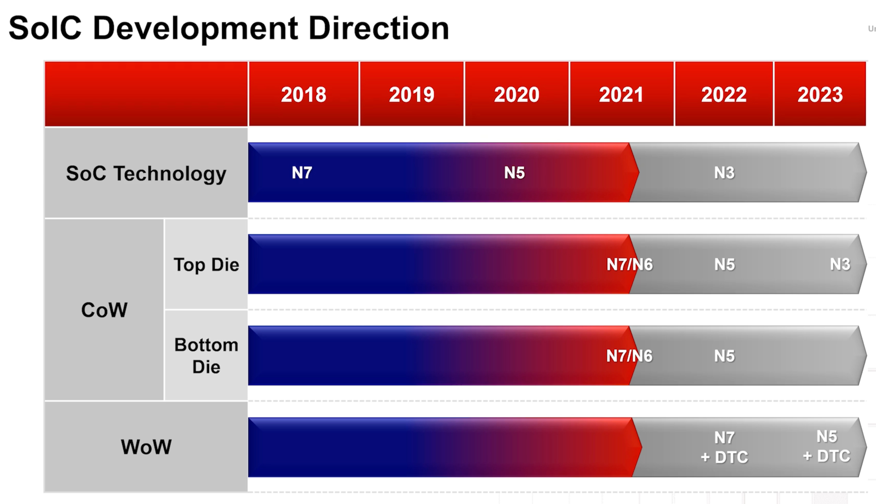
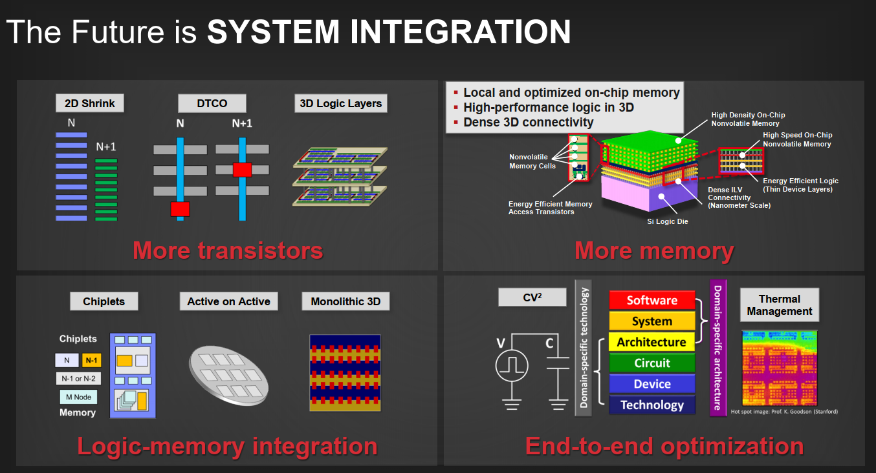
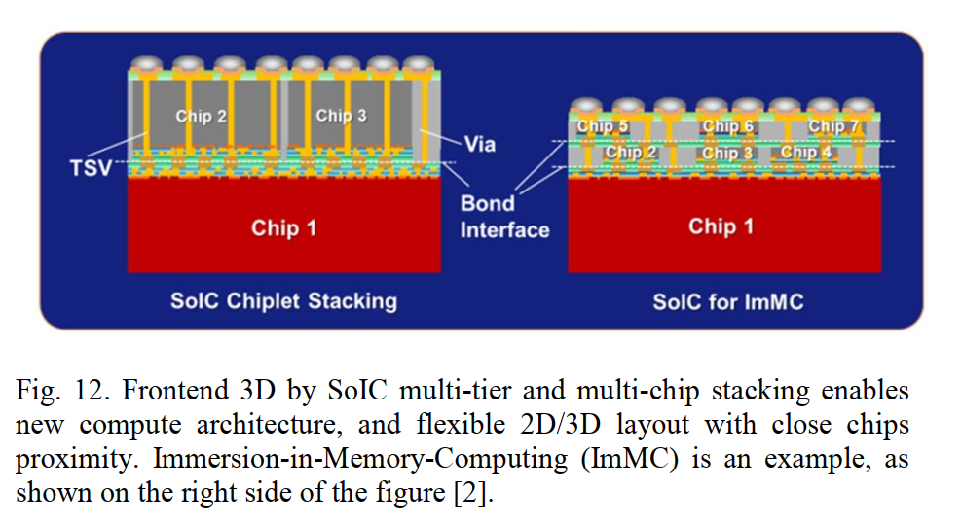
3DIC Technologies Enable Continued Scaling Benefits
Source: TSMC, IEDM 2019
Source: TSMC, Hot Chips 2021
Source: TSMC,ECTC 2020
Source: TSMC,ISSCC 2021

Slide 7
2024-26 Leading-Edge Product Roadmap Intercept
TECH NODE
N3B
ARL-PX/S/G2, LNL-M
IN EXECUTION
1st A0
1st PRQ
Dual-Drive
IN PLANNING
N3E/E+
1st PRQ
Product Portfolio
IP* Start
PTL-X/M/Gfx, CWF, DG-C, A. Bridge
1st A0
Capacity Window → Commit
N2
Product-Technology
DTCO/STCO
Dual-Drive
IP* Start
1st A0
1st PRQ
NVL, Next Forest, DG-D, etc.
Capacity Window → Commit
* Critical IP includes Cores (Cove/Mont) & Long Lead-Time IPs (e.g. DDR)
N3E/E+ Capacity & Dual-Drive Investment Provides Roadmap Flexibility;
N2 D/STCO to Maximize Benefit of Leading-Edge Silicon & Advanced Packaging
BU/DEG/GEMS Collaboration Needed to Engage TSMC Now
Notes:
1st half
TSMC N3B & N3E nodes competitively ahead in 2022-23
Driven through branch initiative, Intel is leveraging N3B capability on ARL-PX/S/G2, LNL-M and SRF for product leadership
Intel 1278.4 & 1278.6 are better in iso-power performance and narrowing density gap in 2024-25
N2 progressing in parallel despite N3 changes, Intel should drive N2 co-optimization on silicon and packaging to leverage best-in-class offerings
2nd half
N3E/E+ dual-drive would provide roadmap flexibility or contingency as Intel optimizes Capex and drives toward ’25+ process leadership
N2 Product-Technology DTCO/STCO needed to maximize industry’s Leading Edge Silicon and Advanced Packaging

Slide 8
Key Messages
Key Messages
TSMC maintains PPA lead over Samsung and Intel through 2022
Evolution from FinFET to Gate-All-Around (GAA) starts in 2022 to enable continued PPA scaling
  Samsung first to HVM with GAA on 3GAE+ in H2’22, based on 4LPP platform; will be pipecleaner for 3GAP
  Intel second to HVM with GAA on 20A in H1’24
  TSMC expected to be last to HVM with GAA on N2 in H1’25
Samsung has lagged TSMC PPA by ~1-2 years, but will catch up to N3E in H2’23 with 3GAP
Intel achieves PPA leadership (HP library) in 2024 with GAA and backside power on 20A/18A
  TSMC expected to extend N3 generation to third year in 2024 with N3E+ (not official name, not confirmed by TSMC)
  Intel lags on HD cell density across entire roadmap
TSMC regains HP library density leadership in 2025 on N2 based on FTE projections
  TSMC will lag on iso-power perf compared to 1278.6 due to expected absence of backside power
Samsung announced 2GAP with HVM H2’25, but no information on PPA
TSMC and Samsung are both highlighting use of 3DIC technologies to enable continued system scaling benefits
RESTRICTED USE: This slide contains or is derived from External Foundry Confidential Information and may only be used to enable or improve the manufacture of Intel Products at the External Foundry. Do not share.

