Slide 1
ATF Scribe Area Reduction
Christopher Chen
April 24, 2020

Slide 2
Agenda
Goal: to fit all of our ATF scribe modules into a single vertical and single horizontal scribe width
Problem: need to fit 50 modules into equivalent space of 18 Keithley modules
The topics we’ll discussed are a subset of Shafqat’s list:
Create a list of must-have and good-to-have structures – Priyanka
So far, have ~35~40 must-haves; possibilities for further reductions (array?)
Will meet today to finalize CMOS and ESD
Routing Arch for inline and EOL e-test for CMOS and interconnect and array – Khaled, Priyanka, Tuhin
How many structures can we put into an interleaved module?
Would interleaving enable to us to fit all the must-have structures?
Prober and probe card capability – alignment, etc. -- Chris
Array Testing needs and how is that comprehended in pad design – Matt, Daniel
RTD & HVM considerations – Matt, Daniel

Slide 3
Scenarios to Evaluate
Need to evaluate the scenarios below to see which ones enable us to fit all must-have modules
Module Area
H1=10612um2 V1 & V4 =8767um2 | H2=11492um2 V2= 13770um2 | H3=10612um2 V3=10720um2
 | Scenario | Pad Height (um) | Pad Width (um) | Pad Pitch (um) | Space Between Pads (um) | Space Between Interleaved Pads (um) | # Vertical Modules | # Horizontal Modules | # K modules
1 | Keithley 1x16 | 65 | 49 | 114.3 | 65.3 | - | 12 K+20 P | 6 K+24 P | 18K
2 | Pyramid 1x17 | 32 | 40 | 50 | 10 | - | 74P | 50P
3 | Keithley 1x16, interleaved | 65 | 49 | 114.3 | 16.3 | 8.15 | 24K+20P | 12K+24P | 36K
4 | TMG 1x16 | 52(48) | 40.8 (37) | 55.7 | 15 | - | 26TMG+14P | 12TMG+24P | 38TMG
4a | TMG 1X16 | 32 | 42 | 56 | 14 |  | 12TMGa
5 | TMG 1x16, interleaved | 52 | 42 | 100 | 56 | 8 | 28 TMG+20P | 12TMG+24P | 40TMG
6 | TMG 1x24 | 52 | 42 | 56 | 14 | - | 18TMG+20P | 7TMG+24P | 26TMG
7 | Altera Benchmark 1x16 | 32 (30.4) | 32(30.4) | 70 | 40->38 | - | 58ALT (using Altera pad pitch) | 38P (using pyramid pad pitch)
640 pads
624 pads

Slide 4
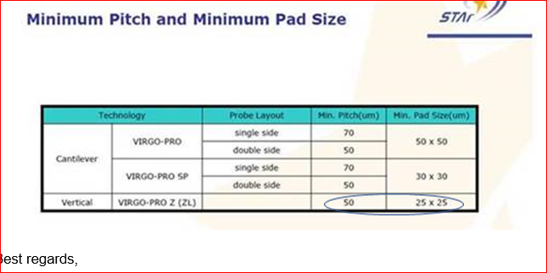
From Vendor
The Pad Size is Pad Opening size.

Slide 5
E-test Options Table (work in progress – please treat these table as Rev0)
 | Pitch | Pad dimensions | Space between pads | Upside | Downside
POR Keithley | 2286 dum 114.3 um | 1300 x 980 dum 65 x 49 um | 1306 dum 65.3 um
POR Pyramid | 1000 dum 50 um | 650 x 800 32.5 x 40 um |  | 3-4x in space of one | Inline test need to move to M4. More metal for assembly to dice. Throughput
Altera Benchmark | 1400 dum 70 um | 30 x 30 um |  | Has been tested in volume at foundry | Never tested in Intel Throughput
TMG | 1120 dum 56 um | 1020 x 840 dum 51 x 42 um |  | ~2x fitting
Pad height Reduction | 2286 dum 114.3 um | 650 x 980 32.5 x 49 um |  | 2 rows in space of one with same routing capability | Never volume tested the pyramid
Keithley Pad Density Doubling | 2286 dum 114.3 um | 1300 x 980 65 x 49 um |  | 2 modules in space of one | Inline test need to be moved to M3 More metal for assembly to dice Design complexity

Slide 6
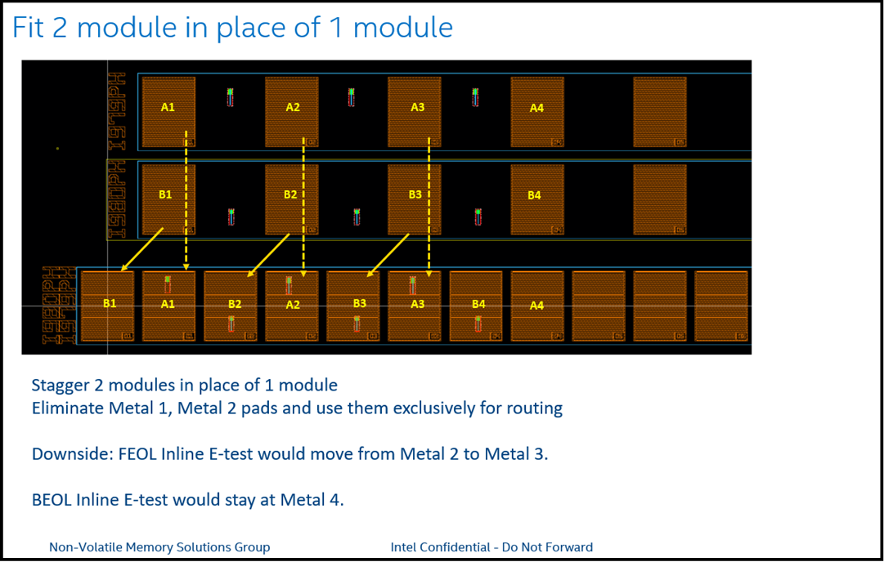

Slide 7
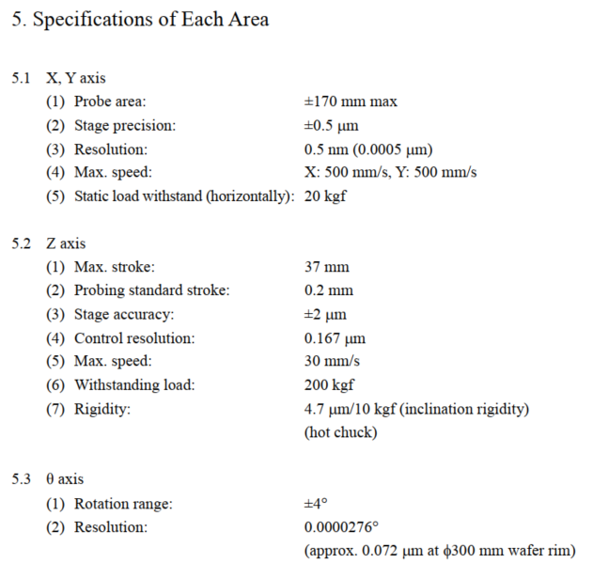
Accretech UF3000EX Prober Specifications
Prober will not be limiting factor for alignment
X/Y alignment tolerance: +/- 0.5um across wafer
Overdrive tolerance: +/- 2um
Theta tolerance: ~0.072um error at wafer edge
Probe card will be limiting factor for alignment

Slide 8
Probe Card Alignment
Alignment limited by probe card, not prober
Use Case | Probe Card Vendor (Model) | Cost per Card | Pad Config | Tip Diameter (um) | X/Y tolerance (um) | Z tolerance (um) | Pad Pitch (um) | Pad Height (um) | Pad Width (um) | Space Between Pads (um) | Comments
Keithley | JEM (A16C45SZ) | $4.6k | 1x16 | 25 +/- 5um | +/- 5 | +/- 5 | 130 | 65 | 49 | 65
Pyramid | Celadon VersaCore (VC20E-17.1) | $2.7k (core), $3k (board) | 1x17 | 8 | +/- 4 | +/- 4 | 50 | 32 | 40 | 10
TMG 40x1 | FormFactor (S40F47) | $1.9k $3.3k high temp (2016) | 1x40 | 10 +/- 2.5um | +/- 5 | +/- 5 | 55.7 | 52 | 40.8 | 15 | Passivation opening 48um (height) x 36.8um (width)
Altera Benchmark | STAr VIRGO-PRO II-HT-SP 22 | $5.9k (2012) | 1x22 | 10 | +/- 5 | < 5 | 70 | 30 | 30 | 40

Slide 9
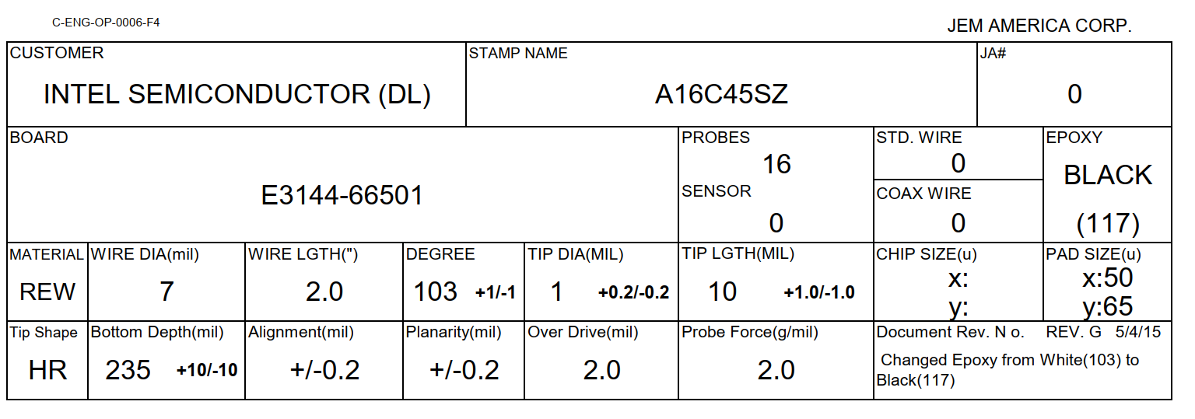
Keithley Probe Card Specs
Tip diameter ~26um, +/-5um alignment, +/-5um planarity
These number increase with usage

Slide 10
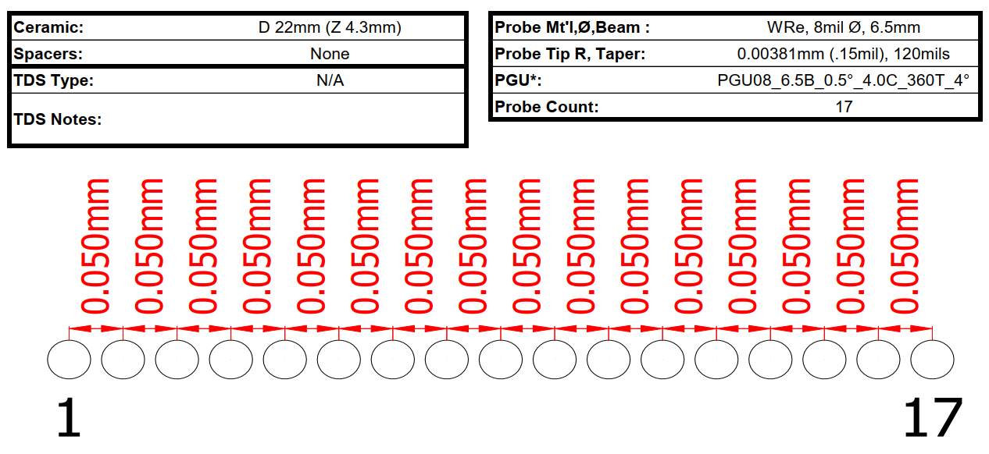
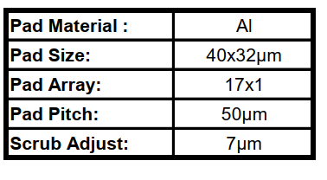
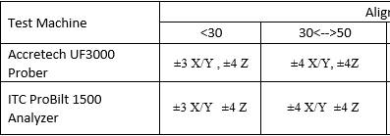
Pyramid Card Specs
Celadon VC20E-17.1
Alignment tolerances:

Slide 11
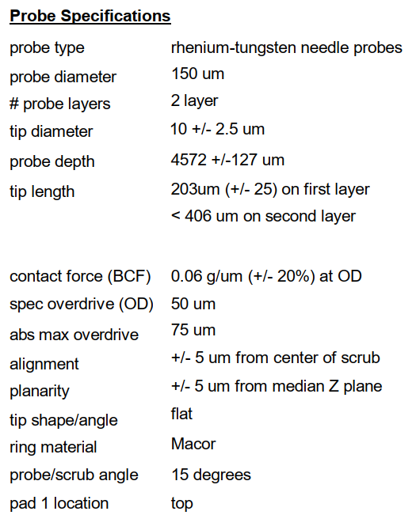

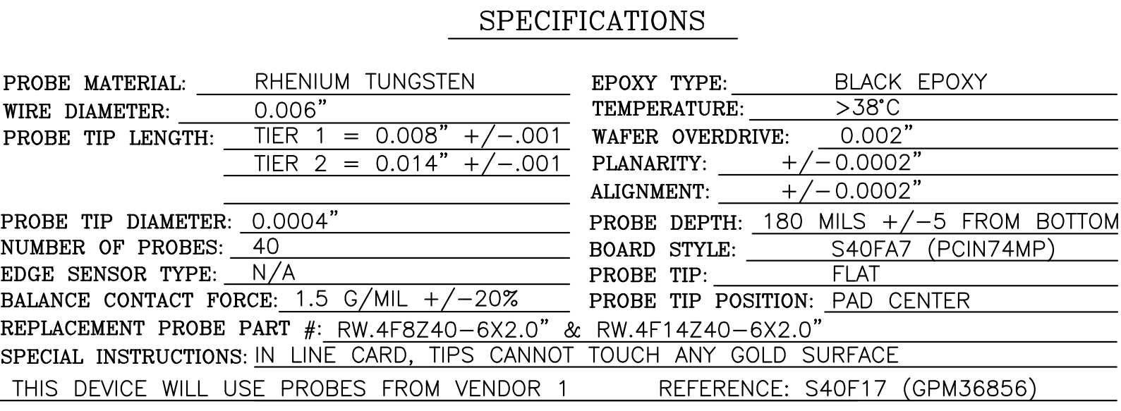
TMG 40x1 Probe Card Spec (S40FA7x)
Information Courtesy of Robert A Miller
Tip size: 10 +/-2.5um
Alignment: +/- 5um
Planarity: +/- 5um
Passivation opening: 48um (height) x 36.8um (width)
Metal pad size: 52um (height) x 40.8 (width)

Slide 12
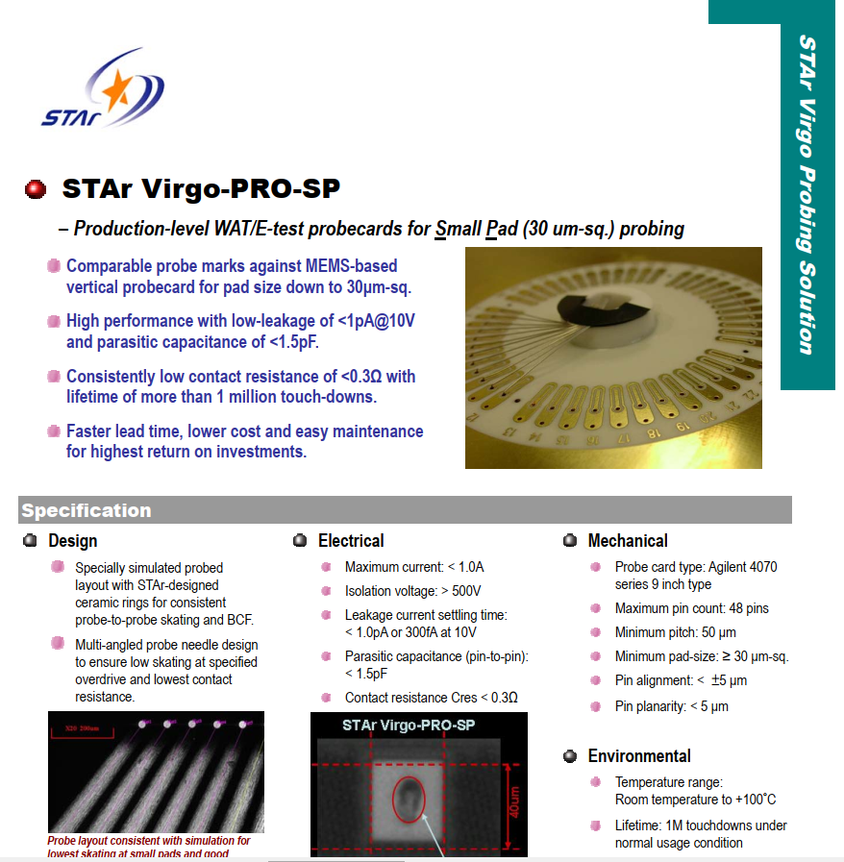
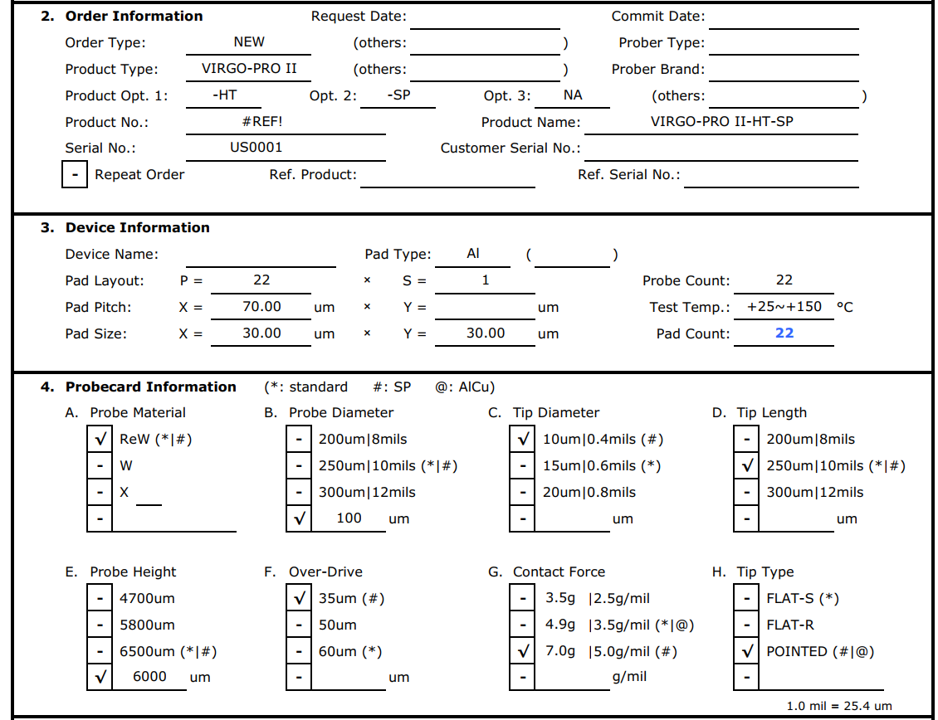
Altera Benchmark Probe Card Specs
STAr VIRGO-PRO-HT-SP
Note: high temp card for probing up to 150C

Slide 13
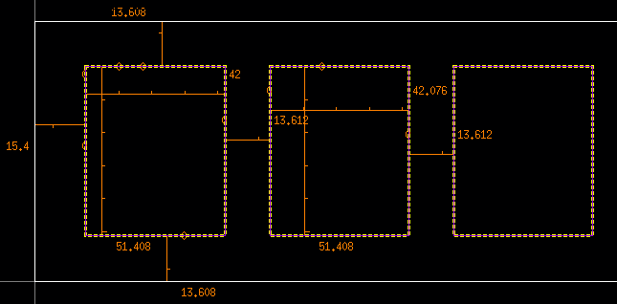
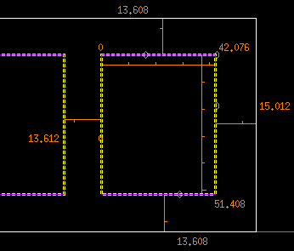
Parametric Probing in 1x40 Pad Configuration
40 pads arranged in 1 row x 40 columns
Pads run horizontal
Pad width and pitch are slightly larger for even pads compared to odd pads
1 2 3 4 …
40
Pad 1 (odd)
Pad 2 (even)
Pad 3 (odd)
………
Pad 40 (even)
Dimension | X (um) | Y (um)
Pad size (odd pads) | 42 | 51.408
Pad size (even pads) | 42.076 | 51.408
Space from pad-to-pad | 13.612 | N/A

Slide 14
Action item and Notes from Discussion (Monday) 19.1
Take TMG Pad-> use them for 40 modules. And take version of same pad with reduced height (32) and do 5 more modules (not needed to be tested much, noisy data) with same TMG pad pitch.
Risk: Noisy data from 5 modules.
Action item: Chris will check with Probe Card Vendor for Option 4a.
Take Altera Pad-> Make same Pad Size to Pyramid. Pad pitch is 70 and space between Pad as 28

Slide 15
Action item and Notes from Discussion (Friday) 19.5
Go with Altera Pad (32x32) –All Pyramid in Horizontal, all critical in Vertical
Testing layers MT2/MT4/TM2
50 Vertical & 46 Pyramid (Action item : Divesh will close with Yun & Kala)
Evaluate TM2 Pad Mask & Altera Pad (5K)
Evaluate in TC03?
Order both Cantilever & {Vertical(50 pitch)- test 4 or 5 masks}
Timeline for Probe Card: Cantilever- 1 month & Vertical 1 ½ month
-> If we see something wrong here.. Backup plan?
Vertical is going to be Back up.

