Slide 1
ATF32 Scribe Status
TD Collateral.

Slide 2
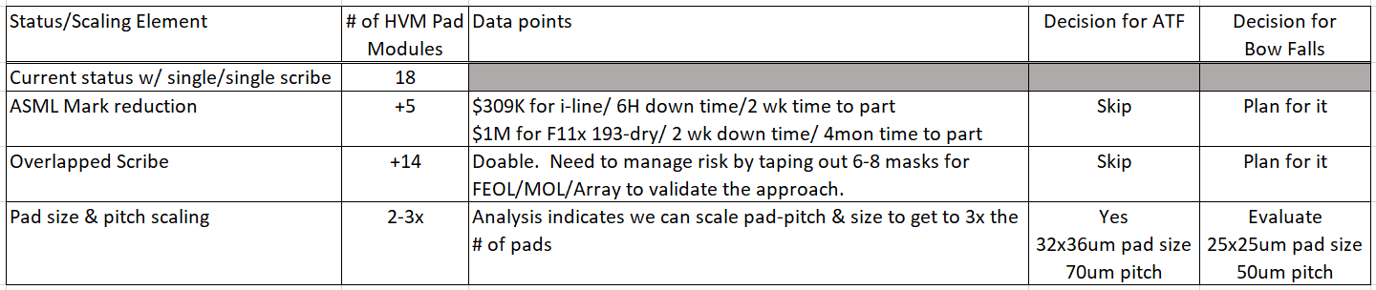
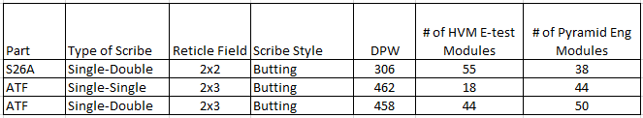
Current Status & Roadmap
*** ASML mark reduction and overlapped scribe pay-back will be much higher (2-3x, combined) with fwd-looking smaller pad pitch.

Slide 3
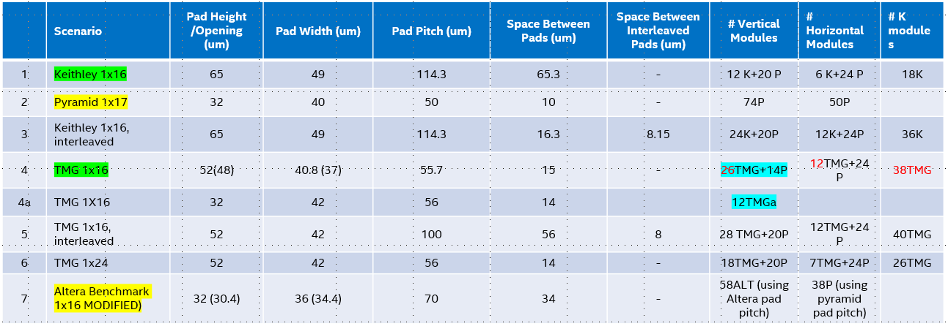
Decision Path & Fit
30.4x34.4um pad opening with 32x36um pad size & 70 um pitch
Enables 58 pads on vertical scribe for E-test (Rev 0 assessment)
Additional 38~40 pads for Eng / Modeling on Horizontal scribe

Slide 4
Next Steps
Near Term (Q2/Q3)
Tape out TM2/Pad mask with the new pad size & pitch
- Capture new POR pad size and future scaled pad size
- also enable new pad at any Cu level (many layers taping out) for inline test validation
Order both Cantilever and Vertical probe cards for evaluation ($15-20K)
Fully validate HVM capability prior to ATF Si arrival at inline / EOL tests
Assembly wants to reduce low-k + narrow scribe risk by enabling SDBG. SDBG not working with P-/P+ epi wafers. Assembly request is to accelerate migration to non-epi p- wafer.
Q3 & Beyond
Plan, budget & execute towards ASML tool upgrade for elimination of large marks in scribe
Start validating new overlap scribe scheme (must have for future)
Plan for further scribe scaling to 65um for Bow Falls

Slide 5
Back-up

Slide 6
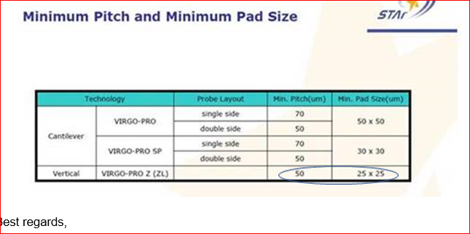
From Vendor
The Pad Size is Pad Opening size.

Slide 7
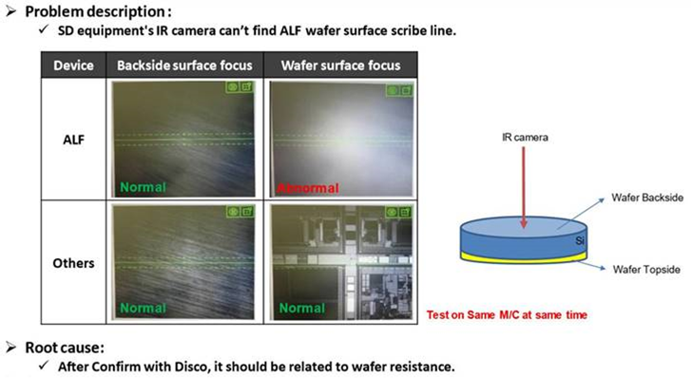
SDBG Concerns.
Problem Statement:
In assembly we have ALF wafers stopped at our Stealth laser Dicing Before Grind process (SDBG) and our IR camera is not able to image through the backside of our ALF silicon which is needed to lock X/Y Zero onto our saw street intersection eye points for accurate dicing.
High TRA moving to a single-single scribe for assembly processing:
ALF has a double-double reticle layout and moving ATF to a Single-Single lay out we may not be able to image anything in the scribe area and hence not be able to have a manufacturing process that will pass qual. (if running other saw processes)
Scribe Shrinks will be another IR camera imaging high risk variable for assembly at SDBG.
Assembly Recommendation:
With the challenges that we currently have at SDBG dicing we recommend staying with a double-double scribe design.
Note: The SDBG Dicing process is needed for thin die stack applications to prevent severe chip out. Currently Fab11x is shipping Assembly some partial finished wafers for process partitioning studies.

