Slide 1
IOG QGS Q1
Alper Ilkbahar DPG Vice President, IOG General Manager 02.04.21

Slide 2

Agenda
Business Updates
Organizational Progress
Recognitions
Q&A
Call to Action
.

Slide 3
Business Updates

Slide 4







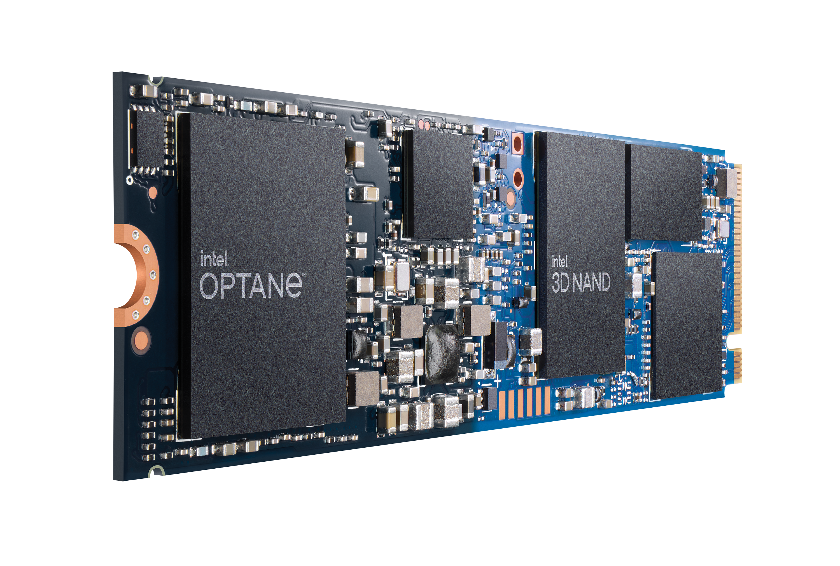
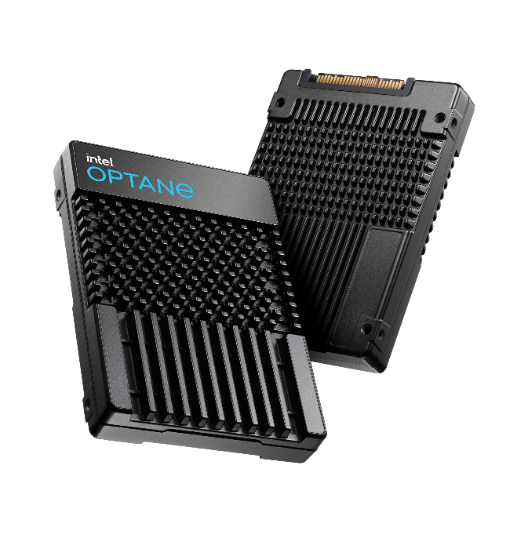


Intel Optane Group is Delivering
27% Growth record Revenue
Customer WIN momentum
Scaling the business
2018
2019
2020
Business Planning
$488M
$385M
Team Alignment
$234M
vSphere
200 SERIES
Ecosystem Buildout
vSAN
2 0 2 0
Client H20
Market Acceptance
APB 1.0!
P5800X
Scale for Disruption

Slide 5
IOG Revenue Update
Detailed financials removed for broad distribution

Slide 6
IOG Revenue and Margin
Detailed financials removed for broad distribution

Slide 7














Optane Technology Success in the Cloud
SOMO LAKE FPGA PILOT $1.6M revenue​ in 2020
SOMO LAKE NRE Paid $6.5M to productize
RUN RATE TARGET $25M /quarter in Q4’21
2nd GEN SOMO LAKE w/ CXL WIP MOU for 50PB (~$100M) Crow Pass ​
100-200K UNITS SPR + CPS
AEP MEMORY TIERING PILOT
PMEM DAOS ENGAGEMENT for HPC
IMPROVED EFFICIENCY W/ PMEM WHILE HITTING SLAs
WIN FOR ICX + BARLOW PASS
COLLAB ON CXL ATTACH OPTANE TECH
P4800X WIN IN AZURE vSANaaS
P4801X WIN FOR XIO STORAGE
RELEASED HANA INSTANCES
LARGEST PMEM DEAL OF 34KU IN 2020
RUN RATE WLs; BIG DATA BREAKTHROUGHS; PRIVATE COUD STRATEGY
CDS/BPS TEST-BED POSSIBLY LEADING TO SPR/CPS
P5800X ON INFERENCE PLATFORM
BUSINESS DRIVERS INCLUDE iMDB, STORAGE, RECOMMENDATION & SEARCH SYSTEM
WORKING TOWARDS SAP CERT IN Q1
GA PMEM INSTANCES + Tair on SCM
COMMITS TO BPS FOR R.2 CLUSTER
P5800X GREY TESTING FOR EBS WIN
>10 PMEM WL’s in EVAL
EXADATA SUCCESS
RAMPING ORACLE CLOUD
100% PMEM COMMITTED FOR NEXT-GEN
6 WLs UNDER EVAL (hackathons / engineering support)
50-100KU BPS IN ’21 (pending budget)

Slide 8
Organizational Progress

Slide 9



Looking Back…
Looking Ahead…
Past 60 Days – IOG Business Restructuring
Roadmap: Newly aligned media & product roadmap (driven by alignment of spending & investments to CPU roadmap & market opportunity)
Business Plan: Improved our long-term business plan, NPV & Terminal value by $1.5B each, while reducing CAPEX by $500M over LRP horizon
Financials: Restructured Optane business to meet ‘21 financial targets, saved nearly $100M over ‘20 run-rate, met corp spending & OM targets
TD & Mfg Cost Improvements: 14nm tools re-use, sharing F11X with other projects, gov’t funding, & capital cost reduction for ATF ramp
Org Structure: Defined Level 1 org structure

Slide 10
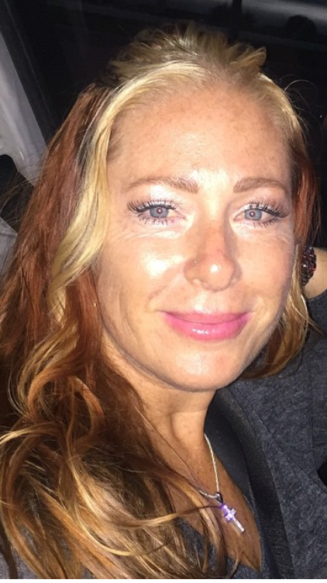

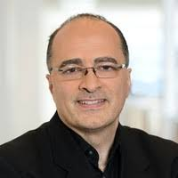
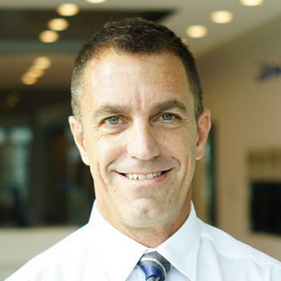
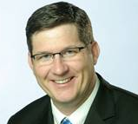
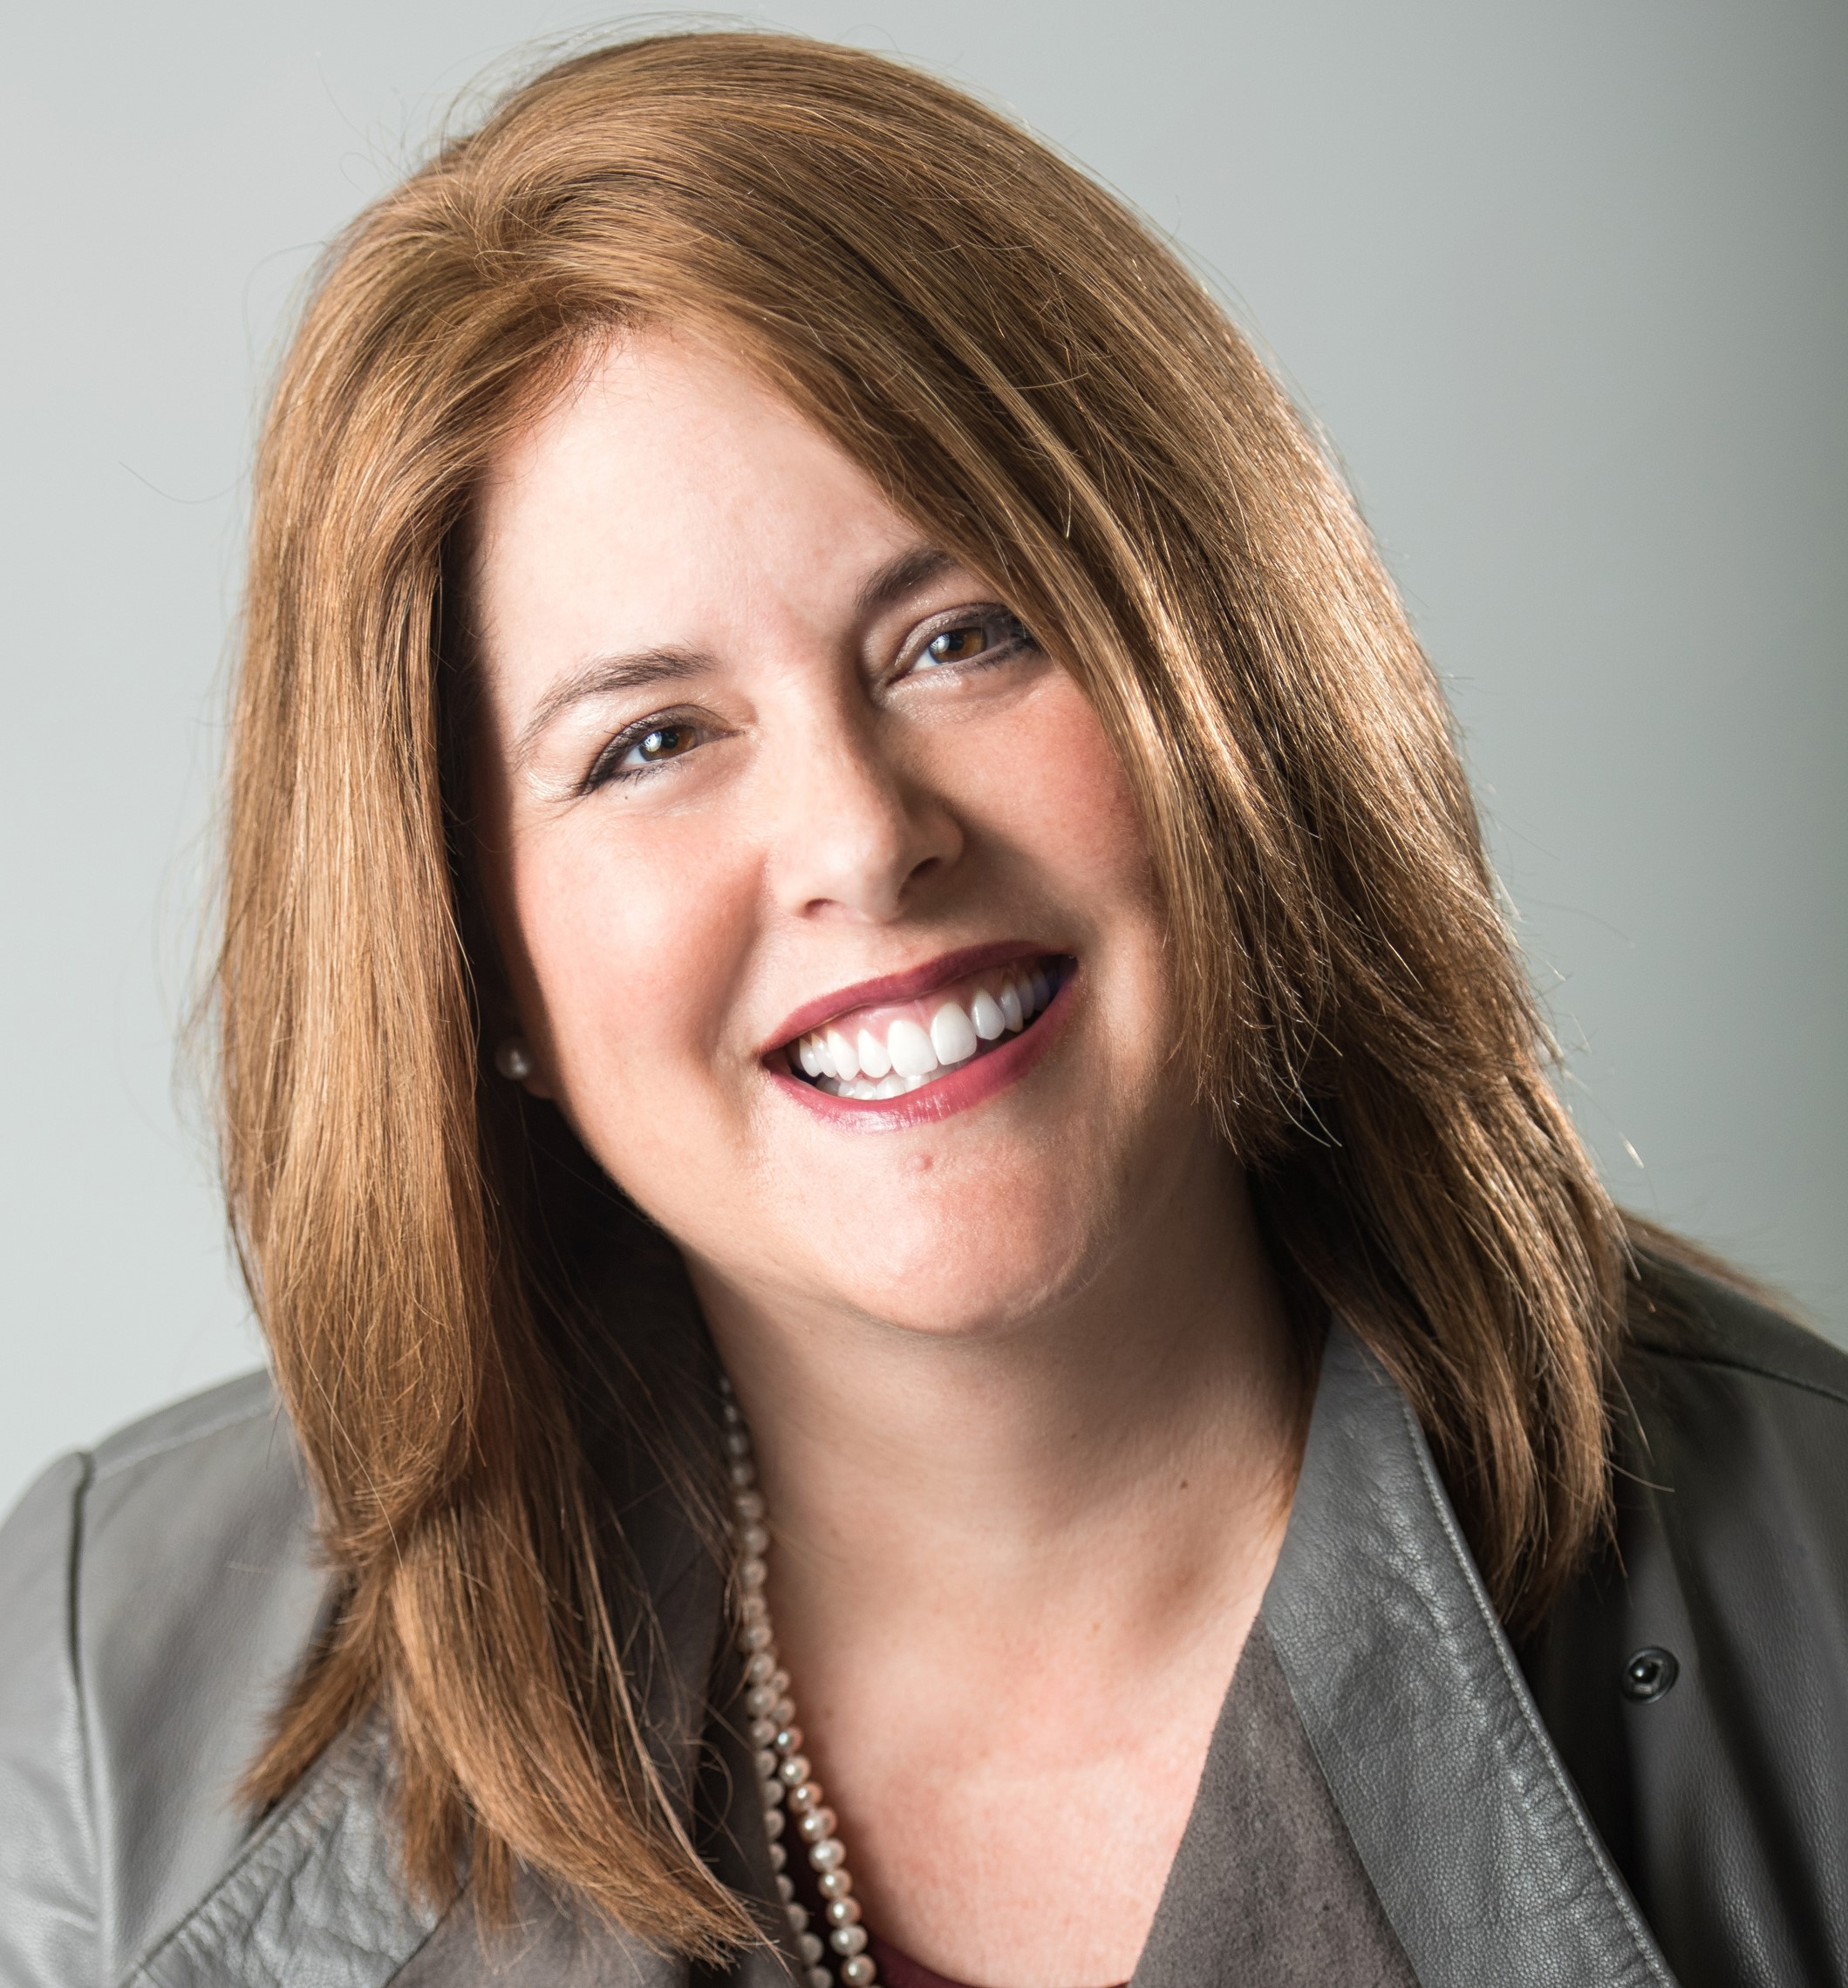
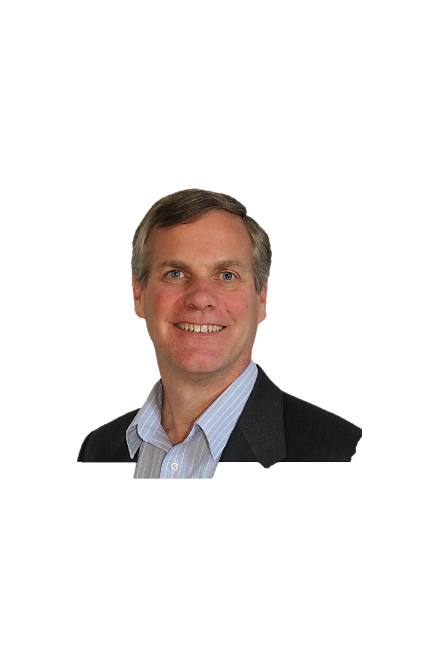
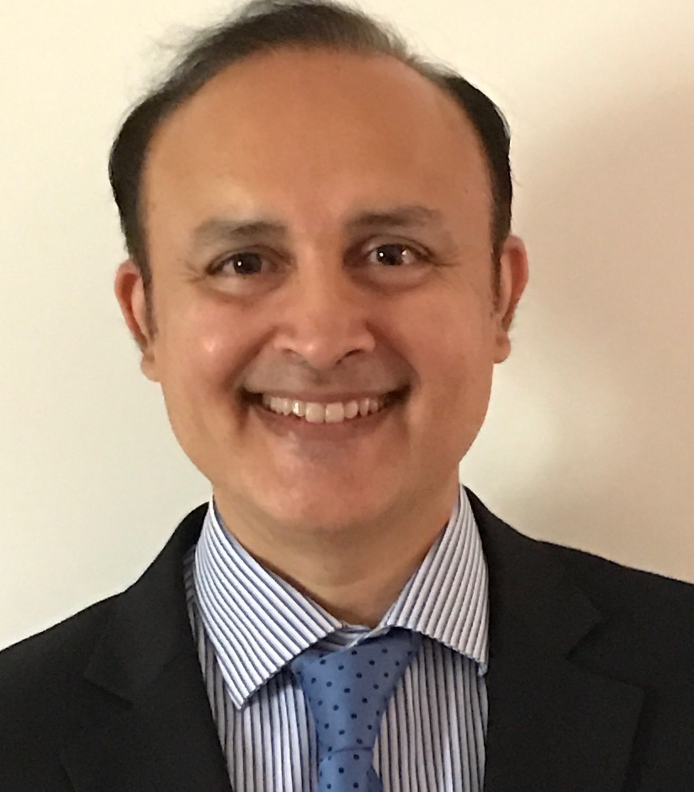
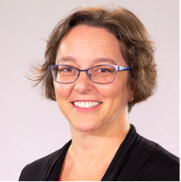
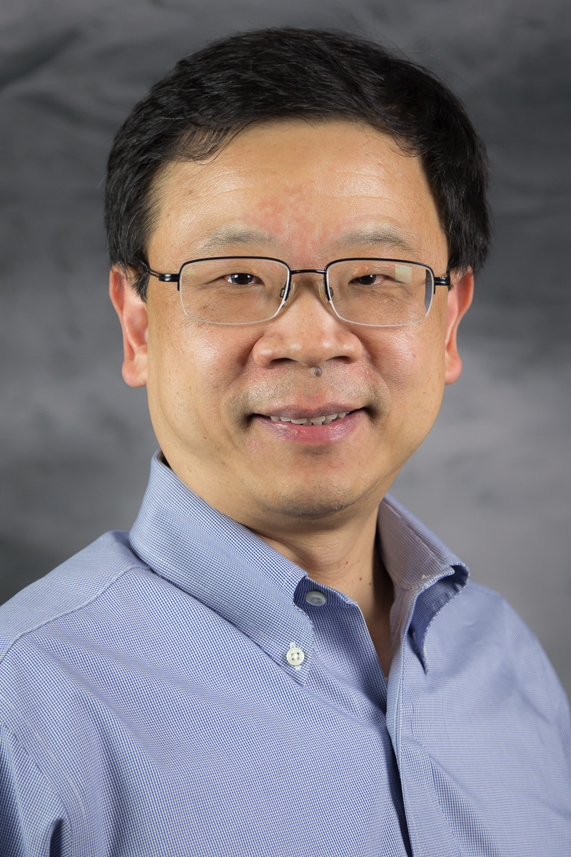
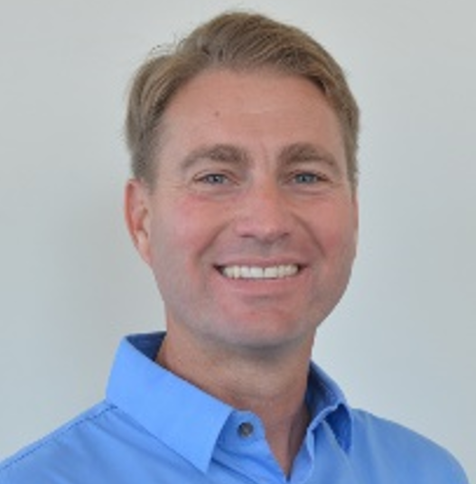

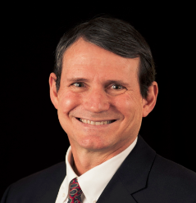
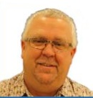
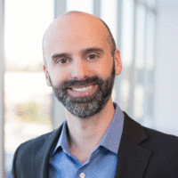
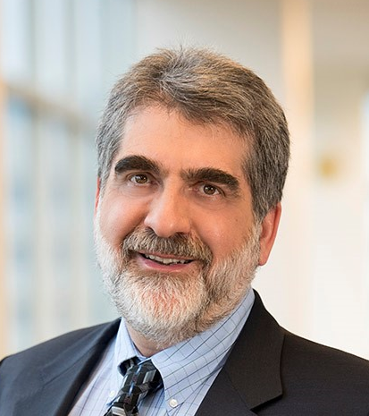
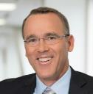
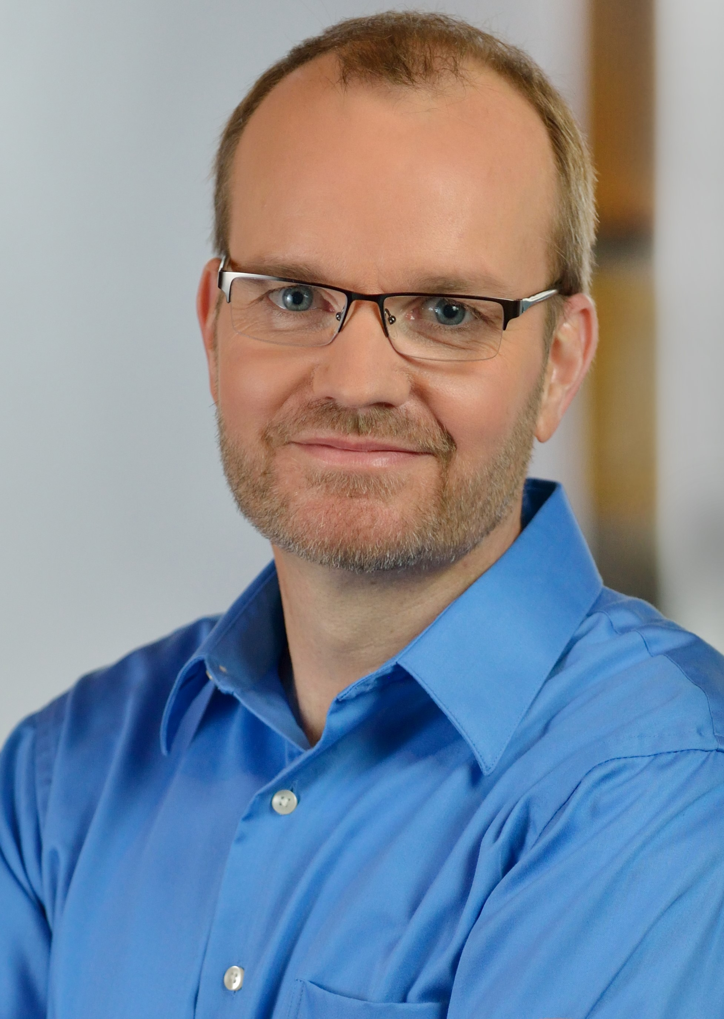
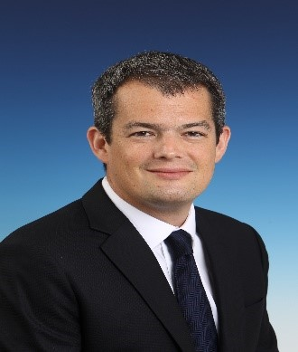
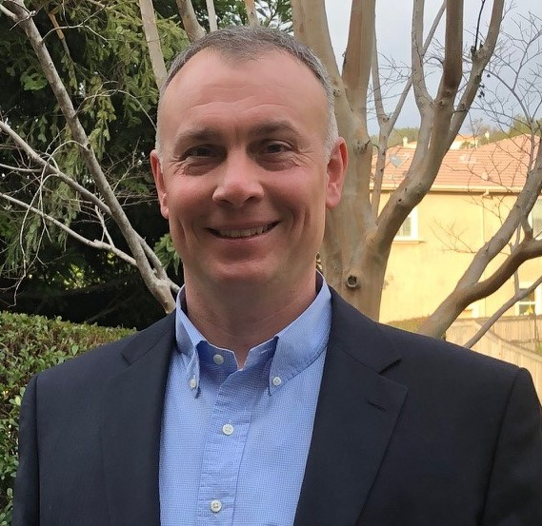

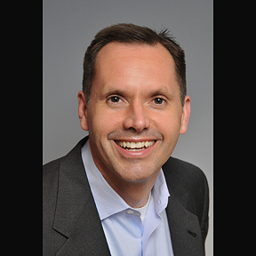
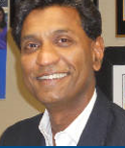
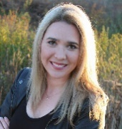
Intel Optane Group
Latesha Forte, EA
New Level One Org Structure
Alper Ilkbahar
DPG VP, GM IOG
Jon Foley, TA/COS
David Tuhy, VP/GM Software & Solutions
Kristie Mann Sr. Director
Mktg & Business Ops
David Lundell, GM
Client Hybrid SSD
Narendra Khandekar
Sr. Director
Data Center
PMem Engineering
Deb Stromberg
Sr. Director Data Center SSD
Engineering
Yi Ding Sr. Director
Program Mgt Office
David Tuhy, VP/GM
Daniel Elmhurst, VP
Architecture & FW Engineering
Tom Macdonald, VP
Controller & HW Engineering
Bert Blaha, VP
Manufacturing
Ed Fozo
Sr. Director
Media Engineering
Ted Taylor, VP
Optane TD
Al Fazio, Sr. Fellow
Advanced Pathfinding
Bert Blaha, VP
Strategic Business Development
Architecture Team
Hardware Design Team
Rick Coulson, Sr Fellow
Frank Hady, Fellow
Firmware Design Team
ASIC Design Team
Tech Leadership Advisors
Jason Fedder
Sales
Josh Philpot
Finance
Genevieve Long
HR
Philip Pedigo
Legal
Venkat Vasudevan
Quality & Reliability

Slide 11
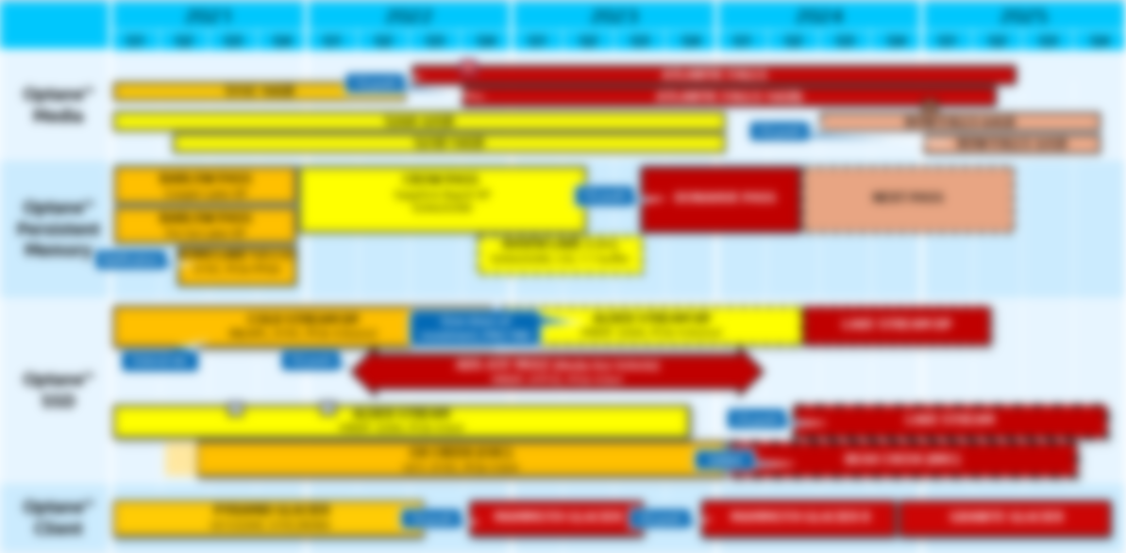
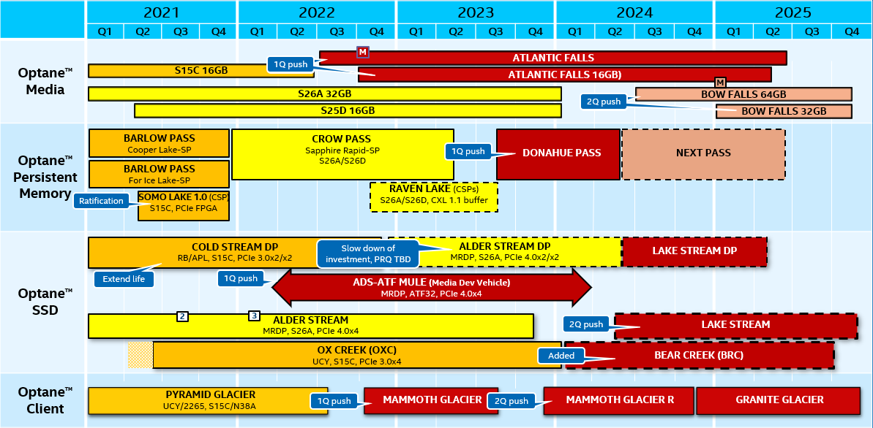
IOG 5 Year NDA Internal Roadmap
For IOG BU Communication Only
Key:
10s
20s
ATF
BWF
Evaluating
Left Edge of Box = Lead product PRQ

Slide 12
IOG 5 Year NDA Internal Roadmap
For IOG BU Communication Only
Key:
S26A/S25D
10s
20s
S26A/S25D, CXL 1.1 buffer
ATF
BWF
Evaluating
Left Edge of Box = Lead product PRQ

Slide 13
IOG 5 Year NDA Internal Roadmap
For IOG BU Communication Only
Key:
10s
20s
ATF
BWF
Evaluating
Left Edge of Box = Lead product PRQ

Slide 14
IOG 5 Year NDA Internal Roadmap
For IOG BU Communication Only
Key:
10s
20s
ATF
BWF
Evaluating
Left Edge of Box = Lead product PRQ
MAMMOTH GLACIER
2Q push
MAMMOTH GLACIER R
GRANITE GLACIER

Slide 15

IOG 5 Year NDA Internal Roadmap
For IOG BU Communication Only
Key:
S26A/S25D
10s
20s
S26A/S25D, CXL 1.1 buffer
ATF
BWF
Evaluating
Left Edge of Box = Lead product PRQ
MAMMOTH GLACIER
MAMMOTH GLACIER R
GRANITE GLACIER
2Q push
MAMMOTH GLACIER R

Slide 16
Alder Stream Dual Port SSD
Decision: IOG to slow ADS DP investment as we monitor market demand, we will stop work on ADS DP after Code Complete milestone in WW08, until we build confidence in market demand for Optane DP products
WW05 Dell EMC decision to not qualify Alder Stream DP or Cold Stream DP in next gen PowerMax V4 system architecture platforms
Dell & Dell EMC continue to be strong partners & are evaluating Optane technologies across their server & storage portfolios including Coldstream DP in Powerstore products & PMem in PowerMax V4
My sincere thanks to IOG employees who consistently delivered milestone-after-milestone of Optane Dual Port technology! Their work will be greatly leveraged in Lakestream program.

Slide 17
2021 IOG PRQ Dates
Product | Key Dates | WW06 Update
Alder Stream Dual Port | Q1 FW CC | FW M8 milestone complete WW51’20 Code Complete target WW08
Pyramid Glacier | Q1 PRQ | Driving toward PRQ/OEM QS in WW08
Alder Stream Single Port (OEM release) | Q2 PRQ | PRQ2 FW Alpha achieved WW05, trending ES1 WW06 Alibaba & Dell-PE quals moving forward at accelerated pace
Ox Creek | Q2 PRQ | Driving to ES2 & RDT start in Q1, PRQ in Q2
PMem Barlow Pass w/ S25D Media | Q2 PRQ | BPS w/ S15 Media: On track for Whitley/ICX PV WW11 BPS w/ S25D: 1st FW in place w/ 100 DIMMs available
PMem Somo Lake 1.0 | Q3 PRQ | SML 0.5/POC: All final boards shipped to AWS SML 1.0/Production: Feb POP driving Q3 PRQ
PMem Crow Pass | Q4 PRQ | ES0/Pre-Alpha FW/SW shipped to lead customers: Dell/HPE/AMI powered on; ES1/Alpha in Feb S25D Media PRQ’d WW05 DDRT2 VV starting WW06: Critical path to SPR E0/PRQ-stepping TI
Need sharp focus on executing to all product milestone dates

Slide 18


Looking Back…
Looking Ahead…
Past 60 Days – Business Restructuring
Roadmap: Newly aligned media & product roadmap (driven by alignment of spending & investments to market opportunity)
Demand & LRP: Balanced investments to focus on core priorities
Efficiencies: Drove efficiencies in every part of org, including priority hiring only in order to save costs
Financials: Restructured Optane business to meet financial targets, saved nearly $100M over ‘20 run-rate, met corp spending & OM targets
TD & Mfg Cost Improvements: 14nm tools re-use, sharing F11X with other projects, gov’t funding, & capital cost reduction for ATF ramp
Org Structure: Defined Level 1 org structure
Next 30 Days – Organizational Clarity
Org Structure: Define Level 2 & 3 org structure
Business Growth: Finalize ‘21 revenue targets, priorities, & programs to achieve our stretch target
Priorities: Identify key business imperatives & ensure alignment of resources to top priorities
Product Execution: Drive to product milestones

Slide 19
Recognitions

Slide 20
Celebrate
Celebrate
BLACK
BLACK
HISTORY MONTH
February celebrates the history, accomplishments & heritage of our Black & African American colleagues & friends
HISTORY MONTH
goto/BHM
Notes:
Together, we are working toward making Intel the most inclusive company on the planet.
We recognize Black History Month in order to:
Build awareness & strengthen the community for Black employees ​
Emphasize Black employee stories, contributions, & accomplishments in technology​
Promote wellbeing of community members
Check out all the virtual events and celebration during the month of February at goto/BHM.

Slide 21


Optane SSD & Client Hybrid SSD Teams
Re-org of 1500 people into DPG
Helped ensure completion of SK Hynix sale
Didn’t miss a beat continuing the march to products
Finished Rewards process 1 quarter early
Faced new leadership & roadmap changes
Took it all in stride. Thank you!

Slide 22
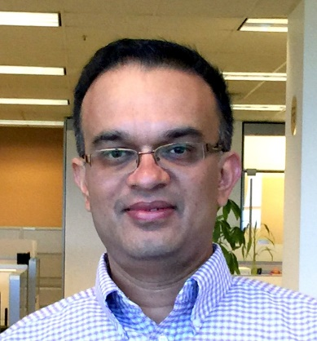
Congratulations on
intel fellow designation!
Kiran Pangal
Optane Fab & Process Technology

Slide 23
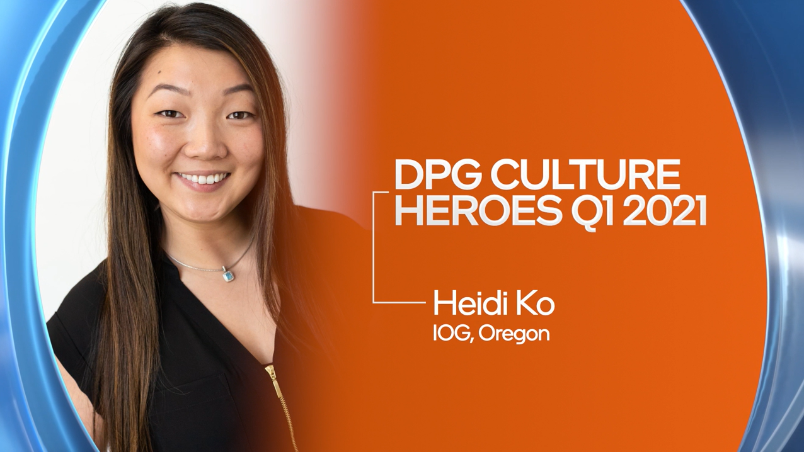
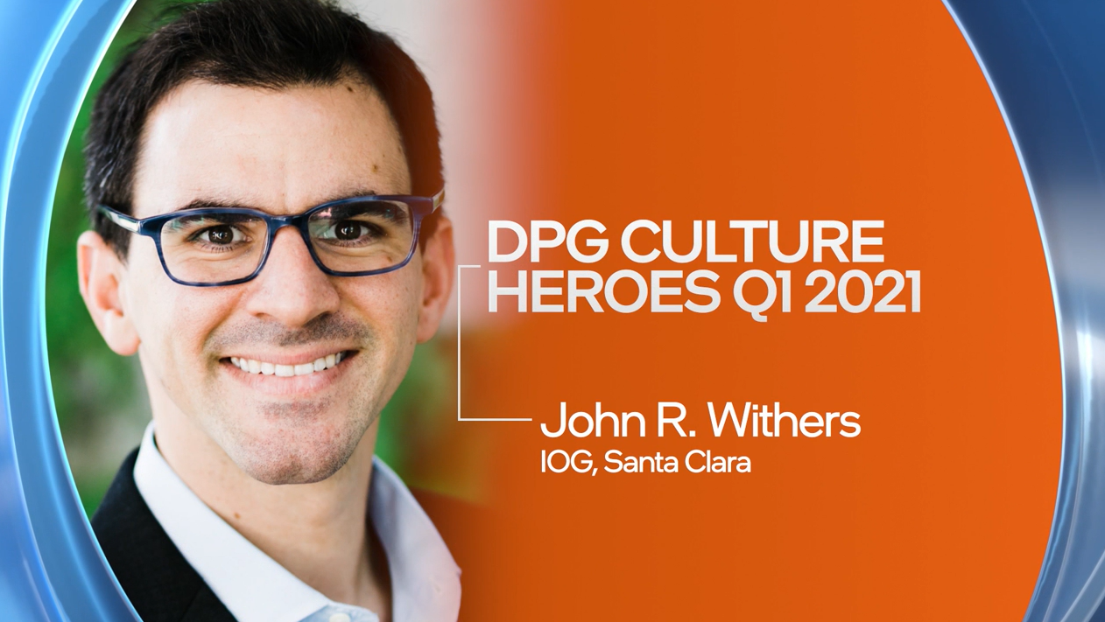
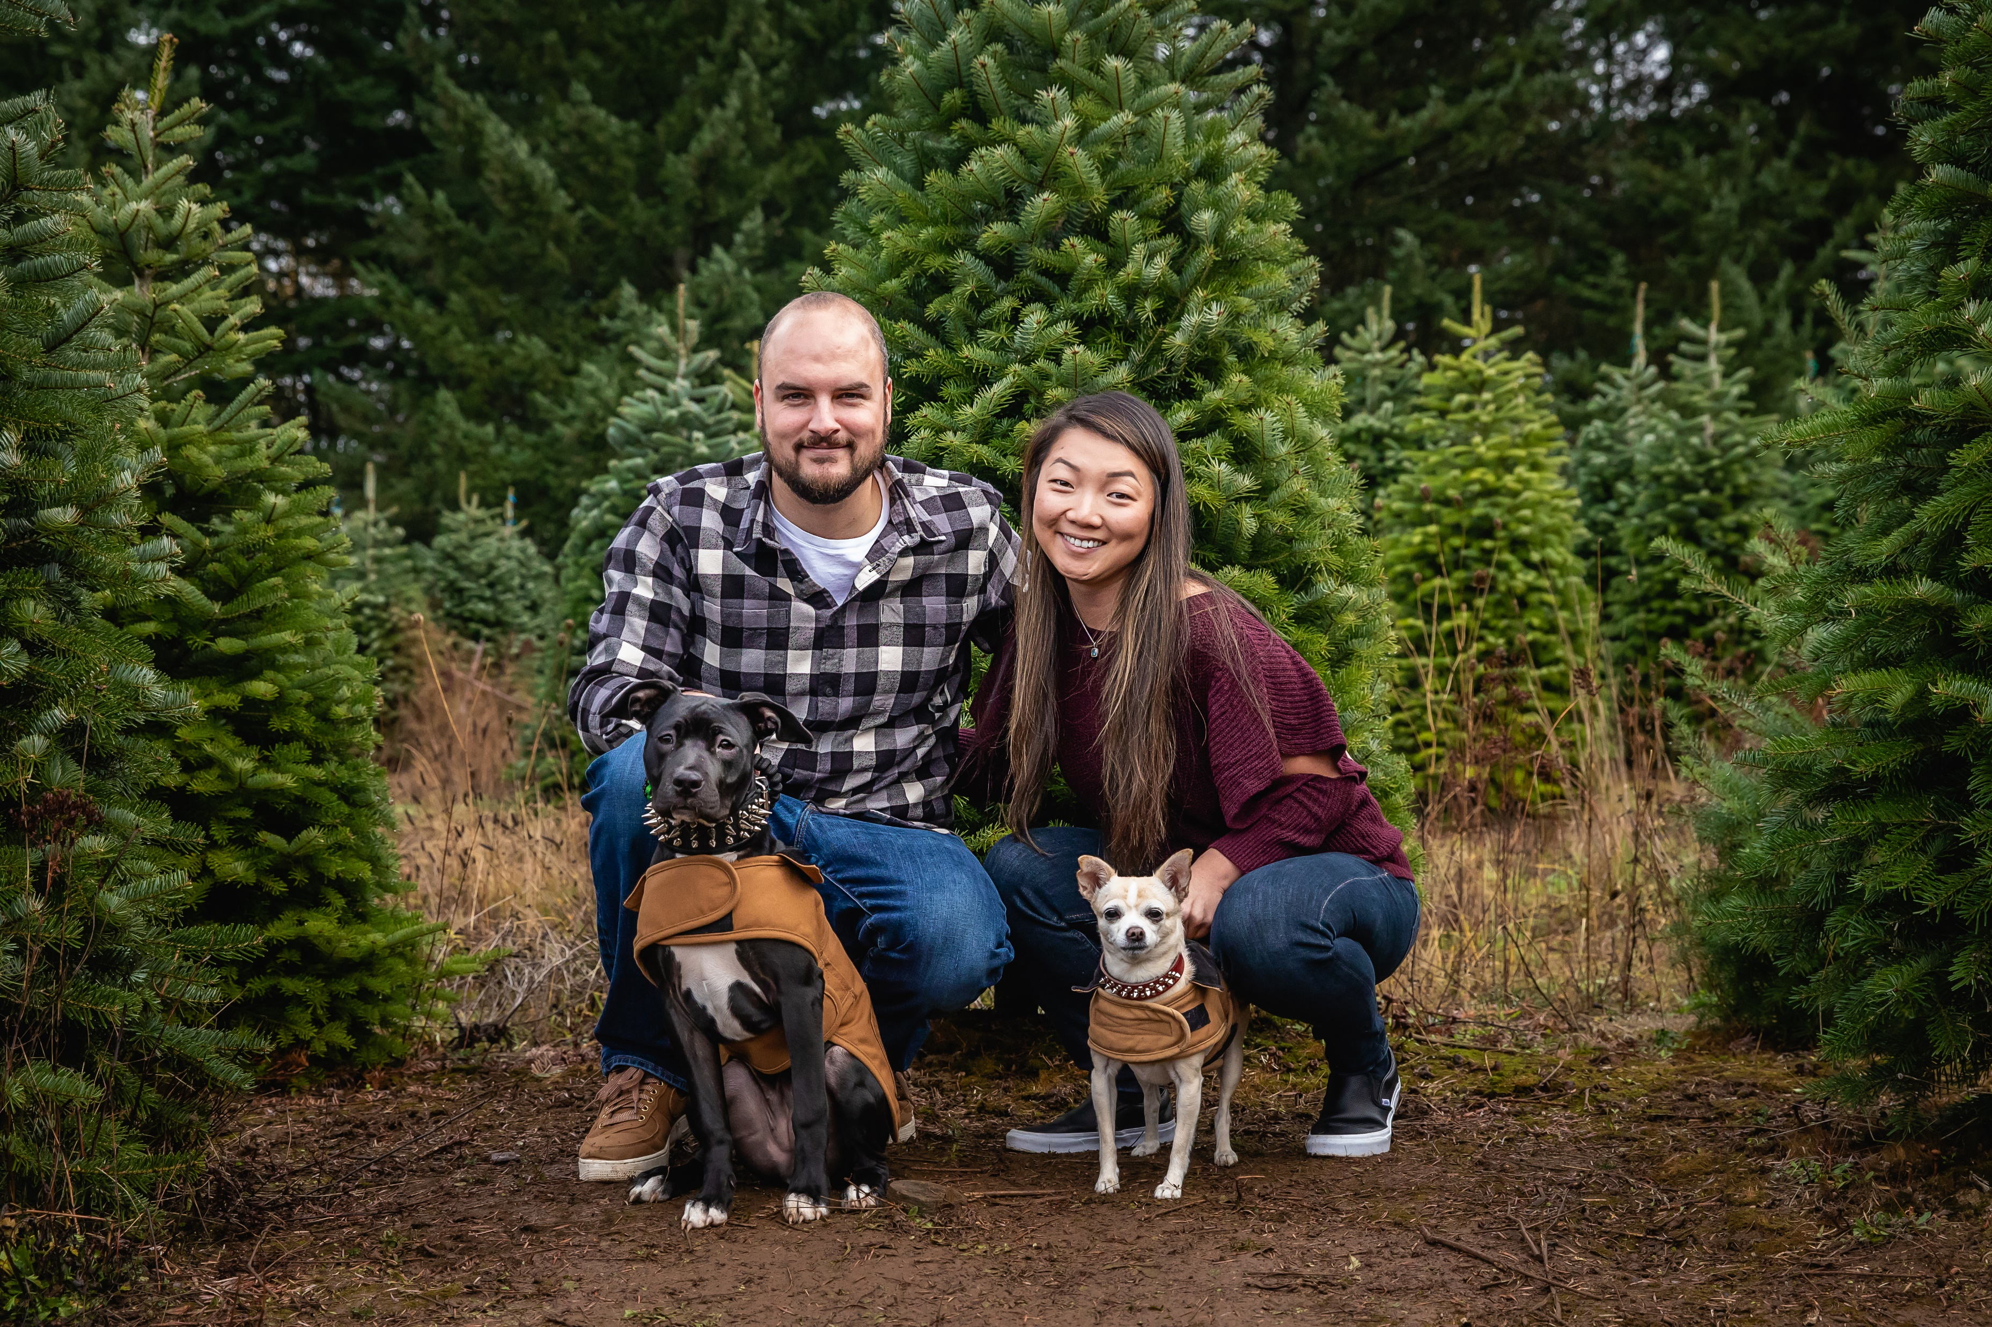
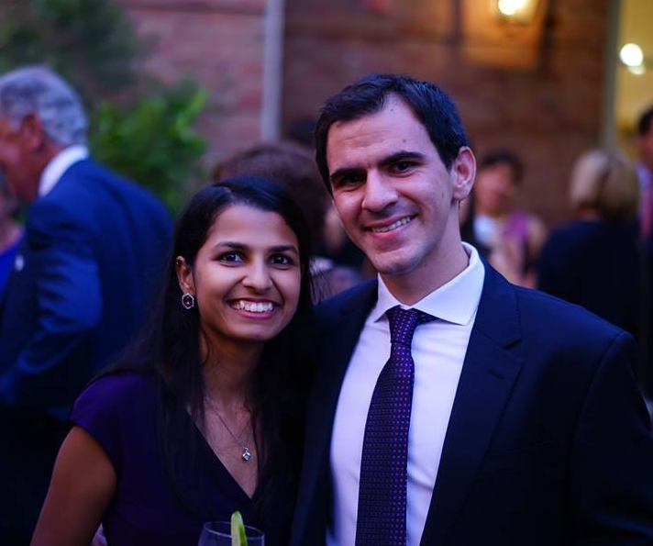
CONGRATULATIONS TO DPG Culture Heroes!

Slide 24
Congratulations on 10 years!
Priya Sekar
David Ungar
Lady Nataly Pinilla Pico
Hubert Soltysiak
Sudheshna Pindiprolu
Sujay Deshmukh
Aaron Kaiway
Lili Zhou
Mark Brown
Andy Sainz
Aravind Sivakumar
Tom Chen
10
10
2011 Top Movie:
Harry Potter & the Deathly Hallows: Part 2

Slide 25
Congratulations on 15 years!
Joann Cai
J.J Sanchez
Tiffanie Kong
Wilson Fang
Lucy Kuria Naim
15
Adena Banas
Mariano Aguirre Hernandez
Mariusz Krzywienski
Carl Martineau
Darren DeNardis
15
2006 Top Movie: Cars

Slide 26
Congratulations on 20 years!
Monish Shah
Shachi Thakkar
Alan Won
Chet Douglas
Scott Kinoshita
20
20
Naveen Narayan
Adnan Yassin
Rajesh Sharma
Sanjay Rangan
2001 Top Movie: A Beautiful Mind

Slide 27
Congratulations on 25 years!
Mike Deen
Raymond Zeng
Dave Leion
Kelly Caleb
25
25
Dave Kaplan
Ioan Scumpu
Khaled Hasnat
1996 Top Movie: Jerry Maguire

Slide 28

Alder Stream product launch!
Thank you!!
INTEL OPTANe GROUP

Slide 29
Shift-left FPGA & emulation platform to support early FW & ROM validation by 6 months
Thank you for pulling in FPGA & Emulation development to support DHV HW/FW/ROM validation 2 quarters ahead of predecessor CWV, resulting in 29 RTL/FW bug fixes & enabling FW/ROM validation in RTL0.3!
Chris Kun K Cheung PSV
Caleb Molitoris PSV
Melanie G Villegas PSV
Luis Flores Gomez PSV
Michal Beringer PSV
Satish Natla Design
Luis E Valdez Design
Min Fu Design
Steven Choi Design
Krzysztof Treder FW VAL
Piotr Gonska FW VAL
Stanislaw Mosiolek FW
Pawel Charkiewicz FW
Pawel Skrzypkowski FW
Kirk Davis FW
Don Wright FW

Slide 30
Delivering robust final ICX Asynchronous DRAM Refresh solution for Pmem
Thank you for working as one Intel, focusing on delivering robust end-to-end solutions for ADR feature for PMem on ICX platforms by removing critical roadblocks for ICX PC release!
Kai Cheng MSPG
Lukasz Redynk MSPG
Kevin M Nguyen MSPG
Andrzej Nalborski MSPG
Wojciech Kolbusz MSPG
Kornel Ostrowski MSPG
Lukasz Paczynski MSPG
Jacek Zloch MSPG
Mariusz Krzywienski MSPG
Mariusz Osinski DPEA
Przemyslaw Rokita MSPG
Srivatsan C R CRSE
Nirmala Sanikere MSPG
Praveena Kunaparaju IPG Memory Controller
Hosein Naaseh IPG Memory Controller
Joshua K Stahl PAG PFW Server FW

Slide 31
Optane PMem Customer Debug Tool
Thank you for overcoming 3 quarter late start & resource gaps to develop & release Optane PMem Debug tool for CPS in time for customer power on!
Jerry Chen MSPG
Christopher Yong MSPG
Jesse Wagner MSPG
Patty Lopez MSPG
Scott Petersen DPEA
Erich Cordoba Malibran DPEA
Daniel Delgado Vargas DPEA
Luis Alvarez Fernandez DPEA
Tom Knezevich DPEA
Sakthivel Sakthivel DPEA

Slide 32
Guide Rock SMI Support
Thank you for your extraordinary support & above-and-beyond collaboration with SMI to achieve the Guide Rock OPC 1.0 milestone!
Howard Yang SCE-VC
Florin Jelea SCE-VC
Steffen Kosinski SCE-VC
Dimpesh Patel SCE-VC
Sahar Khalili SCE-VC
Jason Yu SCE-VC
Jonathan Gay SCE-VC
Scott Crippin SCE-FM
Curtis Gittens SCE-VC

Slide 33
High Rock ASIC Design Kick-off
Thank you for relentlessly driving towards vendor selection with quality & procure all IPs under a very short timeline & budget constraints!
Dave Mulvenna SCE-VC
Bart Yong SCE-VC
Dave Vogel SCE-FM
Tein Yu SCE-FM
Jason K Tan SCE-VC
Kevin Campbell SCE-FC
Jason Yu SCE-VC
William Low SCE-VC
Andrew Morning-Smith SE-VC
Henry Lin SCE-VC

Slide 34
F68-F11X CMOS Tariff in-bound Improvement project
Team saved $1.9M on tariff cost in 2020 & is on track to save an estimated $15M in 2021. They exemplified “One Intel” by working across boundaries, countries & governments; leading the development of a comprehensive tracking & cost savings process.
Duane Symes Construction
Rod Spaulding TD
Roy Jacques TD
Chris Debrand TD
Mario Reyes Global Trade
Melvin Garcia F11X
Selene Dominquez F11X
Young Spaulding RTD IE
Frank Kidder F11X Planning
Jorge Murillo Chinchilla Global Trade

Slide 35
enabling atf CMOS Yield, Reliability & Spec Compliance
Through rigorous methodologies the team tackled structural, inline detection & defect issues to improve yield, reliability and transistor performance.
Srikumar Raman
Aloka Khanna
Hari Chandresekaran
Anna Alvarado
Jay Kill
Md Golam Faruk
Evan Sperling
Scott Alder
Tekle Yohannes
Abhinav Jain

Slide 36
Q
A
&

Slide 37


WIN in the Cloud
Drive revenue GROWTH
Execute
Roadmap

Slide 38
Thank you!

