Slide 1
Phase 1 (2H/2020)
  Use paper design rule requirement for die size for nominal L and Z
  2 DOE was completed
Phase 2 (1H/2021)
  Silicon segmentation from Phase 1 problem statement
  Experimental design collateral aligning CMOS and Design PF
Phase 3 (2H/2021)
  Validating DTS with Technology and Design risk assessment and mitigation
  Speculative design collateral narrowing down the skews with corners
Phase 4 (1H/2022)
  Close transistor definition with med risk to MTS/DTS and transition from PF to TD
  Silicon based design collateral released for NPI/NTI

Slide 2
Device | DTS Demonstrated | DTS Gap to Goal | Further Assessment Needed
NHV LXS (NHV SSH) | Ion met at standard bias and decoder operation condition. Ioff meets goal | Ioff is 25x higher than ATF. New leakage spec required | Isubmax increase 20% for NHV LXS device (reliability assessment). 50x higher GISL (standby leakage)
NHV LYD (NHV SSH) | Ion met at standard bias and decoder operation condition. Ioff meets goal
PHV LYS (PHV SVT) | Projected to meet Idlin and Ioff goals with Vt on target | Idsat projected to have 5-10% gap to goal without EPI SD | Isubmax 6x to 12x higher than ATF. CHC & HEIP rel assessment needed. Need to confirm GIDL on 2nd DOE
PHV LXD (PHV SVT) | Ion projected to meet DTS target with Vt on target (without EPI SD)
NHV SVT | TBD based on the 2nd HV DOE
PHV SVT | TBD based on the 2nd HV DOE
PHV LVT | TBD based on the 2nd HV DOE
Device | L | Implant Scheme | Risk Items | Next Steps | Owners | ECD
NHV SSH | 5 | Separate implants | Narrow width variation | Transistor optimization to minimize performance delta between wide and narrow devices (TCAD and Si experiment) | Baofu/Luo
 |  |  | Reliability degradation | Reliability assessment on short L~5 NHV SSH device | Kia/Rel
 |  |  | High GISL | Design evaluation of GIDL impact to circuit operation and power spec | Balaji
NHV SSH | 5 | Shared implants | The same as above with more reliability concern | Reliability assessment on short L~5 NHV SSH device | Kia/Rel
NHV SVT | 7.6 | Shared implants | DTS gap to goal | Transistor optimization (TCAD and next HV DOE) | Baofu/Luo
 |  |  | Reliability degradation | Reliability assessment on scaled NHV SVT device | Kia/Rel
PHV SVT | 5 | Separate implants | Reliability degradation | Reliability assessment on short L~5 PHV SVT device | Kia/Rel
 |  |  | High GIDL | Design evaluation of GIDL impact to circuit operation and power spec | Balaji
PHV SVT | 5 | Shared implants | Not meeting DTS (low Vt/high Ioff) | Transistor optimization (TCAD and next HV DOE) | Baofu/Luo
PHV SVT | 7.6 | Shared implants | Scaled PHV SVT has 200mV higher Vt than ATF | Design assessment of high Vt impact to circuit operations | Balaji
 |  |  | Reliability degradation | Reliability assessment on scaled PHV SVT device | Kia/Rel
PHV LVT | 7.6 | Share LDD with SVT | TBD

Slide 3
Device 1: NHV SSH 2.64/5
Known:
  L=5µm assessment is based on 4.56µm silicon (22nm smaller than target)
  The Good: On and Off for both selected and deselect are within the allowed deviation from the goals
  The Bad: I_{submax} increases 20% and 50x higher GISL
  Gate control improves at lower Z; L1D exhibits no corner thinning;
Unknown:
  The Narrow width enhancement and its manageability; Device I-V is extrapolated between Z =1.43 & 3.43µm
  Validity of DTS particular on leakage (I_{off} and GIDL/GISL) and reliability spec
Model and Synopsis
  L=5µm works ➔ Successful channel/halo engineering adequately supports Pitch shrink
  Higher peak field/power degrades impact ionization and gated diode leakage
  TCAD & 1st order calculation refute T_{ox,eff} or doping effect but suggest endcap fringing field augment gate control
Technology validation Strategy and Design Collateral alignment
  I_{submax} and GISL limited skew
  Inner Junction seeking for ATF-matching (interaction such as delta L can be addressed thru L_{G} bias/sizing) thru Tip/SD implant and/or spacer width including 1) Tip doping profile 2) Peak field 3) peak power density
  Explore narrow Z effects
    do we know the linearity of width dependence; how to model it for design
    Poly warping based on ATF MTS. But need to explore the latitude and variability/manageability of pillar height
  Should Tox and L_{G} skew be included in this phase of TD-DE exploration? ⬅ what is the expected outcome for path correction?

Slide 4
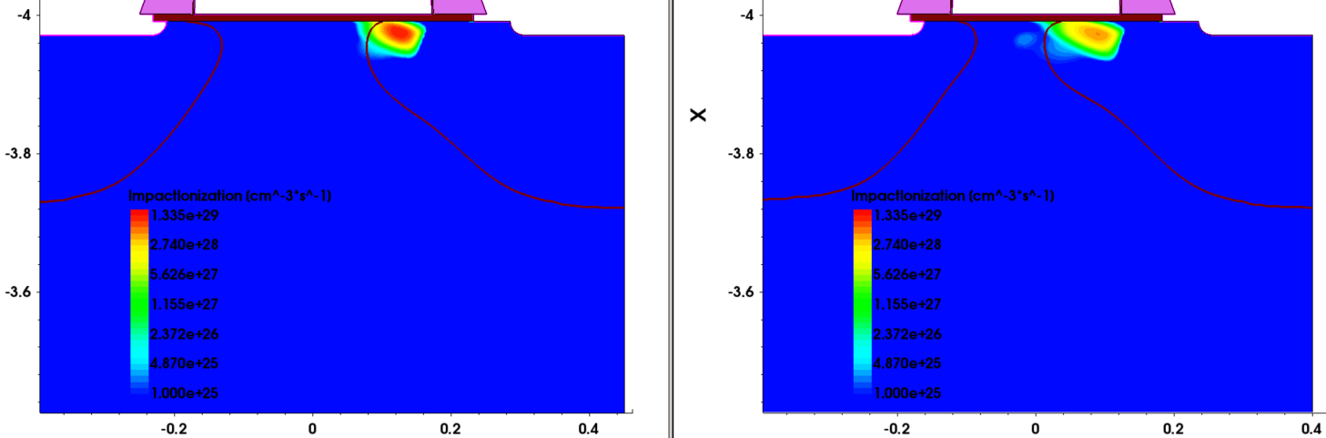
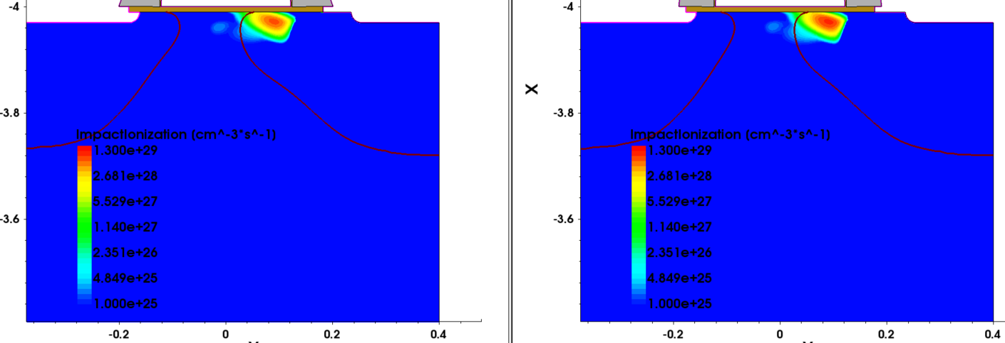
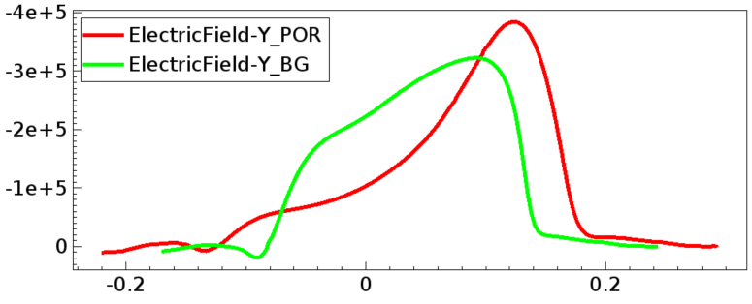
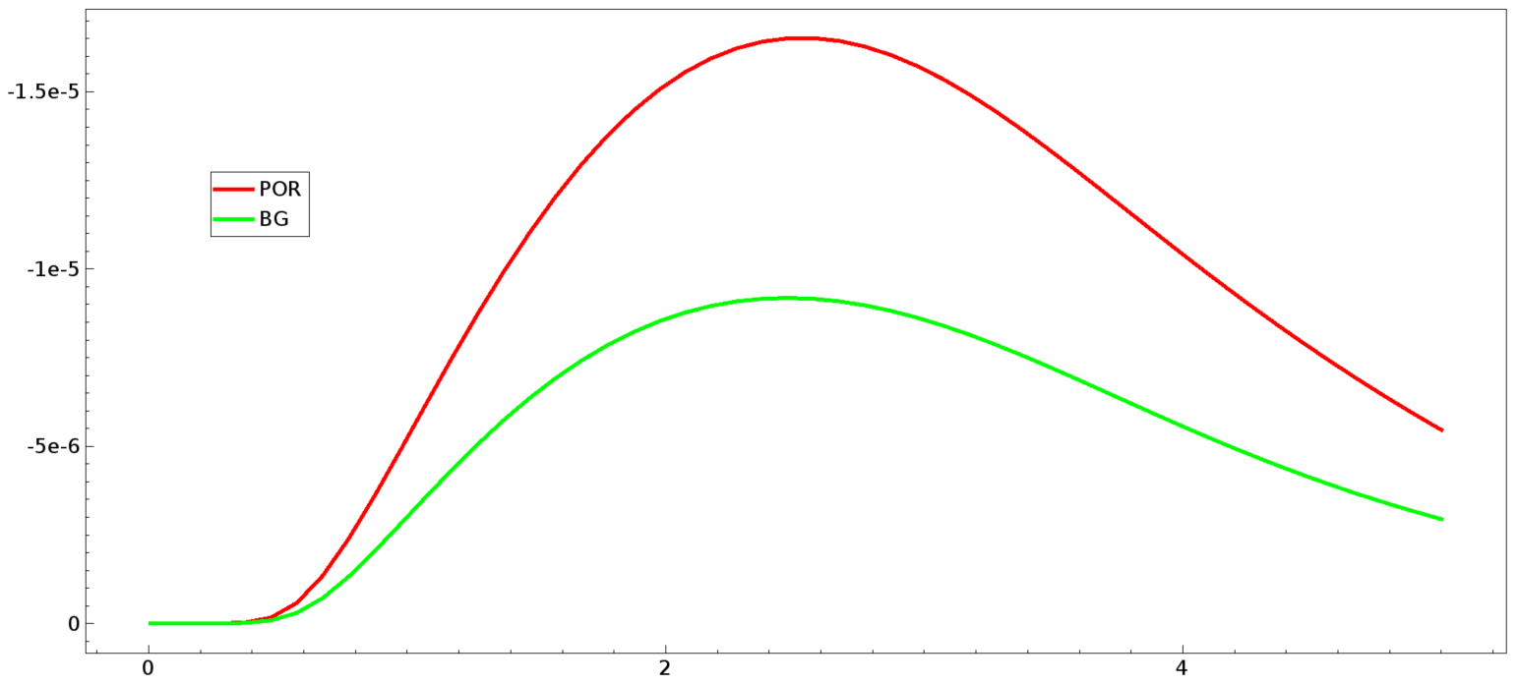
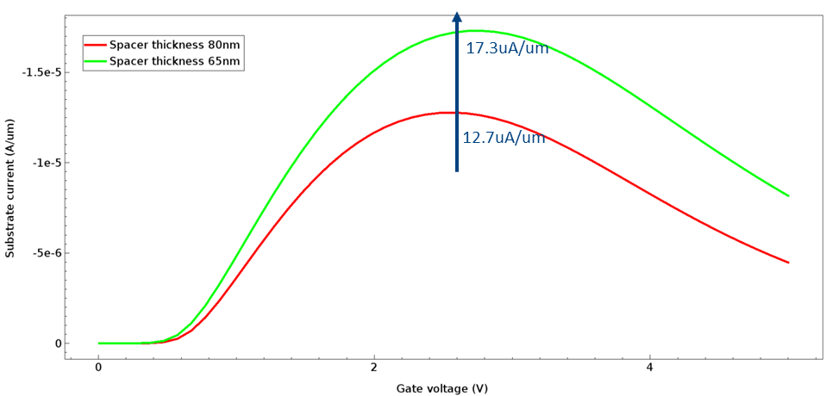
ATF L_{G}=350nm, 80nm Spacer
Exp1: 250nm L_{G}, 80nm Spacer
Exp2: 250nm L_{G}, 65nm L_{G}
ATF
Exp2
Exp1
Exp1

Slide 5
Device 2: PHV 6.88/5 for LYS & 2.64/5 for LXD
Known:
  L=5µm assessment is based on 4.56µm silicon (22nm smaller than target)
  The Good: On and Off for both selected and deselect are within the allowed deviation from the goals (5% slower)
  The Bad: I_{submax} increases, ~10X higher
  L1D exhibits no corner thinning; Unknown:
  Validity of DTS particular on leakage (I_{off} and GIDL/GISL) and reliability spec
Model and Synopsis
  L=5µm works ➔ Successful channel/halo engineering adequately supports Pitch shrink
  Higher peak field/power degrades impact ionization and gated diode leakage
Technology validation Strategy and Design Collateral alignment
  I_{submax} and GISL limited skew
  Inner Junction seeking for ATF-matching (interaction such as delta L can be addressed thru L_{G} bias/sizing) thru Tip/SD implant and/or spacer width including 1) Tip doping profile 2) Peak field 3) peak power
  Narrow Z effects for LXD ? Alos, how to model it (primitive design collateral questions to compact model and netlist) ?
  Similar to Device 1, should Tox and L_{G} skew be included in this phase of TD-DE exploration? ⬅ what is the expected outcome for path correction?

Slide 6
Scrach Pad

Slide 7
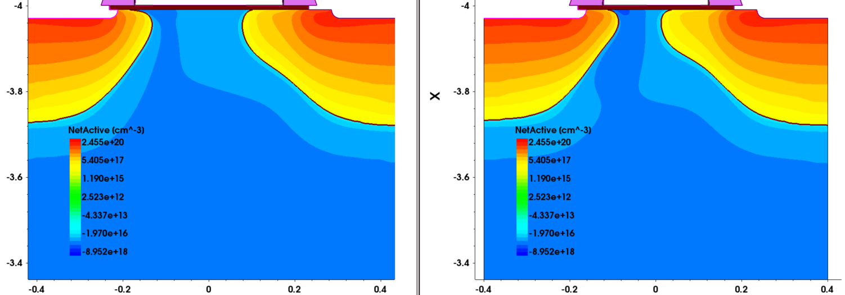
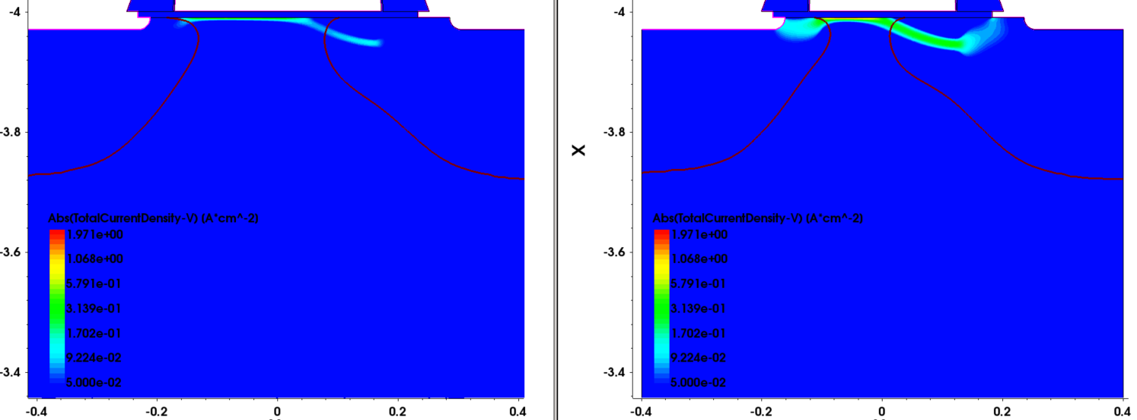
1. NHV SSH L250 DoE9 Idlin 86uA/um targeting best guess condition
Split | Lgate | NHVSVT_ Dose | SLDD_ Dose | SLDD_ Energy | SSH Halo Dose | SSH Halo energy | DLDD_ Dose | DLDD_ Energy | DLDD_ Tilt | Vtgm (V) | IdLin (uA/um) | IdSat (uA/um) | Isubmax (uA/um) | IdOff (pA/um) | BVdss (V)
POR | 0.35 | 3.5E+12 | 1E+14 | 20 | 2.6E+13 | 16 | 5E+13 | 45 | 35 | 0.535 | 68.4 | 533 | 16.46 | 15.4 | 9.9
BG | 0.25 | 3E+12 | 3E+14 | 10 | 4.0E+13 | 16 | 3E+13 | 55 | 45 | 0.766 | 86.94 | 609.9 | 9.185 | 44.53 | 10.5
Target |  |  |  |  |  |  |  |  |  |  | >86 |  | <16.5 | <1nA/um | >7
Net doping
Idoff current
211nm
100nm
POR
BG
POR
BG
Impact ionization @Vg=2.5V&Vd=5V
Lateral electrical field
Cut line
Isubmax
reduction
POR
BG
BG condition gives Idlin on target, Idoff within control, better Isubmax and BV than target.
The good BG performance comes from scaled gate length, shallower and heavier SSLDD implant as well as deeper and lighter drain side LDD implant.

Slide 8
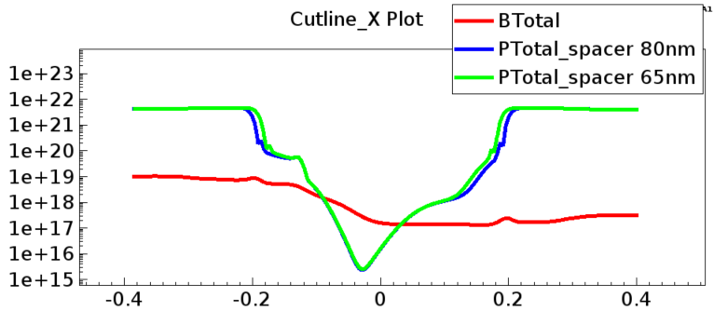
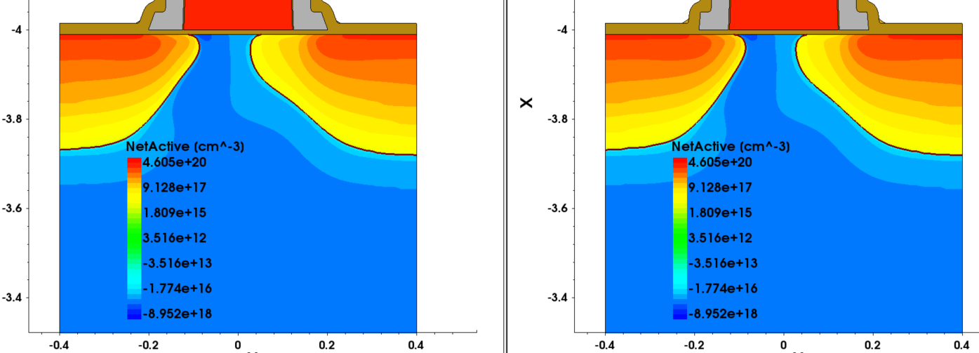
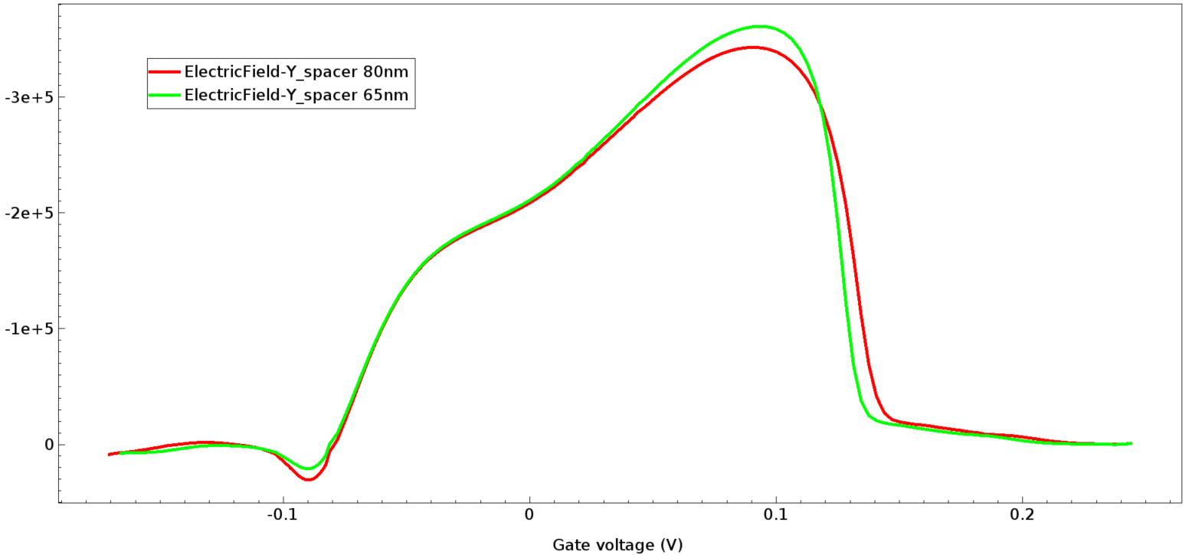
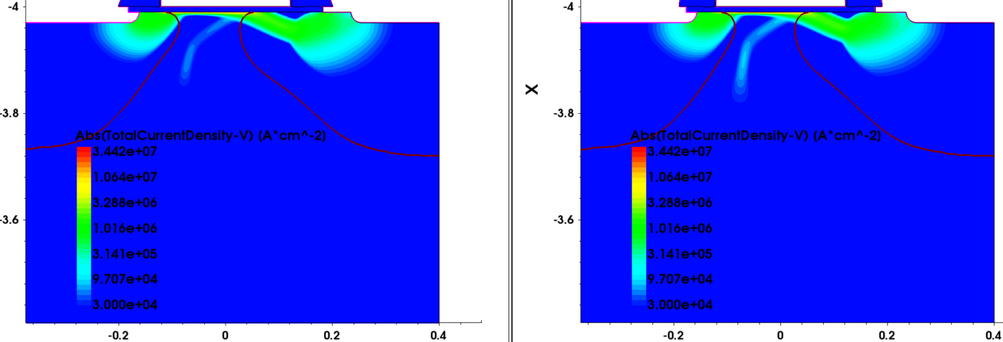
2. Thinner spacer impact on Isubmax @Vg=2.5V&Vd=5V
Spacer 80nm
Spacer 65nm
Doping profile
Current path
(+36%)
Impact ionization

Slide 9
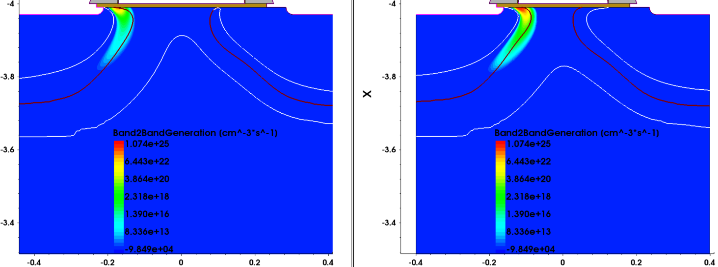
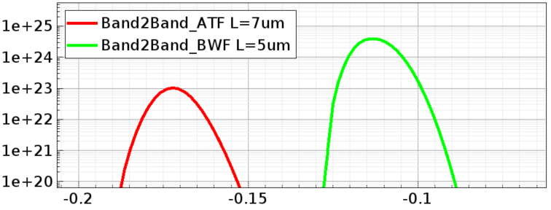
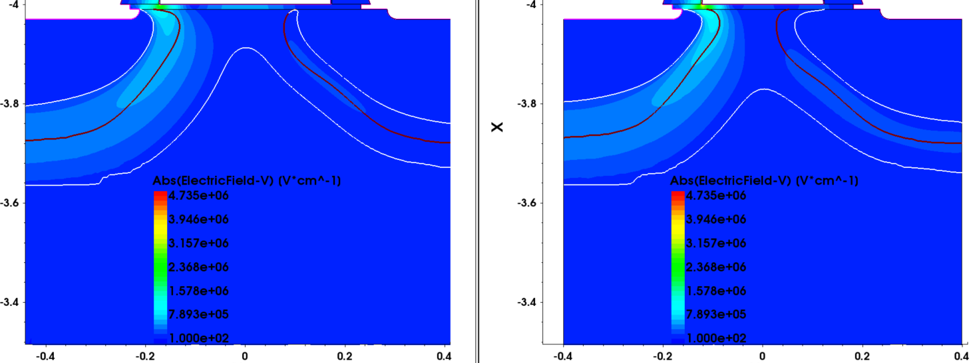
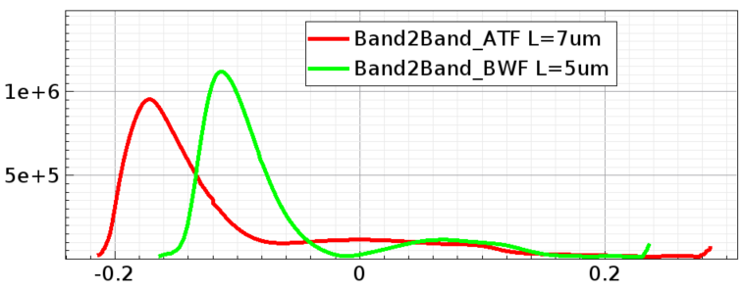
3. GISL comparison between ATF L=7 and BWF L=5
ATF L=7
BFW L=5
Band2band generation
Electrical field

Slide 10
4. Source side LDD impact on device
NHVLVT_Dose | Lgate | SLDD_Dose | SLDD_Energy | SLDD_Tilt | SLDD2_Dose | SLDD2_Energy | SLDD2_Tilt | Spacer | Vtgm | IdLin | IdSat | IdOff5 | Isubmax | GISL5
 |  |  |  |  |  |  |  | nm | V | A/um | A/um | A/um | A/um | A/um
3.50E+12 | 0.35 | 1.00E+14 | 20 | 7 | 0 | 20 | 30 | 80 | 0.535 | 6.83E-05 | 5.33E-04 | 1.54E-11 | 1.65E-05 | 3.29E-12
3.50E+12 | 0.35 | 1.00E+14 | 20 | 7 | 0 | 20 | 30 | 65 | 0.529 | 7.14E-05 | 5.46E-04 | 2.03E-11 | 1.81E-05 | 1.48E-11
3.00E+12 | 0.25 | 3.00E+14 | 10 | 7 | 0 | 20 | 30 | 80 | 0.78 | 8.55E-05 | 5.94E-04 | 1.62E-11 | 1.28E-05 | 1.16E-10
3.00E+12 | 0.25 | 3.00E+14 | 10 | 7 | 0 | 20 | 30 | 65 | 0.763 | 8.86E-05 | 6.05E-04 | 4.13E-11 | 1.73E-05 | 1.24E-10
3.00E+12 | 0.25 | 1.01E+14 | 20 | 7 | 0 | 20 | 30 | 80 | 0.79 | 7.08E-05 |  | 2.47E-12 |  | 4.80E-12
3.00E+12 | 0.25 | 1.01E+14 | 20 | 7 | 0 | 20 | 30 | 65 | 0.769 | 7.72E-05 |  | 1.07E-11 |  | 2.85E-11
3.00E+12 | 0.25 | 1.50E+14 | 10 | 7 | 1.50E+14 | 20 | 30 | 80 | 0.371 | 9.81E-05 |  | 1.28E-06 |  | 7.54E-11
3.00E+12 | 0.25 | 1.50E+14 | 10 | 7 | 1.50E+14 | 20 | 30 | 65 | 0.365 | 1.02E-04 |  | 2.60E-06 |  | 8.03E-11

