Slide 1
AR Update: Identify Checkpoint for MLC Decision Point(s)
Understand controlling & engineering intermediate PM state, without disturb
  Success Criteria including assumption and model for a working mid state (one model)
    Validate of mid state physically (αSDαPM) – data collected, analysis pending
    Defining success criteria of ‘amorphous’, ‘nucleation’ and ‘growth’ distribution – not start
  Model Validation
    Components of variance quantified – partially done, question raised on “initial state”, ie. is mid state amorphous PM
    Understand source of within bit (trial to trial) sigma – Same above
    How to control (process/device)? – Not Start, likely need silicon experiment on composition and corresponding interface (lamina and seal)
  What is impact of scaling?
    Amorphous, nucleation and growth distribution of scaled cell meeting success criteria – Not start, plan to use ATF silicon in Q4
    Scaling projection for array operation – Not start
Understand controlling & engineering non-phase change state
  Paper models articulated with assumptions – WIP; Two speculated “interfacial” models with physical abstract yet to be quantified.
  Model validation
    TTT Fingerprint – wip; <10% of NPC bits available after pulse, most of mid-state bits exhibit partial crystalline behavior; no POR SD on single-chal si
    Empirical models segmentation for the source of memory window – not start, PFA vs. TTT planned (may compete with Lab resources)
    Reliability such as retention, disturb and cycling endurance – Not start, use exiting S26 and SC silicon in hand
    Physical models & validation – not start, S26 based SD experiment segmentation (material composition and thickness variation, single chal preferred) for ∆VT tuning and sigma tightening.
  What is impact of scaling – not start, ATF based full stack and single chal experiment on SD
Required to answer basic questions/understanding and/or convince black-box can be controlled – some started, wip.
Study Plan
  Resource(s) allocated with this as primary job – Fuga 33% + team Hemant (to be finalized, 100% expected). Process resources ZBB’d until ATF gate lifted
  Study Plan in place (DK + Resource) – Fuga owns it. We are 75% complete; revising study plan of Engineering amorphous PM states.
  Scope contained (resources/silicon) until above questions answered – Yes with RTD process constraint management kicked in (ie. no ATF SC flow and experiment).
Strategic goal: EOY step up / down – no visibility today. Will know in a couple week team reengaged.

Slide 2
AR: Publish definitions for collateral naming
AR: Establish explicit linkages to Mase’s PLC
Design Collateral Schedule | 2020 |  |  |  | 2021 |  |  |  | 2022
 | Q1 | Q2 | Q3 | Q4 | Q1 | Q2 | Q3 | Q4 | Q1 | Q2 | Q3 | Q4
Design Milestone |  |  |  |  |  |  |  | R0 | R1 | R2 | R3 | DBR
Scaling assessment
Window Assessment |  |  |  |  |  | 0.1.0
Silicon based Collateral Development |  |  |  |  |  |  |  | 0.6.0
NTI readiness |  |  |  |  |  |  |  |  |  | 0.8.0 |  | 1.0.0
Stage | Collateral | CMOS Scope
Scaling assessment | Use ATF & Judgement (Spread sheet) | Analyze ATF design, TC03 & ALF etest to set DR/x’tor expectations to meet LRP Investigate simple line/space scaling and alternatives for x’tor augmentation Two TC03 LCs to validate scaling strategy at “1st principle” Use the calibrated TCAD model to generate R0.1 design collateral Corners (20nm L_{G} sizing window) and skews (±120mV Vt centering) cover assumptions and uncertainties for alignment
Window assessment | Rev 0.1.0 ~ Rev 0.5.x | Use R0.1 corners and skews for circuit function yield assessment Use 2~3 TC03 LCs for technology capability and realistic worst-case assessment (5 HVTs from disaggregated processed wafers) The union of circuit function yield and technology capability establishes the speculative technology boundary The corresponding TC03 HVTs will be used for reliability assessment and mitigation Low level of DR change from Collateral R0.1
Silicon Based Collateral Development | Rev 0.6.0 ~ Rev 0.7.x | TC04 TO/NTI for the integrated P1250 development by the end of Q2/21 (10 WNF estimated) 2~3 TC04 LCs for DTS &DR RA/RM and centering Design collateral to be generated from TC04, plus engineering judgement, for design execution
NTI readiness | Rev 0.8.0 ~ Rev 1.0.0 | A self consistent MTS and DTS/DR is validated by TC04 “yield” 3~4 LCs with ”final white paper” quality demonstrated Yielding the final design collateral for pre silicon DV; LVS, SIM and DRC gate tape-in

Slide 3
AR: Bring back learnings from ATF collateral (went worked well, what didn’t) in order to improve learning for BWF
Known Known:
  ATF DBR was gated by swimlane review ➔ Swimlane review at key milestones in product life cycle
  Missed critical silicon-based reliability mitigation incorporated with Collateral Rev 0.8 for Design Rev 2
  Rev 0.8 equivalent model was released with significant amount of speculation with no loop closure before target silicon was available (Is there a Rev 1.0 to gate TI?)
  No gate to collateral release – need to establish success picture for Rev 0.6, 0.8 and 1.0
Known Unknown:
  We are analyzing the required change incurred via ATF post silicon DV (see Santosh’s analysis on DTS change for ATF stepping)
Known good process:
  P1250 follows P8x3/P8x4 TD-DE workflow model (TD vs. FPG/WCCG).
  Likely to reintroduce Allowed Deviation from Target (ADT) methodology for Rev 0.8

Slide 4
AR: Add ATF silicon learning line to collateral schedule
wip

Slide 5
Backup Materials

Slide 6
Optane Media PLC (BWF)
Technology and Component Design Definition/Pathfinding
Technology and Component Design Pre-Si Validation
Technology and Component Design Silicon Validation and Development
~3-4 qtrs
~4 qtrs
~8 qtrs
TC04 TI
BWF33 TI
Spider TI
A0 TI
Media PRQ
Anchors
MEDIA FAB
NTI/NPI
PILOT
LINE
LVM
PROD RAMP
HVM
TC04
C-ES0 C-ES1 C-ES2 C-QS C-PRQ
Spider
Media Sample Milestones
BWF33
Platform Samples Build
ES0 ES1 ES2 QS
TD/DE/PDE Collateral
0.1
0.6
0.8
1.0
Design
PFS
DS
R0
R1
R2
R3
TI
CSpec (inc policy)
-0.3
-0.2
-0.1
0.0
0.1
0.45
0.6
1.0
CMOS Functional
Die
Functional
PLS
LVM
Prod Silicon
PFS = Pathfinding Start
DS = Design Start
R0/R1/R2/R3 = Deign rev Milestones
TI = Tape In
TC04 = CMOS Test Chip fo BWF
BWF33 = Cell Stack Study on ATF
Spider = Cell Scaling Study on ATF
C-ES0/1/2/QS = Component Engineering Samples
ES0/1/2/QS = Platform Samples Build
C-PRQ = Media PRQ
Handshakes to other UPLC swim lanes
Early Spec Checkpoint
Optane Media Spec Alignment
Optane Media Spec Checkpoint 2
Optane Media Spec Checkpoint 1
Optane Mdia Si Validation Complete
Optane Media Pre-Si Validation Complete

Slide 7
Example –
Post ATF NTI changes (Rev a.24)
Courtesy of Santosh Raghavan

Slide 8
ATF NHV DTS Change Beyond NPI: Si-target based model update
NHV/NHV-TW/NHV-TW-SSH
NHVLVT
Device category | Dimensions affected | Changes in model compared to rev.a.22
Wide W devices | 200x200, 200x12, 200x9.7 | Idsat ↑
Middle W=10 devices | 10x9.7, 10x12, 10x200 | DVt ↑, Idlin ↓
Narrow W & short L devices (non-SSH) | 5.2x12, 4.24x9.7, 4.24x8, GYD (3.16x9.7), | DVt ↑, Idlin/Idsat (4.24x8) ↓, Idlin/Idsat (3.16x9.7) ↑, Idsat ↓ (5.2x12)
NHV-COL | LYD (3.16x5.52) | Vt ↓, DVt ↑
Short L & Narrow W SSH devices (L=7) | GXD (4.24x7), LXS (8.52x7) | Vt (8.52x7) ↓, DVt ↑, Idlin/Idsat ↓
Short L & Wide W devices (L=7, 10< W<50) | Fuse select (45x7), GXS (15.02x7) | Vt ↓, DVt ↓ at W45, DVt ↑ at W15, Idoff ↑, Idsat ↑, Idlin ↓
Device category | Dimensions affected | Changes in model compared to rev.a.22
Wide W devices | 200x200, 200x12, 200x9.7 | DVt ↓ , Idlin/Idsat ↑ at L200
Narrow W devices | 10x200, 10x12, 10x9.7 | DVt ↑ , Idlin/Idsat ↑ at L200, Idlin/Idsat ↓ at short L

Slide 9
ATF PHV DTS Change Beyond NPI: Si-target based model update (rev.a.24)
PHV
PHVLVT
Device category | Dimensions affected | Changes in model compared to rev.a.22
Wide W devices | 200x200, 200x12, 200x9.7, | Vt ↓, DVt ↓, Idsat (L200/L9.7)↓
Middle W=10 devices | 10x200, 10x12, 10x9.7 | Vt ↓ at high L, DVt ↑ at short L, Idlin/Idsat ↓
Narrow W, short L devices | 4.24x9.7, 4.24x8, 5.2x12, | Vt ↑, DVt ↑, Idlin/Idsat ↓
PHV-ROW | LXD (3.16x8) | Vt ↑, DVt ↑, Idlin/Idsat ↓
SiGe devices (L=7) | GYS (20.38x7), LYS (8.52x7) | DVt ↑, Idlin ↑, Idsat ↑
Device category | Dimensions affected | Changes in model compared to rev.a.22
Wide W, short L devices | 200x9.7 | Vt ↑, Idsat ↓
Narrow W, short L devices (W<=10, 9.7<= L<=12) | 10x12, 10x9.7, 5.2x12 | Vt ↑, DVt ↑ , Idlin/Idsat (W10) ↓

Slide 10
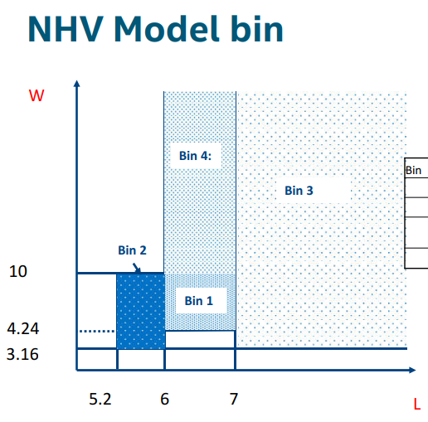
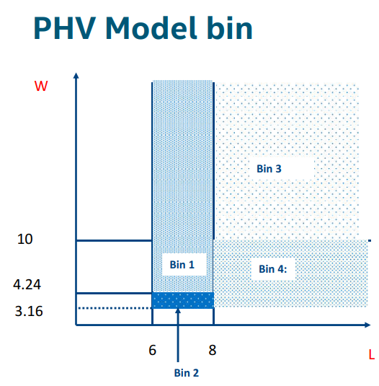
X – Provided targets
Missing targets in intermediate W/L region (shaded in green)
200
X
X
X
200
X
X
X
100
100
X
X
X
X
X
X
X
X
X
X
X
X
X
X
X
X
X
X
X
X
X
12
100
200
12
100
200

Slide 11
ATF A0 Postmortem (WIP)
Courtesy of Erv Hill

Slide 12
How did we get here?
Model release at ATF Rev 1was done with knowledge that FEOL flow was undergoing significant change
Closest silicon to end state was partial flow change, model was judged based on that silicon
  Vt, Idsat, Idlin, Idoff were captured reasonably well
  Body effect was missed
Class – Process file model was released with significant amount of engineering judgement with no loop closure when target silicon was available (4-6 weeks post model release)
  Total impact was HV and LV models being incorrect

Slide 13
How do we avoid in the future? (Green highlight items are new relative to ATF)
Swimlane review at key milestones in product life cycle
  ATF DBR was gated by swimlane review
BWF cycle should have swimlane review at the following milestones
  Design Start – are we ready to kick this into motion
  Rev 1 – is collateral ready? (goal is 80%)
    Conscious acceptance of gaps with closure plans
  Rev 3 – collateral should be >95%
  DBR – same as ATF

