Slide 1
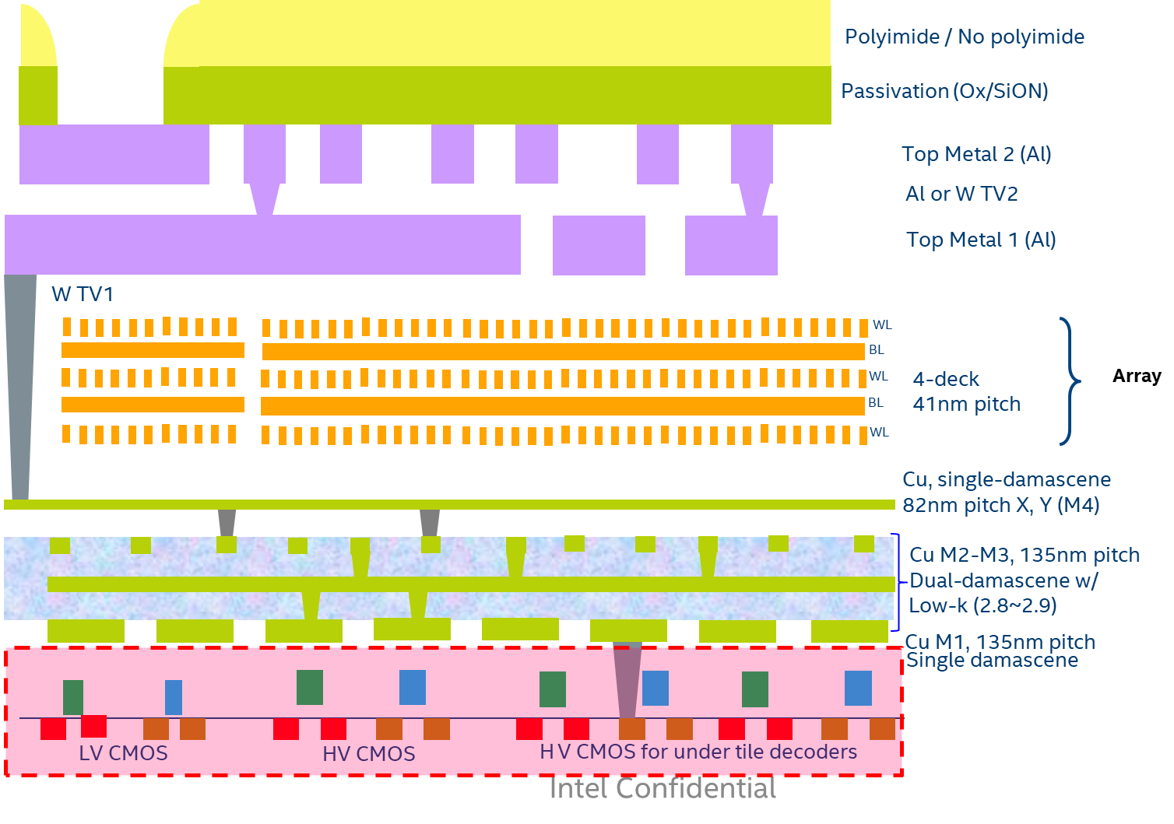
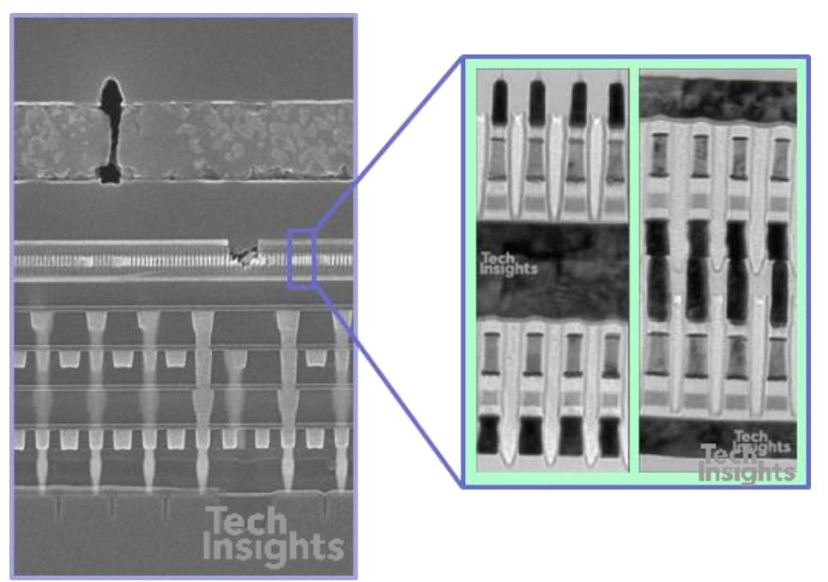
Array WL BL Metals
Schematic (4 Deck)
Teardown S15 (2 Deck)
Single Metal
Stack Metal

Slide 2
Towards Low Resistance WL BL Metals
Assess POR Line Resistance (RL) P1241, P1242
from RL and BL dimensions, extract ρ
Benchmark alternative materials (ρ vs CD, AR) for potential scaling/energy benefits

Slide 3
DTS (from Sachin)
WL BL Metals
Feature | Units | S26 WL0 (single) | S26 BL (stack) | P1241 (WL0 single) | P1241 (BL stack) | P1242 (WL0 single) | P1242 (BL stack)
Width W (nm) | nm | 20.00 | 20.00 | 14.00 | 14.00 | 14.00 | 14.00
Height H (nm) | nm | 35.00 | 80.00 | 30.00 | 60.00 | 30.00 | 60.00
AR | NA | 1.75 | 4.00 | 2.14 | 4.29 | 2.14 | 4.29
X-section Area | nm2 | 700.00 | 1600.00 | 420.00 | 840.00 | 420.00 | 840.00
Cell Pitch | nm | 40.50 | 40.50 | 33.50 | 33.50 | 26.50 | 26.50
Lenth L for 4K cells (nm) | um | 165.89 | 165.89 | 137.22 | 137.22 | 108.54 | 108.54
R (cell) | ohm | 9.30 | 5.40 | 16.87 | 11.13 | 13.34 | 8.80
R line | ohm/micron | 229.63 | 133.33 | 503.58 | 332.24 | 503.58 | 332.24
Resistivity calc | uohm.cm | 16.07 | 21.33 | 21.15 | 27.91 | 21.15 | 27.91
RL for Length with 4K cells | Kohm | 38.09 | 22.12 | 69.10 | 45.59 | 54.66 | 36.06
Capacitance/cell/side | aF | 5.80 | 14.00 | 4.74 | 10.67
Capacitance/line | aF/um | 286.42 | 691.36 | 282.99 | 637.01
Capacitance for 4K cells line | fF | 47.51 | 114.69 | 38.83 | 87.41

Slide 4
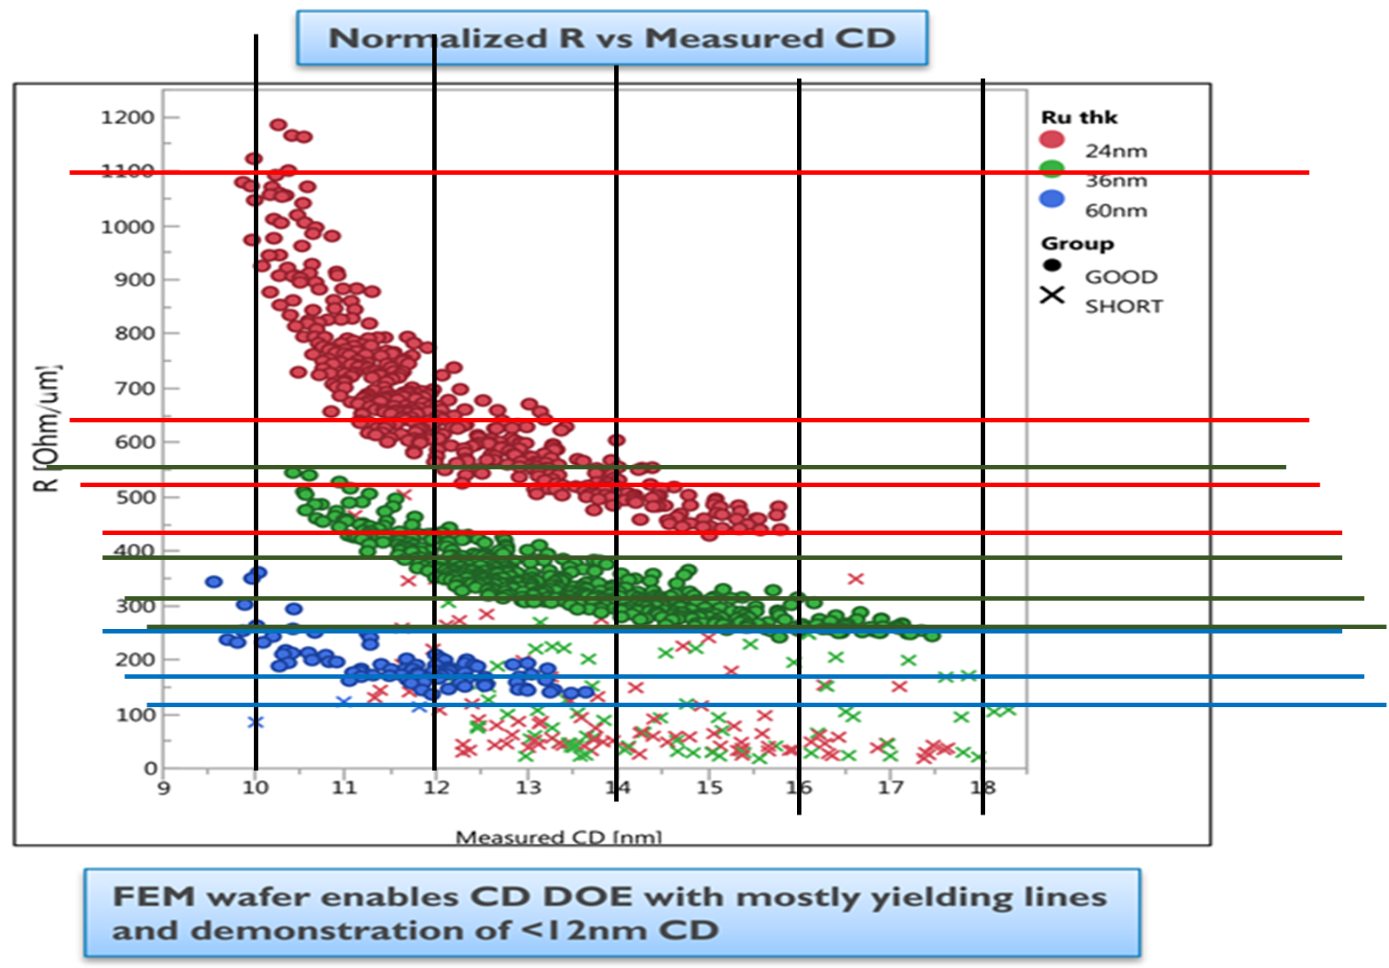
Ru vs W POR
H: 24 nm
ρ: 21.5 [30nm]
[p1241]
Ru Subtractive Etch
CD (nm) | Height (nm) | AR | Line R (ohm/micron) | Resistivity (uohm.cm)
10 | 24 | 2.40 | 1100 | 26.40
12 | 24 | 2.00 | 640 | 18.43
14 | 24 | 1.71 | 520 | 17.47
16 | 24 | 1.50 | 440 | 16.90
10 | 36 | 3.60 | 550 | 19.80
12 | 36 | 3.00 | 390 | 16.85
14 | 36 | 2.57 | 310 | 15.62
16 | 36 | 2.25 | 260 | 14.98
10 | 60 | 6.00 | 250 | 15.00
12 | 60 | 5.00 | 170 | 12.24
14 | 60 | 4.29 | 120 | 10.08
H: 36 nm
ρ [uohm.cm]
H: 60 nm
CD [nm]
R: 503 ohm/um[30nm]
[p1241]
CD 14nm and H 24 closest to matching DTS => Potential for ~ 17% capacitance reduction @ H 25nm

Slide 5
Status of Ru Work @ IMEC
Best IMEC Ru data suggest potential line capacitance reduction of ~17%
IMEC mainly focused on ALD/CVD for semi-damascene
Early (limited) work on PVD; Anelva tool
Blanket films Rsh vs thickness
Preliminary assessment of grain size vs thickness [no grain size modulation expts]
Note: Most of IMEC work subjected to w/ 420C FG anneal
Follow-up AR’s:
Assess line capacitance/reduction reduction based on 1242 DTS
Assess Electromigration of Ru (vs W)
Work on proposal (Max) for RTD Process Modules to start internal project
Engage vendors and/or IMEC on Custom Work etc?

Slide 6
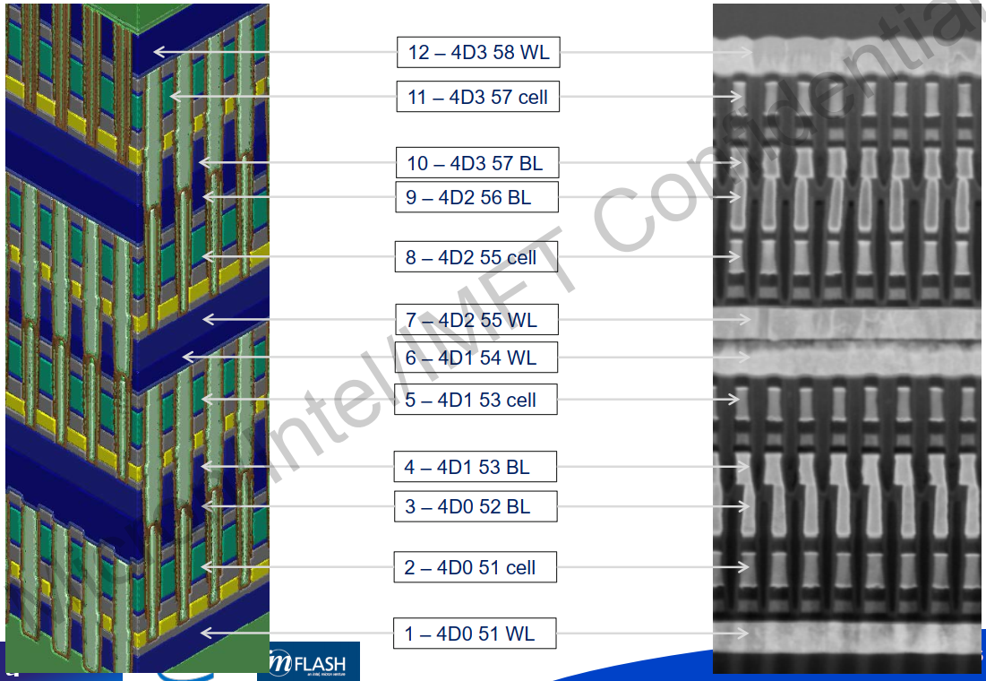
Methodology for DTS Capacitance
Line Capacitance known for S26
S26 ➔ ATF Capacitance
Si data available for line cap vs W height at 40nm Pitch
Based on this and known W height, Pitch changes, ATF capacitance estimated for DTS
WIP:
Addressing concerns about data of Cap vs W thickness
Use more recent / normalized experimental data
Develop TCAD based assessment of Cap vs Line P/H
ATF ➔ BWF Capacitance
Use calibrated TCAD and estimate of effective K to extrapolate line capacitance
TCAD based BWL Capacitance vs Metal Height

Slide 7
Ratio Math Based Capacitance Estimate
19.5nm
12.5nm
W
W
W
W
12.5nm
Ru
Ru
30nm
30nm
25 nm
P1241 (W)
P1242 (W)
P1242 (Ru)
 |  | P1241 (W) | P1242 (W) | P1242 (Ru)
Line CD | nm | 14 | 14.00 | 14.00
Line Height | nm | 30 | 30.00 | 25.00
Line Pitch | nm | 33.5 | 26.50 | 26.50
Line Space | nm | 19.5 | 12.50 | 12.50
Keff Space |  | 8 | 8.00 | 8.00
Cap / Cell / Side | aF | 4.74 | 5.85 | 4.87
Cap / 4K Cells | fF | 37.92 | 46.79 | 39.00
Cap / um | aF/um | 282.99 | 441.46 | 367.88
change vs 1241 |  | 1 | 1.23 | 1.03
change vs 1242 (W) |  |  | 1.00 | 0.83
P1241 (W) ➔ P1242 (W) Line Cap/Cell inc ~23%
P1242 (W) ➔ P1242 (Ru) Line Cap/Cell dec ~17%
P1241 (W) ➔ P1242 (Ru) Line Cap/Cell inc ~3%
These rough estimates to be updated with TCAD calibrated to expt data and realistic Keff for P1242

Slide 8
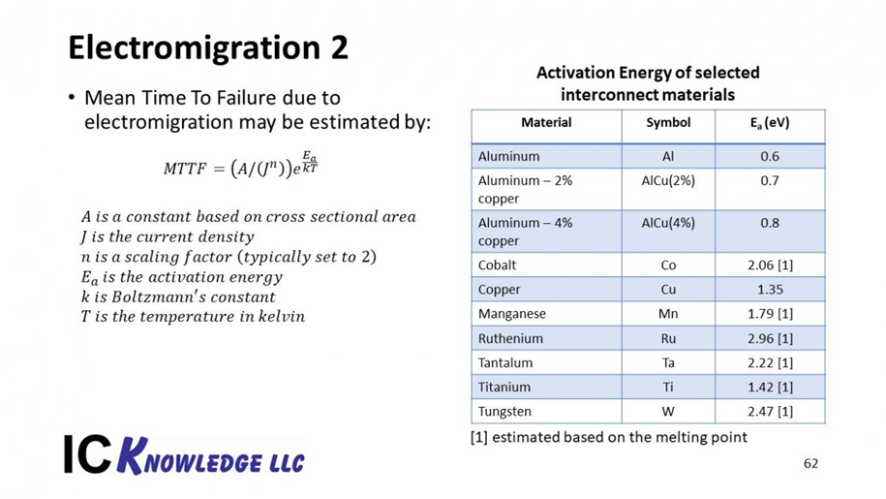
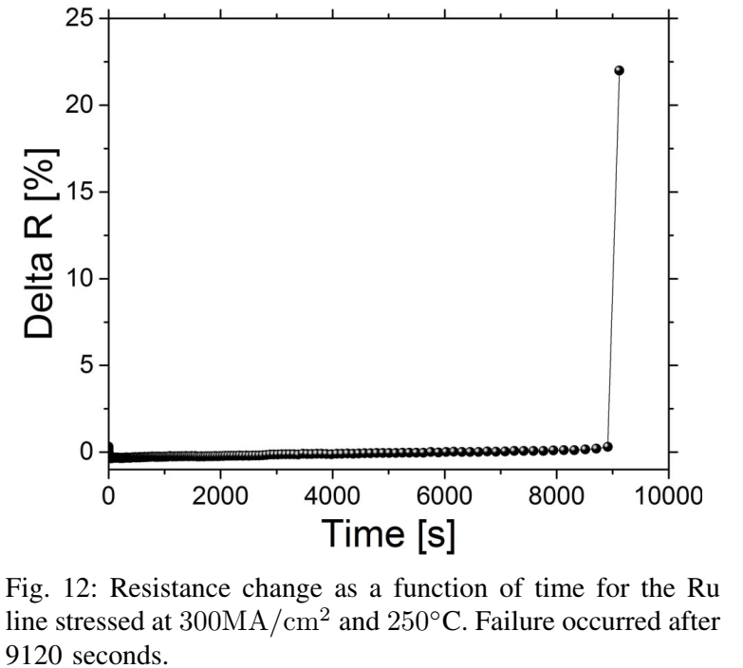
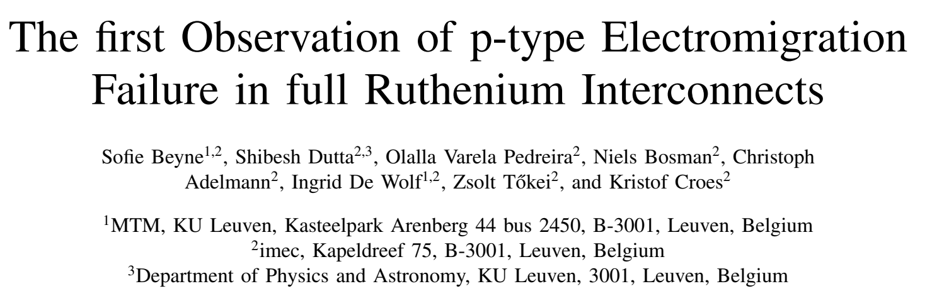
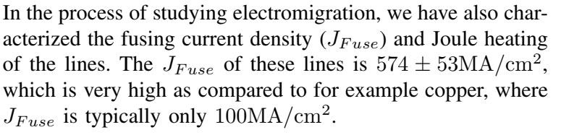
Electromigration of Ru lines
Ru expected to be resilient to EM, based on material properties
Recent experiments suggest that the onset of EM in scaled Ru line occur at high current densities [300MA/cm2 @ 250C induces failure after 9000 sec]
EM not expected to be show-stopper if Ru used for P1242

Slide 9
Backup

Slide 10
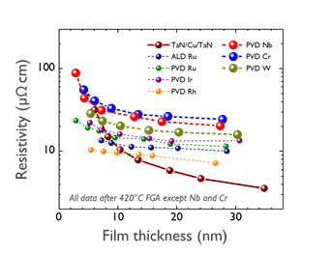
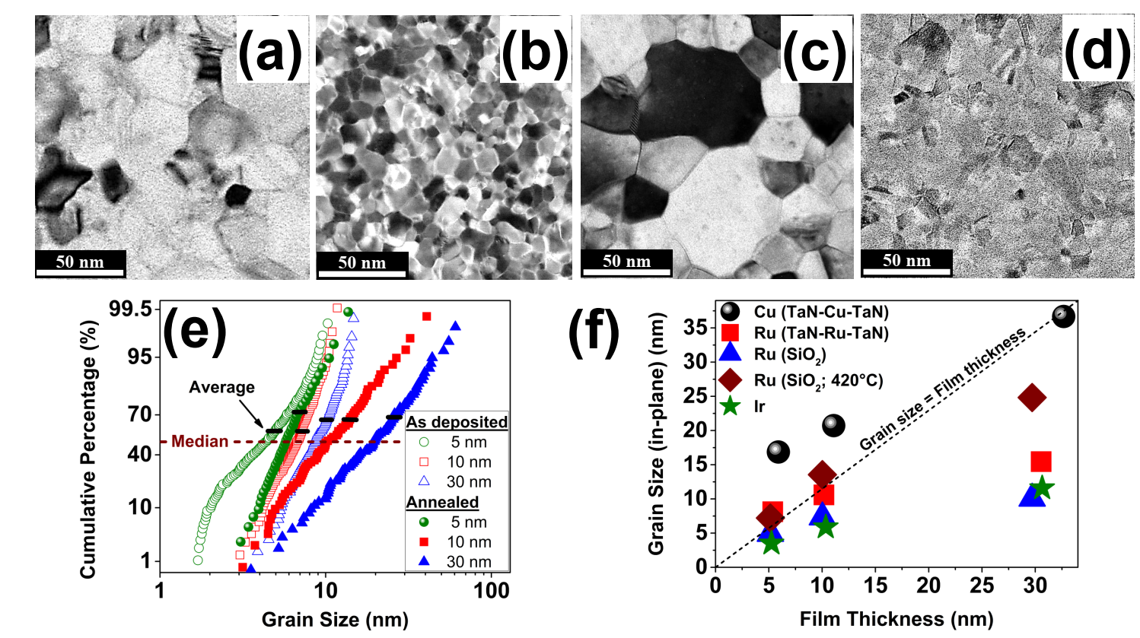
Early Work on PVD Ru

Slide 11
