Slide 1
Bow falls update
Frank, Diwakar, Khajak, Hongqian, Toan, Max, Rich
20 Apr 2020

Slide 2
Agenda
Cost analysis – what is the impact if OPO spec relaxed: Khaled
Wafer yield impact and ASML forecast decision: Frank
KLA process control analysis and tool roadmap alignment: Diwakar
ASML next-gen tool recommendation: Khajak

Slide 3
Cost analysis – what is the impact if OPO spec relaxed
Khaled

Slide 4
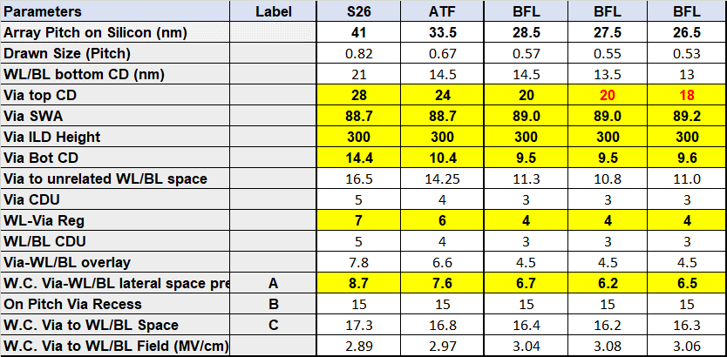
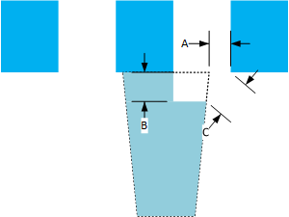

Array Registration
Array-Via registration impacts array pitch directly through w.c. array-via space requirements.
For each nm of pitch relaxation die size is impacted by ~5%.

Slide 5
Wafer yield impact and ASML forecast decision
Frank

Slide 6
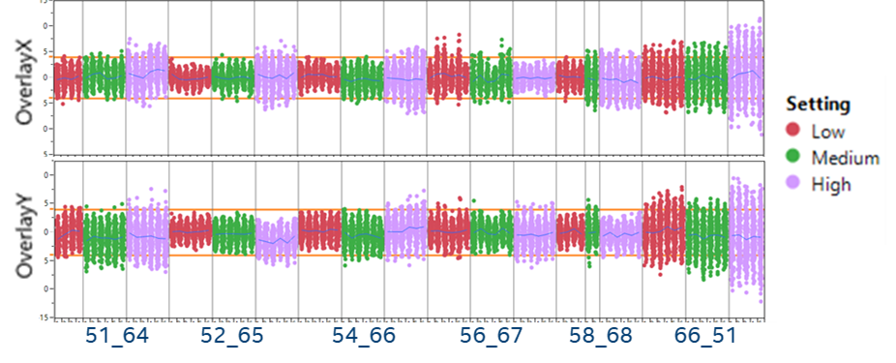
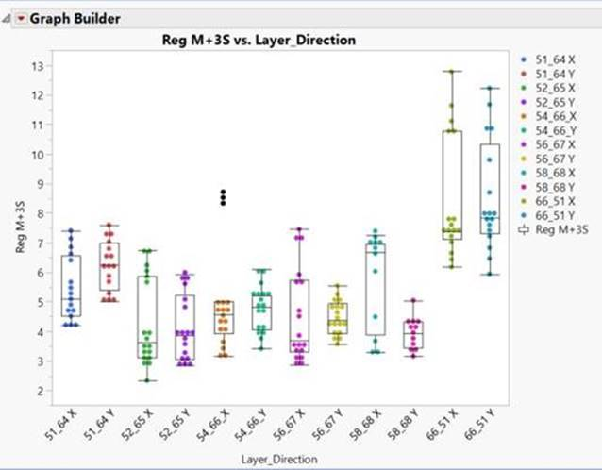
Projected Yield
Worked with statistician Rich Newman on analysis
Estimate site level yield at 4nm OPO with current overlay capability
S26A overlay data
Reviewed the 6 critical levels requiring 4nm OPO
3 lots per layer
  Lot with low variability, represent highest potential yield
  Lot with median variability; median yield
  Lot with high variability, worst yield
Range of the mean+3sigma results mimics inline data of last 30 lots

Slide 7
Estimated Litho Yield
Layer | Align to: | Reg meas to: | Critical Direction |  | Estimated Yield / CpK
 |  |  |  |  | High | Median | Low
51 | 64 | 64 | x | Yield | 98.8% | 95.1% | 80.4%
 |  |  |  | CpK | 0.93 | 0.78 | 0.52
52 | 94 | 65 | y | Yield | 100.0% | 99.9% | 87.8%
 |  |  |  | CpK | 1.34 | 1.05 | 0.59
54 | 94 | 66 | x | Yield | 99.7% | 98.5% | 91.2%
 |  |  |  | CpK | 1.09 | 0.83 | 0.57
56 | 94 | 67 | y | Yield | 99.5% | 98.3% | 97.4%
 |  |  |  | CpK | 0.97 | 0.96 | 0.76
58 | 94 | 68 | x | Yield | 99.8% | 92.1% | 86.5%
 |  |  |  | CpK | 1.07 | 0.60 | 0.53
66 | 94 | 51 | x | Yield | 88.9% | 82.3% | 55.0%
 |  |  |  | CpK | 0.59 | 0.55 | 0.31
Cumulative Litho Yield |  |  |  |  | 87.0% | 69.7% | 29.8%
At 4nm OPO
Estimated yield litho can deliver
  Between 87% to 30%
  Median around 70%
CpK values below what is needed for manufacturing
  Desired CpK @ 1.3
66 layer
  Improvement is primary focus for litho
  Noise in overlay measurements
    Mark damage during wafer processing

Slide 8
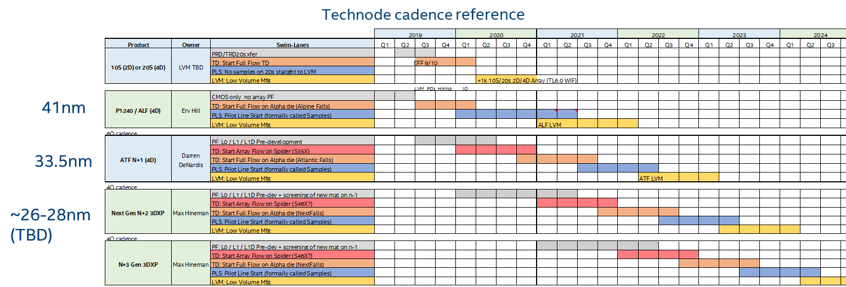
Technology Node Overlay Implications
Bow Falls requirements from Max
50% of wafer meeting design rule – Q3/2021
50% of wafer meeting structural yield inline – Q2/2022
  70% litho yield equates to ~56% structural yield going into cell optimization
Yield analysis indicates the NXT1980i could meet these requirements

Slide 9
Recommendation
RFP date of NXT2050i can be pushed until Q2/2023
Forecast: Apr 2020 => Q1/2022
Purchase order: Aug 2020 => Q2/2022
On-dock: Apr 2021 => Q1/2023
Required to meet manufacturing capability – CpK at 1.3
Provide litho time to continue to work on improving overlay
Alignment mark design and alignment strategy development
Registration target design and recipe optimization
Improvements to APC system
  Close on decision if internal APC solution is capable and can deliver developments needed to support tech node timeline

Slide 10
Improvement opportunities
Lot data
Low volume and for S26A it is convoluted between two sites
  Intel APC systems cannot support advanced partitioning (i.e. cell rev)
D2 and D3 optimization is lagging
Additional APC improvements
Scan up, scan down correction
Lateral movement from die to die
Dynamic NZO & CPE with sparse sampling
Full coverage of high order terms
Feedforward
Options
KLA R2R control has these capabilities available now
  Would need support to prioritize implementation
Add to internal APC system
  Need additional resources; updates take too long to create, validate, and implement

Slide 11
Diwakar

Slide 12
Outline
Optane 4nm OPO Evaluation Status and Roadmap
Metrology Roadmap

Slide 13
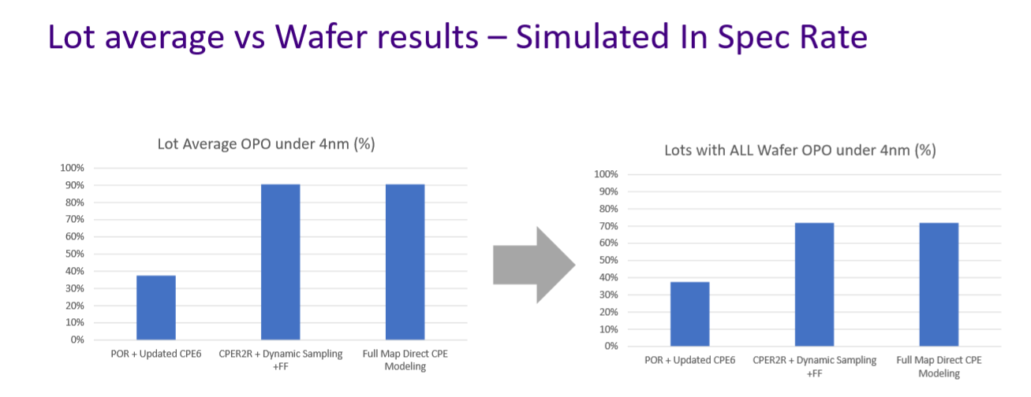
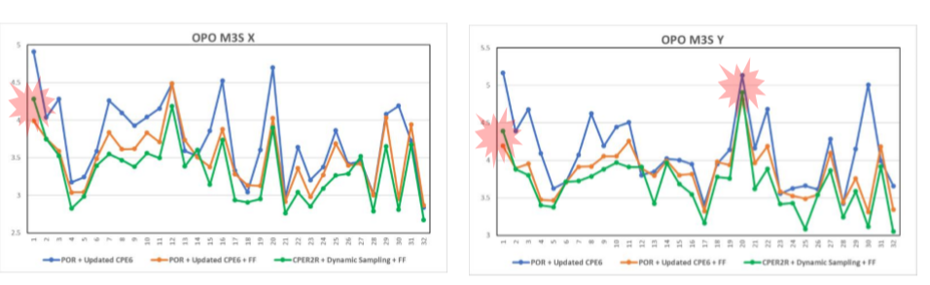
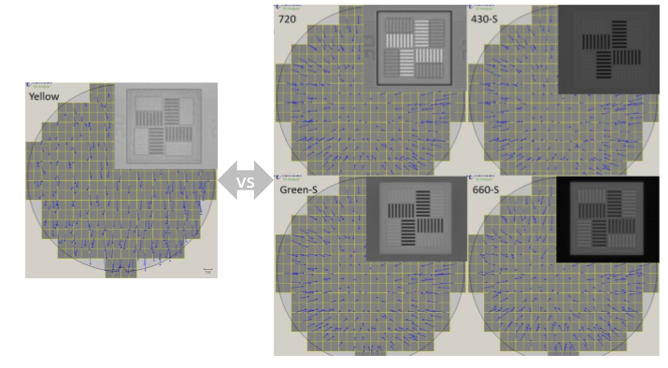
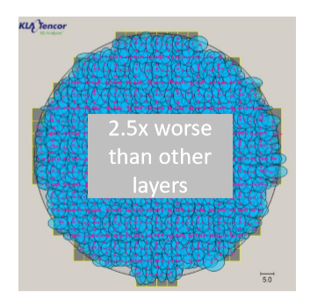
Optane 4nm OPO Update
R2R/Process Control (5DA+Qoniac) CPER2R + Feedforward
  KLA Simulation @ 53L results show 70% wfr passing rate with best performing layer 53L @ 4nm m+3s spec (99.7% site passing rate)
  15 lot test starting WW17 – expect data in next few weeks on Si to validate improvements
Metrology Improvements
  66L - Identified high noise in measurement, recipe optimization complete, ETA to convert WW20, pending end of the line verification (inline ACI read not robust to validate)
Metro Mark Improvements – simulated marks placed on
  KLA DBO marks added to ATF spider for 52L and 53L – ETA to validate measurements ~WW21
66L Metro measurement Opportunities – 3-4nm

Slide 14
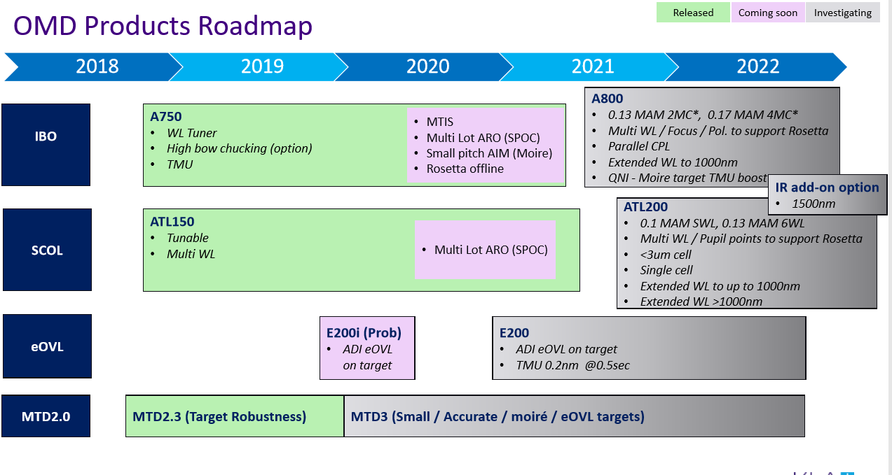
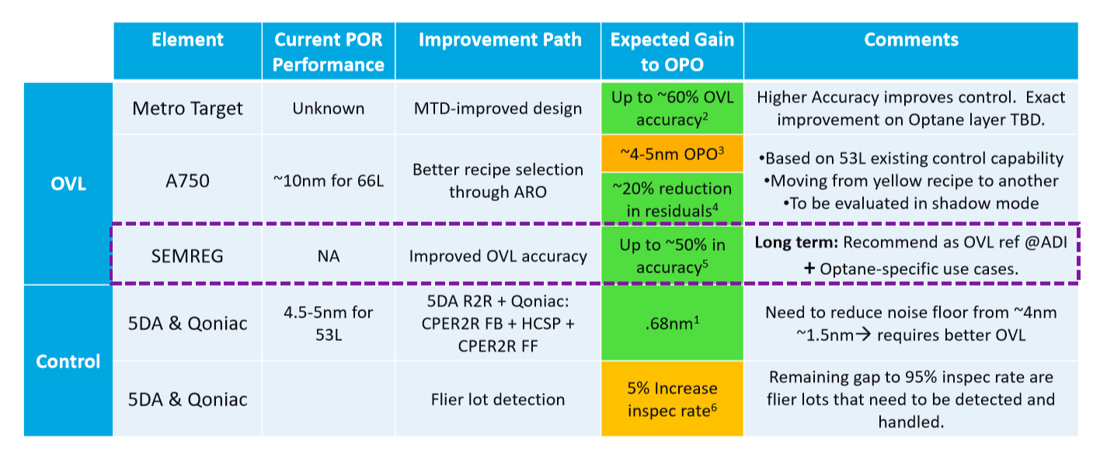
Metrology Roadmap
Metrology budget by technology needs to be <5% of OPO budget
Current tool @RTD ~ A750, TMU (tool spec) is not where need for bow falls, some layers for S26A show tighter performance
Opportunity on improving accuracy, need to explore DBO and eOVL – plan to send wfrs to eval to evaluate the benefits (potential to intersect eOVL)
Tool | TMU
A700 - IBO | <0.38nm
A750 - IBO | <0.25nm
A800 - IBO | Better - TBD
ATL150 - DBO | <0.2 nm
E200 – eOVL | 0.2nm
Intel Metrology Tool budget requirements

Slide 15
ASML next-gen tool recommendation
Khajak

Slide 16
Outline
Optane OPO improvement potential
Wafer-to-wafer OPO improvement
Comparison of NXT platforms

Slide 17
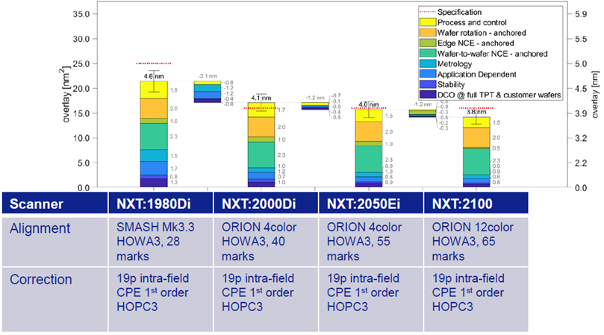
Estimated OPO improvement: 1980->2050
OPO improvement per layer:
  51L-64L: 13%
  52L-65L: 18%
  53L-52L: 13%
  66L-51L: 9%*
  * Noisy overlay measurement
  * Overlay recipe optimized; conversion ongoing
  Major OPO improvements come from:
  Wafer stage Mk5
  Reticle stage
  Alignment system
Assumptions made for calculations:
  Only hardware improvements intrinsic to each platform
  Mark number increase possible on all tools
    No TPT/cost penalty only on newer tools
  If NCE is not improving, that is with HARDWARE only
    No new software included
    No new APC/modeling included
    NCE could still improve by new apps/SW/APC

Slide 18
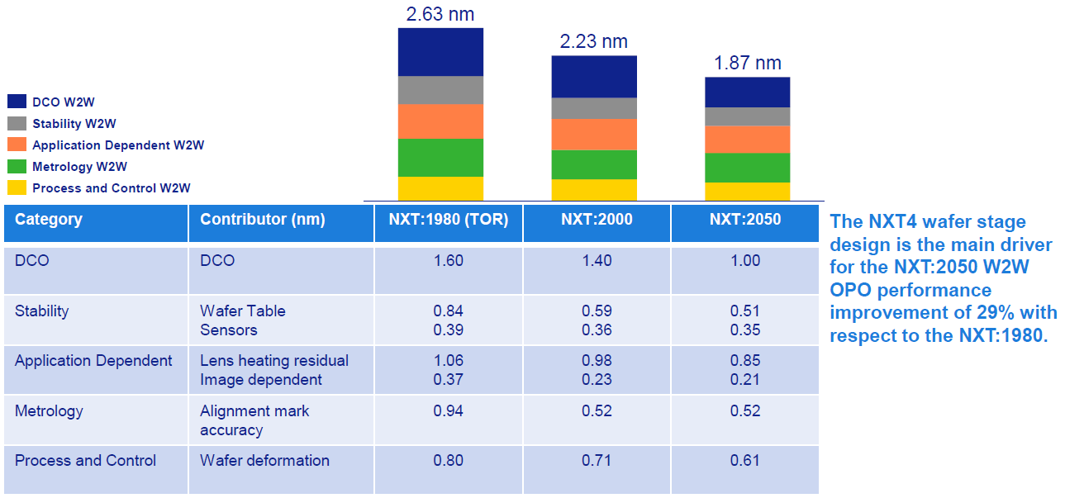
W2W OPO improvement 1980->2050i: 29%

Slide 19
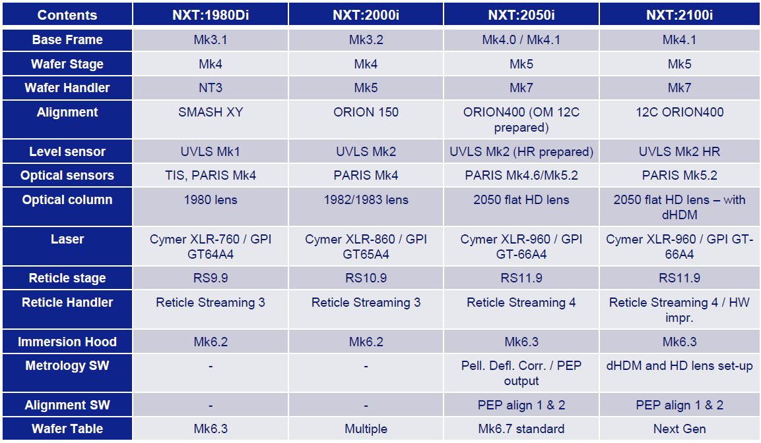
Comparison of NXT platforms
Major improvements 1980->2050:
  Wafer stage Mk4->Mk5
  Reticle stage 9.9->11.9
  Alignment system SMASH->ORION

Slide 20
Conclusions
1980 -> 2050/2100: best forward-looking purchase
  1980 -> 2000: not sufficient platform improvement for Optane TD/HVM
Tool purchase order can be pushed out to Q2/2022
  Based on Bow Falls program timeline and moving from TD to LVM/HVM
Critical help needed: one more dedicated resource to NSGa-Litho to deliver LOCNES
  Dynamic control will significantly improve OPO
  Mark design will drastically reduce noise
  Improved metrology (Archer 750, DBO) will reduce measurement noise

Slide 22
Backup

Slide 23
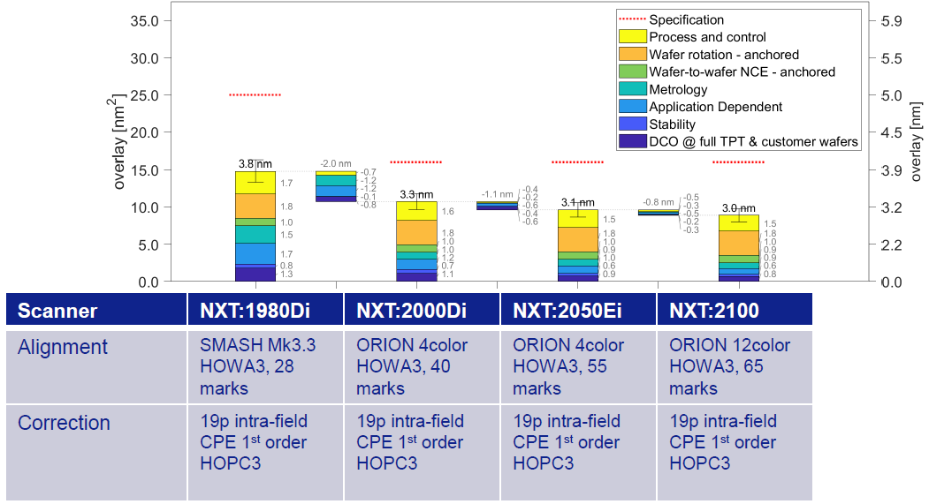
52L-65L estimated OPO improvement: 18%
Assumptions made for calculations:
  Only hardware improvements that come with a specific platform.
  Mark number increase possible on all platforms
    No TPT/cost penalty only on newer platforms.
  If NCE is not improving, that is with HARDWARE only
    No new software included
    No new APC/modeling included
    NCE could still improve by new apps/SW/APC
  Major OPO improvements come from:
  Wafer stage Mk5
  Reticle stage
  Alignment system

Slide 24
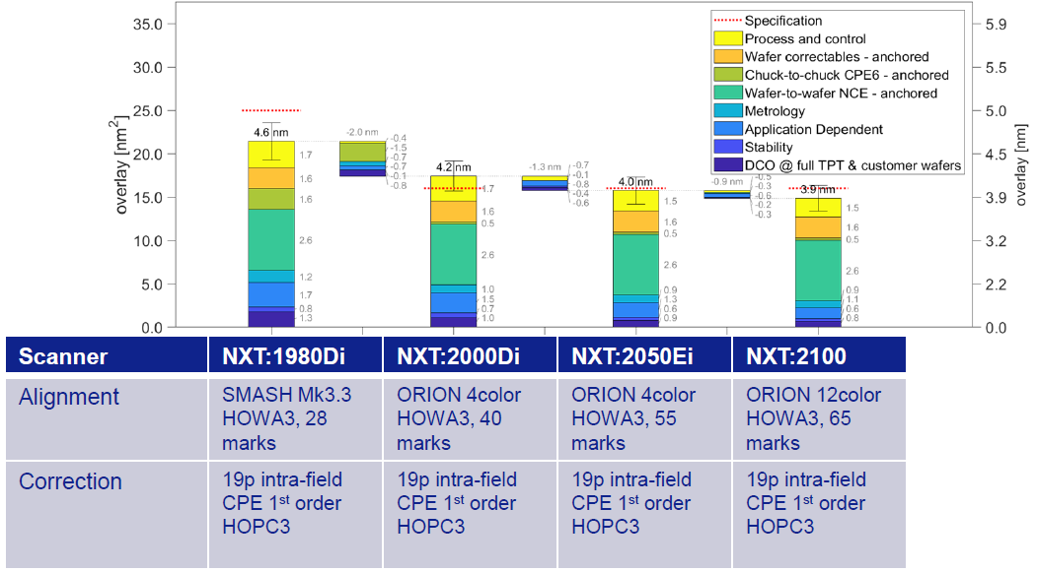
53L-52L estimated OPO improvement: 13%
Assumptions made for calculations:
  Only hardware improvements that come with a specific platform.
  Mark number increase possible on all platforms
    No TPT/cost penalty only on newer platforms.
  If NCE is not improving, that is with HARDWARE only
    No new software included
    No new APC/modeling included
    NCE could still improve by new apps/SW/APC
  Major OPO improvements come from:
  Wafer stage Mk5
  Reticle stage
  Alignment system

Slide 25
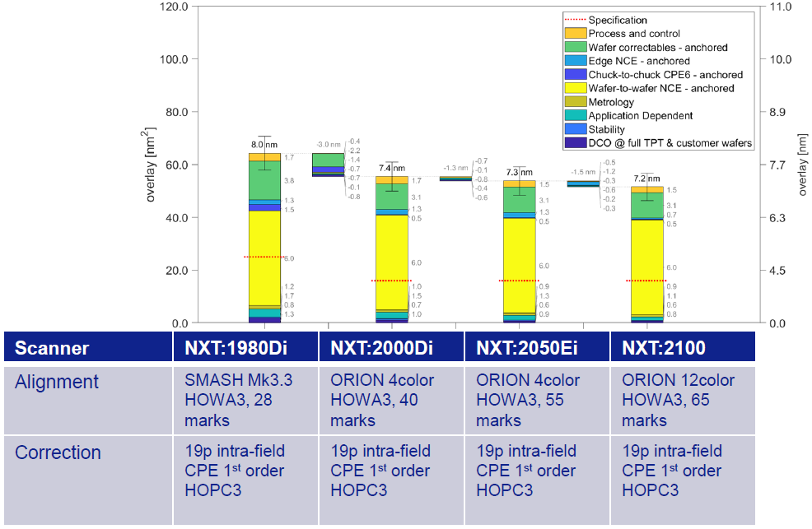
66L-51L estimated OPO improvement: 9%
Assumptions made for calculations:
  Only hardware improvements that come with a specific platform.
  Mark number increase possible on all platforms
    No TPT/cost penalty only on newer platforms.
  If NCE is not improving, that is with HARDWARE only
    No new software included
    No new APC/modeling included
    NCE could still improve by new apps/SW/APC
  Major OPO improvements come from:
  Wafer stage Mk5
  Reticle stage
  Alignment system
Overlay measurement signal very noisy.
Needs overlay recipe optimization. Conversion ongoing.

