Slide 1
3DXpoint PHV devices simulation
NSG TCAD
Baofu Zhu
04/02/2021

Slide 2
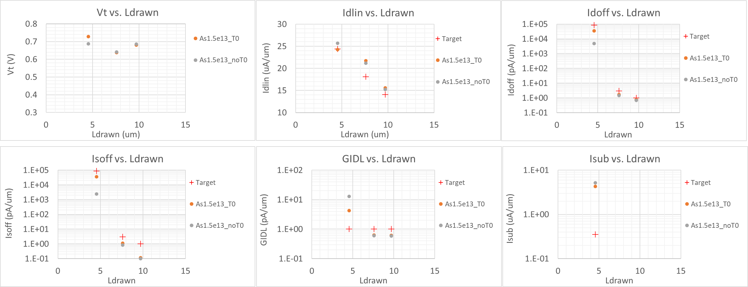
PHV pitch devices (20210406)
Phosphorus ENH implant: Ph 1e12, 86KeV (PHVLVT, PHVSVT, Pitch)
As ENH implant: As 1.5e13, 200KeV (PHVSVT and Pitch)
Phosphorus ENH implant: Ph 1.2e13, 86KeV (Pitch)
PHV tip implant: BF2 5e13, 65KeV, tilt 45 twist 22
BF2 2e13, 75KeV, tilt 0, twist 0

Slide 3
PHV implant table (20210406)
BWF | N-Well/PTS/VT imp | Enh Imp. | Enh Imp2. | Tip Imp
Pitch cell 250nm | P³¹ 1.3E13 @700KeV x4 P³¹ 6.0E12 @290KeV x4 P³¹ 1E12 @86KeV X4 | As⁷⁵ 1.5e13, 200KeV | P³¹ 1.2E13 @86KeV X4 | BF₂ 5E13@65KeV Tilt45/Twist0 X4 BF₂ 2E13@75KeV Tilt0
SVT. 400nm |  |  |  | BF2 7E13@45KeV Tilt45/Twist22
LVT 500nm
ATF | N-Well/PTS/VT imp | Enh Imp. | Enh Imp2. | Tip Imp
Pitch 350nm | P³¹ 1.3E13 @700KeV x4 P³¹ 6.0E12 @290KeV x4 P³¹ 4.5E12 @86KeV X4 |  |  | BF₂ 5E13@65KeV Tilt30/Twist0 X4
SVT 500nm |  |  |  | BF2 7E13@45KeV Tilt45/Twist22
LVT 500nm |  | B¹¹ 3.5e12 @32KeV X4

Slide 4
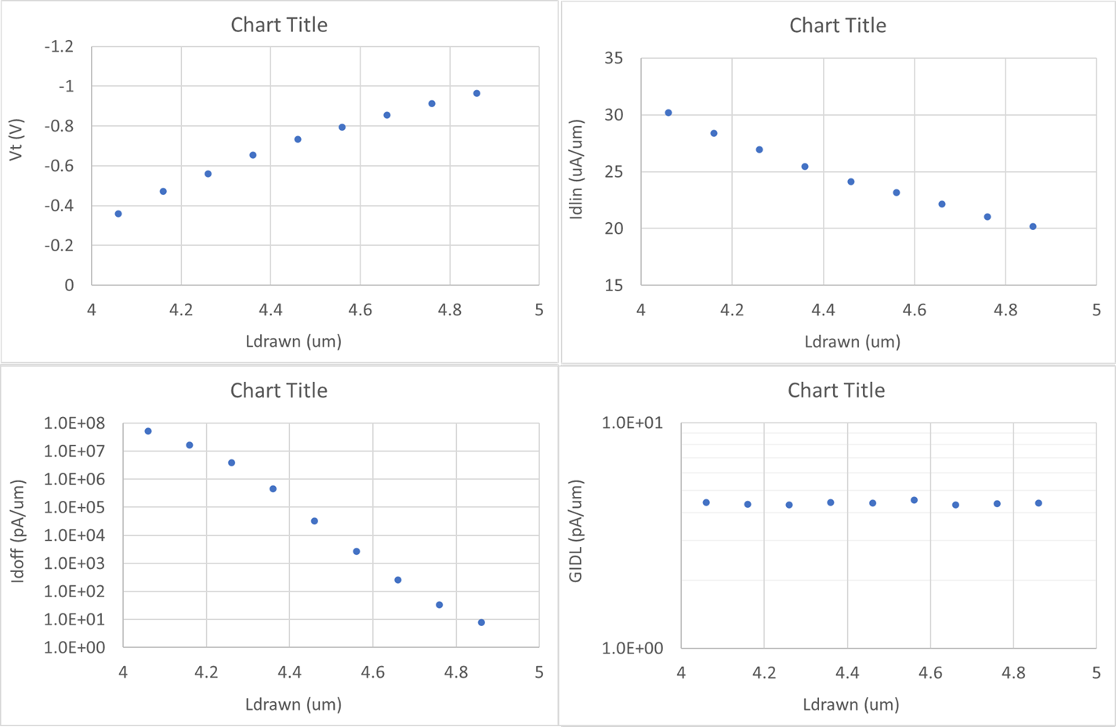
PHV pitch device roll off (20210407)
Physical gate length is changed by every 5nm.
~70mV/5nm
~5%/5nm
Tgt
5nm
L_{GP} = 225nm
Design rule is 5 lambda
-25nm total bias needed
PF: 228nm
Tox=100A
Spacer = 70nm
Slow: Lg 230nm
Tox = 102A
“Vt” doping +2%
Tip doping no change
Spacer =71nm
Slow: Lg 220nm
Tox = 98A
“Vt” doping -2%
Tip doping no change
Spacer =69nm
---------
RTA impact?
Fast
Tgt
~10X/5nm
Tgt

Slide 5
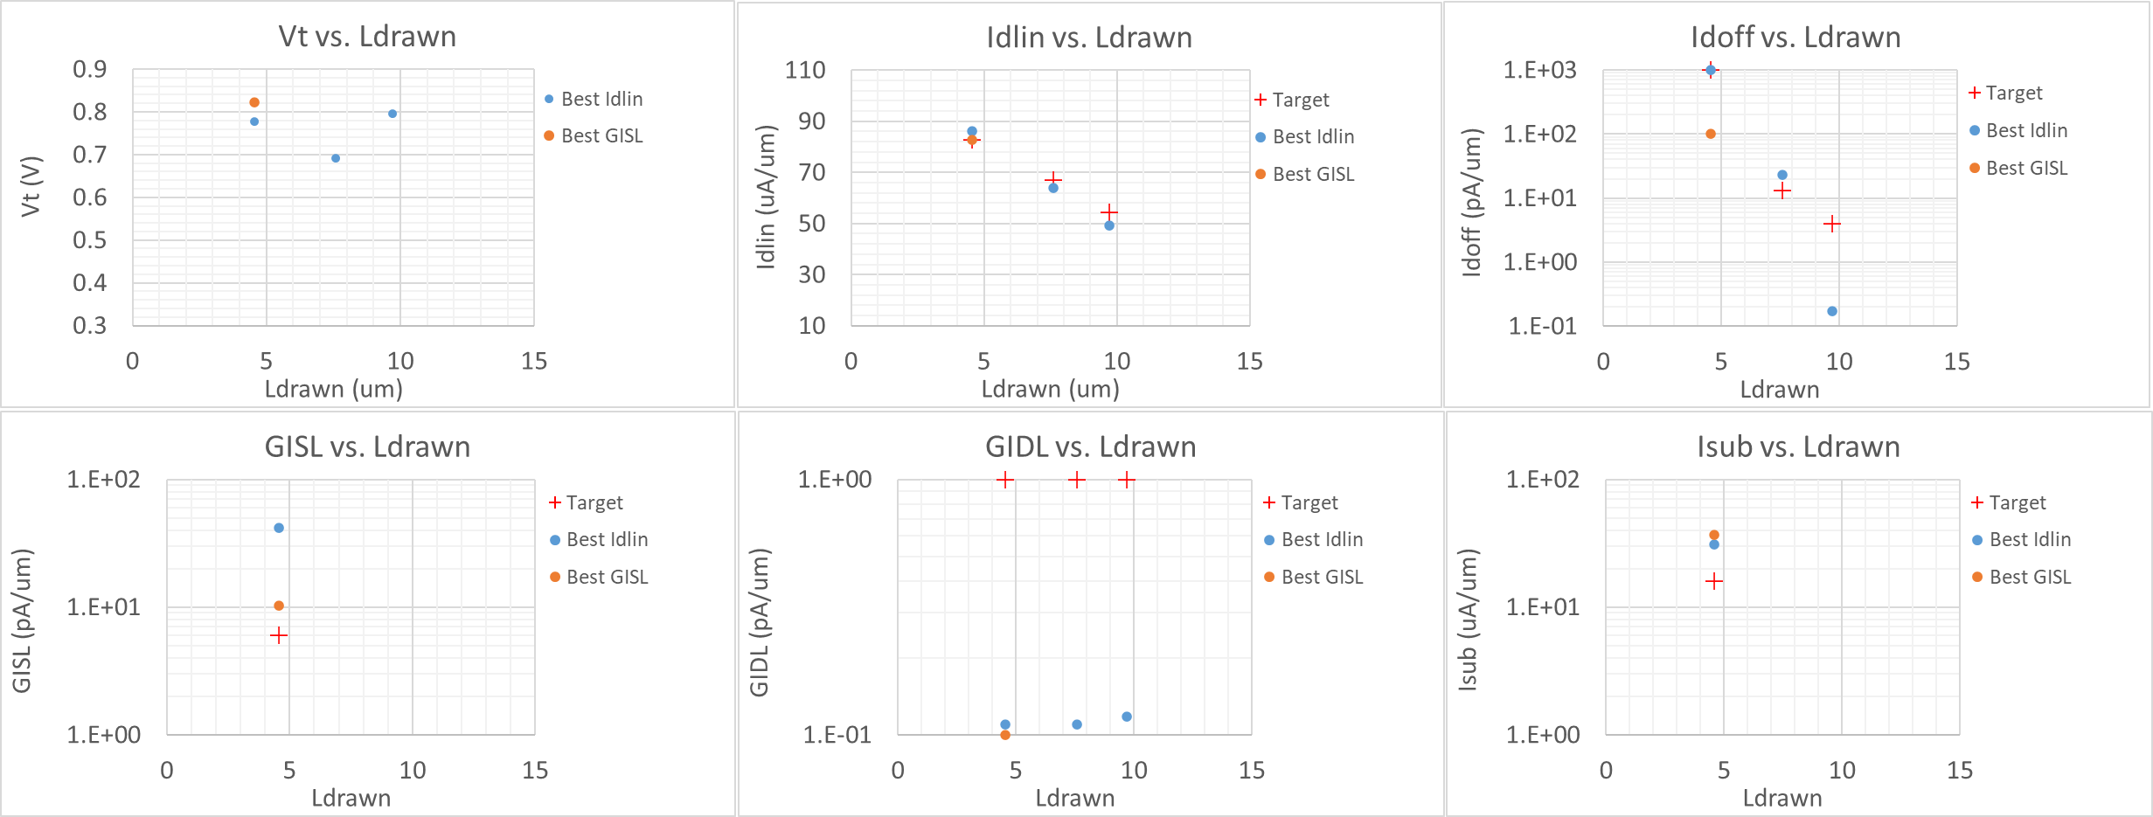
NHV implant table (20210407)
Pitch device projection is from 2D simulation
Pitch Conditions | SSH | SLDD
Best Idlin | B¹¹ 2.4E13 @25KeV tilt 30 twist 0 X4 | P³¹ 3e14, 10KeV, tilt 38 twist 22 X4
Best GISL | B¹¹ 2.2E13 @25KeV tilt 30 twist 0 X4 | P³¹ 2e14, 10KeV, tilt 38 twist 22 X4

Slide 6
NHV pitch devices (20210406)
BWF | P-Well/PTS/VT imp | ENH | SSH SLDD |  | DLDD
Pitch | B¹¹ 2.7E13 @340KeV X4 B¹¹ 9.0e12 @110KeV X4 B¹¹ 3.5e12 @32KeV X4 |  | B¹¹ 2.2E13 @25KeV tilt 30 twist 0 X4 | P³¹ 2e14, 10KeV, tilt 38 twist 22 X4 | P³¹ 4e13, 55KeV, tilt 45 twist 0 X4
SVT |  | B¹¹ 3e12 @32KeV X4
ATF | P-Well/PTS/VT imp | ENH | SSH SLDD |  | DLDD
Pitch | B¹¹ 2.7E13 @340KeV X4 B¹¹ 9.0e12 @110KeV X4 B¹¹ 3.5e12 @32KeV X4 |  | B¹¹ 3.7E13 @16KeV tilt 30 twist 0 X4 | P³¹ 1e14, 20KeV, tilt 7 twist 0 X4 | P³¹ 5e13, 45KeV, tilt 35 twist 0 X4
SVT |  | B¹¹ 1.7e12 @32KeV X4

Slide 7
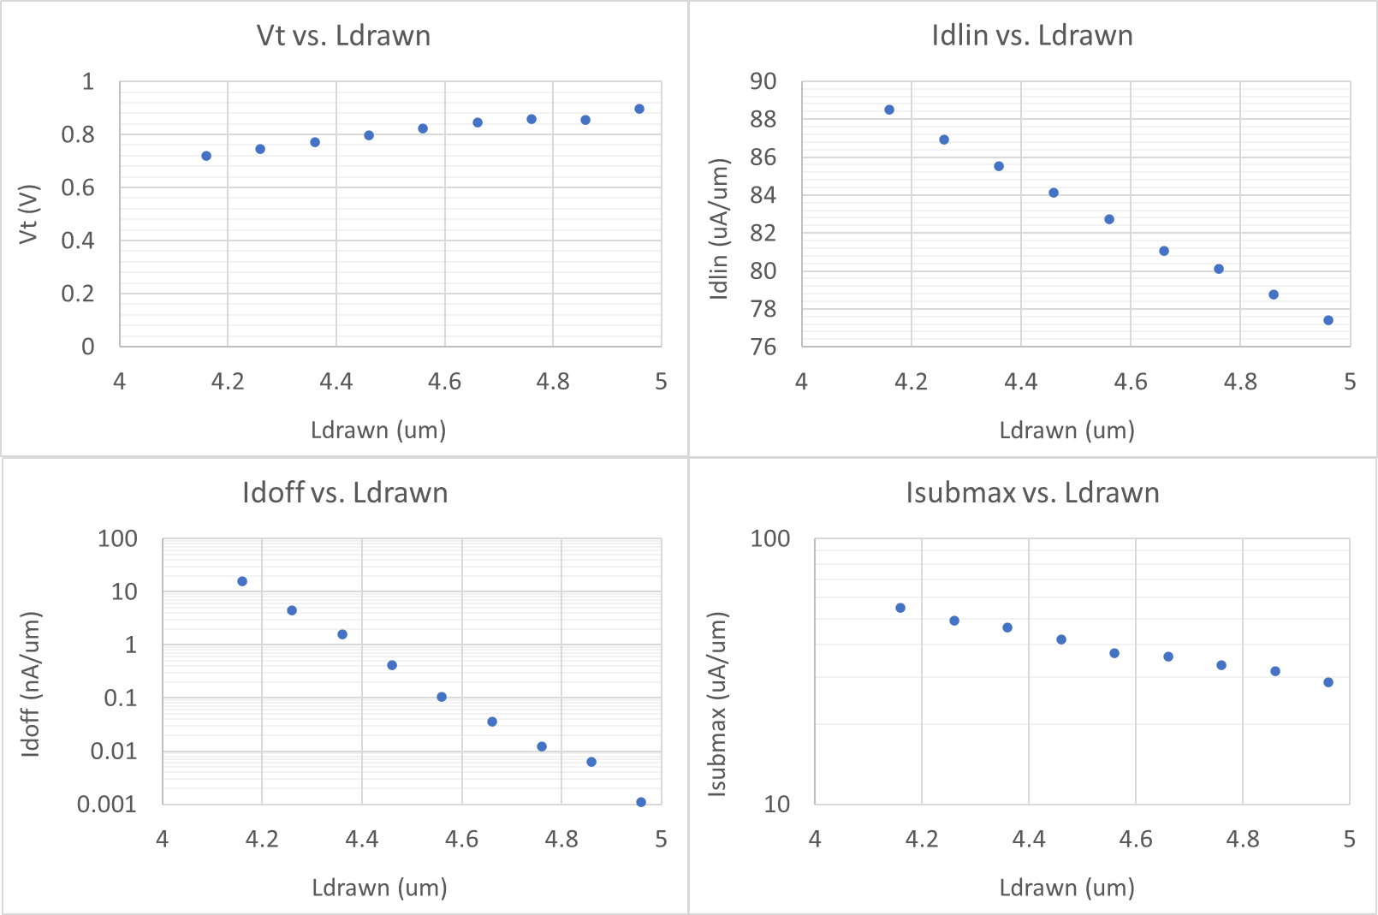
NHV pitch device roll off (20210407)_projection of 2D simulation
Physical gate length is changed by every 5nm.
5nm
~22mV/5nm
~1.7%/5nm
Tgt
L_{GN} = 225nm
Design rule is 5 lambda
-25nm total bias needed
PF: 228nm
Tox=100A
Spacer = 70nm
Slow: Lg 230nm
Tox = 102A
“Vt” doping +2%
Tip doping no change
Spacer =71nm
Slow: Lg 220nm
Tox = 98A
“Vt” doping -2%
Tip doping no change
Spacer =69nm
---------
RTA impact?
Fast
Tgt
~5X/5nm
Tgt

Slide 8
C_{comm}C_{N}C_{P}
 | TCAD T_{N}T_{P} | T_{N}T_{P} | F_{N}F_{P} | S_{N}S_{P} | F_{N}S_{P} | S_{N}F_{P}
Lg | 228 | 225nm | 220nm | 230nm | 225nm | 225nm
Tox | 100Å | 100Å | 98Å | 102Å | 100Å | 100Å
Spacer | 70nm | 70nm | 69nm | 71nm | 70nm | 70nm
Vtn/halo | Baofu’s sim | 100% | 98% | 102% | 95% | 105%
U_{n0}
Vtp | Baofu’s sim | 100% | 98% | 102% | 105% | 95%

