Slide 1
Why TC04
Khaled, Sandeep, Kia and DerChang, WW25/2021
TC04, formerly TC03 D-stepping, was planned to provide design collateral for P1250/BWF
  Integrated silicon for device modeling
  Design Rule verification
It became “all” masks (STI to M2 then TM2) taepeout due to F11x processing cost on TC03 unique tool set (Nikon stepper).

Slide 2
Tapeout for Design-Technology Co-Optimization
 | Test Chip (CMOS NTI) | α-product NPI/NTI | Spider (Array NTI) | S26 like or 1.5bpc | Full Stepping S15B/C like
CMOS Technology Node (-1: production, 0: Main TD, 1: new tech) | 1 | 0 | -1 | 0 | 0
Primitive Design Collateral (SPICE, DR, D0, FEM, IC) | d,s | s | s | s | s
Basic DC (Standard Cell Library, Analog) |  | s* |  | s
New Device | d
New Circuit |  | s* |  | s | s
Circuit accuracy, sensitivity, noise (analog, transient) |  | s* |  | s | s
Function Modularity and Interaction |  | s* |  | s | s
d: structure or circuit in dropin die
s: structure or circuit in scribe lane
*: eg. BFC, pump, electrical seal and etc; not on ATF

Slide 3
Why
Problem Statement
  Design collateral – Transistor & metal pitch scaling at BWF like topology – for device model generation and design rule verification
  Integrated P1250 CMOS Process development
Known solution
  TC03 for P1241, ATF scribe
Why-TC04, why-now
  Modification of TC03 for P1250 design collateral
  To intercept BWF design schedule

Slide 4
Who
Endorsers
  Sponsors: Optane Pathfinding – Al Fazio
  Stakeholders: RTD (Chuck Dennison), F11x (Summer Hollingsworth)
  Customers: MCD (Mase Taub), RTD (BWF CMOS owners)
Leadership:
  Coach: Kia
  Leaders: Khaled
  Co-leaders (function coverage)
    DFM
    Modeling
    Device/integration
    Reliability
    Frame
    OPC
Contributors

Slide 5
What
Scope
  P1250 CMOS + Interconnect process development.
  All CMOS layers up to M2 + TM2 first, then add M3/4 later
Objectives
  CMOS device development
  FEOL, BEOL design rule validation
  Process file generation.
  Device, interconnect reliability assessment.
Strategy
  Use BWF design rule/device definition for content definition.
Critical Path
  Structure definition, Etch tool, litho process definition for OPC layers.
  Layout completion, verification.
Metric for tracking

Slide 6
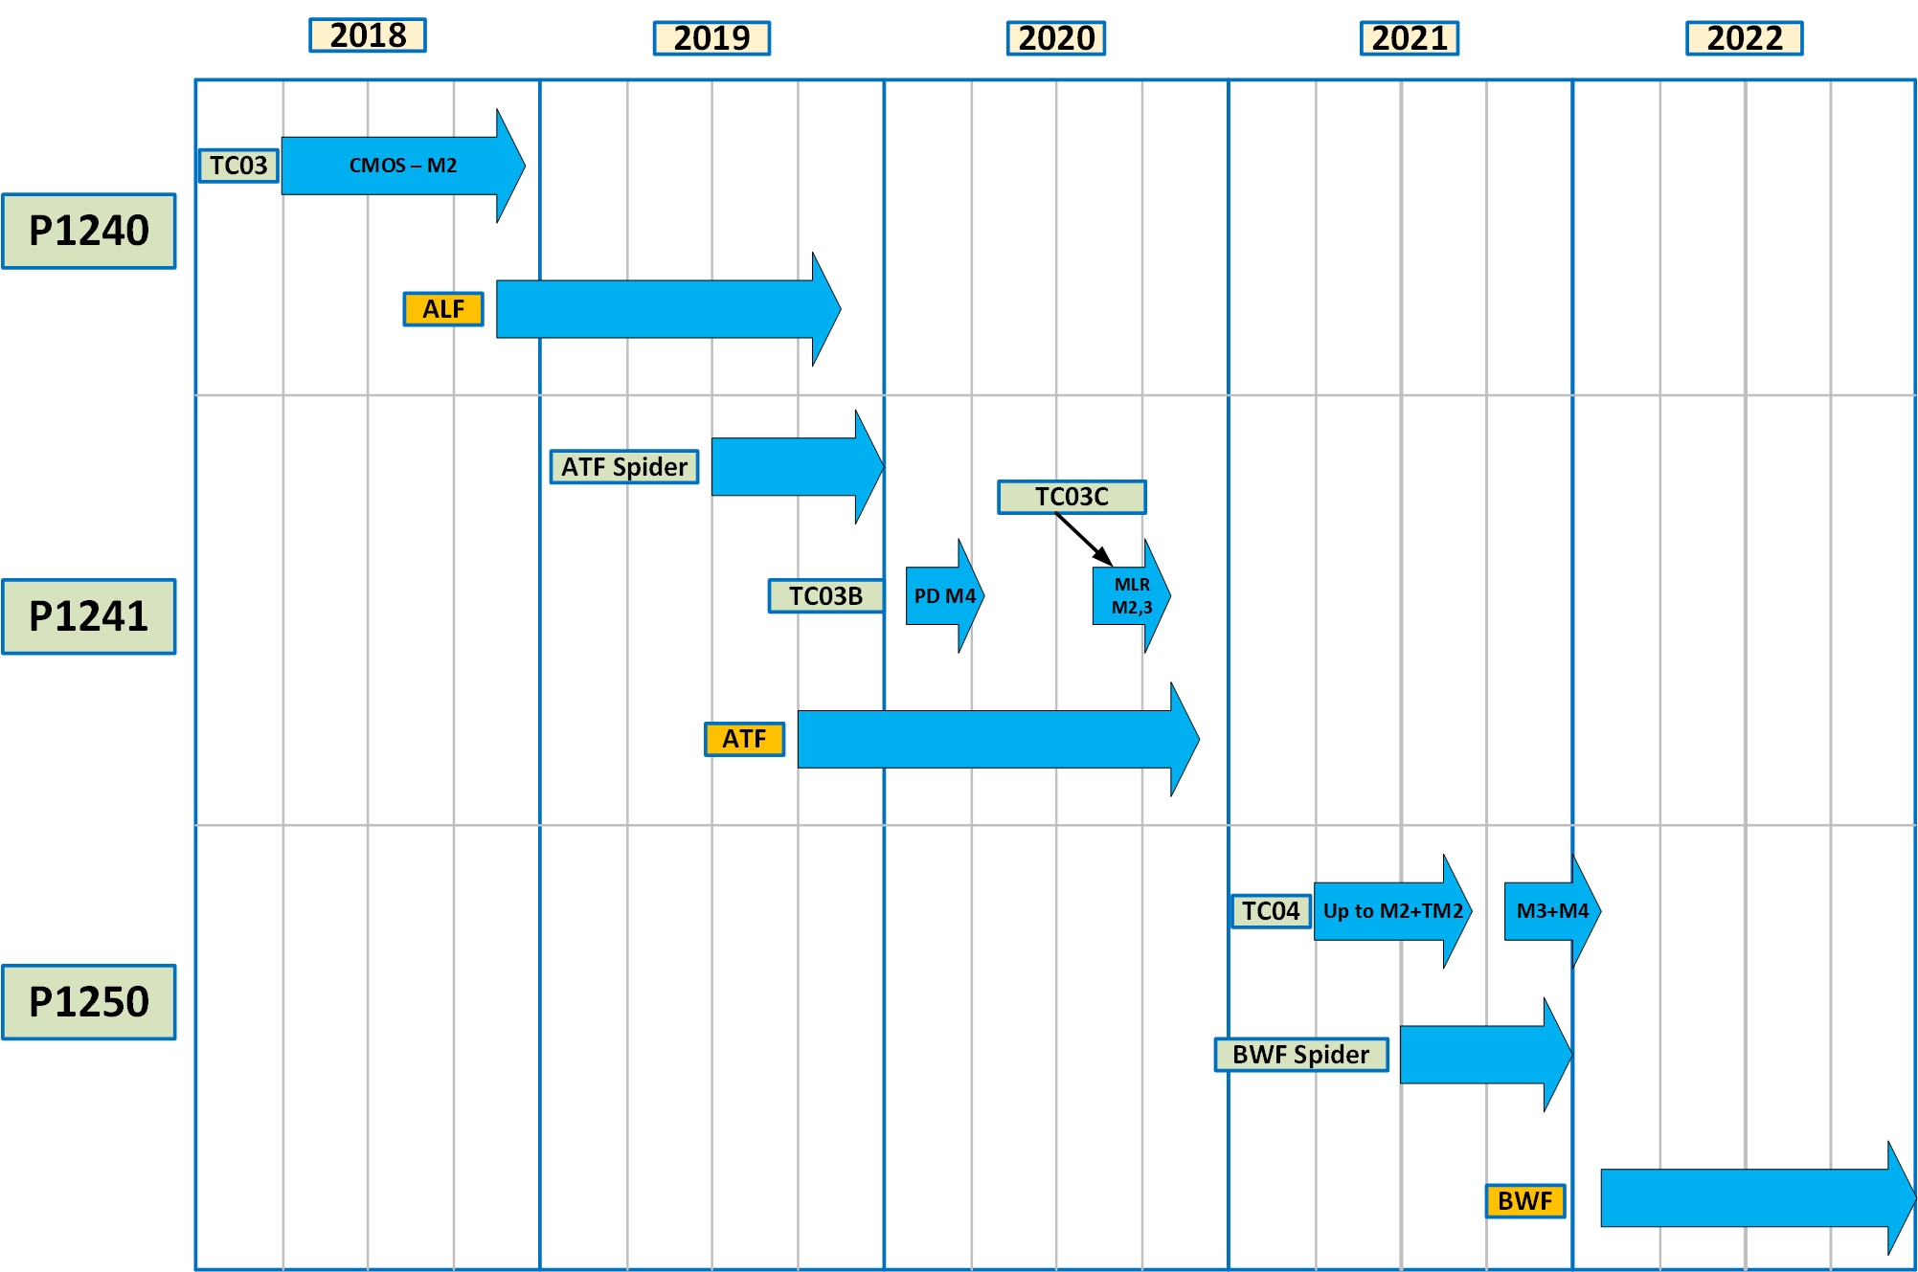
Timelines

Slide 7
Guardrail
Assumptions
Boundary Conditions
  limited metal (M1, M2 and TM1) for routing
Timeline (Schedule and Schedule Logic)

Slide 8
Learnings from TC03 for P1241
Done Right
  Look ahead scaled layout for device/design rule scaling. (limited by patterning capability.)
Done Wrong
  Design rules based on S37A (different from ALF or ATF).
  P1241 scaling goal defined after TC03 tapeout.
  LV transistor architecture changed after TC03 tapeout.
  Litho tool/OPC models based on different litho tools (due to tool availability).
  Not sufficient coverage of ALL design rules.
  Test structures defined before paper collateral
  Do not have flow and options prepared for test chip
IR
  Define content based on BWF design rules. Build reasonable variations around target.
    Future changes need to be assessed for their risk before commit.
  Better coverage/resolution for all design rules/device configurations.
  DFM and defect density modeling
Should but did not
  Forward looking beyond P1250

