Slide 1
ATF | N-Well/PTS/VT imp | Enh Imp. | Tip Imp
Pitch | P³¹ 1.3E13 @700KeV x4 P³¹ 6.0E12 @290KeV x4 P³¹ 4.5E12 @86KeV X4 |  | BF₂ 5E13@65KeV Tilt30/Twist0 X4
SVT |  |  | BF2 7E13@45KeV Tilt45/Twist22
LVT |  | B¹¹3.5E12@32KeV
BWF (today) | N-Well/PTS | VT imp | Tip Imp
Pitch | P³¹ 1.3E13 @700KeV x4 P³¹ 6.0E12 @290KeV x4 | P³¹1.4E13@86KeV | BF₂ 7E13@45KeV Tilt45/Twist22 X4
SVT |  | As⁷⁵ 8E13@400KeV | BF2 7E13@45KeV Tilt45/Twist22
LVT |  | P³¹4.5E12@86KeV B¹¹3.5E12@32KeV
ATF POR; 3 masks: well/pts/Vt, Enh and Tip, one each
BWF is TCAD best projected targets for Q2 silicon validation and for experimental process file.
Enh Imp. to be finalized this week.; 5 masks if we integrated all in one piece of silicon.
To reduce Vt roll-off, tighter control, SVT will use As for super-steep retrograde (SSR) channel doping

Slide 2
ATF | N-Well/PTS/VT imp | Enh Imp. | Tip Imp
Pitch | P³¹ 1.3E13 @700KeV x4 P³¹ 6.0E12 @290KeV x4 P³¹ 4.5E12 @86KeV X4 |  | BF₂ 5E13@65KeV Tilt30/Twist0 X4
SVT |  |  | BF2 7E13@45KeV Tilt45/Twist22
LVT |  | B¹¹3.5E12@32KeV
ATF option 1 | N-Well/PTS/VT imp | Enh Imp. | Tip Imp
Pitch | P³¹ 1.3E13 @700KeV x4 P³¹ 6.0E12 @290KeV x4 P³¹ 1.0E12 @86KeV X4 | P³¹3.5E12@86KeV | BF₂ 5E13@65KeV Tilt30/Twist0 X4
SVT |  |  | BF2 7E13@45KeV Tilt45/Twist22
LVT
BWF (today) | N-Well/PTS | VT imp | Tip Imp
Pitch | P³¹ 1.3E13 @700KeV x4 P³¹ 6.0E12 @290KeV x4 | P³¹1.4E13@86KeV | BF₂ 7E13@45KeV Tilt45/Twist22 X4
SVT |  | As⁷⁵ 8E13@400KeV | BF2 7E13@45KeV Tilt45/Twist22
LVT |  | P³¹4.5E12@86KeV B¹¹3.5E12@32KeV
ATF Option 1 illustrates a device optimization idea of removing counter doping sensitivity
This idea should be tested with BWF silicon; 1 mask reduction can be achieved (see next page)

Slide 3
ATF | N-Well/PTS/VT imp | Enh Imp. | Tip Imp
Pitch | P³¹ 1.3E13 @700KeV x4 P³¹ 6.0E12 @290KeV x4 P³¹ 4.5E12 @86KeV X4 |  | BF₂ 5E13@65KeV Tilt30/Twist0 X4
SVT |  |  | BF2 7E13@45KeV Tilt45/Twist22
LVT |  | B¹¹3.5E12@32KeV
ATF option 1 | N-Well/PTS/VT imp | Enh Imp. | Tip Imp
Pitch | P³¹ 1.3E13 @700KeV x4 P³¹ 6.0E12 @290KeV x4 P³¹ 1.0E12 @86KeV X4 | P³¹3.5E12@86KeV | BF₂ 5E13@65KeV Tilt30/Twist0 X4
SVT |  |  | BF2 7E13@45KeV Tilt45/Twist22
LVT
BWF (today) | N-Well/PTS | VT imp | Tip Imp
Pitch | P³¹ 1.3E13 @700KeV x4 P³¹ 6.0E12 @290KeV x4 | P³¹1.4E13@86KeV | BF₂ 7E13@45KeV Tilt45/Twist22 X4
SVT |  | As⁷⁵ 8E13@400KeV | BF2 7E13@45KeV Tilt45/Twist22
LVT |  | P³¹4.5E12@86KeV B¹¹3.5E12@32KeV
BWF Option 1 | N-Well/PTS/VT imp | Enh Imp. | Tip Imp
Pitch | P³¹ 1.3E13 @700KeV x4 P³¹ 6.0E12 @290KeV x4 P³¹ 1.0E12 @86KeV X4 | P³¹1.3E13@86KeV | BF₂ 7E13@45KeV Tilt45/Twist22 X4
SVT |  | As⁷⁵ 8E13@400KeV | BF2 7E13@45KeV Tilt45/Twist22
LVT

Slide 4
BWF (today) | N-Well/PTS/VT imp | Enh Imp. | Tip Imp
Pitch | P³¹ 1.3E13 @700KeV x4 P³¹ 6.0E12 @290KeV x4 | As⁷⁵ 8E13@400KeV | BF₂ 7E13@45KeV Tilt45/Twist22 X4
SVT |  | P³¹1.4E13@86KeV | BF2 7E13@45KeV Tilt45/Twist22
LVT |  | P³¹4.5E12@86KeV B¹¹3.5E12@32KeV
BWF Option 1 | N-Well/PTS/VT imp | Enh Imp. | Tip Imp
Pitch | P³¹ 1.3E13 @700KeV x4 P³¹ 6.0E12 @290KeV x4 P³¹ 1.0E12 @86KeV X4 | P³¹1.3E13@86KeV | BF₂ 7E13@45KeV Tilt45/Twist22 X4
SVT |  | As⁷⁵ 8E13@400KeV | BF2 7E13@45KeV Tilt45/Twist22
LVT
BWF MOR | N-Well/PTS/VT imp | Enh Imp. | Tip Imp | SSH
Pitch | P³¹ 1.3E13 @700KeV x4 P³¹ 6.0E12 @290KeV x4 P³¹ 1.0E12 @86KeV X4 | As⁷⁵ 8E13@400KeV | Optimized Tip for I² and GIDL reduction | Optimized
SVT |  | P³¹1.4E13@86KeV | BF₂ 7E13@45KeV Tilt45/Twist22 X4
LVT
For pitch PMOST, replace SSR channel doping with SSH

Slide 5
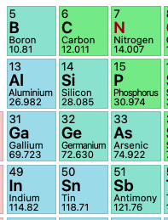
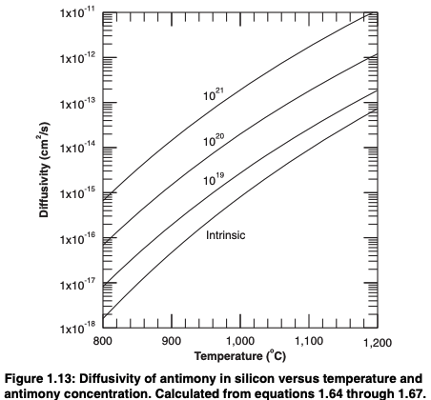
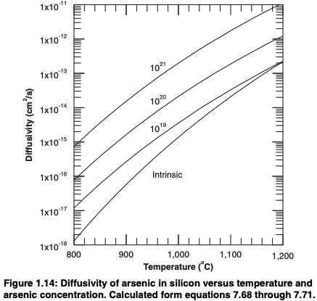
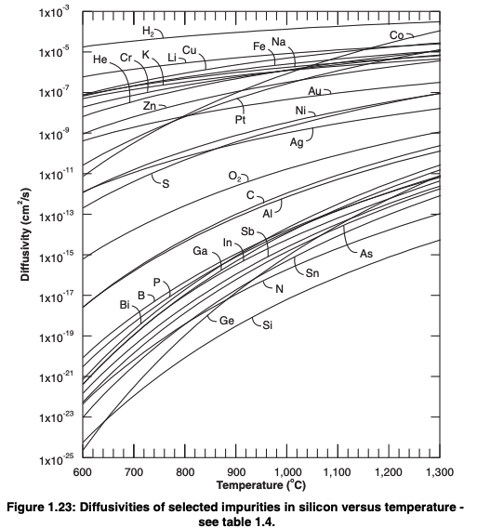
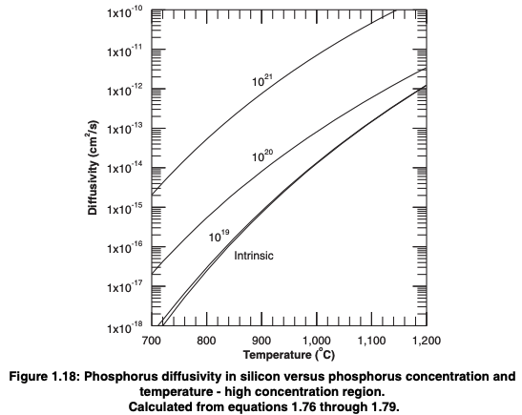
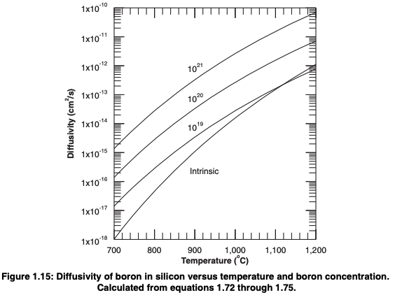
Dopant in Silicon | D₀ (cm²/s) | E_{A} (eV) | D (cm²/s) = D₀ / exp(E_{A}/K_{B}T); T in table is °C
 |  |  | 850 | 900 | 950 | 1000 | 1050
B | 0.76 | 3.46 | 2.25E-16 | 1.04E-15 | 4.20E-15 | 1.52E-14 | 5.02E-14
Ga | 225 | 4.12 | 7.29E-17 | 4.47E-16 | 2.37E-15 | 1.10E-14 | 4.55E-14
In | 16.5 | 3.9 | 5.19E-17 | 2.89E-16 | 1.40E-15 | 5.99E-15 | 2.30E-14
 | 269 | 4.19 | 4.23E-17 | 2.68E-16 | 1.46E-15 | 6.94E-15 | 2.94E-14
P | 3.85 | 3.66 | 1.45E-16 | 7.25E-16 | 3.19E-15 | 1.25E-14 | 4.40E-14
As | 22.9 | 4.1 | 9.12E-18 | 5.55E-17 | 2.91E-16 | 1.34E-15 | 5.51E-15
Sb | 0.214 | 3.65 | 8.91E-18 | 4.45E-17 | 1.95E-16 | 7.59E-16 | 2.67E-15

Slide 6
BWF (today) | N-Well/PTS/VT imp | Enh Imp. | Tip Imp
Pitch | P³¹ 1.3E13 @700KeV x4 P³¹ 6.0E12 @290KeV x4 | As⁷⁵ 8E13@400KeV | BF₂ 7E13@45KeV Tilt45/Twist22 X4
SVT |  | P³¹1.4E13@86KeV | BF2 7E13@45KeV Tilt45/Twist22
LVT |  | P³¹4.5E12@86KeV B¹¹3.5E12@32KeV
BWF TCAD SIM | N-Well/PTS/VT imp | Enh Imp. 1 | Enh Imp. 2 | Tip Imp
Pitch @ 4.6λ | P³¹ 1.3E13 @700KeV x4 P³¹ 6.0E12 @290KeV x4 P³¹ 1.0E12 @86KeV X4 | As⁷⁵ 6E13@400KeV | P³¹ 1.5E13@86KeV | BF₂ 5E13@65KeV Tilt45/Twist22 X4
SVT @ 7.6/9.7λ |  | As⁷⁵ 6E13@400KeV |  | BF2 7E13@45KeV Tilt45/Twist22
LVT @ 9.7/12λ
WIP
Need Ixoff, GIDL, Idlin, Idsat, Vt vs. L
L_{Pitch} = 4.6, 4.2λ ; L_{SVT} = 9.7, 7.6, 7.2λ ; L_{LVT} = 12, 9.7, 9.3λ
L_{G, pitch} = 230, 210nm ; L_{G, SVT} = 485, 380, 360nm ; L_{LVT} = 600, 485, 465nm
Do we have silicon data from ATF lead lot or SIM on Ixoff, GIDL, Idlin, Idsat, Vt vs. L
L_{Pitch} = 7, 6.6λ ; L_{SVT} = 12, 9.7, 9.3λ ; L_{LVT} = 12, 9.7, 9.3λ
L_{G, pitch} = 350, 330nm ; L_{G, SVT} = 600, 485, 465nm ; L_{LVT} = 600, 485, 465nm

Slide 7
Ideal SSR doping Profile
A: Reduce Energy 1
As⁷⁵ 6E13 400KeV
Reduce Energy 2
Reduce Dose
A + Reduce Dose
Maximum
depletion Width
Si-SiO₂ Interface

Slide 8
BWF TCAD SIM | N-Well/PTS/VT imp | Enh Imp. 1 | Enh Imp. 2 | Tip Imp
Pitch @ 4.6λ | P³¹ 1.3E13 @700KeV x4 P³¹ 6.0E12 @290KeV x4 P³¹ 1.0E12 @86KeV X4 | As⁷⁵ 2E13@200KeV | P³¹ 1.5E13@86KeV | BF₂ 5E13@65KeV Tilt45/Twist22 X4 (optional: + 1 BF₂ 2E13@75KeV tile 0°)
SVT @ 7.6/9.7λ |  | As⁷⁵ 6E13@400KeV |  | BF2 7E13@45KeV Tilt45/Twist22
LVT @ 9.7/12λ
4/2/2021
Need Ixoff, GIDL, Idlin, Idsat, Vt vs. L (12, 9.7, 9.3, 7.6, 7.2, 4.6, 4.2λ)
L_{Pitch} = 4.6, 4.2λ ; L_{SVT} = 9.7, 7.6, 7.2λ ; L_{LVT} = 12, 9.7, 9.3λ
L_{G, pitch} = 230, 210nm ; L_{G, SVT} = 485, 380, 360nm ; L_{LVT} = 600, 485, 465nm
Use 4/2/2021 (+ Enh imp.2 optimization) to generate I-V curve for experiment file #1
Use next page to Ehn Imp.1 to center Vt (~-100mV); we can decide if this will be experiment file #2

Slide 9
Ideal SSR doping Profile
As⁷⁵ 2E13 200KeV
As⁷⁵ 6E13 400KeV
As⁷⁵ 1.5E13 200KeV
BKM 4/2: As⁷⁵ 2E13 200KeV
Leakage and On-state current, Short Channel effect meet expectation
Vt is ~100mV higher
Further experiment to lower dose to meet Vt
Maximum
depletion Width
Si-SiO₂ Interface

Slide 10
PHV
ATF | N-Well/PTS/VT imp | Enh Imp. | Tip Imp
Pitch @ 7λ | P³¹ 1.3E13 @700KeV x4 P³¹ 6.0E12 @290KeV x4 P³¹ 4.5E12 @86KeV X4 |  | BF₂ 5E13@65KeV Tilt30/Twist0 X4
SVT @ 9.7/12λ |  |  | BF2 7E13@45KeV Tilt45/Twist22
LVT @ 9.7/12λ |  | B¹¹3.5E12@32KeV
BWF TCAD SIM | N-Well/PTS/VT imp | Enh Imp. 1 | Enh Imp. 2 | Tip Imp
Pitch @ 5λ 235±20nm | P³¹ 1.3E13 @700KeV x4 P³¹ 6.0E12 @290KeV x4 P³¹ 1.0E12 @86KeV X4 | As⁷⁵ 1.5E13@200KeV | P³¹ 1.2E13@86KeV | BF₂ 5E13@65KeV Tilt45/Twist22 X4 BF₂ 2E13@75KeV tile 0°
SVT @ 7.6/9.7λ |  | As⁷⁵ 6E13@400KeV |  | BF2 7E13@45KeV Tilt45/Twist22
LVT @ 9.7/12λ
4/6/2021

Slide 11
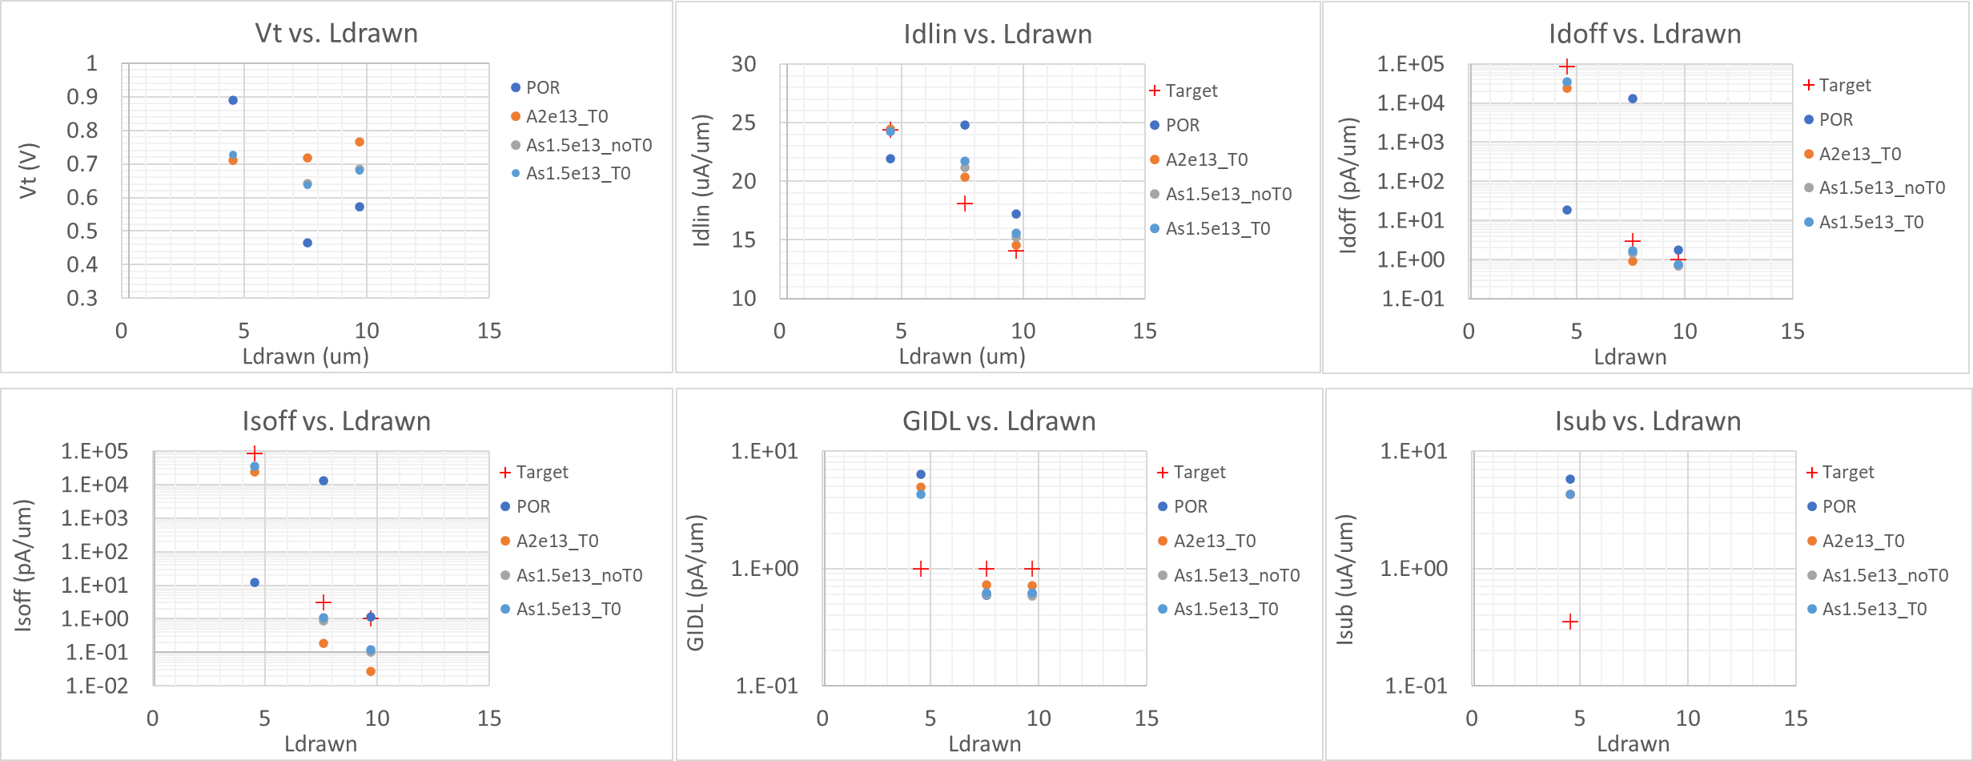
PHV pitch devices (20210406)
Phosphorus ENH implant: Ph 1e12, 86KeV (PHVLVT, PHVSVT, Pitch)
As ENH implant: As 1.5e13, 200KeV (PHVSVT and Pitch)
Phosphorus ENH implant: Ph 1.2e13, 86KeV (Pitch)
PHV tip implant: BF2 5e13, 65KeV, tilt 45 twist 22
BF2 2e13, 75KeV, tilt 0, twist 0

