Slide 1
Design-Tech CoPathfinding: HVT Experimental Targets
CMOS Pathfinding, WW16.1/2021
Device Design
Window Exploration
Experimental Target and corners
MTS/DTS Risk and Mitigation
DTCP Schedule and NF

Slide 2
High Voltage Transistor Design
PHV | N-Well/PTS/V_{T} imp | Enh Imp. | Enh Imp2. | Tip Imp
Pitch X’tor L_{G}=5λ | P³¹ 1.3E13 @700KeV P³¹ 6.0E12 @290KeV P³¹ 1E12 @86KeV | As⁷⁵ 1.5e13, 200KeV | P³¹ 1.2E13 @86KeV | BF₂ 5E13@65KeV Tilt45/Twist0 X4 BF₂ 2E13@75KeV Tilt0
SV_{T} L_{G}≥7.6λ
LV_{T} L_{G}≥9.7λ
NHV | P-Well/PTS/V_{T} imp | Enh Imp. | SSH/SLDD | Tip Imp
Pitch X’tor L_{G}=5λ | B¹¹ 2.7E13 @340KeV B¹¹ 9.0e12 @110KeV B¹¹ 3.5e12 @32KeV |  | B¹¹ 2.2E13 @25KeV tilt 30 twist 0 X4 P³¹ 2e14, 10KeV, tilt 38 twist 22 X4 | P³¹ 4e13, 55KeV, tilt 45 twist 0 X4
SV_{T} L_{G}≥7.6λ |  | B¹¹ 3.0e12 @32KeV
L_{G} | Type | V_{T} | I_{S,OFF} | I_{D,lin} | I_{D,sat} | GIDL, GISL | I_{sub,max}
(Spec/TCAD Projection) |  | V | pA/μm | μA/μm | μA/μm | pA/μm | μA/μm
5λ | NHV | .621/.822 | 1000/100 | 82.6/82.7 | 637/643 | 0.7,6/0.1,10.2 | 16/37.1
 | PHV | .409/.728 | 8E4/3.6E4 | 24.4/24.4 | 349/296 | 1/4.3 | 0.35/4.26
7.6λ | NHV | .666/.692 | 13/22.8 | 67/64 | 507/513 | .7/.11 | 14/26.2
 | PHV | .561/.638 | 3/1.72 | 18.1/21.7 | 241/221 | .63/.63 | 0.35/1.15

Slide 3
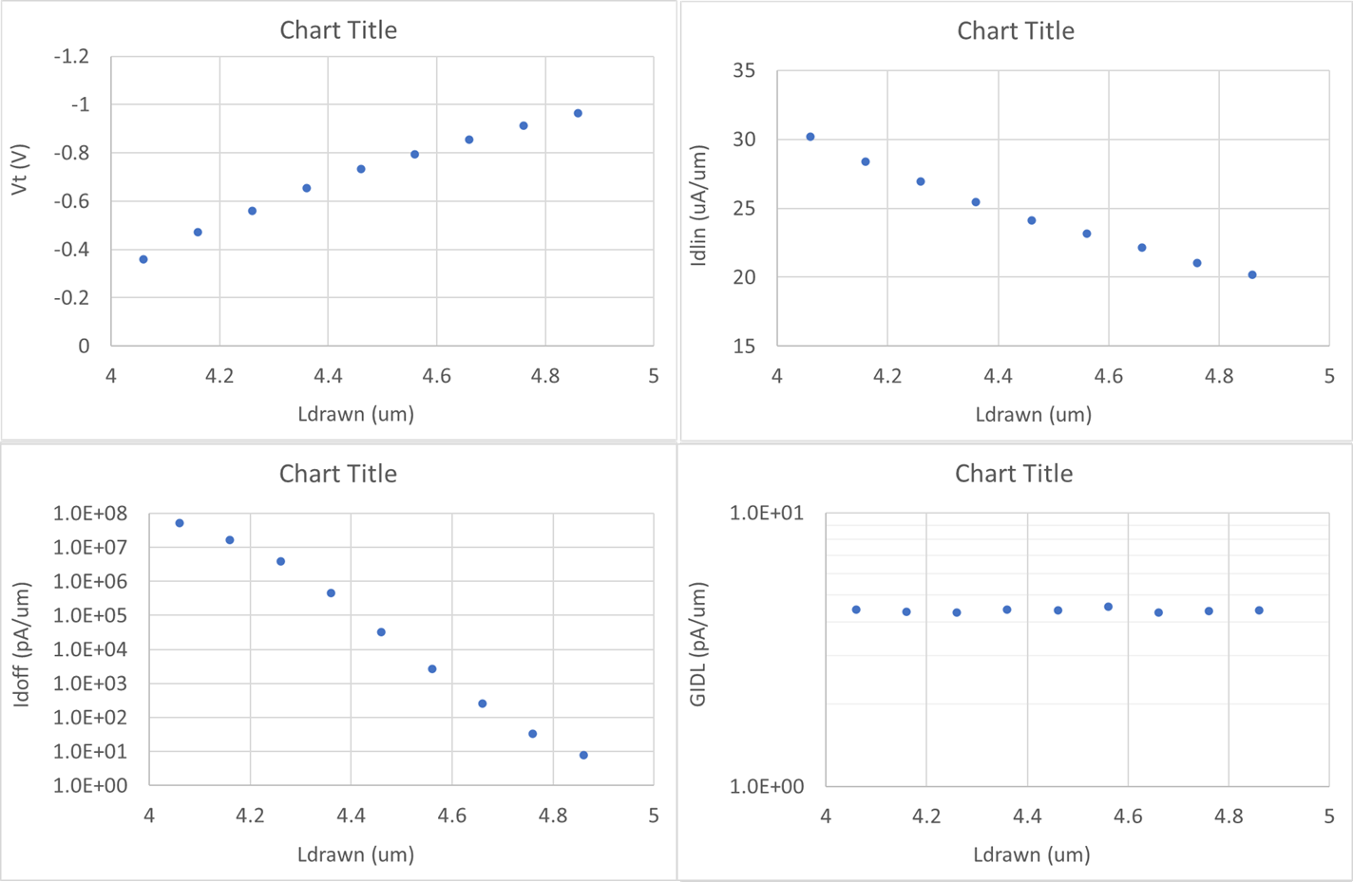
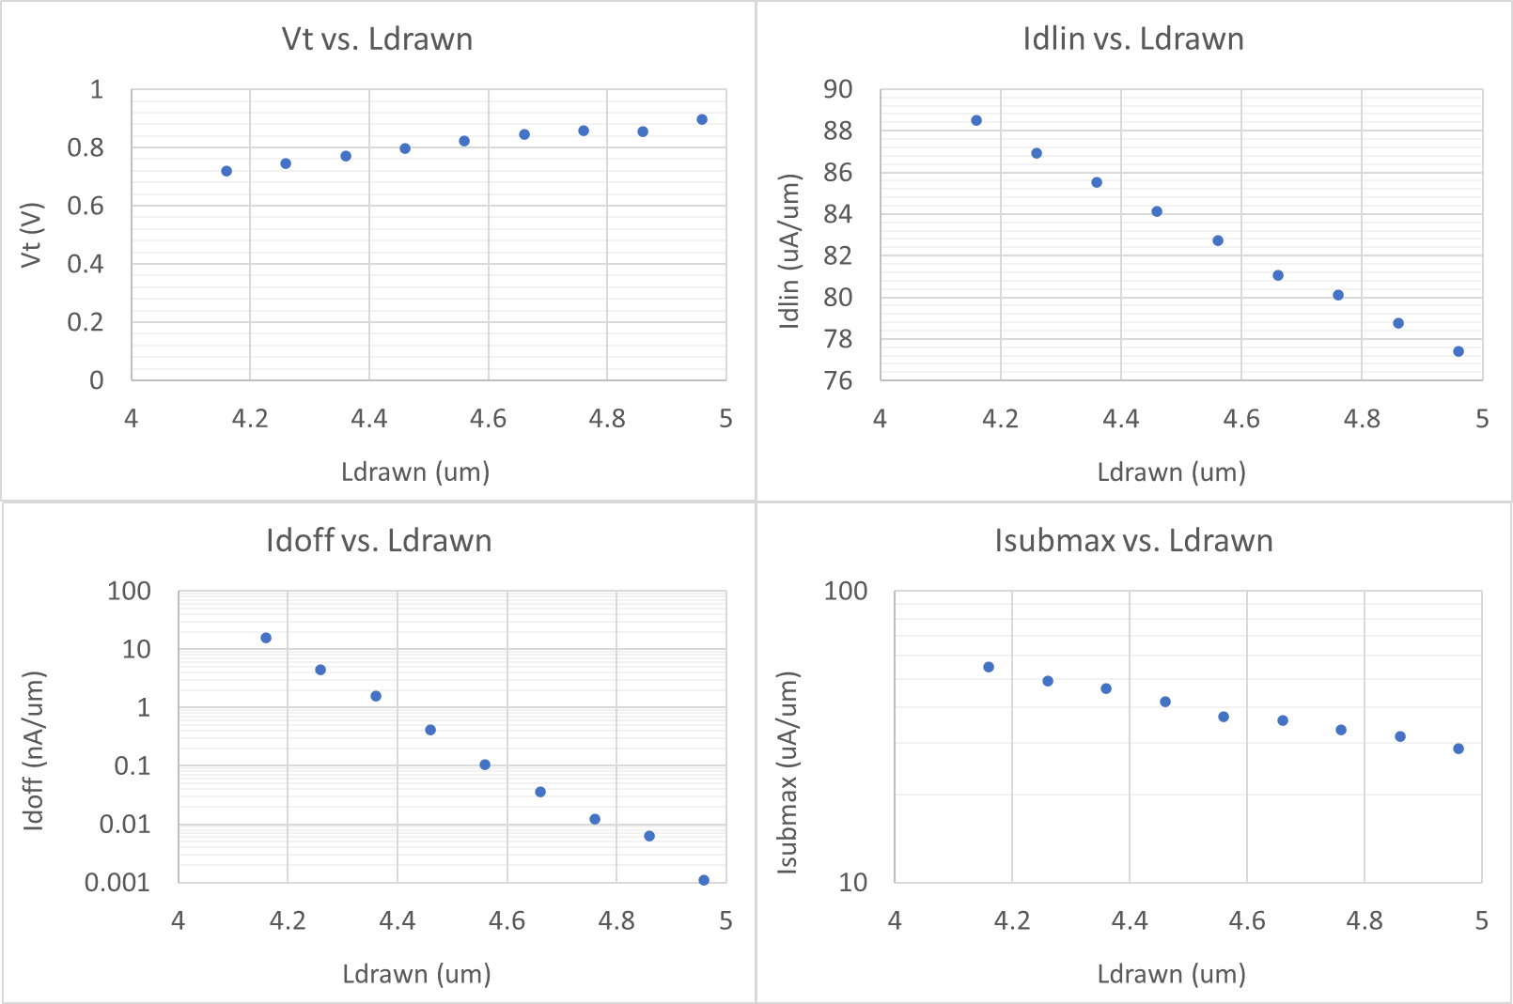
HV Poly Sizing and Window Exploration
225nm
225nm
~70mV/5nm
~22mV/5nm
DR Target
@ ATF sizing
TGT: 225nm, meeting I_{D,lin} Spec
LSL: 215nm limited by PHV leakage
USL: +5nm from target, consistent with pitch cell design rule in stack gate configuration
DR Target
@ ATF sizing
Tgt
Tgt
~5%/5nm
~1.7%/5nm
Fast
Fast
Min Poly CD
@ max Ioff spec
Min Poly CD
@ max Ioff spec
~5X/5nm
~10X/5nm
200
210
220
230
240
250
200
210
220
230
240
250
HVP Poly CD [nm]
HVN Poly CD [nm]

Slide 4
Pitch X’tor Target and Corners
Deviation from Target
 | TCAD | Target | ATF spec | F_{N}/F_{P} | S_{N}/S_{P} | F_{N}/S_{P} | S_{N}/F_{P}
T_{ox} [Å] | 100 | 100 | < 2 | –2/–2 | +2/+2 | 0 | 0
L_{G} [nm] | 228 | 225 | 3 | –10/–10 | +5/+5 | 0 | 0
Z_{D} [nm] | 132 | 132 | < 2 | +3/+3 | –3/–3 | 0 | 0
Spacer | 70 | 70 | 1 | –1/–1 | +1/+1 | 0 | 0
Well/PTS | Model | Model | <2% | NA | NA | NA | NA
VT/Halo | Model | Model | <2% | –2%/–2% | +2%/+2% | –5%/+5% | +5%/–5%
Tip/SD | Model | Model | <2% | +2%/+2% | –2%/–2% | +2%/–2% | –2%/+2%
√D·t | Model | Model |  | NA | NA | NA | NA
RTA | Model | Model |  | NA | NA | NA | NA
μ₀ | Model | Model |  | +3%/+3% | –3%/–3% | +3%/–5% | –3%/+5%

Slide 5
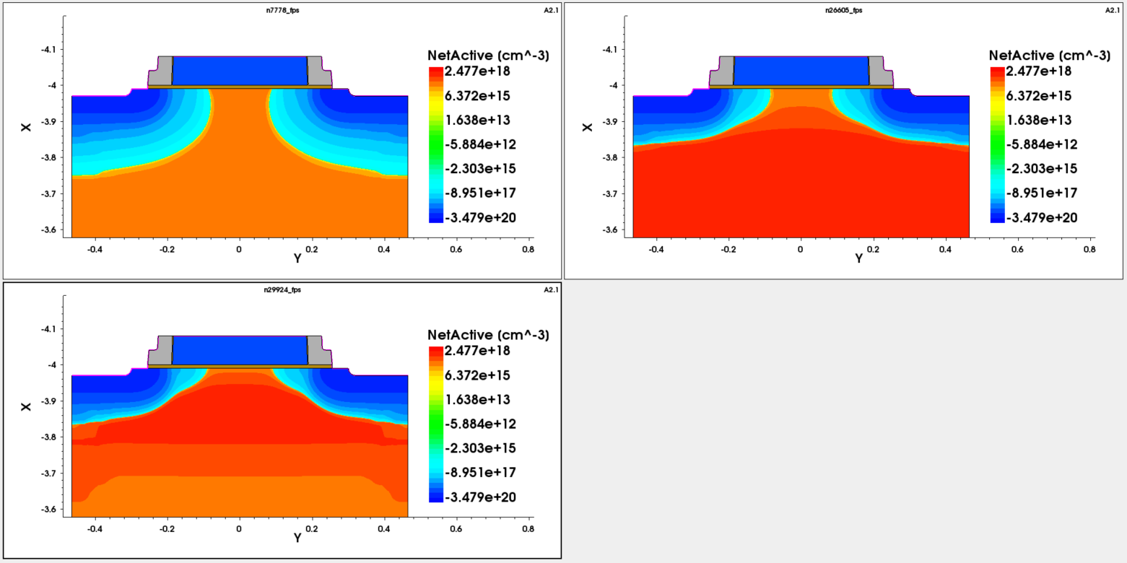
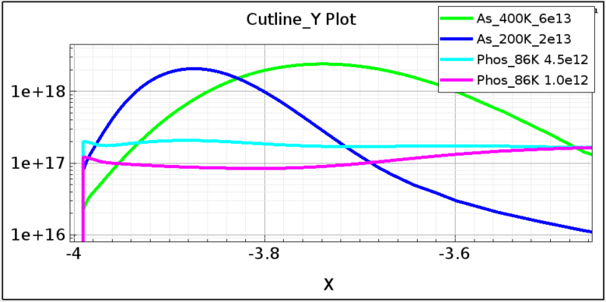
Problem #1: Uncalibrated Arsenic doping profile
Ideal SSR doping
Profile for PHV
As⁷⁵ 2E13
200KeV
Calibrated
Uncalibrated
As⁷⁵ 6E13
400KeV
As⁷⁵ 1.5E13
200KeV
Uncalibrated
Risk Level – 2.5 (no data) / Stage – 4 to 5 (Segmentation and Validation)
Mitigation Strategy and action plan –
  Prioritize L0 skew on implant energy/dose and root D·t ; SIMS movies for TCAD calibration.
  Fast learning cycle; also leverage appliable collateral from 3D-NAND
  In parallel starting 1 cycle of L2 learning on As⁷⁵ implant optimization
Maximum
depletion Width
Si-SiO₂ Interface

Slide 6
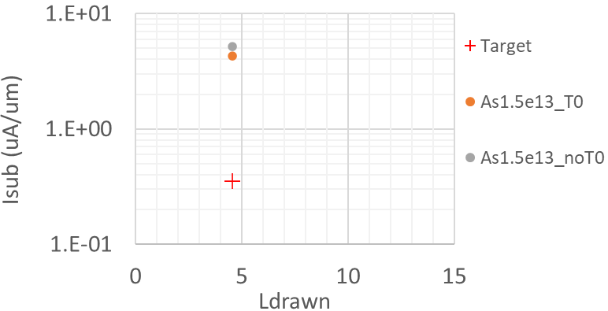
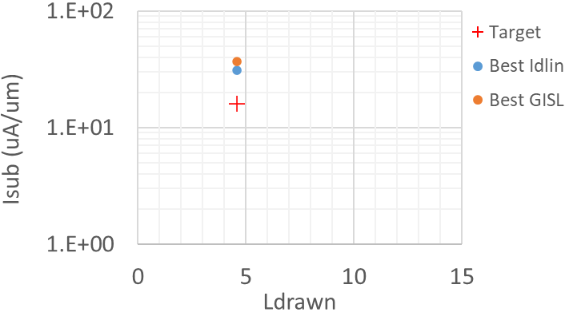
Problem #2: 2X~10X impact ionization (hot carrier damage) Accelerated V_{T}, I_{D,lin}, I_{D,sat} degradation
PHV Pitch x’tor
NHV Pitch x’tor
Model: Accelerated V_{T}, I_{D} degradation at higher impact ionization during hot switching due to
1) 10nm spacer reduction and 2) Steepened LDD doping profile for 30% L_{G} scaling
Risk level – 2.5 (no data) / Stage 3 – Speculation with limited data (TCAD based LDD doping and spacer)
Segmentation Strategy:
  Spec validation
    Correlate device metrics to circuit reliability – device hot switching parameter vs. decoder aging
    Silicon base aging emulation – such as V_{T}, I_{D} aging at operating points
  TCAD based DOE on LATI S/D and SSR Channel to reduce I²; follow up with silicon validation
  Stack gate design rule true spec

Slide 7
P1250/BWF DTCP
Speculative Design Collateral development
Tech-Design Co Pathfinding use experimental model to flesh out mis-alignment, identify issues and mitigate risk
3~5 cycle of si learning is expected to narrow down DTS spec corner; however, HCI (risk 2.5) may impact Idlin and Idsat.
Key results 70% MTS and DTS validated by silicon. Speculative design collateral is used for component level simulation
Module definition to scope out changes from ATF to BWF.
Assumption and POR: 75% $/GB, 15% CoT, 26.5p,space scaling, ATF cell DTS.
Key results 2Kx4K, interlock tile, +1 PD socket, planar CMOS, pitch cell design rule for die size, transistor MTS/DTS and options for Read/Write functionality.
 | 2020 |  |  |  | 2021 |  |  |  | 2022
 | Q1 | Q2 | Q3 | Q4 | Q1 | Q2 | Q3 | Q4 | Q1 | Q2 | Q3 | Q4
BWF NPI/NTI |  |  |  |  |  |  |  |  |  |  |  | X
Module definition
Experimental Collateral |  |  |  |  |  | X
Speculative Collateral |  |  |  |  |  |  |  | X
MTS/DTS for Tapeout |  |  |  |  |  |  |  |  |  | X
Experimental Design Collateral development.
2 cycle of silicon learning to validate W/L scaling and to calibrate TCAD for target and skew projection
Key results preliminary alignment completed between design rule, MTS and DTS. Experimental process file
Experimental Process File will serve DE-TD alignment for speculative collateral development. ~5WNF
CMOS MTS and DTS development
TC04 based MTS and DTS risk are assessed. Full RA/RM and gap closure planned deemed med to low risk.
S/D epi evaluation (at BWF design rule) will be planned.
Process File and design rule will be used for Tapeout.

Slide 8
Supporting Material

Slide 10
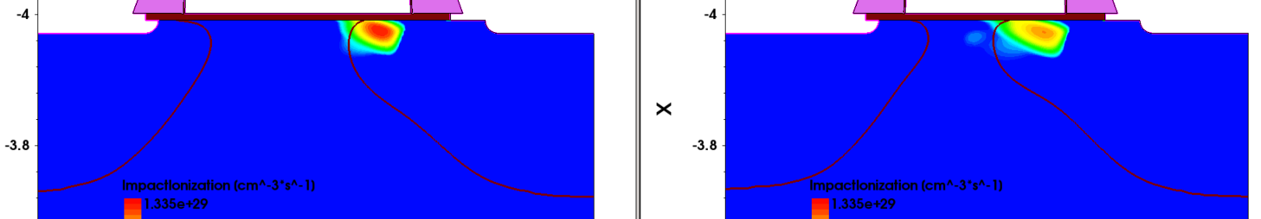
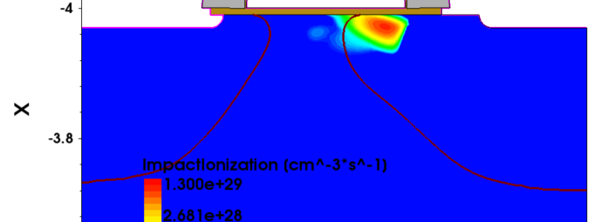
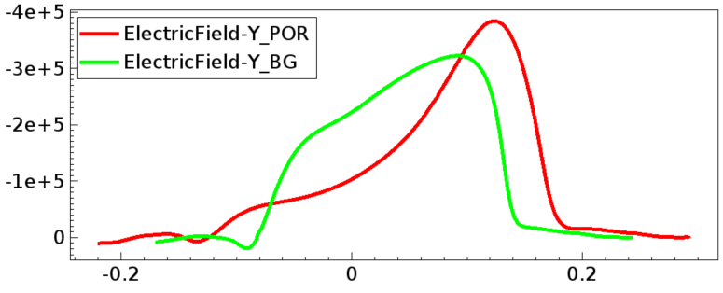
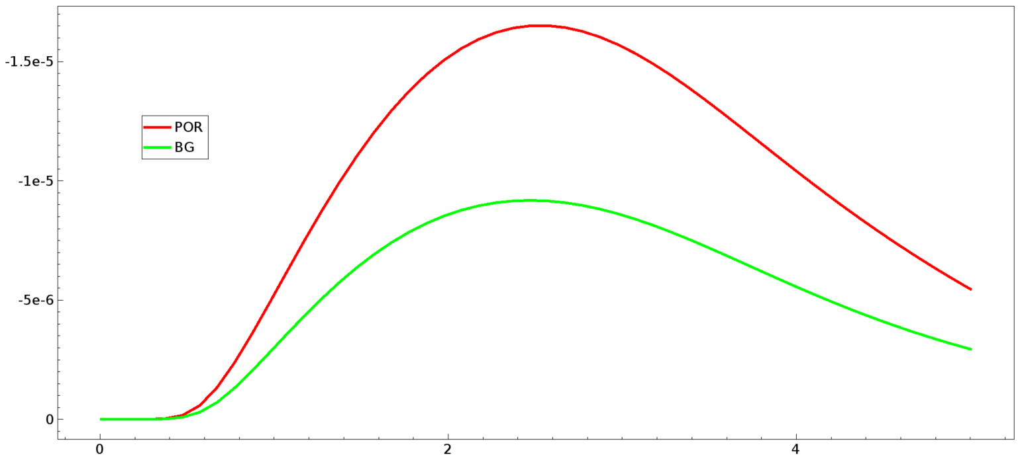
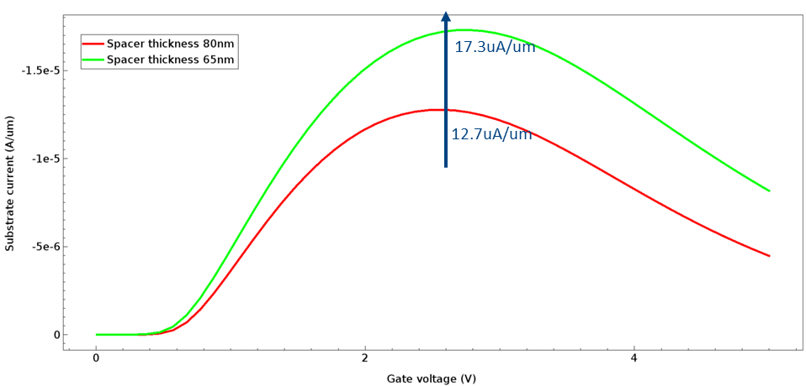
NHV Impact Ionization
ATF L_{G}=350nm, 80nm Spacer
Exp1: 250nm L_{G}, 80nm Spacer
Exp2: 250nm L_{G}, 65nm L_{G}
ATF
Exp2
Exp1
Exp1

