Slide 1
BWF Pathfinding
Scaling expectation – Cost/bit ≤ 75% & bandwidth ≥ 1.5X at ≤15% of Cost of Transition
4 paths under evaluation. Decision need-date is the end of 2021 for BWF design start
Cell Scaling – Goal: 0.75x $/GB and capacity increase
  Strategy: Array pitch scaling to 26.5nm, primarily in space.
  Issue: Requires ALD Nitride liner/seal (have not gotten to work in JDP and CR) new tool/capability.
2Kx4K – Goal: BW/GB increase
  Strategy: Partition count increase (smaller tile)
  Issue: Aggressive CMOS design rule scaling and tile control circuit compaction (scope); +1 PD metallization (cost)
1.5b/c – Goal: Density increase, lower $/GB, higher BW (metric for each)
  Strategy: Intermediate state that gets selected, without disturb; leverage unipolar memory effect of selector
  Issue: Nucleation distribution control; memory effect physics & engineering
BiSM – Goal: simpler cell stack, faster write access cycle time , without liability of PM;
  Strategy: Bipolar operation of selector only cell
  Issue: RWB and disturb margins at scaling, array tile layout with bipolar design

Slide 2
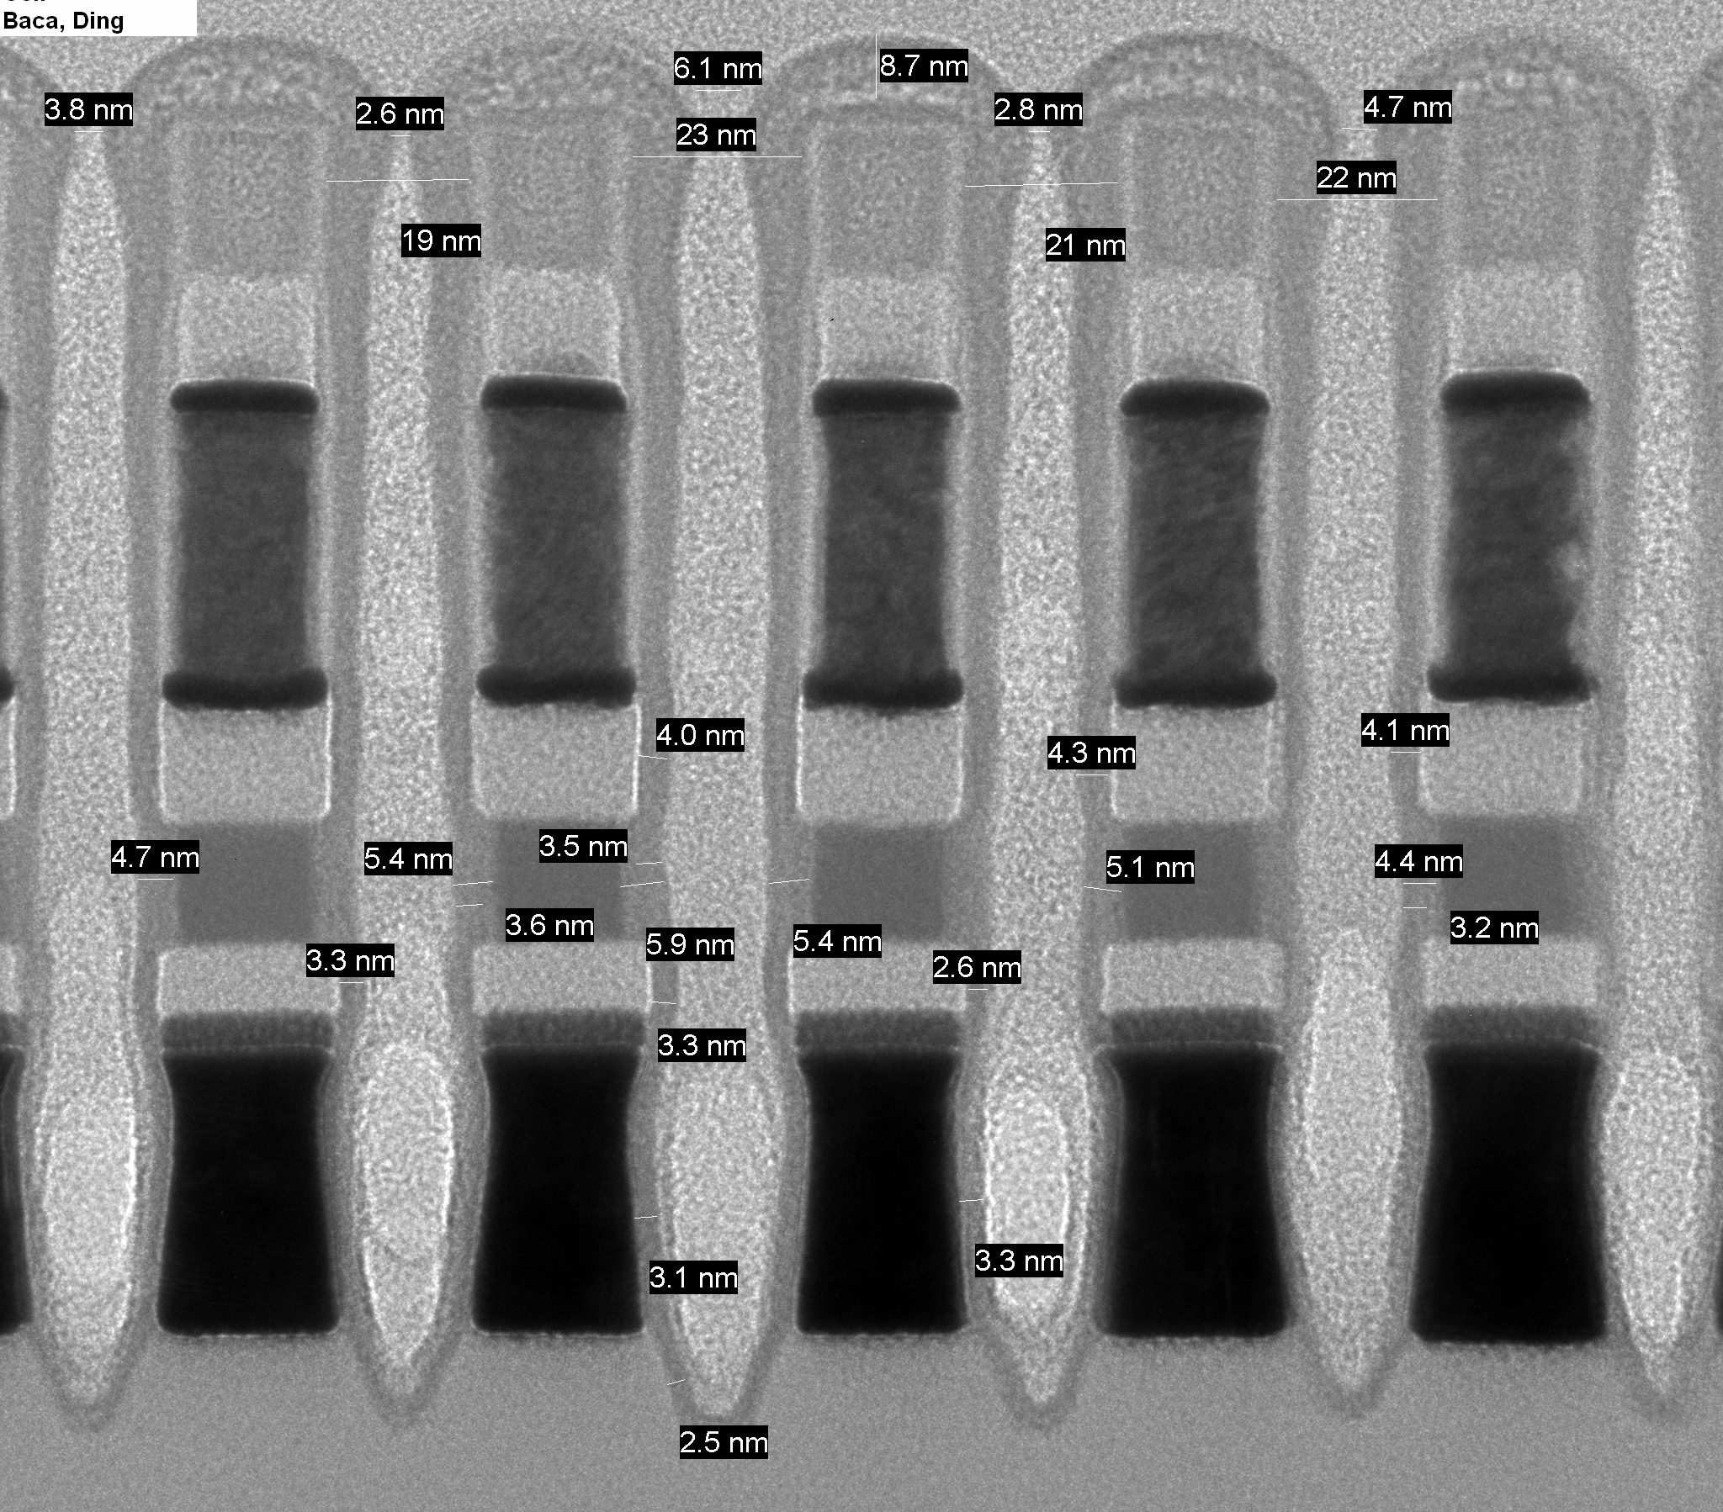
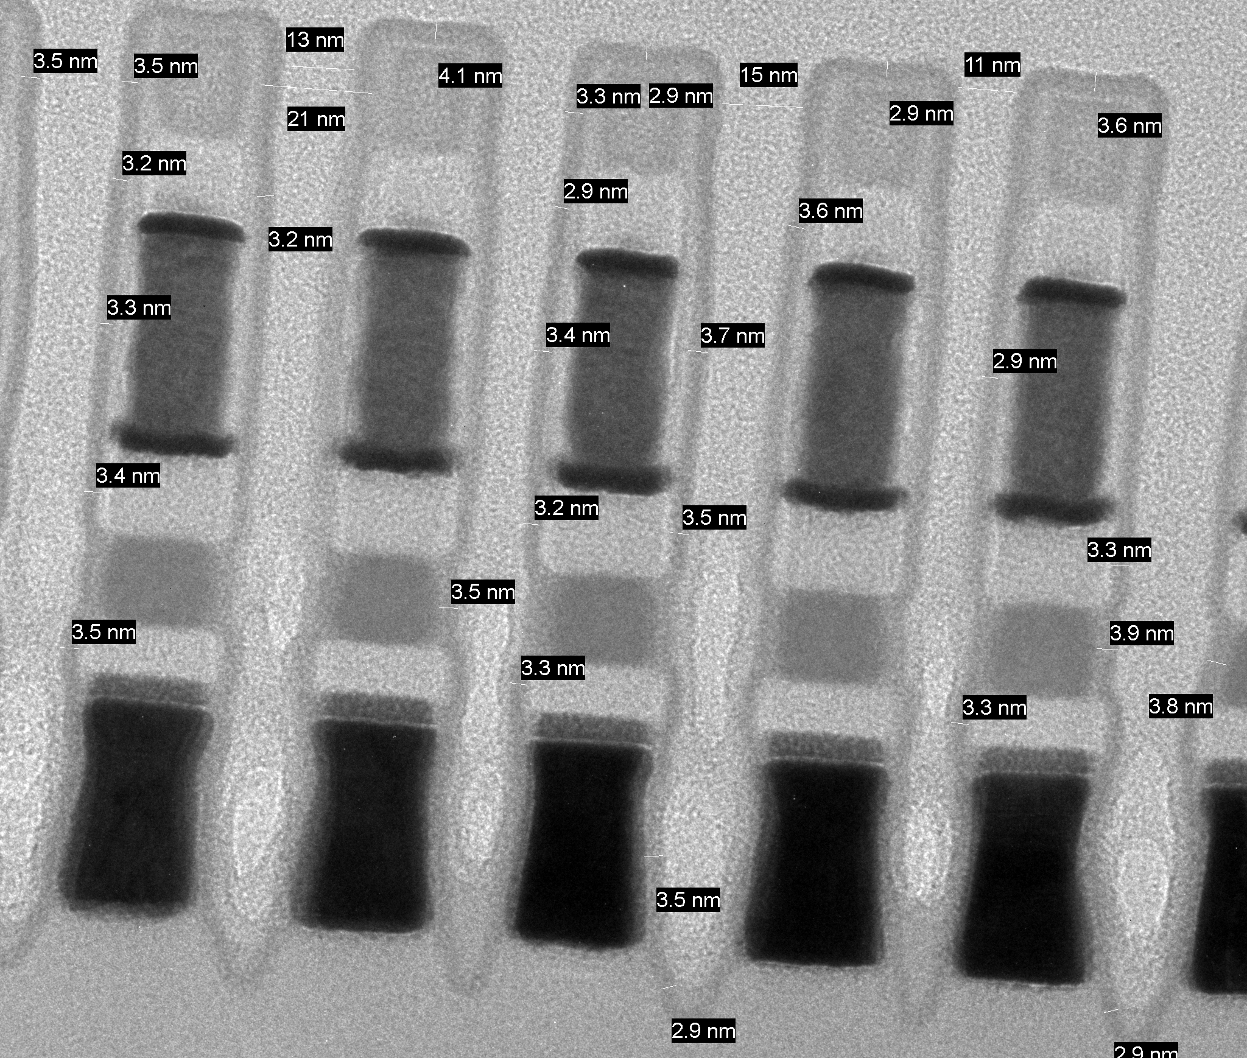
BWF Encapsulation Tool Demo Status
41nm pitch Demo
Scaled pitch option (26.5nm)
POR 306A TSN
Lam GN PEALD (250C, N2H2) 40A
Expected post-seal gap ~5nm w/ 40A film
Average post-seal gap ~4nm
Average post-seal gap ~13nm
ALD Liner/Seal Scorecard – Demo on Future in-house tool
 |  | Step coverage tests |  |  |  |  |  | Barrier Capability and Deposition Damage tests
Split | 40A TP (wfs/hr) single chamber | 51FP Step coverage |  |  | 51LP Step coverage |  |  | Adhesion to carbon | Steam Test | XRF Liner PM Loss |  |  |  | XRF Seal SD Loss |  | 60s, 1000:1 HF Sidewall WER (A/min) (90s WER) |  |  |  | Comments
 |  | mid SiN | mid TEC | mid PM | mid PM | mid MEC | mid SD | tape test |  | Te | In | Sb | Ge | As | Se | top | mid SiN | mid TEC | mid PM
BKM | 2 (roadmap to 12) |  |  |  |  |  |  |  | WIP |  |  |  |  |  |  |  |  |  |  | GN has new ionless plasma source, not tried before with PM/SD, more uniform sidewall quality.
N2H2 |  |  |  |  |  |  |  |  | WIP

Slide 3
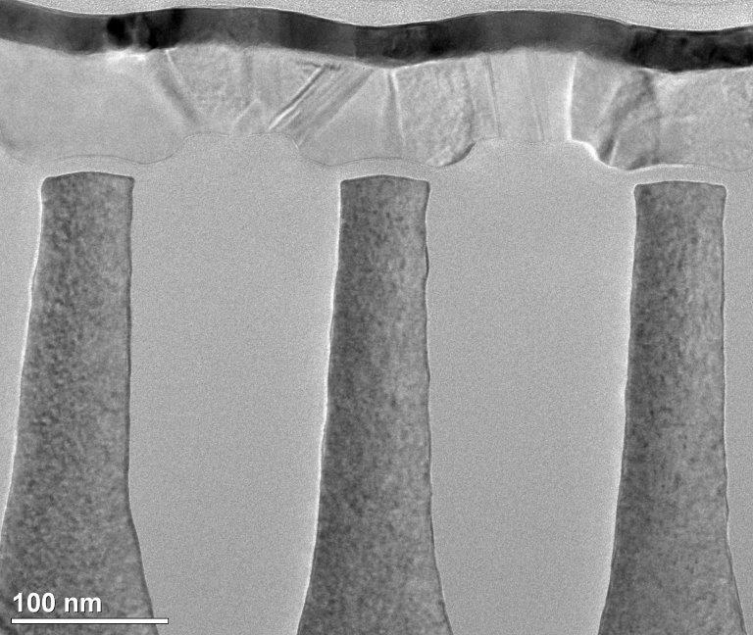
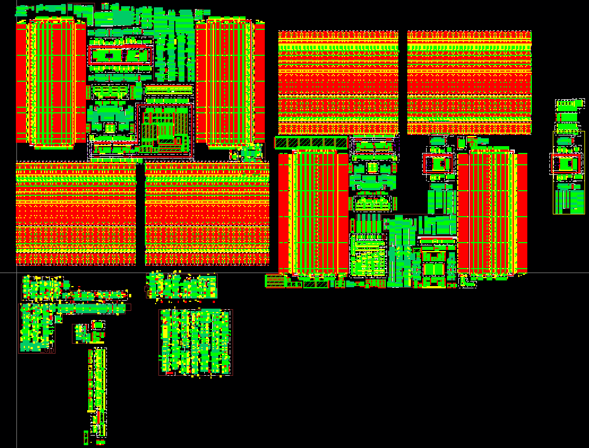
2Kx4K CMOS and Design status
Array footprint
100% CUA needed
14% tile gap to goal
Aggressive pitch cell x’tor scaling
Physical rules @ med risk; L1D exhibits no corner thinning.
Electrical capability @ high risk; segmenting gate control improvement at lower Z
Circuit Compaction WIP to address 14% CUA gap (med risk)
Full validation with SPICE sim to be completed in Q2

Slide 4


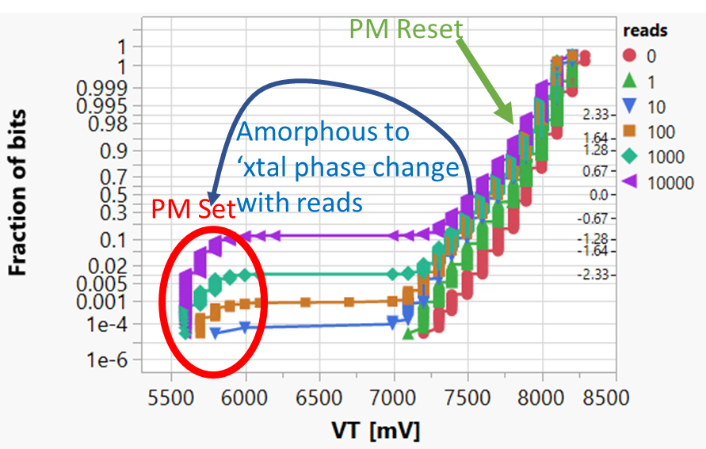
1.5b/c
Intermediate State
Read Disturb
1 bit per cell
1.5 bit per cell
X’tal PM
x-PM
low V_{T} SD
αPM
low V_{T} SD
αPM
High V_{T} SD
# of bits
# of bits
Reset
Set
Set
Intermediate
Reset
Amorphous PM
Vt
Vt

Slide 5
Supporting Materials

Slide 6
Challenge and Status for Decision Making
 | Challenges | Status
Cell Scaling | Array pitch scaling enablers validated (die size) | · New Modules L1D – including litho, PQ, Linear/Seal, Clean and etch.
 | 79% CMOS Design Rule Scaling capable (die size) | · Reuse ATF LV X'tors + scaling of HV X'tors at med-low risk · Aggressive pitch cell scaling at high risk in leakage and reliability · IC scaling at med risk on patterning and fill
 | Path to 55ns WR2WR reduction (speed) | · Primarily on access control with circuit innovation · Leveraging ATF on composition and algo tuning for CD scaling
 | Cell Stack for 15% reset current reduction (energy) | · Leveraging ATF; experiment exhibit paths in electrodes optimization
 | 400mV E4 reduction (energy) | · Pareto building based on S26
2Kx4K | All in "Cell Scaling” + adding IC scope | · All in "Cell Scaling” + 193i for M1 & adding one PD metallization
 | Additional 10% CMOS Design Rule scaling (die size) | · ~5% scaling explored with high DTS risk assessed, die size WIP
 | Tile topology changes to "Interlock” (die size) | · POC done in circa S37, low risk
 | Tile control circuit compaction (die size, energy) | · WIP at Med risk, SPICE based RA/RM ECD Q2
1.5b/c | PM2 read disturb immunity and scalable (physics) | · Developing nucleation physics and statistics subject to Read transient.
 | New SD for unipolar memory window (physics) | · new material exhibits memory window tunability vs. composition · Ab initio modeling for physics understanding · Scalability pending Si funding
 | Distribution reduction for RWB (functionality/BER) | · Leveraging ATF sigma reduction and drift reduction
BiSM | Bipolar architecture (die size) | · 3T decoder is die size (+40%) prohibitive w/o significant advances in IC. · 2T decoder analysis starts
 | BiSM scalable (physics) | · Leveraging 1.5b/c pathfinding

Slide 7
Critical Path to BWF Design Start
 | 2020 | 2021 |  |  |  | 2022 |  |  |  | 2023
 | Q4 | Q1 | Q2 | Q3 | Q4 | Q1 | Q2 | Q3 | Q4 | Q1 | Q2
DPOR | (BWF 2 quarters push out) |  |  |  |  | BWF DS |  |  |  | BWF DBR
BWF Design Rev |  | Circuit PF |  | Rev-2 | Rev -1 | Rev 0 | Rev 1 | Rev 2 | Rev 3
BWF Design Collateral
Process File/DTS |  | Exp |  | SP |  |  | TO
Design Rules |  | Exp |  | SP |  | TO(FE) | TO(BE)
MTS/DTS silicon Fab out (needed for TO design collateral) |  |  |  | LV | HV/Array¶ | PC/IC
Building CMOS/IC Design Collateral
LV (low voltage x'tor) |  | TC03 vs. P1250 CMOS/DR Gap | FE Stepping | Si
HV(high voltage x'tor) |  |  | FE Stepping |  | Si
PC(pitch cell) |  |  |  |  |  | Si
IC(interconnect) |  |  |  | BE Stepping |  | Si
Building Array Design Collateral
Array/26.5p(cell/array RC) |  | Gridding TO | BWF Spider TO | BWF Spider TO | Si
Exp – Experimental Process file and design rule, paper based. Used primary for circuit pathfinding, sanctioned by technology and design team
SP – Speculative Process file and design rule, limited silicon support, some experimental content. Used primary for circuit implementation to prepare for C-spec alignment and design start.
TO – Process File and design rule will be used for Tapeout. Silicon based MTS and DTS risk are assessed. Full RA/RM and gap closure planned deemed med to low risk.
Array¶ – Array MTS/DTS silicon. In order to support 1.5b/c and BiSM decision process, SD3 and/or SD4 validation by end of 2021 is the critical path. Alignment with SD exploration, process module pathfinding and corresponding silicon funding from L0 to 33.5p L2/3 are needed.

Slide 8
Module Requirements & capabilities for cell scaling
Base assumption for either 2k x 4k or 4k x 4k is 26.5nm pitch w/ equal line/space and equivalent films/cell. The items below are minimum requirements for pitch reductions below ATF pitch.
This is a small line scale off ATF (90% cell area versus ATF) which adds ~ 11% or 13ns tnuc margin risk versus ATF, 3% resistivity degradation for the array conductors
Module | Driver/Process Need | Strategy | Status | Risks
Liner / seal | 26.5nm Improved step coverage w/ matched barrier | tALD/PEALD – innovation required to start | Vendor demo L1D/L0 Lam process in house ~ March 2021 | Prior ALD nit impact to PM setability Composition
Cleans and Drying | 26.5nm Toppling margin w/o composition impact | iLPC SC CO2 Sublimation Dev to start, innovation long term | In house ~ late Q1 2021 Vendor demo Vendor demo, eval approved (SCS) | Process window? Cost Composition, inhouse process Q4 2021
FP/LP cut etch | 26.5nm etch space @MTS profile/composition | Kiyo GX – Aegis Dev to start, lots of dev for LT | In house, tool UTP KFX593 KFX587 | Limited old JDP small pitch data.
Litho | 26.5nm ~4nm spec for array line to via, via to line | 1980i upgrades LOCNES, KLA analysis tools Dev to start, dev to LT, tool? | Eval in SPOR, CPA pending Implemented in house, Pushed 2 years | Cost
Patterning | 26.5nm Space CDU improvement of ~ 30% Via | Alt PQ spacer flows HM Dev to start, innovation? LT | L1D vendor demo L1D mixed vendor and in house | Solutions not yet demo’ed w/ ATF

Slide 9
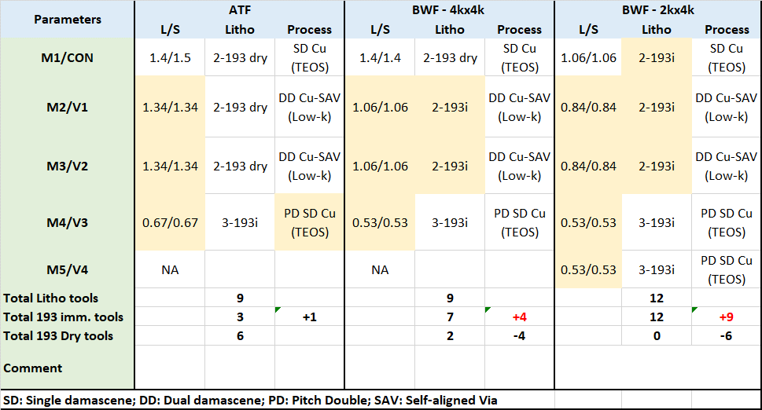
Interconnect Scaling Summary
No change to TM2.
TM1 thickness increase is under consideration. May impact minimum design rules once thickness finalized.
+0.9% cost
+4.8% cost

Slide 10
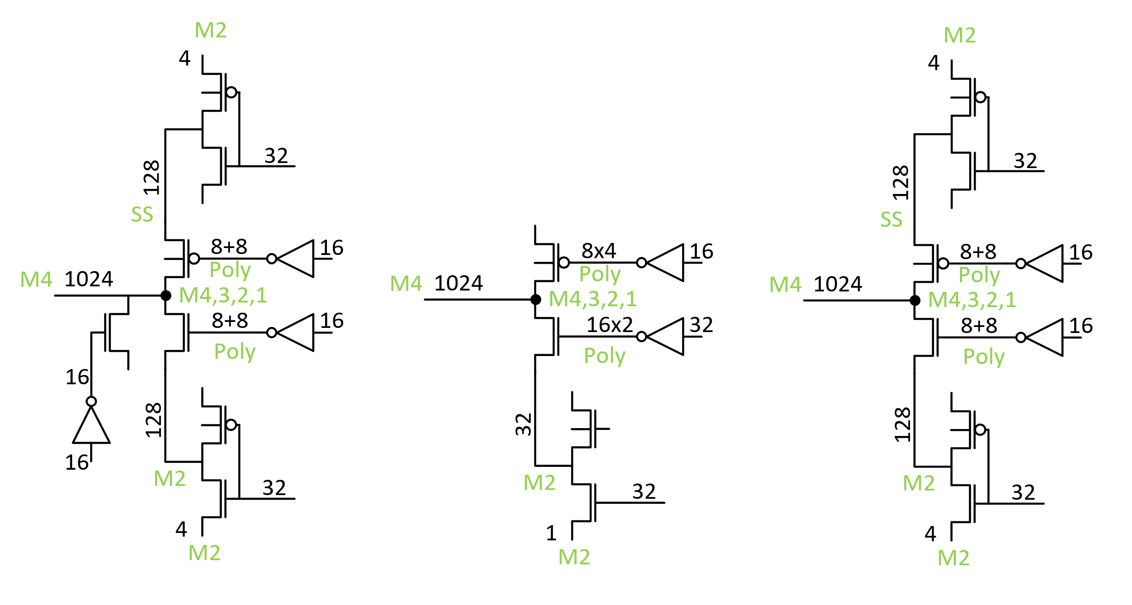
Bipolar Decoder
FP – wip, expect smaller
than 3t
Track count is smaller x16
Need adjacent wl grounding
scheme – prevent false
selection, minimize refresh
Powerup init and periodic
refresh.
3T Bipolar
Decoder
2T Unipolar
Decoder
2T Bipolar
Decoder

