Slide 1
Optane 1.5-BPC ResearcH update
Sanjay Rangan, Hemant Rao, Saad Monasa, Mohammad-Hadi Sorabi, Rouhollah Mousavi Iraei, Shashank Chandrashekara, Sandeep Chekuri

Slide 2
Objective – Review current understanding of 1.5b/cell and discuss next steps
Current status –
Focus over the last quarter has been on establishing viability on two areas for the intermediate state
Placement –
SD memory effect set back with no PM disturb (nucleation/growth)
Disturbs –
Ability to do multiple back to back reads without disturbing PM (nucleation/growth), while setting back the SD after each read
Results
We are able to set back the SD for both reads and writes without disturbing the PM through appropriate current and time values
These values line up well with our understanding of PM nucleation and growth providing confidence on viability (details in key learning slide)
This presentation will discuss the details on the different phases of validation/implementation and further review key data to recommend moving forward on 1.5bpc. There are no fundamental cell/device show stoppers.

Slide 3
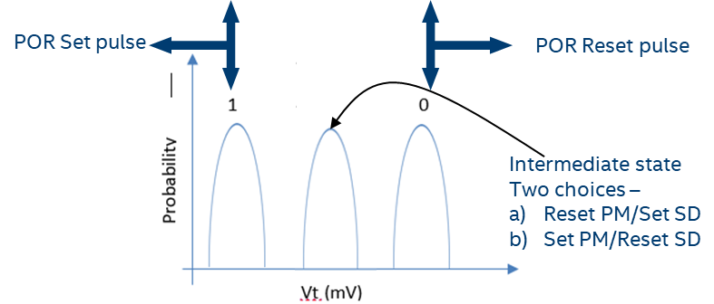
Background: Key challenges for read and placement for middle state
PM: Xtal
SD: lowVT state
PM: Amorphous
SD: highVT state
Intermediate/middle state
PM : Amorphous
SD : is in lowVT (setback) state
Writing to the intermediate state requires PM to be amorphous and SD in the low VT (setback) state
Challenges: SD prefers a low current/short time to SET while PM nucleation currents are also in the similar range. Need to manage the current/time window budget properly [discussed in next slide]
We need to threshold switch the intermediate state similar to the POR SET state so read should be able to do a similar behavior on both SD(setback state) /PM (amorphous) same as placement pulse
Challenges: sensing current/time window needs to be managed similar to writing pulse

Slide 4
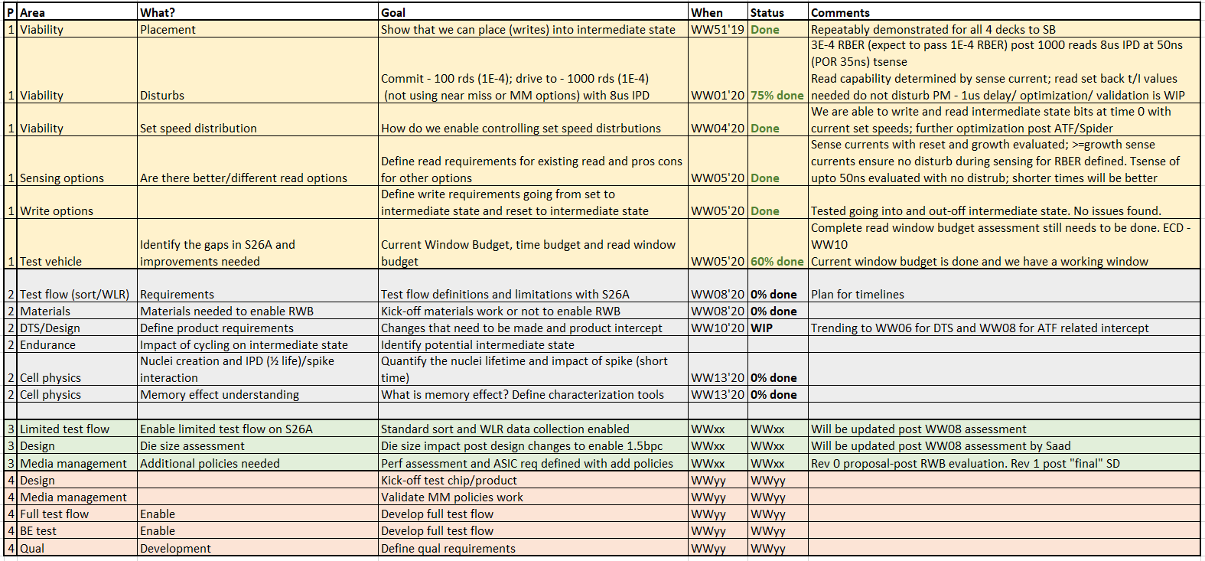
Summary table of the phases and status for 1.5bpc

Slide 5


Key learning
Set time distribution
Read
t_sen
Sense current outside the low current window
Issr
(1)
Rate
Currents
Log(Currents)
low current
(2)
(3)
Seed window
t_low current
Issr
Time
Log(Time)
Temp
Write (intermediate state placement):
No (single) read disturb observed for intermediate state
Read disturb:
Sensing - If Sense current is >=growth, then read disturb is a non-issue; far current delivery needs management
Set back/term – Time/current optimization minimizes RD RBER
Write and read
Set back
Holdcurr
Low curr
Probability
Issr
Current

Slide 6
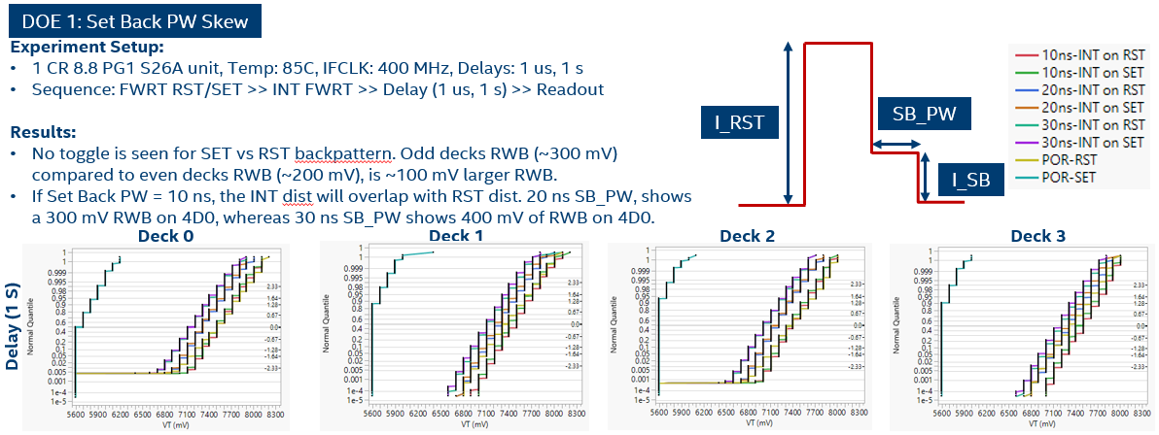
Placement to the middle state : Setback time dependence
Requirement: Single pulse enabling max memory effect without PM disturb
Results: No PM disturb observed (validated through reads upto 20ns SB PW)
Fraction of bits
Increasing T_{SB}
Fraction of bits
Histo artifact
Histo artifact

Slide 7
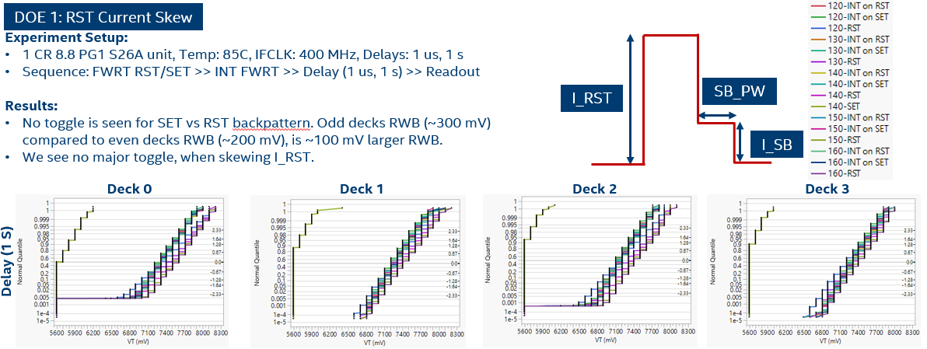
Placement to the middle state : Precondition effect
Requirement: Single pulse enabling max memory effect without PM disturb
Results: No PM disturb observed and no prior pattern dependency observed
Fraction of bits
Fraction of bits
Fraction of bits
Fraction of bits
Histo artifact
Histo artifact
Notes:
1) Next slide has the read related segmentation for validating PM is not disturbed

Slide 8
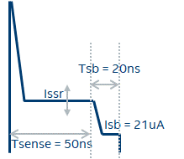
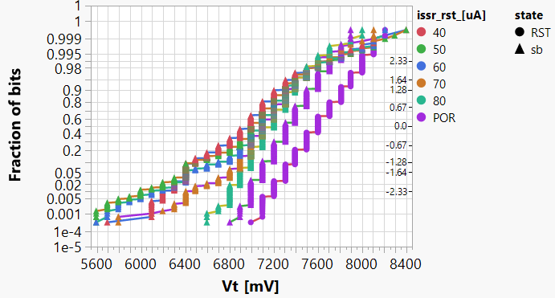
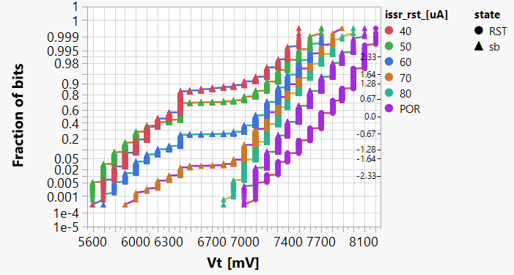
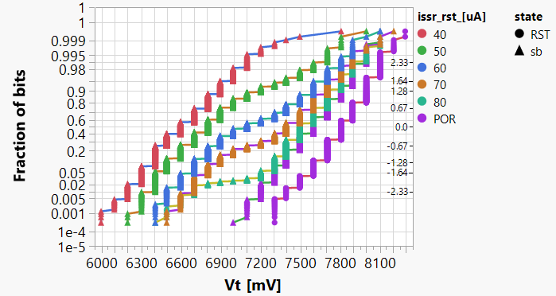
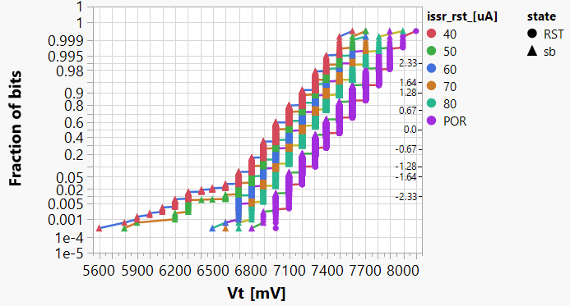
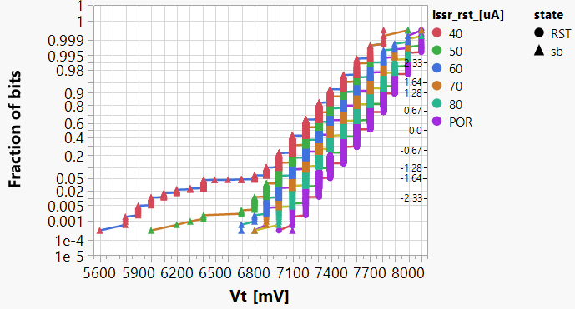
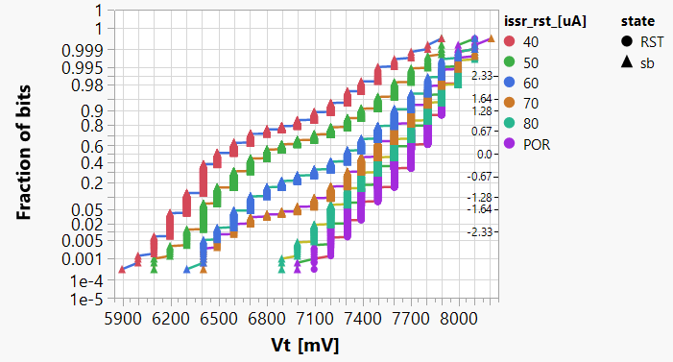
Read disturb on middle state: Issr dependence
Read pulse
Requirement: 1k reads < 1e-4 RBER at 50ns Tsense with setback
Results: Meets requirements at Issr >= Igrowth
4D0, ED1
4D0, ED4
Post 1k reads on intermediate state
4D0, ED8
Higher Issr
0 read setup:
RST, intermediate state
Current delivery related optimized is WIP
4D3, ED1
4D3, ED4
4D3, ED8
Notes:
1) Tsense longer for margin building

Slide 9
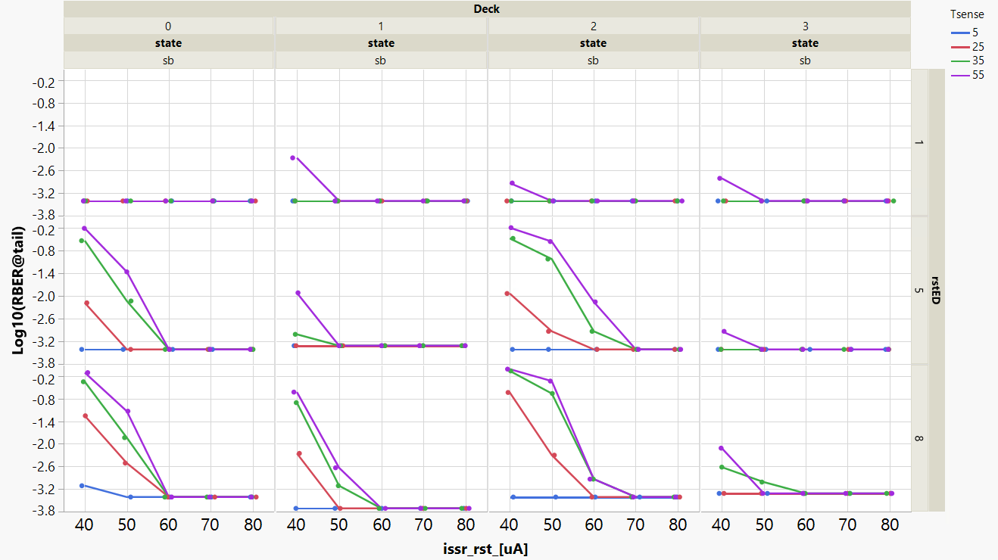
Read disturb on middle state : Tsense dependence
Requirement: 1k reads < 1e-4 RBER at 50ns Tsense with setback
Results: Meets requirements at Issr >= Igrowth and Tsense@50ns

Slide 10
Summary
No fundamental cell show stopper
Key Linchpins to viability –
Current delivery capability needs to be resolved
2020 results required to step up/down
With 20.5nm cell, recommendation is to step up
Validation on 14nm is needed, but no clear issues identified
RWB evaluation – window budget and drift to define MM policies
Needs from Process/Integration
New SD with larger memory effect needed for stack validation and RWB

Slide 11
Back-up

