Slide 1
IL Workstream 2.0 Overview & Update
Updated: September 1, 2020
Find the latest version of this file at http://goto.intel.com/ILWS2info
For additional information, contact W. Steven Conner

Slide 2
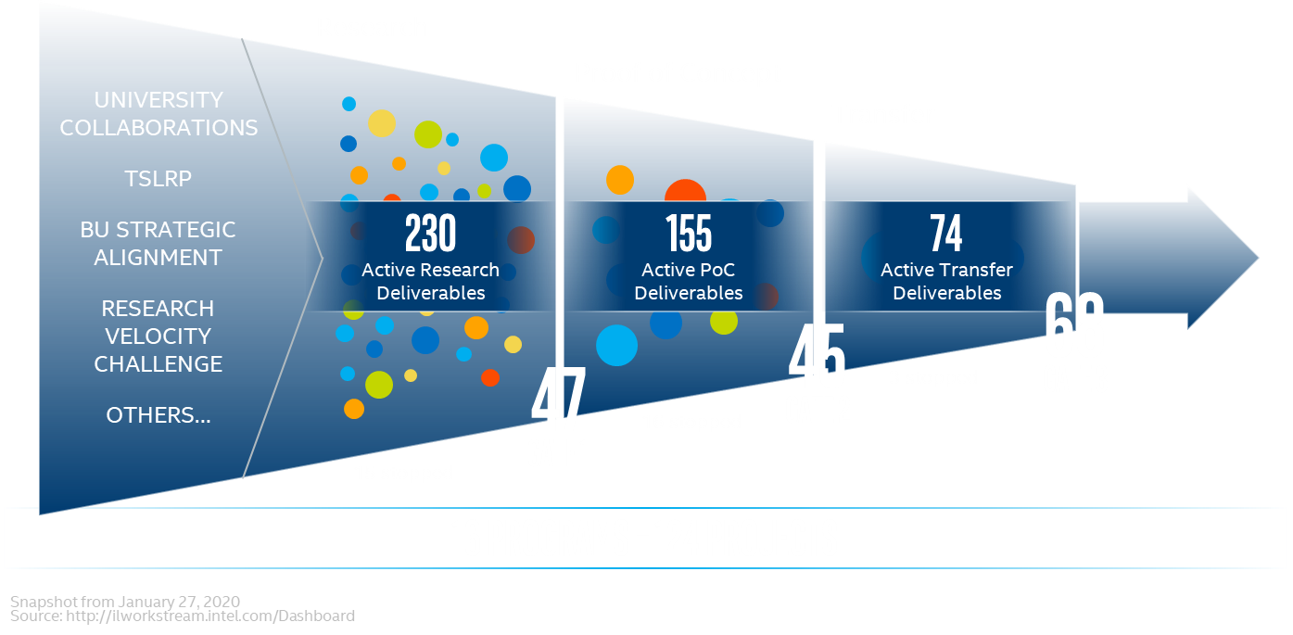
Problems with WS 1.0 that Motivated Workstream 2.0
2019 Workstream Summary

Slide 3
Problems with WS 1.0 that Motivated Workstream 2.0
Research
Proof of Concept
While the original Workstream brought benefits through transparency and disciplined innovation, the system became overwhelming over time
Many of the 120+ projects were open-ended, continuing for many years without a clear end-goal or expectation of renewal
Projects were typically “containers” for an average of 3-4 stand-alone “deliverables” – de-facto sub-projects with independent plans and leaders
Granularity made it difficult for stakeholders to understand what’s important out of the 400+ deliverables
There was a lot of “process” associated with micro-tracking each deliverable, which was increasingly overwhelming for IL researchers
UNIVERSITY COLLABORATIONS
TSLRP
BU STRATEGIC ALIGNMENT
RESEARCH VELOCITY CHALLENGE
OTHERS…
Transfer
231
Active Research
Deliverables
158
Active PoC
Deliverables
65
Active Transfer
Deliverables
60
GATE 3
29
GATE 2
36
GATE 1
16 programs – 126 projects

Slide 4
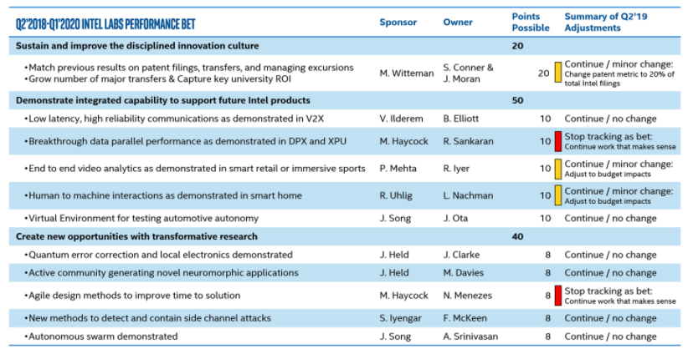
Opportunity to Converge & Simplify IL Processes
IL Workstream 1.0
IL Performance Bet
IL Research Portfolio
CAT3 - ‘Pioneering’
CAT2 - ‘Leapfrogging’
CAT1 - ‘Competitive’
% IL Headcount
Gate reviews, tech transfer,
BU alignment…
2-year cross-IL goals tracked
with metrics & milestones
Impact-focused
portfolio analysis
Going forward, we want to combine the best attributes into one framework and simplify
with one granularity of focus: fewer, larger, higher-impact Intel Labs projects

Slide 5
Principles for Workstream 2.0 (from Q1’20 QGS)
Ideation
Research
UNIVERSITY COLLABORATIONS
TSLRP
BU STRATEGIC ALIGNMENT
RESEARCH VELOCITY CHALLENGE
OTHERS…
Proof of Concept
Transfer
Focus of Q2 Pilot
IDEATION & EXPLORATION
Improved, Streamlined Idea Solicitation
New process and supporting tools
Funded Exploration Projects
Focused efforts to develop research proposals
Documented Research Plans
Establish goals and basis for milestone tracking
Fixed Project Durations
Supporting portfolio renewal over time
Broader Value-Capture Tracking
Tech transfers, open source, publications, patents, standards…
RESEARCH PROJECTS
Note: Discontinue tracking “Workstream Deliverables” as sub-projects with their own leaders and plans

Slide 6
Elements of a Workstream 2.0 Project Research Plan
What is the problem statement & compelling end point?
  What is the desirable future state that would be enabled by the research? What is the end user value?
What are the proposed solution and key assumptions?
  What do we expect to deliver? Is it stand-alone or part of something else? What is the secret sauce?
  What are your key assumptions you believe to be true that may later be proven wrong?
How does this work fit into the competitive landscape?
  What gives us confidence our solution will provide lasting competitive advantage vs alternatives?
Why is Intel Labs the right place to do this research?
  Why is this not more appropriate to do at a BU as advanced development or at an academic research center?
How do we envision Intel capturing business value?
  What is the proposed approach to translate this research into a net positive business result for Intel?
What is the proposed methodology and plan?
  How long will it take? What are the key milestones? Go/no-go decision points? Resource plan?
  See template/guidance for more details: Workstream 2.0 Documentation

Slide 7
How are Gate Reviews Changing with Workstream 2.0?
 | Workstream 1.0 | Workstream 2.0
Gate 1 | Deliverable Research-to-PoC Transition Typically reviewed and approved at lab-level Timing: typically multiple quarters after project starts | Project Research Plan Review Decider: IL Staff lab director with most resources on the project Agreers: Other IL Staff lab directors with resources on the project Inputter: Rich Timing: required at project start, refreshed in renewal reviews
Gate 2 | Alignment with BU on Transfer/Joint Development Plan Decider: Rich Agreers: Senior BU transfer owner, IL Staff lab director(s) with resources committed
Gate 3 | Confirm Completion & Handoff of Transfer/Joint Development Plan with BU Decider: Senior BU transfer owner Agreers: Rich, IL Staff lab director(s) with resources committed
    Note: framework is flexible and optionally allows multiple Gate 2/3 transfers for a given project. Granularity should be tailored to what’s most helpful for efficiently managing a project and aligning expectations with BUs. Keep in mind that aggregate project impact is the key metric of focus, not the total count of gate reviews.

Slide 8
Workstream 2.0 Pilot Learnings & Next Steps
10 Projects Reviewed with IL Staff
Learnings
Cross-IL forum was helpful to calibrate new project methodology and expectations
Good to identify one “Decider” lab director, along with “Agreers”
Project definition as important as writing a good project plan
(synthesized & focused projects vs aggregation projects)
Areas where we’d like to continue raising the bar: competitive analysis, risks/mitigations, why Intel Labs, resource planning
Next Steps
All WS 2.0 projects should have documented research plans & lab director reviews by end of 2020
We’ll continue to review most large projects and projects with significant multi-lab resourcing in cross-IL project review forum
Project | Presenter(s)
Agile SW/HW Co-Design | Desmond Kirkpatrick, Steve Burns, Jin Yang
Cryptographic Computing | Dave Durham
Continual Learning | Yimin Zhang
Enhancements to IA Sys Arch | Raj Sistla, David Koufaty
Side Channel Mitigation | Carlos Rozas
Dependable AI | Michael Paulitsch
Gaming, Generative, and Graphics (G3) | Selva Panneer, Carl Marshall
Infrastructure on Demand | Shilpa Talwar
Collaborative Robotics Systems | Margaret Huang, Amit Baxi
Optane Accelerator | Ted Willke, Mariano Tepper
Notes:
The primary goals of the pilot were to:
Iron out new expectations for WS2.0 project plans & reviews
Calibrate expectations among IL Staff lab directors
Start building new “muscle memory” in the organization
Identify a few role-model example plan docs & PPTs

Slide 9
Links to Key Documents
  IL Workstream 2.0 Overview and Update.pptx
  IL Workstream 2.0 Written Project Plan Guidance.docx
  IL Workstream 2.0 Written Project Plan Template.docx
  IL Workstream 2.0 Gate 1 Project Review Guidance and Presentation Template.pptx
  IL Workstream 2.0 Gate 2 and Gate 3 Guidance and Template.pptx
  The latest versions of these documents are available here:
  https://intel.sharepoint.com/sites/IntelLabsWorkstream2.0/SitePages/Intel-Labs-Workstream-2.0-Documentation.aspx

Slide 10
Q&A / Discussion

Slide 11
BACKUP

Slide 12
WS 2.0 Key Areas of Feedback / Learnings So Far
Project Scope
  Scope should be bounded with specific and measurable end goal (how do we know we’re done?)
  Should be clear what novel idea IL is focused on to deliver the end goal
  Avoid simple aggregation – multiple research vectors should fit together in meaningful way
Research Plan:
  BKM: Summarize overall plan timeline chart showing major milestones & resource planning
Value Capture
  The value capture strategy should be as specific as possible, e.g. listing specific target platforms, subsystems, processes (as applicable) & strategy to achieve the desired adoption/impact
  Do we understand what it’s going to take to convince BU(s) to adopt the output?
  Risk Factors & Assumptions:
  Highlight biggest risk factors that might derail envisioned project outcome, and plan to mitigate the risks
  What key assumptions do you believe to be true that may later be proven wrong? ?
  Why Intel Labs:
  Why not more appropriate to do as BU advanced development or at an academic research center?

Slide 13
WS 2.0 Frequently Asked Questions (FAQ) – 1 of 2
Is Workstream 2.0 a Change in Process or a New Tool?
    ➔ First and foremost, Workstream 2.0 is a change in how Intel Labs defines, tracks, and communicates our research investments. We are combining the best attributes of what had been multiple processes into one framework and simplifying with one granularity of focus: fewer, larger, higher-impact Intel Labs projects, each defined with an end goal and bounded scope and timeline. We’re discontinuing tracking Workstream deliverables as stand-alone sub-projects with separate leaders, goals, compliance, etc.
    ➔ While we are planning to eventually release a new tool optimized and simplified for the new Workstream 2.0 process, in the near-term we will utilize the existing Workstream tool with minor changes to begin facilitating the transition in process and increased focus on projects.
Will we continue to have Gate Reviews with Workstream 2.0?
    Yes – Gate 1 will review the overall project plan at the beginning of a project (plus future project renewal checkpoints), Gate 2 & Gate 3 continue for alignment of tech transfer(s) with BUs in the context of a project’s plan, with flexible granularity.
    Note: The framework is flexible and optionally allows for multiple Gate 2/3 transfers for a given project. Granularity should be tailored to what’s most helpful for efficiently managing a project and aligning expectations with BUs. Keep in mind that aggregate project impact is the key metric of focus, not the total count of gate reviews.

Slide 14
WS 2.0 Frequently Asked Questions (FAQ ) – 2 of 2
Are we planning to define a next Performance Bet for Intel Labs?
    ➔ No, we are sunsetting Performance Bets as a stand-alone process. Instead, we expect every
    WS 2.0 project to define challenging goals with metrics and milestones for tracking progress.
Do we plan to continue holding Program Reviews?
    No – we are shifting the focus to Project Reviews going forward. Flexible grouping of related projects will continue to be used for summarizing and communicating the IL portfolio, but we’re discontinuing tracking of formal programs with owners and regularly scheduled reviews.

Slide 15
Workstream 2.0 Project Example 1
Legend
Project
Project Review
Key Milestone
Value Capture
Start
End
Height represents resources
allocated to
project
Decision Point:
Approve Proposed
Project Plan
(new Gate 1)
Decision Point:
Go/No-Go to
Increase Resources
Decision Point:
Align Significant BU Transfer
(Gate 2)
Decision Point:
Confirm Transfer Done (Gate 3),
Assess Overall Value Capture Impact,
Conclude/Stop Project
2021
Timeline
2022
Note: Aggregate project impact is key metric of focus – not the total count of granular milestones, value capture, or alignment decisions.
The framework is flexible and allows for multiple Gate 2/3 transfers for a given project. Granularity and methodology within the project framework should be tailored to what is most helpful for efficiently managing a project and aligning expectations with BUs and other key stakeholders.
Notes:
Note: Aggregate project impact is key metric of focus – not the total count of granular milestones, value capture items, or formal transfer reviews completed within the project…. having more than one Gate 3 transfer is not necessarily more impactful than a single combined Gate 3 for the project. Granularity should be decided based on what is most helpful for efficiently managing the project and aligning transfer expectations and plans with BU(s) and other external partners.

Slide 16
Workstream 2.0 Project Example 2
Legend
Project
Project Review
Key Milestone
Value Capture
Start
End
Height represents resources
allocated to
project
Decision Point:
Approve Proposed
Project Plan
(new Gate 1)
Decision Point:
Go/No-Go to
Increase Resources
Decision Point:
Align Signif. BU Transfer
(Gate 2 for Ingredient #1)
Decision Point:
Align Signif. BU Transfer
(Gate 2 for Ingredient #2)
Decision Point:
Confirm Transfer Done
(Gate 3 for Ingredient #1)
Decision Point:
Confirm Transfer Done
(Gate 3 for Ingredient #2),
Assess Overall Value Capture Impact,
Conclude/Stop Project
2021
Timeline
2022
Note: Aggregate project impact is key metric of focus – not the total count of granular milestones, value capture, or alignment decisions.
The framework is flexible and allows for multiple Gate 2/3 transfers for a given project. Granularity and methodology within the project framework should be tailored to what is most helpful for efficiently managing a project and aligning expectations with BUs and other key stakeholders.
Notes:
Note: Aggregate project impact is key metric of focus – not the total count of granular milestones, value capture items, or formal transfer reviews completed within the project…. having more than one Gate 3 transfer is not necessarily more impactful than a single combined Gate 3 for the project. Granularity should be decided based on what is most helpful for efficiently managing the project and aligning transfer expectations and plans with BU(s) and other external partners.

Slide 17
First Phase of Workstream 2.0 Implementation – Q2 2020
IL Staff Aligned on Two Parallel Adoption ARs on 2/18:
    Each Lab clean-up 2020 project list in Workstream before the end of Q2 (sooner better)
      See slides 8-9 for details
    Kick off a pilot to iron out cross-IL expectations on written project research plans &
    project reviews
      Project reviews scheduled between May – early July
      See slide 10 for details

Slide 18
Lightweight Documentation in ilworkstream.intel.com
During this first phase of WS 2.0 implementation, continue using existing Workstream tool, utilizing new “WS 2.0” project flag (new simplified tool being designed for future)
Lightweight data to capture about each WS 2.0 project in the tool:
  Project Name
  Headcount in HAT (size aligned to what’s needed for project scope – cross-Lab resourcing encouraged)
  Project Leadership & Contributor Names (based on HAT)
  Proposed Project End-Date
  Next Renewal Date (max 2-years in future, or earlier if logical go/no-go decision point)
  Recommended Portfolio Category (Competitive, Leapfrogging, Pioneering)
  Uploaded Research Plan document (only required for pilot projects in initial Q2 phase)
  Discontinue use of “Workstream Deliverables” as stand-alone sub-projects with separate leaders, goals, compliance, etc.

