Slide 1
AGS Entitlements: Corporate Roadmap Publications
Mapping: AGS > Version >Publication >Audience
AGS Entitlement | Version / SharePoint | Published Title | Audience
ELT Roadmap in Execution Wide Distribution Read | Corporate Roadmap - Exec Sync | Corporate Roadmap Wide Distribution Package | CEO extended -Exec Sync ,Executive Sync Audience, VPs, Fellows, Senior PEs, Key GM Executives
ERM ELT Roadmap in Execution General Purpose Read | Corporate Roadmap - General Purpose Version | HW and IP Roadmap | BB Employees requiring access

Slide 2
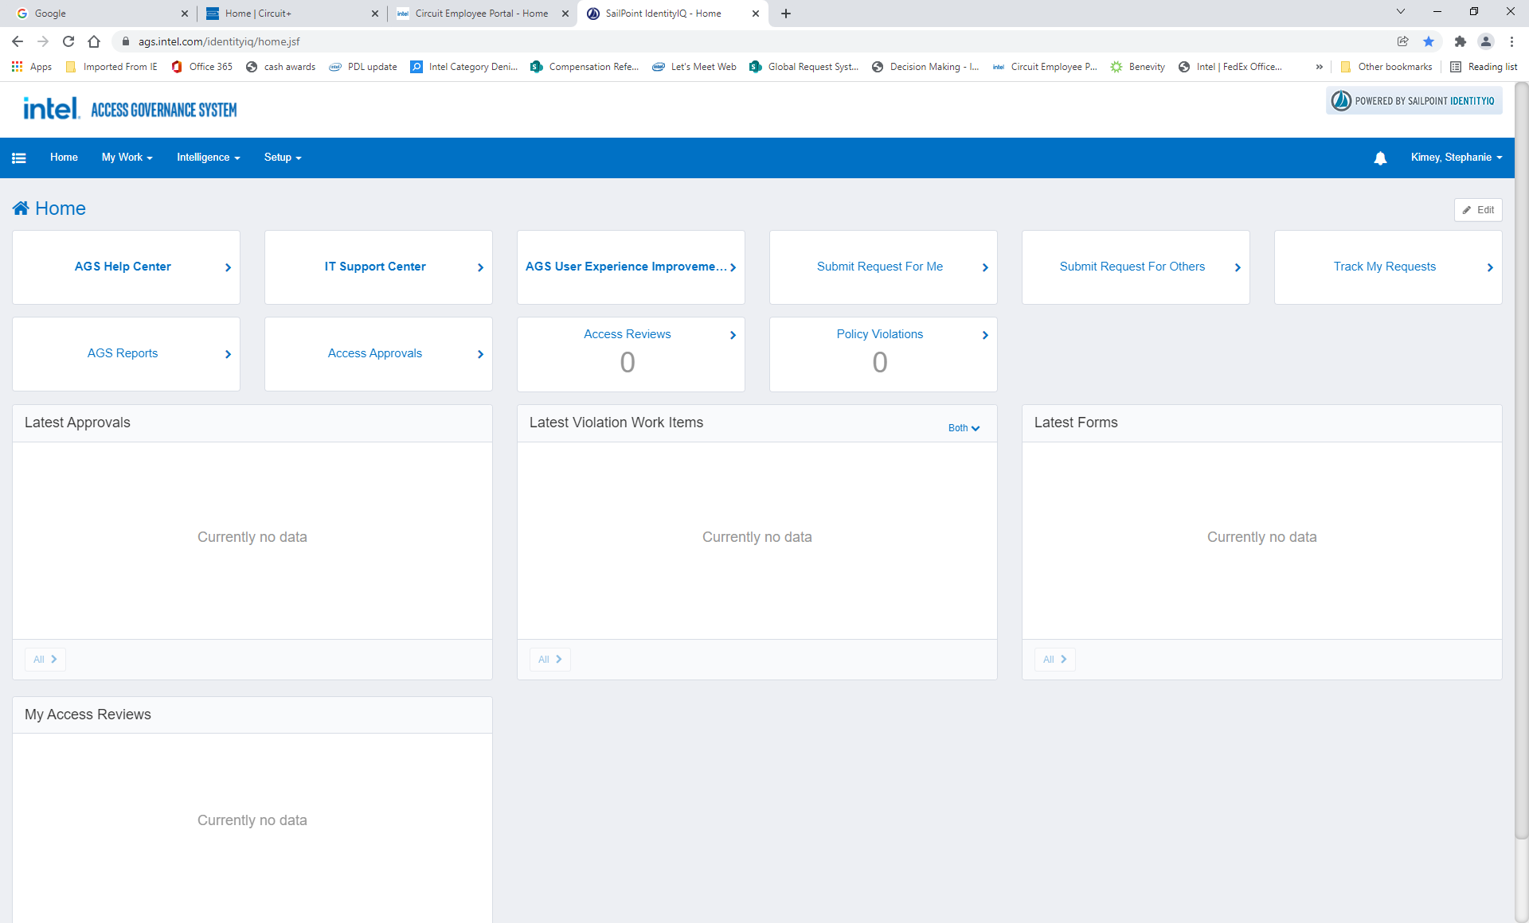
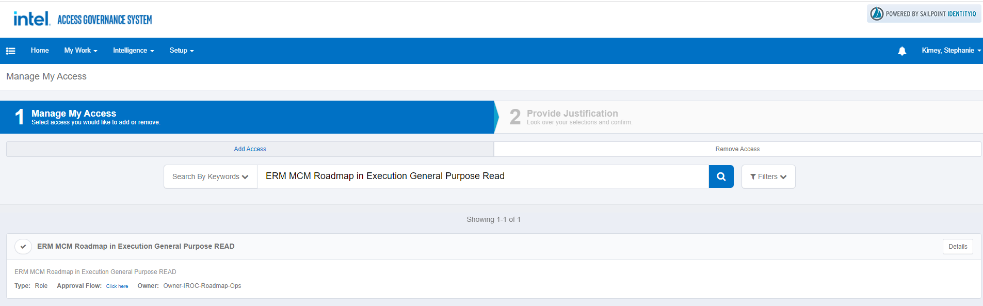
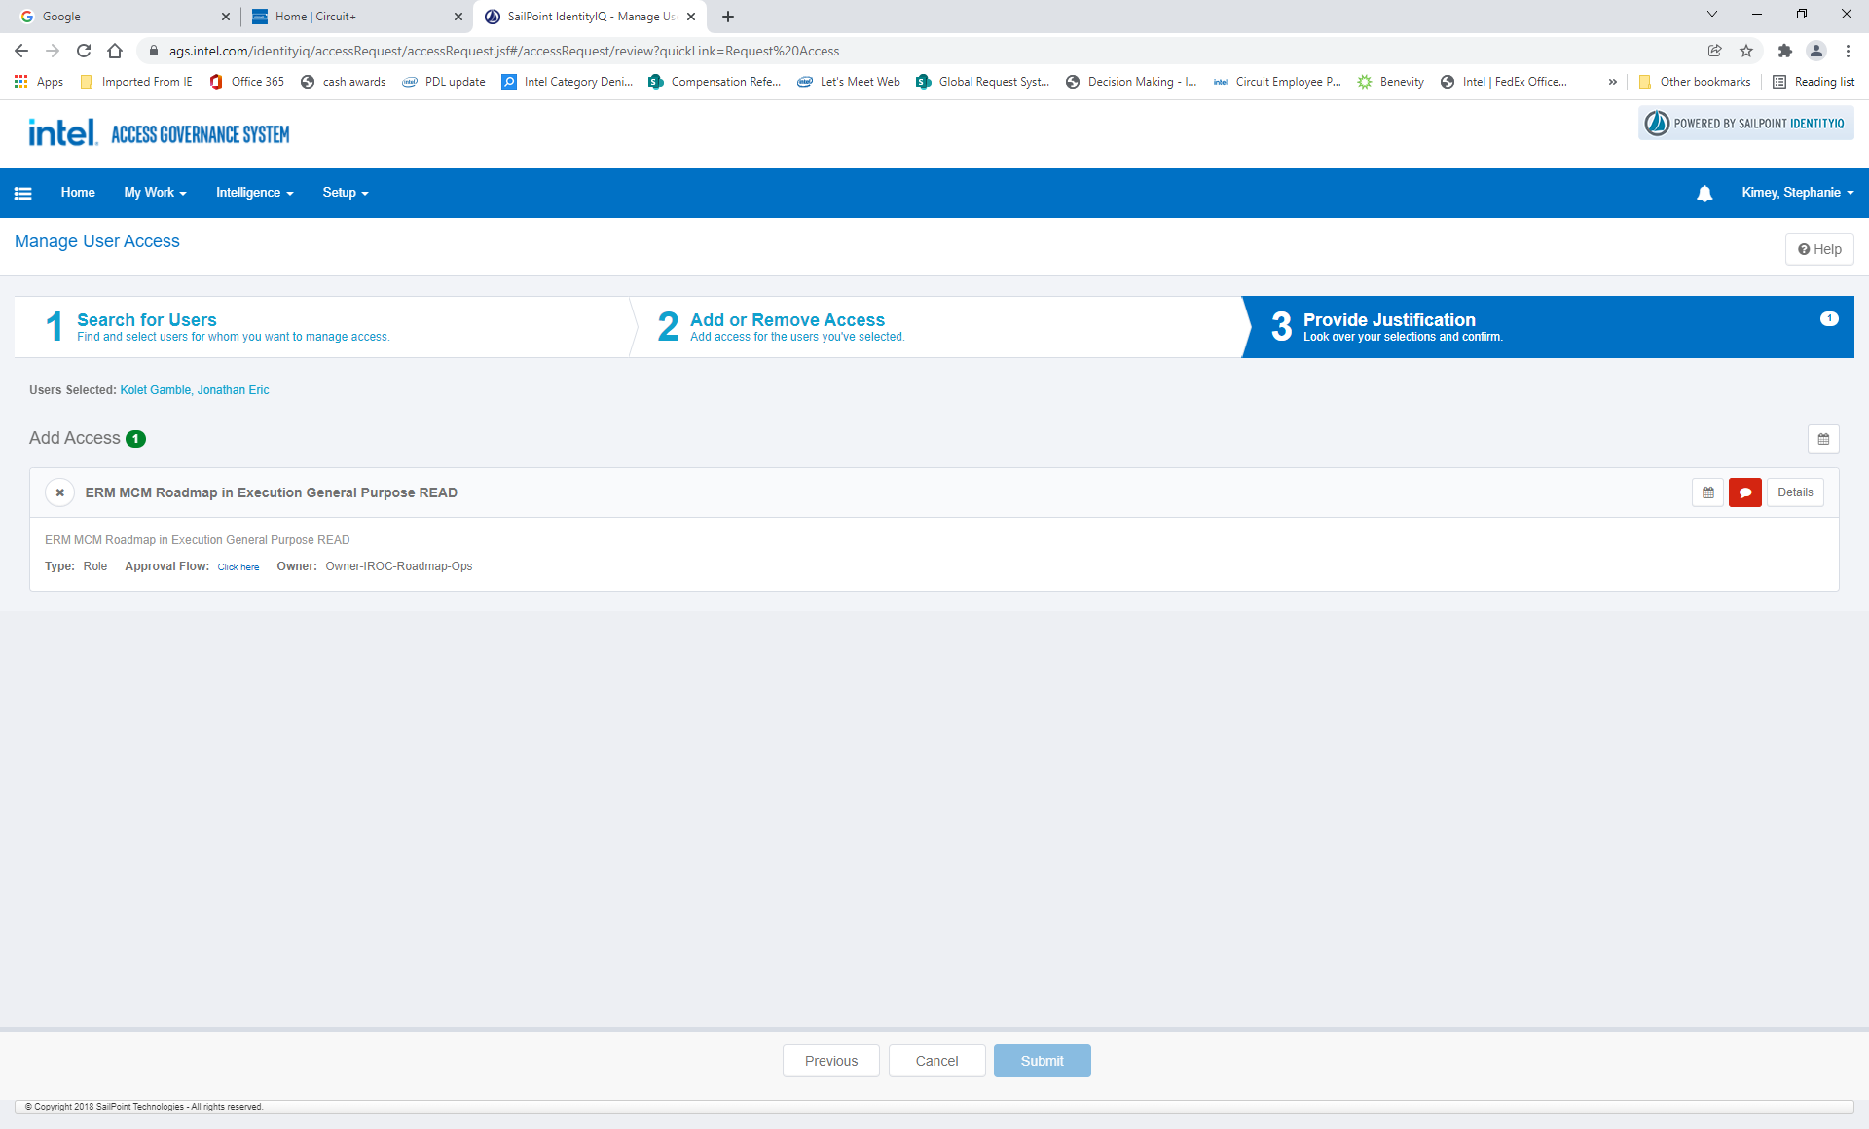
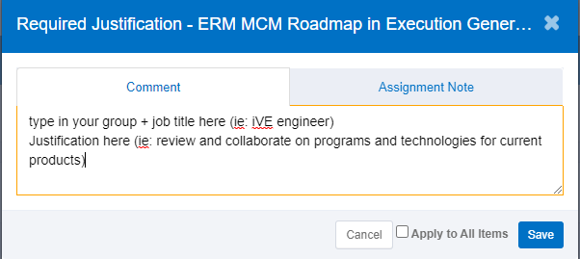
AGS – Access Governance System: Step by Step Instructions for Access
1: From the home screen - click on Submit Request for Me or Others
2: Type in appropriate access and click search
3: Select access type
4: Provide justification using the comment icon
5: Click Submit.
Note: Approval flow will go to direct manager, then to entitlement owners
Step 4

